Slide 1
Development of compact accelerator neutron source
A. Marchix, H. Tran, N. Chauvin, A. Letourneau, J. Schwindling
Irfu, CEA-Saclay, Université Paris-Saclay
A. Menelle, F. Ott
LLB, CEA-Saclay, université Paris-Saclay

Slide 2
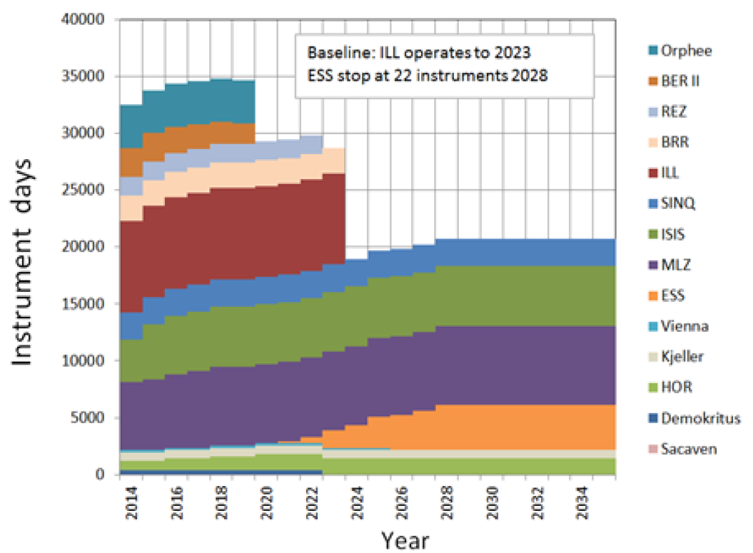
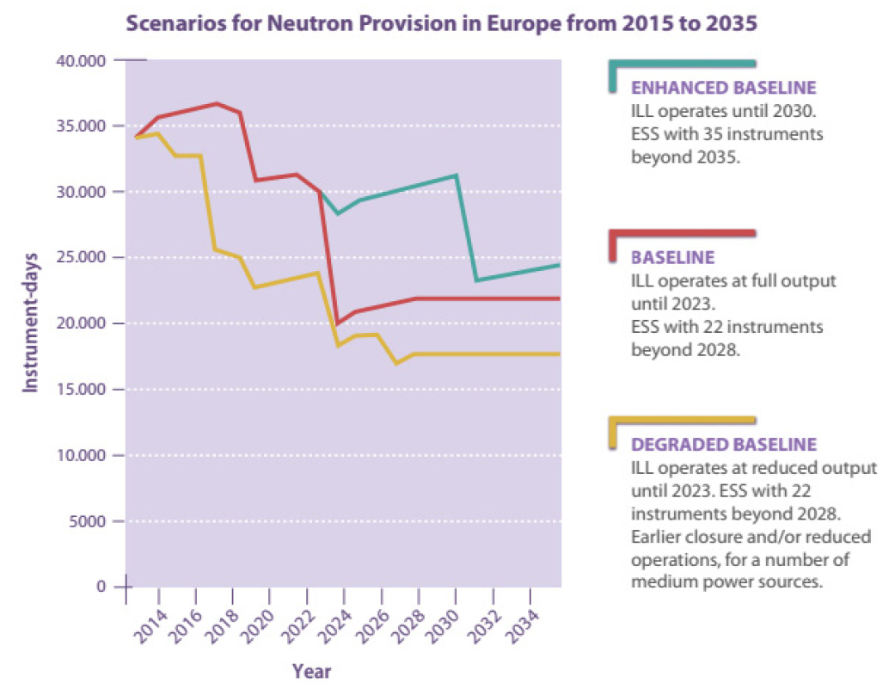


Scenarios for neutrons in Europe
Source: Neutron scattering facilities in Europe, ESFRI report (2016)
Main reactor-based neutron sources would stop in the next decade
  Very unlikely to be any new research reactors built in Europe
  “Low-cost” sources (200-500M€) to be affordable by individual countries
Opportunity for Compact Accelerator Neutron Source (CANS)

Slide 3
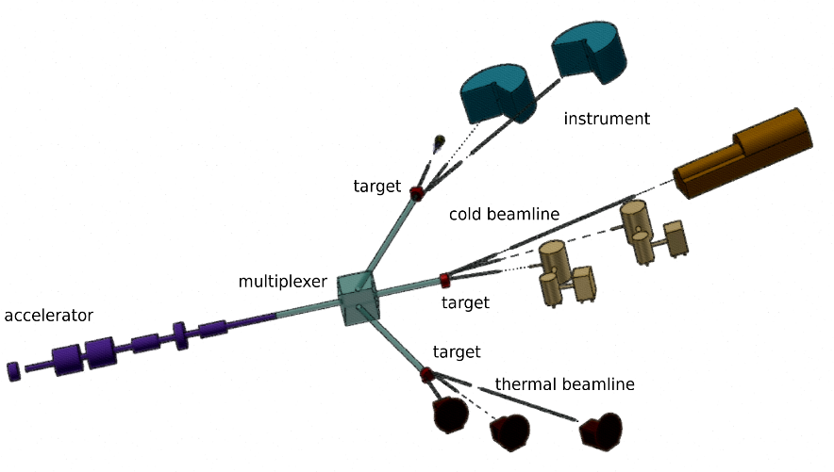
Neutron sources in France
  French community is strongly affected
  No new facility expected in a near future
IPHI-NEUTRON & SONATE projects launched at CEA Saclay
Instrument.days
  Keep knowledge in neutron scattering
  Training (university)
  Demand from industrial users
  Development of instruments
  Preparation of experiments for high brilliance neutron sources

Slide 4
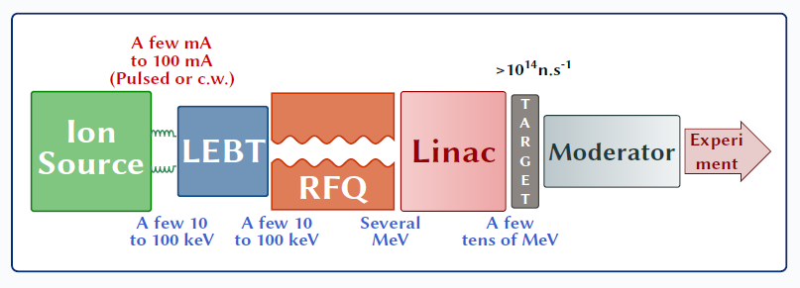
Main Challenges for CANS developments
Accelerator
  Strong space charges (emittance growth, beam halo… and beam losses)
  Beam dynamics can be challenging
  Even very small losses can be harmful and can cause: activation, quench of SRF cavities, machine damages due to power deposition
  → Need expertise in high intensity accelerator technology
Target/Moderator/Reflector
  Heat removal from the target
  Optimize the target/moderator assembly for required neutron production
  → Validated and Predictive Monte-Carlo simulation tools

Slide 5
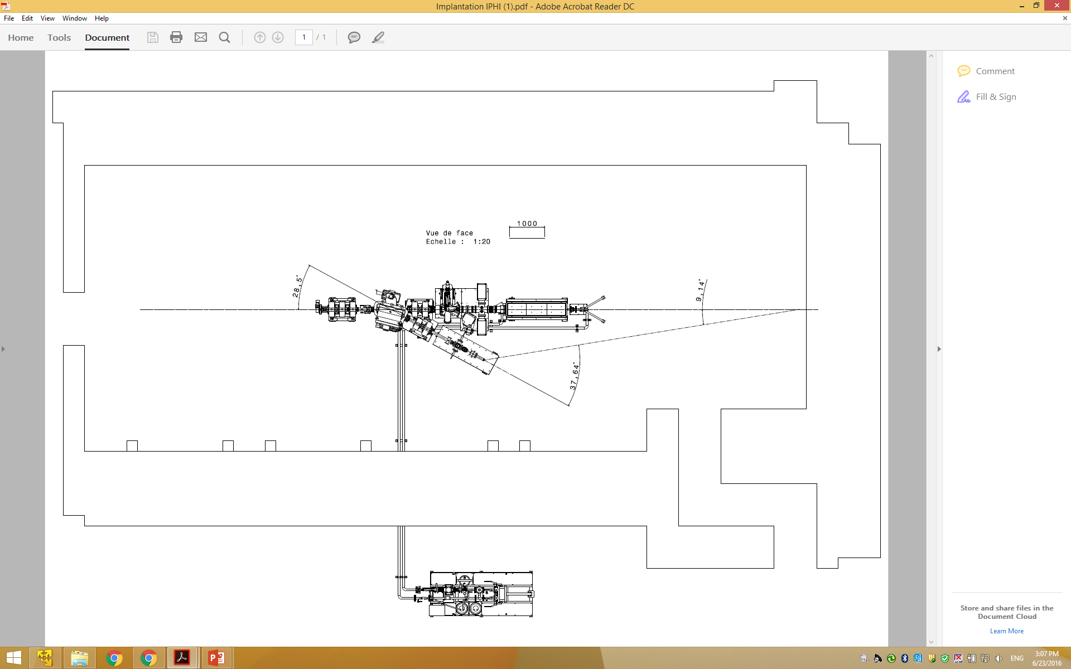
Tests AT Saclay with IPHI injector
3 MeV proton beam and the current set to ~3 µA (~1.8E+13 proton/s),
Moderator in polyethylene (blue): 30 x 30 x 40 cm3,
Angle of detector 38 degrees,
The distance from the target to detector (violet) : 840 cm.
4 days of measurements at ~3 µA (3.6 1017 protons on Be target)
840 cm
Proton beam 3 MeV

Slide 6
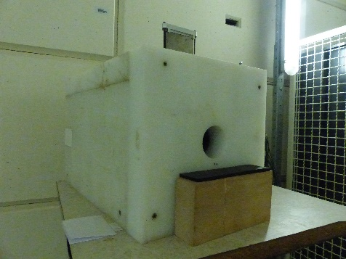
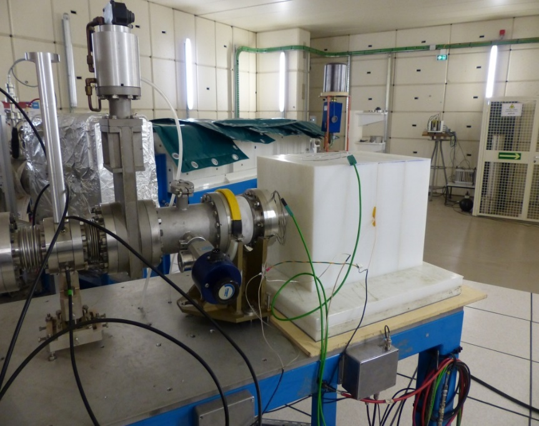
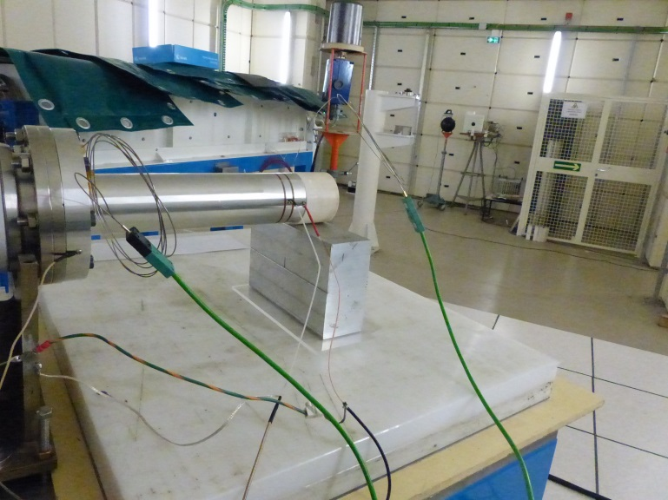
TEST Experiment with IPHI
Polyethylene Moderator
³He detector shielded with polyethylene and B₄C (8 m from the target)
Be target (inside)

Slide 7
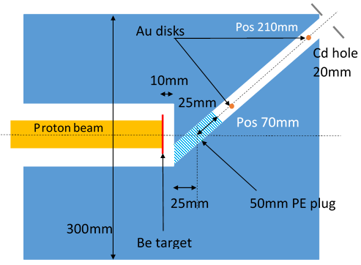
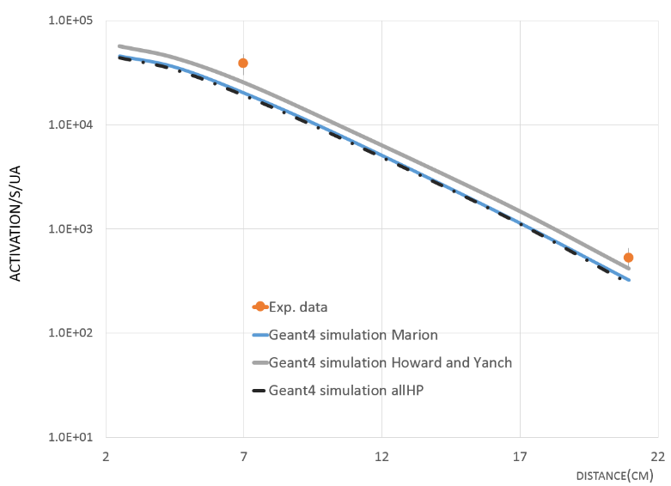
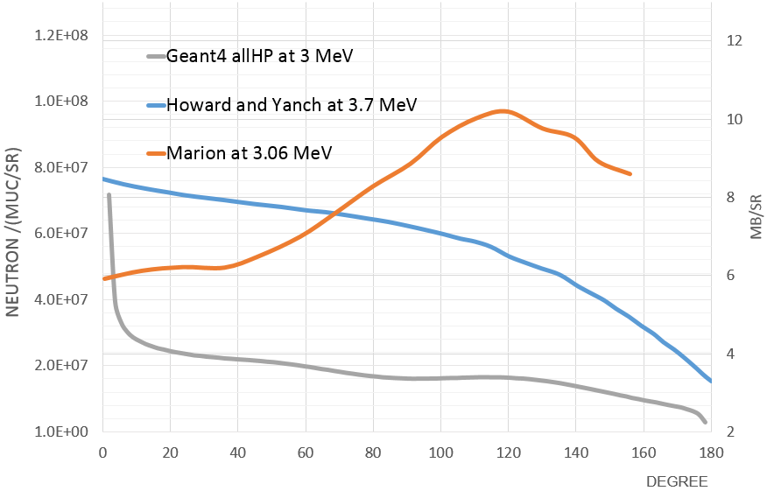
GOLD foils activation inside the moderator
¹⁹⁸Au isotopes/µC
  Good agreement data & GEANT4 simulation with Howard’s angular distribution
  New experiment planned next July to confirm primary neutron angular distribution

Slide 8
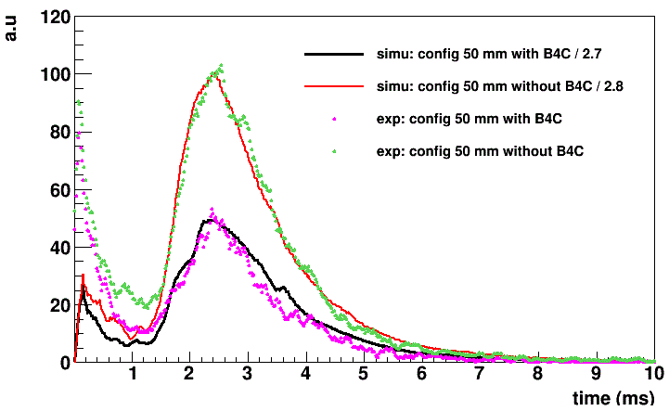
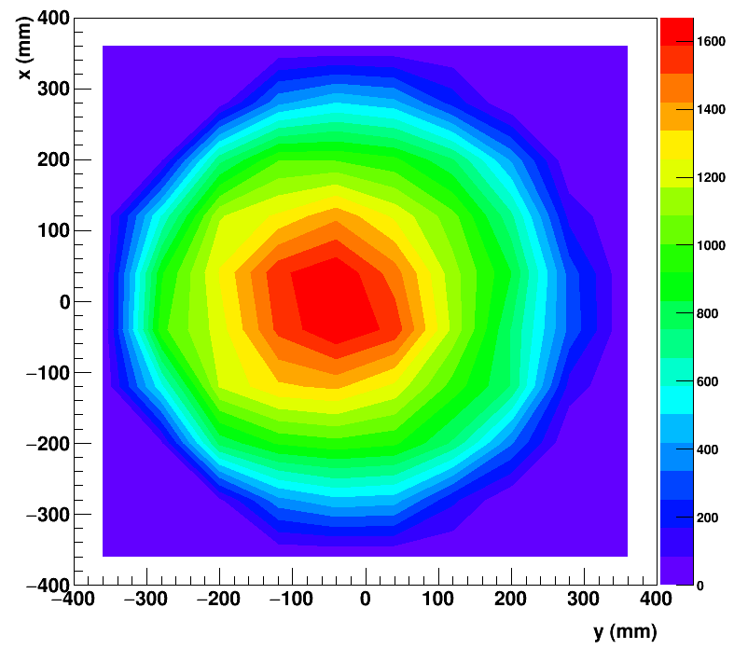
³He measurements: TOF @ 8.4 meters
Neutron counts (a.u)
  Good agreement on the shape of the distribution (GEANT4 simulations)
  Discrepancies on absolute values: could be explained by wrong alignment between ³He detector and collimator

Slide 9
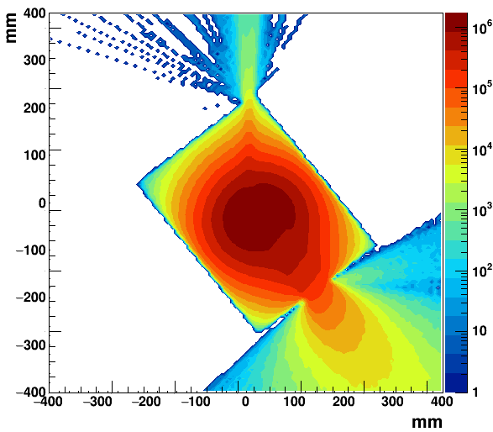
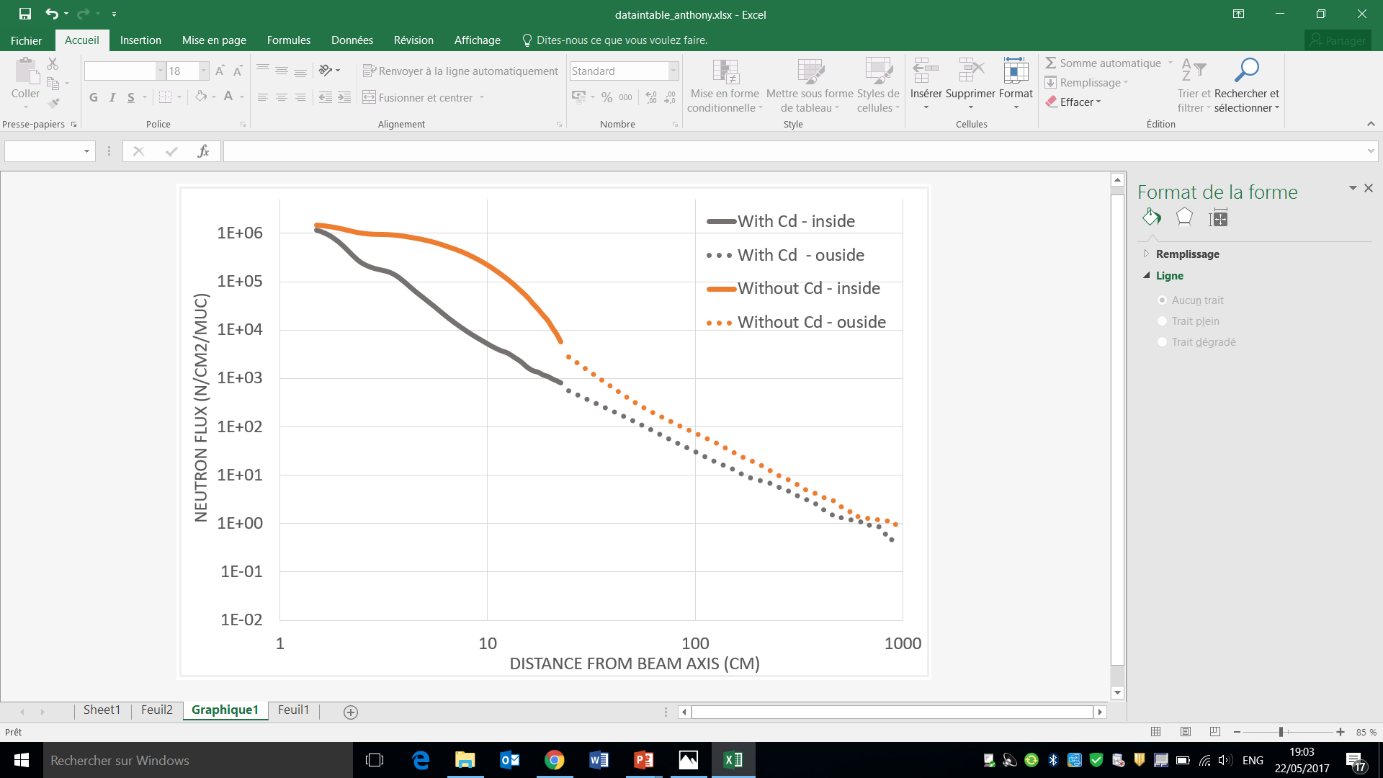
NEUTRON flux
Neutrons/cm²//µC
  Exit neutrons mainly come from the bottom surface of the collimator
  IPHI-NEUTRON project (50 kW) -> a factor 2000 larger

Slide 10
Conclusions
  Experiment performed with IPHI (3MeV proton) in order to test & qualify the concept
  Good agreement observed between data and GEANT4 simulations for Gold foils activation inside the moderator
  Good agreement on the shape of the TOF distribution for thermal neutrons with GEANT4 simulations
  Discrepancies on data for primary neutron angular distribution @ 3 MeV
  Discrepancies on absolute values for TOF measurements
  Perspectives:
    GEANT4 moderation process validated
    New experiment planned next July
Under study: concept of compact thermal moderators (simulations)
Development of 50 kW target (heat removal challenge)
Project IPHI-Neutrons (2020): 3 MeV proton, Be target, 50 kW
Project SONATE (2025): 20 MeV proton, Be target, 80 kW

Slide 11
PERSPECTIVES: SONATE
SONATE’s reference baseline for design studies
  E_{p} = 20MeV, I_{peak} = 100mA, duty cycle = 4%, P = 80kW
  Beryllium target
Technique | Flux on sample | Reference spectrometers
Reflectivity | 0.8x10⁷ n/s/cm² | HERMES@LLB 1x10⁷ n/s/cm² POLREF@ISIS ~1x10⁷ n/s/cm²
SANS | 0.7x10⁶ n/s/cm² (low Q) 2.2x10⁶ n/s/cm² (med Q) 6.7x10⁶ n/s/cm² (high Q) | PAXE@LLB (low Q) 0.7x10⁶ n/s/cm² SANS2D@ISIS 1x10⁶ n/s/cm²
Low resolution powder diffraction | 2x10⁶ n/s/cm² | G41@LLB 2x10⁶ n/s/cm²
Imaging (white beam) | 1.5x10⁶ n/s/cm² (for L/D = 240) 1.3x10⁷ n/s/cm² (for L/D = 80) | ICON@PSI 1x10⁷ n/s/cm² CONRAD@PSI 1x10⁷ n/s/cm² (for L/D = 240)
Imaging (time resolved) | 1x10⁵ n/s/cm² (for L/D = 500) dl/l = 1% | ANTARES@FRM2 5x10⁵ n/s/cm²
Spin-Echo | 2x10⁶ n/s/cm² | MUSES@LLB 2x10⁷ n/s/cm² (at 5A°)
TOF | 6x10⁷ n/s/cm² | OSIRIS@ISIS 3x10⁷ n/cm²/s

Slide 12
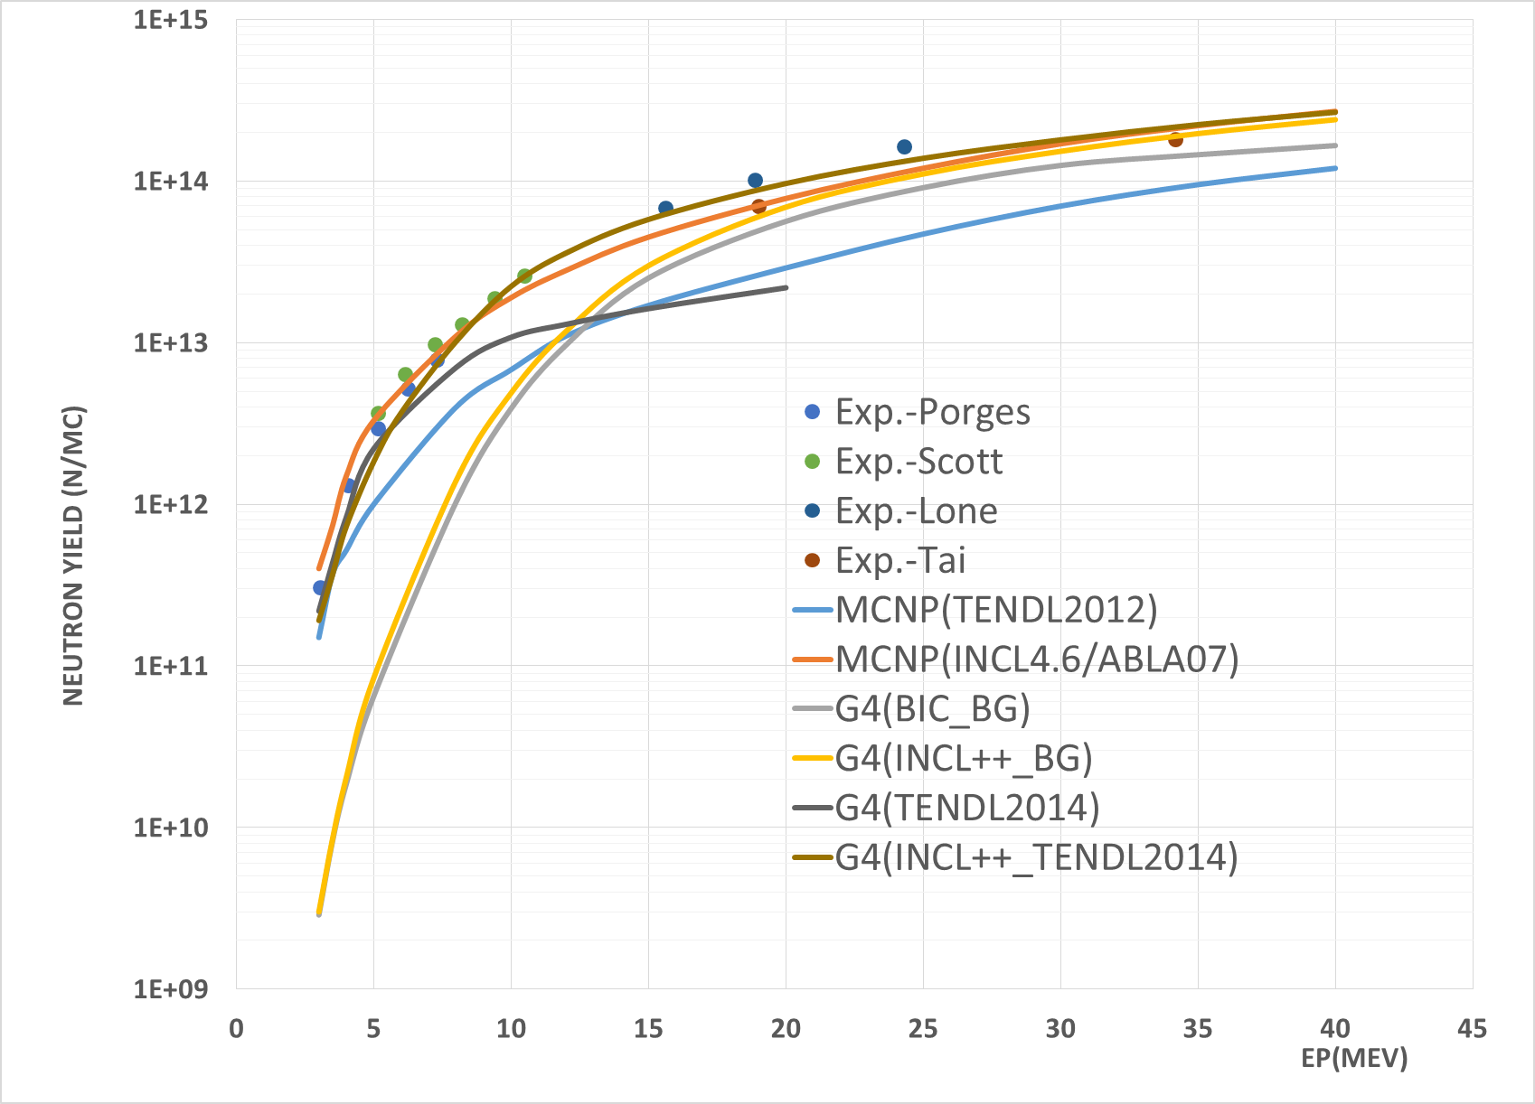
Neutron production in Be(n,p)

Slide 13
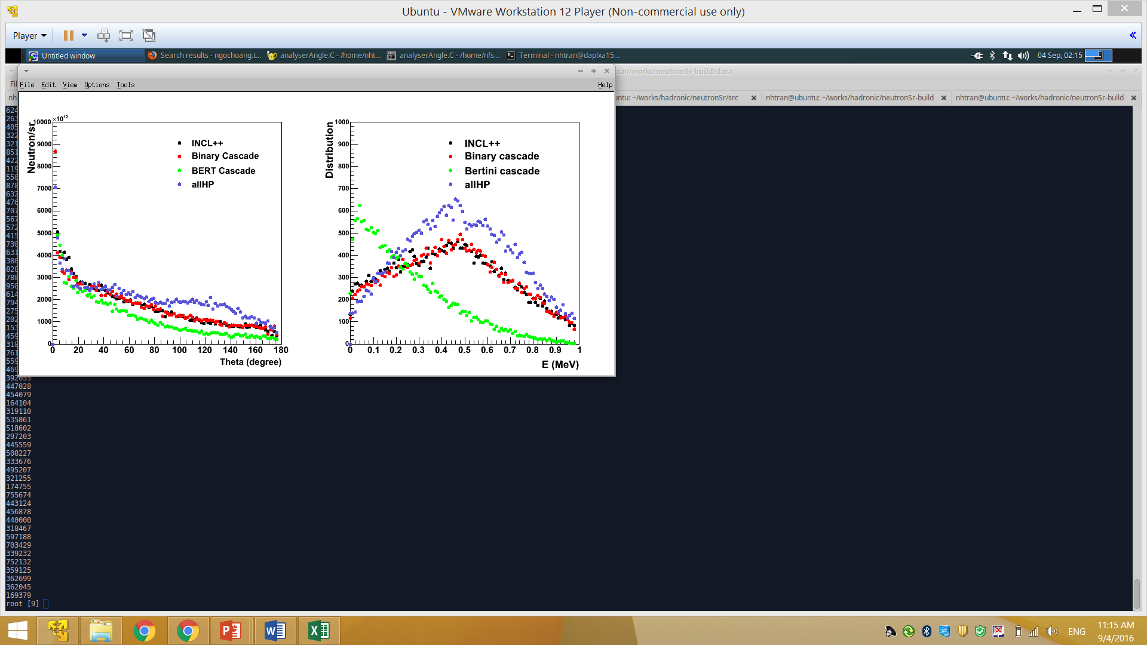
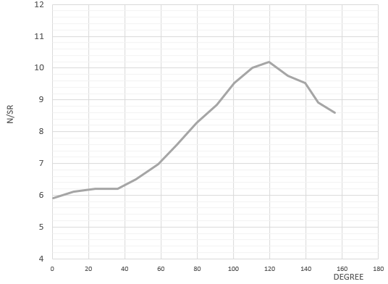
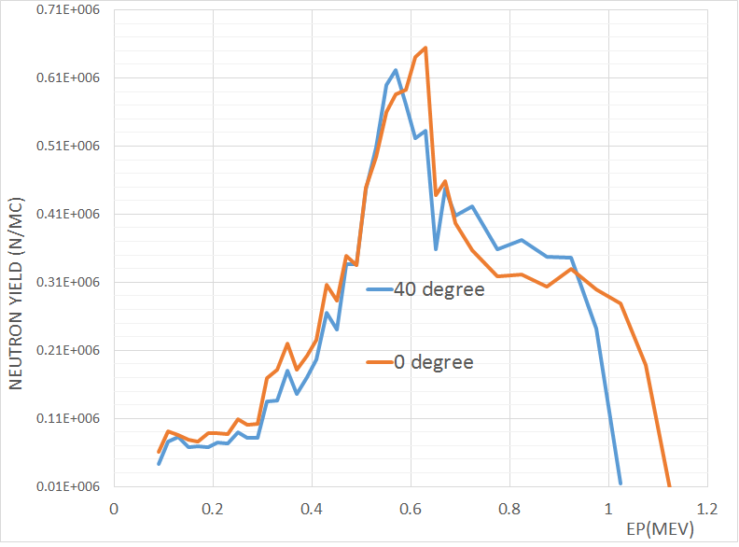
Geant4 Neutron production in ⁹Be(p,n)

Slide 14
Status of Accelerator-based Neutron sources in the world
SONATE

Slide 15
DRF
Irfu
DPhN
LEARN
Commissariat à l’énergie atomique et aux énergies alternatives
Centre de Saclay | 91191 Gif-sur-Yvette Cedex
T. +33 (0)1 69 08 xx xx | F. +33 (0)1 69 08 99 89
  Etablissement public à caractère industriel et commercial | RCS Paris B 775 685 019

