Slide 1
In-situ determination of residual specific activity in activated concrete walls of a PET-cyclotron room
In-situ determination
concrete walls
Hiroshi Matsumura, Akihiro Toyoda, Kazuyoshi Masumoto
High Energy Accelerator Research Organization (KEK), JAPAN
Toshiyuki Yagishita, Takayuki Nakabayashi, Hiroyuki Sasaki, Kazuhiro Matsumura, Yoshiyuki Yamaya
Japan Environment Research Co., Ltd., JAPAN
Yoshiharu Miyazaki
The Medical and Pharmacological Research Center Foundation, JAPAN

Slide 2
Typical image of a PET-cyclotron room
PET-cyclotron body
Concrete walls
of PET-cyclotron room
Target for RI production

Slide 3
Typical image of a PET-cyclotron room
PET-cyclotron body
Activated by neutrons
Concrete walls
of PET-cyclotron room
For accelerator decommissioning, specific activity in the concrete walls has to be determined in order to identify the contaminated part.
eg. Eu-152: 0.1 Bq/g
Co-60: 0.1 Bq/g
Clearance
limit
Target for RI production
Purpose of this study is to establish methodology of specific activity determination in concrete walls.

Slide 4
Methods of specific activity determination
1. Off-site measurement with a Ge detector after core boring
Depth profile
Concrete wall
2. In-situ measurement with a Ge detector
Activation mapping
Concrete wall
3. In-situ measurement with a NaI survey meter
Easier method
Concrete wall

Slide 5
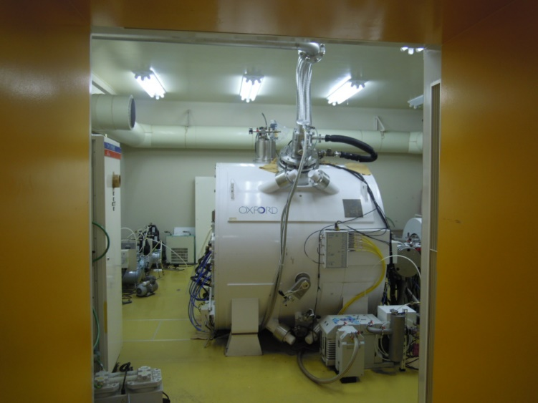
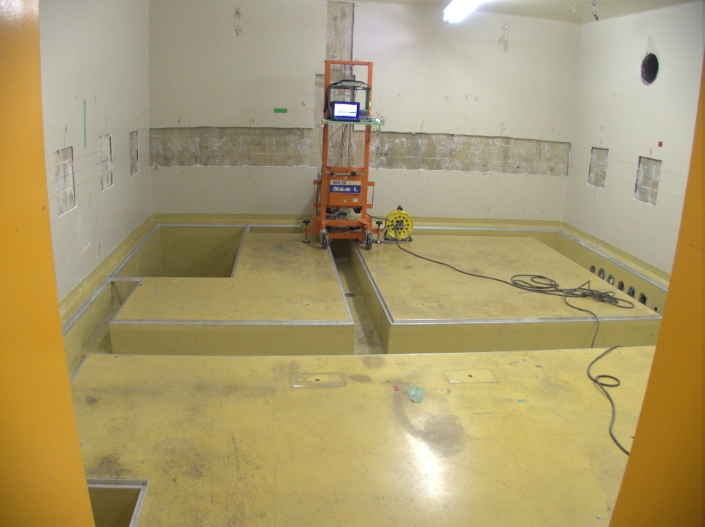
Examination site
Facility:
The Medical and Pharmacological Research Center Foundation in Hakui, Ishikawa, Japan
Accelerator:
Purpose of use:
Operation duration:
Room size:
Measurement:
12-MeV (0.1 mA) proton cyclotron (NKK/Oxford)
Production of radiopharmaceuticals for PET
Operation end:
~15 years ~2 years ago
5.6 m x 5.2 m x 2.7 mH
January 2017 at empty room

Slide 6
Methods of specific activity determination
1. Off-site measurement with a Ge detector after core boring
Depth profile
Concrete wall
2. In-situ measurement with a Ge detector
Concrete wall
3. In-situ measurement with a NaI survey meter
Concrete wall

Slide 7
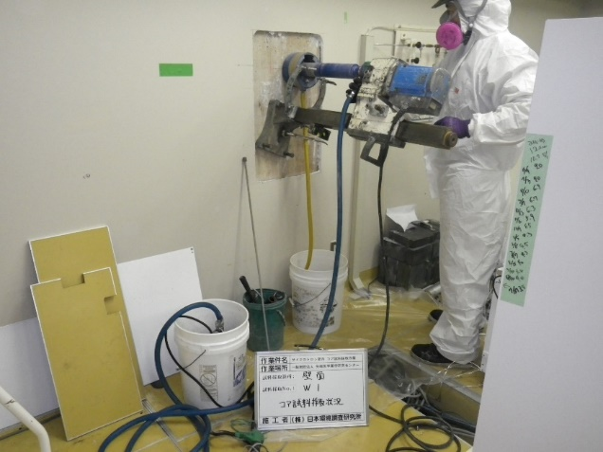
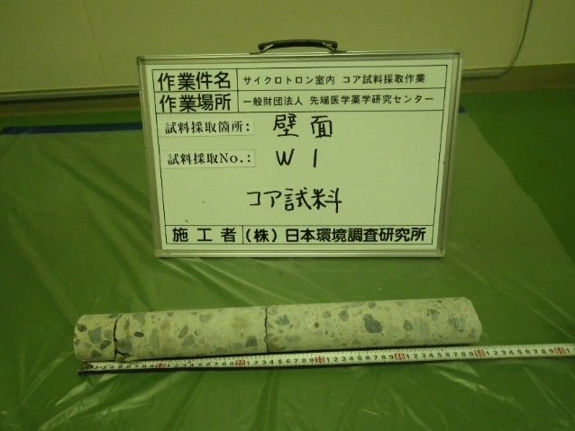
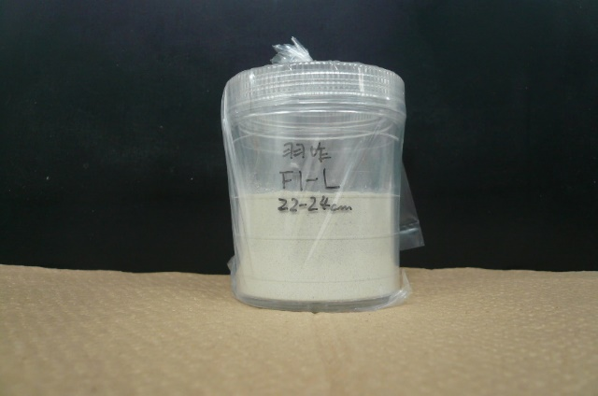
Core boring locations
CW1
South wall
CW4
Target
CW5
East wall
West wall
Cyclotron
Shield
door
CW2
North wall

Slide 8
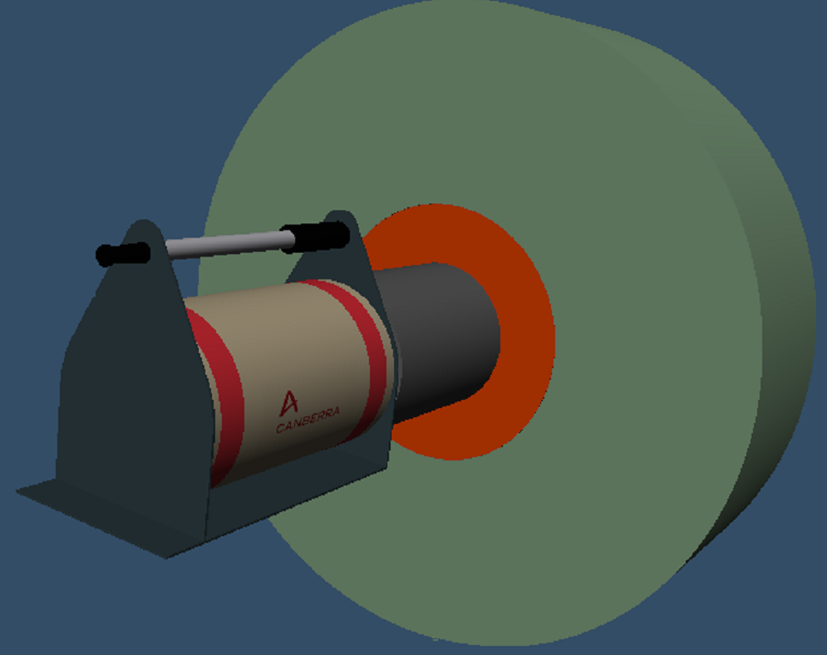
Depth profile of the specific activity
Turned to be decrease
Constant specific activity
Efficiency was calculated by ISOCS.
CW1
Independent of nuclide
Specific activity (Bq/g)
Concrete depth (cm)
FIG. Typical example of depth profile of specific activity (CW1).
Attainable region of gamma rays agreed with the constant region of specific activity.
Good for direct measurement at concrete surface

Slide 9
Methods of specific activity determination
1. Off-site measurement with a Ge detector after core boring
Demerit
Measurable
at a few locations
Concrete wall
2. In-situ measurement with a Ge detector
Merit
Measurable
at many locations
Concrete wall
3. In-situ measurement with a NaI survey meter
Concrete wall

Slide 10
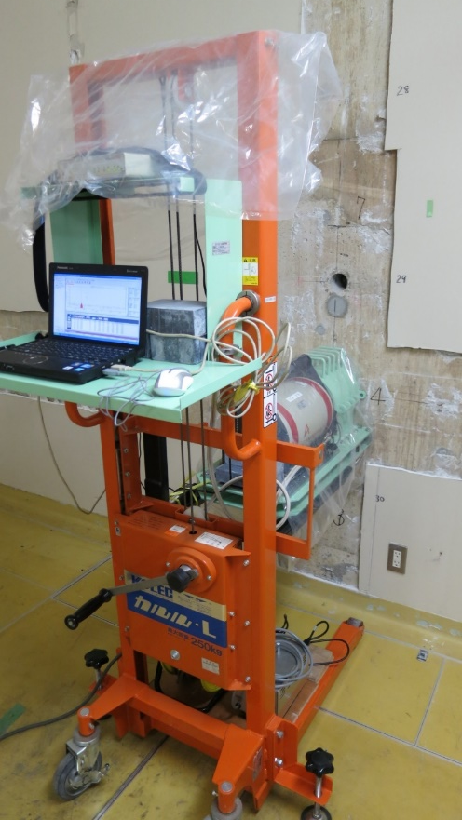
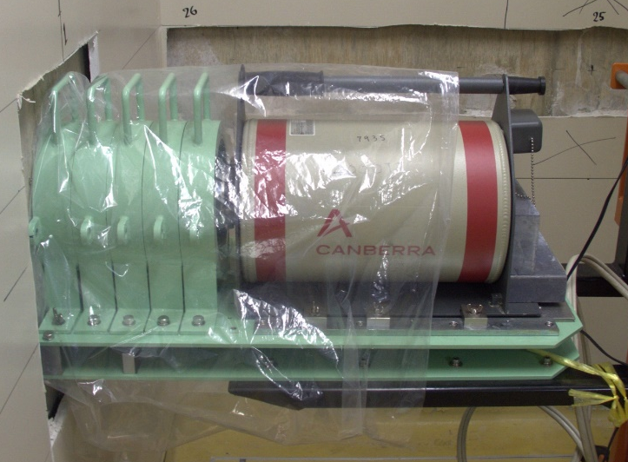
Measured locations
S7(high)
S4
S8(low)
South wall
S6
S5
S3
S2
S1
E1
W5
E2
Target
W4
East wall
West wall
E3
W3
Cyclotron
6.5-cm-thick Pb shield
E4
W2
20 locations
E5
W1
N2(high)
N1
Shield
door
North wall

Slide 11
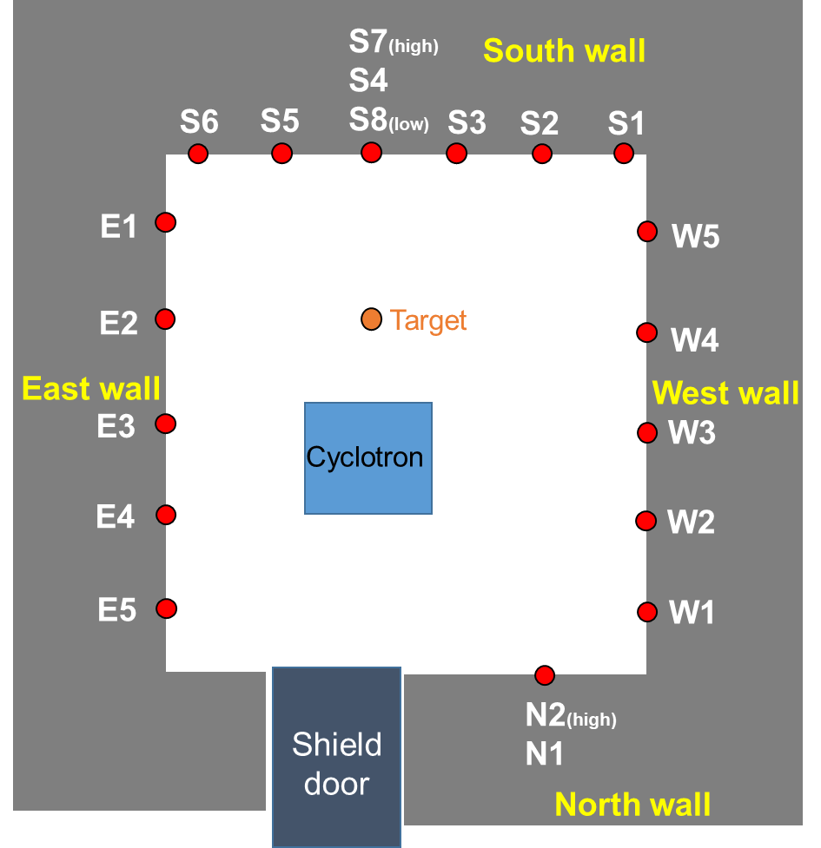
Specific activity distribution
Eu-152
Co-60
Cs-134
Specific activity (Bq/g)
Eu-154
Mn-54
Location name
FIG. Distributions of specific activity
Eu-152, Co-60, Cs-134, Eu-154, and Mn-54 were determined.
Major nuclides are Eu-152 and Co-60.
We could obtain detailed distributions of the specific activity.

Slide 12
Relative specific activity
Eu-152/Co-60
Eu-152/Co-60 = 1.59
Co-60/Co-60 = 1.00
Specific activity ratio
of each nuclide for Co-60
Co-60/Co-60
Cs-134/Co-60
Cs-134/Co-60 = 0.239
Eu-154/Co-60 = 0.165
Mn-54/Co-60 = 0.138
Eu-154/Co-60
Mn-54/Co-60
Location name
The activity ratio was independent of location.
Specific activity ratio of each nuclide for Co-60 was obtained.
Although specific activity of Eu-152 was higher than Co-60, dose rate from Co-60 became higher than Eu-152.

Slide 13
Methods of specific activity determination
1. Off-site measurement with a Ge detector after core boring
Concrete wall
2. In-situ measurement with a Ge detector
Demerit
Require great care
Concrete wall
3. In-situ measurement with a NaI survey meter
Merit
Easier
Concrete wall

Slide 14
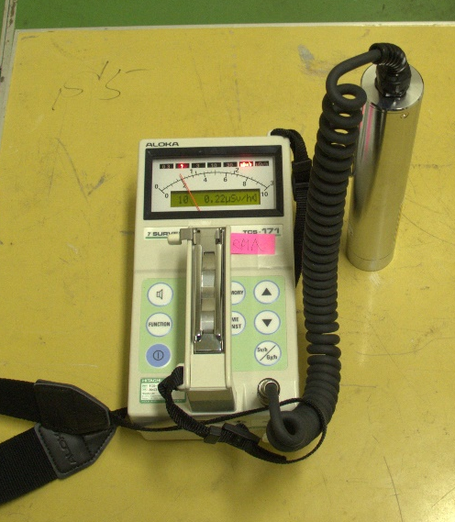
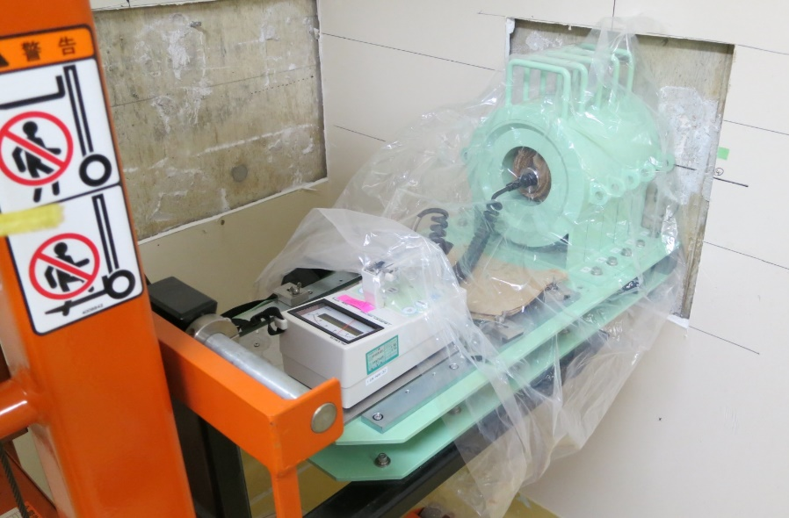
Measured locations
S7(high)
S4
S8(low)
South wall
S6
S5
S3
S2
S1
E1
W5
E2
Target
W4
East wall
West wall
E3
W3
Cyclotron
E4
W2
E5
W1
N2(high)
N1
Shield
door
North wall

Slide 15
Contact dose rate vs specific activity
Specific
activity
of Co-60
Eu-152/Co-60 = 1.59
Co-60 specific activity (Bq/g)
by Ge detector
Cs-134/Co-60 = 0.239
Eu-154/Co-60 = 0.165
Mn-54/Co-60 = 0.138
Specific activity
of Eu-152, Cs-134,
Eu-154, and Mn-54
Measured dose rate
Contact dose rate (μSv/h) by NaI survey meter
FIG. Correlation curve between dose rate and specific activity
Co-60 specific activity is correlated with contact dose rate by NaI survey meter.

Slide 16
Reproducibility of specific activity from dose rate
Results determined by using Ge detector
TOTAL
Eu-152
Co-60
Specific activity (Bq/g)
Cs-134
Eu-154
Mn-54
Location name
FIG. Distributions of specific activity

Slide 17
Reproducibility of specific activity from dose rate
Put Co-60 results estimated from dose rates
TOTAL
Eu-152
Co-60
Specific activity (Bq/g)
Cs-134
Eu-154
Mn-54
Location name
FIG. Distributions of specific activity

Slide 18
Reproducibility of specific activity from dose rate
Put all results estimated from dose rates
TOTAL
Eu-152
Co-60
Specific activity (Bq/g)
Cs-134
Eu-154
reproduced well from dose rate!
Mn-54
Location name
FIG. Distributions of specific activity

Slide 19
Conclusion
We obtained an efficient method
for specific activity determination
in concrete wall of PET cyclotron.

Slide 21
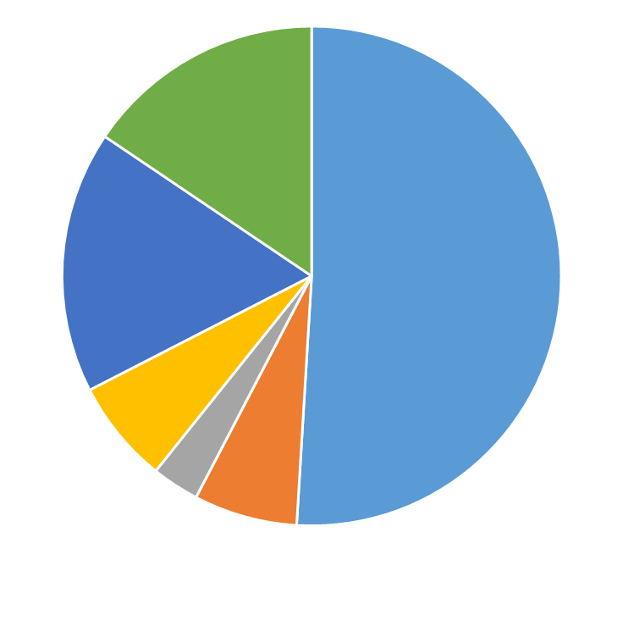
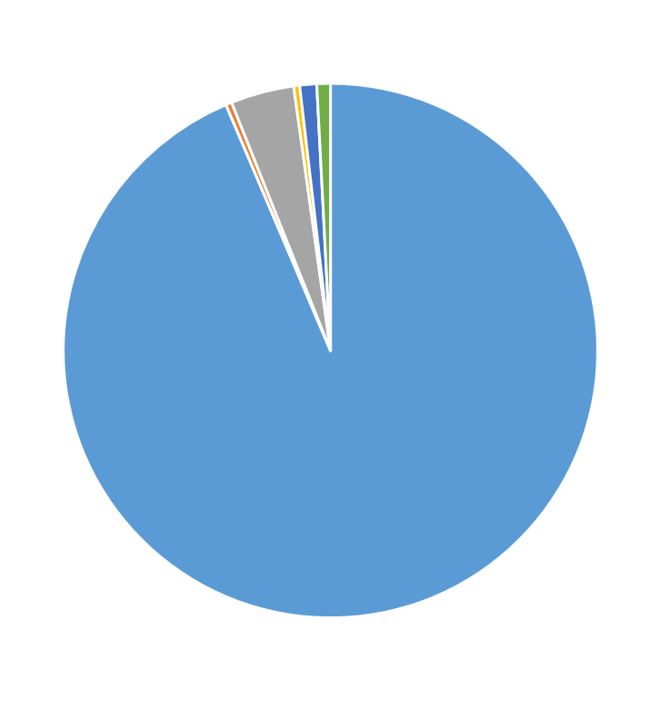
Contribution from surrounding wall
6
No shield
~50%
4
1
3
2
6.5-cm thick Pb shield
~94%
5
Contribution ratio from each wall in gamma-ray counting.
6.5-cm thick Pb shield is important for avoiding contribution from other walls.

Slide 22
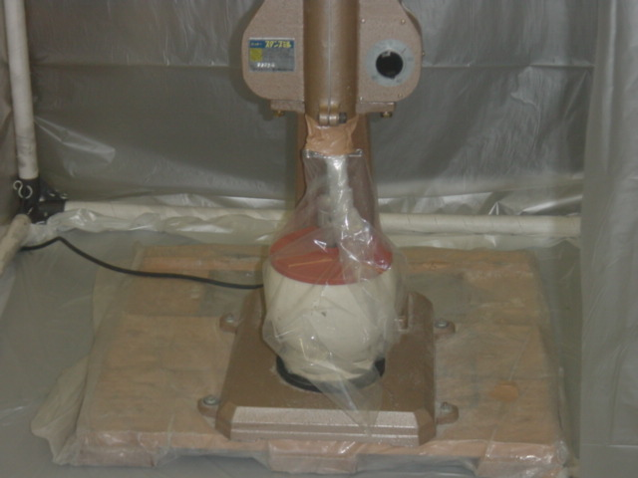

Slide 23
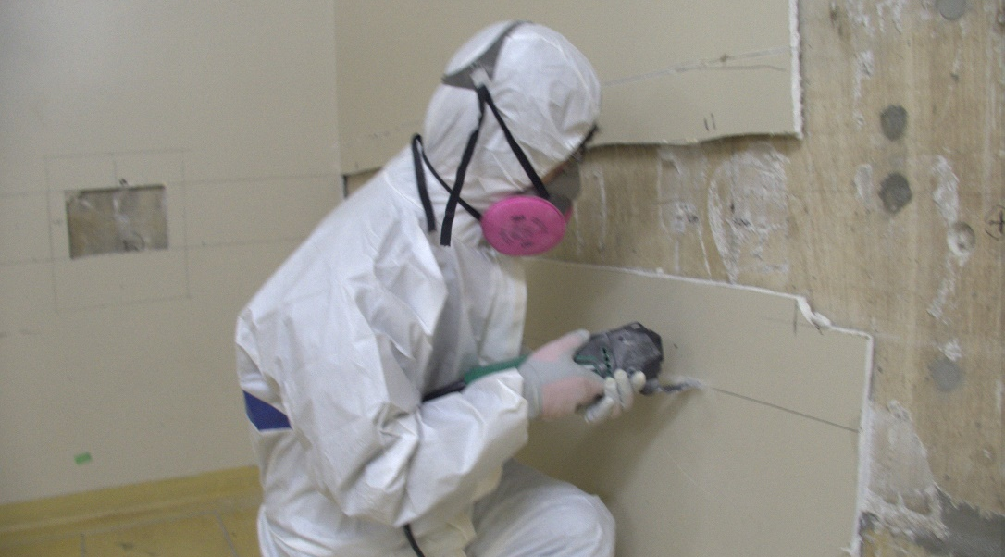
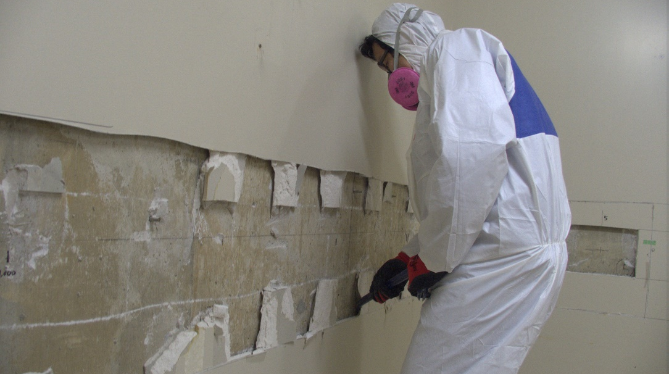
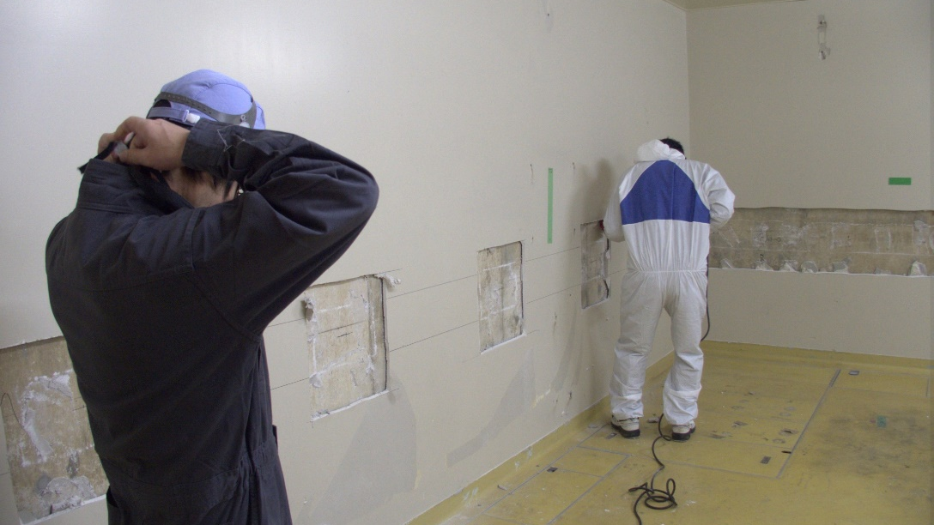
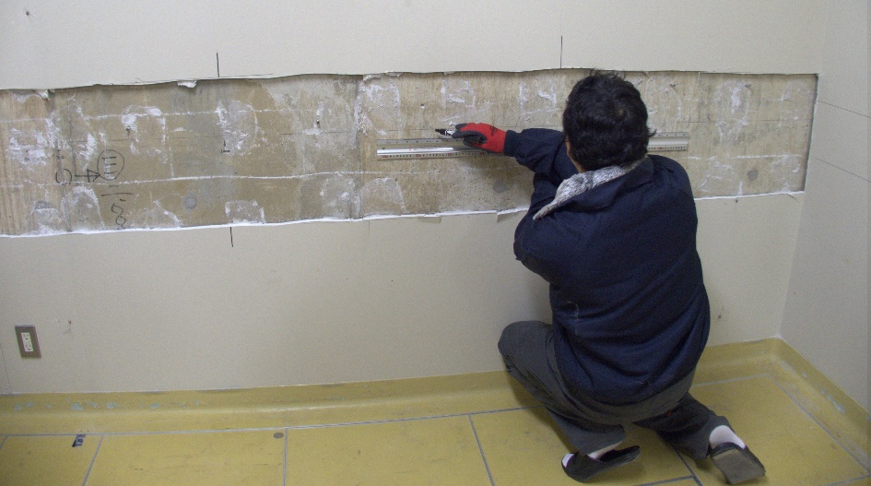
石膏ボード（約1.5cm厚）切断
石膏ボードはがし
モルタルはがし
測定場所マーキング

Slide 24
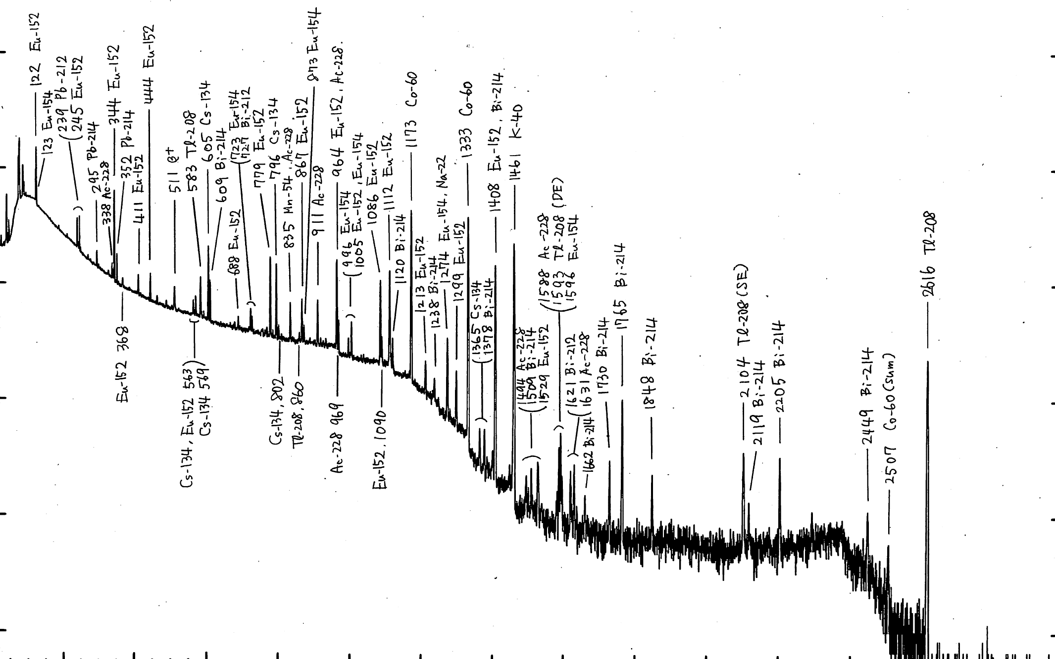
Gamma-ray spectrum
Eu-152
Co-60
Eu-154
Cs-134
Na-22
Mn-54

