Slide 2
Induced activation studies for the LHC upgrade to High Luminosity LHC
Cristina ADORISIO and Stefan ROESLER, CERN, HSE/RP
4th International Workshop on Accelerator Radiation Induced Activation, ARIA'17

Slide 3
Outline
LHC and HL-LHC
RP studies (using ©)
Operational scenario
LHC Simulation Geometry
LHC Simulation vs. measurements
LHC residual dose rate estimation
HL-LHC new underground galleries
HL-LHC residual dose rate estimation

Slide 4
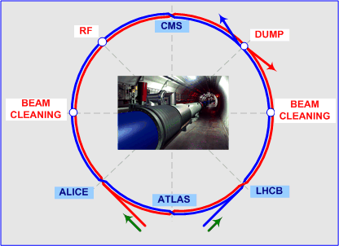
LHC and the High Luminosity upgrade
LHC
27 km circular accelerator
8 sectors
4 experiments
two counter rotating beams of protons or heavy ions
p-p collision @ 14 TeV
HL-LHC
The High-Luminosity Large Hadron Collider (HL-LHC) project aims to crank up the performance of the LHC in order to increase the potential for discoveries.
The objective is to increase luminosity by a factor of 10 beyond the LHC’s design value.

Slide 5
Outline
LHC and HL-LHC
RP studies (using ©)
Operational scenarios
LHC Simulation Geometry
LHC Simulation vs. measurements
LHC residual dose rate estimation
HL-LHC new underground galleries
HL-LHC residual dose rate estimation

Slide 6
LHC/HL-LHC Operational Scenarios
 | Year of (HL-)LHC Operation | Peak / levelled luminosity [cm⁻²s⁻¹] |  | Integrated luminosity [fb⁻¹]
 | ≤2012 | 0.8E+34 |  | 30
LS1
 | 2015 | 6.30E+33 |  | 4
 | 2016 | 1.40E+34 |  | 40
 | 2017 | 1.60E+34 |  | 50
 | 2018 | 1.60E+34 |  | 50
LS2 | (2 years)
 | 2021 | 2.0E+34 |  | 60
 | 2022 | 2.0E+34 |  | 60
 | 2023 | 2.0E+34 |  | 60
LS3 | (3 years) | Nominal | Ultimate | Nominal | Ultimate
 | 2027 | 5.0E+34 | 7.5E+34 | 250 | 300
 | 2028 | 5.0E+34 | 7.5E+34 | 250 | 300
 | 2029 | 5.0E+34 | 7.5E+34 | 250 | 300
LS4 | (1 year)
 | 2031 | 5.0E+34 | 7.5E+34 | 250 | 300
 | 2032 | 5.0E+34 | 7.5E+34 | 250 | 300
 | 2033 | 5.0E+34 | 7.5E+34 | 250 | 300
LS5 | (1 year)
 | 2035 | 5.0E+34 | 7.5E+34 | 250 | 300
 | 2036 | 5.0E+34 | 7.5E+34 | 250 | 300
 | 2037 | 5.0E+34 | 7.5E+34 | 250 | 300
LS6
Luminosity gives a measure of how many collisions are happening in a particle accelerator
past
Simulation is done considering the luminosity targets announced by the LHC Operation team
~TOT 350 fb⁻¹
3 blocks of 3 consecutive years of operation + 1 year Long Shutdown each
Nominal: 5.0x10³⁴ – 250 fb⁻¹/y
Ultimate: 7.5x10³⁴ – 300 fb⁻¹/y
HL-LHC
TOT ~2600 fb⁻¹
TOT ~3050 fb⁻¹

Slide 7
LHC – Simulation geometry
Simulation geometry kindly prepared by the CERN FLUKA Team
Long Straight Sections in the two interaction regions, IR1 and IR5:
Actual machine layout
Real collimators settings
LHC IR1 LSS
LHC IR5 LSS

Slide 8
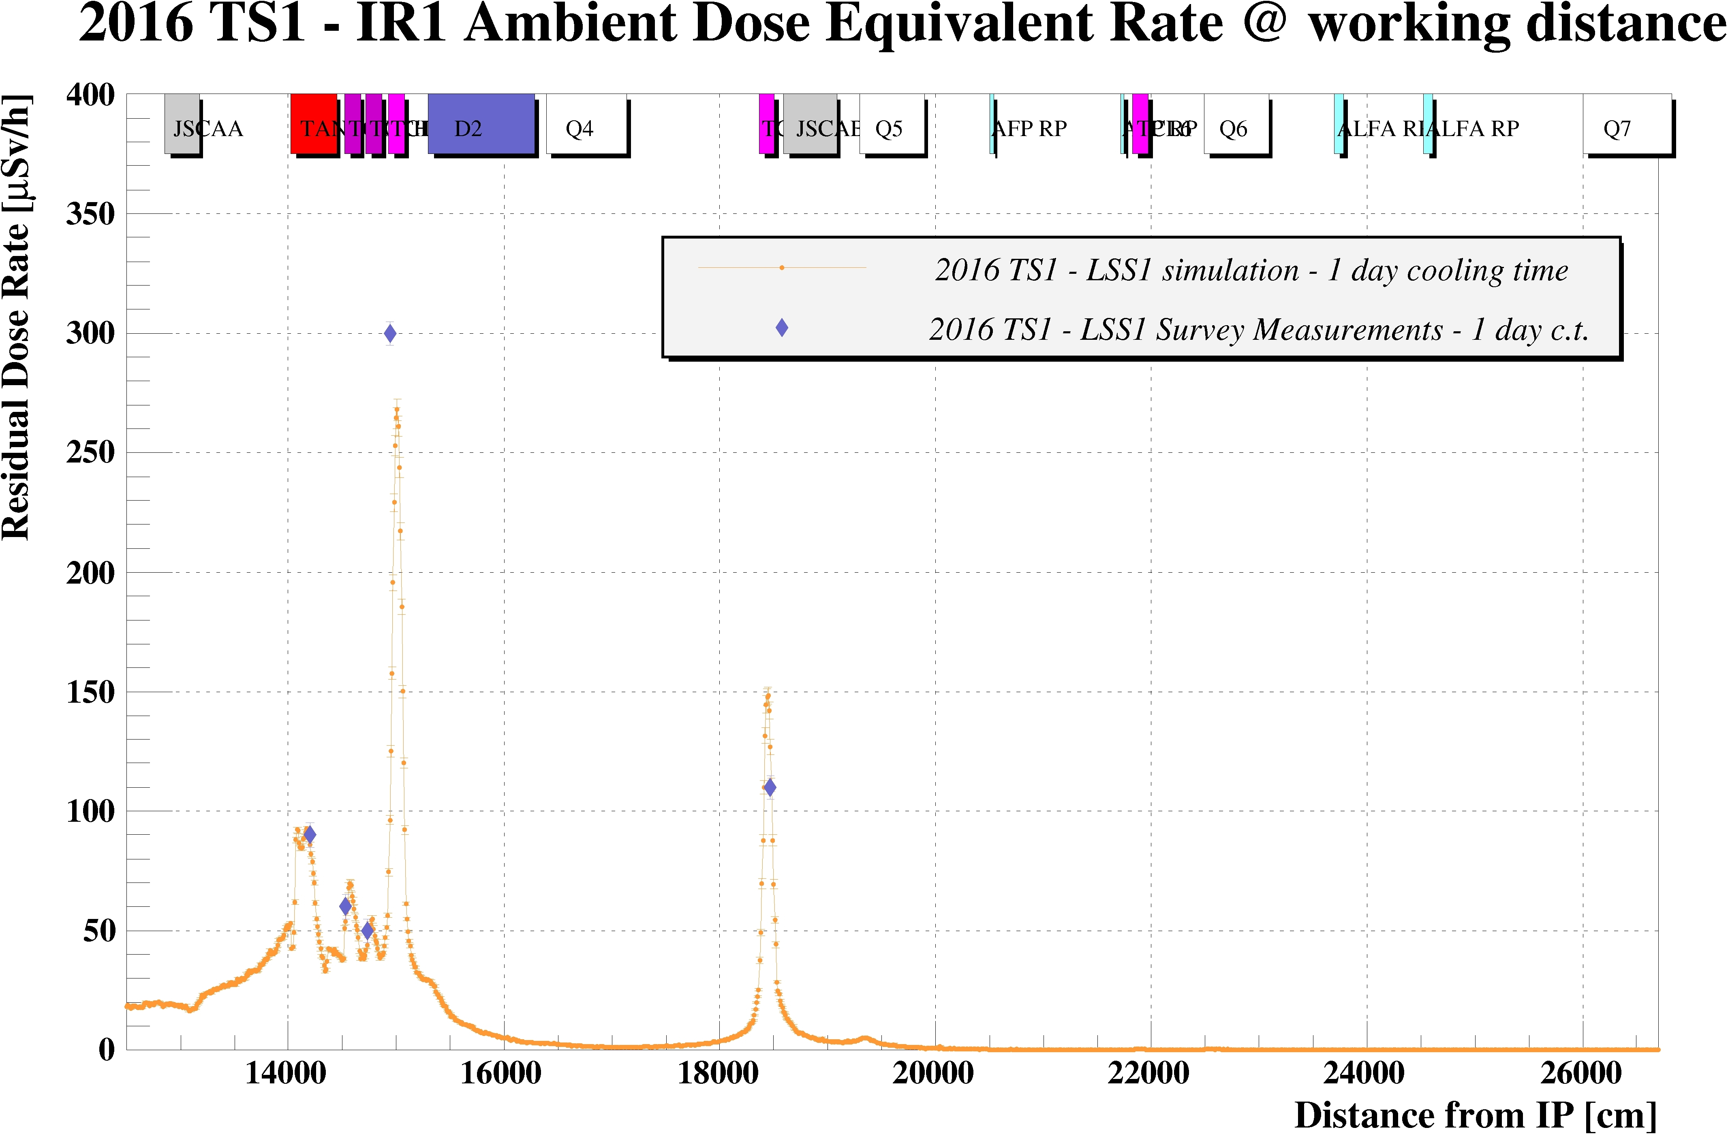
LHC – Simulation/measurement comparison
During the year, simulations are performed in order to prepare the Work and Dose Planning (WDP) in advance for each Technical Stop (TS)
Radiation measurement, which performed at the beginning of TS, in order to classify the area and prepare WDP for interventions, used to benchmark the simulation

Slide 9
Outline
LHC and HL-LHC
RP studies (using ©)
Operational scenarios
LHC Simulation Geometry
LHC Simulation vs. measurements
LHC residual dose rate estimation
HL-LHC new underground galleries
HL-LHC residual dose rate estimation

Slide 10
LHC - Residual Dose Rate estimation Long Shutdown 3
LS3 – IR1 Ambient dose equivalent rate – 1 month cooling time
During LS3 the full LSS in IR1 and IR5 will be dismantled and new equipment will be installed in order to reach the target luminosity

Slide 11
LHC - Residual Dose Rate estimation Long Shutdown 2 and 3
~ 40÷50% more

Slide 12
Outline
LHC and HL-LHC
RP studies (using ©)
Operational scenarios
LHC Simulation Geometry
LHC Simulation vs. measurements
LHC residual dose rate estimation
HL-LHC new underground galleries
HL-LHC residual dose rate estimation

Slide 13
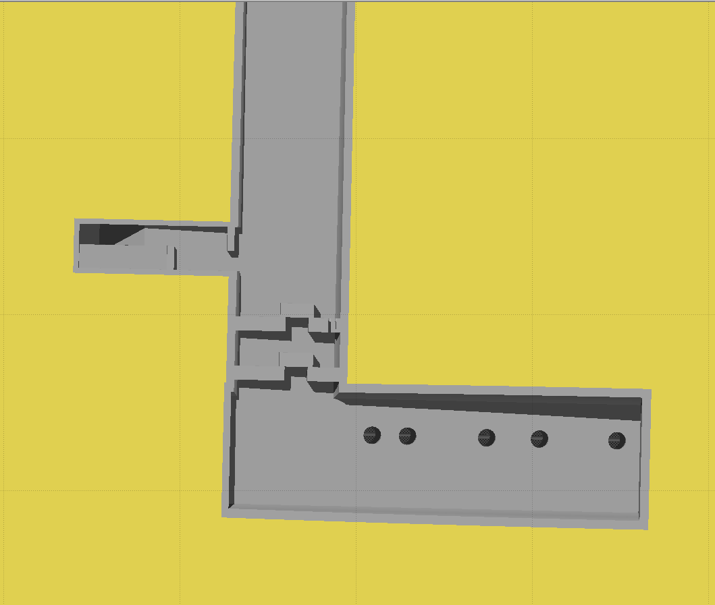
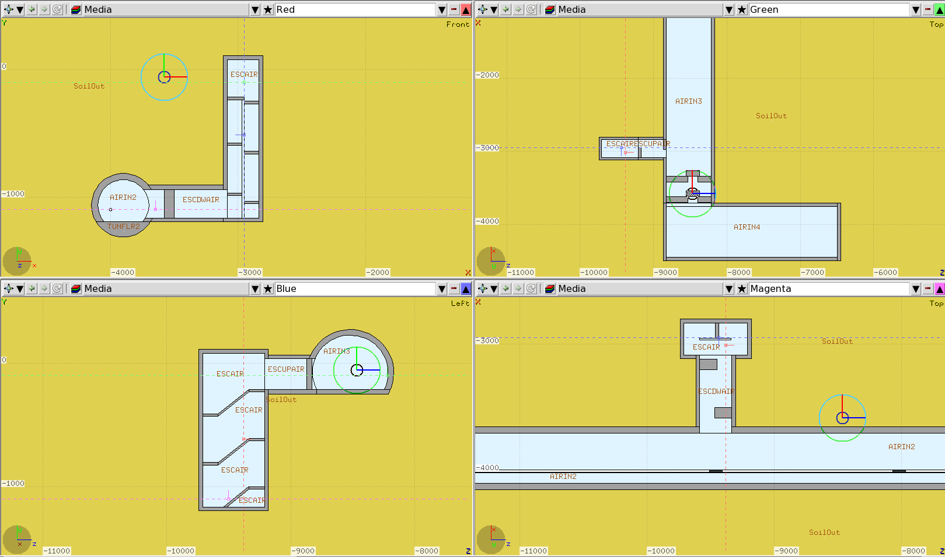
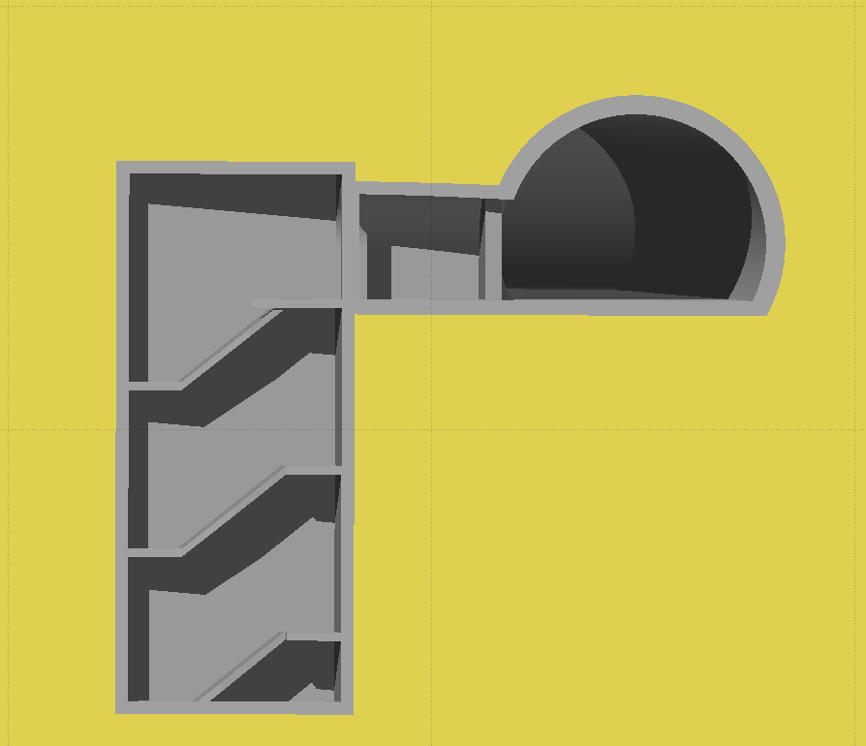
HL-LHC new underground galleries
New galleries will be excavated to locate new services
RP assessment:
Shielding requirements to access the new underground during operation
Excavation spoils activation
Emergency escape
Emergency escape
LHC
Emergency escape
Emergency escape
LHC

Slide 14
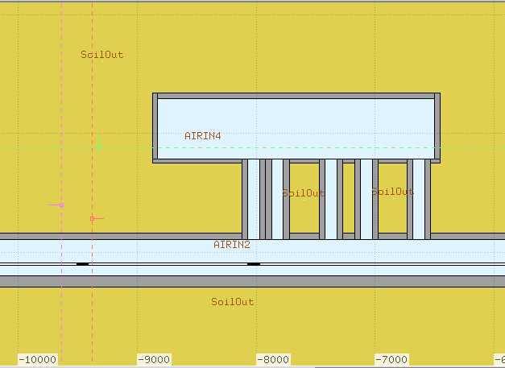
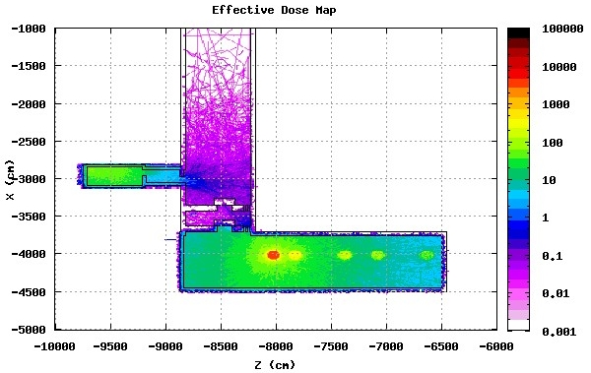
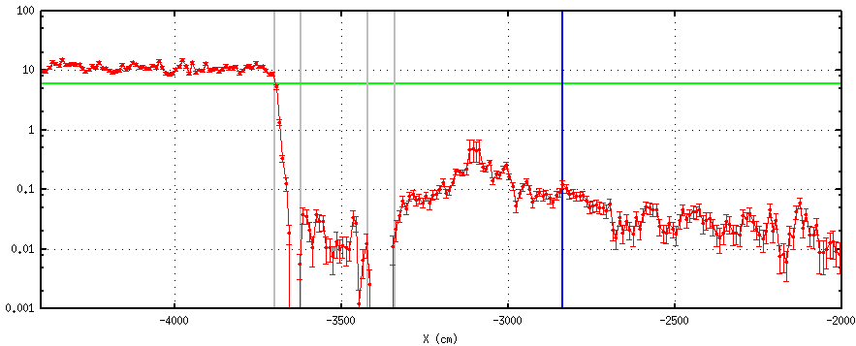
HL-LHC new underground galleries Shielding
Accidental scenario
Full beam loss
just in front of the nearest connection
1 m x 10 cm x 10 cm tungsten target
Beam parameters considered:
2808 bunches
2.2·10¹¹ ppb
Supervised Radiation Area:
< 6 mSv
Escape path
One tungsten block
(100cm x 10cm x 10cm)
in front of the nearest connection
LHC
6 mSv
Effective Dose (mSv)
Effective Dose (mSv)

Slide 15
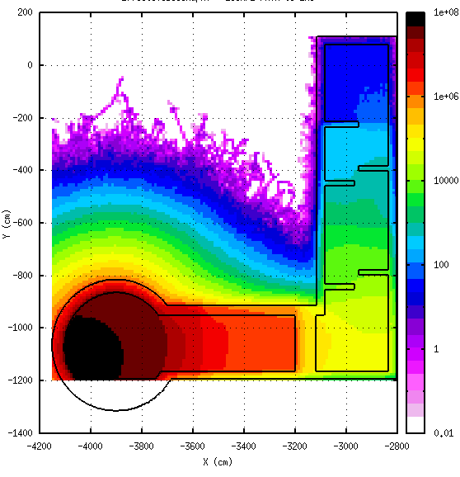
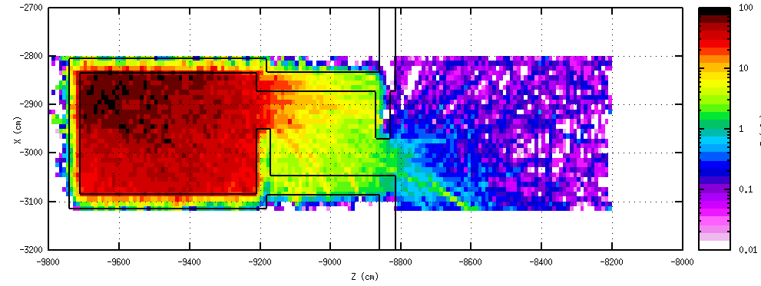
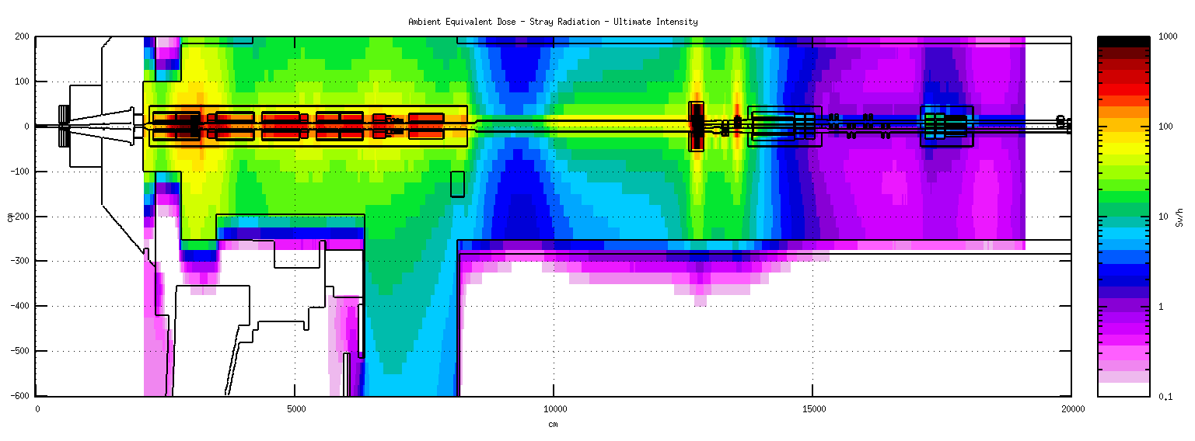
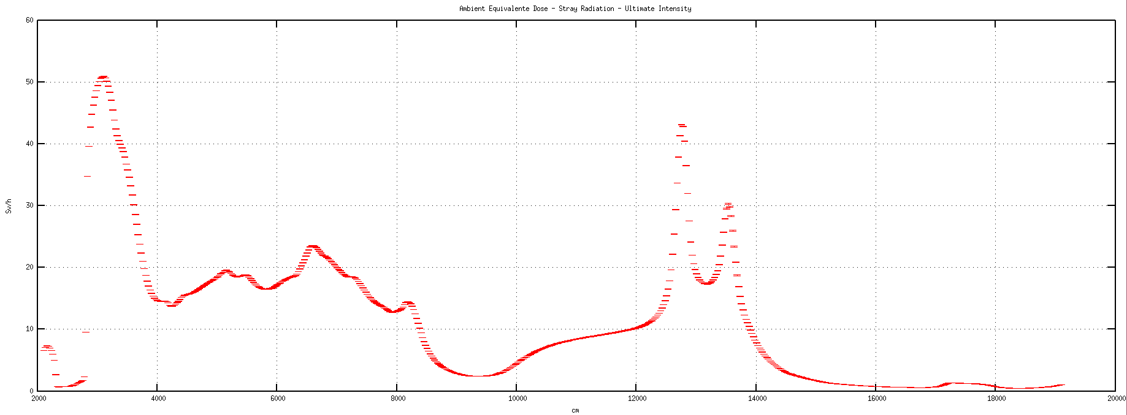
HL-LHC new underground galleries Shielding
Normal proton operation
Ultimate scenario
Levelled luminosity 7.5·10³⁴ cm⁻²s⁻¹
The attenuation provided by the shielding walls and the concrete stairs in the UPR escape path is evaluated by the accidental case
Supervised Radiation Area:
< 3 μSv/h
< 15 μSv/h
Effective Dose (mSv)
Effective Dose (mSv)
~10⁻⁸
HL-LHC Run at Ultimate intensity
Ambient Dose Equivalent– Stray radiation – Ultimate intensity
60
Max dose rate next to the tunnel wall is 50 Sv/h
⇒ In the underground gallery closest accessible point 0.5 μSh/h
50
40
Ambient Dose Equivalent Rate (Sv/h)
Ambient Dose Equivalent Rate (Sv/h)
30
20
10
0

Slide 16
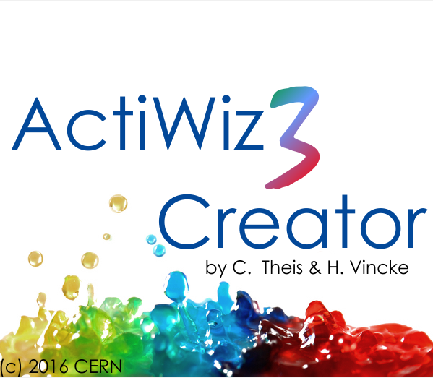
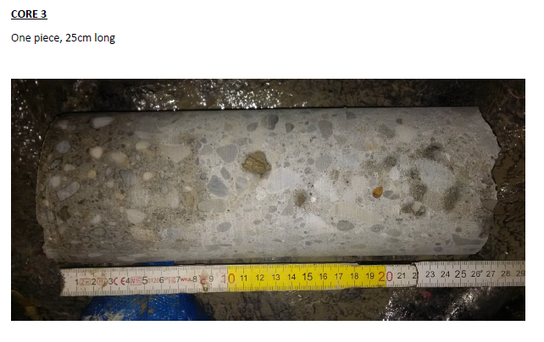
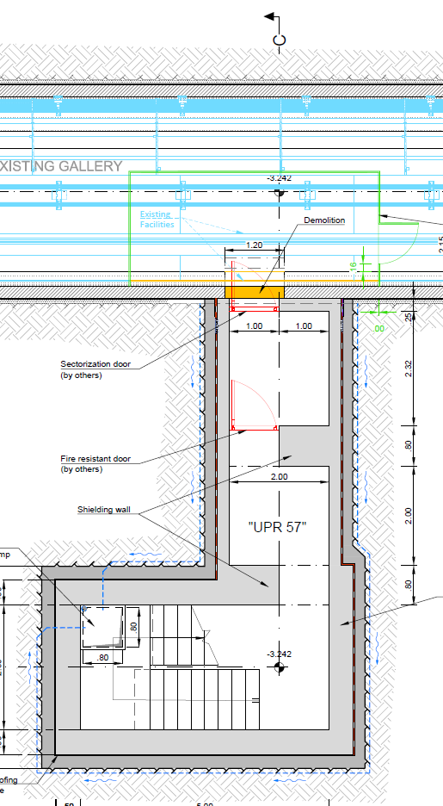
HL-LHC new underground galleries Spoil activation
Is it radioactive?
The specific and absolute activity of a radio-nuclide exceeds the exemption limit, which in reality means, since an object contains normally a large number of different radio-nuclides:$\sum_{i}{\frac{a_{i}}{{LL}_{i}}}>1$
During 2016 end of the year TS some concrete wall and rock samples were taken and analysed
$$\sum_{i}{\frac{a_{i}}{{LE}_{i}}}$$ | EYETS 2016-17 (~3 months cooling time)
UPR | γ spectrometry measurements | ActiWiz 3 Creator©
 |  | full | only γ
concrete | 1.15E-01 | 4.96E-01 | 9.70E-02
soil | 8.17E-03 | 1.65E-02 | 5.30E-03
$$\sum_{i}{\frac{a_{i}}{{LL}_{i}}}$$ | LS2
UPR | ActiWiz 3 Creator©
 | 1 month | 4 months
1st meter | 5.19E+00 | 4.15E+00
2nd meter | 3.19E-01 | 2.90E-01
3rd meter | 1.87E-02 | 1.70E-02
Ca-45 is a pure β emitter: cannot be seen with γ-spec
Ca-45 | 68%
Na-22 | 28%
S-35 | 2%
Ca-45 | 80%
Na-22 | 7%
Zn-65 | 3%
Fe-55 | 3%
S-35 | 1%
Mn-54 | 1%

Slide 17
Outline
LHC and HL-LHC
RP studies (using ©)
Operational scenarios
LHC Simulation Geometry
LHC Simulation vs. measurements
LHC residual dose rate estimation
HL-LHC new underground galleries
HL-LHC residual dose rate estimation

Slide 18
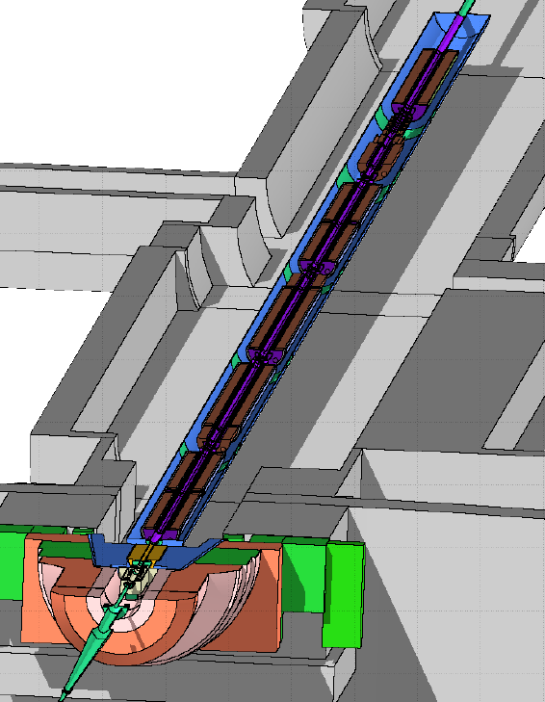
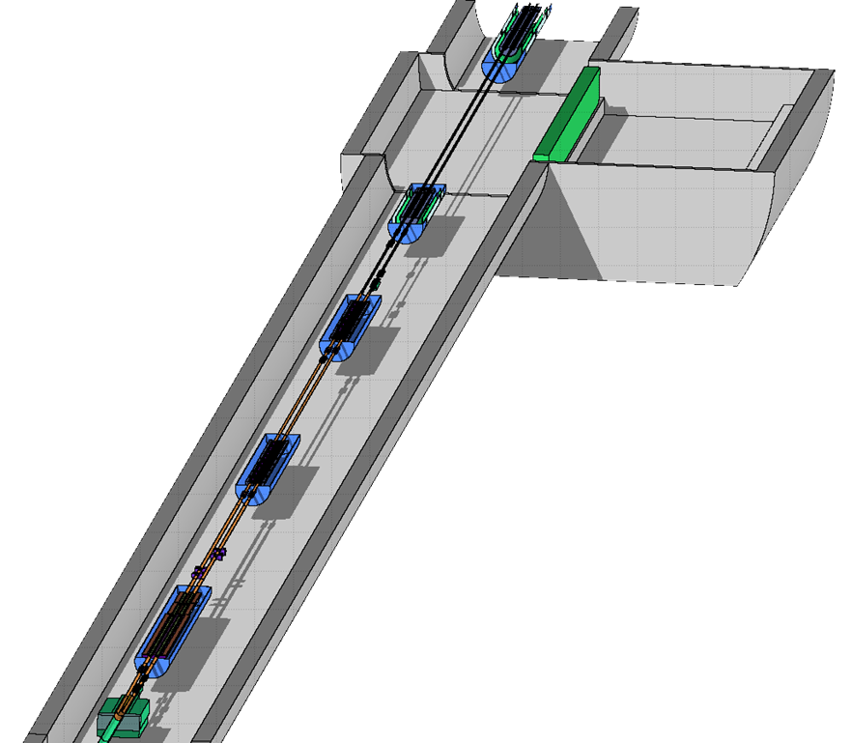
HL-LHC - Simulation Geometry
Simulation geometry kindly prepared by the FLUKA Team
HL-LHC IR1 v1.3
HL-LHC IR5 v1.3

Slide 19
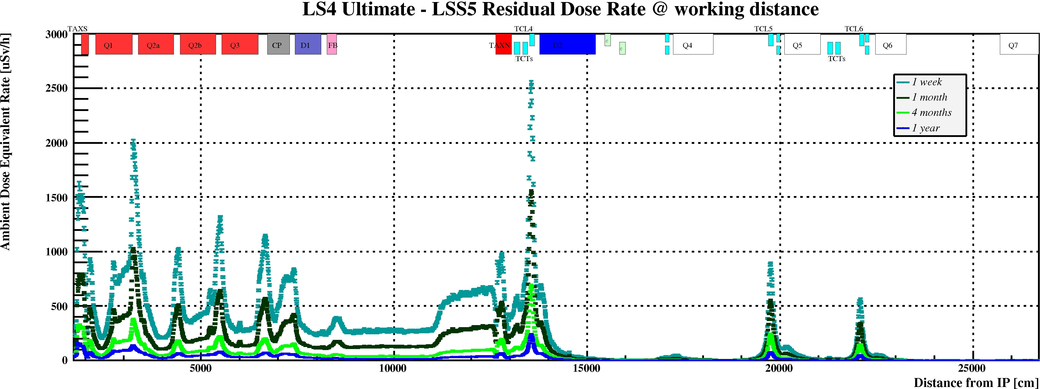
HL-LHC – Residual Dose Rate estimation
HL-LHC LSS1 – LS4 1 month cooling time
The optics and the collimator settings are the same for IR1 and IR5.
Only difference is crossing angle plane.
HL-LHC LSS5 – LS4 1 month cooling time

Slide 20
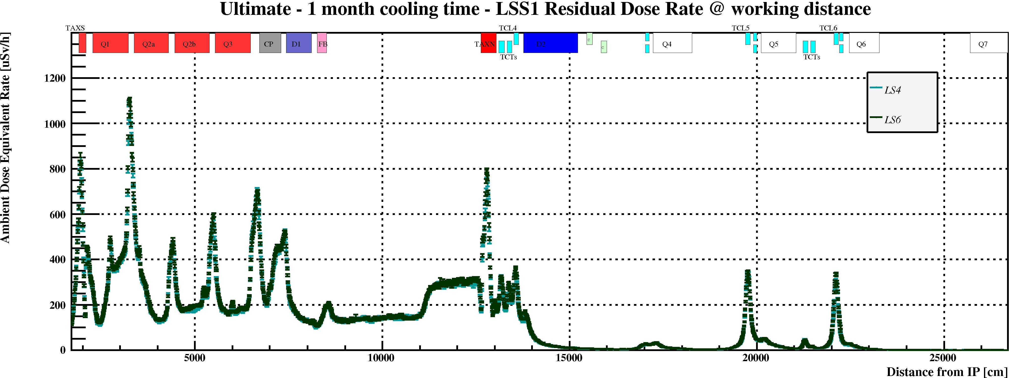
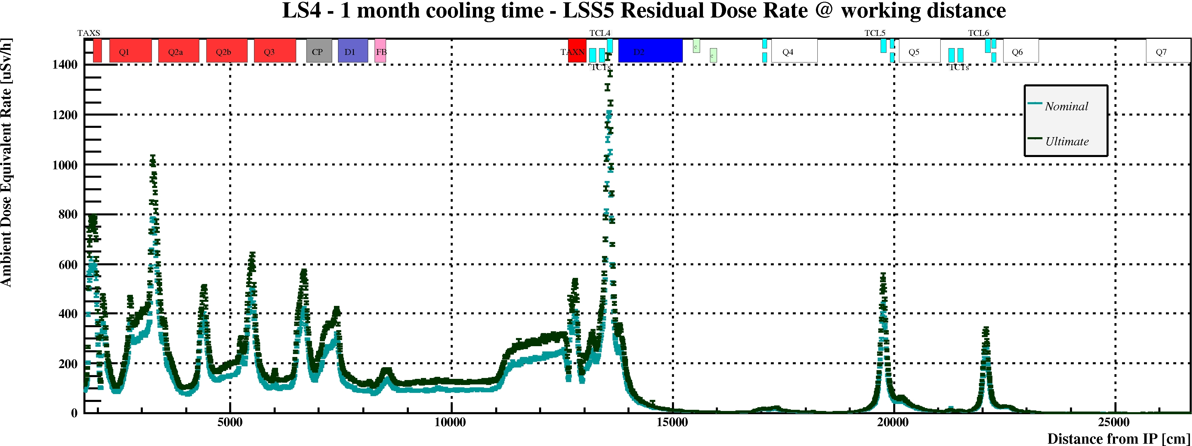
HL-LHC – Residual Dose Rate estimation LS6 vs LS4 and Nominal vs Ultimate
Cooling time | LS6/LS4
1 hour | 1.02
1 day | 1.03
1 week | 1.06
1 month | 1.09
4 months | 1.18
1 year | 1.29
Cooling time | Ultimate/ Nominal
1 hour | 1.50
1 day | 1.46
1 week | 1.35
1 month | 1.30
4 months | 1.24
1 year | 1.23

Slide 21
Summary and Conclusion
Fluka Monte Carlo code is extensively used to perform induced activation studies for the LHC accelerator machine and its High Luminosity upgrade
Simulation are performed using a very long and detailed geometry which reproduce the real accelerator environment in great detail
Radio nuclide inventory and activity estimation are done using Fluka and Actiwiz 3 Creator code
The simulation results are continuously benchmarked with the radiation measurements performed in the LHC machine
Notes:
so stess here that ActiWiz is used for convenience to get fast results for otherwise complex and lengthy calculations

Slide 23
Optimization during operation ALARA procedure
CERN dose objectives
Operational Periods
2 mSv/yr
Long Shutdowns
3 mSv/yr
6/20 mSv/yr 1 mSv/yr 300 μSv/yr
Radiation Workers
Other workers
Population outside CERN
On CERN site
On CERN site
On CERN site
Limits
CERN Radiation Protection
Safety Code F Limitation / Optimization
Optimization / ALARA to be demonstrated
Optimization Thresholds
100 μSv/yr 10 μSv/yr 10 μSv/yr
Optimized (by definition)

Slide 24
Optimization during operation ALARA procedure
CERN dose objectives
Operational Periods
2 mSv/yr
Long Shutdowns
3 mSv/yr
ALARA categories for individual interventions
Primary criteria
Individual Dose
Collective Dose
Secondary criteria
Ambient dose equivalent rate
Airborne activity
Surface contamination
Level I
Level II
Level III
100 μSv
1 mSv
500 μSv
5 mSv
CERN Radiation Protection
Safety Code F ALARA
50 μSv/h
2 mSv/h
5 CA
200 CA
10 CS
100 CS
100 μSv / intervention
Detailed work-and-dose planning
ALARA committee

Slide 25
ALARA at CERN
Interventions or group of intervention can be classified in three ALARA levels
Level definition mainly depends on planned collective or individual doses (other criteria application depends on risk analysis)
Graduate approval workflow depending on the level
 | Level 1 | Level 2 | Level 3
Collective dose | 0.5 man.mSv 5 man.mSv
Individual dose | 100 µSv 1000 µSv
Dose rate | 50 µSv/h 2 mSv/h
Atmospheric contamination | 5 CA 200 CA
Surface contamination | 10 CS 100 CS

Slide 26
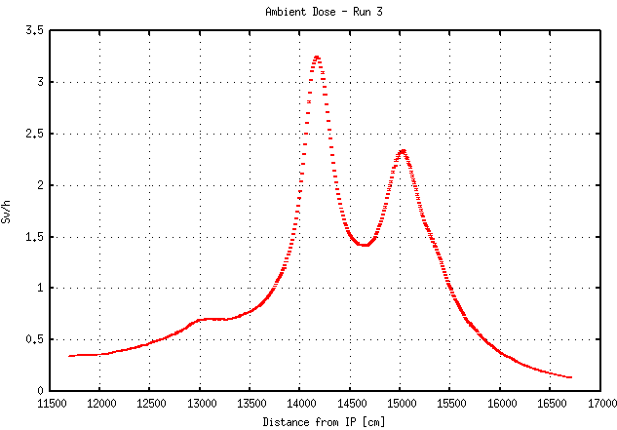
HL-LHC new underground galleries LHC Run 3 – stray radiation
TAN – TCTs – TCL4
RF cores
Connection Points in the LHC (distance from IP) | Max ambient equivalent dose rate in the LHC (Sv/h) | Estimated ambient dose rate in the HL underground (μSv/h)
UA elbow (~ 150-170 m) | 2.5 | 2.5 x 10⁻¹
UL13/17 (~ 89 m) | 1.0 | 1.0 x 10⁻¹
UPR17 (~ 137 m) | 1.5 | 1.5 x 10⁻²
UPR17 (~ 184 m) | 1.0 | 1.0 x 10⁻²
Considering an attenuation factor 10⁻⁸ provided by the UPR escape path (UPRs) and 10⁻⁷ provided by the ~7m of soil by the un-excavated cores

Slide 27
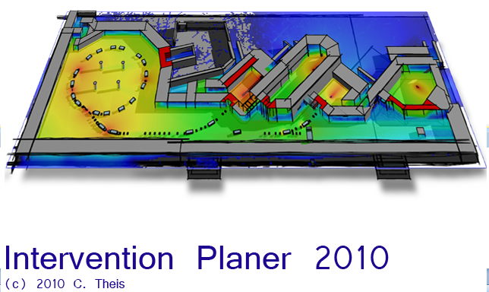
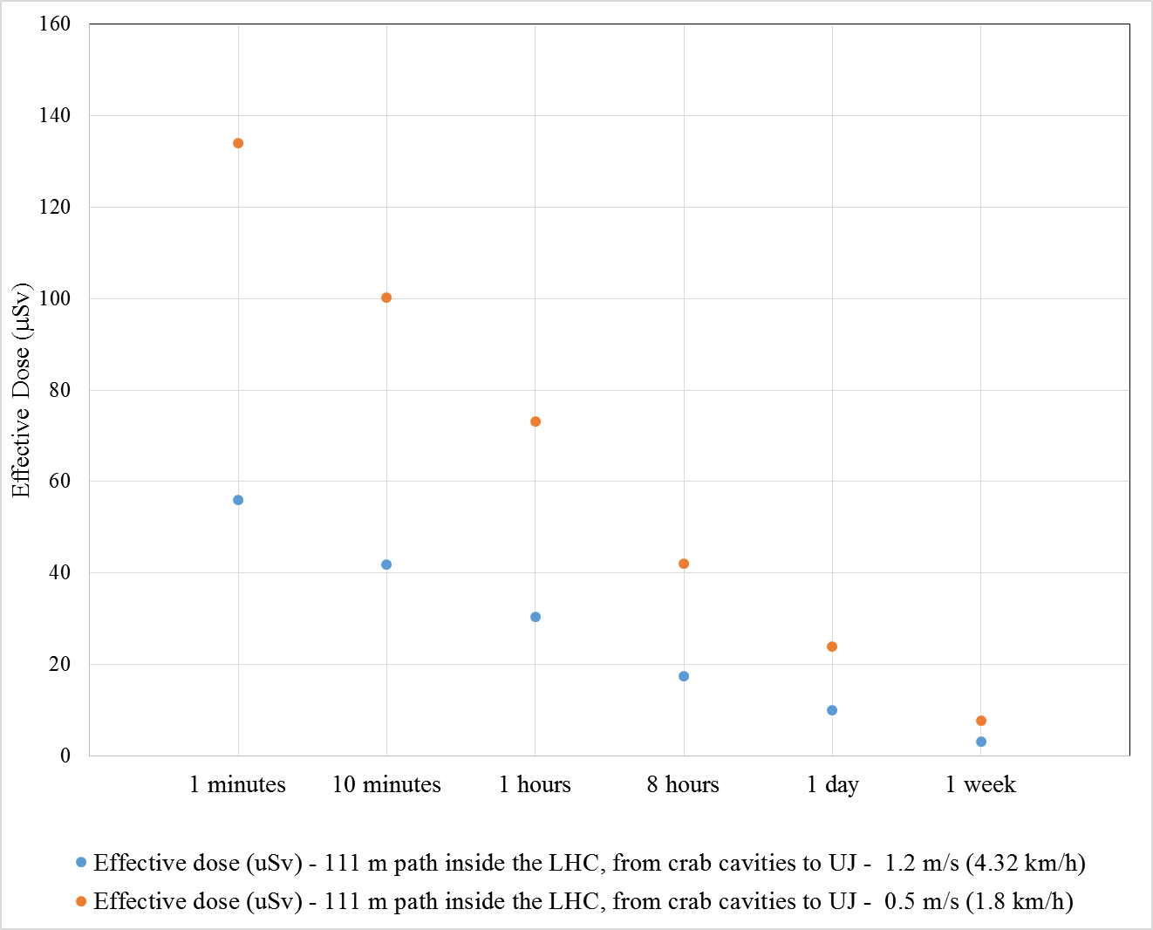
HL-LHC new underground galleries Escape path: Dose to personnel escaping though LHC (during Run 4 - Ultimate)
IVPlaner©
Path length (from escape path exit to LHC tunnel exit) ~ 100 m
LHC beam dump triggered by access system (normal functioning):
Effective Dose due to activated components
80 μSv (1 second cooling time)
Committed effective dose (internal and external dose) due to exposure by activated air (estimated for envelope case of Point 7):
< 15 μSv
 |  | Effective dose (μSv) 111 m path inside the LHC, from escape path exit to UJ (LHC tunnel exit)
 |  | 1.2 m/s (4.32 km/h) | 0.5 m/s (1.8 km/h)
cooling times | 1 second | 80 | 190
 | 1 minute | 56 | 134
 | 10 minutes | 42 | 100
 | 1 hours | 31 | 73
 | 8 hours | 17 | 42
 | 1 day | 10 | 24
No dump triggered (abnormal situation):
115 mSv (average dose rate 6 Sv/h)

Slide 28
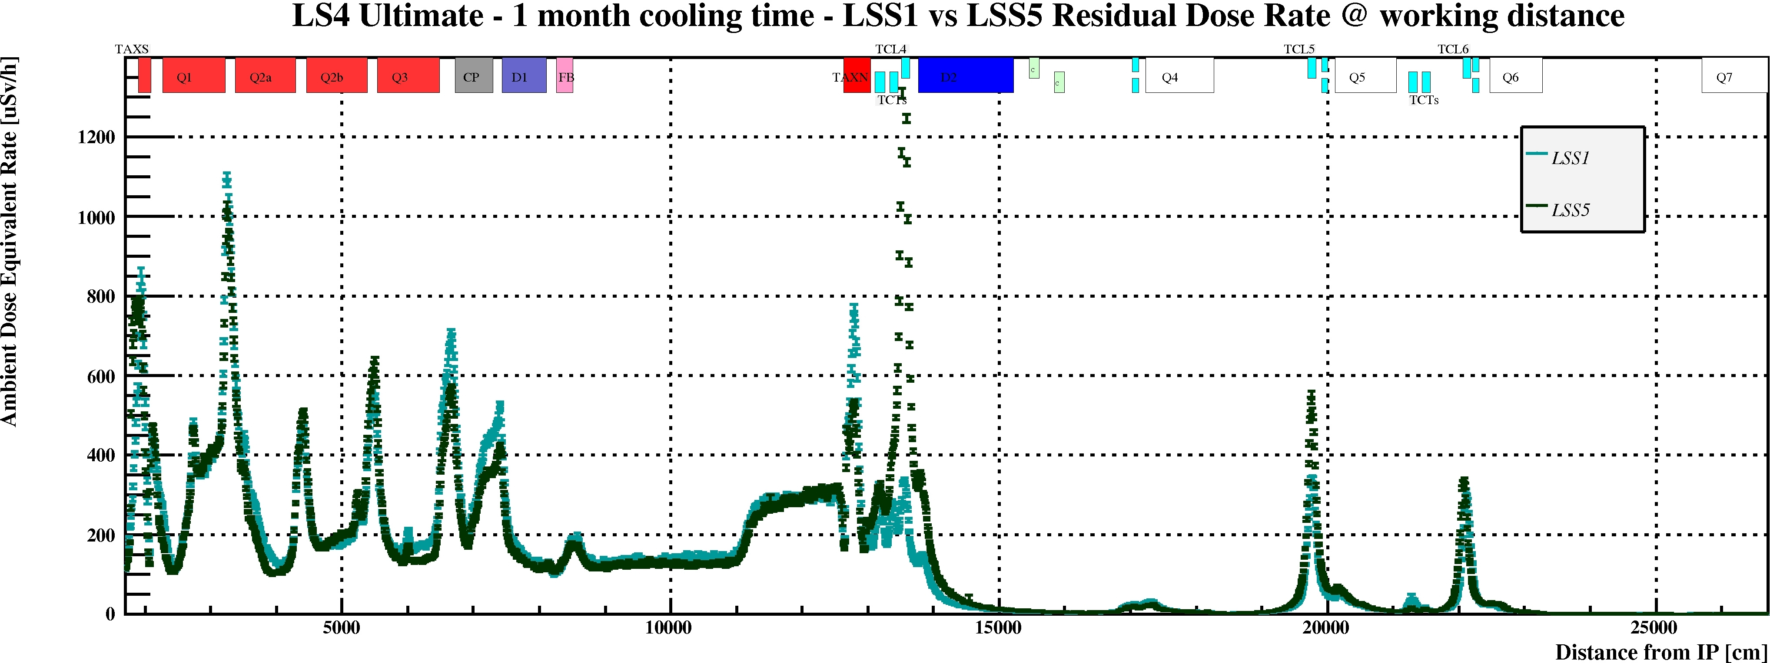
HL-LHC – Residual Dose Rate estimation IR1 vs IR5
HL-LHC LSS1 – LS4 1 month cooling time
The optics and the collimator settings are the same for IR1 and IR5.
Only difference is crossing angle plane.
HL-LHC LSS5 – LS4 1 month cooling time

