Slide 1


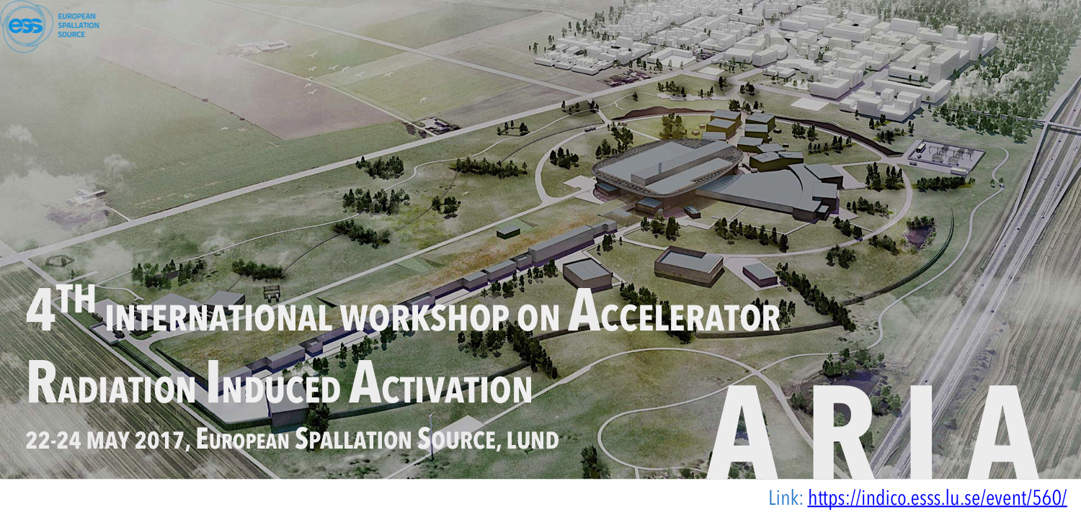
SPhN
(Nuclear Science Division)
Nuclide production in spallation reactions:
How useful are the simulations?
Jean-Christophe David

Slide 2
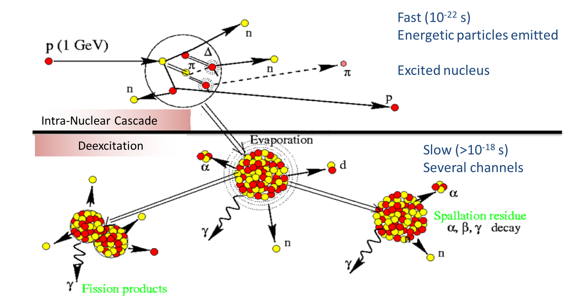
Introduction
Spallation reactions
4 topics addressed about nuclide production
    Design (optimisation) EURISOL – DS
    Predictive power (reliability) Megapie
    Feasibility (uncertainty estimate) ESS
    Mitigating the lack of experimental data Meteorite study
Recurrent tool: INCL model (often associated to Abla)
cem, cascade-x, cascade-04, cascade-asf, BIC, Bertini (geant4, mcnp, phits), incl, isabel, jam, jqmd, …
gem, smm, gemini++, abla, dresner(+fission), …
~150 MeV < Projectile Energy < ~2 GeV
(0 MeV < Projectile Energy < ~20 GeV)
Nuclide production in spallation reactions:
How useful are the simulations?

Slide 3
Design and optimisation
EURISOL-DS
Nuclide production in spallation reactions:
How useful are the simulations?

Slide 4
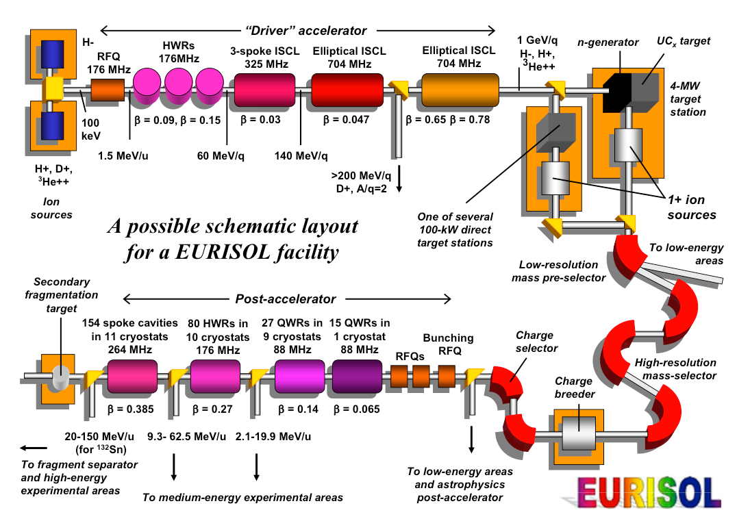
EURISOL-DS
Design and optimisation
EUropean Isotope Separation
On-Line Radioactive Ion Beam Facility
Design Study
Nuclide production in spallation reactions:
How useful are the simulations?

Slide 5
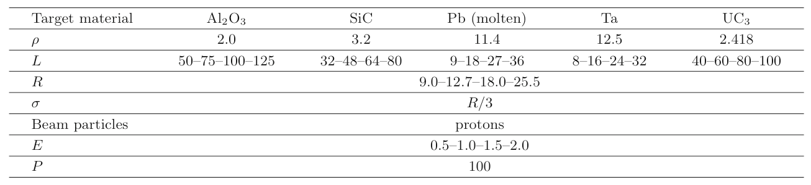
EURISOL-DS
Design and optimisation
EUropean Isotope Separation
On-Line Radioactive Ion Beam Facility
Design Study
fission target
direct target
One of our tasks (direct target)
  Production rate of using INCL4.2-Abla and CEM2k (MCNPX)
  Which isotopes in Be, Li, Mg, Ar, Ne, Ni, Ga, Kr, Sn, Hg, Fr (NuPPECC)
  Which target material of Table below
  Which size (considering a cylinder)
(g/cm³)
(cm)
(GeV)
(kW)
320 configurations!!!
Nuclide production in spallation reactions:
How useful are the simulations?

Slide 6
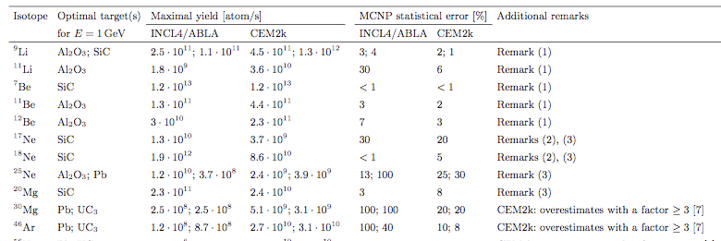
EURISOL-DS
Design and optimisation
Example of results
S. Chabod et al., EPJ A45, 131 (2010)
With comments, for future works (models evolve)
R1: Nuclei from a long evaporation process:
overestimated by CEM2k
underestimated by INCL4.2/ABLA
R3: A specific benchmark should be done for light targets to disentangle between both models.
Thanks to fast/benchmarked codes
Exotic physics cases can be studied
in Safe facilities
for a given budget
(The best compromises can be obtained)
Nuclide production in spallation reactions:
How useful are the simulations?

Slide 7
Predictive power and reliability
Megapie
Nuclide production in spallation reactions:
How useful are the simulations?

Slide 8
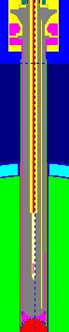
Megapie
Predictive power and reliability
Liquid Pb-Bi target Prototype
Irradiated at SINQ (PSI)
4 months in 2006
Proton - 575 MeV and 1.4 mA (~0.8 MW)
One of our tasks
  Estimate of residual nucleus production
  → Safety (Activation, volatiles)
p
Nuclide production in spallation reactions:
How useful are the simulations?

Slide 9
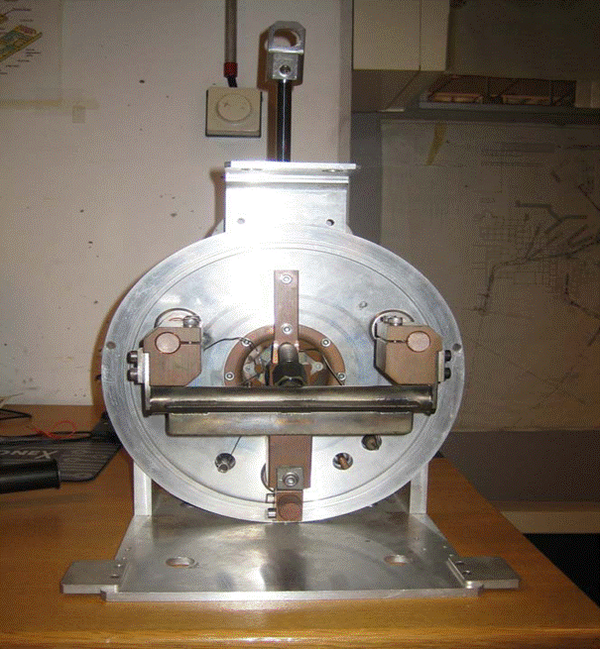
Megapie
Predictive power and reliability
Volatile
An ancillary experiment @ ISOLDE:
    Volatile release from a Pb-Bi target (He, Ne, Ar, Br, Kr, Cd, I, Xe, Hg, Po and At)
Target
  Liquid Pb-Bi in Ta cylinder
  (L=20 cm, r=1 cm)
Projectile
  Proton beam: 1.0 and 1.4 GeV
proton
Nuclide production in spallation reactions:
How useful are the simulations?

Slide 10
Megapie
Predictive power and reliability
Volatile
An ancillary experiment @ ISOLDE:
    Volatile release from a Pb-Bi target (He, Ne, Ar, Br, Kr, Cd, I, Xe, Hg, Po and At)
An interesting case: Astatine release
      At volatile (more than Po in Pb-Bi) and decays into Po
      Po: safety issue (long-lived α emitters)
Results in 2007
Release of all elements rather well described, except astatine!
No model able to reproduce the A distribution!
At
Nuclide production in spallation reactions:
How useful are the simulations?

Slide 11
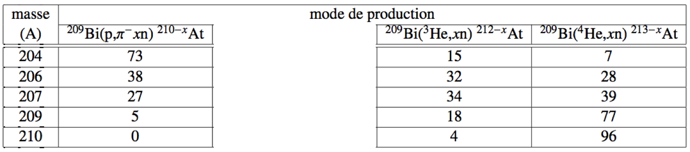
Megapie
Predictive power and reliability
Production mechanisms of At from Bi
Direct channel (π- emission)
Secondary reaction (He)
Light At
Heavy At
So INCL and Abla improved/extended
particle emitted
INCL4.2 | n, p, π
Abla | n, p, α
INCL4.6 | n, p, π, d, t, ³He, α and A ≤ 8
Abla07 | n, p, d, t, ³He, α and IMF
( and pion potential: V_{π}(τ) )
Benchmarks of the elementary processes…
Nuclide production in spallation reactions:
How useful are the simulations?

Slide 12
Megapie
Predictive power and reliability
α
α
Direct production
Not bad for low masses
alpha production
OK
At from Bi
α-induced: great
Nuclide production in spallation reactions:
How useful are the simulations?

Slide 13
Megapie
Predictive power and reliability
However results
remained BAD!!!
But calculation results in the target
and exp. data outside…
Generally time release negligible (Kr, Xe, …)
What about At???
If a release time included...
OK with T ~ 5 or 10h
J.-C. David et al., EPJ A49, 29 (2013)
Reliable tool → new assumption made possible
→ new information obtained (T_{release})
… to be measured now...
Nuclide production in spallation reactions:
How useful are the simulations?

Slide 14
Feasibility and uncertainty estimate
ESS
Nuclide production in spallation reactions:
How useful are the simulations?

Slide 15
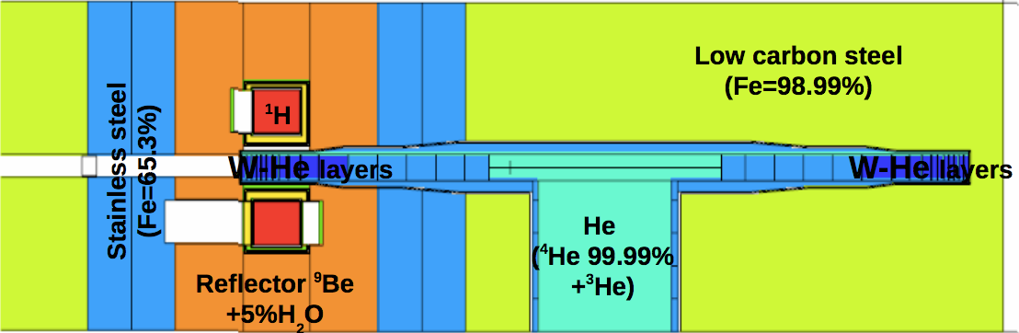
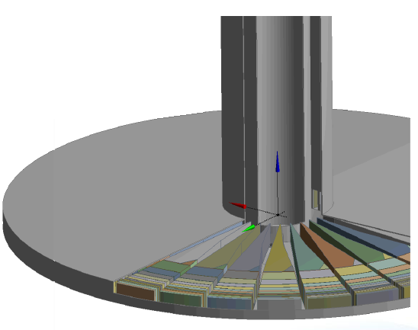
ESS
Feasibility and uncertainty estimate
Technical Design Report (2013)
Our tasks:
  Target activity calculations
  Uncertainty estimates
p
geometry in MCNPX
Nuclide production in spallation reactions:
How useful are the simulations?

Slide 16
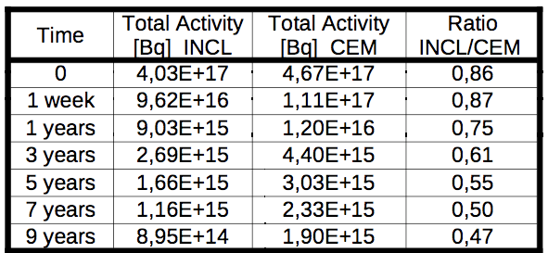
ESS
Feasibility and uncertainty estimate
Activities from INCL4.6-Abla07 and CEM03
This ratio:
a “crude” estimate of uncertainties
Uncertainties:
What are the reasons of those differences? Can they be assessed?
Nuclide production in spallation reactions:
How useful are the simulations?

Slide 17
ESS
Feasibility and uncertainty estimate
Method
Differences in Activities
Differences in Contributors
(produced isotopes)
Nuclide production in spallation reactions:
How useful are the simulations?

Slide 18
ESS
Feasibility and uncertainty estimate
Method
Differences in Activities
Differences in Contributors
(produced isotopes)
Projectile Fluxes
Elementary σ_{production}
Nuclide production in spallation reactions:
How useful are the simulations?

Slide 19
ESS
Feasibility and uncertainty estimate
Method
Differences in Activities
Differences in Contributors
(produced isotopes)
Projectile Fluxes
Elementary σ_{production}
Mainly n and p
spectra ~well simulated
Nuclide production in spallation reactions:
How useful are the simulations?

Slide 20
ESS
Feasibility and uncertainty estimate
Method
Differences in Activities
Differences in Contributors
(produced isotopes)
Projectile Fluxes
Elementary σ_{production}
σ_{p-induced} : when exp. data → σ^{calc} benchmarked! ratio C/M
σ_{n-induced} : En < 25 MeV from CINDER (database) → OK
25 < En < 200 MeV Few data… (issue)
200 MeV < En n = p (assumed)
Mainly n and p
spectra ~well simulated
negligible
Nuclide production in spallation reactions:
How useful are the simulations?

Slide 21
ESS
Feasibility and uncertainty estimate
Method
Differences in Activities
Differences in Contributors
(produced isotopes)
Projectile Fluxes
Elementary σ_{production}
σ_{p-induced} : when exp. data → σ^{calc} benchmarked! ratio C/M
σ_{n-induced} : En < 25 MeV from CINDER (database) → OK
25 < En < 200 MeV Few data… (issue)
200 MeV < En n = p (assumed)
Mainly n and p
spectra ~well simulated
negligible
negligible
Tricky and rests on elementary exp. data
Nuclide production in spallation reactions:
How useful are the simulations?

Slide 22
ESS
Feasibility and uncertainty estimate
Results
Done for 9 years of cooling (total activity)
    primary result 8.95 10¹⁴ Bq
    method applied 7.95 10¹⁴ Bq (correction: 12%)
This method helps correcting the calculated value using exp. data (elementary processes)
BUT does not give uncertainties!!!
From GUM (JCGM 100:2008; http://www.bipm.org/fr/publications/guides/gum.html)
    uncertainty: "parameter, associated with the result of a measurement, that characterizes the dispersion of the values that could reasonably be attributed to the measurand”
    error: "result of a measurement minus a true value of the measurand”
Both are important/useful, but the way to assess them are different! And difficult!
Nuclide production in spallation reactions:
How useful are the simulations?

Slide 23
Mitigating the lack of exp. data
Meteorites
Nuclide production in spallation reactions:
How useful are the simulations?

Slide 24
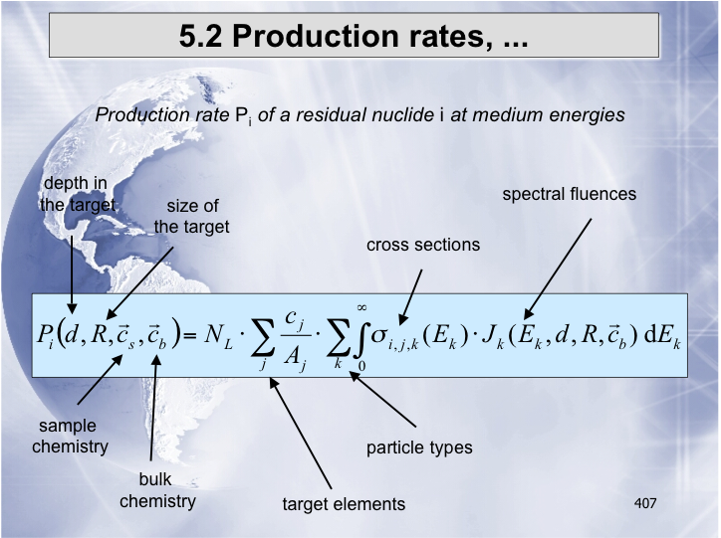
Meteorites
Mitigating the lack of exp. data
« Was erzählen uns Meteorite über das frühe Sonnensystem ? »
(Ingo Leya – Univ. Bern)
σ production of
isotope i
with projectile k
on target nucleus j
from Experiments
or Models
GCR spectra
H
(87%)
He
(12%)
spallation
Used to study
. the meteorite history
. the GCR spectra
Nuclide production in spallation reactions:
How useful are the simulations?

Slide 25
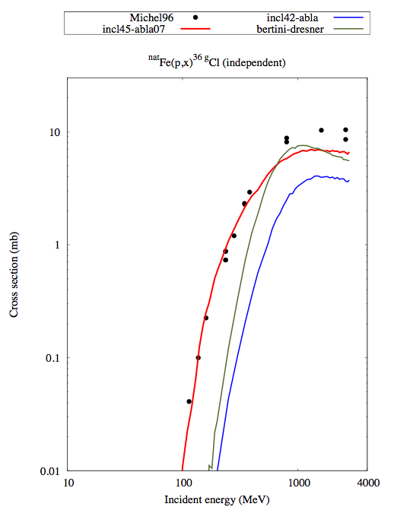
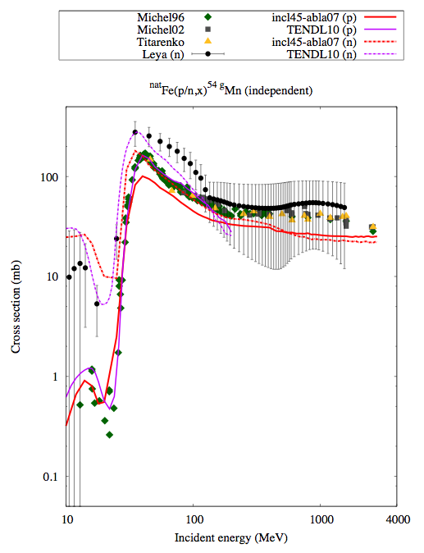
Meteorites
Mitigating the lack of exp. data
INCL Results
secondary reactions
proton
alpha
neutron
p+Fe →³⁶Cl
α+Fe →⁵⁷Co
n
N+Fe →⁵⁴Mn
α=2p+2n
p
INCL4.6-Abla07 significantly improved
INCL4.6 reliable with
α-induced reactions
INCL4.6 covers a large range…
Improving residual nucleus calculations
can play a role in topics like meteorite study
Nuclide production in spallation reactions:
How useful are the simulations?

Slide 26
Conclusion
Nuclide production simulation in spallation reactions
can be done by numerous models in several
transport codes (from J.-C. David EPJ A51, 68 (2015))
For the last 20 years significant improvements
done in nuclide production
Reliability/uncertainties-errors is still a difficult question
→ benchmarks are necessary
    already done
        by transport code developers
        as project (e.g. IAEA benchmark (2010) https://www-nds.iaea.org/spallations/ )
    to be done (new ones…)
Nuclide production in spallation reactions:
How useful are the simulations?

Slide 27
Outlook
Some models give “good” results, BUT improvements and extensions are still needed!
e.g. in INCL model (since the last IAEA Benchmark)
    Clusters (as projectiles and emitted particles)
    Extension toward low and high energies (smooth transition over a large energy range)
    Specific cases ( (p,2p), (p, pn) reactions) --- D. Mancusi / J.L. Rodriguez-Sanchez
    Uncertainties (Bayesian method) --- G. Schnabel
    Strangeness (Hypernucleus) --- J. Hirtz
Nuclide production in spallation reactions:
How useful are the simulations?

Slide 28
INCL team
A. Boudard, J. Cugnon, J. Hirtz, S. Leray, D. Mancusi,
A. Marchix, J.L. Rodriguez-Sanchez, G. Schnabel
Nuclide production in spallation reactions:
How useful are the simulations?

Slide 29
Thank you!
Tack!
Nuclide production in spallation reactions:
How useful are the simulations?

