Slide 1

European Spallation Source Update
Instruments Collaboration Board
22 June 2016
James H. Yeck
Director General
European Spallation Source ERIC

Slide 2
Construction investment
CURRENT
Sweden (member) | 35.0 %
Denmark (member)* | 12.5 %
Germany (member)* | 11.0 %
United Kingdom (member) | 10.0 %
France (member) | 8.0 %
Italy (member) | 6.0 %
Spain (founding observer)* | 5.0 %
Switzerland (member) | 3.5 %
Norway (member) | 2.5 %
Poland (member) | 2.0 %
Czech Republic (member) | 2.0 %
Hungary (member) | 0.95 %
Lithuania (future member) | 0.45 %
Estonia (member) | 0.25 %
Total (minus preconstruction*) | ~97 %
FUTURE
Belgium (founding observer) | tbd
Netherlands (founding observer) | tbd
Greece (future observer) | tbd
Turkey (future observer) | tbd
Latvia, Portugal, Finland | tbd
Notes:
Founding Members
Czech Republic
Denmark
Germany
Estonia
France
Italy
Hungary
Norway
Poland
Sweden
Switzerland
Founding observers
Belgium
Spain
Netherlands
United Kingdom
Ireland

Slide 3
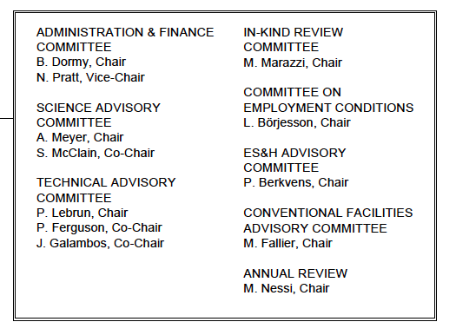
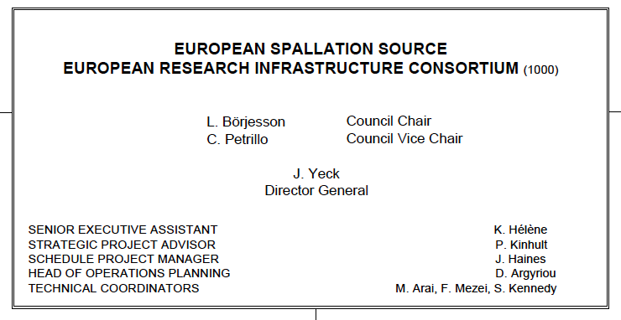
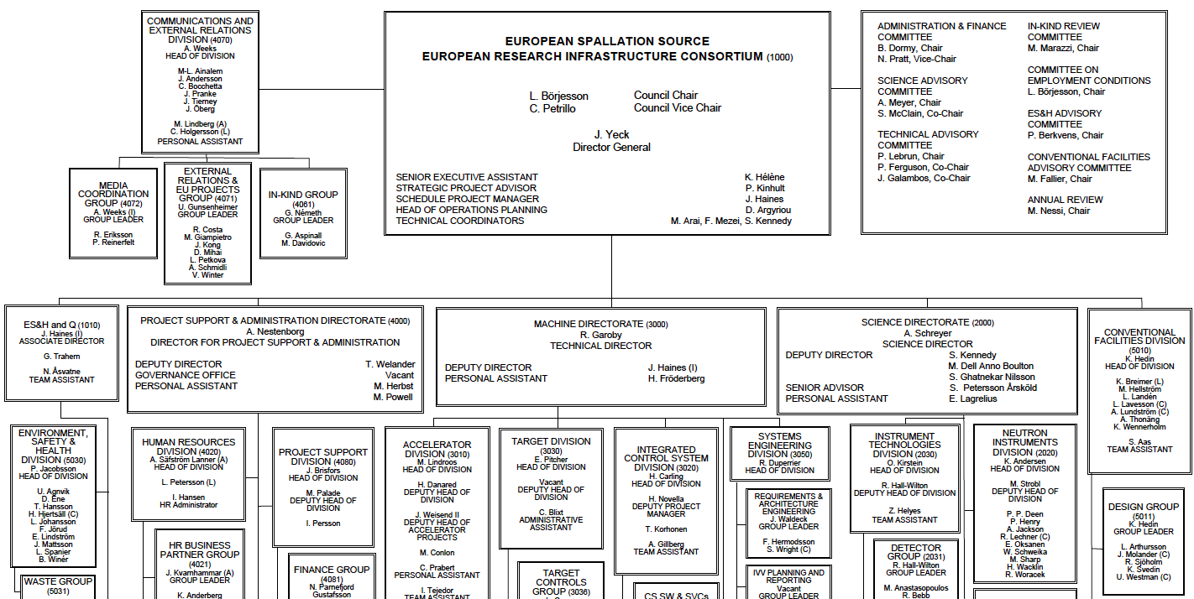
Organisation
~ 100
Collaborating Institutions
42 In-kind Partners
60 Collaboration, MoU and Grant Partners
47
Nationalities
368
Employees

Slide 4
Project objectives and execution strategies
Deliver Technical Design Report scope and performance at defined cost
  5 MW accelerator capability
  22 “public” instruments (up to 16 financed within the construction budget)
  Construction cost of 1,843 B€₂₀₁₃ and annual ops cost target of 140 M€₂₀₁₃
Execute on a “technically limited” schedule that is not constrained by liquidity
Identify risk and risk treatment strategies
  10% cash contingency, In-kind contributions defined as deliverables
  Conventional Facilities (CF) risk, within limits, addressed by host countries
  Ring fenced budget for Neutron Scattering Systems (NSS)
  Defined scope contingency (accelerator power equipment)
  EU grant (brightness) for technical, administrative, and in-kind management risks
Annual comprehensive reviews of performance and plans

Slide 5
Project execution context
Green field site, single purpose organization, in-kind delivery model
Key planning milestones
  Machine Ready for 1st Beam on Target – End of 2019 (Aggressive)
  Machine Installation Complete – End of 2022
  Instrument Installation Complete – End of 2025
Critical external delivery milestone – Start User Program in 2023
Major schedule execution risks include making timely project decisions (project culture); in-kind deliveries; integration, installation and commissioning uncertainties; and, liquidity issues
Major cost risk factors include potentially significant cost of schedule delays (green field site) and securing a shared commitment by member countries and partner institutions to ESS cost goals and to deliver at ESS cost book values

Slide 6
Cost baseline – 1 843 M€ (2013 pricing)
(M€) Project | Original Baseline (2013 prices) | Original Baseline (cash budget indexed) | Current Baseline (includes changes)
Conventional Facilities | 438.9 | 458.1 | 458.0
Accelerator Systems | 510.2 | 518.0 | 513.1
Target Systems | 155.3 | 158.7 | 162.0
Integrated Control Systems | 73.0 | 75.1 | 79.6
Technical Management Services | 31.0 | 32.4 | 39.5
Neutron Scattering Systems | 350.0 | 361.9 | 361.9
Project Support & Administration | 126.5 | 132 | 138.9
Contingency | 158.5 | 176.5 | 159.6
Total | 1 843.3 | 1 912.6 | 1 912.6
Host Countries’ CF Scope | 93.0 | 100.5 | 115.9
Total including Host CF | 1 936.3 | 2 013.1 | 2 028.5

Slide 7
ESS Schedule Objectives
2013
2014
2015
2016
2017
2018
2019
2020
2021
2022
2023
2024
2025
Jun 2014
Sep 2016
Oct 2017
Jun 2019
Sep 2022
Dec 2025
Ground break
First installations on-site (Accelerator)
Start of
User Programme
First installations on-site (Target & NSS)
Machine* ready for first beam on Target
Machine installed
for 2.0 GeV
Dec 2019
First instrument
ready for hot commissioning
Dec 2022
6m
Late finish – Machine installed for 2.0 GeV
3m
Last Construction Phase
Instrument handover
to Operations
Machine*: Accelerator, Target & ICS

Slide 8
Construction and operations budget profiles

Slide 9
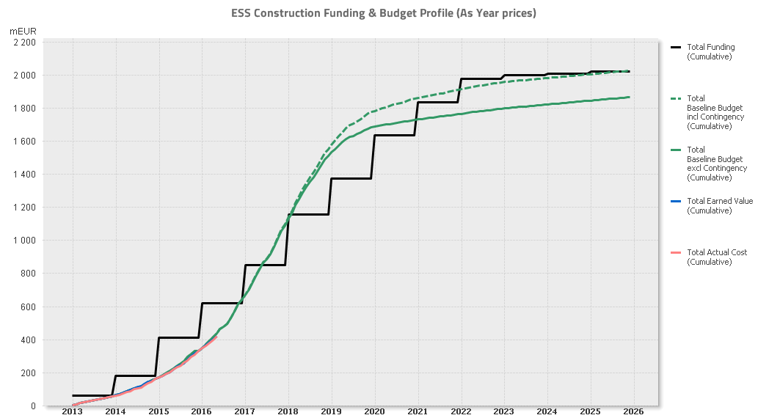

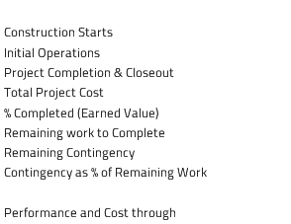
Construction Profile, 2016-05-31
16 Instruments ready for Comm.
⧫ Machine 2.0 GeV
⧫ First installations
(of Machine Systems)
⧫ 1st Call for
User Proposals
⧫ Construction
Starts
⧫ First Neutrons
⧫ Operations Starts
Notes:
Schedule variance = Earned – Schedule
Cost Variance = Actuals - Earned
SPI = Earned/Scheduled
CPI = Earned/Actuals

Slide 10
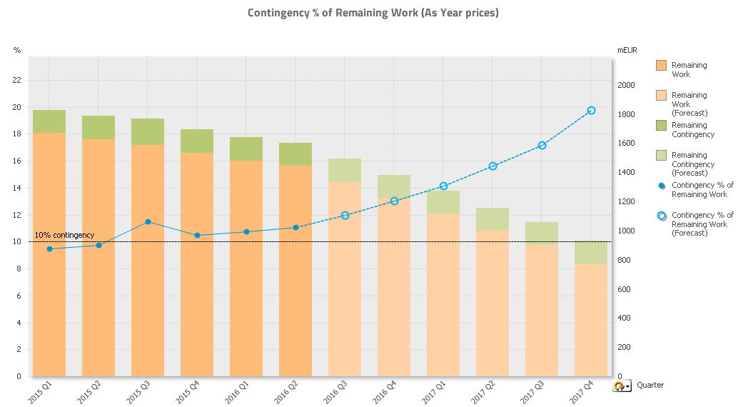
Contingency Tracking
Notes:
Schedule variance = Earned – Schedule
Cost Variance = Actuals - Earned
SPI = Earned/Scheduled
CPI = Earned/Actuals

Slide 11
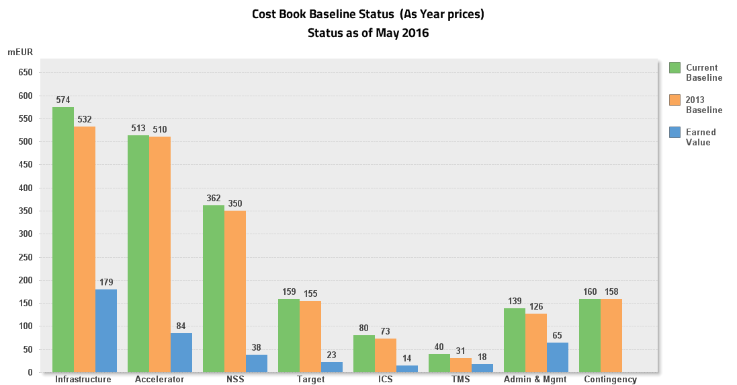








Level 2 Cost Baseline Tracking
Notes:
Schedule variance = Earned – Schedule
Cost Variance = Actuals - Earned
SPI = Earned/Scheduled
CPI = Earned/Actuals

Slide 12
In-kind status and plans
Stretch Goal 747 M€
€675M
€545M

Slide 13
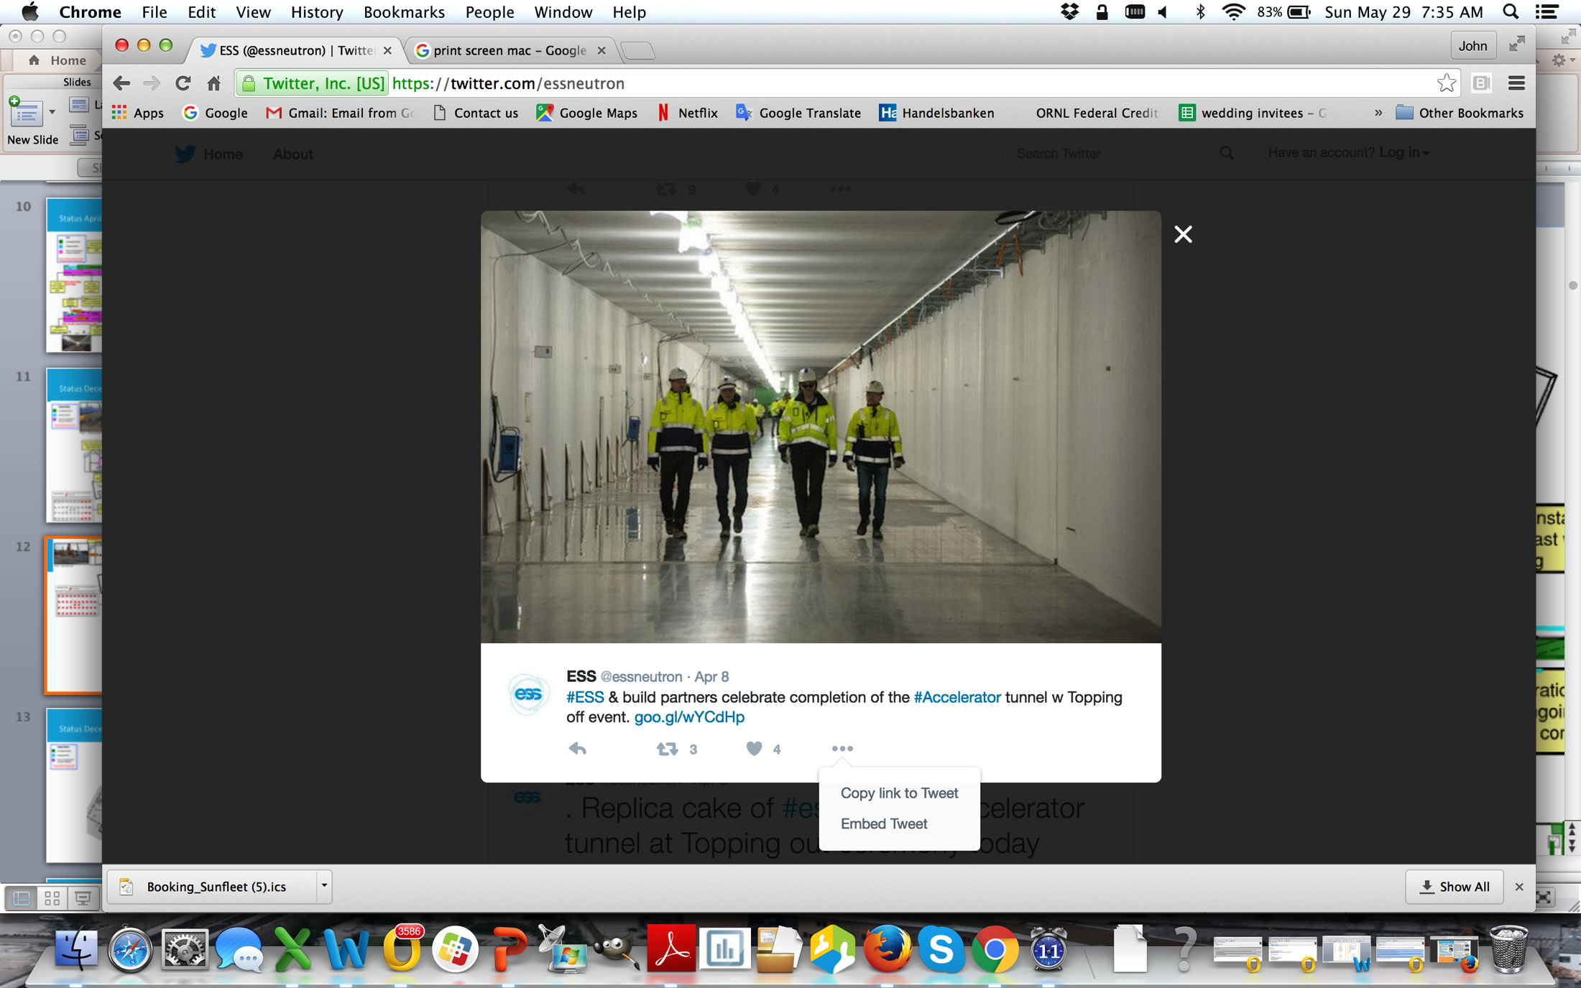
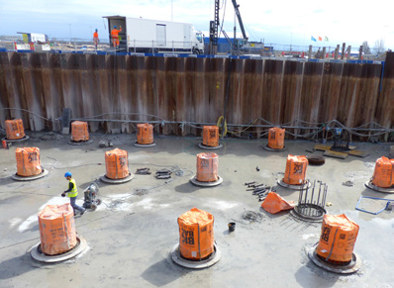
Recent construction site highlights
Completed 535 m long accelerator tunnel structure (April)
Completed all 62 large-diameter bored piles that provide earthquake resistance for the target monolith and active cells (May)

Slide 14
Conventional facilities context
Construction:
  CF construction started in 2014 when the facility requirements and design were still under development
    Biggest challenge for joint ESS and Skanska team continues to be delivery of stable requirements to the Detailed Design Team
  Expect final CF cost to be within 10% of Nov 2013 baseline
    Maintaining schedule is essential to controlling costs
Contract:
  Skanska work governed by cost plus fixed fee contract with Target Prices negotiated as substantial design work is completed
  Target Prices provide performance incentive --> cost savings or increases relative to the Target Price are shared
  The next, and final, Target Price will be negotiated by the end of October and finalized before the end of the calendar year

Slide 15
Actively managing CF costs to meet requirements
Contingency is low at ~10%, but remains nearly constant as a fraction of costs to go
 | Nov 2013 | Current | Explanation of change
Baseline | 532 M€ | 575 M€ | Includes indexation (27 M€) and scope increases (15 M€, pending final approval of host states)
Remaining Contingency | 50 M€ | 35 M€ | Evaluated and approved following established change control process, final approval with host countries
Contingency as % of Remaining Work | 9% | ~10% | Approximately 55% of CF work scope is locked into a Target Cost and CF project is 30% complete
Pursuing scope contingency items to create additional margin against risks
Scope Contingency Items | M€ | Comment
Outsourcing Central Utility Building | 8 | Pursuing options for this item, very likely
Logistics Building | 7 | May remove for now; and add back later if possible

Slide 16
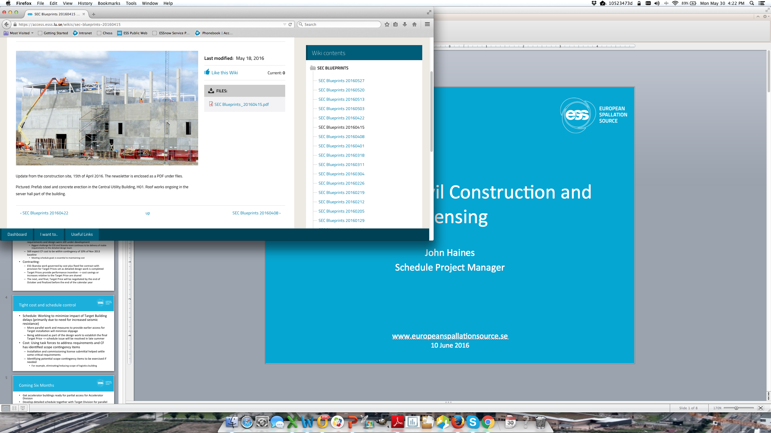
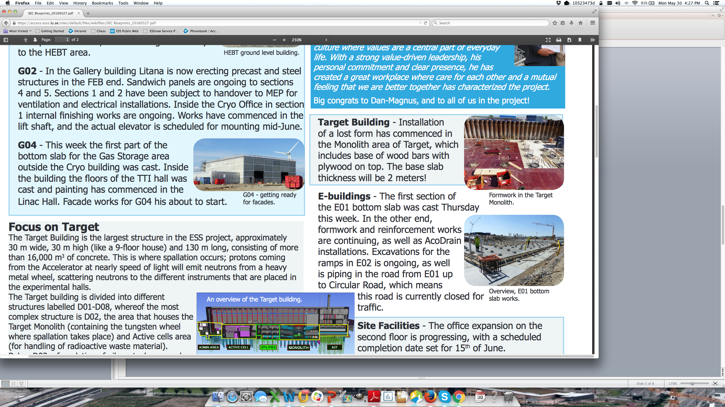
Coming six months
Finalize parallel works plan with CF and Target Division to minimize schedule delays
Negotiate final Target Price for C101 conventional construction contract
Execute staged Detailed Design of Target & Instrument Halls
Prepare accelerator buildings for partial access for installation by Accelerator Division
Establish site rules and processes for access and work on site by other divisions
Start process of handing over buildings from C101 to ESS during construction
Prefab steel and concrete erection in the Central Utility Building (H01)
Bottom slab cast in Experimental Hall 3 (“long guide hall”, E01)

Slide 17
2nd License submittal seeks permission to install machine and commission its first stage
Goal: Bring facility online in 6 steps (including Target and Instrument Bunker in 6th step)
Goal: Verify machine and neutron production performance
MS: Accelerator Readiness Reviews 1 - 6
MS: Machine ready for first beam on Target
2016 | 2017 | 2018 | 2019 | 2020 | 2021 | 2022 | 2023
MS: Submit 2nd License application to SSM
MS: 2nd License approved
MS: Submit 3rd License application to SSM
MS: 3rd License approved
MS: Submit 4th License application to SSM
MS: 4th License approved
MS: Start User Program
Goal: Infrastructure and processes for User Program operational
Goal: Permission to install and commission first stage of accelerator
Goal: Permission to commission beam on Target
Goal: Permission for routine operation
SSM = Swedish Nuclear Authority = ESS Regulator

Slide 18
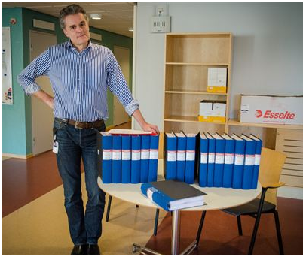
Status of 2nd license application
Preliminary Safety Analysis Report + other documents presented to Swedish regulator (SSM) on May 3
  Includes ~ 250 ESS-generated reference documents; > 10 000 pages
  SSM expressed appreciation for submitting the licensing package on time
Series of meetings will be held with SSM over the next few months to discuss details
  Meeting on releases during highly unlikely events held on 16 May with SSM and SSM + local officials on 27 May

Slide 19
CF and licensing summary
CF 30% complete today with final Target Cost to be set by end of year
Schedule remains challenging with project-wide effort to resolve issues to hold major delivery milestones
Expect CF cost to land within 10% of November 2013 baseline, working with hosts on risk coverage
2nd license application submitted on schedule, a major critical path item
Good relationship with the Swedish Radiation Authority; working proactively to identify and resolve critical issues
Reviewing lessons learned on both CF and licensing to strengthen future plans

Slide 20
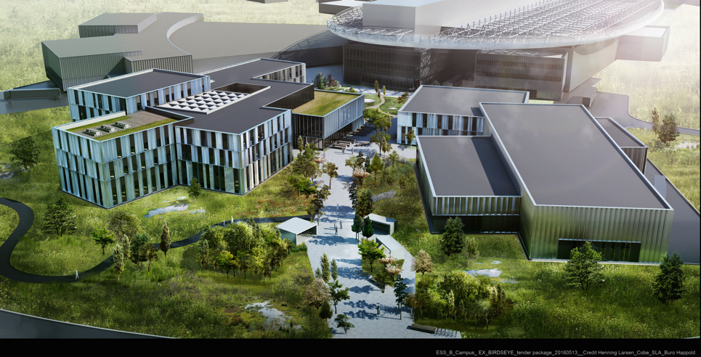
ESS campus offices, labs, and workshops

Slide 21
Financing strategy for campus buildings
Investment value of ~€50M based on lease of €4M/year, included in €140M ops cost
ESS responsible for specifications and the design/construct process
Guarantee is a combination of property security and risk assessment of ESS by lessor
Repayment or “rent” according to amortization curve of lease (base rate + margin + amortization + cash flow financing during construction)
Lease term of 20-25 years with options for ESS to repurchase the property at chosen optional year(s) or renewal/continuation of lease
PwC contracted as financial advisor to assist in sourcing a competitive financing solution
  Phase 1 – Start of investigation 14 June
  Phase 2 – Information Memorandum, negotiations started and draft LoI(s) by 1 Oct
  Phase 3 – Complete and secure financing by 14 November, finalized 21 Dec 2016
Key dates:
  AFC November 2016 (phase 2 reporting and agreement/acceptance)
  Council December 2016 (phase 3 reporting and agreement/acceptance)

Slide 22
2016 priorities
Continue emphasis on schedule performance – key to success
Transition In-kind partners into execution phase (instruments!)
3rd Annual Project Review and Response – April
Submit application to regulatory authority for license to commission first stages of accelerator systems – May
Establish a “cash facility” for liquidity gap/hold schedule – June
Start machine installation (accelerator cryogenic piping) – Sep
Establish operations plans consistent with requirements – Dec
Engage new members – ongoing

Slide 23
Summary
  Construction ~23% complete today and over 30% by end of 2016
  Priority on schedule performance – key to success
  Emphasis on securing in-kind deliverables in collaboration
  Additional work to ensure European Spallation Source ERIC provides the institutional framework needed for long term success
  Working to establishing operations plans consistent with facility requirements and supportable by the Council
  Core Values are Excellence, Openness, Collaboration, and Sustainability
  Mission – design, build, and operate the world’s
  leading research facility using neutrons

Slide 24
Annual Review 2016
Top 10 Recommendations & Response
www.europeanspallationsource.se
22 June 2016

Slide 25
Response to annual review recommendations
Level 1 Technical Coordination, Communication, Integration: The ESS technical coordination scheme is helping to facilitate technical integration risks, however the committee finds there is still a need for technical ownership of the entire ESS facility. Reconsider the need for a TC or DDG at Level 1.
  ESS response: John Haines, current Interim Associate Director for ES&H and QA and Schedule Project Manager, will be appointed as full time ESS Project Manager effective August 1. Technical Coordinators will report to the PM. The PM roles, responsibilities, accountabilities, and authorities will be clearly defined. Response agreed by JW.
Installation schedule (steering, organization, …): Related to #1, there remains a need for an overall technical coordination of ESS to manage the installation activities, as well as coordination of space and logistics.
  ESS Response: Issue revised P6 schedules that include fully resource loaded and integrated Installation plans for the accelerator, target and related parts of the ICS and NSS bunker. Also, finalize and issue plans that identify types of resources (people and equipment) needed to support installation efforts and the plan for acquiring these resources, as well as the methodology for coordinating activities, space, and logistics across all projects and with CF.
  Covers planning. Steering and organization still to being discussed. Defined by this fall.

Slide 26
Response to annual review recommendations
ESS liquidity: ESS will run out of cash by the end of 2016, even if all the approved contributions are received as planned. It is absolutely essential to place now a final decision at the June Council meeting. Solutions exist.
  ESS response: Formal request for approval from Council to initiate and conclude negotiations on a "Cash Facility" for addressing the liquidity gap presented to AFC in May and prepared for the June Council meeting.
VAT, taxation and employment conditions for in-kind partners @ ESS: The ESS ERIC Agreement provides VAT tax exemption for its in-kind partners, however the specific implementation plan for VAT exemption in each country are not in place. This uncertainty is a high risk for schedule delay (upcoming in-kind contracts). ESS should work closely with the ERIC in-kind partner representatives to resolve this as soon as possible.
  ESS Response: 1) Find a way forward for In-kind partners regarding VAT hence avoiding additional costs to the construction project. 2) Find a solution for in-kind staff to remain taxed in their home countries. VAT workshop last week reviewed VAT implementation in Member countries. Pragmatic ad hoc solutions taken to hold schedule.

Slide 27
Response to annual review recommendations
In-kind organization: Although some 50% of expected TAS (235) are agreed or under preparation, the Committee remains concerned about the local follow up and progress made with respect to set schedules and milestones. The Committee is pleased to see the EC-funded Brightness project offering tracking and assistance for its regional hub partners, but does not consider it as sufficient. The Committee thus recommends a stronger presence of ESS staff at IK partner production locations, in particular in the early phases of the agreement execution.
  ESS response: The ESS WP leaders will follow-up with partners regularly with respect to milestones in TA's and project tracking. The central IKCM team and Brightness field coordinators will their lead and support the project and partners with coordiantion of intergration, quality and standards. Kickoff meetings and design reviews held between projects and partners.
  Good general response but not enough. Critical point to remember is that the line project organization is responsible for delivery of ESS through in-kind partners. Every WP needs to answer the specific question on follow-up presence at production locations.

Slide 28
Response to annual review recommendations
7-12 months projected delay: As this reported delay has a fundamental impact on other projects, the Committee recommends that under the leadership of ESS management, a thorough analysis is made resulting in a resources loaded schedule, where the necessary interfaces are identified. The updated baseline plan needs to reflect the phasing of the work, realistic staffing, funding profile and clearly identify areas where scope reduction could provide tangible contingency. The advice is to re-baseline the overall schedule, focusing on delivering science in 2023 and incorporating consistent contingency provisions (“float”).
At the time of the review there was a potential delay in the EARLY finish date for the milestone “Machine Ready for 1st Beam on Target” of 7-12 months under study, potentially eliminating 6 months float. This delay is now reduced by half and still being worked.
  ESS response: Re-baselining is not judged to be required to incorporate the specific changes needed to optimize the integration of CF and Target work. Instead, we will re-establish the "Machine Ready for Beam on Target" milestone consistent with measures taken to minimize schedule slippage on this part of the ESS project. Based on this outcome, other parts of the ESS plan will be re-integrated consistent with this new date, while maintaining the start of the User Program in 2023 and incorporating opportunities to increase schedule float where possible. The current schedule is aggressive and remains a constructive driver for performance.

Slide 29
Response to annual review recommendations
NSS construction agreements and schedule: There are serious doubts that the budget plan for 16 instruments is feasible within the 350 M€. Thus the NSS should descope instruments to fit within its budget. This must be done in a way that does not significantly affect initial scientific capabilities. Performance should be prioritized over the number of instruments. Furthermore, the Committee recommends that the NSS develop a detailed plan for multiple simultaneous installations in the bunker that will involve reviewing the order and priority for the initial instrument suite. Urgency should be given to establish all pending agreements.
  ESS response: Proposal to Council on the way forward with instruments and bunker. The proposal will include a cost breakdown (including in-kind resources), detailed schedules, and which 8 instruments to build first and have in user operation by 2023. An important focus will be on ensuring early science success.
Regulatory permits: ESS management is encouraged to increase its current interactions with SSM to avoid the absence of required permits causing delays in the construction, installation schedules and start of operation.
  ESS response: Continue regular and frequent meetings with the regulator to avoid delays due to lack of license approvals. Besides almost daily email and phone contact, a series of presentations and discussions will be conducted to communicate various aspects of the material submitted in the 2nd license application submitted on May 3, 2016. ESS is prepared to rapidly respond to provide additional or revised material as we proceed through this year long process.

Slide 30
Response to annual review recommendations
Bunker story: bunker design, requirements and construction are on the critical path. Thus the NSS must move aggressively to produce a detailed design of the bunker and to have it manufactured and installed. This will require much more interaction between the various parties in the different projects. Waiting for an in-kind partner for this item looks unrealistic and a possible source of problems and delays.
  ESS response: Deliver detailed design of the bunker and ensure funding for manufacturing. NSS is working on all fronts to accelerate this project. In response to this recommendation we have strengthened the engineering core team and are actively pursuing our major in-kind partners to secure their engagement, in engineering design and manufacture.
Risks analysis and financial implications: The risk register appears to contain items which are entered inconsistently across the different projects. The software-calculated value is not well understood. It is recommended that once the baseline cost and forecast variances are, consistent guidelines are followed across the projects to update the registry and to identify risks that established contingency allocation mechanisms will not be able to cover.
  ESS response: Project risk register review and information about guidelines planned end of June for all projects. Exercise includes cross-checking with forecast values. Traces back to #1.

