Slide 1
NSS Project update; including budgets, bunker, moderators and response to the annual review
Shane Kennedy
NSS Project Leader
www.europeanspallationsource.se
22 June 2016

Slide 2
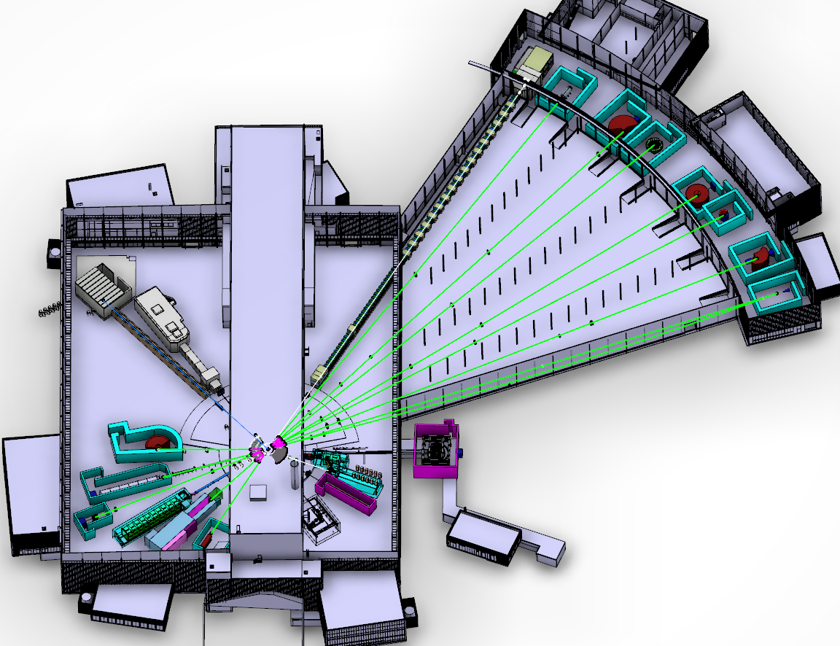
The ESS Neutron Instruments revised layout (June 2016)
Instruments 1-16; funded by NSS construction project
Instruments 17-22; funded by initial operations
NMX
BEER
C-SPEC
BIFROST
MIRACLES
Two instruments have moved;
ESTIA; E1 -> E2 – for cleaner view of source
SKADI ; E8 -> E5 – for more space (= lower technical risk)
MAGIC
T-REX
ODIN
DREAM
HEIMDAL
VOR
15 (+1) Neutron Instruments (2025)
LoKI
VESPA
FREIA
HR-NSE
SKADI
ESTIA
Proton beam
50 m
100 m
150 m
Instrument Layout (June 2016)

Slide 3
NSS Budget overview -with current IK estimates for Instruments and bunker
NSS total budget (ring-fenced) = 350 M€
NSS In-Kind Target (65%) = 227,5 M€
NSS Cash Target (35%) = 122,5 M€
In-kind commitment so far = 176.5 M €
In-Kind uncommitted* = 51.0 M €
We are at 78% of our In-kind target
Cash budget = 122.5 M €
Cash spent (May 2016) = 37.8 M €
We have spent 31 % of our cash
Cash contingency is 7.1 % of cost to complete
SJK, 19 June 2016

Slide 4
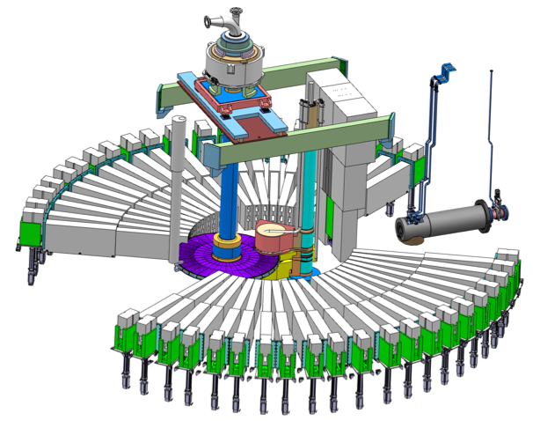
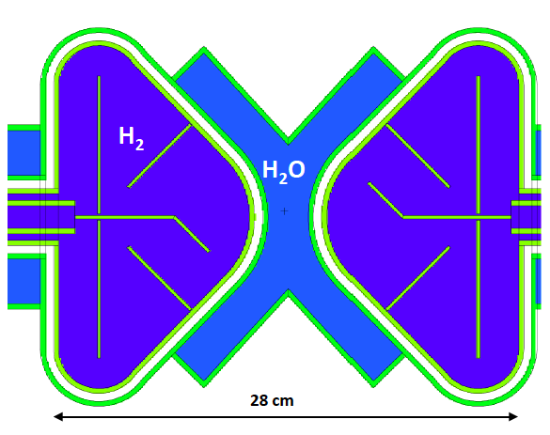
Optimization of ESS moderators
ESS target wheel and beam ports,
also showing upper (3 cm) moderator assembly
ESS butterfly moderator; allowing extraction of thermal, cold and bi-spectral neutron beams from 42 radial beam ports in two arcs of 120°

Slide 5
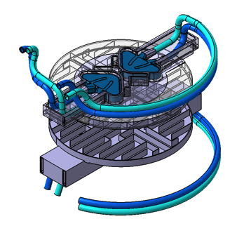
Comparison of ESS moderator options
ESS concept includes an upper 3 cm high and lower 6 cm high version of the butterfly moderator
Most (~75 %) of funded neutron instruments plan to view top moderator, due to it’s higher brightness
The other instruments plan to use lower moderator due to it’s higher area integrated brightness
Could all the neutron instruments perform as well (or better) viewing the upper moderator?

Slide 6
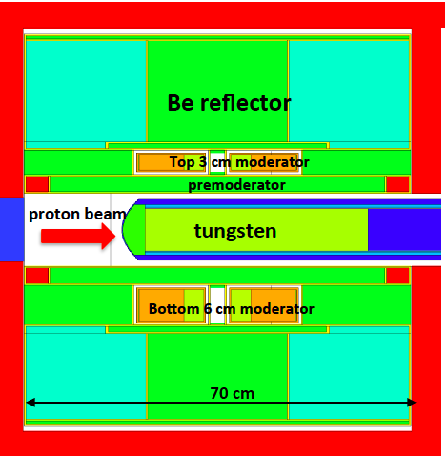
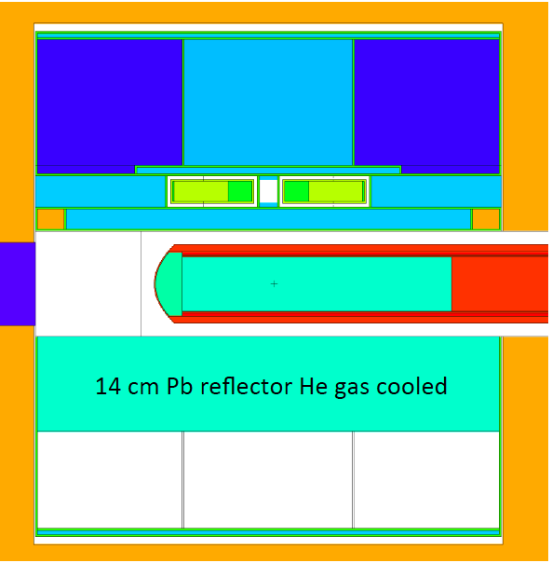
Comparing moderator options; (L. Zanini & F. Mezei)
Current design;
3 cm upper + 6 cm lower moderator
Alternate design;
3 cm upper moderator + 14 cm lower reflector

Slide 7
Comparing calculated source brightness
Configuration | moderator | Relative brightness (n/cm²/s/sr/Å)
 |  | cold neutrons | thermal neutrons
Current design; 3 cm upper + 6 cm lower moderator | upper | 1.00 | 1.00
 | lower* | 0.64 | 0.70
Alternate design; 3 cm upper moderator + lower reflector | upper | 1.17 | 1.15
* Relative area integrated brightness of the lower moderator scales in proportion to its height (x 2)
Can the beam transport system of the concerned neutron instruments be optimized to take advantage of the brighter single upper moderator?
For ODIN, the conclusion is Yes
For HEIMDAL & MIRACLES, the conclusion is probably
Table derived from ESS internal report by F. Mezei, 18 Nov. 2015

Slide 8
Summary slide; neutron moderators
The ESS primary upgrade path is more instruments on the primary target station
The two moderators provide similar performance for the planned instrument suite, offering limited flexibility
Average performance of the facility increases by > 10 % by replacing the lower moderator by a neutron reflector (e.g. Ni or W),
This change has been estimated to save ~ 1 M€ in construction and > 1.5 M€/year in operation
Installation of a lower moderator now would block the life cycle flexibility of ESS benefitting from future source developments tailored to specific scientific challenges*
Possible future developments include; very cold neutrons, maximum brightness moderator for small phase space instruments, more directional moderator…
*Cost of repositioning instruments viewing lower moderator would be prohibitive
Notes:
Construction savings ~ 1 M€ in less Be material
Operations ∼2 MW Lower power consumption + lower cost & labor at moderator changes

Slide 9
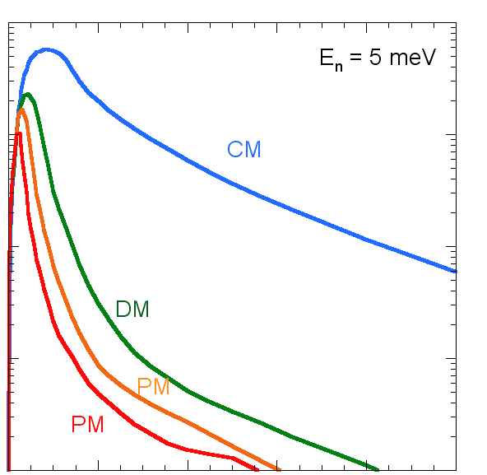
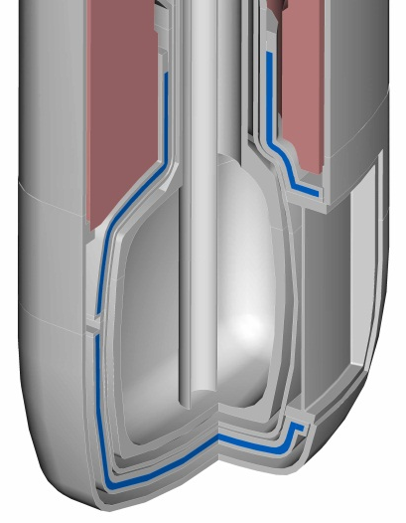
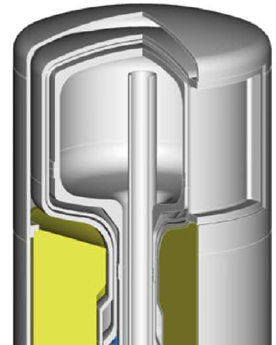
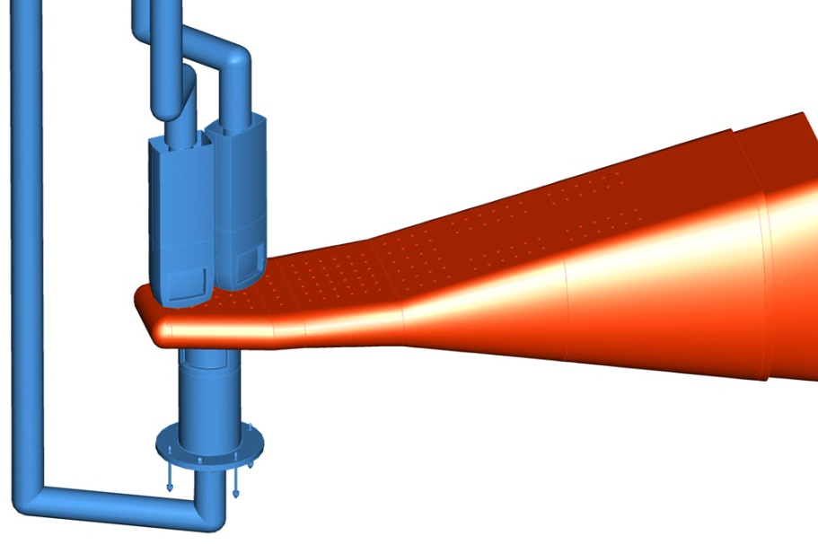
J-PARC Supercritical Hydrogen Moderators
Poisoned Decoupled
moderator (PM)
Decoupled moderator(DM)
for balanced performance
for high resolution
Neutron Intensity (Log. scale)
0.0 Time [ms] 1.0
Adoption of Ag-In-Cd (AIC) alloy for high decoupling energy at 1 eV - optimized decouple coverage for lower pulse tail - Adoption of Cd poison
Coupled moderator (CM)
for high intensity
Hg-target
large & cylindrical - wide angle beam extraction
Proton beam
- All 100 % para-hydrogen
Slide courtesy of Masa Harada (JPARC)
Notes:
I would like to remind you the J-PARC moderators.
There are three supercritical hydrogen moderators.
The coupled moderator locates below the mercury target while the decoupled moderator and the poisoned decoupled moderator sit on the target,
This graph shows typical pulse shapes of the three moderators.
The coupled moderator provides high-intensity neutron pulses while decoupled and poisoned moderator provide sharp neutron pulses for high resolution experiments.
There are many features in the moderator design.
I am going to explain these features in this talk.

Slide 10
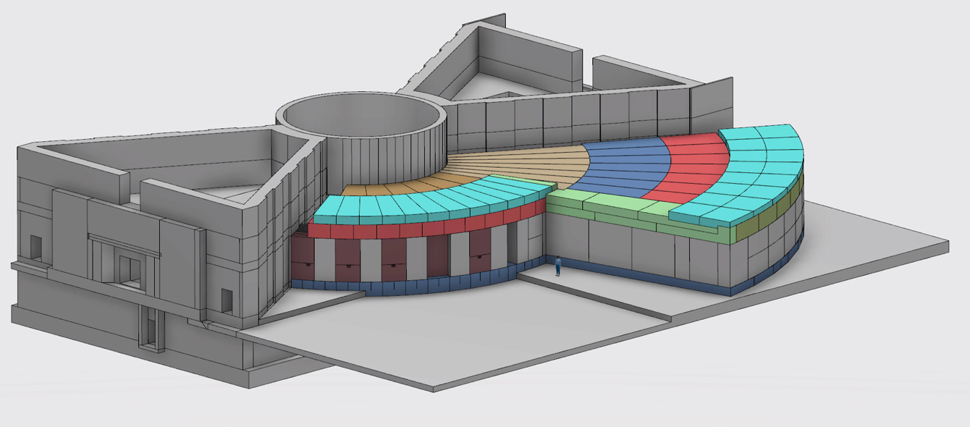
Developing a baseline for the neutron guide Bunker
Neutronics simulations have taken into account:
Dose levels outside the Bunker must be < 3 μSv/h -> simulate < 1.5 μSv/h.
Floor loading in the Bunker: 30 tonnes/m²
Floor loading in the experimental halls: 20 tonnes/m².
Engineering design is ongoing to optimize on safety, performance & cost
Monolith shield wall
Bunker roof, 2 m thick
R = 15 m
R = 28 m
6 m
Bunker end wall, 3.5 m thick.
Notes:
Work started in August.

Slide 11
Vertical section through a beam line within Monolith and Bunker
Lead
R = 5.86 m
Boronated-PE-Concrete
2.5-3.0 m
Cast Iron
R = 15 or 28 m
0.2 m
0.3 m
0.8 m
2.0 m
0.4 m
0.3 m
+1.7-2.0 m
Beam center upper moderator
TCS = 0.0
Beam center lower moderator
-2.5 m (North)
≈ -1.2 m

Slide 12
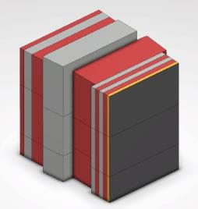
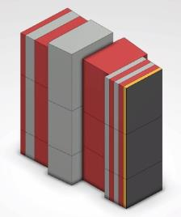
North and West sector wall
Lead
Boronated-PE-Concrete
Cast Iron
B4C

Slide 13
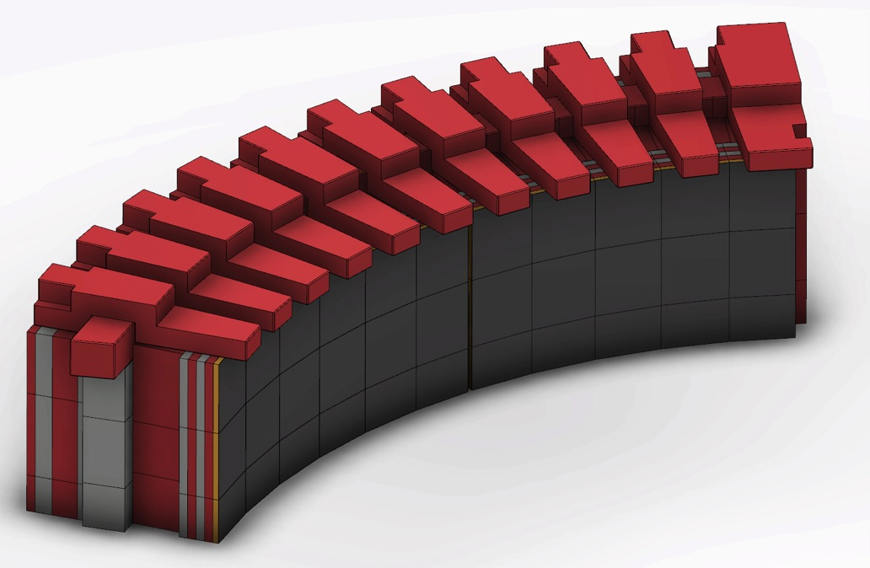
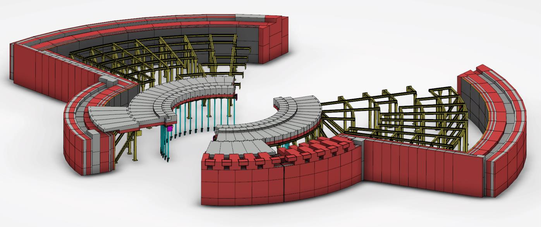
The neutron Bunker mechanical design
Lead
Boronated-PE-Concrete
Cast Iron
B4C

Slide 14
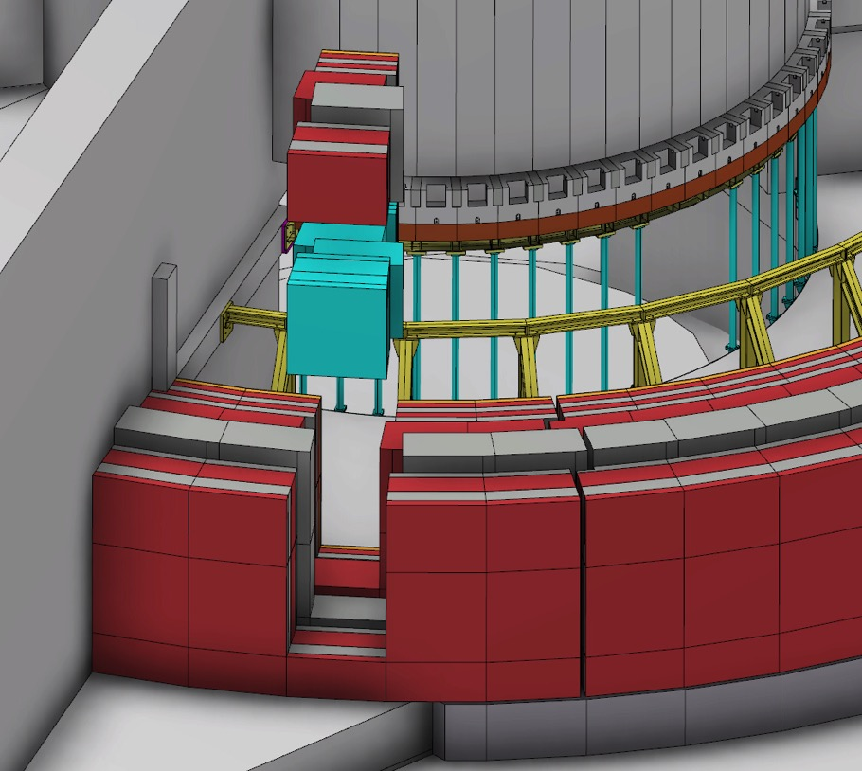
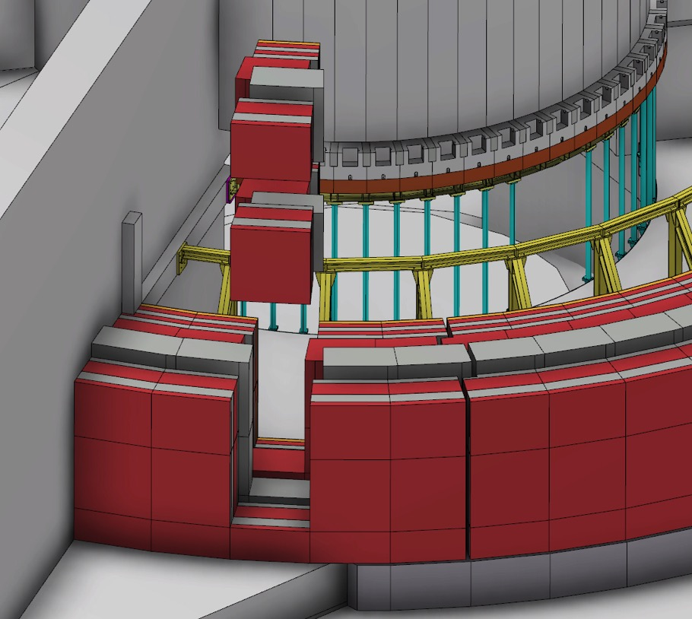
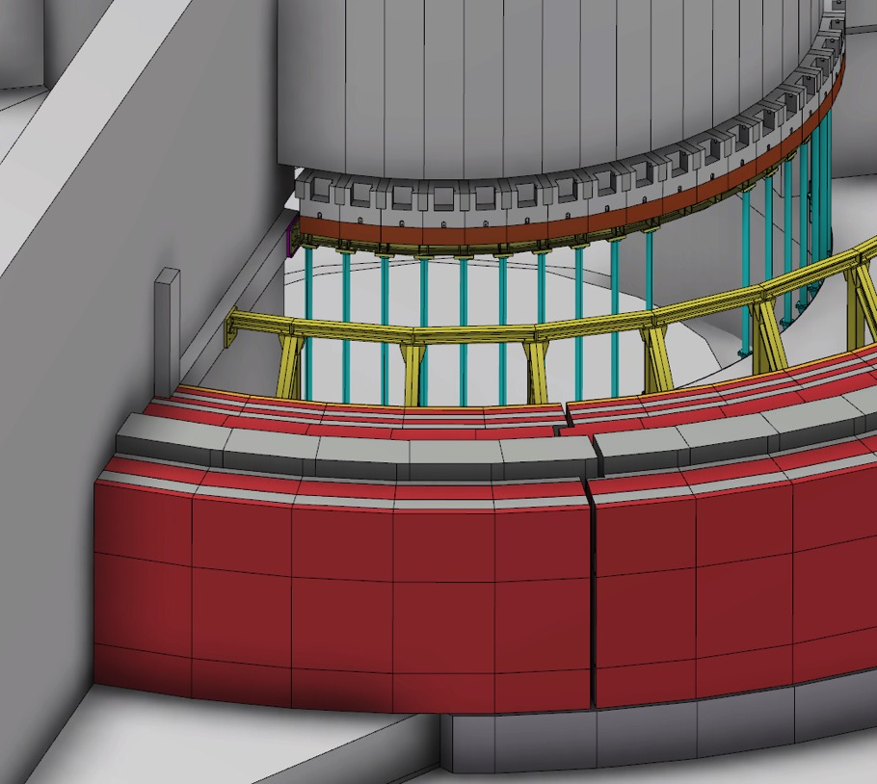
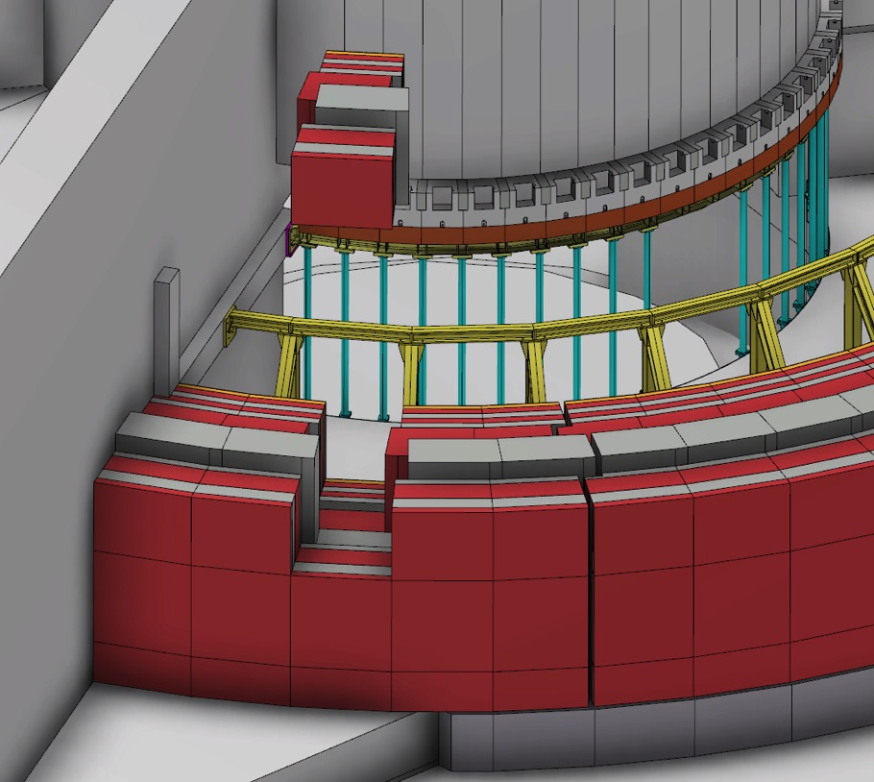
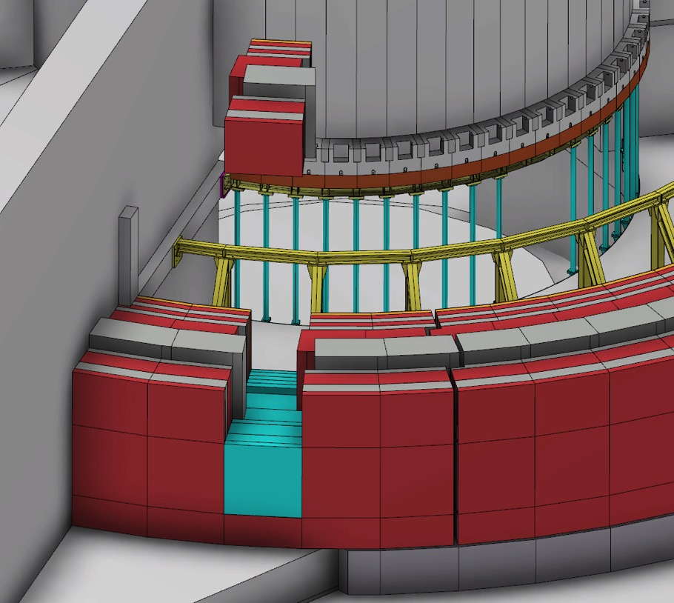
Sequence for R15m wall mid-section replacement with customized instrument penetration block set

Slide 15
Sequence for R15m wall mid-section replacement with customized instrument penetration block set

Slide 16
Sequence for R15m wall mid-section replacement with customized instrument penetration block set

Slide 17
Sequence for R15m wall mid-section replacement with customized instrument penetration block set

Slide 18
Sequence for R15m wall mid-section replacement with customized instrument penetration block set

Slide 19
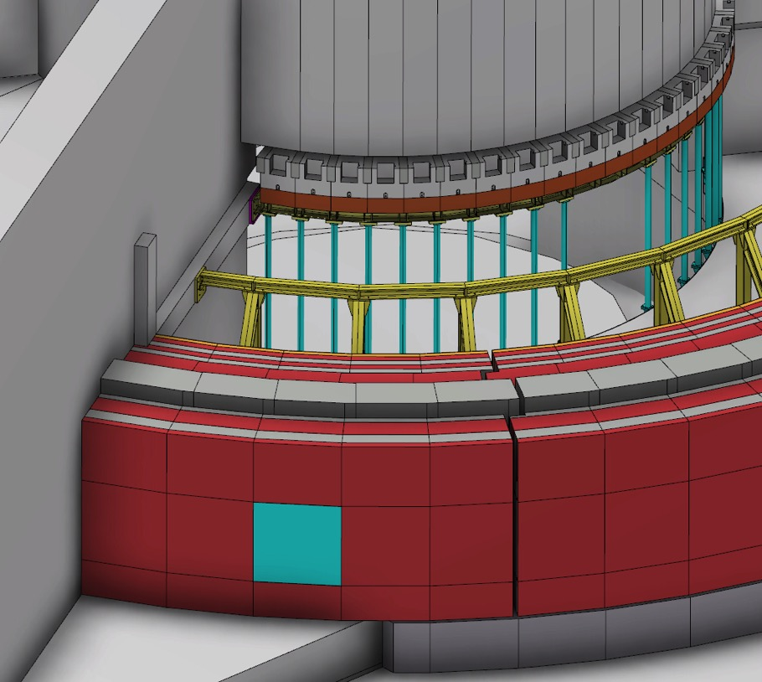
Sequence for R15m wall mid-section replacement with customized instrument penetration block set

Slide 20
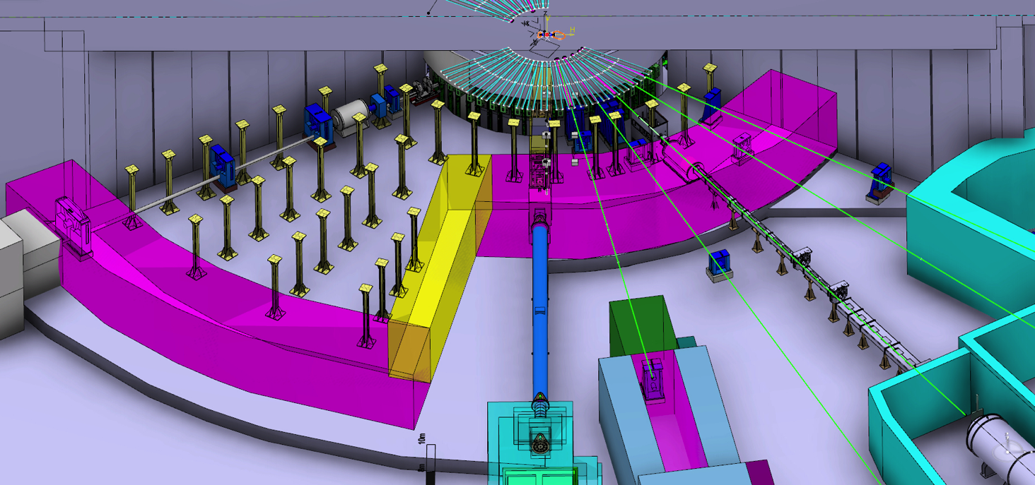
Instrument penetration through bunker wall

Slide 21
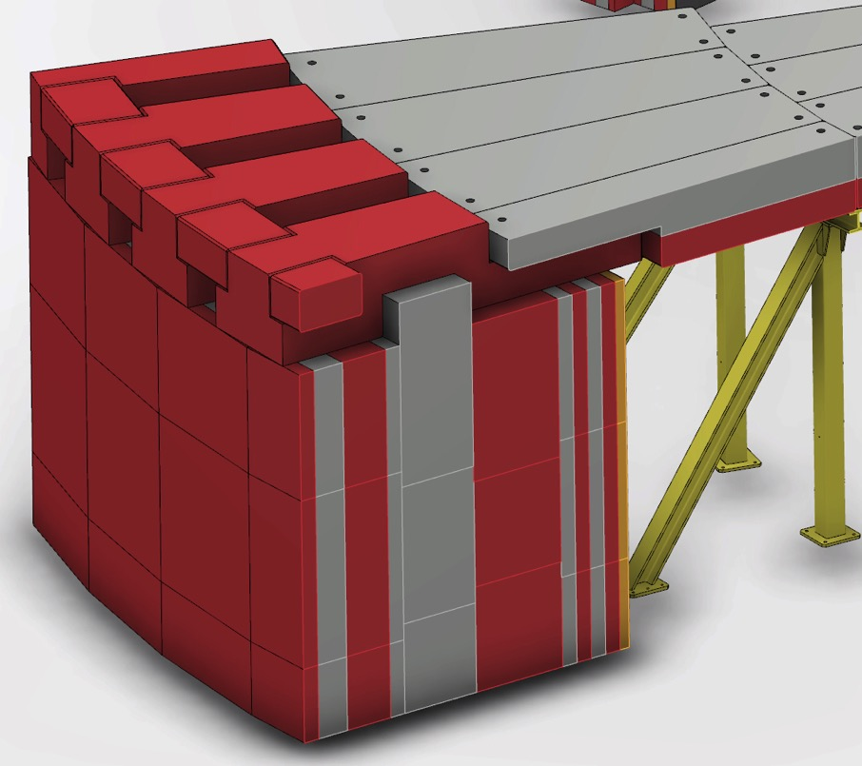
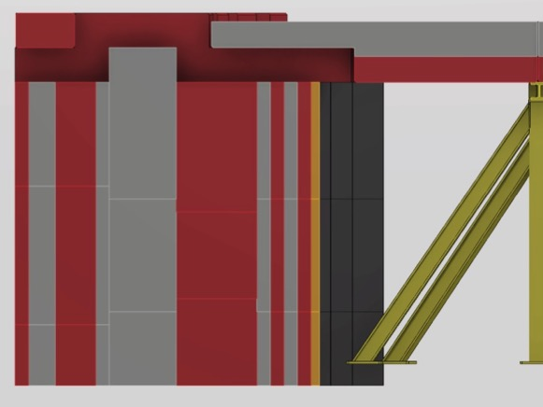
Bunker Utilities Routing -Current status
Utilities routing above the wall, under the roof.
(Note – There are a few layers of roof missing in this image)

Slide 22
Neutron Bunker delivery options (1/2)
NSS has pursued three different options for Bunker delivery over the past year:
1. One country delivers the Bunker including detailed design, procurement, manufacturing, delivery and installation on site.
2. The Bunker is divided into WPs, e.g. detailed design, steel work, concrete, manufacturing of blocks, etc, which are allocated to different partners. In this case one partner could take responsibility for co-ordination of partners, or if necessary NSS could take responsibility.
3. Levy a fund with all countries involved in NSS, by which each country contributes with a share corresponding to their share in the instruments budget.
Regardless which option we take, NSS will maintain leadership in neutronics and in ensuring delivery meets requirements (safety, performance and engineering requirements of the instruments).
Hence, NSS will retain performance risk for the bunker project.
NSS expects our delivery partners will take responsibility for manufacturing risk.

Slide 23
Neutron Bunker delivery options (2/2)
FZJ management is willing to manage detailed design and manufacturing of the bunker, as part of the German In-Kind contribution. NSS and ZEA (FZJ Engineering) are evaluating the feasibility of such a partnership.
Competent engineering companies in CZ and FR are willing to partner with NSS in the bunker project.
Potential partnerships have been identified in NO and SE and are being pursued.
Option A is our preferred option at this time
Options B & C are being pursued as back-up plans
The deadline for these ‘partnered’ options is 31 August 2016,
Beyond that NSS will manage the full delivery

Slide 24
The ESS 3rd Annual Review
Review held over 3 ½ days from 20 – 23 April 2016
Subcommittee 4: Neutron Scattering systems
Panel members:
Dan Neumann (Chair)
Ken Herwig
Mark Johnson
Toshi Kanaya
Thomas Proffen

Slide 25
ESS 3rd Annual Review 19-23 April, Sub Committee 4: Recommendations (1/8)
1. The NSS must move aggressively to produce a detailed design of the bunker and to have it manufactured and installed. This is beyond urgent
Response:
NSS has appointed a design engineer manage the bunker project with a strong support team
Neutron Bunker Project:
Lead: Zvonko Lazic
Technical req. & specs:
Lead: Iain Sutton
Thomas Gahl
Richard Hall-Wilton
Phil Bentley
Masa Arai
Gabor Laszlo
Ken Andersen
Henrik Carling
IK coordination & Planning:
Lead IK: Sara Ghatnekar-Nilsson
Lead Planning: Sofie Ossowski
Engineering design:
Lead: Benjamin Davidge
Bengt Jönsson
Peter Sångberg
Zvonko Lazic
Neutronics:
Lead: Douglas de Julio
Valentina Santoro
Stuart Ansell
Safety:
Lead: Sara Ghatnekar-Nilsson
Monika Hartl
Stuart Birch

Slide 26
Key milestones for Bunker project
Operational Requirements Complete June 2016
Delivery partner(s) selected August 2016
Scope/budget setting September 2016
Preliminary Design Review Nov- Dec 2016
Critical Design Review March 2017
Manufacturing contract June 2017
First deliveries on site June 2018
Installation complete June 2019
16 Neutron Instruments
19 June 2016

Slide 27
ESS 3rd Annual Review 19-23 April, Sub Committee 4: Recommendations (2/8)
2. The NSS must descope instruments to fit within its budget. This must be done in a way that does not significantly affect initial scientific capabilities. Performance should be prioritized over the number of instruments. In addition, NSS must descope scientific support by setting priorities for all aspects of these activities including sample environment, laboratories, and DMSC. As a final point, NSS should work to better understand shielding costs including the bunker.
Response:
NSS is already reviewing scope of the neutron instruments;
All Instrument teams were given cost targets in December 2015.
NSS is also reviewing scope of all internal projects (instrument concepts, science support systems, DMSC, Instrument Technologies). All work package leaders were given cost targets in May 2016.
All work package leaders were given cost targets in May 2016.

Slide 28
NSS Budget Breakdown by Work Package
Contingency
Notes
NSS needs contingency > 10 % of cost to complete (over instrument contingencies)
Pressure to increase Neutron instrument component
NSS budget to be resolved in 2016
16 Neutron Instruments
3 April 2016

Slide 29
Forecasting NSS Budget – 2017 and beyond
NSS budget pressures
Proposed budgets for the 16 Instruments endorsed by SAC total ~248 M€ (~ 59 M€ higher than provisional NSS Instrument allocation of 189 M€)
NSS expects Instrument teams will argue strongly for increased budget during scope setting process. (possible total of requests up to ~ 27 M€)
NSS top level contingency must increase > 10 % of cost to complete before fixing cost book (over instrument contingencies of 10%)
Integration, management and NOSG budgets need to increase
Science Directorate operations budget plan for 1st & 2nd 5-year periods include;
25 M€ for additional scope for Instruments 1 -16
17.5 M€ for Hot Commissioning of Instruments 1 -16
85 M€ for construction + 6.4 M€ for Hot Commissioning of instruments 17-22
3.3 M€ per year for instrument spares during normal operation, with essential spares to be established earlier
16 Neutron Instruments
19 June 2016

Slide 30
Possible NSS Budget Scenario: 2017 and beyond
Assumptions
NSS Instrument budget grows by 5 M€ with additional provision of 22 M€ for Instruments 3-16 from Initial Operations budget
Other increases as shown previously
Budgets for Science Support Systems, DMSC and Instrument Technologies adjusted accordingly
16 Neutron Instruments
13 April 2016

Slide 31
Possible NSS Budget Scenario: 2017 and beyond
Budgets for;
Science Support Systems,
DMSC
Instrument Technologies
reduced by average of 10%
(~ 15 % of remaining budget)
16 Neutron Instruments
Transfer from Instrument Concepts, mainly to Instrument Integration Management, due to shift from concept development to co-ordination if IK Instrument teams
13 April 2016

Slide 32
ESS 3rd Annual Review 19-23 April, Sub Committee 4: Recommendations (3 & 4/8)
The NSS must continue to clarify scope ownership and the interfaces between NSS and other organizations within the ESS and between NSS and its external partners. This includes formal agreements, standards documents, etc.
The NSS must maintain robust communications between NSS and other organizations within the ESS and between NSS and its external partners.
Response:
NSS has formed a strong support team for the neutron instrument construction
NSS is has formed a strong core engineering team to address engineering integration issues and initiate installation planning

Slide 33
NSS Organization: Project management
Director for Science
Andreas Schreyer
ESS Technical Board
Chair: Roland Garoby
Project Leader: Shane Kennedy
Deputy Project Leader: Oliver Kirstein
Instrument Collaboration Board
Chair: Andreas Schreyer
Safety and Licensing:
Lead: Arno Hiess
Neutron Instruments:
Lead Scientist: Ken Andersen
Lead Engineer: Gabor Laszlo
In-Kind Office:
Lead: Sara Ghatnekar-Nilsson
Integration Activities:
Lead: Zvonko Lazic
Planning:
Lead: Sofie Ossowski
SSM application
Partner coordination
Neutron Bunker
Budgets & workflow
LOKI (ISIS)
ODIN (TUM/PSI)
Safety Systems analysis & design
Requirements & Standards
Schedule
SKADI (FZJ)
BEER (HZG/NPI)
Memoranda of Understanding
ESTIA (PSI)
Risk Management
Systems Engineering
Four Instrument Classes
Large scale structures
Engineering & imaging
Spectroscopy
Diffraction
C-SPEC (TUM)
Heads Of Agreements (& IKCA’s)
FREIA (ISIS)
T-REX (FZJ)
Conventional Facilities
DREAM (FZJ)
BIFROST (DTU)
Technical Annexes
Target Project
HEIMDAL (ÅU)
MIRACLES (ESS Bilbao)
Standard devices
NMX (ESS)
VESPA(CNR)
MAGIC (LLB)
VOR or HR-NSE

Slide 34
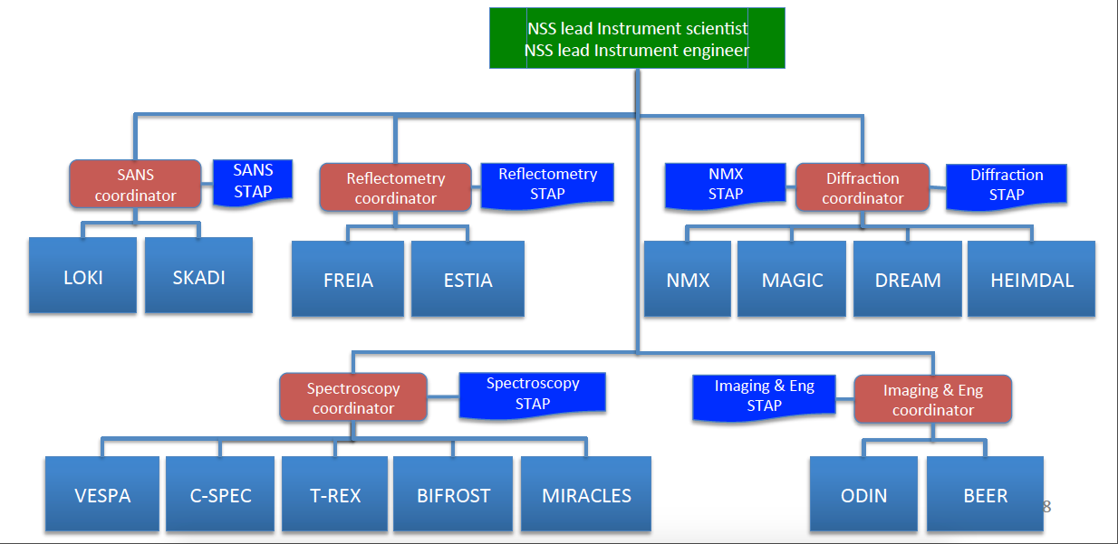
Neutron Instrument class co-ordinators
..

Slide 35
NSS Project: Engineering Integration
Safety
Shielding
legislation
Common shielding bunker
Systems Engineering
Peter Sångberg
Engineering design
Zvonko Lazic
Technology
Iain Sutton
Construction
TBA
In-kind
Sara Ghatnekar-Nilsson
Instruments Gabor Laszlo
certification
Backgrounds
PSS
MPS
Transport optics
Utilities
Beam extraction
NSS
Core Engineering
Team
Cooling
Beam shutters
Iain Sutton
Power
& grounding
Choppers
Controls
Vacuum
Routing
Logistics
Hall layout
cranes
Penetrations
waste
access
Building integration
operations & maintenance
Remote handling

Slide 36
ESS 3rd Annual Review 19-23 April, Sub Committee 4: Recommendations (5/8)
The NSS must develop a detailed plan for multiple simultaneous installations and maintenance activities in the bunker and have it reviewed by an external committee.
Response: NSS is recruiting a construction engineer to lead in installation planning

Slide 37
ESS 3rd Annual Review 19-23 April, Sub Committee 4: Actions (6 & 7/8)
The NSS should continue to refine its operational plan to efficiently and effectively deliver science at the beginning of user operations. A crucial element will be to ensure that sufficient staff, with the right skills, are identified in advance of this date.
The NSS operational plan should include funds to fully exploit the initial suite of instruments, including completion of the scope, procurement of an expanded set of sample environments, and to complete the promised complement of instruments. It should also provide resources for advancing the state-of-the-art in neutron instrumentation including instrument upgrades, neutron devices, and sample environments.
These points have been covered in the responses above

Slide 38
ESS 3rd Annual Review 19-23 April, Sub Committee 4: Recommendations (8/8)
The development of the neutron test station must not divert resources from NSS or its attention from its primary activities as the relationship of the test station to delivering world-class neutron instrumentation at the beginning of ESS user operations is unclear.
Response: NSS Planning for the test station is on hold until more is known about the schedule of neutron instrument construction

Slide 39
Backup
..

Slide 40
NSS response to 3rd Annual Review (x/y)
NSS is developing a standard T_{zero} chopper. This will involve In-kind partners.
NSS is developing its plans to ensure best possible integration of NSS Project and initial operations phases. This planning includes budgets, schedules, resources and standardization

