Slide 1
Science Support Systems
-
Strategy and Delivery
Arno Hiess
Scientific Activities Division
www.europeanspallationsource.se

Slide 2
Outline
Scope and Priorities for Science Support Systems
Delivery Strategy for Science Support Systems
Laboratories, Workshops and Sample Environment Equipment
Schedule and Milestones
Cost, In-Kind and Staff
Operational planning towards the User Program
Summary

Slide 3
Recommendations from Annual Review 2015
NSS 4.2: Clarify within the budget of each instrument what is provided by whom: (…) Ensure (…) compliance with ESS standards.
NSS 4.6: Develop an operations plan to ensure efficient and effective delivery of science by the start of user operations. A crucial element of this will be to ensure that sufficient, staff with the right skills are in place well in advance of this date.
NSS 4.7: Develop a plan to address current staffing gaps in key areas, particularly in (…) support for scientific operations. Formally incorporate safety considerations early in instrument design via a rigorous hazards analysis.
OTHER additional recommendations from SAC and STAP.

Slide 4
Recommendations from Annual Review 2016
Need for coherent, project-wide, integrated approach to establish a safety culture.
De-scope instruments and scientific support w/o affecting initial scientific capabilities.
Clarify scope ownership including standards documents.
Refine operational plan to deliver science early on:
Ensuring sufficient staff with right skills
Including funds to procure sample environments and to complete instruments.

Slide 5
Charge: to provide an overall critique of the sample environment considerations in the current project plan –
Recommendations STAP (April 2016) - comments AH 1/2
Is the programme balanced across different user communities? – take a more organic view across the programme. Conditions still too unknown to judge this. Keep agile in adjusting work plans to needs; don’t attribute budget in too much detail on platforms.
Pool vs instrument-specific – which when? – A list should be set up indicating whether equipment is from the pool or from instruments, to ensure that any gaps are intentional. Instrument teams must communicate with the SE team. Who has ownership of the decision on who provides which equipment needs to be established. Start tracking equipment provided as instrument specific (or mini-pool). Ensure decisions have rational attached. Identify if equipment can really be pooled. Transparent procedures are needed and decisions to be well-documented.
Match with construction schedule? – The potential achievements at the beginning of operation need to be realistically considered given constraints. Don’t spread too thin but focus on some equipment (parameters) provided reliably. Consider what is to be done during pre-operations e.g. next five year plan.
Meets needs of instruments? – concentrate on the first eight instruments to start with. OK

Slide 6
Charge: to provide an overall critique of the sample environment considerations in the current project plan –
Recommendations STAP (April 2016) - comments AH 2/2
Methodological requirements? - the team clearly recognise need to train with equipment and to get it set up and integrated. The plans proposed are clear, but there are serious manpower concerns, in all areas. Technical resources should be trained and form integrated team early on. This should enhance credibility in respect to partners.
Instrumental challenges and novelty – the working environment is severely constrained financially. Work on novel techniques should focus on ESS-specific issues (e.g. small samples, high flux). Setting up the SE from scratch is already very challenging. Focus on the basic and SOME developmental activities required at the start e.g. relevant for safety and operability.
Money should be released now. Technicians should start now, and then borrow from other facilities. Could leverage additional support from other facilities. Team is enthusiastic and motivated and can achieve with right support. BBS strategy and fixing broken equipment might be cost efficient and serve training purpose.
Will suggest that a separate pot be established for big-ticket potential scientific highlights. Ensure that spending on large budget items (e.g. magnets) is well motivated and that they fit to the needs.

Slide 7
SAC comment and SAC recommendation on STAP report
June 2016
Unclear how to identify and surmount ESS challenges for Sample Environment. Clear goals need to be identified and advised on upon by the STAP.
Concerns about the SE strategy, how the work flow is organized and how R&D will be implemented. Unclear of interfaces between SAD team and instrument design and user community will work on practical levels.
SAC requests clear mission statements and clear paths to success. Clear directions to the STAP are required. Milestones should be linked to overall construction schedule.
SAC requests report and presentation by Nov SAC.

Slide 8
Science Support Systems – Vision
Neutron
Methods
User
Access
Science,
Research
Provide a coherent scientific service and collaborative scientific environment that makes NEUTRONS more accessible, powerful and efficient to USERS from diverse SCIENTIFIC FIELDS and to harness the full scientific potential of the ESS facility.
idea
by user
proposal,
sample, labs
experiment,
sample env.
data,
modeling
publication
by user
Notes:
Focus on enabling an user experiment; theory is operational scope for DMSC

Slide 9
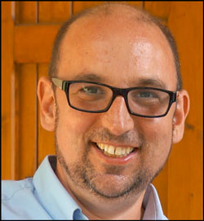
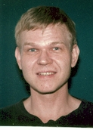
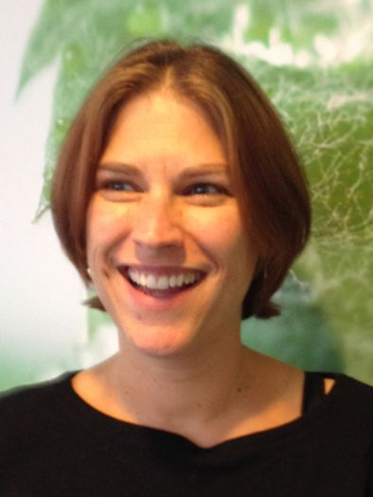
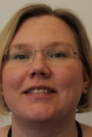
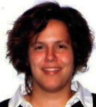
Science Support Systems – Scope and Priorities
Science Support Systems
Scientific Coord.
User Office
Temperature
Field
High Pressure
Mech. Proc.
Fluids incl. gases, vapor, compl. fl.
Deuteration
Crystallisation
Sample handling
general labs
Mechatronics
Integration
The NSS Work Package ‘Scientific Support Systems’ (SSS) delivers ‘pool’ sample environment equipment, scientific labs and user office by providing seven platforms.
This maximizes cross benefits, ensures topical balance, smoothens instrument team interactions, streamlines interfaces, increases partner involvement and support instrument specific sample environment as needed.
Platform priorities during construction:
interactions to cover interfaces,
set-up laboratories and workshops,
new technologies to meet challenges,
core technologies for bulk of ‘pool’.
Notes:
Present experience: fragemtnation, only partly supporting all topics …
New approach …mainaining balance; bringing it colse to the user

Slide 10
Science Support Systems - Strategy
Emphasis on standardization and integration as well as workshops, laboratories and infrastructure.
Cover Internal ESS Interfaces providing important functions such as:
Env. Health & Safety and Conv. Facilities for Safety and Security
Motion control & Automation and Integrated Control Systems
Cryogenics, Cooling and Vacuum for central infrastructures
Cover Interfaces to Instruments Teams and prioritize in respect to instrument construction schedule e.g. just in time.
Instrument specific sample environment and labs are part of instrument. ‘Pool’ sample environment and common labs are for whole instr. Suite. Consider also possible synergies with other instruments (mini-pool).
Maximize in-kind potential by involving partners with unique competences incl. students and junior staff in developmental activities already now.
Additional functionalities require third-party funding.
10

Slide 11
Towards an integrated ESS: Science Support Systems in Operations
Equipment
Availability
Safety, Robustness, Reliability, Ease-of-use
Maintenance, Workflow, Cost, Schedule
Maximal range
Multiple parameters
Precision, accuracy
Stability, control speed
Total range sweep
Return to ‘off’
Equipment
Change-over
Parameters
Mobility
Modularity
Rapidity
Reproducibility
Work flow
Sample Change
Positioning precision
Reliability, speediness
Labs
Prepare and characterize
Align, condition, mount
Register, tag, store, ship, dispose

Slide 12
Towards an integrated ESS: Science Support Systems and Instruments
Equipment
Availability
Safety, Robustness, Reliability, Ease-of-use.
Maintenance, Workflow, Cost, Schedule.
Sample Environment Pool Equipment vs. Instrument Specific Equipment
Equipment
Change-over
Parameters
Sample Environment Reference Documents:
Utilities Supplies
Mechanical Interfaces
Control Systems
Sample Change
Safety and Sample Workflow Reference Document
Labs
Common User Laboratories vs.
Instrument Sample Preparation Areas
Instrument interaction 1 FTE e.g.
providing 6 PM per instrument until hot comm.

Slide 13
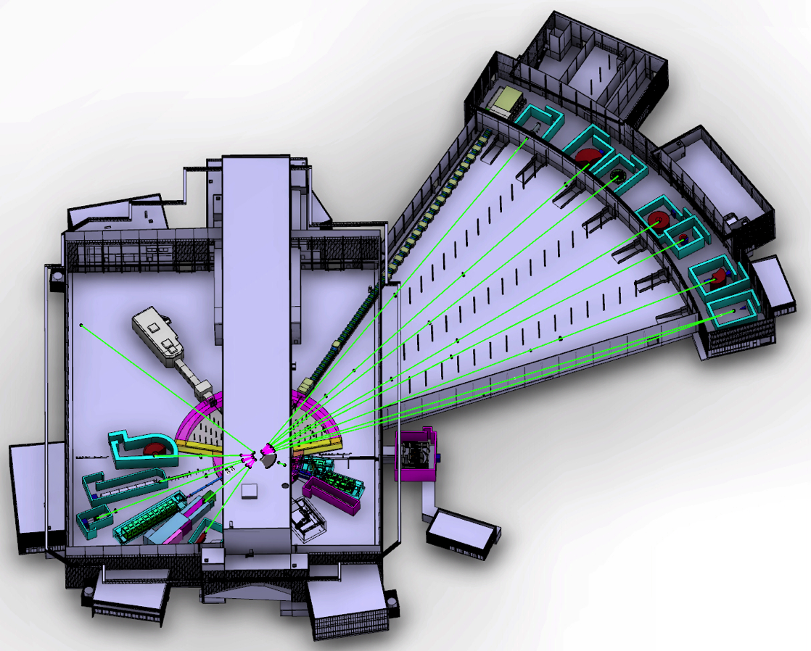
The ESS Neutron Instrument Suite
NMX
BEER
C-SPEC
BIFROST
MIRACLES
MAGIC
T-REX
ODIN
HEIMDAL
DREAM
VOR
15 (+1) Neutron Instruments (2025)
SKADI
LoKI
FREIA
VESPA
ESTIA
HR-NSE
Instrument Layout (Jan 2016)
Proton beam
50 m
100 m
150 m

Slide 14
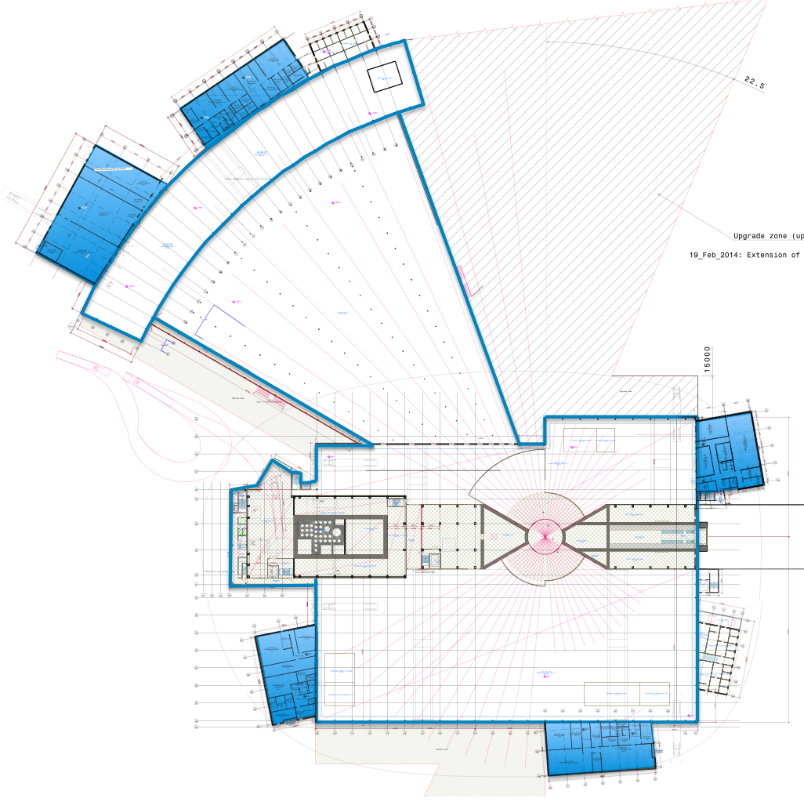
User laboratory and workshop delivery plan in construction cf. instrument baseline layout
Hall3
Instr. NMX / Beer / C-Spec / Bifrost
Miracles / Magic / T-Rex / Heimdal
E03 1 × Engineering
E04 1 × Life Science, 1 × Cold room
1 × Instrument room
1 × Chemistry, 1 × Characterization
E04
Hall 3
E03
Hall 2
Instr. Freia / Loki / HR-NSE
D04 1 × Life Science, 1 × Cold room
2 × Instrument room
Hall 2
D04
Hall 1
Instr. Estia / Vespa / Skadi / Odin / Dream / Vor
D07 1 × Life Science, 1 × Cold room
D08 1 × Chemistry, 1 x Radioactive Mat. L.
D08
Hall 1
D07
RML laboratory and central ESS sample storage facility in D08
Sample Environment labs and workshops in E03, D04, D08
Initially 15 Labs (out of 22) incl. RML
Additional workshops in Campus (later)
Notes:
The room fit out has been aligned with instrument layout. Each hall has access to a basic laboratory. Main labs not included in construction are the basic chemistry in D04 and instrument rooms in D07, D08 and E04.
No large ticket, capital equipment is included in construction budget scope.

Slide 15
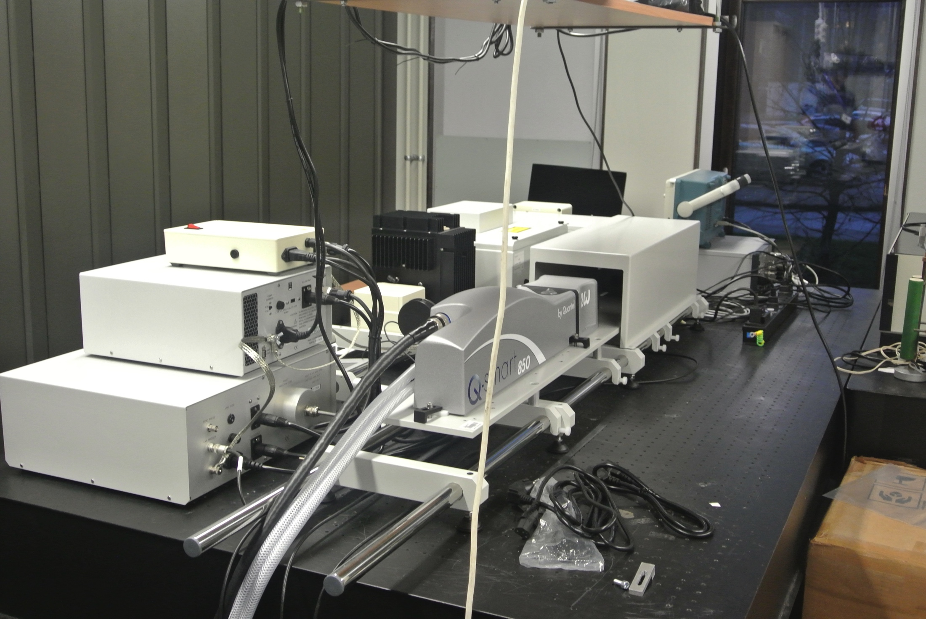
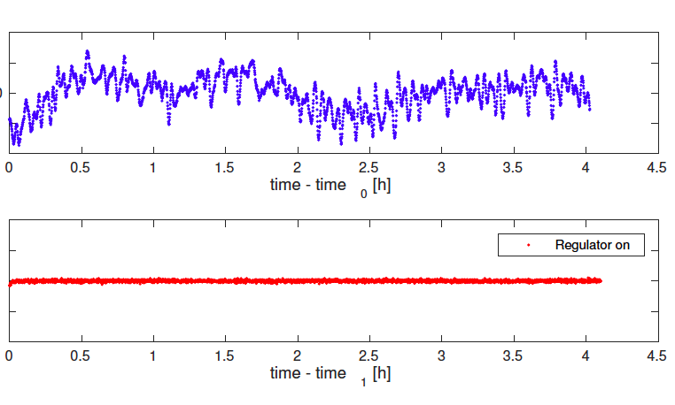
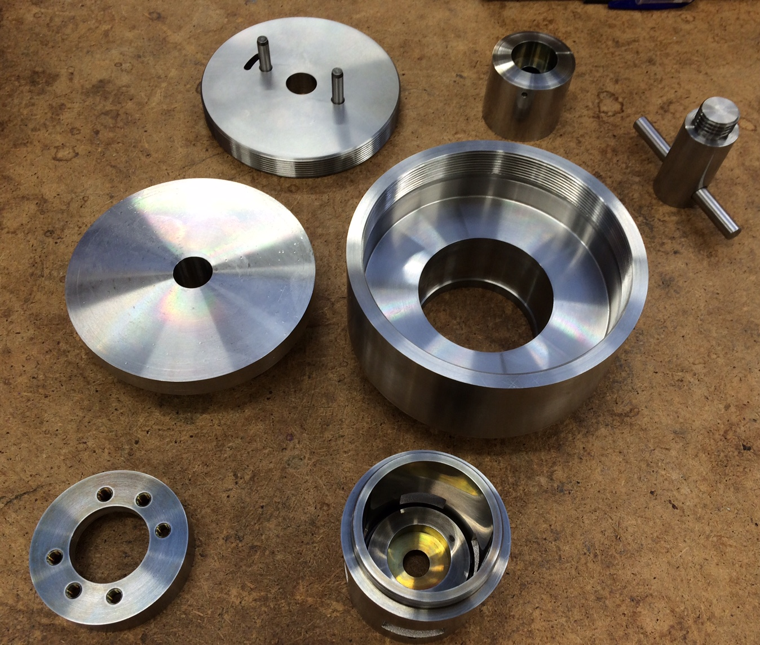
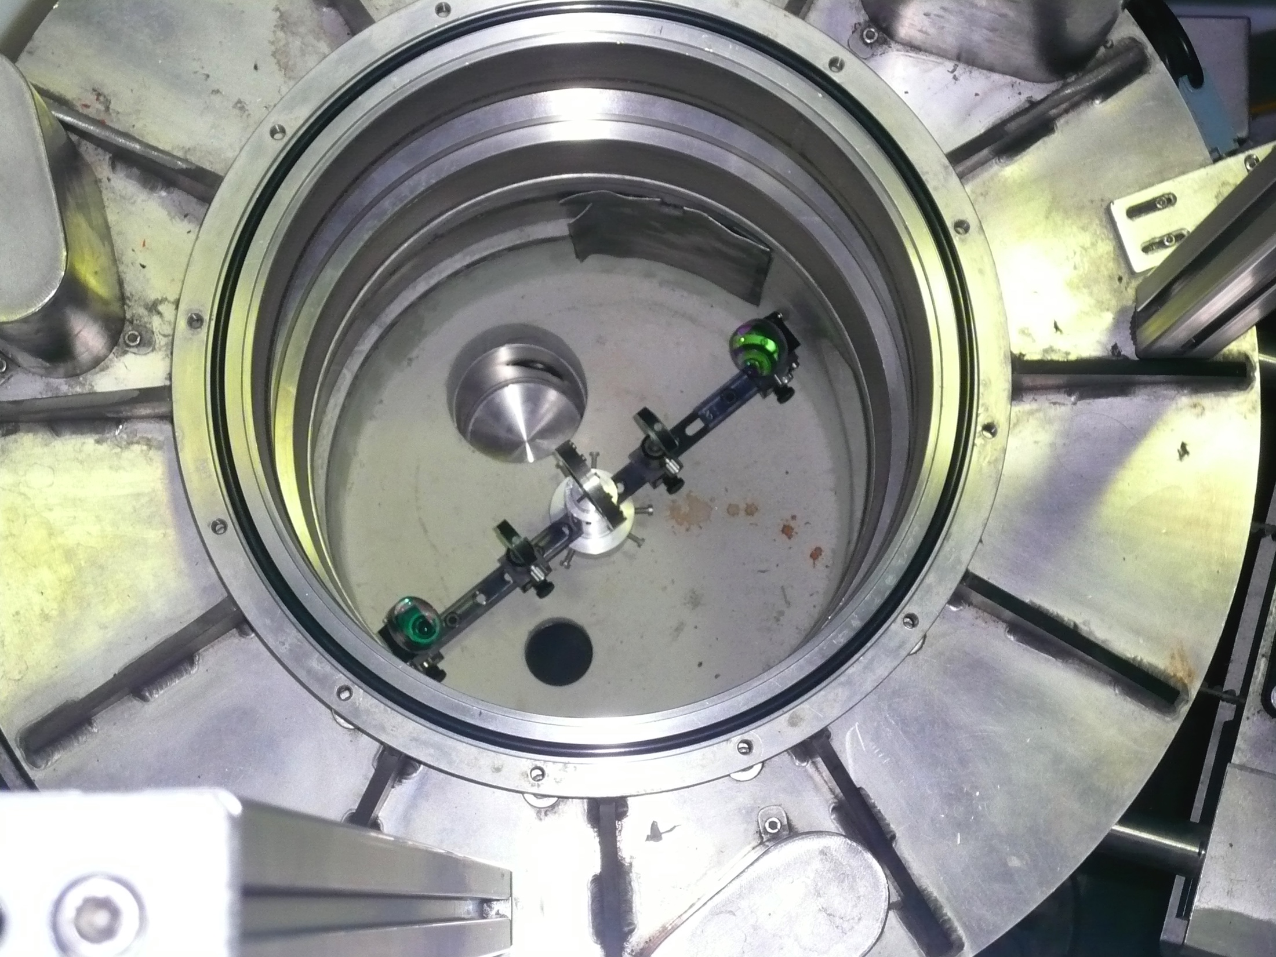
Developmental Activities
Challenge | Activity | Partner
Extreme cond / high pressure | DAC 50GPa; Toroidal anvil cell | ISIS / U Edinburgh collaboration
Multiple parameters / in-situ | Laser system Pump Probe In-situ Rheometer In-situ AC chi | U Tartu (IK completed) NN In-house incl. ILL collaboration
Fast / remote sample change | Robotic changer for cryostat | MCA with U Chemnitz
High precision T control | Peltier sub-cryostat | RUC (IK started)
Efficient parameter control | Peltier differential changer | RUC (IK started)
Laser
in lab
on IN5
at ILL
10 mK
10 mK
DAC cells
4 hours
15
Notes:
Disolve this slide or use as summary; link to SAC comments
Needs to specifc what it want from the pool and what they build for their instrument.
Instrumet team takes team during construction (and potentially in operation)

Slide 16
Instrument needs on Sample Environment Equipment
 | Needed
 | Possible
 | not applicable
 |  | BEER | BIFR | CSPC | DREA | ESTIA | FREIA | HEIM | NSE | LoKI | MAGi | MIRA | NMX | ODIN | SKADI | T-REX | VESP | VOR
Temp. & Field | Horizontal cryomag 11T |  | n | n | y |  | n |  | n | n | y | n |  | y | y | n | n | n
 | Vertical cryomag 9T | n | y | y |  | y | n |  | n | n | y | y |  | y | n | y | n | y
 | Electromag | y | n | n |  | y |  | y | n | y |  | n |  | y | y | n | y | n
 | Pulsed Tube Refrigerator | y |  | y | y | y | n | y | y |  | y | y | y | y | y | y | y | y
 | Orange CryoFurnace | y | y | y | y | y | n | y | y |  | y |  |  | y | y | y | y | y
 | Dilution |  | y | y | y |  | n |  |  | n | y |  |  |  | y | y | y | y
 | HT Furnace | y | y | y | y | y | n | y | y |  | y |  | y | y | y | y | y | y
 | IR Furnace | y | y |  | y |  | n |  |  | n | y |  | y |  | y | y | y | y
 | He3 Sorption stick |  | y | y | y |  | n |  |  | n | y |  |  |  | y | y | y | y
 | 6kV HV supply | n |  |  |  | y | y |  | y | y | y | y |  |  | y
 | Pulsed magnet | n | y | y |  |  | n | n | n | n | y |  | n |  |  | y | n | y
Pressure... | DAC |  | n | n | y | n | n | y | n | y | y |  | y |  | y | n | y
 | Paris-Edin. |  | y | y | y | n | n | y | n |  | y | n | n |  | n | y | y
 | Clamp cells <3GPa |  | y | y | y | n | n | y | n |  | y |  | n |  | n | y | y
 | Gas cells < 1GPa |  | y | y | y | n | n | y | y |  | y |  | n |  | n | y | y
 | stress/strain rig (generic) | y | n | n | n | n | n | n | n | y | n | n | n | y | y | n | n | n
 | Raman system |  | n | y | y |  |  | y | n | y | y |  | y | y | y | n | y
 | Gleeble | y | n | n | n | n | n | n | n | n | n | n | n | n | n | n | n | n
 | Portable laser heating assembly | y | n | n | y | n | y | y | n | n | n | n | n | n | n | n |  | n
Fluids, Gases … | Humidity chamber |  |  | y | n | y | y | y | y | y | n | y | y |  | y
 | Stopped flow | n | n | n | n | y | y |  | y | y | n | n | n | n | y | n | n | n
 | Pump probe | n | n | y | n |  |  |  | y | y | n | y |  |  | y | y | y | n
 | In-situ light scattering |  |  | y |  | y | y |  | y | y | n |  |  |  | y |  | y
 | Shear cells | n | n | n | n | y | y | n | y | y | n |  | y |  | y | n | n | n
 | Gas processing | y | y | y | y | y | y | y | y | y | y | y | y | y | y | y | y | y
 | Rheometer | n | n | n | n |  |  |  | y | y | n | n |  |  | y | n | n | n
 | Julabo-type circulating chiller/heater |  | y |  |  | y | y |  | y | y | n | y |  |  | y
 | Liquid surface troughs | n | n | n | n | y | y | n | n | n | n | n | n | n | n | n | n | n
 | in-situ gas adsorption meas. |  | n |  | n |  |  | y | y | y | n | y | y | y | y | n | y
 | in-situ thermal analysis meas. |  | n |  | n |  |  | y | y | y | n | y | y | y | y | n | y
 | injection systems, syringe pump |  | n |  | n | y | y |  | y | y | n | y | y |  | y
 | SANS magazine 5*10 | n | n | n | n | n | n | n | n | y | n | n | n | n | y | n | n | n
 | SANS magazine 5*10 indi T-ctrl | n | n | n | n | n | n | n | n | y | n | n | n | n | y | n | n | n

Slide 17
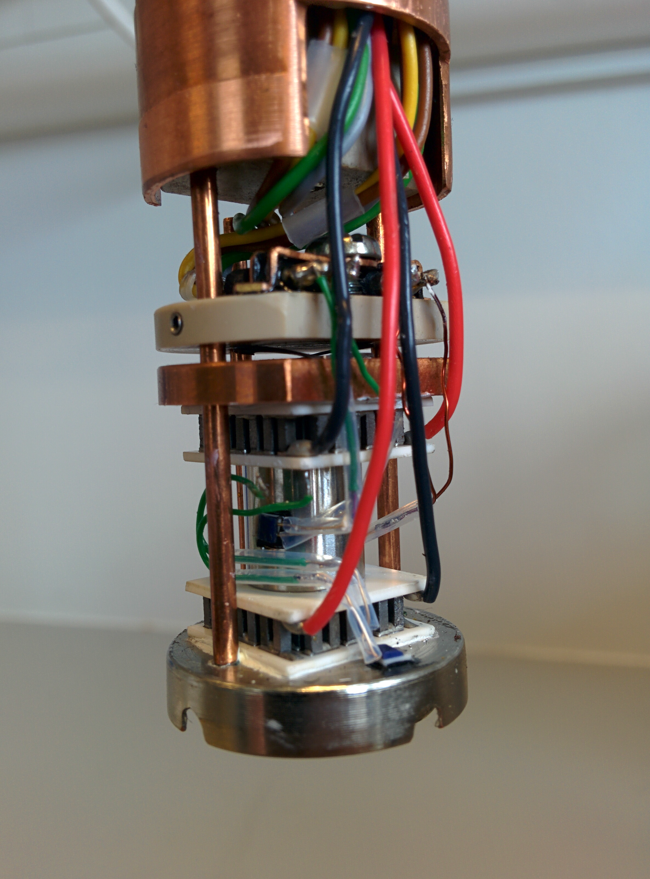
Temperature and Fields – current plans
 | Need 8 | scope | k€ | Mitigate
Horizontal cryomag 11T | 3 | 1 | 500 | Share Dream Magic Odin
Vertical cryomag 9T | 5 | 1 | 400 | Share Bifrost C-Spec Estia Magic Odin
Electromag | 4 | 1 | 50 | Share Beer Estia Loki/Skadi Odin
Pulsed Tube Refrigerator | 7 | 2 | 100 | Ops; share all instruments
Orange CryoFurnace | 7 | 1 | 50 | Ops; share all instruments
Dilution | 4 | 0 | 250 | Ops (use sorption stick)
HT Furnace | 8 | 2 | 75 | Share All Instruments
IR Furnace | 5 | 1 | 50 | Share Beer Bifrost Dream Magic
Sorption stick | 4 | 1 | 150 | Ops; share Bifrost, C-Spec, Dream, Magic
6kV HV supply | 2 | 0 | 50 | ops
Pulsed magnet | 3 | 0 |  | external

Slide 18
Pressure and Mechanical Processing – current plans
 | Need 8 | scope | k€ | Mitigate
Diamond Anvil Cells | 3 | 1 | 150 | External, share Dream Loki Magic
Paris-Edinburgh Cells | 4 | 1 | 200 | Ops, share Bifrost C-Spec Dream Magic
Clamp cells < 3GPa | 4 | 2 | 50 | Ops, share Bifrost C-Spec Dream Magic
Gas cells < 1GPa | 4 | 2 | 50 | Ops, share Bifrost C-Spec Dream Magic
stress/strain rig (generic) | 3 | 1 | 50 | Share Beer Loki/Skadi Odin
Raman system | 6 | 1 | 50 | Share C-Spec Dream Loki/Skadi Magic Odin
Gleeble mech. processing | 1 | 0 | 1000 | Instr. Specific Beer
Portable laser heating | 2 | 0 | 150 | ops
Corrosive gas manifold | 2 | 0 | 50 | ops

Slide 19
Fluids incl. Gases, Vapor and Complex Fluids – current plan
 | Need 8 | scope | k€ | Mitigate
Humidity chamber | 3 | 1 | 100 | Share C-Spec Estia Loki/Skadi
Stopped flow systems | 2 | 1 | 100 | Share Estia Loki/Skadi
Pump probe laser system | 2 | 1 | 200 | Share Estia Loki/Skadi
In-situ light scattering | 3 | 0 | 120 | ops
Shear cells | 3 | 0 | 20 | ops
Gas processing | 9 | 2 | 200 | Share All Instruments (2x)
Rheometer in-situ | 1 | 1 | 250 | Share Loki/Skadi
Julabo-type chiller/heater | 3 | 3 | 7 | shared Bifrost Estia Loki /Skadi
Liquid surface troughs | 1 | 0 | 20 | Instr. Specific Estia
in-situ gas adsorption meas. | 3 | 0 | 250 | external
Gas blower | 3 | 1 | 150 | Share Bifrost Estia Loki/Skadi
injection syst, syringe pump | 3 | 0 | 20 | ops
SANS magazine 5*10 | 1 | 0 | 50 | Mini-pool Loki/Skadi
SANS magazine 5*10 Ind. T | 1 | 0 | 50 | Mini-pool Loki/Skadi

Slide 20
Science Support Systems – time line
Notes:
Disolve this slide or use as summary; link to SAC comments
Needs to specifc what it want from the pool and what they build for their instrument.
Instrumet team takes team during construction (and potentially in operation)

Slide 21
Key Milestones
Milestone | Date | Description
Rad. Materials Lab. ready | End 2019 (first spectrum) | Rad. Materials Lab. needed for activated samples and equipment.
First laboratories and sample environ. workshops in exp. hall | Early 2021 (first 8 instruments start hot commissioning) | Labs needed for sample handling as defined in sample managm. procedure
First sample environment equipment | Early 2021 (first 8 instruments start hot commissioning) | SEE needed for demonstrating instrument performance
Initial suite of laboratories and sample environment workshops | Mid 2023 (start user program with eight instruments) | Labs needed for sample preparation during emerging user program
Initial suite of sample env. Equipment for first eight instr. | Mid 2023 (start user program with eight instruments) | SEE needed for conditions needed for emerging user program

Slide 22
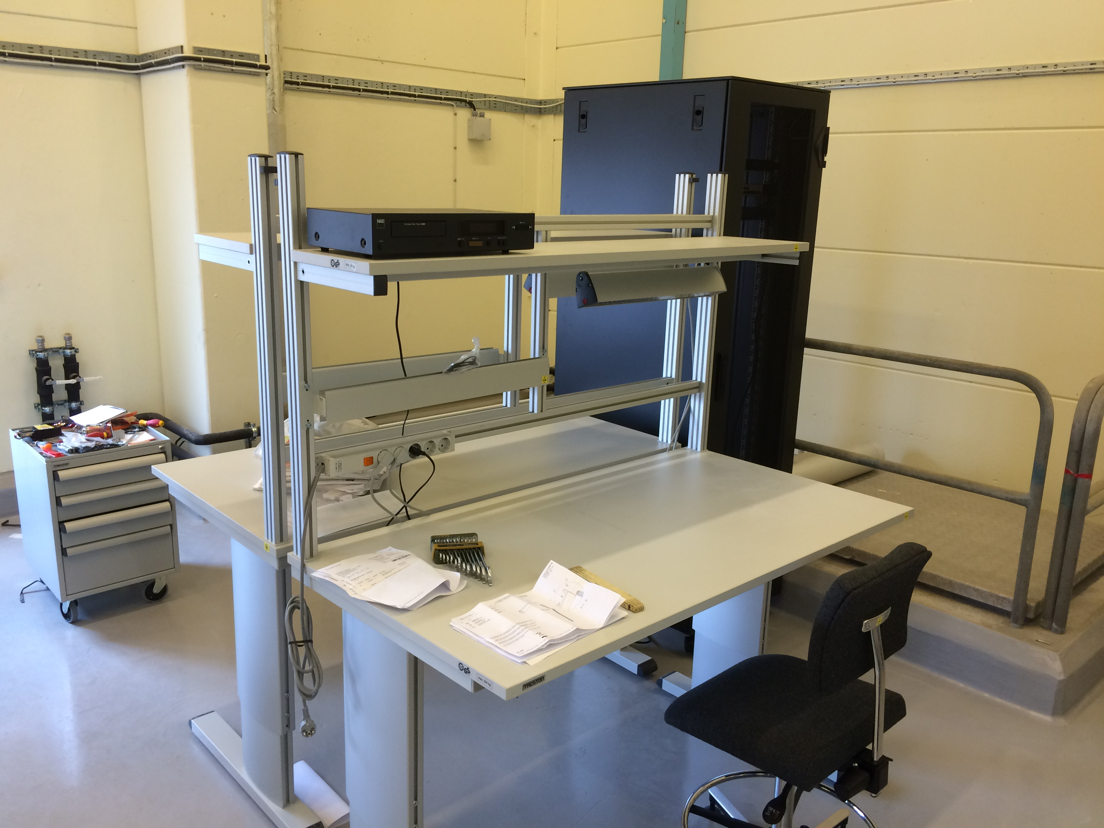
Sample Environment - Budget and Staffing
11.6 M€ (11.1 M€) Spent ‘13-’15: 0.5 M€ | TOTAL | IK % | Coord. & Interaction | Labs, Infrastr Workshops | Equipment
Mechatronic & Software Int | 1960 k€ | 37 | 1105 k€ | 553 k€ | 292 k€
Fluids incl Gases Liquids … | 2572 k€ | 55 (FZJ HZG) | 1111 k€ | 231 k€ | 1230 k€
Pressure & Mech Process | 3060 k€ | 64 (ISIS Edi.) | 1110 k€ | 1122 k€ | 828 k€
Temperature & Fields | 3844 k€ | 62 (ISIS) | 1079 k€ | 895 k€ | 1870 k€
Workshops set-up for testing / commissioning.
Used equipment obtained from partners for training purposes.
Currently prototyping standard supply panels, kinematic mounts, controls.
Participation in ESS instrument integration project incl. also ICS.
Synergies on helium management with accelerator cryogenics team.
INKIND: Framework agreements ˜1M€ preferred /discussed but individual work plans also available; staff in-kind contributions in addition.
2016 staffing NSS ~ 2.5 FTE TOTAL ~ 3.5 FTE (grants, shared ICS, Instr. Int)
22
Notes:
Disolve this slide or use as summary; link to SAC comments
Needs to specifc what it want from the pool and what they build for their instrument.
Instrumet team takes team during construction (and potentially in operation)

Slide 23
Sample & User Laboratories and Deuteration & Crystallisation Facilities
5.1 M€ (4.7 M€); spent: 0.4 M€ | TOTAL | IK % | Coordination | Laboratories | Equipment
Sample and user labs fac. | 3085 k€ | 62 UK EE NN | 1134 k€ | 1748 k€ | 203 k€
Deuteration & crystallization | 1931 k€ | 21 (NO) | 921 k€ | 400 k€ | 610 k€
Deliver and (later) operate user laboratories in exp. halls incl. rad. mat. lab.
Implement sample management procedure incl. safety.
Deuteration and protein crystallization as a collaborative scalable cost-efficient LU-MAX IV-ESS partnership to support users by access / expertise.
IK: Lab fit-out (1000k€ UK) and RML glove boxes (70k€ EE) active.
IK: Framework incl. xtal robots (400k€) discussed with partners (NO).
IK: RML/Eng. fit-out (250k€), equipment (200k€), techn. staff (400k€) avail.
2016 staffing NSS ~ 1.5 FTE; TOTAL ˜3.3 FTE mainly by grants.
Notes:
Stress that SULF construction IK agreements ONLY cover basic fit out of labs with fume hoods, benches, gases, cold rooms, etc.
IK card available for equipment (see page 4) but only 203k EUR and this will be for things like balances, provision of millipur water, heater-stirrer plates, glassware, drying ovens, fridges, industrial dishwashers, etc.(i.e. small cost items). Initial feedback from IK partner is that the current planned lab fit out will not be possible within the stated budget so likely this money will be used for basic fit out and all equipment must be delivered from pre-operations.
There is NO money in construction for large pieces of capital equipment (diffractometers, SAXS, SQUID, etc) but rooms are set aside in the D & E buildings for these when funding is available (hopefully in operations)
While 14 of 22 labs seems a lot, they will NOT be fully functional in 2022 without significant pre-operations additional budget.

Slide 24
Science Support Systems - budget
6.3 M€ (3.4 M€) | TOTAL | Spent ‘13-15
Management Inst. Interaction | 4552 k€ | 2632 k€
Scientific Coord User Office | 1793 k€ | 336 k€
5.1 M€ (4.7 M€) | TOTAL | IK % | Coordination Interaction | Labs and Infrastruct. | Equipment | Spent '13-15
Sample and user labs fac. | 3085 k€ | 62 | 1134 k€ | 1748 k€ | 203 k€ | 126k€
Deuteration & crystallisation | 1931 k€ | 21 | 921 k€ | 400 k€ | 610 k€ | 199 k€
11.6M€ (11.1M€) | TOTAL | IK % | Coordination Interaction | Labs, Infrastr Workshops | Equipment | Spent ‘13-15
Mechatronic & Software integr. | 1960 k€ | 37 | 1115 k€ | 553 k€ | 292 k€ | 102 k€
Fluids incl Gases Liquids … | 2572 k€ | 55 | 1111 k€ | 231 k€ | 1230 k€ | 252 k€
Pressure & Mech Process | 3060 k€ | 64 | 1110 k€ | 1122 k€ | 828 k€ | 122 k€
Temperature & Fields | 3844 k€ | 62 | 1079 k€ | 895 k€ | 1870 k€ | 75 k€
24
Notes:
Disolve this slide or use as summary; link to SAC comments
Needs to specifc what it want from the pool and what they build for their instrument.
Instrumet team takes team during construction (and potentially in operation)

Slide 25
Science Support Systems – Breakdown for NSS construction budget

Slide 26
Risks
Risk | Affects | Description | Mitigation
Licenses (NSS-22 / 37) | Commissioning and Operation | Inability to obtain licenses from authorities | ESH competence at NSS; ensure communication.
Orphan scope for infra-structure and exp. hall | Cost for operation and construction | Scope creep of central services helium infrastructure, vacuum, radiation monitors incl. staffing. | Ensure signature of service level agreements to previously agreed terms.
Insufficiently trained technical operation staff | Operation and user program | Technical staff for reliable ops of labs and sample environment on instruments during user prg. | Timely recruitment of technical staff and training at (IK) partners in projects.
Inability to access in-kind funds | Cash budget, schedule slip | De-prioritization of SSS increases cash exposure on time critical installations | Ensure framework agreements incl. less attractive but critical parts
Inability to attract external funding | State-of-the-art sample environ. | Additional developmental activities rely on ext. funds | Ensure sufficient staffing for credible applications
Insufficient instr. Integration | Efficiency and Operability | Insufficient infrastructure at instruments for ops demands | Standards reference docs; TG decisions
Change instr suite priorities | schedule | Changes in individual instr. Constr. Schedule & unclear requirements | Agile prioritization; modular SEE

Slide 27
Science Support Systems – in operation
Science Support Systems
Scientific Coord.
User Office
Temperature
Field
High Pressure
Mech. Proc.
Fluids incl.
Gases, Vapor
Deuteration
Crystallization
Sample handling
general labs
Mechatronics
Integration
FTE OPS | k€ / yr
3 | 1630
4 | 1060
5 | 930
5 | 880
4 | 730
6 | 720
4 | 560
5 | 1280 + usr remb
Current SSS Budget within NSS for 8 Instr.
Requested budget within (Pre-) OPS
User Reimbursement (300€ / BAU)
M€
8
6
4
2
4 Divisions within Science:
SAD operating Science Support Systems
Instruments incl. Techn. Instr. Support 24/7
Technologies incl. Projects.
DMSC.
Notes:
Present experience: fragemtnation, only partly supporting all topics …
New approach …mainaining balance; bringing it colse to the user

Slide 28
Interactions with instrument teams – milestones follow construction schedule
Instrument
2018
2021
2023
Construction
Commissioning and Operation
Instrument Proposal
Phase-0
Preparation for Preliminary Design
Phase-1
Preliminary Design
Phase-2
Detailed Design
Phase-3
Procurement, Construction & Installation
Phase-4
Cold Commissioning
Phase-5
Hot Commissioning
Phase-6
User Operations
Tollgate 1
Tollgate 2
Tollgate 3
Tollgate 4
Tollgate 5
Sample Environment Equipment
SE 1
Instrument Specific SEE €
SE 2
SE 3
Pool SEE €
SE 4
Infrastructure for SEE €
SE 5
SE 6
Support Laboratories
LAB 1
Instrument Specific Labs €
L 2
LAB 3
Common User Laboratories €
LAB 4
Sample workflow (safety) €
LAB 5
Notes:
Present experience: fragemtnation, only partly supporting all topics …
New approach …mainaining balance; bringing it colse to the user

Slide 29
Interactions with instrument teams – questions and answers for TG 2
Instrument
Help all Instrument Teams in Scope Setting and TG2.
Instrument Proposal
Phase-0
Preparation for Preliminary Design
Phase-1
Preliminary Design
Instrument interaction estimated to 1 FTE in average.
e.g. providing 6 PM per instrument until hot comm.
TG 1
TG 2
Currently designing and building supply panels,
kinematic mounts and control systems to standards.
Sample Environment Equipment
SE 1
Instrument Specific SEE €
Any SEE required /available for instrument only ? When ?
Synergies possible with other instruments (mini-pool) ?
Pool SEE required for commissioning / user operation ?
Which SEE needs to be used on my instrument ? How ?
Any specific LAB required for my instrument? Where ?
Common user LABs needed for commissioning / ops ?
How to condition, change and store samples / SEE ?
Pool SEE for instr. suite €
Infrastructure for SEE €
Support Laboratories
LAB 1
Instrument Specific Labs €
Common User Laboratories €
Sample workflow (safety) €
Notes:
Present experience: fragemtnation, only partly supporting all topics …
New approach …mainaining balance; bringing it colse to the user

Slide 30
Future user program
Users on site in steady state requiring access, training, controls and sample handling labs. Users: ~60 non-local, ~30 local, ~30 long term; Access Experimental hall: ~50 indiv. users/day
Radiological Materials Lab, two user labs, work-shops ready incl. lab readiness review in 2019.
User Office will interface with ESH, user training, dosimetry, access to supervised areas
Experimental Review System: Procedures have been developed.
Accepted proposal
Safety Review Procedure
Sample Handling Procedure
Exp. is finished
Idea by user
Proposal
experiment,
sample handling
data
Publi-cation

Slide 31
Summary
Core team to help instrument teams, cover ESS interfaces, manage in-kind.
Developmental Activities aligned with challenges and now starting.
Initial ‘Pool’ Sample Environment for first 8 instr. defined but remains agile.
Laboratories and workshops set-up for Integration and Testing.
Reference docs on mech. interfaces, supplies, controls, safety provided; Equipment currently designed and will be built such as panels, mounts.
CF and ESH interface on zoning of exp. hall & labs for smooth operation.
Individual work plans for all (potential) in-kind contributions SEE written.
Schedule aligned with instrument construction and user program.
31
Notes:
Disolve this slide or use as summary; link to SAC comments
Needs to specifc what it want from the pool and what they build for their instrument.
Instrumet team takes team during construction (and potentially in operation)

Slide 32
THANK YOU
32
Notes:
Disolve this slide or use as summary; link to SAC comments
Needs to specifc what it want from the pool and what they build for their instrument.
Instrumet team takes team during construction (and potentially in operation)

Slide 33
Background info and assumptions for current, consolidated and reduced scope
Current Scope (total budget 22.8 M€ but 3.9 M€ spent in ’13 - ‘15)
Interactions with instrument teams to ease integration.
Infrastructure investments early on and until MS hot commissioning.
Some developmental activities to meet ESS challenges.
Common Pool Sample Environment Equipment for first 8 instruments.
Initial support available for MS instrument hot commissioning.
Consolidated Scope (total budget 20.6 M€; net saving 550k€, shift 5yOPS 1650k€)
User Office (SCUO) activities postponed until operational funds are available.
User Labs and Deuteration Platform moved to operation after MS first neutrons.
Assuming certain scope is covered by agreements: vacuum, cryogenics, admin …
Reduced Scope (total budget 18.1 M€; net saving 3100k€, shift 5yOPS 1650k€)
(Almost) all SCUO activities stopped (SFTs, symposia, seminars).
Developmental activities further reduced and many sample environment systems postponed using operational funds initially foreseen for instruments #9 - #15.
Very limited support for MS hot commissioning; reduced pool for MS user prg hampering science case (parameters) and efficient neutron use (integration).

Slide 34
Temperature and Fields – reduced scope
 | Need 17 | Poss 17 | Need 8 | In scope | Cost (k€) | Mitigate
Horizontal cryomag 11T | 4 | 8 | 3 | 0 | 500 | share
Vertical cryomag 9T | 8 | 11 | 5 | 0 | 400 | share
Electromag | 7 | 11 | 4 | 1 | 50 | share
Pulsed Tube Refrigerator | 14 | 16 | 7 | 2 | 100 | ops
Orange CryoFurnace | 13 | 16 | 7 | 1 | 50 | ops
Dilution | 8 | 15 | 4 | 0 | 250 | ops
HT Furnace | 14 | 16 | 8 | 2 | 75 | share
IR Furnace | 9 | 15 | 5 | 1 | 50 | share
Sorption stick | 8 | 15 | 4 | 1 | 150 | ops
6kV HV supply | 6 | 16 | 2 | 0 | 50 | ops
Pulsed magnet | 5 | 9 | 3 | 0 |  | external

Slide 35
Pressure and Mechanical Processing – reduced scope
 | Need 17 | Poss 17 | Need 8 | In scope | Cost (k€) | Mitigate
Diamond Anvil Cells | 7 | 11 | 4 | 1 | 150 | external
Paris-Edinburgh Cells | 6 | 11 | 3 | 0 | 200 | ops
Clamp cells < 3GPa | 7 | 12 | 4 | 0 | 50 | ops
Gas cells < 1GPa | 8 | 13 | 4 | 0 | 50 | ops
stress/strain rig (generic) | 4 | 4 | 3 | 1 | 50 | share
Raman system | 9 | 14 | 6 | 1 | 50 | share
Gleeble mech. processing | 1 | 1 | 1 | 0 | 1000 | Instr.
Portable laser heating | 4 | 5 | 2 | 0 | 150 | ops
Corrosive gas manifold | 3 | 3 | 2 | 0 | 50 | ops

Slide 36
Fluids incl. Gases, Vapor and Complex Fluids – reduced scope
 | Need 17 | Poss 17 | Need 8 | In scope | Cost (k€) | Mitigate
Humidity chamber | 8 | 14 | 4 | 1 | 100 | share
Stopped flow systems | 5 | 5 | 2 | 0 | 100 | share
Pump probe laser system | 7 | 11 | 2 | 1 | 200 | share
In-situ light scattering | 6 | 16 | 3 | 0 | 120 | ops
Shear cells | 6 | 8 | 3 | 0 | 20 | ops
Gas processing | 17 | 17 | 9 | 2 | 200 | share
Rheometer in-situ | 3 | 8 | 1 | 0 | 250 | share
Julabo-type chiller/heater | 7 | 17 | 3 | 3 | 7 | ops
Liquid surface troughs | 2 | 2 | 1 | 0 | 20 | Instr.
in-situ gas adsorption meas. | 6 | 12 | 3 | 0 | 250 | external
Gas blower | 7 | 17 | 3 | 0 | 150 | share
injection syst, syringe pump | 7 | 13 | 3 | 0 | 20 | ops
SANS magazine 5*10 | 2 | 2 | 1 | 0 | 50 | Mini-pool
SANS magazine 5*10 Ind. T | 2 | 2 | 1 | 0 | 50 | Mini-pool

Slide 37
Sample Environment - Budget and Staffing reduced scope
9.2 M€ (8.7 M€) Spent ‘13-’15: 0.5 M€ | TOTAL | IK % | Coordination Interaction | Labs, Infrastr Workshops | Equipment
Mechatronic & Software Int. | 1665 k€ | ? | 1030 k€ | 400 k€ | 235 k€
Fluids incl Gases Liquids … | 2055 k€ | ? | 1040 k€ | 230 k€ | 785 k€
Pressure & Mech Process | 2730 k€ | ? | 1110 k€ | 1120 k€ | 500 k€
Temperature & Fields | 2780 k€ | ? | 1040 k€ | 790 k€ | 950 k€
Workshops set-up in Medicon Village & Utgård for testing / commissioning.
Used equipment obtained from partners for training purposes.
Currently prototyping standard supply panels, kinematic mounts, controls.
Participation in ESS instrument integration project incl. also ICS.
Synergies on helium management with cryogenics team at accelerator.
INKIND: Framework agreements preferred (leverage, flexibility) but individual work plans REVISED; staff in-kind contributions in addition.
2016 staffing NSS ~ 2.5 FTE TOTAL ~ 3.5 FTE (grants, shared ICS, Instr. Int)
37
Notes:
Disolve this slide or use as summary; link to SAC comments
Needs to specifc what it want from the pool and what they build for their instrument.
Instrumet team takes team during construction (and potentially in operation)

Slide 38
Sample & User Laboratories and Deuteration & Crystallisation Facilities – reduced scope – ops funds from 2020
3.3 M€ (2.9 M€); spent: 0.4 M€ | TOTAL | IK % | Coordination | Laboratories | Equipment
Sample and user labs fac. | 2170 k€ | ? | 320 k€ | 1650 k€ | 200 k€
Deuteration & crystallization | 1125 k€ | ? | 435 k€ | 80 k€ | 610 k€
Deliver and (later) operate user laboratories in exp. halls incl. rad. mat. lab.
Implement sample management procedure incl. safety.
Deuteration and protein crystallization as a collaborative scalable cost-efficient LU-MAX IV-ESS partnership to support users by access / expertise.
IK: Lab fit-out (1000k€ UK) and RML glove boxes (70k€ EE) active.
IK: Framework incl. xtal robots (400k€) discussed with partners (NO).
IK: RML/Eng. fit-out (250k€), equipment (200k€), techn. staff (400k€) avail.
2016 staffing NSS ~ 1.5 FTE; TOTAL ˜3.3 FTE mainly by grants.
Notes:
Stress that SULF construction IK agreements ONLY cover basic fit out of labs with fume hoods, benches, gases, cold rooms, etc.
IK card available for equipment (see page 4) but only 203k EUR and this will be for things like balances, provision of millipur water, heater-stirrer plates, glassware, drying ovens, fridges, industrial dishwashers, etc.(i.e. small cost items). Initial feedback from IK partner is that the current planned lab fit out will not be possible within the stated budget so likely this money will be used for basic fit out and all equipment must be delivered from pre-operations.
There is NO money in construction for large pieces of capital equipment (diffractometers, SAXS, SQUID, etc) but rooms are set aside in the D & E buildings for these when funding is available (hopefully in operations)
While 14 of 22 labs seems a lot, they will NOT be fully functional in 2022 without significant pre-operations additional budget.

Slide 39
Science Support Systems – budget reduced scope
5.6 M€ (2.6 M€) | TOTAL | Spent ‘13-15
Management Inst. Interaction | 4552 k€ 4390 k€ | 2632 k€
Scientific Coord User Office | 1793 k€ 1185 k€ | 336 k€
3.3 M€ (2.9 M€) | TOTAL | IK % | Coordination Interaction | Labs and Infrastruct. | Equipment | Spent '13-15
Sample and user labs fac. | 3085 k€ 2170 k€ | 62? | 1134 k€ 320 k€ | 1748 k€ 1650 k€ | 203 k€ 200 k€ | 126k€
Deuteration & crystallisation | 1931 k€ 1125 k€ | 21? | 921 k€ 435 k€ | 400 k€ 80 k€ | 610 k€ 610 k€ | 199 k€
9.2 M€ (8.7 M€) | TOTAL | IK % | Coordination Interaction | Labs, Infrastr Workshops | Equipment | Spent ‘13-15
Mechatronic & Software integr. | 1960 k€ 1665 k€ | 37? | 1115 k€ 1030 k€ | 553 k€ 400 k€ | 292 k€ 235 k€ | 102 k€
Fluids incl Gases Liquids … | 2572 k€ 2055 k€ | 55? | 1111 k€ 1040 k€ | 231 k€ 230 k€ | 1230 k€ 785 k€ | 252 k€
Pressure & Mech Process | 3060 k€ 2730 k€ | 64? | 1110 k€ 1110 k€ | 1122 k€ 1120 k€ | 828 k€ 500 k€ | 122 k€
Temperature & Fields | 3844 k€ 2780 k€ | 62? | 1079 k€ 1040 k€ | 895 k€ 790 k€ | 1870 k€ 950 k€ | 75 k€
39
Notes:
Disolve this slide or use as summary; link to SAC comments
Needs to specifc what it want from the pool and what they build for their instrument.
Instrumet team takes team during construction (and potentially in operation)

Slide 40
Science Support Systems – Breakdown for NSS construction budget

Slide 41
Science Support Systems – reduced scope Breakdown for NSS construction budget
REDUCED*
SPENT ‘13-15
* Assumes increased OPS budget and postponed MS

Slide 42
Key Milestones - REVISED
Milestone | Date | Description
Rad. Materials Lab. ready | End 2019 (first spectrum) | Rad. Materials Lab. needed for activated samples and equipment.
First laboratories and sample environ. workshops in exp. hall | Early 2021 (first instruments start hot commissioning) requires OPS budget | Labs needed for sample handling as defined in sample managm. procedure
Very few sample environment equipment | Early 2021 (first instruments start hot commissioning) | SEE not available for demonstrating instrument performance
Initial suite of laboratories and sample environment workshops | Mid 2023 (start user program) requires increase OPS budget | Labs needed for sample preparation during emerging user program
Initial suite of sample environment equipment | Mid 2023 (start user program) uses OPS budget intended for Instruments #9 - #15. | SEE needed for more basic conditions (reduced science capabilities) but less integration (inefficient beam use) for emerging user program

Slide 43
Risks - REVISED
Risk | Affects | Description | Mitigation
Scope Reduction within NSS/SSS | USR PRG (science) OPS (integration) | Reduced scope due to budget constraints: postponed equipment | Await and use ops funds initially for instr. #9 - #15
Licenses (NSS-22 / 37) | Commissioning and Operation | Inability to obtain licenses from authorities | ESH competence at NSS; ensure communication.
Orphan scope for infra-structure and exp. hall | Cost for operation and construction | Scope creep of central services helium infrastructure, vacuum, radiation monitors incl. staffing. | Ensure signature of service level agreements to previously agreed terms.
Insufficiently trained technical operation staff | Operation and USR PRG (reputation) | Technical staff for reliable ops of labs and sample environment on instruments during user prg. | Earlier recruitment of technical staff and training at (IK) partners in projects.
Inability to access in-kind funds | Cash budget, schedule slip | De-prioritization of SSS increases cash exposure on time critical installations | Ensure framework agreements incl. less attractive but critical parts
Inability to attract external funding | State-of-the-art sample environ. | Additional developmental activities rely on ext. funds | Ensure sufficient staffing for credible applications
Insufficient instr. Integration | Efficiency and Operability | Insufficient infrastructure at instruments for ops demands | Standards reference docs; TG decisions
Change instr suite priorities | schedule | Changes in individual instr. Constr. Schedule & unclear requirements | Agile prioritization; modular SEE

Slide 44
Summary – current, consolidated and reduced scope
Current SSS construction plus 5yOPS19-23 budget required to deliver initial NSS scope e.g. Science Support Systems for instrument suite #1 - #16.
Consolidated SSS construction scope is based on revised milestones for first neutrons / hot commissioning / user programme. Assumes all SLA are accepted. Saves about 500k€ for NSS construction budget but transfers 1650k€ as operational tasks into 5yOPS19-23.
Reducing scope further results in about 2 year delay e.g. no trained staff for hot commissioning (inefficient neutron use), reduced sample environment pool for user programme (hampered initial science case) and insufficient funds to cater for instruments #9 - #16.
44
Notes:
Disolve this slide or use as summary; link to SAC comments
Needs to specifc what it want from the pool and what they build for their instrument.
Instrumet team takes team during construction (and potentially in operation)

