Slide 1
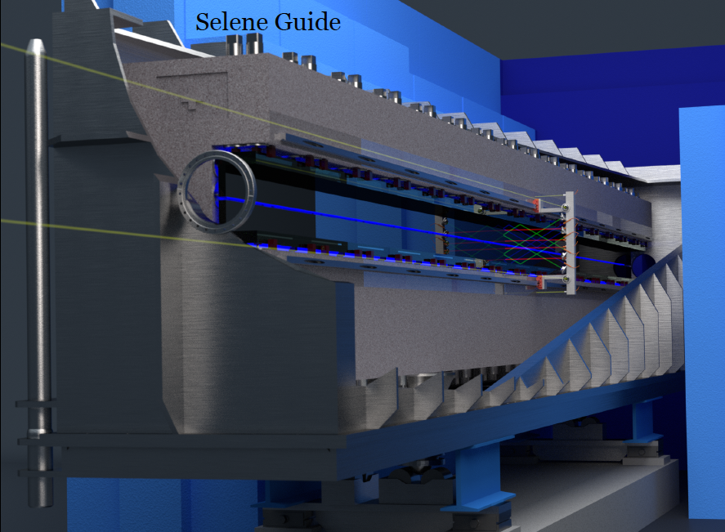
Status ESTIA
CH-DK: ESTIA
PHASE 1, CH contribution 100%
Instrument team:
Jochen Stahn, PSI, ESTIA proposer
Artur Glavic, PSI, Lead scientist
Sven Schütz, PSI, Lead engineer
Schedule:
July 2015 Start Phase 1 work
15 June 2016 STAP Presentation
20 July 2016 SCOPE Setting
27 Sept 2016 TG2 Review
2020 Commissioning
Some lessons learned:
- Costing: 10.7 MEUR for initial installation, 12.3 MEUR for full scope
- Unclear costs for installation (work, delays) and interfaces with ESS (services, etc)
Page 1

Slide 2
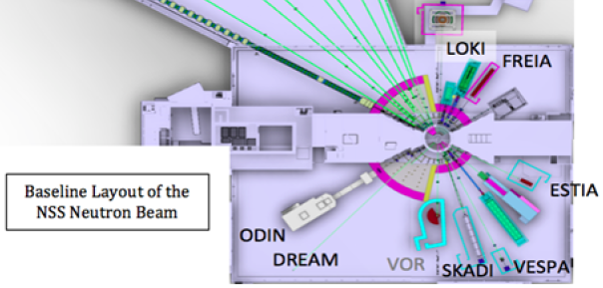
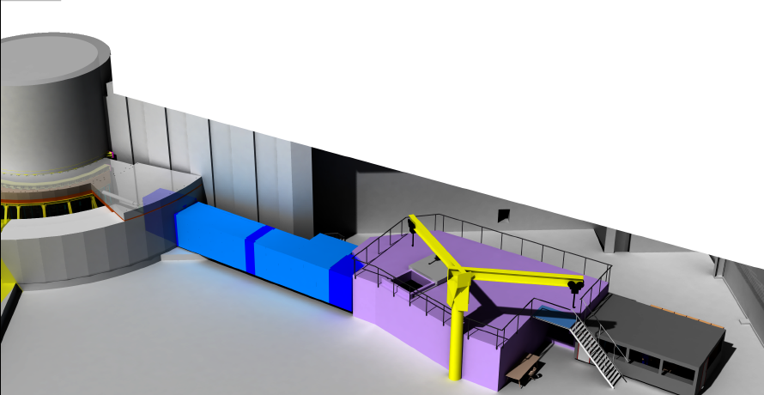
Status ESTIA
Page 2

Slide 3
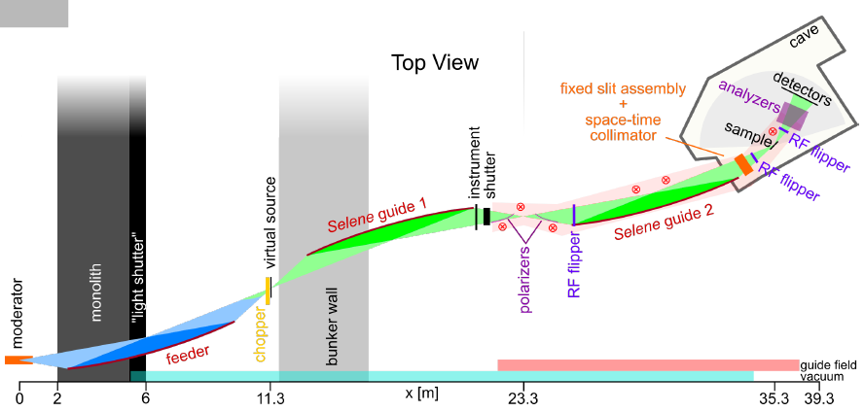
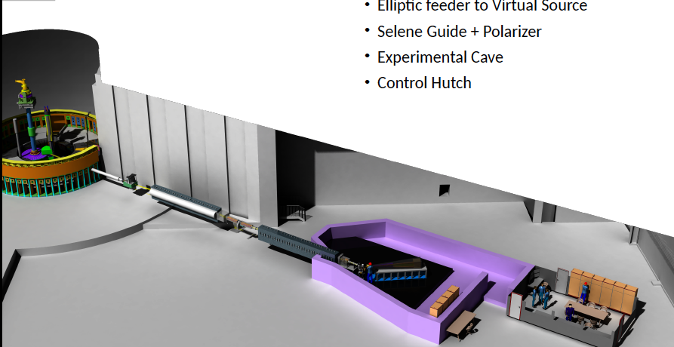
Status ESTIA
Page 3

Slide 4
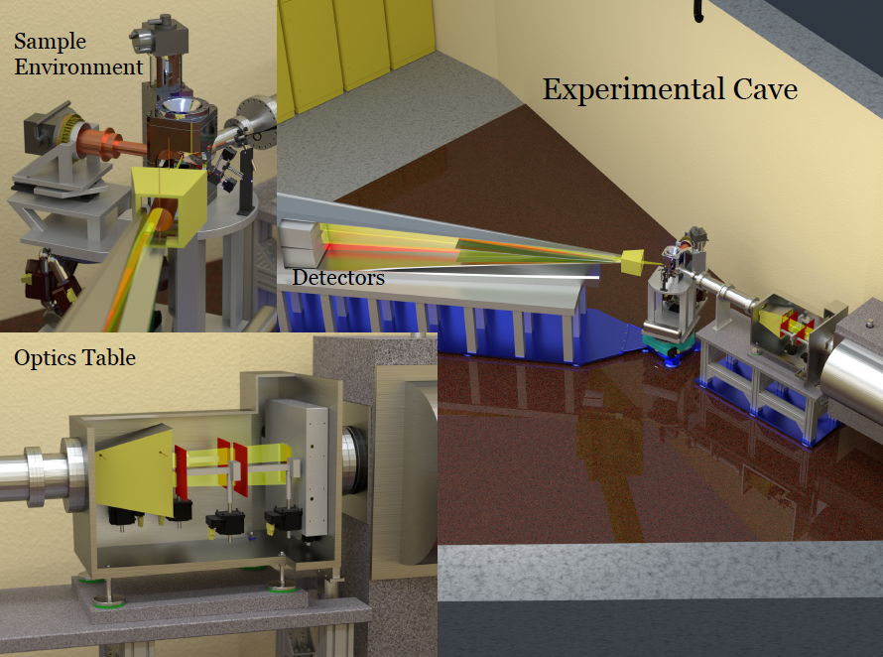
Status ESTIA
Page 4

