Slide 1
Technische Universität München Forschungs-Neutronenquelle Heinz Maier-Leibnitz (FRM II).
Jürgen Neuhaus
Dept. sci. director
www.europeanspallationsource.se
16-06-21

Slide 2
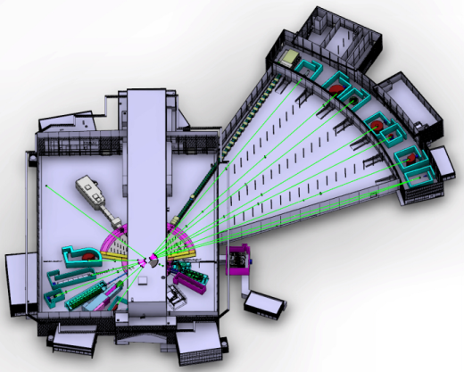
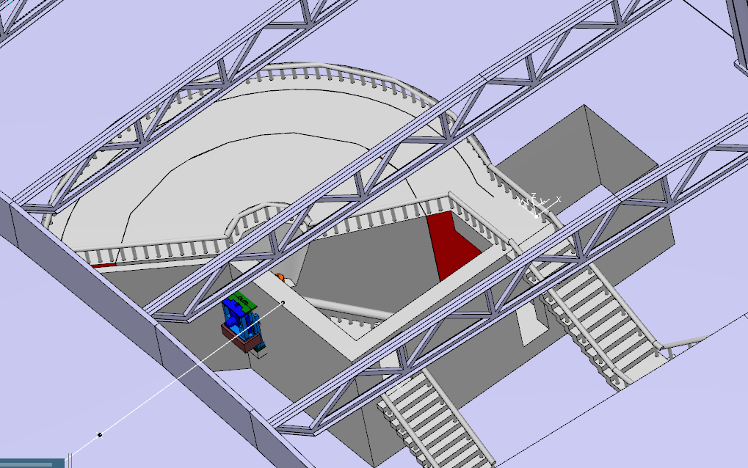
C-SPEC TUM ; LLB
CORE TEAM
Lead scientist : Pascale Deen (ESS for TUM)
Lead engineer: Joseph Guyon Le Bouffy(LLB)
W3 : C-SPEC
PROGRESS SINCE LAST ICB
Start of Phase 1
Guide & Chopper system optimization
Engineering design incl. shielding underway
CURRENT ISSUES
Budgetary quotes for detectors, chopper system and guide system
Scope-setting: 2016-10-07
Tollgate 2: 2017-01

Slide 3
ODIN TUM, PSI
CORE TEAM
Lead scientist : Michael Lerche (TUM)
Lead engineer: Elbio Calzada
Instrument scientist : Manuel Morgano (PSI)
PROGRESS SINCE LAST ICB
Team complete (June 1st 2016)
Moderator design changes reset the guide design
Optional curved guide design in progress
Straight bi-spectral neutron guide design near completion
CURRENT ISSUES
Shielding in general, forward scattering of relativistic neutrons, streaming
Massive shutter design: requirements
Scope-setting: 2016-10-05
Tollgate 2: early 2017

Slide 4
CONSENSE (Spin Echo) FZ Jülich, TUM
CORE TEAM
Michael Monkenbush (FZJ), Robert Georgii (TUM)
Still in proposal phase
PROGRESS SINCE LAST ICB
STAP meeting on September, 16
Basic design of a hybrid instrument (NSE + NRSE) under study
Decision of acceptance 2017
CURRENT ISSUES
TUM part of proposal phase pre-financed
FZJ part of proposal phase pre-financed
Proposal acceptance: 2017-12-01
Scope-setting: 201x-xx-xx
Tollgate 2: 201x-xx-xxx

