Slide 1
Beamline for European materials Engineering Research / BEER
Petr Lukáš (NPI) & Martin Müller (HZG)
www.europeanspallationsource.se
16-06-22

Slide 2
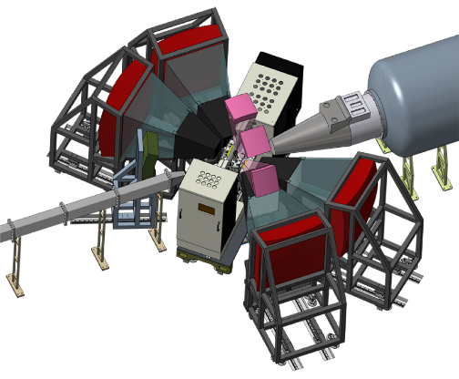
BEER Helmholtz-Zentrum Geesthacht; Nuclear Physics Institute Řež
CORE TEAM
Lead scientist: J. Fenske (HZG), P. Beran (NPI)
Lead engineer: D. J. Siemers (HZG) , NPI – recruitment in progress
PROGRESS SINCE LAST ICB (technical and project)
phase 1 schedule - NPI signed on 31/5/2016
phase 1 docs in progress (draft SysReq and ConOps)
STAP 17/6 – set priorities for scope setting
open CZ tender for shielding and engineering design
CURRENT ISSUES
shielding simulations – waiting for ESS bunker results
changing choppers arrangement due to bunker pillars
Scope-setting: 2016-10-14
Tollgate 2: 2017-01-xx

