Slide 1
ISIS project update Loki and FREIA
Sean Langridge
Loki and Freia
www.europeanspallationsource.se
16-06-22

Slide 2
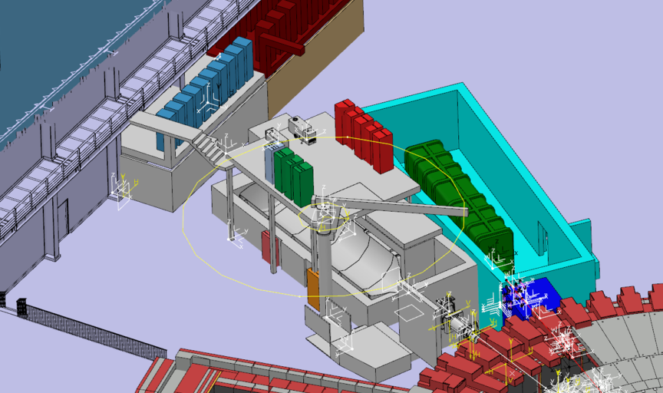
Loki ISIS
CORE TEAM
Lead scientist Andrew Jackson
Lead engineer David Turner
Integration Engineer Clara Lopez
PROGRESS SINCE LAST ICB (technical and project)
Neutronics design progressing
Neutronics design now delivering into engineering
Components in the bunker rationalised
Requirement for heavy shutter
Project documentation delivered to ESS
1st Project board held
CURRENT ISSUES
Budget
Lack of clarity on the bunker
Detector solution
Risk ownership of ESS supply
Schedule
Scope-setting: Complete
Tollgate 2: Complete

Slide 3
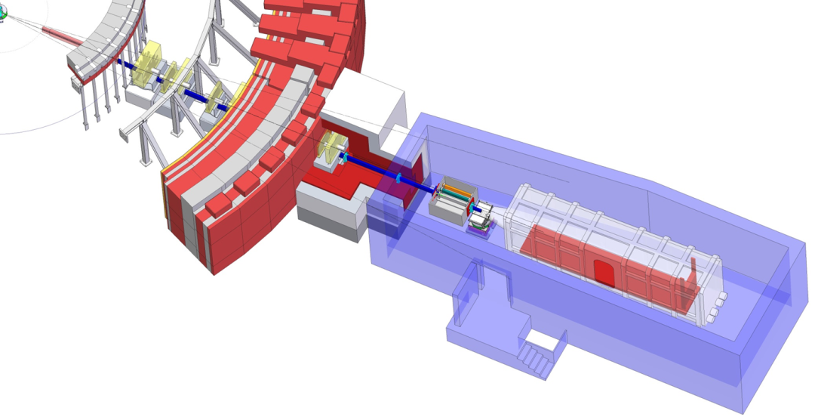
FREIA ISIS
CORE TEAM
Lead scientist Hana Wacklin
Lead engineer Jim Nightingale
Integration Engineer Clara Lopez
PROGRESS SINCE LAST ICB (technical and project)
FREIA Technical Workshop (May 2016)
FREIA STAP (June 2016)
Dedicated project team in place
Basic layout in progress
Team preparing for scope setting meeting
CURRENT ISSUES
Lack of clarity on the bunker
Chopper development
Fast Shutters
Scope-setting: 17/10/16
Tollgate 2: April 2017

