Slide 1
Presentation of
TARGET HELIUM COOLING SYSTEMS
May 2016
Jens Harborn
Work unit leader Target cooling
www.europeanspallationsource.se
May 2016

Slide 2
Outline
Introduction
Purpose and functions
Requirements
Technical solution overview
Technical solution, P&ID’s
Modes of operation
Layout
Classification
Documentation

Slide 3
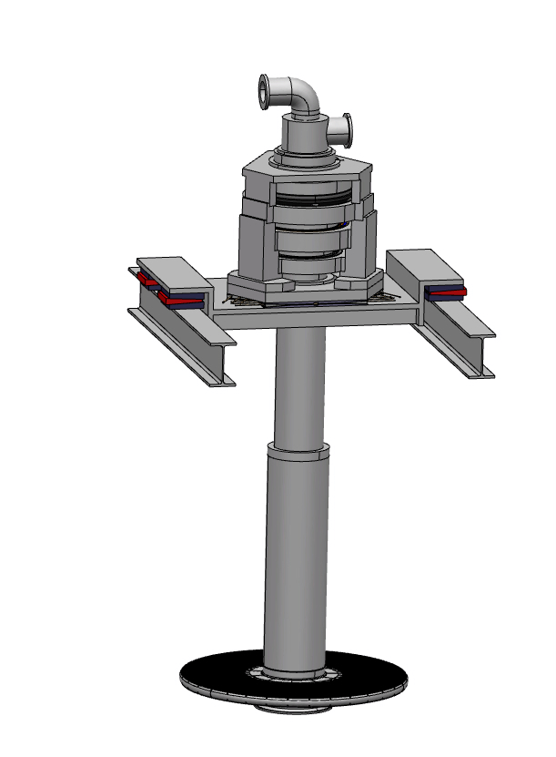
1. INTRODUCTION
Target helium cooling systems
ESS Target is a rotating wheel, 2.5m diameter with tungsten rods where the spallation process occurs
The target itself is a small part of the Target station
3MW heat from the spallation process is removed to keep a stable condition
Target wheel assembly
Tungsten slabs inside
6 m
Proton beam

Slide 4
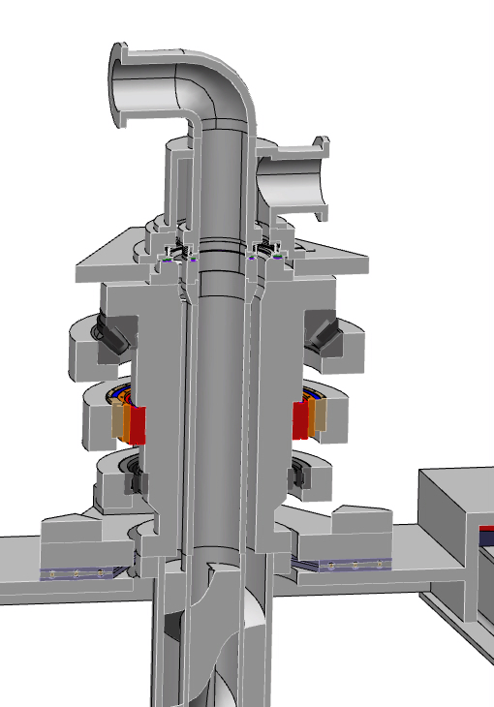
1. INTRODUCTION
Target helium cooling systems
The wheel is connected to the cooling circuit with helium at approximately 1MPa pressure and a flow of 3kg/s
Target cooling consists of 3 systems, the cooling circuit is the main system
The target cooling has 2 support systems; Target Helium Purification and Pristine Helium
The heat is transferred to Target intermediate cooling system
He
He
Rotary seal

Slide 5
2. PURPOSE AND FUNCTIONS
Target helium cooling systems
Main functions:
1. Continuous heat removal from the target including pressure control (systems 1010, 1011)
2. Keeping the potentially activated / contaminated fluid enclosed in the system(all)
Sub functions:
3. Collecting potentially radiated particles in a few locations, i.e. filters (system 1010)
4. Maintain particle content in the circuit at an acceptable level (system 1010 and support system 1015)
5. Inject and/or collect helium to the rotational sealing in system Target wheel, shaft, bearings & drive (system 1013)
6. Enable filling, emptying, storage and removal of O_{2,} H₂O, CO₂ etc (systems 1010, 1011 and support system 1030 Pristine Helium)

Slide 6
3. REQUIREMENTS
Target helium cooling system
    Selected examples of most important requirements
Continuous heat removal from the target
Operation pressure of the cooling circuit 10-11 bar
Continuous pressure control of the primary circuit
Operation maximum inlet temperature to the Shaft 60°C
Maximum total leakage rate of helium from the total system is 1 g/h
Monitor and report the content of O₂, C (Σ carbon compounds) and H₂O in the helium gas in the system
The system must be possible to condition to acceptable concentration of helium/nitrogen/air
Guarantee that no particulates larger than 0.5mm enters the target wheel
Notes:
Four optional cooling circuit pressures has been considered; 3.6 bar, 7.0 bar, 10 bar and 13 bar. 10 bar was found the optimal based on equipment size, available suppliers for circulator units, general performance and pressure classification considerations.

Slide 7
4. TECHNICAL SOLUTION
Architecture
Target helium cooling sub systems
1010: Primary cooling circuit
1011: Pressure control & Helium storage
1013: Helium injection
Support systems:
1015 Target He purification
1030 Pristine helium (helium supply)
1140 Offgas system

Slide 8
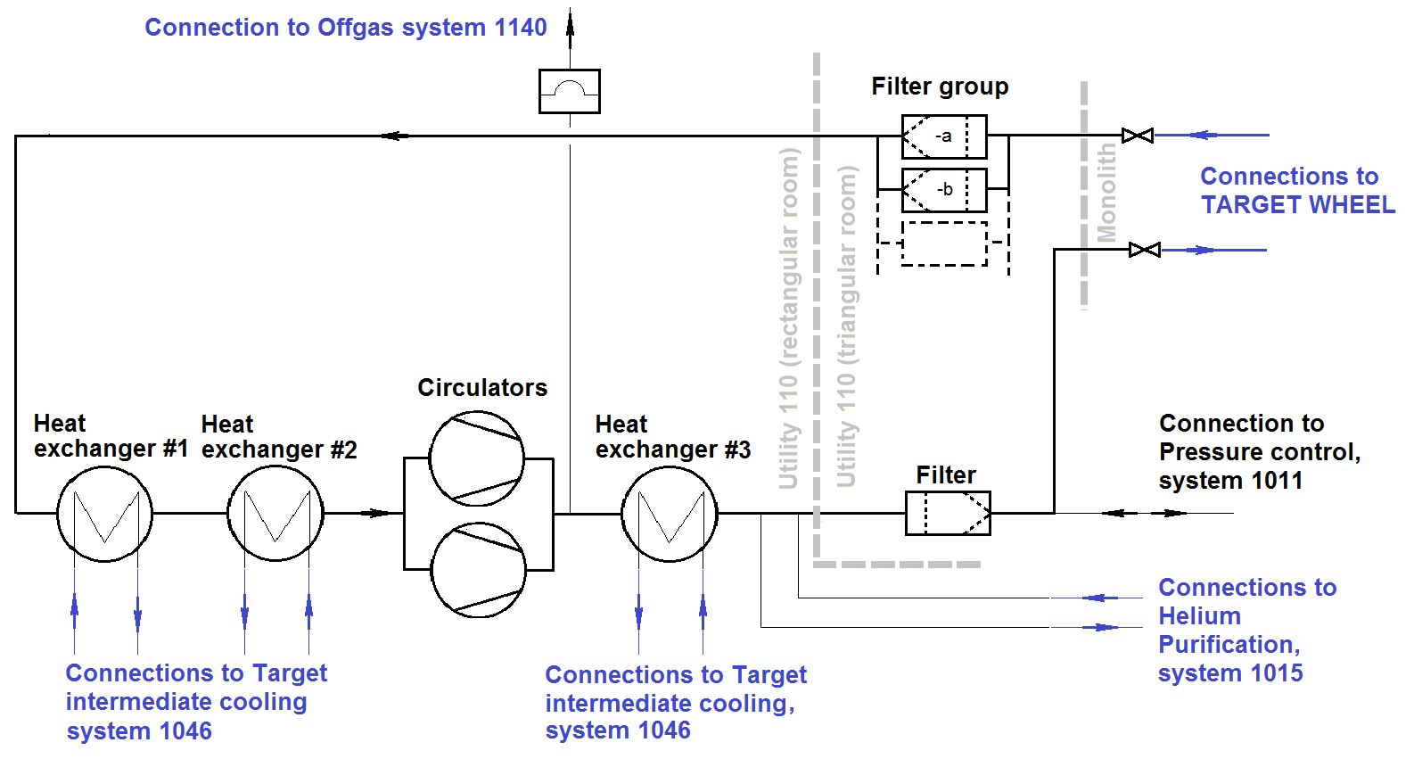
4. TECHNICAL SOLUTION
Overview Target cooling

Slide 9
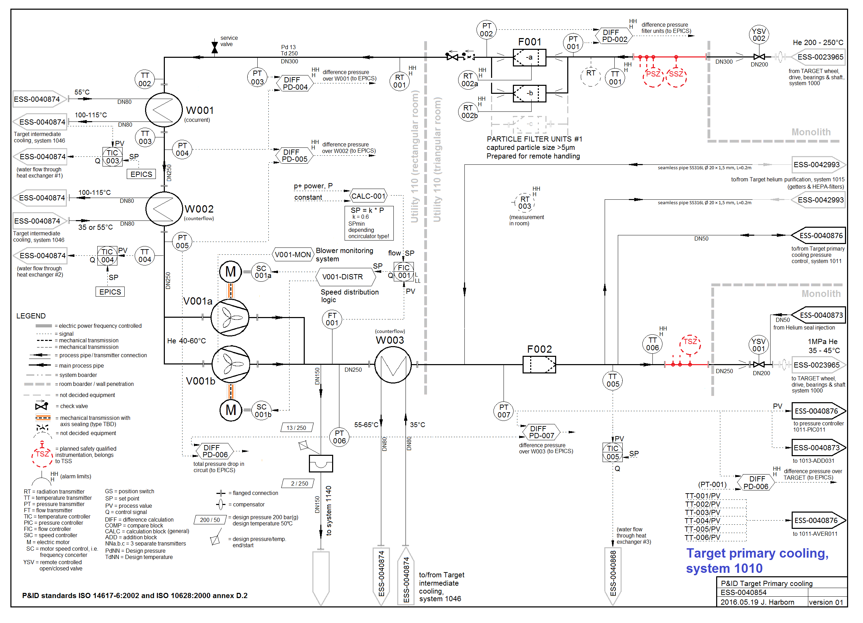
5. TECHNICAL SOLUTION
P&ID system 1010

Slide 10
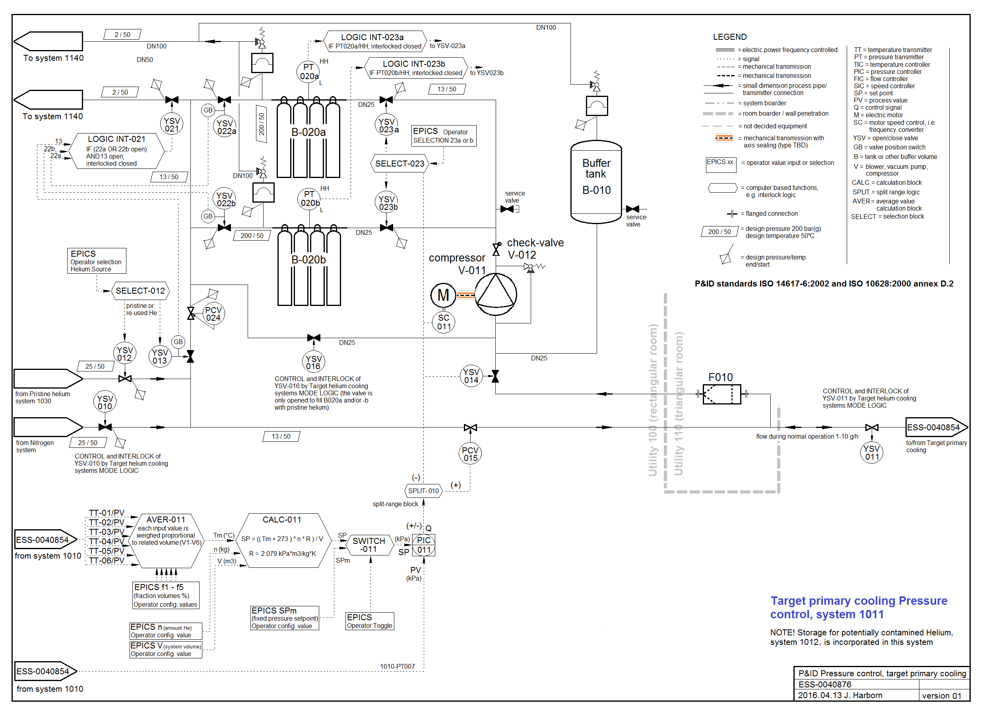
5. TECHNICAL SOLUTION
P&ID system 1011
This system keeps the amount or of helium at a stable level in the loop or to fill/drain

Slide 11
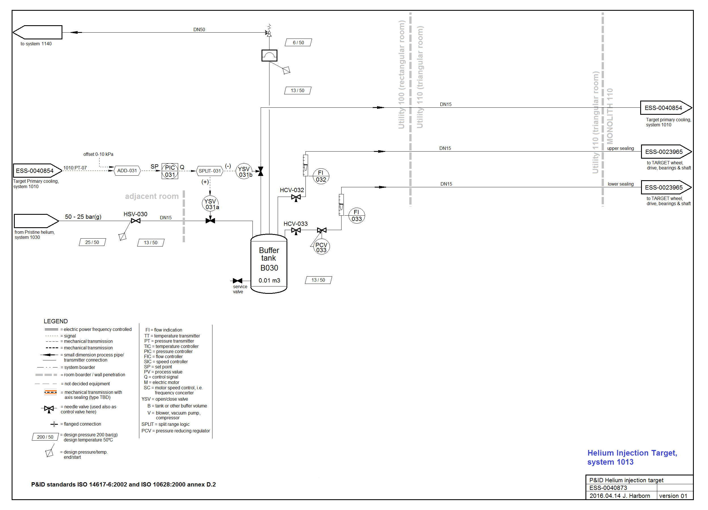
5. TECHNICAL SOLUTION
P&ID system 1013
This system provide seal flows to rotational sealings of the target

Slide 12
6. MODES OF OPERATION
Target helium cooling systems
The mode selection is directly dependent on the target station current mode and/or events that for example forces proton beam shut down.
The target helium cooling systems operate together as one system regarding mode of operation.

Slide 13
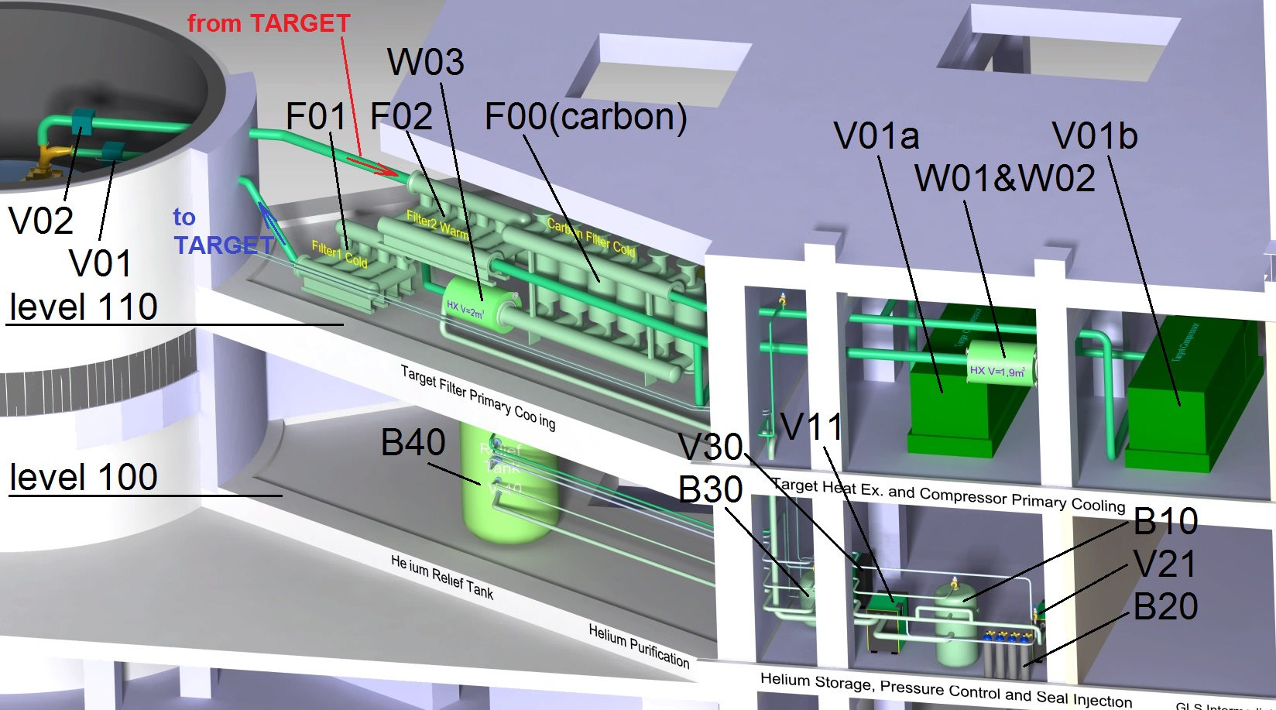
7. LAYOUT
Target helium cooling system
  Cooling loop layout

Slide 14
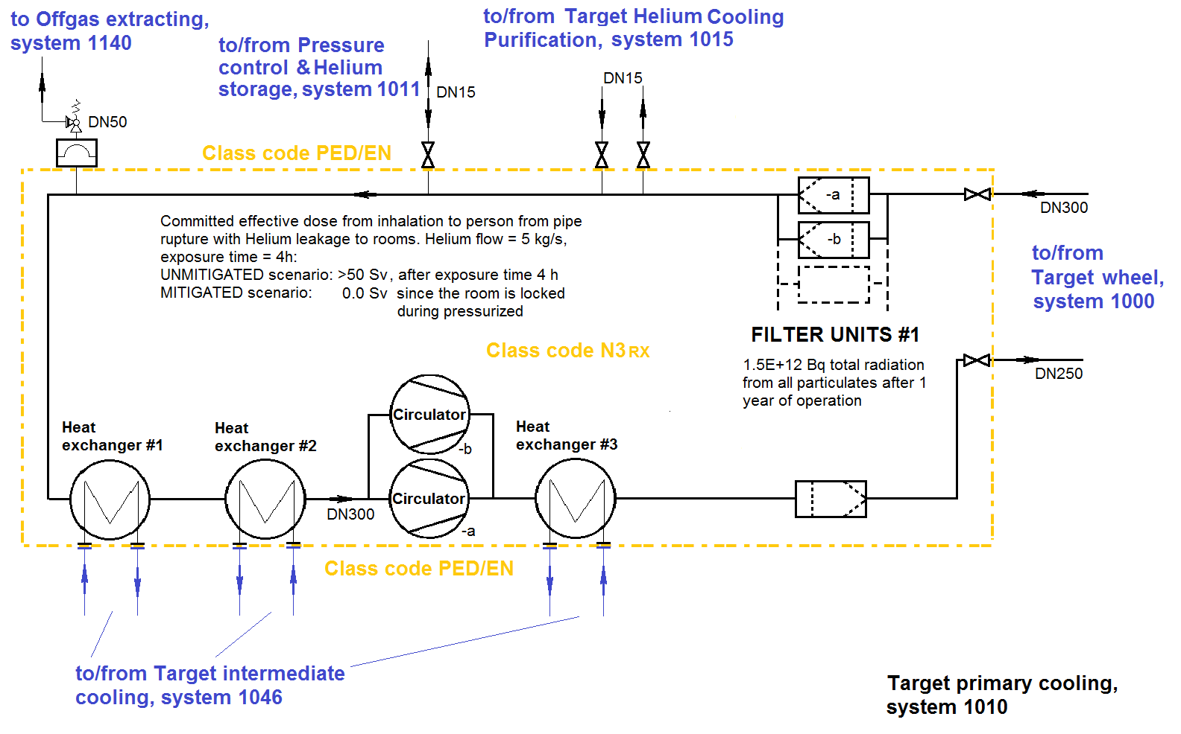
8. CLASSIFICATION
Overview system 1010
Notes:
Four optional cooling circuit pressures has been considered; 3.6 bar, 7.0 bar, 10 bar and 13 bar. 10 bar was found the optimal based on equipment size, available suppliers for circulator units, general performance and pressure classification considerations.

Slide 15
8. CLASSIFICATION
Target helium cooling system
Proposed classifications:
Primary cooling circuit, system 1010
Class RCCMRX N3(circulator, heat exchangers, filters and valves)
Pressure control & Helium storage, system 1011
PED/EN
Helium injection, system 1013
PED/EN
The loop cooling function, flow & pressure controller functions and the injection functions are not safety classified!

Slide 16
9. DOCUMENTATION
Target helium cooling systems
Document | State
ESS-0012524 SDD-req; Requirements and references | Ready for approval
ESS-0012527 SDD-sol; System description and functional spec. | Ready for approval
ESS-0040855 PFD Target cooling systems overview | Ready for approval
ESS-0040854 P&ID Target primary cooling, system 1010 | Ready for approval
ESS-0040876 P&ID Pressure control & storage, system 1011 | Ready for approval
ESS-0040855 P&ID Helium seal injection, system 1013 | Ready for approval
ESS-0051819 Manufacture Process specification for Circulator system 1010 | Ready for approval
ESS-0052140 Manufacture Verification plan for Circulator system 1010 | Ready for approval
ESS-0051820 Purchase/procurement specification for the circulator | Approved
ESS-0035383 Target helium cooling system - pressure loss calculation | Ready for approval
.ppt presentation Target Helium Cooling requirements and motivations | N/A
.ppt presentation Target Helium Cooling (this file) | N/A
ESS-0016380 ICD-R Target primary cooling, 1010 – TSS | Approved
ESS-0018673 ICD-R Target primary cooling, 1010 - Target Intermediate cooling, 1046 | Approved
ESS-0019346 ICD Target cooling systems - Target wheel & shaft, 1000 | Approved
ESS-0019347 ICD-R Target cooling systems - Process control system/MPS | Approved
ESS-0030664 ICD-R Target primary cooling, 1010 - Helium purification, 1015 | Approved
ESS-0020682 ICD-R Target cooling systems - CF (site infrastructure & building) | Review
ESS-0038061 ICD-R Target primary cooling pressure control & storage, 1011 - Fluid supply & process | Approved

