Slide 1
Target Cooling System Filters
Ulf Odén
WP Manager Target Systemn
www.europeanspallationsource.se
29 September 2016

Slide 2
Outline
Particle production
Helium Cooling System Design
Filter Efficiency
Possible Filter Solution
Filter Maintenance
Tritium

Slide 3
Particle production
From the TDR….:
(TDR Chapter 10 page 580)
“The tungsten target is prone to ablation and dust formation. An ablation rate of 10μm/y ….is a reasonable upper limit …. This amounts to 0.07% of the target mass becoming dust per year, or roughly 3 to 4 kg/y.”

Slide 4
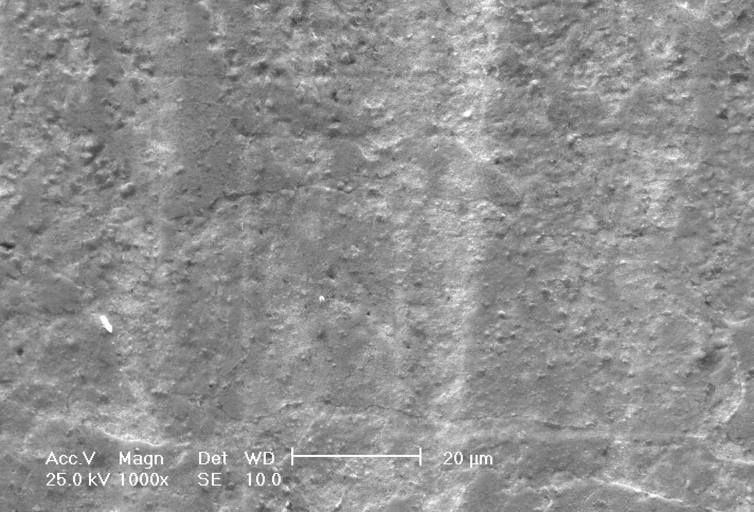
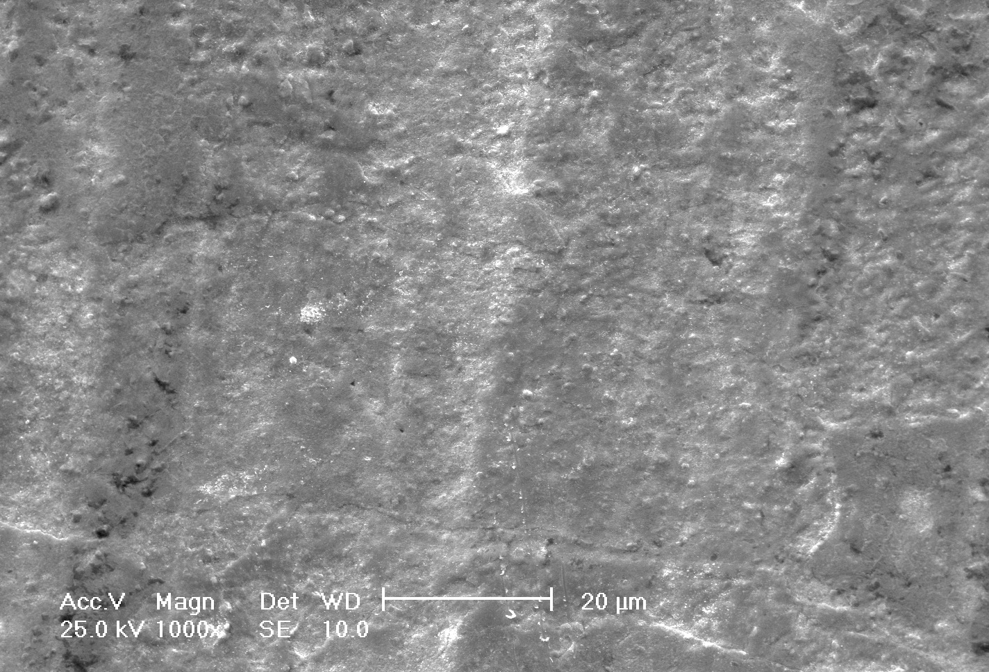
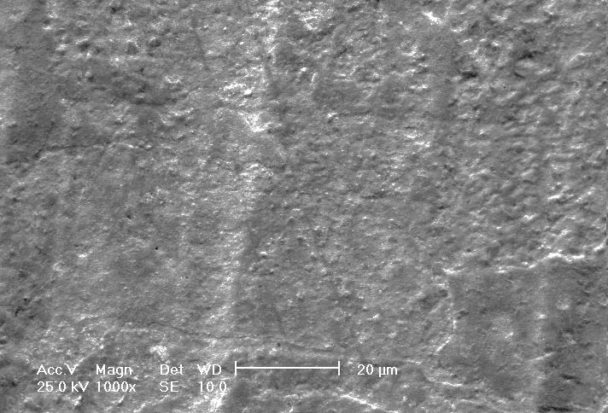
Particle production
Conclusions based on the ETHEL experiments (ESS-0051445, Per Nilsson):
The experiments do not show any significant erosion over time .
Test set up:
Two samples were pre-oxidised at 500° C in He + 0.5 % O² for 1 h
Helium jet of > 100 m/s at 9 bar and > 200° C was blown perpendicularly onto tungsten samples at above 300° C
After 5 h helium flow in ETHEL
After 10 h in ETHEL
After 25 h in ETHEL

Slide 5
Particle production
Conservative estimate of erosion,
(ESS-0051445, Per Nilsson):
All protruding features are all blown off
The volume of the features in the pictures are estimated. Extrapolated to the total tungsten surface gives ~ 40 g/5y.
The test samples are pre-oxidized in 500°C He with 0,5% oxygen during 1h. Compared to the steady state condition in the system, 0,00001% oxygen, the oxide formation on the test samples could correspond to 5 year of normal operation.

Slide 6
Particle production
Maximum oxide formation (ESS-0051742, Yong Joong Lee)
Calculated maximum tungsten oxide production with an oxygen impurity level of 5 ppm => 10g/y Assuming that all oxygen in the He system is used for oxidation of the tungsten surface

Slide 7
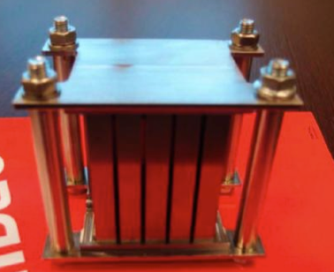
Particle production
ESS Bilbao vibration tests (ESS-0055645)
Vibration test data: 500 Hz - 1 hour – 1G – 0,1 mm amplitude
Collected debris from the 11 bricks test rig => 0.0364 mg
Total number of bricks 7000 => 0.023g of dust
No tungsten particles in the dust

Slide 8
Particle production
Conclusions
Assumed particle production of 10g/y is calculated from both theoretical figures and experimental results.
The assumed 10 g/y is still conservative
The assumed 10 g/y will be used in the filter design and hazard analysis

Slide 9
Helium Cooling System Design

Slide 10
Filter Efficiency
1 ppm 300 nm
>99% of total 10g
2 g/s
Full flow

Slide 11
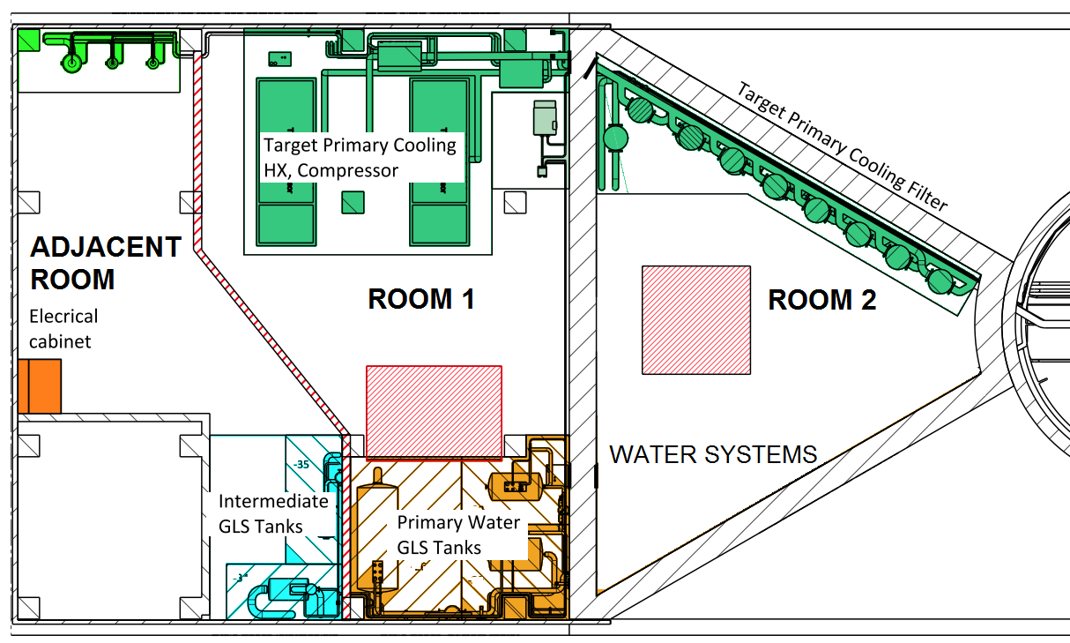
Helium Cooling System Design

Slide 12
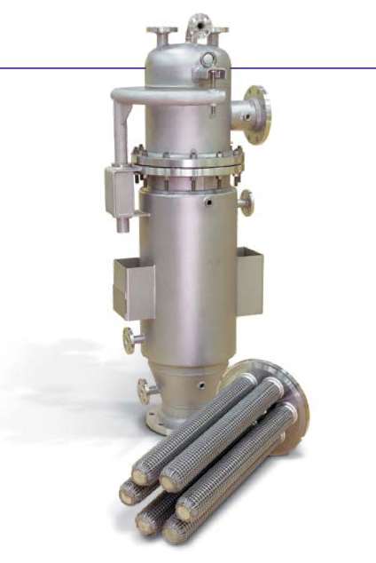
Possible Filter Solution
Pulsed Jet Self Cleaning Air and Gas Filters
Pulsed Jet Filter Cleaning;
Cleaning pulse can be 0.25 second or less
Cleans In-situ
Doesn’t Interrupt Process flow
Returns Dust To the User
Minimising Pressure Loss
Operates at a stable DP Plateau
Proven
Reliable
Lead
.
.
.
.
.
.
.
.
.
.
.
.
.
.
.
.
.
.
.
.
.
.
.
.
.
.
.
.
.
.
.
.
.
Lead

Slide 13
Filter Maintenance
Collection Pan, dose after 1 year in operation
Dose
Remote Handling
Maintenance Periods
collection pan
Pb shielding
μSv/h
15 cm
Assumption:
access to the triangular rooms 12h after beam shutdown
=> activity of the main isotopes no more than 5*10⁻⁶ of their activity in the tungsten target
=> gamma script source term for the collection pan = 5*10⁻⁶ times gamma script source term for the tungsten target

Slide 14
TRITIUM (PRELIMINARY CALCULATIONS!!!)
Normal industry designed heat exchangers*
He purification => 0.074 PPM Tritium in the He system
Tritium in the He system during operation dose to public 0.24 μSv/y dose to workers 0 (2.7) mSv/h room closed
Tritium in the intermediate water system and pipe rupture dose to public 0,002 μSv dose to workers 1,17 mSv/2 min
Total Tritium inventory in the intermediate 570 10⁹ Bq water cooling loop after 1 year of operation We are working with the waste handling group to develop a strategy for disposal
*Oxide layer (Alumina) in the heat exchanger will decrease the tritium flux by 0.01 to 0.001

