Slide 1
Update of the Cryogenic Moderator System (CMS)
TAC 14
October 06, 2016
WPM Marc Kickulies
WUL Jesper Ringnér

Slide 2
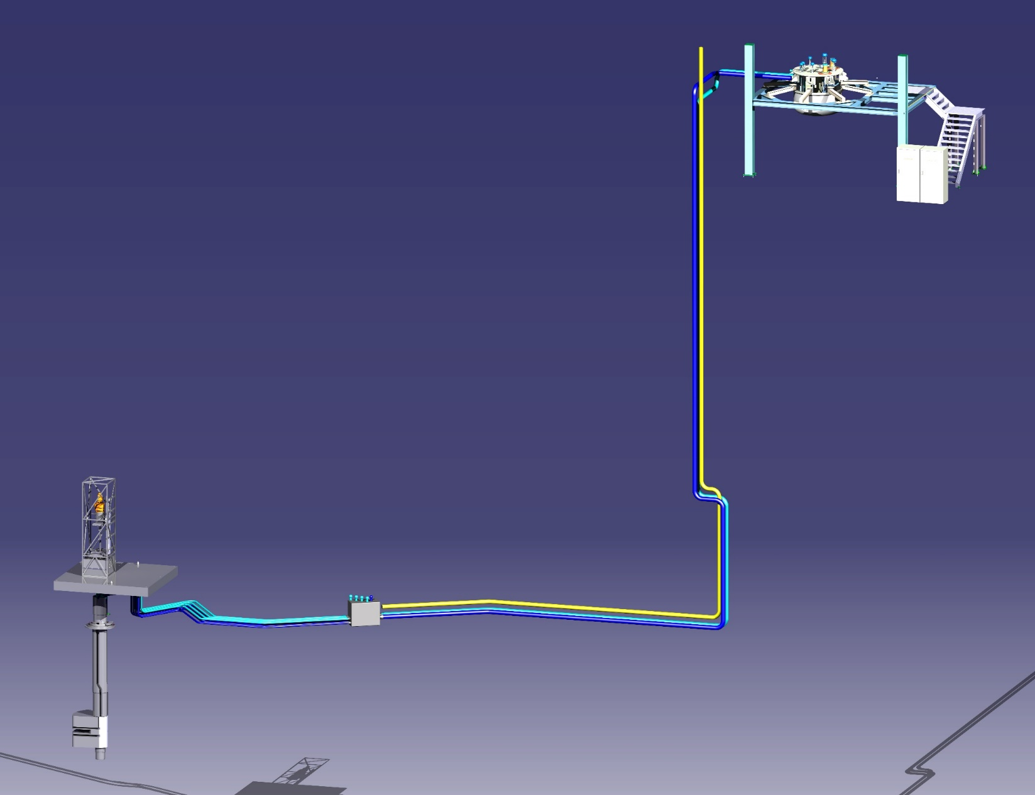
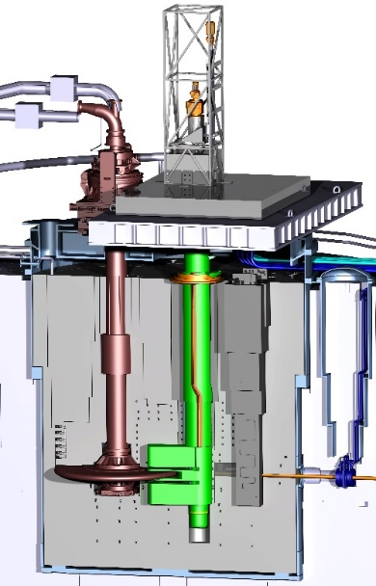
Moderator and Reflector Systems
Update of CMS
Cryostat, Hydrogen room
Transfer lines
Manifold
Moderator plug

Slide 3
Outline
General
  Requirement
  P&ID
  Reduced pressure
  LH₂ Pump
  Transfer lines
O-P measurement
  RAMAN & probes
  Sapphire glass
  Solution
  Validation
O-P catalyst
  Requirement
  Technical solution
  Catalyst

Slide 4
General - CMS Requirement
Main task for the Cryogenic Moderator System.
The Target Station shall use para-H2 material as cold moderator coolant such that the neutronic performance will sustain the required brightness while the technical risk will be residual thanks to the available experience using this material.
Expected Heat load neutronic: 19.0kW incl. contingency margin
Expected Heat load static: 9.8kW
Hydrogen content in system: 24.5kg liquid hydrogen
Working Temperature: 17-20.5K
Working pressure: 11bar
Design pressure: 17bar
Pressure drop: 1.8bar
Expected mass flow: 1000 g/s
Ortho-Para catalyst: placed in a by-pass line
OP ratio: >99.5%
In line measurement: Raman spectroscopy down-, and up-, stream of moderator
Pressure control: Active buffer, expansion vessel.
Time to cool down first time after maintenance, warm TMCP, warm CMS: 24h
Time to cool down, cold TMCP, warm or cold CMS: 6h

Slide 5
Schematic configuration of the CMS
Op detection point

Slide 6
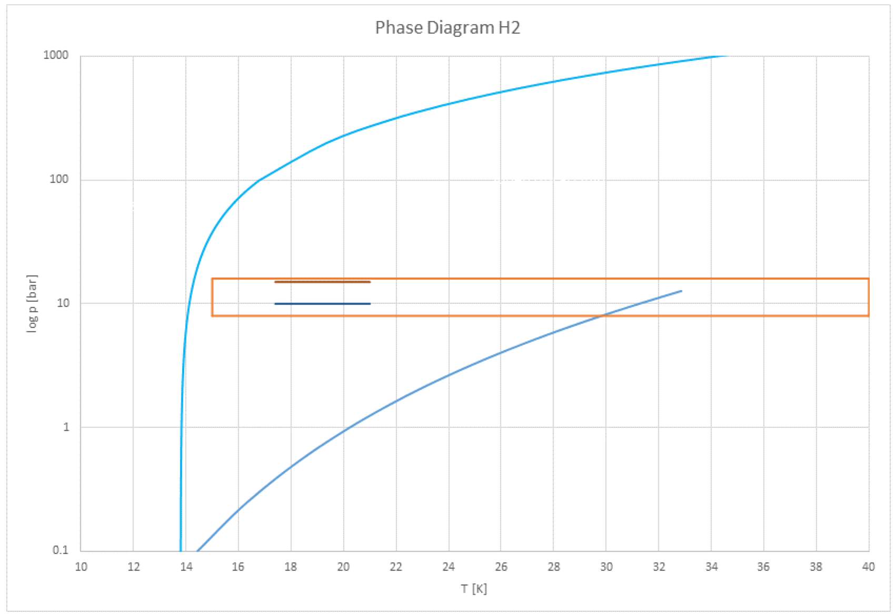
General - Study of changed operating pressure in the Cryogenic Moderator System
Requirements for the PDR design
P_{min}: 13bar
P_{max}: 17bar
P_{op}: 15bar
Aim is to be above supercritical pressure at all time
The margin between design and operating pressure in the CMS is narrow and will potentially be very hard to maintain
Lower operational pressure has been analysed.
The moderator design do not allow a higher operational pressure, the only way to increase the range, is to lower P_{op}.
New requirements
P_{min}: 7*bar
P_{max}: 17bar
P_{op}: 11 bar
*When the beam trips, the pressure drops for a couple of seconds until the expansion vessel responds and regain pressure.

Slide 7
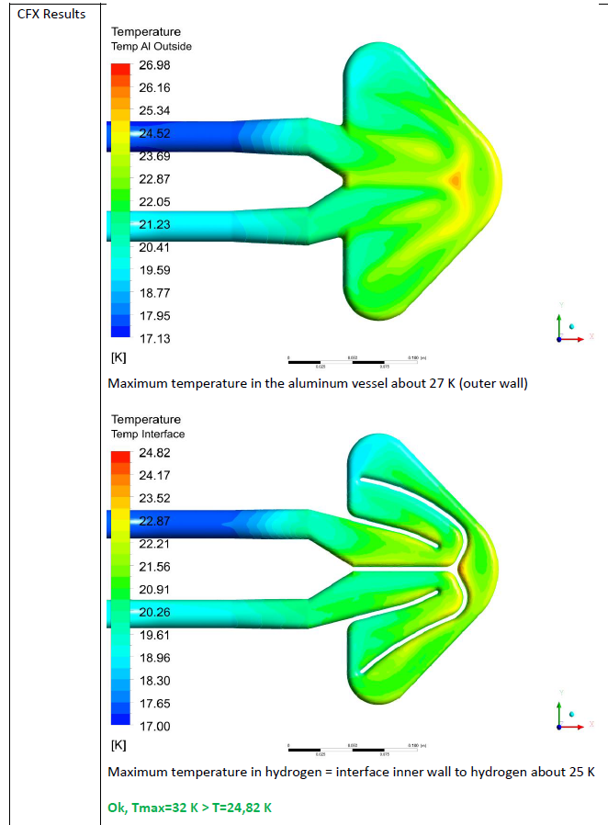
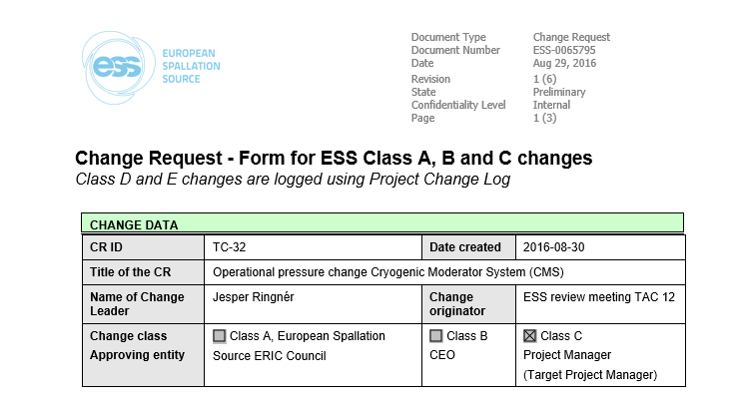
General - Study of changed operating pressure in the Cryogenic Moderator System
The hydrogen will always be in a liquid phase. @10 bar the boiling temperature is 31.87K
Calculations made to verify that the temperature stays within boundary, below 25K (30 K at peak pulse) at all time.
Simulation of the expansion buffer shows better performance below supercritical pressure
Pressure drop and heat capacity will not be significantly affected
During cool down the pressure will be kept at >13bar to avoid phase changes
Change request no.TC32 is ongoing
Ref: Interim report ESS cold moderators design, Y.Bessler 2015-12

Slide 8
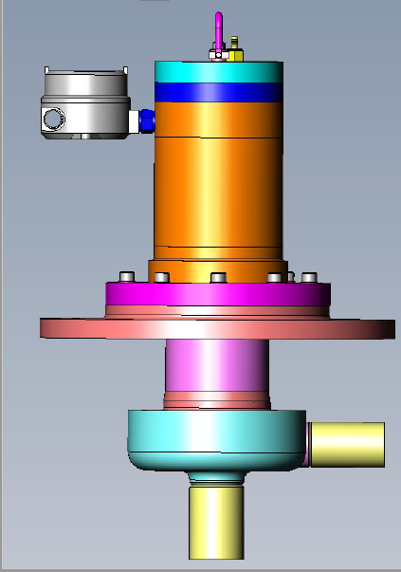
General - LH₂ Pumps
Main specifications:
Two pumps in serial
  Normal (two pumps): 100% flow, 50% pressure drop each
  Fault mode (one pump): 100% flow, 100% pressure drop
Mass flow 1000g/s
Pressure drop 1.8bar
Possible to shift to one pump during operation
Pump CDR performed in May -16. Committee recommendation followed and specification updated accordingly.
Pump ordered according to revised specification from FZJ
Performance test with Methanol as part of FAT
Delivery expected Aug 2017 to Jülich for assembly and system tests with LN2

Slide 9
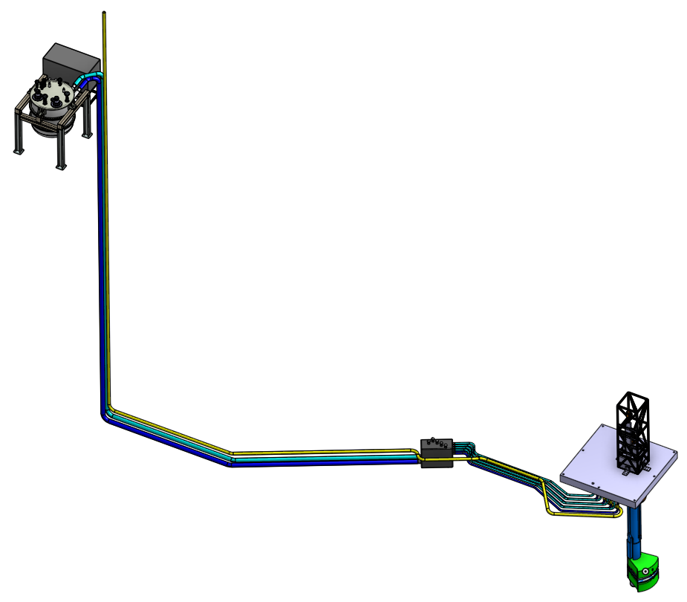
General - Transfer lines
Transfer line CDR performed in May -16. Committee recomendation followed and specification updated accordingly.
Currently under review.
Open call for tender planed 2016
Cryostat in hydrogen room
Main transfer lines ~40m
H₂ Pipes DN40
Connections to moderator plug
Jumper transfer
lines and moderator ~9m
H₂ Pipes DN20
Transfer lines with manifold/valve box ~7m
H₂ Pipes DN20

Slide 10
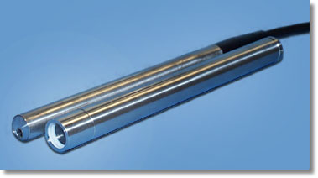
Ortho-Para measurement -Solution
To be able to guarantee the neutronic performance an Ortho – Para an in-line measurement system is required
In line measurement equipment
Raman spectroscopy e.g.:
Turnkey laser system by Ocean Optics (Laser-532-series):
power >100 mW
FWHM <0.05nm
wavelength stability +/- 0.1 nm (-20°C-50°C)
Raman probe e.g.:
A pressure-tight stainless steel extension tube with a compression-welded sapphire window at the tip

Slide 11
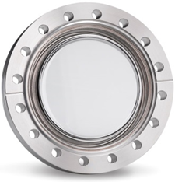
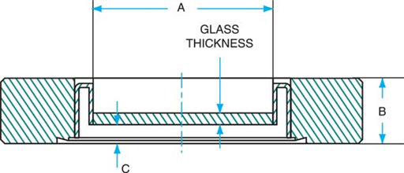
Ortho-Para measurement -Solution
The sensors need clear view into the hydrogen flow.
To solve this, 5x sapphire viewports will be installed into the hydrogen lines.
1x viewport in the main flow hydrogen line, downstream of the pumps
1x viewport in each upstream pipe, after the moderators (4x total)
This setup gives full control of O-P content into the moderators and also the the O-P production in each moderator, if desired.

Slide 12
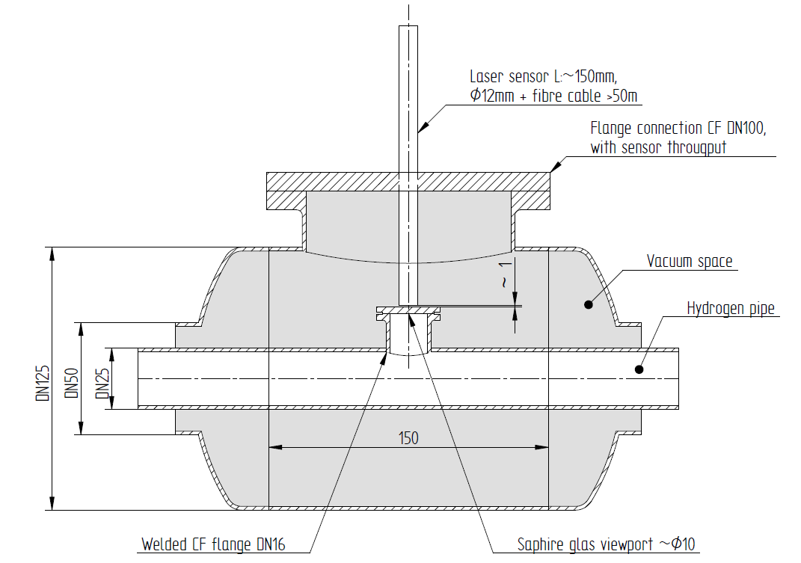
Ortho-Para measurement -Solution
Installation of sensor and sapphire viewport.
COLD: Viewport is installed in to the hydrogen line.
WARM: Sensor is installed in the vacuum space
through a special made adapter.

Slide 13
Validation of equipment
Viewport:
Design Requirements: 17-20 K, 17 bar
Viewports off the shelf are in general only validated for ~70K and 4bar.
To validate the sapphire viewport to comply with the PED directive, tests need to be done. Detailed test method is not defined yet.
Probe:
Design Requirements: In case of the viewport fails the sensor needs to withstand a cold shock of 20 K and a sudden overpressure of 2 bar.
To validate the sensor to comply with PED directive, test need to be done. Detailed test method is not defined yet.

Slide 14
Ortho-Para Catalyst Requirements
The O-P content in the Cryogenic Moderator system is required to have a minimum Para content of 99.5% during operation
Ortho back conversion due to beam is expected to be *1 – 3 mol/min (regarded as a conservative assumption). Requirement for the system is to be able to handle a back conversion of 3 mol/min during operation.
Conversion to equilibrium during cool down shall be able to be performed within 6h.
Expected lifetime of catalyst shall be >5 years between change/reactivation
*Iverson, E.B., Carpenter, J.M., 2003, Kinetics of irradiated liquid hydrogen, ICANS-XVI, 707-718

Slide 15
Catalyst
Back conversion is the design driver
With a back conversion of 3 mol/min
By-pass flow 50 g/s to 100 g/s
OXISORB (10kg) : 14.3 l
safety factor of 2 TOTAL= 28.6 l (20kg)
IONEX (20 kg) : 15,4 l
safety factor of 2 TOTAL= 30,8 l (40 kg)
Conclusion: A catalyst volume of < 30 l will be a conservative assumption to achieve back conversion and cool down (in 6 hours).

Slide 16
Handling of catalyst
Requirement for the system is a high level of cleanliness
Precausions that prevent catalyst to pollute the system is taken with filters/strainers
Possibility to handle the catalyst in an inert environment during filling etc.
Purging procedure needs to be thoroughly set up and followed
System needs to maintain an inert atmosphere at all time when no hydrogen is present
Catalyst shall maintain performance over a 5 year period without re-activation

Slide 17
Ortho-Para catalyst - Solution
During cool down of the system (24 h warm, 6 h cold), all warm hydrogen pass through heat exchanger 2, into the catalyst vessel and then led into the main loop.
During operation a by pass flow is led from the main flow over the catalyst to ensure equilibrium Para content at all time.

Slide 18
Summary
CMS is on track
Qualification of viewport for 17-20 K and 17 bar and RAMAN probe for cold chock and 2 bar
Ortho back conversion requirement of
*3 mol/min
Catalyst volume of < 30 l
*Iverson, E.B., Carpenter, J.M., 2003, Kinetics of irradiated liquid hydrogen, ICANS-XVI, 707-718

Slide 19
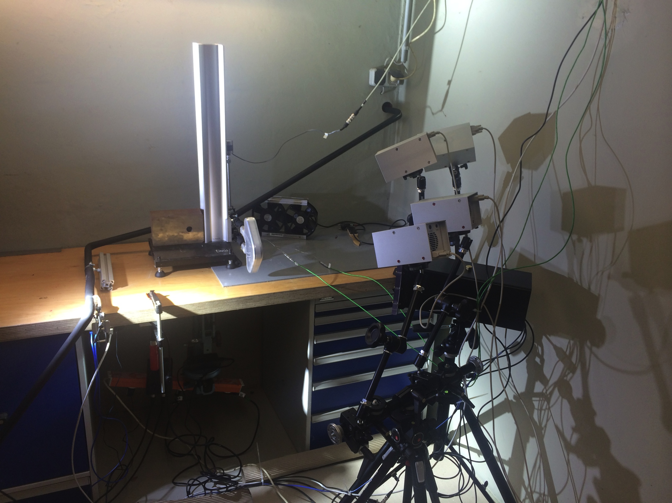
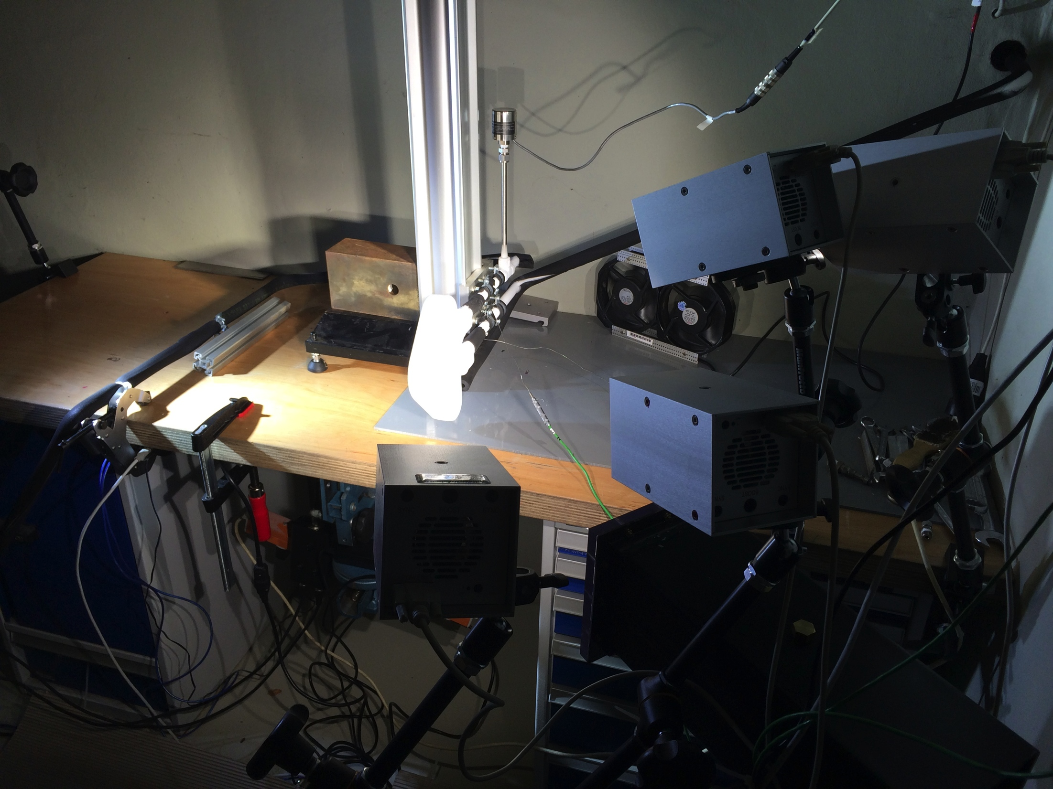
Highlight
Cold Moderator LN2 Burst Test (a try )
Test done in Jülich
Test with LN2
Reached pressure 115 bar (before leakage due to no cryogenic valves)
Ambient burst test with water; 200 bar reached at burst
Still design pressure 17 bar, design according to RCC MRx code

