Slide 1
Update on Monolith Vacuum Operation Mode
Rikard Linander
WP Manager, Monolith Systems
www.europeanspallationsource.se
29 September 2016

Slide 2
Monolith Operational Modes as presented to TAC #13
Vacuum Op Mode
Helium Op Mode
Proton Beam Window need not to be installed.
Monolith vessel is under high vacuum 10⁻⁴ – 10⁻⁵ mbar.
Monolith vessel is directly connected to the accelerator beam tube that operates under ultra high vacuum conditions.
Monolith vacuum system will evacuate water and air leakages
Proton Beam Window installed.
Monolith atmosphere is high purity helium, nominally 1 bar.
Monolith vessel and accelerator beam tube are physically separated by the proton beam window.
Monolith atmosphere system includes equipment for water removal and helium purification.

Slide 3
The opportunity with vacuum operation mode
Allows elimination of the proton beam window, which means
Increased facility availability
Decreased operational costs
Decrease of rad waste stream
Reduced dose to workers (ALARA)
Passive shutdown of accelerator in case of target wheel failure
Loss of helium (LOCA) or helium flow (LOFA)
Loss of wheel rotation
Improved proton beam quality on target (sharper footprint)
Reduced activation of in-monolith components near the beam path
Potentially reduced background for NSS

Slide 4
Monolith Atmosphere System preliminary design
Main requirement from interfacing stakeholders
ACCSYS
Monolith vacuum level < 0.01 Pa (10⁻⁴ mbar)
Allowing a conventional and straightforward vacuum system to provide the necessary differential pumping between the monolith and the UHV accelerator tube
NSS
Total impurities: < 100 ppmV (translated to ~10⁻¹ mbar in vac mode)
Water: < 3 ppmV (~10⁻³ mbar)
Nitrogen: < 70 ppmV (~10⁻¹ mbar)
Chosen technical solution with two sub-systems
Monolith Vacuum Pump System
Maintaining vacuum level < 10⁻⁴ mbar
Also respecting the impurity levels given by NSS
Monolith Atmosphere System
For use (as backup) when PBW installed
Maintaining sufficiently pure helium gas at slight under-pressure, in accordance with stipulated requirements
Preliminary Design Review conducted 20 June

Slide 5
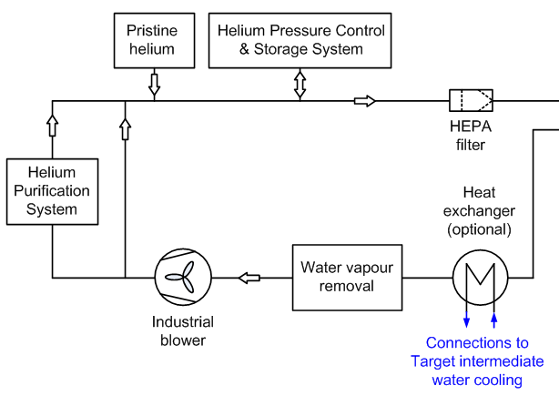
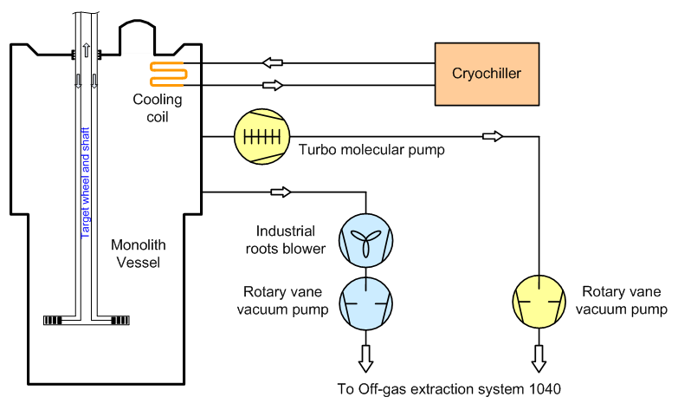
Simplified system scheme
Monolith Atmosphere System, 1020
Monolith Vacuum Pump System, 1024

Slide 6
Drawbacks, weaknesses and risks with high vacuum operation option
Requires design and manufacture to high vacuum standards and practices
Cleanliness
Allowable materials
Surface treatments
Manufacturing (e.g., machining, weld procedures and inspection)
Handling and transport
Sensitivity to fluid leaks and contamination that may occur during facility lifetime as a result of e.g.
Thermal fatigue
Corrosion
Mechanical deformation
Handling mishaps, like drop of equipment or spill of liquids

Slide 7
Post PDR changes of requirements and design considerations
PDR findings resulted in changed requirements from NSS
It was understood that conductive/convective heat transfer may be essential for specific in-monolith neutron beam optics equipment
Two possible solutions have been discussed
Establishment of separate atmosphere for specific neutron beam port insert → introduction of additional beam guide windows
Increasing the monolith vacuum pressure to 1.0 mbar → may lead to a need to relax the impurity level requirements

Slide 8
Modification of the Monolith Atmosphere Systems
Monolith Atmosphere System, 1020
Monolith Vacuum Pump System, 1024
Potential removal of cryochiller and TMP,
Extending 1020 to be able to circulate a small helium flow for removal of impurities.
but keeping provisions for later installation of that equipment.
Adding capability of simultaneous and integrated operation of these two sub-systems, to provide an atmosphere of 1 mbar helium

Slide 9
Introduction of a higher capacity differential pumping system in A2T region
On-going investigations for a design of a higher capacity differential vacuum pumping system
1 mbar in monolith
<10⁻³ mbar upstream the neutron shield wall contraction

Slide 10
Concluding remarks
The incentive to be able to operate without a PBW is very strong → monolith vacuum operation mode is still the preferred baseline
Stakeholder requirements from NSS and ACCSYS are challenging and somewhat conflicting → current proposal is to go for a rough vacuum level, with a 1 mbar helium pressure
Risks of not satisfying the preferred operation mode specifications will be mitigated through
General ambition to, as far as reasonable, adhere to high vacuum standards and practices in the design and fabrication of monolith vessel and in-monolith components
A robust monolith atmosphere system design that allows altering between
Vacuum operation without PBW
High vacuum operation without PBW
Vacuum operation with PBW
Atmospheric pressure helium operation with PBW
All operation mode options should reasonably accommodate anticipated leak rates of air and water as well as spills and contamination that may happen during the facility lifetime

Slide 11
Thank you.
www.europeanspallationsource.se
6 October 2016

