Slide 1
Target System Instrumentation
Ulf Odén
WP Manager Target System
www.europeanspallationsource.se
29 September 2016

Slide 2
Target System Instrumentation
OUTLINE
Target Instrumentation Parameters
Target Instrumentation Concept Design
Proposed solution

Slide 3
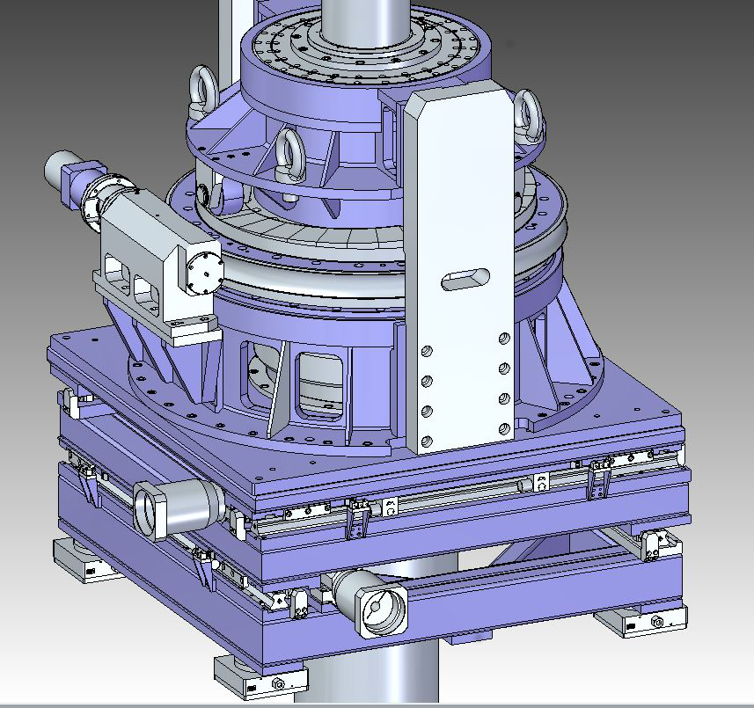
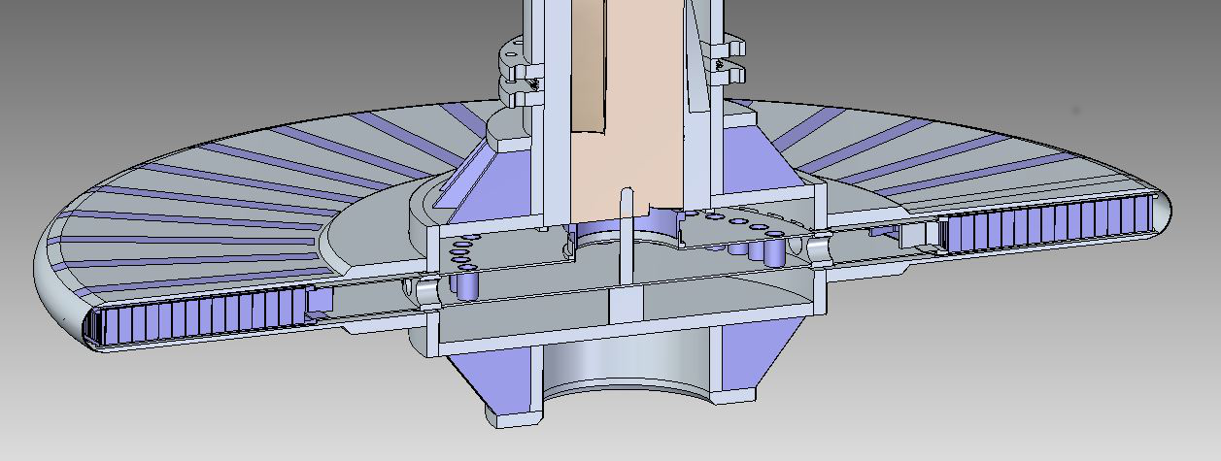
Target Wheel Drive & Shaft

Slide 4
Target Instrumentation Parameters

Slide 5
Target Instrumentation Concept Design
Target Wheel
Spallation Material Geometry
Wheel Position
Wheel Balance
Spallation Material Temperature

Slide 6
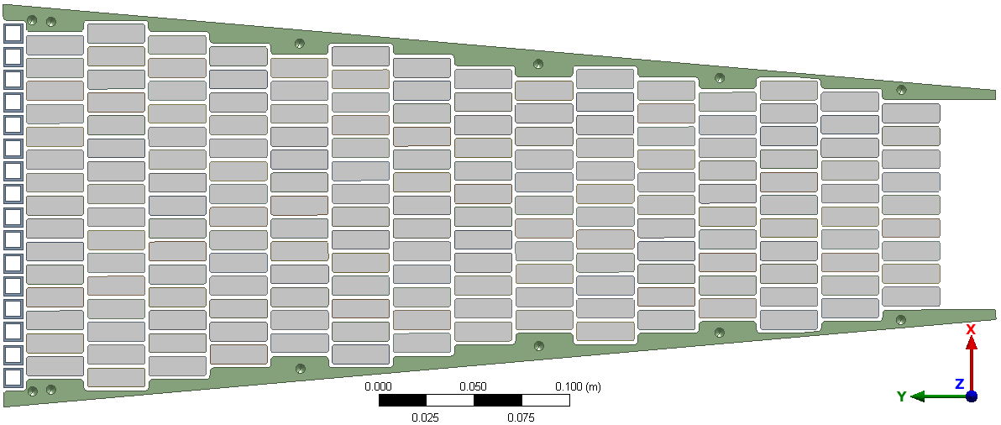
Target Instrumentation Concept Design
Spallation Material Geometry
see Nicolo Borgi presentation
Target Monitoring Plug
Gamma
1x1mm 2m long groves
Scintillator
Fiber
CCD Camera

Slide 7
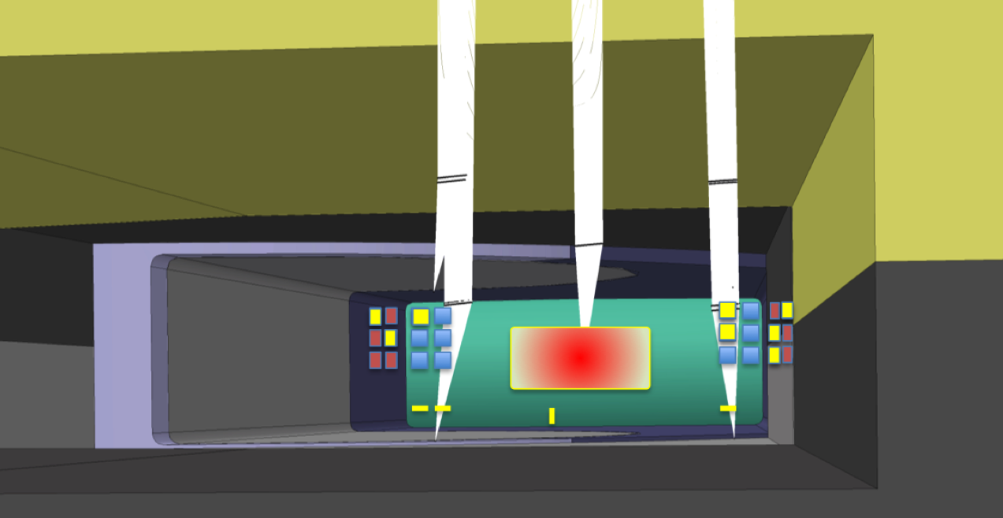
Target Instrumentation Concept Design
Wheel Position
z
Target Monitoring Plug
- Optical
x
y
Target Wheel Pedestal
- ??
Target Wheel
Pedestal
Moderator Plug
- ??
green – target wheel
red - P⁺ Beam
squares - fiducials
Proton Beam Instrumentation Plug
- Optical vision of BEW

Slide 8
Target Instrumentation Concept Design
Wheel Balance (vibration)
Target Driver Unit
- Bearing Measurement
Target Monitoring Plug
- Optical
Proton Beam Instrumentation Plug
- ??
green – target wheel
red - P⁺ Beam
squares - fiducials

Slide 9
Target Instrumentation Concept Design
Temperature
Target Monitoring Plug
IR camera
Thermocouples??

Slide 10
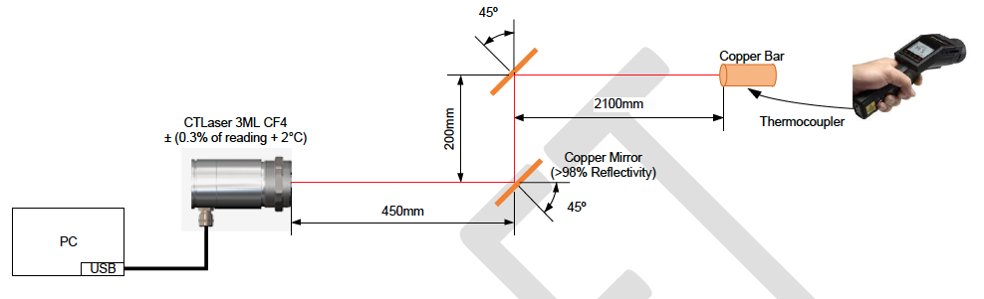
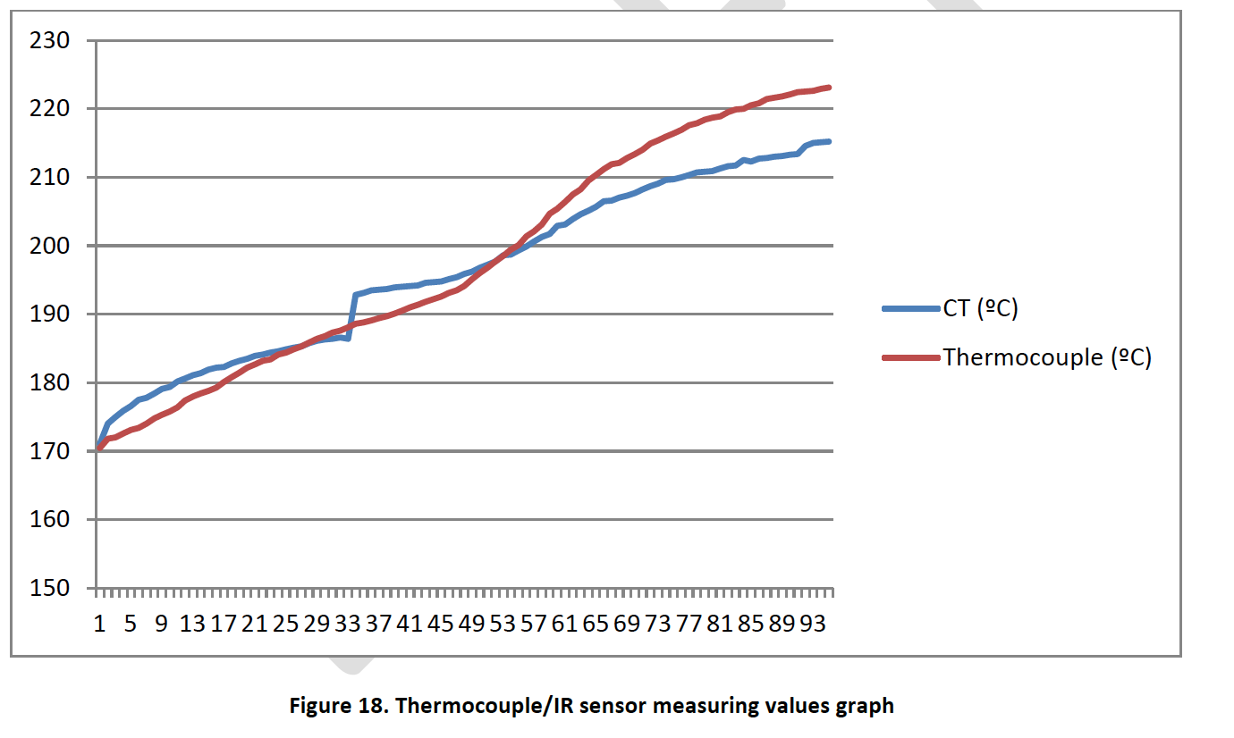
Target Instrumentation Concept Design
Temperature
IR camera

Slide 11
Target Instrumentation Concept Design
Temperature
IR camera

Slide 12
Target Instrumentation Concept Design
Conclusion
Proposed solution
Continue explore the gamma imaging system
Distance measurement (x y z) by laser placed in the Target Monitoring Plug supplemented by Proton Beam Instrumentation Plug (z)
Vibration measurement in the Drive Unit bearings supplemented by laser measurement, placed in the Target Monitoring Plug
IR temperature measurement of each sector, placed in the Target Monitoring Plug

