Slide 1
Component/Signal naming, and Controls Configuration
aTAC 14
Iñigo Alonso
Linac Integration Section Engineer
www.europeanspallationsource.se
6 October 2016
Notes:
The Integration Section is part of the Linac Group. It is composed of only four members and has a mostly advisory role. Iñigo Alonso has been appointed at the Accelerator Division to coordinate in collaboration with the ICS Integrators on defining the workflows for data entry.
Some of the topics (naming, data handling, tools…) discussed in this talk have been previously mentioned in the presentations by T. Korhonen, S. Regnell, and D. Piso on the ICS track of the TAC.

Slide 2
Table of Contents
ESS Naming Convention
Naming of Accelerator Components
  General naming rules for the Accelerator
  Cryogenic Systems
  Cooling Systems
  Cables
Controls Configuration Management
  Naming Service (NS)
  Controls Configuration Database (CCDB)
  Cable Database (CDB)
  IOC Factory (FACT)
  Workflow
Notes:
1. Brief description of the ESS Naming Convention
2. Overview of the strategy for naming accelerator components, with some examples
3. Tools and workflows we will use to manage the controls configuration

Slide 3
Scope of the distributed controls system
Expected number of controls items to be configured and monitored
~600
~10⁴
~6*10⁵
~10⁶
IOCs
Devices
Records
Process Variables
(PVs)
Notes:
The ICS distributed system will include almost a thousand IOCs, interacting with around an order of magnitude more devices, resulting in hundreds of thousands of EPICS database records and over a million PVs.
Each “real” signal or “channel” results in approximately 4-5 EPICS database records.
Records:
FRIB ~200.000
SNS ~500.000

Slide 4
1. ESS Naming Convention
Notes:
Established six years ago, first version 2010/10/26 (authored by G. Trahern)

Slide 5
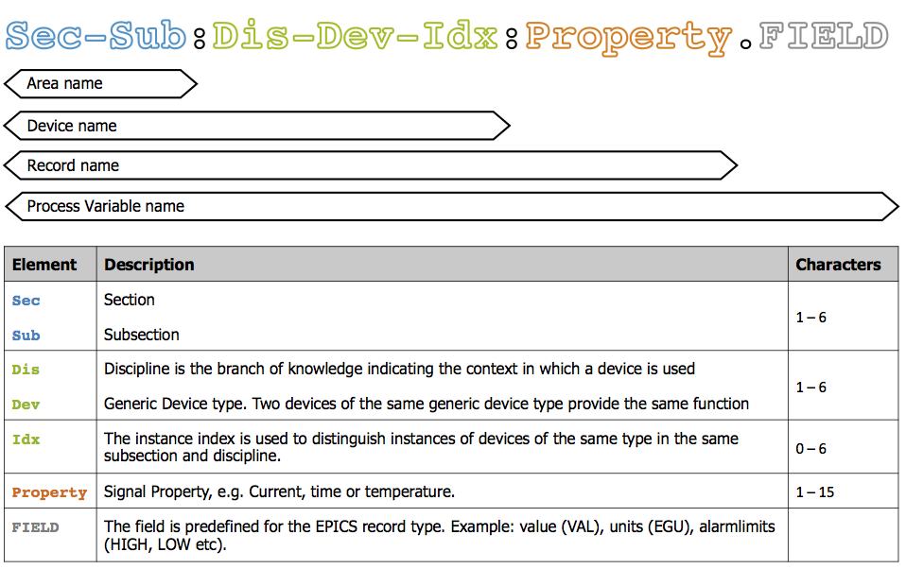
ESS Naming Convention
ESS-0000757
Notes:
Thanks to Karin Rathsman, who developed the convention and currently maintains the Naming Service tool. ICS Integrators (in Daniel Piso’s group) are in charge of naming.
3 structures: Area (approx location), Device, and Signal
Some levels in those structures are not reflected on the name, more on that later. For example, we also have SuperSections.
Devices are not structured hierarchically through the naming convention, it is a flat name space. We know that relying on a name convention to specify a hierarchy is error prone, there are exceptions, and it is high maintenance.
A class hierarchy would allow structuring with no name convention requirement (that is the approach taken by the FBS effort).

Slide 6
2. Naming of Accelerator Components
General Naming Rules for the Accelerator
Cryogenic Systems
Cooling Systems
Cables
Notes:
Overview of the strategy for naming accelerator components, with some examples

Slide 7
Naming of Accelerator Components
What do we need to name?
ESS
SPK-010LWU:BMD–QH-010
Accelerator
Components
Quadrupole
Directly Controlled Devices
Beamline Components
Magnetic Field…
SPK-010LWU:PWRC-PSQH-010
Power Supply
Current Output…
Cable
30E000001
Notes:
Of all the components of ESS, only some are directly controlled by ICS, but others are indirectly controlled. Both kinds need to have names registered in the naming service so they can be represented in the CCDB and cables can be connected to them in the Cable Database.

Slide 8
ESS Naming Convention
Accelerator Area Structure
Sections
ISRC
LEBT
RFQ
MEBT
DTL
SPK
MBL
HBL
HEBT
A2T
DMPL
RFT
Subsections
010LWU
…
070CRM
…
120ROW
…
SPK-010LWU
Notes:
The definition of the area structure names (within the Accelerator SuperSection) and to some extent the disciplines and device types related to the accelerator is under the responsibility of the Accelerator Integration team.
Next, we communicate with the ICS Integration team, who has the final approval. The reason is that the they have visibility of other systems (Target, Instruments) and they can ensure consistency over the whole machine. Also, they need to limit possible damage in the functioning of the control system derived from the data.

Slide 9
ESS Naming Convention
Accelerator Device Structure
Disciplines
BMD
CNPW
CRYO
EMR
ID
ISS
PWRC
PBI
RFS
VAC
WTRC
Device Types
BPM
…
PSQH
…
PAmp
…
Instances
010
020
…
SPK-010LWU:PWRC-PSQH-010
Notes:
The definition of the area structure names and to some extent the disciplines and device types related to the accelerator is under the responsibility of the Accelerator Integration team.
Next, we communicate with the ICS Integration team, who has the final approval. The reason is that the they have visibility of other systems (Target, Instruments) and they can ensure consistency over the whole machine. Also, they need to limit possible damage in the functioning of the control system derived from the data.

Slide 10
ESS Naming Convention
Accelerator Configuration Structure
Properties
Device + Property = Record
Cur
Flow
…
Fields
Predefined for a given Record Type
VAL
EGU
LOLO
LOW
HIGH
HIHI
…
SPK-010LWU:PWRC-PSQH-010:Cur.VAL
Notes:
The definition of the area structure names and to some extent the disciplines and device types related to the accelerator is under the responsibility of the Accelerator Integration team.
Next, we communicate with the ICS Integration team, who has the final approval. The reason is that the they have visibility of other systems (Target, Instruments) and they can ensure consistency over the whole machine. Also, they need to limit possible damage in the functioning of the control system derived from the data.

Slide 11
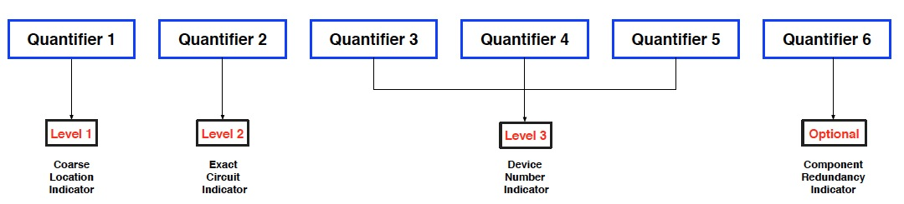
ESS Naming Convention
Cryogenic Systems
Super Section: Central Services
Section: CrS
Subsections:
  ACCP Accelerator Cryoplant
  CMS Cryogenic Moderator System
  LCG Linac Cryoline Gallery
  PHS Pure Helium Storage
  TICP Test and Instruments Cryoplant
  TMCP Target Moderator Cryoplant
Discipline: CRYO
Device types: Listed in the reference document: ESS-0061612
Instance indexes: XXXXX(X)
Notes:
Thanks to Philip Arnold and the Cryogenics team.
Example: CrS-ACCP:CRYO-HZ-20001
HZ: Emergency Stop
2: Compressor system
0: Guard System
001:device number

Slide 12
ESS Naming Convention
Cooling Water Systems
Accelerator Cooling Systems Area Structure
  As the rest of the Accelerator Systems
Cooling Water Skids/Systems Area Structure
  Super Section: Central Services
  Sections: CWH, CWM, or CWL
  Subsections: CWS01, CWS02…
Device Structure
  Discipline: WTRC
  Device Types: As defined in ESS-0033888,
  Graphical symbols and letter codes for process plants according to ISO 10628 and ISO 14617
  Instance Indexes: XXXYYY
  XXX cavity/BMD/klystron serial name
  YYY 100 CWH
  200 CWM klystrons
  300 circulators
  400 modulators
  500 CWL
  110 second inlet valve
  900 is reserved for tunnel items to differentiate e.g. klystrons/cryomodules
Reference Document ESS-0047684 (Work-in-progress)
Notes:
Thanks to Anton Lundmark and the Cooling Systems team.
The accelerator cooling systems interfaces with conventional facilities process systems on one hand (i.e. CWL, CWM and CWH systems) and the accelerator end users on the other.
The main principle for this naming system has been a point of view of the service personnel and technicians.
The cooling systems can broadly be divided into three separate parts:
G01 – accelerator tunnel systems
G02 – RF gallery systems
Test stands
All cooling skids that supply cooling water to accelerator components inside the tunnel (G01) are located in G02 Front End Building.
Equipment located in the RF gallery, such as klystrons, Modulators, Loads and Circulators interface directly with conventional facilities systems, i.e. there are no secondary systems separating the circuits.
Cryogenic systems, located in G04, follow the naming convention of cryogenic systems or conventional facilities systems depending on location. E.g. equipment located in the G04 process substation follows CF naming convention.
From the technicians point of view it is important to know what component is affected by a particular valve or instrument. One example is isolation valves in the tunnel for magnets. Instead of naming these valves according to the skid from where the water is supplied the naming of the valve instead reflect that it isolates the water to a particular magnet.

Slide 13
Cable Naming
ABCXXXXXX
A: [1..9] System
  1 Safety & Environmental
  2 Front End
  3 Super Conducting Linac
  4 HEBT-A2T, DMPL
  5 Target Systems
  6 NSS Instruments
  7 Site Infrastructure (Conventional Facilities)
  8 ICS
  9 Cryogenics
C: [A..Z] Cable Class
  A Very Low Level Signal (less than 10V)
  B Signal and Instrumentation
  C Control signals (< 200V, AC or DC)
  D Low Power AC (1kV or less, 32A or less per phase)
  E DC power cables (< 1kV )
  F High Power AC cables (more than 1 kV or less, more than 32A per phase)
  G Medium AC Voltage cables (1 kV-50kV)
B: [0..9] Sub System (Example for SC Linac)
  0 Magnets
  1
  2 Diagnostics
  3 Vacuum
  4 Cooling
  5 RF
  6 Cryogenics
  7 PS
  8 CNPW
  9
XXXXXX: 6 digits for sequential numbering (automatically attributed by Cable DB)
Examples:
  40B000001
  33C000042
Reference document:
  ESS-0015420
Notes:
Thanks to Eugene Tanke for authoring the original schema, and Frithiof Jensen and Evangelia Vaena from the Conventional Power work package for taking over and keeping it updated.

Slide 14
Naming of cable trays
Generic Name:
  TrayType-Area-RouteTypeWithIndex-CableClass
  Tray Type: UG or UB (power or signal)
  Area: FEB, DTL, SPK…
  Route Type + Index: W001… or X001…
  Cable Class: A, B, C, D, or E
Examples:
  For power cable trays: UG-DTL01-W001-D
  For signal cable trays: UB-DTL01-W002-A
Notes:
Thanks to Frithiof Jensen and Evangelia Vaena.
Used to define the routing of the cables in the CableDB.

Slide 15
3. Controls Configuration Management
Naming Service (NS)
Controls Configuration Database (CCDB)
Cable Database (CDB)
IOC Factory (FACT)
Workflow
Notes:
Thanks to both Susanne’s and Daniel’s teams at ICS.
As it was noted in previous presentations by Timo and Susanne, the tools are in initial use, with so far mostly good feedback. But their bulk use is still unproven.

Slide 16
Controls Configuration Management
Naming Service
Controls Configuration
ESS-0000757
Notes:
Device Names are registered in the Naming Service.
The rest of the signal names is handled by the Controls Configuration Database and IOC Factory.

Slide 17
Controls Configuration Management
Super Section
Section
Subsection
Discipline
Category
Device Type
Instance Index
Specific Device Name
Signal Property
Field
Area
Structure
Device Names
registered in the
Naming Service
Device
Structure
PV Names
managed by the
CCDB, FACT…
Record Names
defined by the
CCDB Properties
Fields defined by Record Type
Notes:
In italics and semitransparent: levels of the structures that are not part of the names.
In the Naming Service:
Partition by geographical location (Area Structure) and technical system (Device Structure)
In the CCDB and FACT:
The property is what is actually being measured: current, voltage, pressure, status…
They are defined in the EPICS Module indicated in the CCDB for a particuler Device.

Slide 18
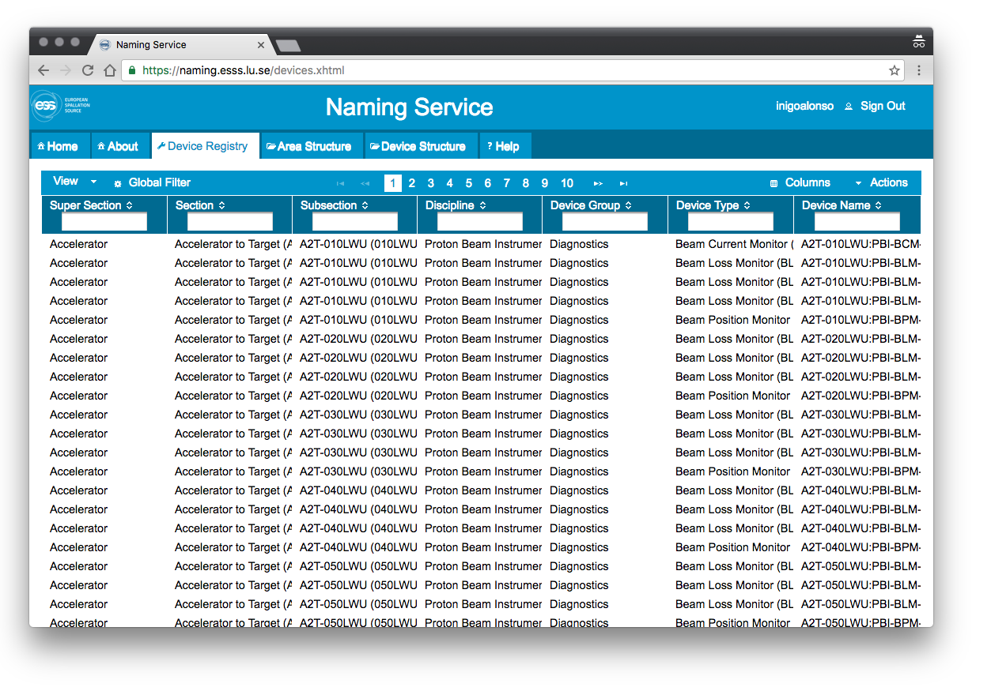
Controls Configuration Management
Naming Service
Only Device Names (e.g. SPK-010LWU:PWRC-PSQH-010) are registered in the Naming Service
It can be accessed via:
  Web app
  Excel import/export
  RESTful API (planned)
Notes:
Thanks to Karin Rathsman.
Naming: ESS Naming Convention + Naming Service
Performance issues (slow web interface) being addressed.
Open questions:
Synchronization with PLM tools (CHESS)?
Integration with Linac Lego?
Development from the Proteus Naming System by the DISCS collaboration

Slide 19
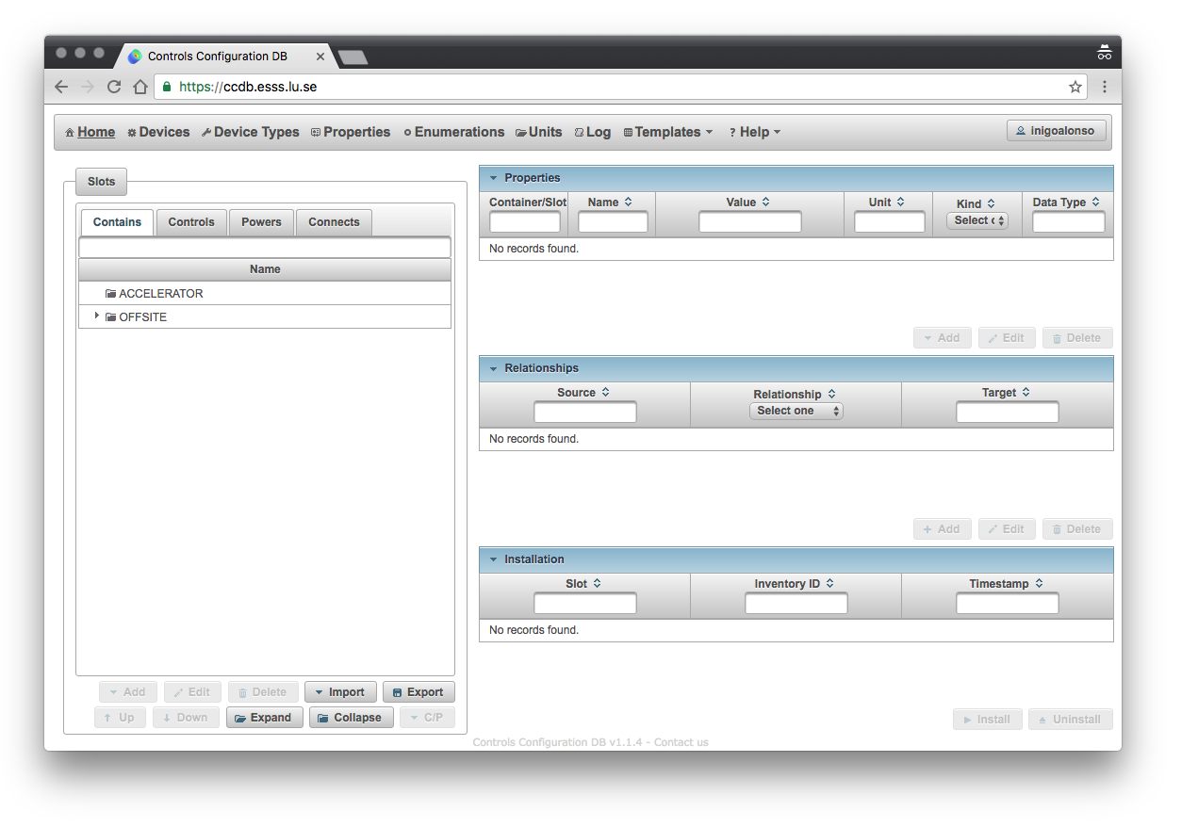
Controls Configuration Management
CCDB
Enables the collection, storage, and distribution of (static) controls configuration data needed to install, commission and operate the control system.
The CCDB manages the information of thousands of (physical and logical) devices that will be in operation at ESS by defining their properties and relationships between these from the control system perspective.
This information is then consumed both by end-users and other ICS applications to enable these to successfully perform their domain specific businesses.
Probably the most important client of this data is the IOC Factory, which handles the deployment of IOCs, without it the machine will not run.
Notes:
Thanks to Ricardo Fernandes.
Relationships -> Hierarchies:
Housing (parent/child)
Control
Power
Connection
Abstraction of most of the equipment (technical systems) needed to operate the accelerator (plant model), provides a high degree of integration of the technical systems (for cross system data correlation).
Documentation of the installed system.
For a robust and easy to manage system design, we aim for a modular design, reuse of code and implementation by configuration.
Per physical device:
Device driver support
Communication protocol?
Template to represent it?
Open questions:
Synchronization with PLM tools (CHESS)? FBS, LBS…
Integration with Linac Lego?
RESTful interface?
Virtual accelerator? OpenXAL? Using the final PV interface?
Unit tests for the modules?
More cases of vertical tests and simulations? Need to take input from operations into account in the hazard analysis and assessment process

Slide 20
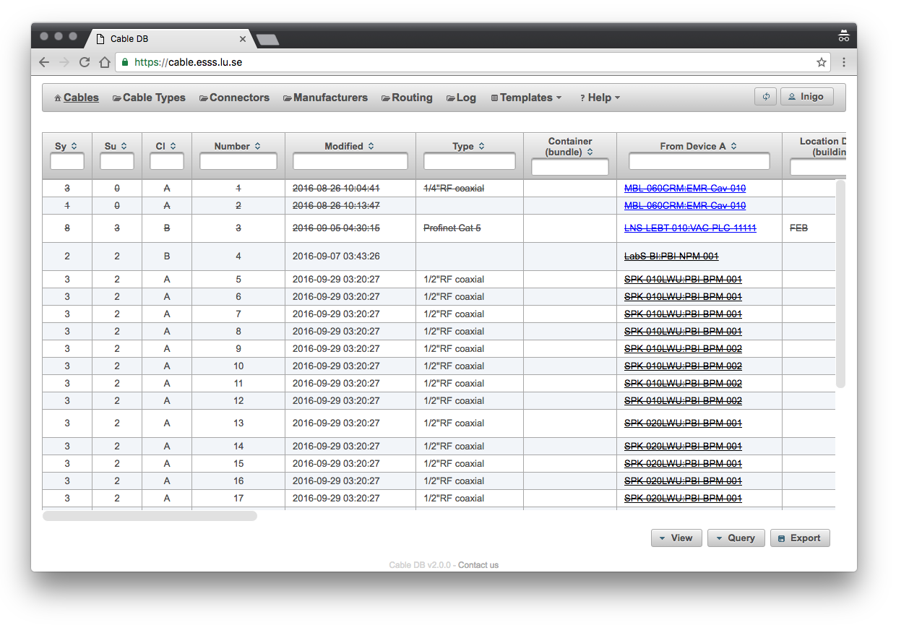
Controls Configuration Management
Cable DB
Manages the information about cables that the ESS Machine Directorate’s Divisions (and its in-kind collaborators) will be responsible for.
More specifically, the CDB supports the tracking, configuration and labeling of (thousands of) cables in all phases of the ESS project.
This information is then consumed both by end-users and other ICS applications (e.g. CCDB) to enable these to successfully perform their domain specific businesses.
Notes:
Thanks to Ricardo Fernandes. And E. Vaena and F. Jensen from AD.
Open questions:
1. Depends on the CCDB for the info on devices?
2. Only names in NS needed?

Slide 21
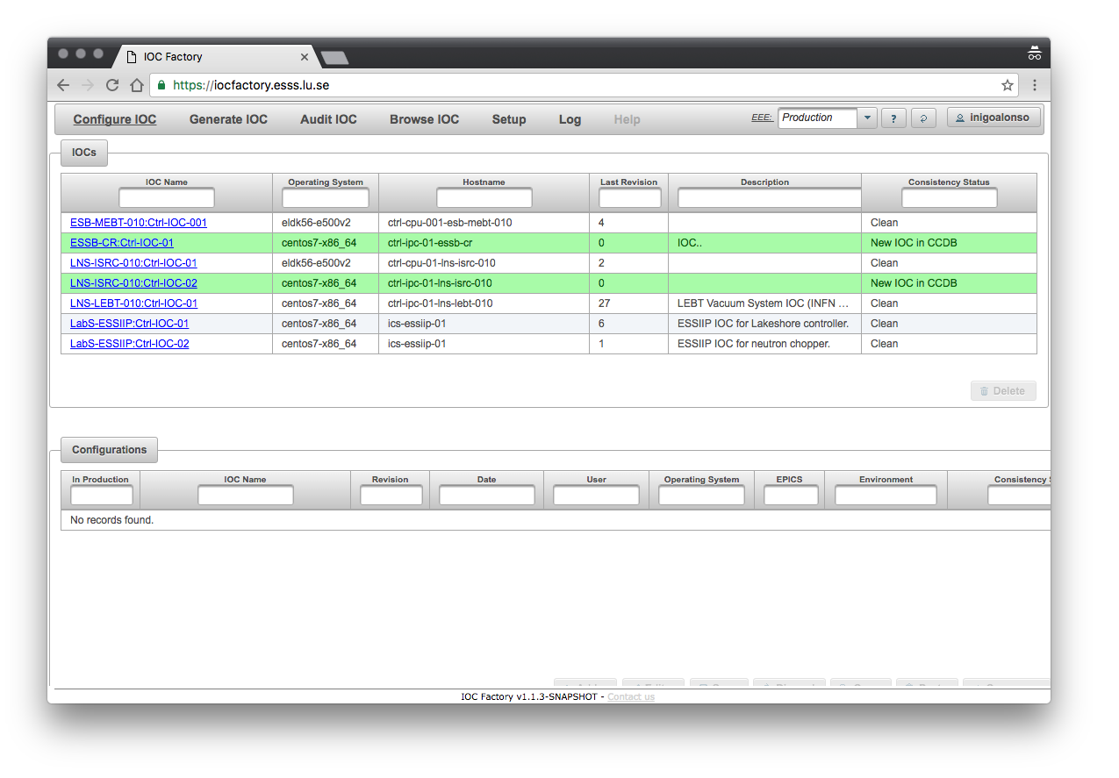
Controls Configuration Management
IOC Factory
Manages IOCs at the European Spallation Source (ESS).
Provides a consistent, formal and centralized approach on how hundreds of IOCs are configured, generated, browsed and audited (which would otherwise have to be performed manually).
Consumes data from the CCDB, the right information needs to be present for the process to succeed.
This system is part of the Controls Configuration Data Management WU which addresses the collection, storage, and distribution of static data needed to install, commission, and operate the control system.
Notes:
Thanks to Ricardo Fernandes.
IOC Factory: automates the building of EPICS databases
Configure: select an IOC from the CCDB and define some additional parameters (EPICS Base, Environment version, port…) for it, and its assotiated EPICS Modules (version)
Generate: select a configuration and deploy it to a Deployment Environment
Browse: all historical deployments
Audit: deployed IOCs

Slide 22
Controls Configuration Management
Workflow
I have a device I want to control/monitor from the Integrated Control System.
Which part of the facility does it provide service to?
  Choose Super Section, Section, and Subsection from the Naming Service to generate the Area Name
What kind of generic device is it?
  Choose Discipline, and Device Type from the Naming Service
  Add an instance index to get the Device Name
What kind of specific device is it?
  When creating the Installation Slot, assign it a Device Type in the CCDB
  Add to the Device Type a Property named “EPICSModule” with the name of the module as value.
  The EPICS Module defines the Records Database via templates and substitution files.
What Record Type is it?
  This defines the Fields -> PV Names
Notes:
1 and 2: Register the Device Name in the NS
3: Define the specific device type and its properties in the CCDB (plus relationships)
4: The EPICS Module takes care of defining the records and fields (ICS will have a “gatekeeper” for the EPICS Modules)

Slide 23
Controls Configuration Management
Workflow
SPK-010LWU:PWRC-PSQH-010
SPK-010LWU:BMD-QH-010
SPK-010ROW:Ctrl-IOC-010
OS, EPICS, etc. versions
EPICS Modules & Snippets
Lattice
Device Names
Cable DB
IOC Configuration
Beamline
Elements+
ESS EPICS Environment
Installation Slot
PS for 1st Quad in 1st SPK LWU
Naming
Service
CCDB
IOC
Factory
Generation
Device
IOC
Controls
Physical Device
Power Supply
Type PSQ5
Inventory ID: 6540
env.sh
st.cmd
Cable
Powers
Relationships
Services and Applications
Installation Slot
1st Quad in 1st SPK LWU
SPK-010ROW:Ctrl-IOC-010 controls SPK-010LWU:PWRC-PSQH-010
SPK-010LWU:PWRC-PSQH-010 powers SPK-010LWU:BMD-QH-010
Physical Device
Quadrupole
Type Q5
Inventory ID: 7830
Specific Device Type and Properties
SPK-010ROW:Ctrl-IOC-010 is of specific device type IOC
SPK-010LWU:PWRC-PSQH-010 is of specific device type PSQ5
Specific device type PSQ5 has property EPICSModule=XXXYYYZZ
SPK-010LWU:BMD-QH-010 is of specific device type Q5
Notes:
Layout Database: LinacLego Parameter Book
Description of the Linac sequence of components (lattice)
Hierarchy: Linac>Sections>Cells>Slots>BeamElements
2 Configurations: ISRC->Target and ISR->Dump
Is updated by Change Requests to the CCB, so it is versioned
Hardware Baseline: Facility Breakdown Structure (FBS)
Lattice: Sections-Cells-Slots-BeamlineElements
Beamline elements and their parameters
Non-beamline elements and their parameters
Installation Slots and their properties
Device Names for those Installation Slots

Slide 24
Status
Tools from ICS are available
Workflows are understood, but not formalized yet
Population of databases:
  Naming Service: 2,332 names registered
  CCDB: test environments
  Cable DB: 129 Cable Types defined, campaign going on now to register the cable instances
Work on these distributed systems beforehand (including complete vertical tests) can greatly minimize the risk of delays, as their troubleshooting time is likely to dominate during installation and commissioning.
Notes:
NS: incomplete, expected ~10⁴.
CCDB: Catania (ISRC+LEBT), and Medicon Village Labs (VAC, PBI…) test environments
Cable DB: Should be almost complete by Feb 2017
During the installation and commissioning time, issues with the control, electrical, and other distributed systems most likely will dominate the troubleshooting time. That is why some upfront enabling work can minimize the risks of delays, for example simulations, and complete vertical tests.

Slide 25
Q&A
Thanks to all the colleagues at ICS and AD that made this presentation possible.

Slide 26
Backup Slides

Slide 27
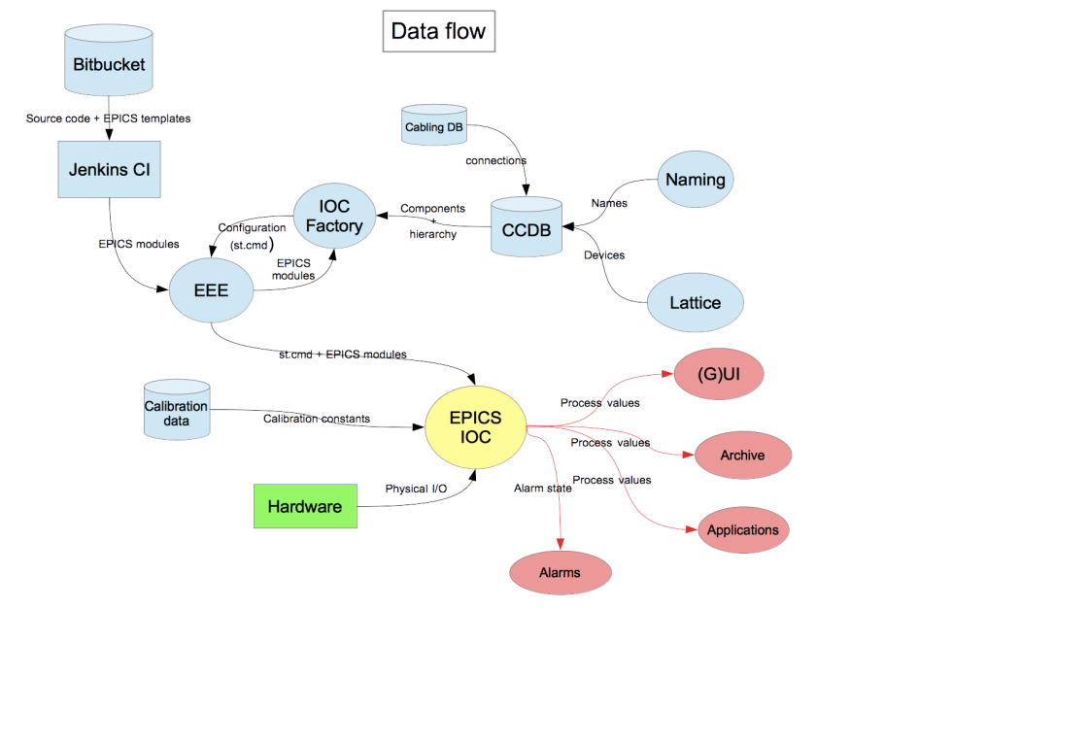
ICS data flow diagram

Slide 28
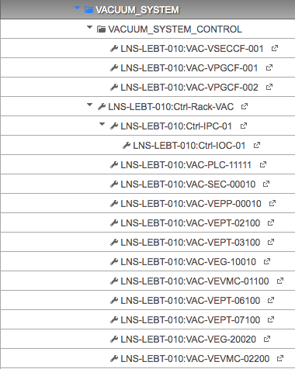
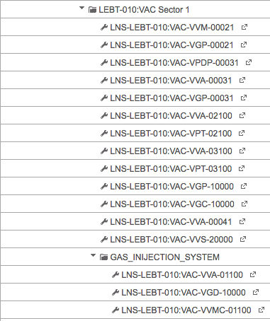
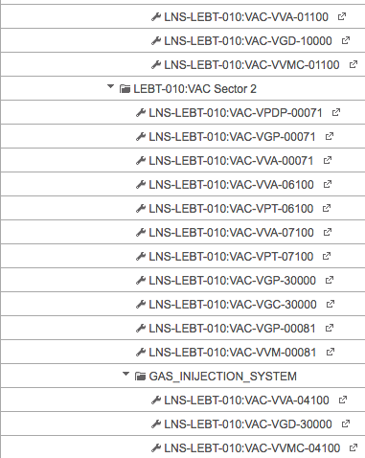
ESS Naming Convention
Vacuum Systems
Discipline: VAC
Ion Source and LEBT Vacuum System
Rack schematics Catania
Reference document: ESS-0043149
Notes:
Work on the vacuum systems led to better integration of the naming system into Eplan

Slide 29
What are we building?
The ESS Linear Accelerator
What does that mean for different people?
Manager: a machine that meets the promises made to the member countries and the users
  Work Breakdown Structure (WBS), and Integrated Schedule
Physicist: series of abstract objects that manipulate ideal beams under ideal conditions
  TraceWin simulation code
Engineer: many physical components that need to meet functional requirements, have interfaces to other physical components and are located in physical locations
  Specifications, Design Reports, EBOMs, part drawings, P&IDs…
Operator: screens with interfaces to all the devices that need to be controlled and monitored for operating the accelerator
  High level applications on the Control Room that display information from field devices and databases
Notes:
Would it be better to always think of the whole machine (neutron source)?
People can wear different hats, even simultaneously.
Sorry for the stereotypes and oversimplifications.

Slide 30
What is our Common Goal?
Control and Monitor the Accelerator
The Accelerator has thousands of components that need to be controlled and/or monitored from the Integrated Control System (ICS). Many ACC-ICS interfaces.
Installation is starting soon, and for commissioning we will need certain services from the ICS ready.
To interact with the ICS services, the Accelerator components need to make their Process Variables (PV) available via Input Output Controllers (IOC). Hundreds of IOCs will need to be deployed.
The PVs need to be distinguishable from each other. They need unique names.
Other components also need names, e.g. components that are connected by cables so these can be registered in the Cables Database.

Slide 31
Functionalities expected from the CCDB
Record system configuration (for each equipment item: ID, status, location, responsible person, PV names, connected cables…)
Configuration change management (history of changes, roll-back mechanisms)
Record of the names of the PVs? (and validation of the Device Names based on the ESS Naming Convention)
This enables the operation (control and monitoring) of the machine, plus:
  Investigation of operation in various modes
  Studies of sensitivity of the design to uncertainties
  Investigation of operational flexibility
Notes:
Location: LBS + within crates

Slide 32
Data sources and aggregation
Layout
Equipment Data
Schematic Layout
Powering Data
Mechanical Layout
TraceWin Input Data
Installation Layout
Cabling Data
Site Infrastructure Geometry
Survey and Alignment Data
Data for Operation
Calibration Data
Manufacturing and Test Data - Travellers

Slide 33
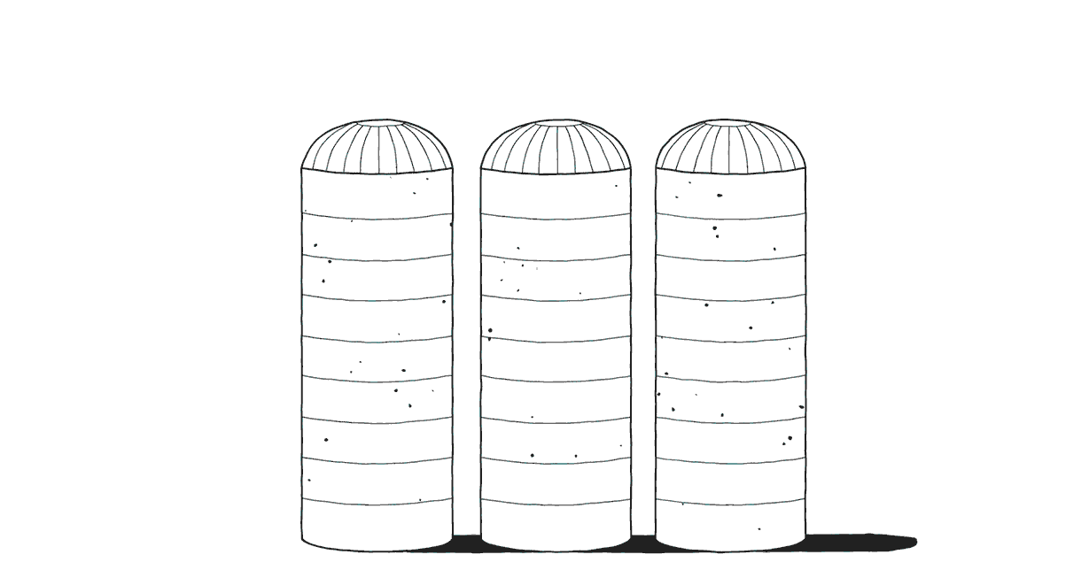
Other related systems
Linac Lego
Alarm Handler
Archiving Service (by storing the PVs related to an equipment item, the archived values can be accessed)
LogBook?
ESS Break down Structures - Project Information Management (PIM)
  Facility Breakdown Structure (FBS)
  Location Breakdown Structure (LBS)
  Physically Installed Structure (PIS)?
Inventory?
Procurement?
Logistics?
Spare parts management?
MRO?
How do these interact with the CCDB etc?
"All together now" by Matt Blease

Slide 34
Definitions of the different breakdowns in
ESS Breakdowns Structures
Facility Breakdown Structure (FBS)
  A functional breakdown of the facility into systems and subsystems that uniquely identify the primary function. Holds the master TAG and its requirements. The FBS is specific to the installation in the facility but it does not hold the specific information of an physical item this is documented in Installation Structure. In the FBS a Physical Item shall be replaceable with another physical item as long as the requirements are met. The FBS is connected to both the design (PART), location (LBS) and the physical items (IS).
Part/E-BOM/Standard part structure
  Generic information about a part. The information should be valid no matter of where the actual device is functional or physical located in the facility. The PART/EBOM/standard part is connected to the FBS if used in the facility.
Location Breakdown Structure
  A location based breakdown of the facility. There are two different breakdowns the site (Area A) and the buildings. The site contains documentation, drawings that are outside the buildings. The buildings are broken down in buildings, levels, rooms. The LBS is connected to the FBS so from a location you can see the functions that are installed in that location. The LBS will consolidate data from a physical locations perspective. It is also in this structure that we will be able to manage and trace physical item installed in a certain locations.
Installation Structure/Physical Item
  Installation Structure/physical item is a specific item installed in the facility. The information associated with this object is only valid for this physical item and when it is needed to be replaced the item is replaced with a new Physical item. It holds the documentation that is connected to a specific item/serial number and cannot be transferred to a new item when the physical item is replaced, if so is the case then the information should be stored in the FBS or PART structure.
Courtesy of the PIM Content Management WG

Slide 35
Names and Tags at ESS
ESS Naming Convention
CF Tag Structure
FBS tags
LBS tags
  Based on BSAB standard, Building Information Models (BIM) for Conventional Facilities (CF)
CHESS IDs

Slide 36
Open questions
We need to populate the CCDB and Cable DB during the construction phase. The databases and their web interfaces are in production (including batch import templates), but the models/templates (device types and associated properties) to represent the different physical devices are to be developed in parallel with the construction of those same devices (or even during their design(!)).
Data and metadata architecture not well understood by some stakeholders?
Why decoupling the interface of the Naming Service and the CCDB? Idem with the Cable DB?
Possible to store Signals in CCDB? But decoupled from the Records defined by the EPICS Modules?

