Slide 1

Cryomodule test stand at ESS site
TAC14
Wolfgang Hees, WP leader Test Stands
www.europeanspallationsource.se
2016-10-06

Slide 2
Contents
outline, progress
layout
organisation of installation
organisation of operation
team
schedule

Slide 3
TS2 outline
TS2 in Lund shall perform the SAT of the elliptical cavity cryomodules
high-level requirements come from WP5
testing shall include:
  reception & preparation
  coupler conditioning
  cooldown
  RF tests up to full power
  heat load tests
  warm up & prepping for installation
detailed testing procedures to be written by IK partners, WP10 and linac group’s SRF specialists

Slide 4
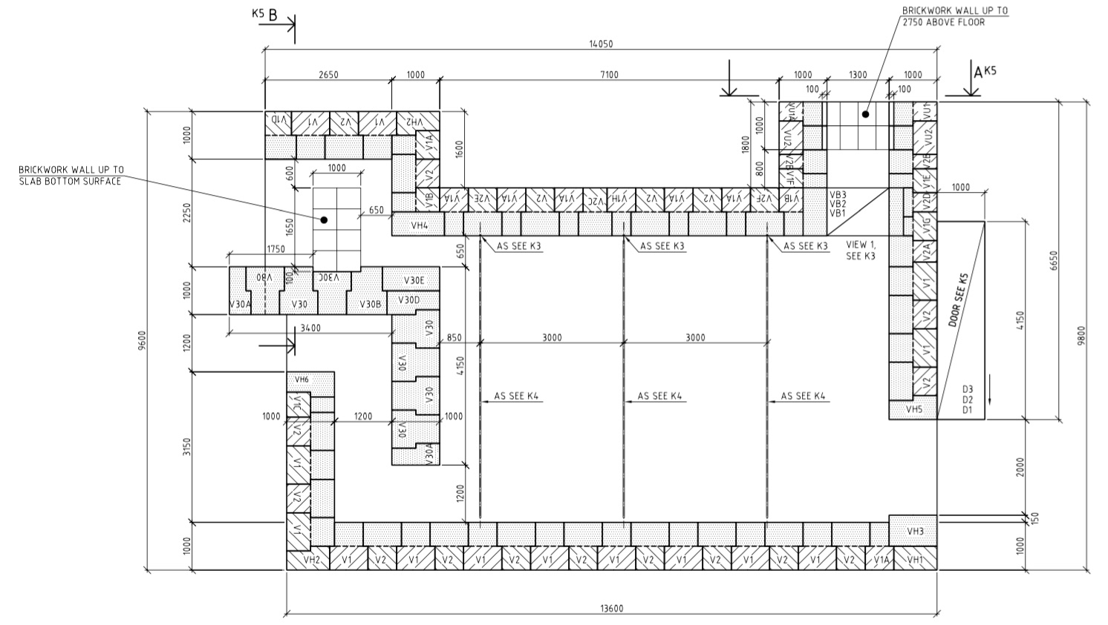
Progress
bunker design finished
(shielding investigation ongoing)
RF station reduced, space saved
1 new test stand engineer hired
interfaces between work packages documented
In-Kind contract with IFJ PAN about to be signed
TS2 building has been erected, nearly finished
close coordination with RF for early installation
Issues
choice of modulator is not finalised
arrival date for first CM to be tested is not finalised

Slide 5
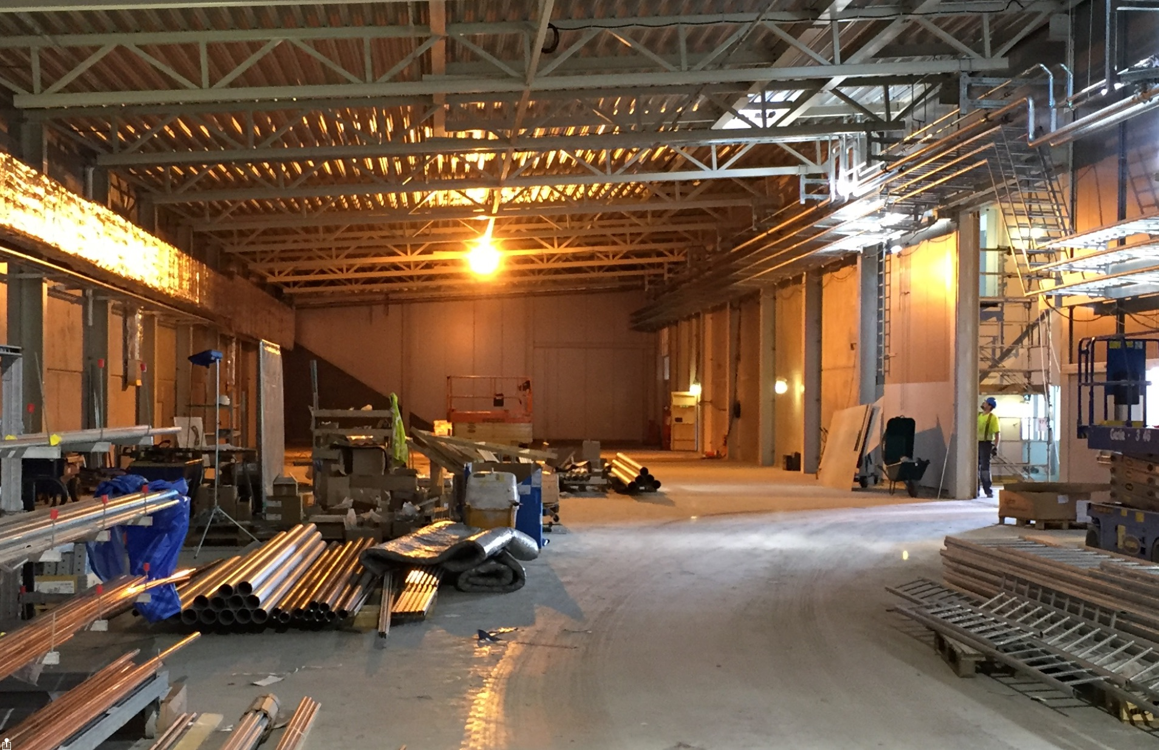
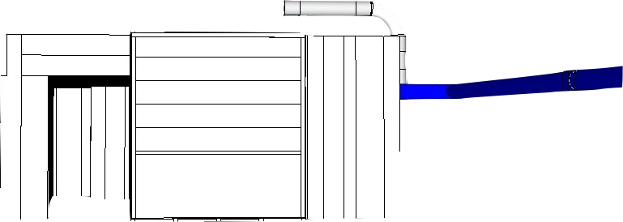
TS2 area in the Klystron Gallery

Slide 6
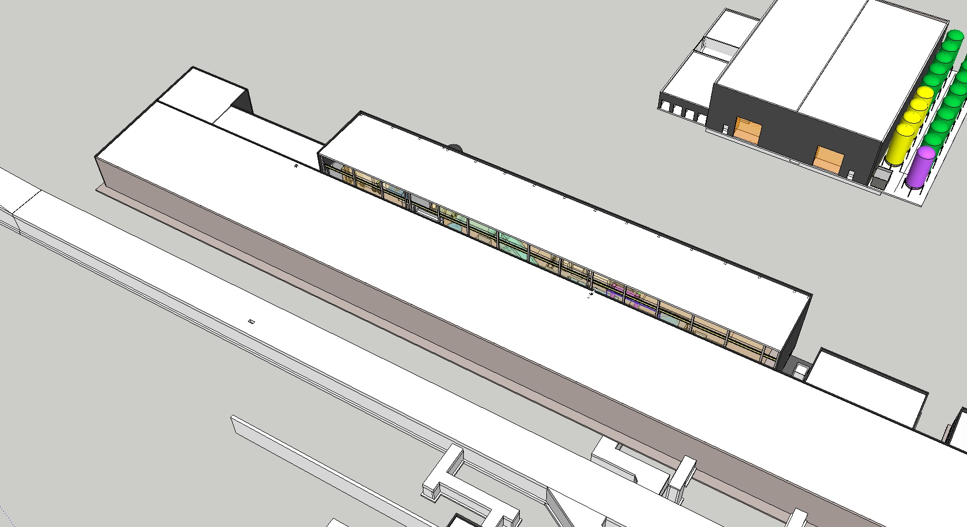
Layout 1
Test Stand 2 will occupy 45 m in the high energy end of the klystron gallery, in the Gallery Technical Area (cont. space).

Slide 7
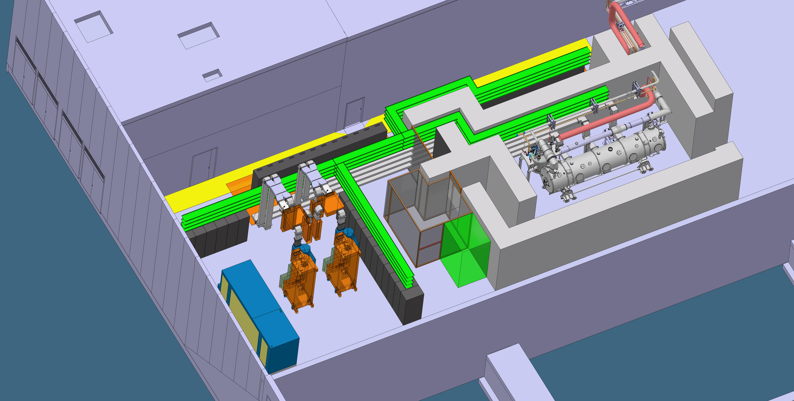
Layout 2
It consists of a bunker, a prep area, an area for RF equipment and a control room.

Slide 8
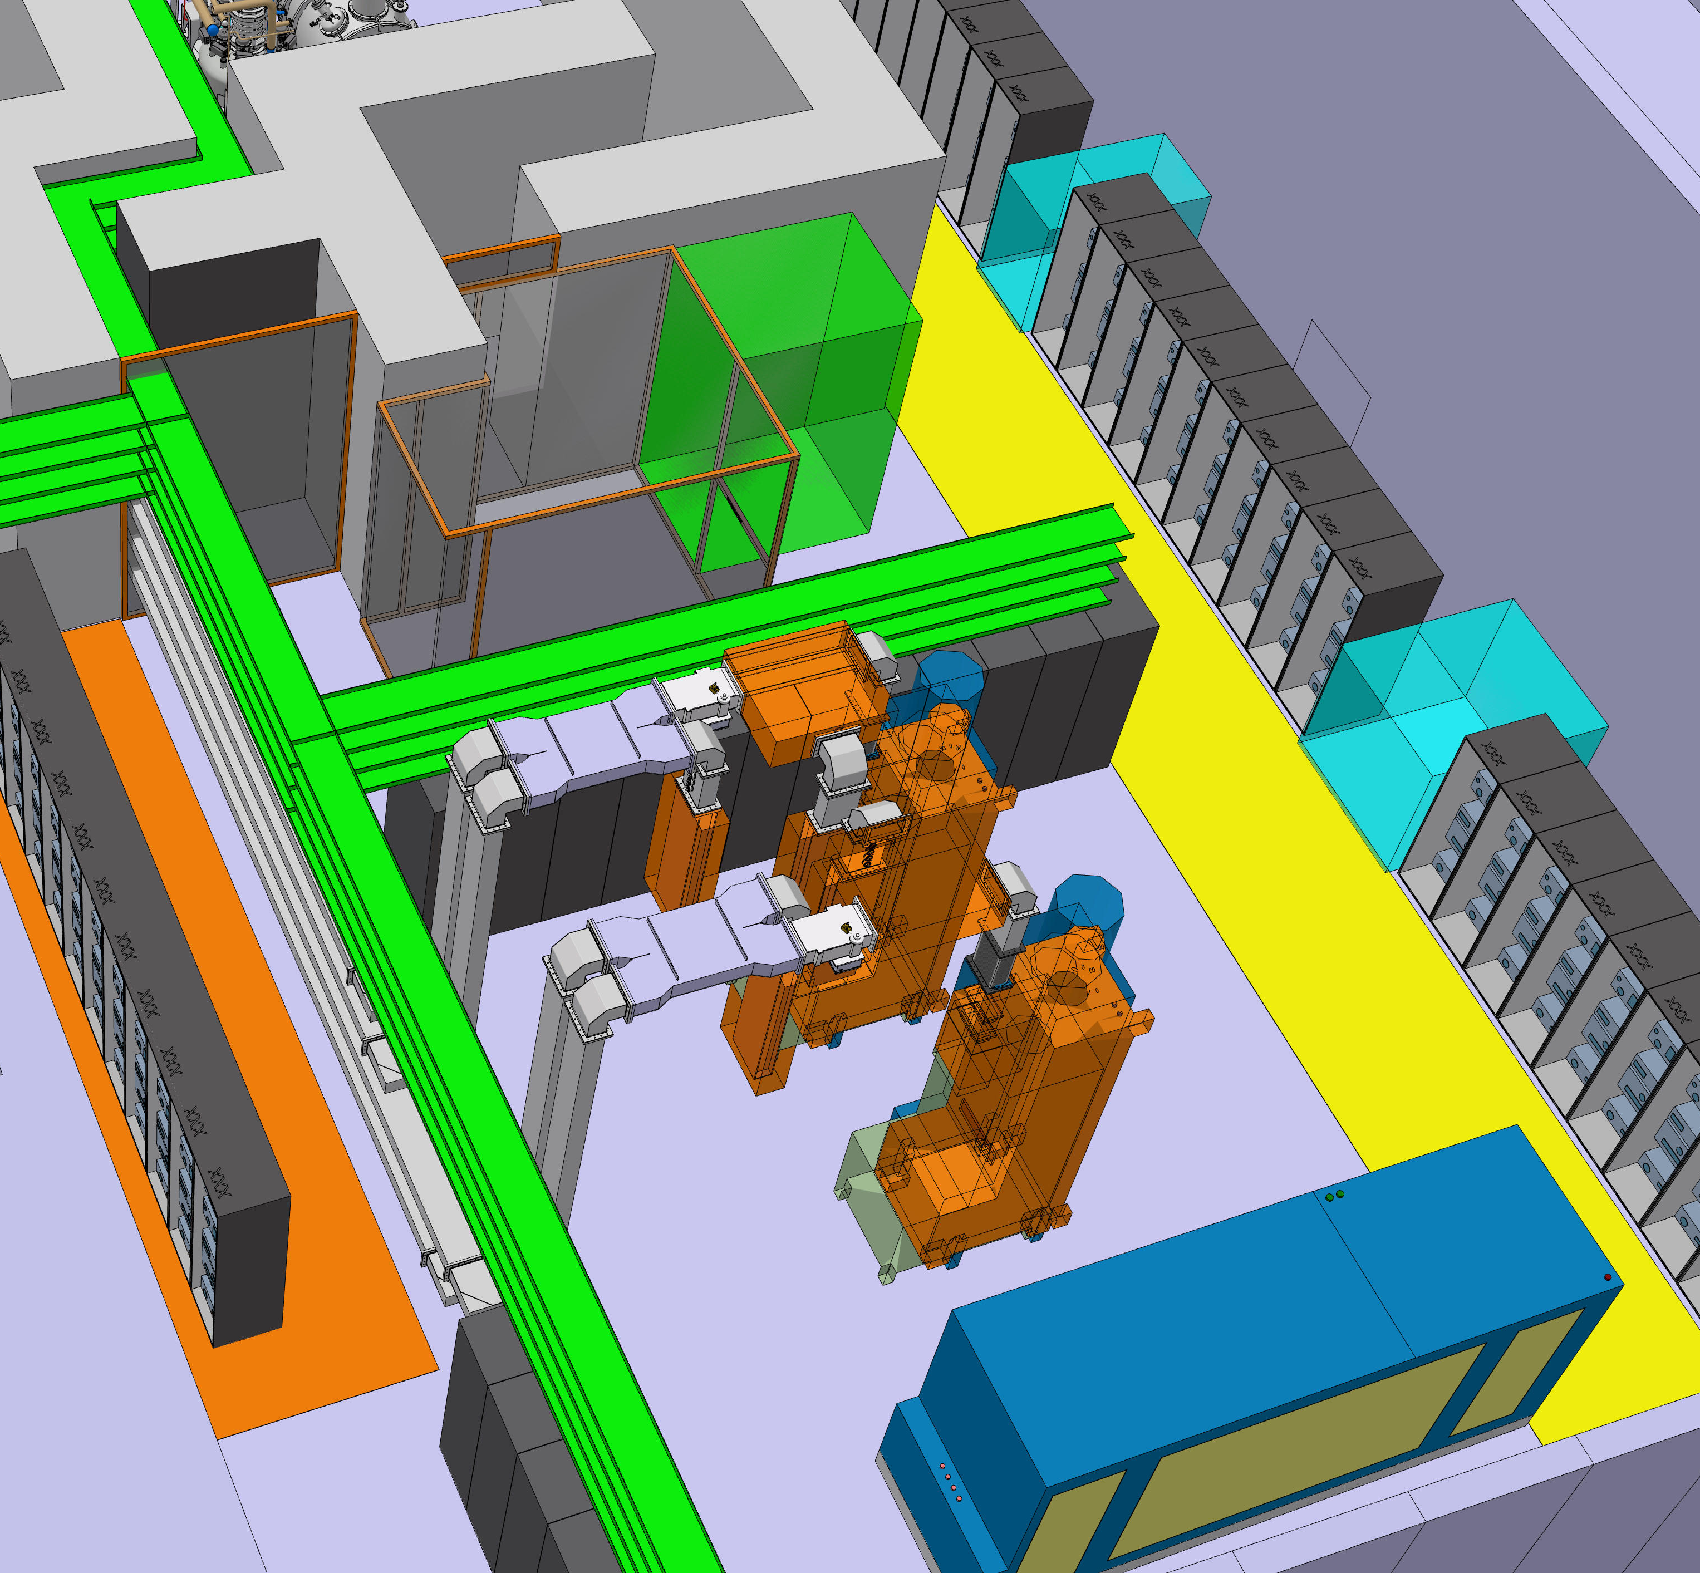
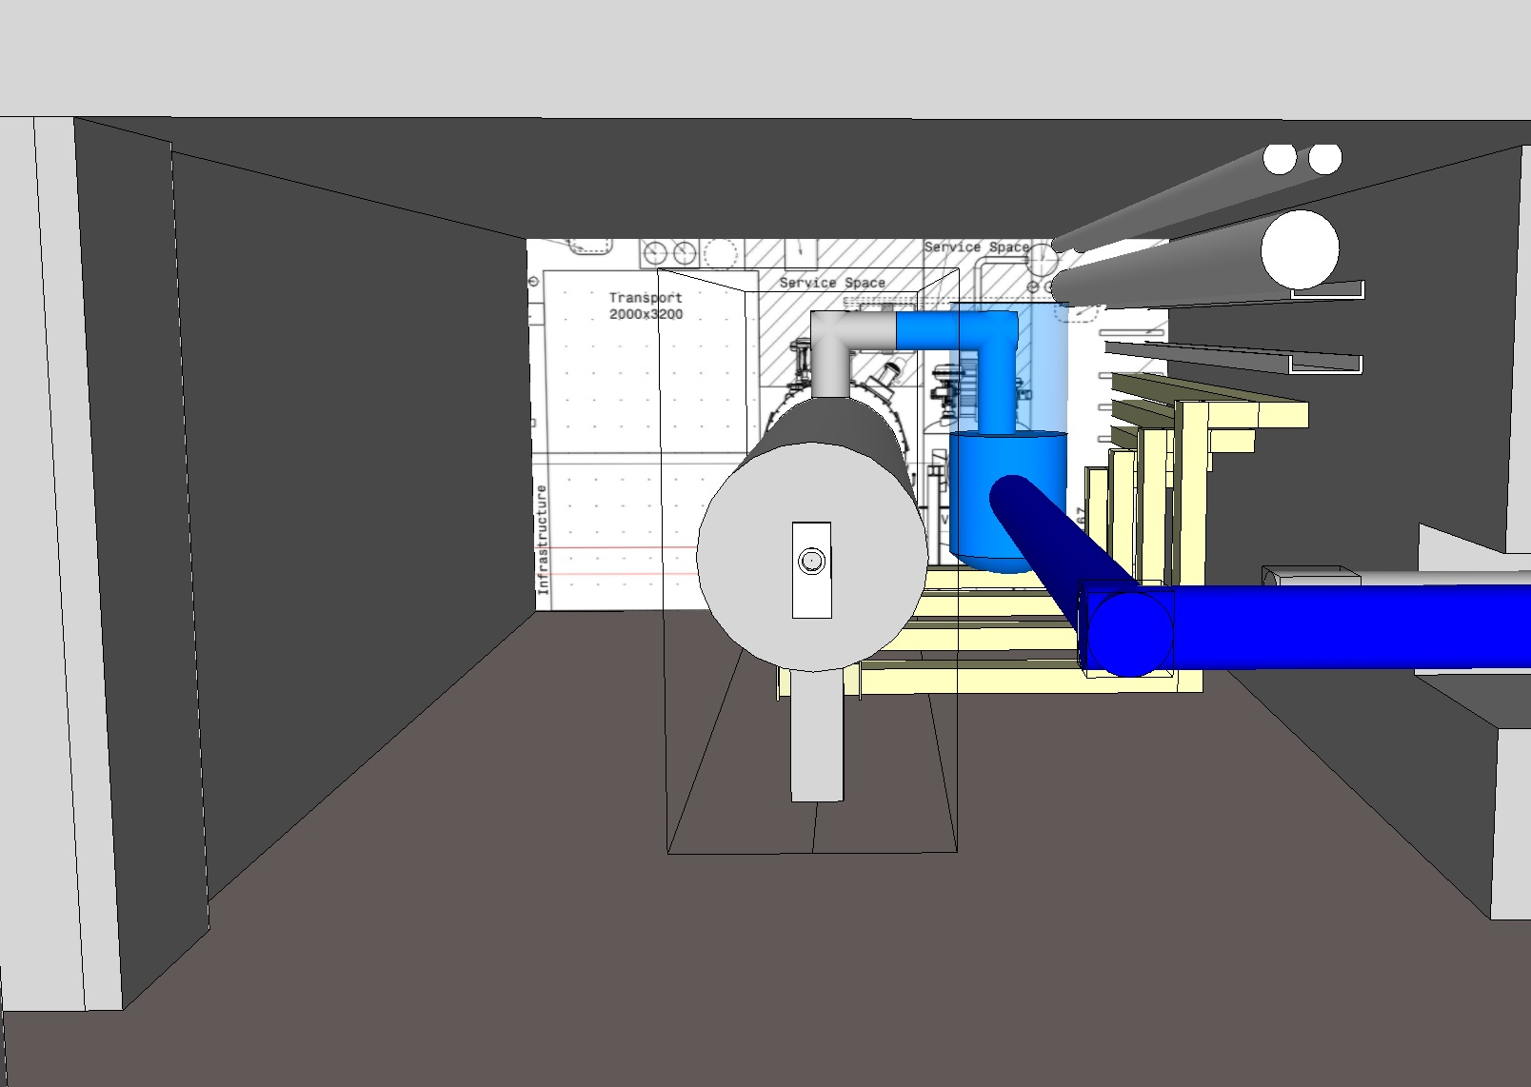
Layout 3
In 2015 the number of RF sources was reduced from 4 to 2.
Saved space benefits the other WPs in the GTA.
The bunker has the same dimensions as a slice of the tunnel.

Slide 9
https://ess-ics.atlassian.net/wiki/display/ATS/Accelerator+Cryomodule+Test+Stand+2

Slide 10
Organisation: Installation
TS2 installation is coordinated by WP10. The other teams provide:
WP11: cryoplant, transfer line (incl. valve box & warm lines)
WP8 & WP17: HP RF (modulator, klystrons, waveguides, circulators, dummy loads and splitters) and LLRF equipment
WP12: portable clean room (inst. & removal of beam vacuum pump), insulation vacuum pump, cryo line purging pump
ICS: controls, timing system, motion control (CTS), PSS (access control, radiation & ODH monitoring)
WP15: cabling, racks
WP16: cooling water connections, cp air connection
CF: building, utilities
WP5 IKC partners (CEA & IPNO, France): advice and support
AD linac group: support on SRF issues

Slide 11
Organisation: operation
TS2 operation is organised by WP10. Other teams provide:
WP11: cryoplant operation, support during CM cooldown
WP8: RF engineers to operate RF equipment during tests
WP12: clean room operation, connection of pumps
ICS: database for test data storage
IFJ PAN (In-Kind partner): specialists for CM handling, preparation, connection, testing (experience from XFEL)
WP5 IKC partners (CEA & IPNO, France): advice and support
AD linac group: support on SRF issues and with testing

Slide 12
The Test Stand Team
ESS staff:
1 WP leader (W. Hees)
1 test stand engineer (Emilio Asensi)
RF engineers
½ cryo operator
IKC staff from IFJ PAN (Poland):
according to IKC: 53 FTEs spread over 7 years

Slide 13
Schedule
2016
2017
2018
2019
2020
2021
2022
design
procurements
access
inst
commissioning
MB prototype transport and test
?
CM production
MB testing
HB testing 1
HB testing 2

Slide 14
TS2 Installation Schedule
CF: TS2 partial access
CF: LCR partial access
CF: TS2 full access
& utilities
WP10: bunker ready
WP5: TD available in Lund
WP5: 1st MB CM available in Lund
2017-02-27
2017-03-31
2017-05-02
October 2017
2018-01-01
2018-07-01 ???
partial access
full access
utilities available
LCR partial access
LCR full access
TD available
cold comm
?
1st MB CM
RF inst. & comm. outside bunker
RF inst. inside
RF dry comm.
MB CM testing
ad hoc cabling
rack inst.
cabling outside
cabling inside
TD inst
controls comm
MB CM inst
TICP inst & comm
TL inst. outside bunker
TL inst. & comm inside
bunker procurement
bunker manufacturing
bunker inst.
PSS inst. & comm

Slide 15
Summary
Test Stand 2 for elliptical cryomodules is on schedule to be ready for operation when the first MB CMs arrive in Lund.
Issues to be resolved:
choice and availability of modulator
number of MB CMs to be tested (re-test modules 1-3 ?)

