Slide 1
Responses to TAC-13 Recommendations
Eric Pitcher
www.europeanspallationsource.se
October 6, 2016

Slide 2
Validate flow correlations
Recommendation:
Experimental validation of assumptions and computations of unique fluid systems will improve confidence in performance. (e.g. failure of flow path in target, leaking gas into the monolith, etc.). Consider options to reduce uncertainty by adequate prototyping (e.g. hydraulics tests of sectors to validate computations, identification of early failure features, etc.), or scaled demonstration experiments.
Response:
Hot flow test of a representative section of the target has established the validity of the heat transfer correlations for our target geometry.

Slide 3
Assess thermal-hydraulic and mechanical integrity of the target
Recommendation:
Assessment of thermal-hydraulic & mechanical integrity of the rotating target during operation should be considered to give an early indication of problems.
Response:
Flow, temperature and pressure sensors measure bulk fluid properties, and a concept for measuring the mechanical integrity of the target during operation is under elavuation (see presentations by Ulf Odén and Nicolò Borghi).

Slide 4
Redundancy and diversity
Recommendation:
Independent train description for redundant/diverse systems (cabling, physical) should be clearly described and communicated to project participants.
Response:
The two-train independent system, including redundant and diverse components for the Target Safety System (TSS), is described in requirements, design, and interface documents. The TSS team also regularly meets with the owners of interfacing systems, including Target (wheel, helium cooling system, monolith), Accelerator (ion source, RFQ, bending magnets), ICS (MPS, EPICS, MCR, cyber security), CF (room requirements, electrical design, cable routing, space), and ESH (SSM conditions, security).

Slide 5
Tritium management
Recommendations:
Management of tritium in cooling water needs further assessment in terms of operational procedures and dose to personnel.
Look at tritium build up. Replacing the water now and then might pose fewer radiological/waste problems.
Responses:
We agree and will work with ESH division to develop operational procedures for tritiated water systems. We will also assess the risk of tritiated water in our accident analyses.
ESH division is establishing limits for tritium in discharged water and stack releases, which will be used to define tritium concentration limits in water loops that we intend to discharge in a controlled manner to the environment.

Slide 6
Dose to personnel during operation
Recommendation:
Location of active components should be analyzed with respect to dose rate of working personnel.
Response:
We are assessing moving the moderator/PBW loop delay tank into the connection cell in order to reduce gamma dose rates in the utilities room (see presentation by Esben Klinkby).
We are assessing the levels of radioactivity of loop components and designing local shielding to limit dose to personnel.

Slide 7
Operational procedures handbook
Recommendation:
Consider generating a handbook on operational procedures (four eyes-principle, personnel protection, etc.)
Response:
ESH division has started the development of such a handbook.

Slide 8
Delay tank size
Recommendation:
Delay tanks of 90 seconds may be longer than necessary. Check half-lives of anticipated radionuclides and see if reduced times may be acceptable.
Response:
The delay tanks address principally one isotope, ¹⁶N, a 7-s-half-life nuclide emitting 6- to 8-MeV gammas. Detailed analyses have been performed to size and locate the delay tanks, which indicate delay tanks of 90 s as the best solution but this is subject to change as the calculations are refined (see presentation by Esben Klinkby).

Slide 9
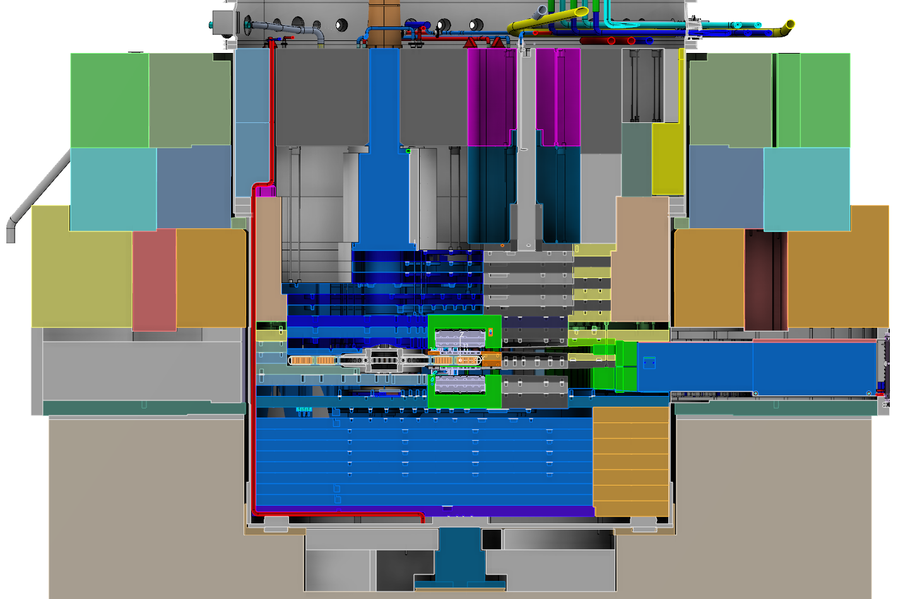
Drain pipe in the monolith vessel
Recommendation:
If you don’t have one, consider adding a drain pipe at lowest point of the monolith.
Response:
The design includes a
pipe running from the
bottom of the monolith
vessel to the connection
ring, with the purpose
of draining any fluids
that might pool at the
bottom of the vessel.

Slide 10
Water chemistry
Recommendations:
Monitoring oxygen in the water should be considered to reduce corrosion rate.
Carefully consider water quality issues impacting radiological and corrosion issues. Bad water chemistry can result in high corrosion rate, down time, and high cost.
Response:
Water chemistry is incorporated in the design, adapting best practices from existing neutron sources (see Chapter 7 of ESS Target Materials Handbook, ESS-0028465). We will have online measurements of conductivity in both of the primary loops as well as in the water purification loops which will indicate increased corrosion production. There will be a possibility to take water samples and analyze them for diagnostic purposes.

Slide 11
Maintenance of water systems
Recommendations:
Access to components (e.g., ion exchangers) for maintenance seems not to be considered in all cases.
Is shielding of the ion exchangers, piping and delay tank sufficient?
Is the standard procedure used in Swedish nuclear power plants, exchanging the resin rather than ion exchange column, applicable for the activity conditions anticipated for ESS?
Response:
The maintenance procedure for exchanging ion-exchange resin is not fully developed but will be studied and investigated in detail during the final design phase. This investigation will include hazard analyses for the operation as well as using the knowledge and experience from facilities in Sweden.

Slide 12
Multiple scattering by upstream components
Recommendation:
Insure beam multiple scattering optics are understood for downstream components as a function of gas pressure, particularly with regard to beamline components requiring hands on maintenance.
Response:
A detailed analysis has been performed to assess impact of primary proton scattering by the proton beam window (PBW) and multi-wire profile monitor (MWPM) on beam divergence. Heating and damage are somewhat higher just downstream of the PBW when it is present, while the MWPM has negligible impact. The impact of gas pressure has yet to be assessed.

Slide 13
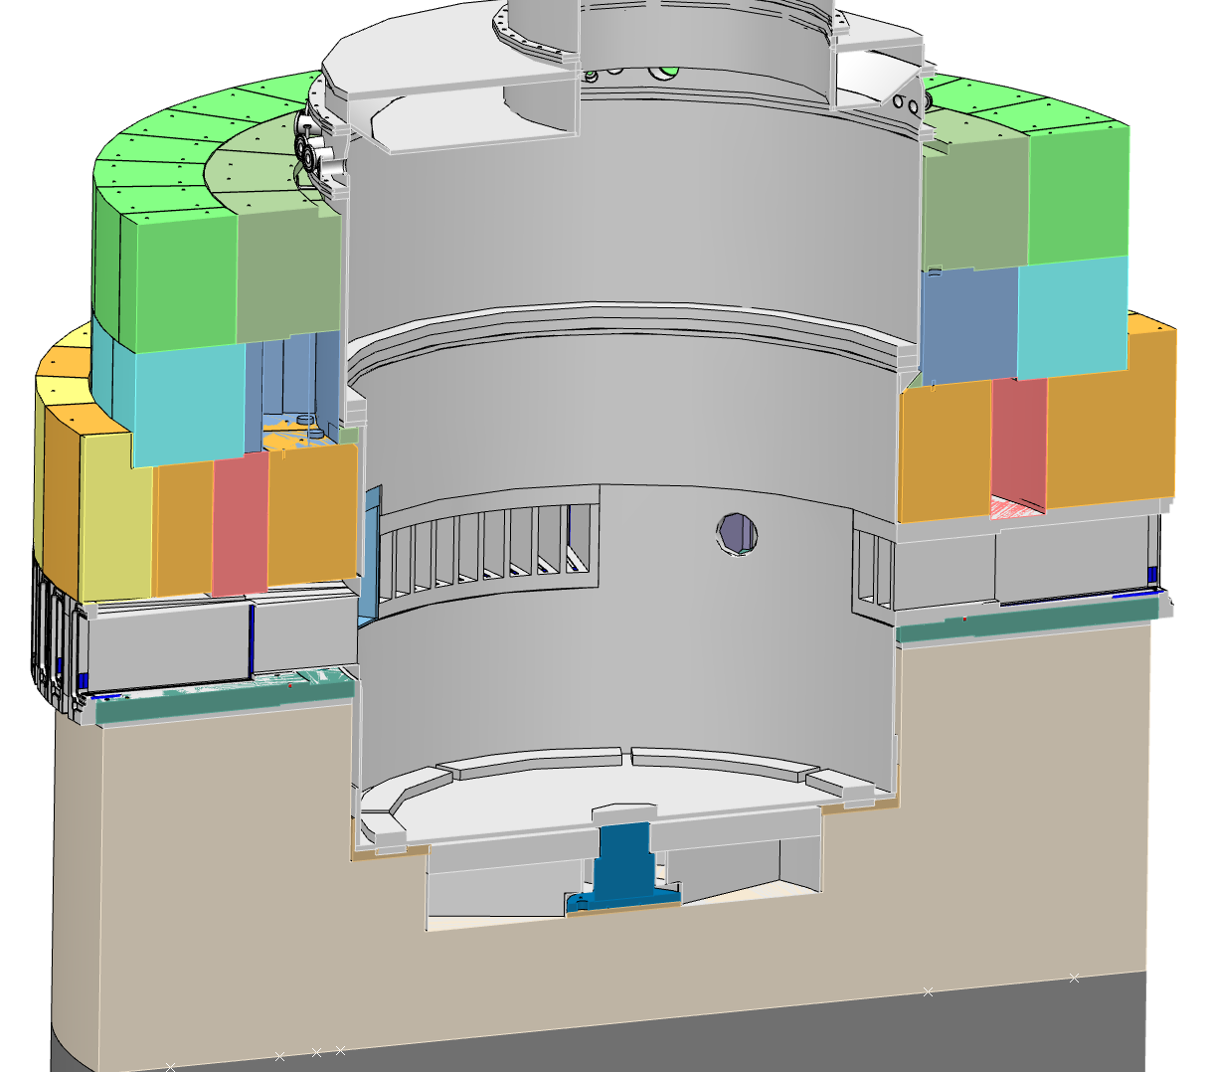
Leak testing of monolith vessel welds and penetrations
Recommendation:
We recommend evaluating leak testing procedure of the monolith penetrations and welds during installation and after operations begin.
Response:
The design includes pipes for
leaking helium in the
vicinity of vessel welds.
All vessel penetrations
are accessible for leak
testing.
1 pipe
4 pipes
4 pipes
1 pipe

Slide 14
Tritium-contaminated vacuum pumps
Recommendations:
Vacuum pumps will become tritium contaminated; controls will be needed to deal with contamination.
Avoid oil sealed pumps.
Response:
ESS plans to adopt best practices from operating facilities to deal with tritium-contaminated components, including vacuum pumps.
Pump types have not yet been selected but we will heed your advice and strive to avoid oil-sealed pumps if possible. The ESS Vacuum Handbook (ESS-0012895) specifies that only dry pumps shall be used on the accelerator.

