Slide 1
ESS organizational efforts to mitigate interface issues
John Haines
Project Manager
www.europeanspallationsource.se
5 Oct 2016

Slide 2
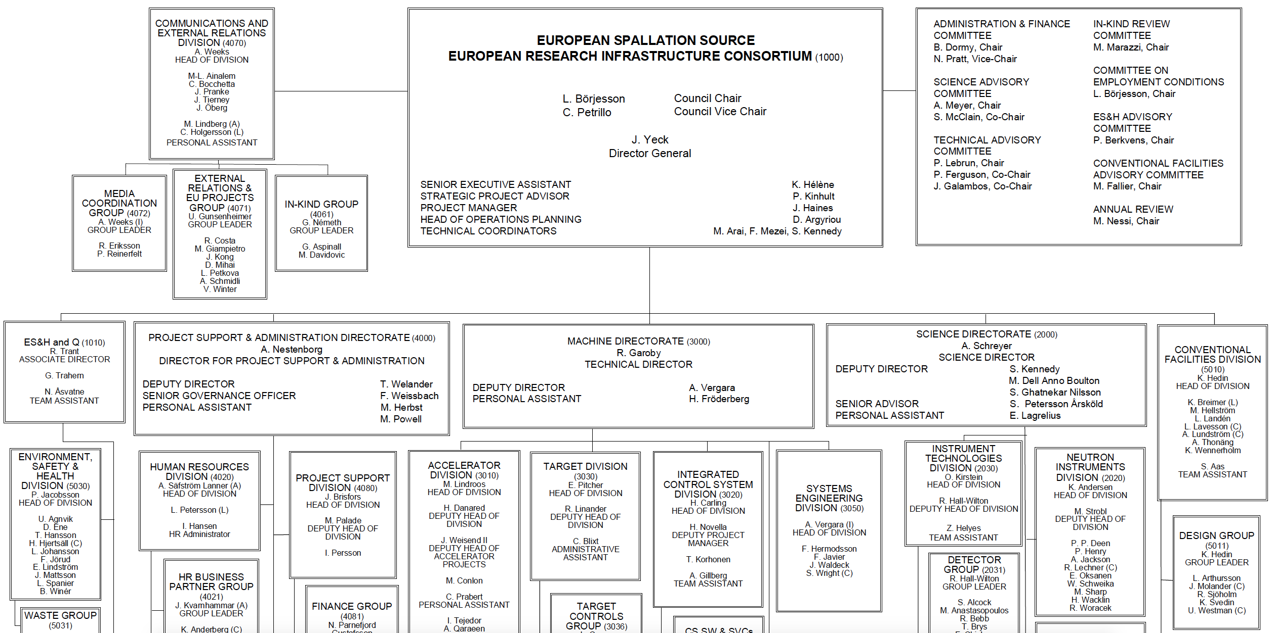
ESS Organization

Slide 3
ESS Project Roles
ESS Project Manager (PM) Role: Assist the DG and work with Directors and Sub-Project Leaders to deliver the ESS Construction Project according to its baseline approved scope, schedule, and cost
Responsibility and authority, and therefore accountability, to successfully complete the sub-projects remains with the existing project and line organization
PM and Technical Coordinators, as part of the DG office, are accountable for the entire project and are focused on interface management and resolving issues/eliminating impediments to progress
  Oversee integration of schedule across entire ESS project and use this as a tool to drive project execution

