Slide 1
ESS Overview & Status
TAC#14
Roland Garoby
Technical Director
www.europeanspallationsource.se
5 October 2016

Slide 2
ESS construction cost baseline
(Jan 2013 pricing) | M EUR
Conventional Facilities | 531,9
CF scope supported by host countries | -93,0
Accelerator Systems | 510,2
Target Systems | 155,2
Integrated Control System | 73,0
Design & Engineering | 33,7
Neutron Scattering Systems | 350,0
Project Support & Administration and Licensing | 123,8
Contingency | 158,2
Total Construction Budget and ESS Cost Book Value | 1843,0

Slide 3
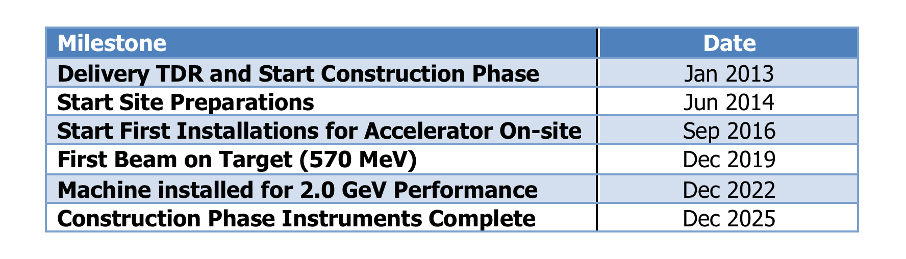
ESS Schedule baseline – external milestones
Ready for Beam on Target!

Slide 4
Construction investment
CURRENT
Sweden (member) | 35.0 %
Denmark (member) | 12.5 %
Germany (member) | 11.0 %
United Kingdom (founding observer) | 10.0 %
France (member) | 8.0 %
Italy (member) | 6.0 %
Spain (founding observer) | 5.0 %
Switzerland (member) | 3.5 %
Norway (member) | 2.5 %
Poland (member) | 2.0 %
Czech Republic (member) | 2.0 %
Hungary (member) | 0.95 %
Lithuania (future member) | 0.45 %
Estonia (member) | 0.25 %
Total (minus preconstruction) | ~97 %
FUTURE
Belgium (founding observer) | tbd
Netherlands (founding observer) | tbd
Greece (future observer) | tbd
Turkey (future observer) | tbd
Latvia, Portugal, Finland | tbd
Notes:
Founding Members
Czech Republic
Denmark
Germany
Estonia
France
Italy
Hungary
Norway
Poland
Sweden
Switzerland
Founding observers
Belgium
Spain
Netherlands
United Kingdom
Ireland

Slide 5
ESS In-kind Partners
Aarhus University
Atomki - Institute for Nuclear Research
Bergen University
CEA Saclay, Paris
Centre for Energy Research, Budapest
Centre for Nuclear Research, Poland, (NCBJ)
CNR, Rome
CNRS Orsay, Paris
Cockcroft Institute, Daresbury
Elettra – Sincrotrone Trieste
ESS Bilbao
Forschungszentrum Jülich
Helmholtz-Zentrum Geesthacht
Huddersfield University
IFJ PAN, Krakow
INFN, Catania
INFN, Legnaro
INFN, Milan
Institute for Energy
Research (IFE)
Rutherford-Appleton Laboratory, Oxford(ISIS)
Kopenhagen University
Laboratoire Léon Brilouin (LLB)
Lund University
Nuclear Physics Institute of the ASCR
Oslo University
Paul Sherrer Institute
Polska Grupa Energetyczna - PGE
Roskilde University
Tallinn Technical University
Technical University of Denmark
Technical University Munich
Science and Technology Facilities Council
University of Tartu
Uppsala University
WIGNER Research Centre for Physics
Wroclaw University of technology
Warsaw University of Technology
Zurich University of Applied Sciences (ZHAW)

Slide 6
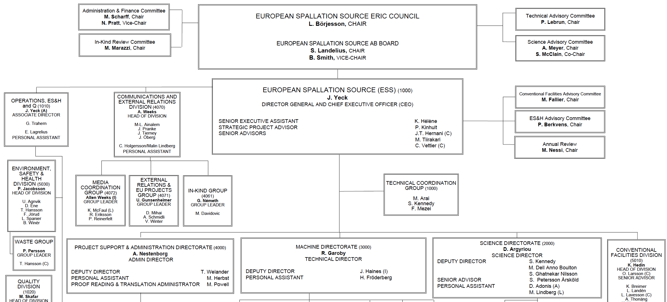
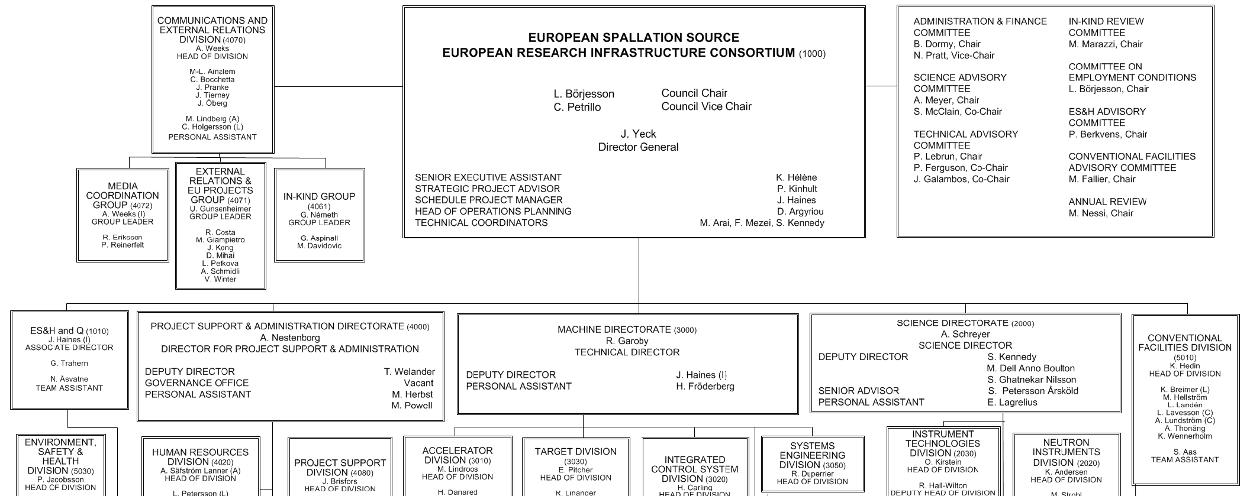
Organisation
~ 100
Partner Institutes
John Womersley
(1 Nov. 2016)
PROJECT MANAGER
John Haines
(15 Aug. 2016)
48
Nationalities
Ralf Trant
(1 Oct. 2016)
Antonio Vergara
(15 Aug. 2016)
375
Employees

Slide 7
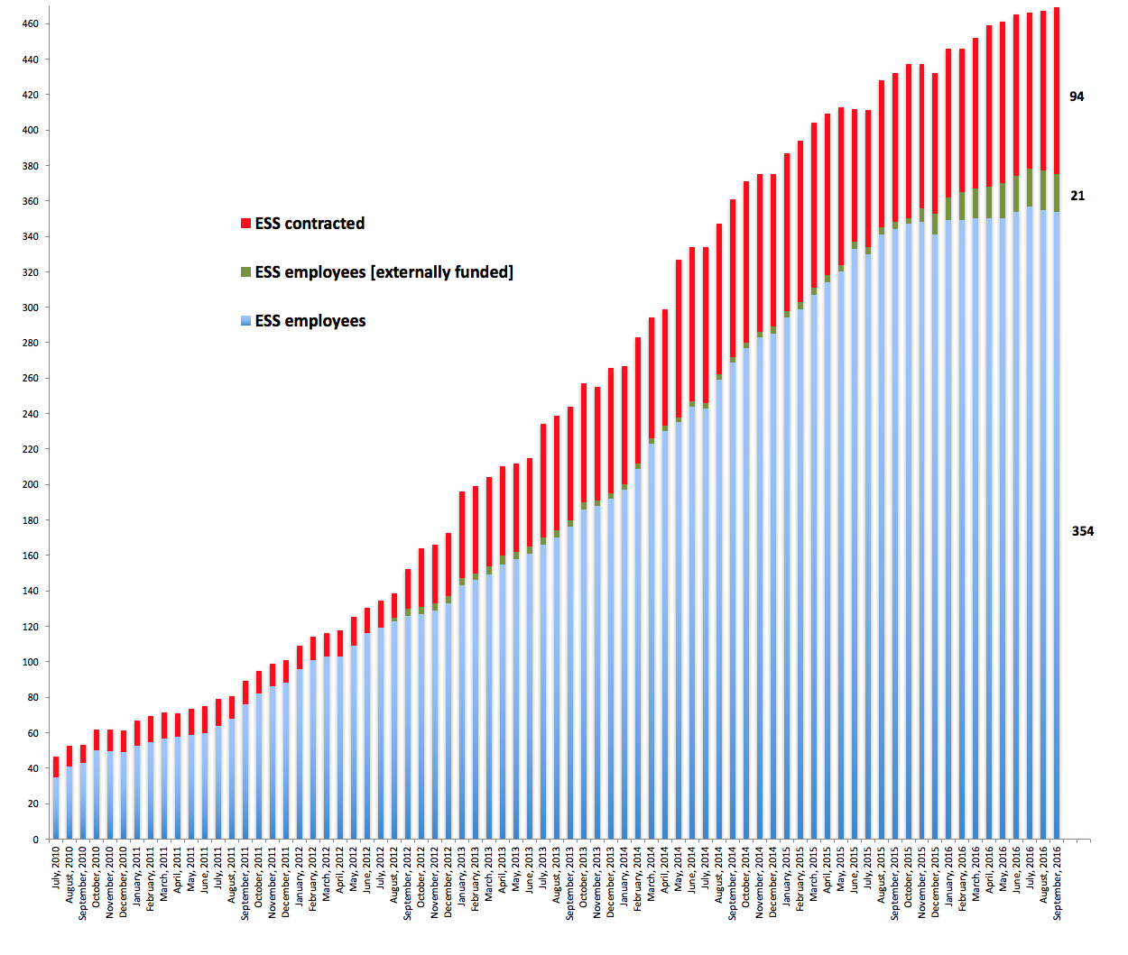
ESS staff 2016-09-30

Slide 8
2016 priorities
Continue emphasis on schedule performance – key to success
Transition In-kind partners into execution phase (instruments!)
3rd Annual Project Review and Response – April
Submit application to regulatory authority for license to commission first stages of accelerator systems – May
Establish a “cash facility” for liquidity gap/hold schedule – June
Start machine installation, e.g., accelerator cryo piping – Sep
Establish operations plans consistent with requirements – Dec
Engage new members – ongoing
Done!
Done!
In progress
In progress

Slide 9
Progress since TAC#13
Construction project 25% complete
Remarkable progress on in-kind program
Success is within the control of ESS and our stakeholders
    Many, many issues, but excellent cooperation exhibited
    Preparing for installation
Annual Review took place as well as many other reviews (PDR as well as CDR) and kick-off meetings (with partners and industry) for each project
“Installation Permit” has been submitted early May 2016 to the SSM (2nd step of licensing); iterations are on-going,
Work has progressed both at Lund on all fronts (Conventional Facilities as well as within projects) and at partners.
Changes in the Management:
  The position of Project Manager has been created. John Haines is in charge.
  Ralf Trant has taken the position of Associate Director for ESH and Q on October 1
  John Womersley will succeed to James Yeck as DG on November 1.

Slide 10
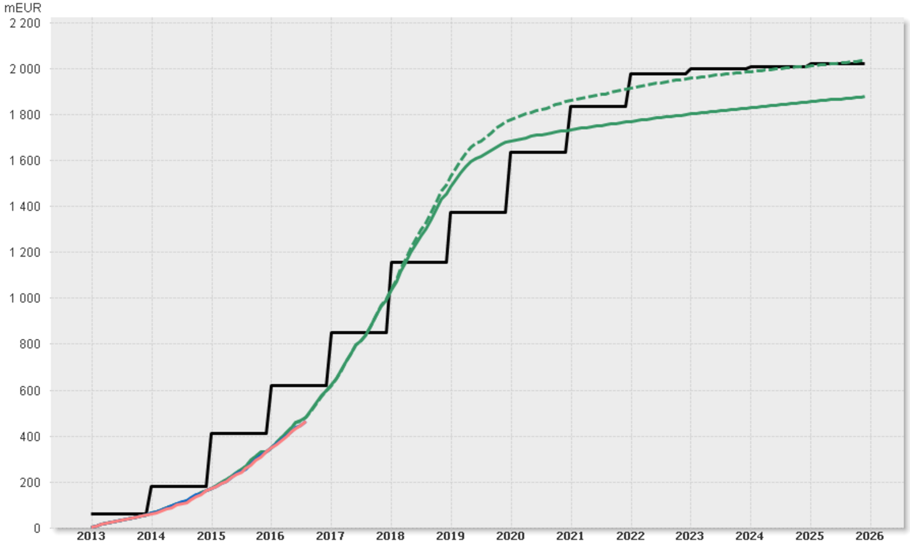
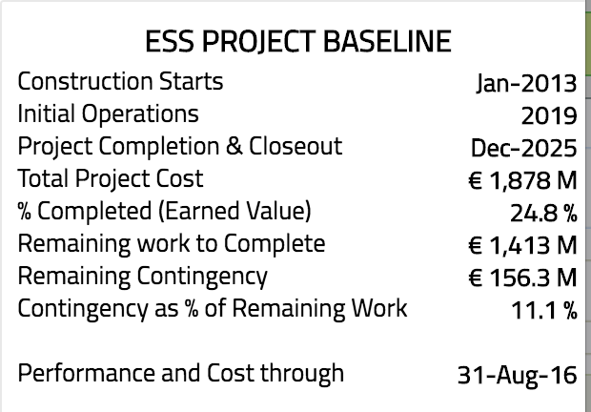
Construction Profile, Aug 2016
ESS Construction Funding and Budget Profile (As Year Prices)
⧫ Construction Project Complete
⧫ Machine 2.0 GeV
⧫ First installations
(of Machine Systems)
⧫ 1st Call for
User Proposals
Total Funding (Cumulative)
⧫ Machine Ready for Beam on Target
⧫ Operations Starts
Total Baseline Budget incl. Contingency (Cumulative)
⧫ Construction
Starts
Total Baseline Budget excl. Contingency (Cumulative)
Total Earned Value (Cumulative)
Total Actual Cost (Cumulative)
Notes:
Schedule variance = Earned – Schedule
Cost Variance = Actuals - Earned
SPI = Earned/Scheduled
CPI = Earned/Actuals

Slide 11
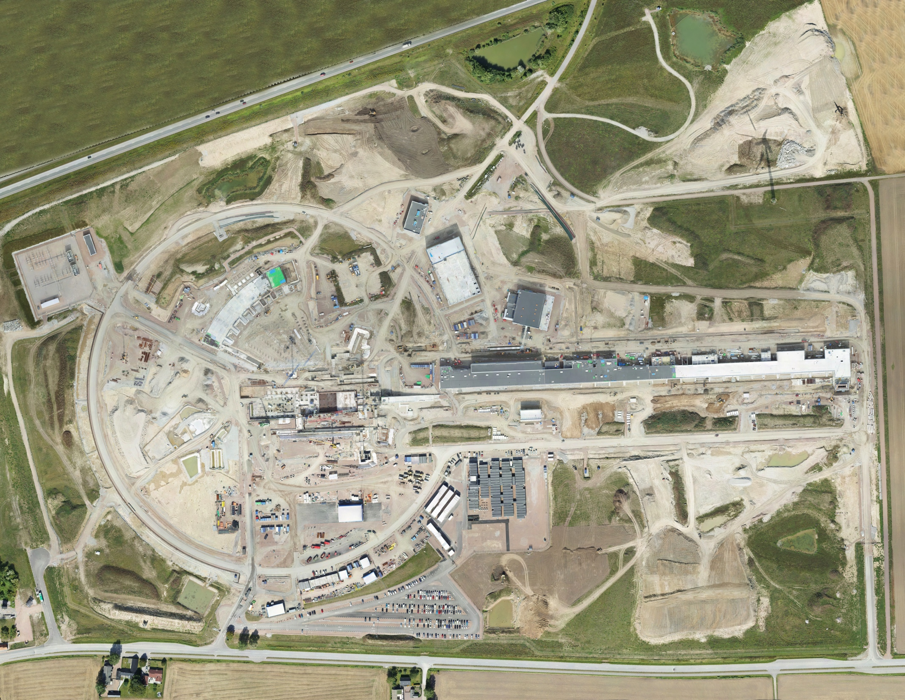
Aerial view
26 August 2016

Slide 12
In-kind possible and agreed/planned
Stretch Goal 747.5m
675m
544.9m

Slide 13
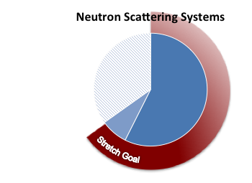
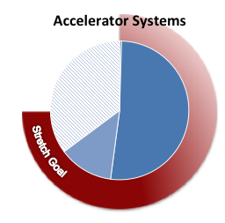
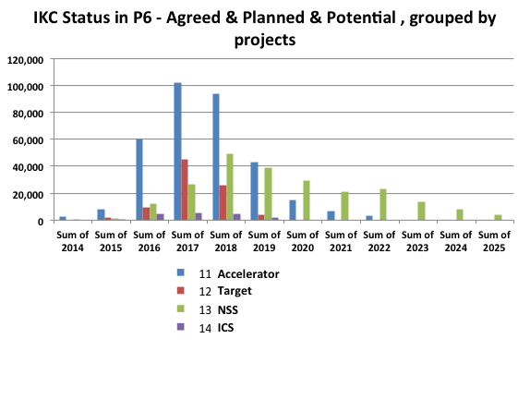
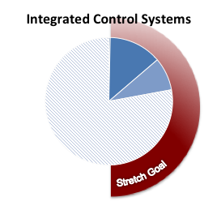
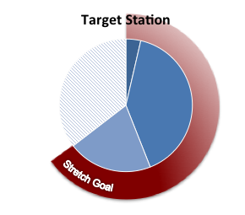
IK status - Project dashboard
Agreed
Planned
Potential
Stretch goal

Slide 14
Level 2 Cost Baseline tracking
% complete
34%
18%
17%
20%
49%
12%
50%
Notes:
Schedule variance = Earned – Schedule
Cost Variance = Actuals - Earned
SPI = Earned/Scheduled
CPI = Earned/Actuals

Slide 15
Annual review themes – April 2016 (1)
Evaluated the results from the annual project review completed in late April, a hard-nosed and constructive review.
Recognized intense effort and impressive progress over the last year and provided excellent advice on issues and future challenges. The feedback is used to strengthen plans and actions defined in response to the recommendations. Key themes:
Schedule Management - Continue to improve integrated schedule and resolve known schedule conflicts and delays. Identify lessons from current experience, e.g., delays starting machine in-kind work, target building construction, etc. and consider these lessons-learned in future plans. Ensure that interim milestones are relevant to delivery of early science success at start of user program in 2023.

Slide 16
Review themes continued (2)
Liquidity Gap – Encouragement to finalize work with lending institutions and the Council so that a “cash facility” for managing the liquidity gap is in place by the last half of the year.
Technical Integration, Installation, and Project Management – Strengthen central technical integration and project management to achieve better ESS-wide communication and optimization. Organize for integrated coordination of installation.
Instrument Program – Take the necessary steps to establish credible schedules for the construction of instruments and increase the probability that the first suite of instruments will be ready at the start of the user program in 2023.

Slide 17
Review themes continued (3)
Operations Transition – Ramp-up planning for operations. Integrate the schedules and plans for construction and initial operations and establish a management approach that can optimize over the total effort.
Safety and Health – Ramp-up efforts on safety and health to be ready for delivery of buildings and the start of installation work on the site later this year.
The report included over sixty recommendations and many positive findings. The committee reviewed an organization with the competency and capacity to benefit from a thorough critique.
“Project reviews are the most important management tool to ensure that the project is staying on track. If you are not required to have them, you should inflict them on yourself.”

Slide 18
Construction project summary
  Construction ~25% complete today and over 30% by end of 2016
  Priority on schedule performance – key to success
  Emphasis on securing in-kind deliverables in collaboration
  Additional work to ensure European Spallation Source ERIC provides the institutional framework needed for long term success
  Working to establishing operations plans consistent with facility requirements and supportable by the Council
  Core Values are Excellence, Openness, Collaboration, and Sustainability
  Mission – design, build, and operate the world’s
  leading research facility using neutrons

Slide 19

Charge and Schedule
of the 14th TAC meeting
5-7 October 2016, Lund
Roland Garoby
https://indico.esss.lu.se/event/578/overview

Slide 20
Questions to the TAC for its 14th meeting
Accelerator (1/2)
a1) The Accelerator session focuses on the RF systems of the accelerator, following the request of the Committee at the last meeting. Does the TAC have recommendations on the systems presented:
  regarding the design and early prototyping?
  regarding the proposed procurements and system assembly which partly is done at IK partners?
  about the plans for integration in the RF gallery and installation?
  about the proposed testing?

Slide 21
Questions to the TAC for its 14th meeting
Accelerator (2/2)
a2) The schedule for the RF systems is challenging and delays are showing up. Success largely depends on the capability of industry to deliver within the foreseen schedule. We would like the TAC to communicate experience on that matter: how likely is it that companies will deliver on time and what can be done to improve the situation? The same question is asked for the installation and RF gallery integration schedule. Any comments or experience to share?
a3) Does the TAC have comments on the organization for installation? Shared experience from other facilities is welcome as part of the answer to this question.
a4) Integration is an on-going effort. Some aspects of accelerator integration with MPS, TSS and PSS are presented and also some aspects of documentation. TAC comments and reactions are expected.

Slide 22
Questions to the TAC for its 14th meeting
Target (1/2)
t1) Are the proposed concepts and preliminary plan for the in-monolith diagnostics and instrumentation appropriate and sufficient to satisfy the needs of monitoring the target wheel?
t2) Are the interfaces with Accelerator Systems and Neutron Science Systems reasonable and manageable, with respect to the presented design solutions and choices for the monolith vacuum operation and the neutron beam extraction system?
t3) Are the performed assessments and validations of the integrity and robustness of the spallation material thorough enough to constitute a solid basis for a safe commissioning and operation of the target?
t4) Comments and suggestions are expected regarding the design solutions for the cold moderator liquid hydrogen system.

Slide 23
Questions to the TAC for its 14th meeting
Target (2/2)
t5) Is the presented filter solution for the target helium cooling system sufficient, robust and appropriate for a safe and reliable operation and maintenance?
t6) Does the proposed organization for installation of the target station seem appropriate for an efficient coordination of all installation activities performed by in-kind partners and contractors, concurrent with on-going building construction and parallel works of the Accelerator, Integrated Control and Neutron Science Systems?

Slide 24
Questions to the TAC for its 14th meeting
ICS
c1) Are the interfaces between the ICS and Accelerator Systems defined and documented well enough for this stage of the project?
c2) Are the progress and the future outlook of the systems presented appropriate and what are potential bottlenecks?
c3) Are the different software tools and infrastructure developed well enough for this stage of the project? Are the processes around these tools properly defined?
c4) Are there any issues/risks with the scalability and performance of the software products when ramped up to operations level?
c5) Do the ICS standardization efforts regarding ICS hardware, ICS software, EPICS, Machine Protection and Personnel Safety Systems correctly and realistically address the requirements needed to implement the ESS mission and schedule?

Slide 25
Additional considerations
General questions
Have the recommendations and concerns of the previous TAC meeting been properly addressed?
Additional suggestions/comments and recommendations?
Planning
A preliminary version of the Committee report is expected on Friday 7, October.
The final report is expected two weeks later.
The Chairman will orally present the TAC#14 report to the Council on December 5-6 in Bilbao.

Slide 26
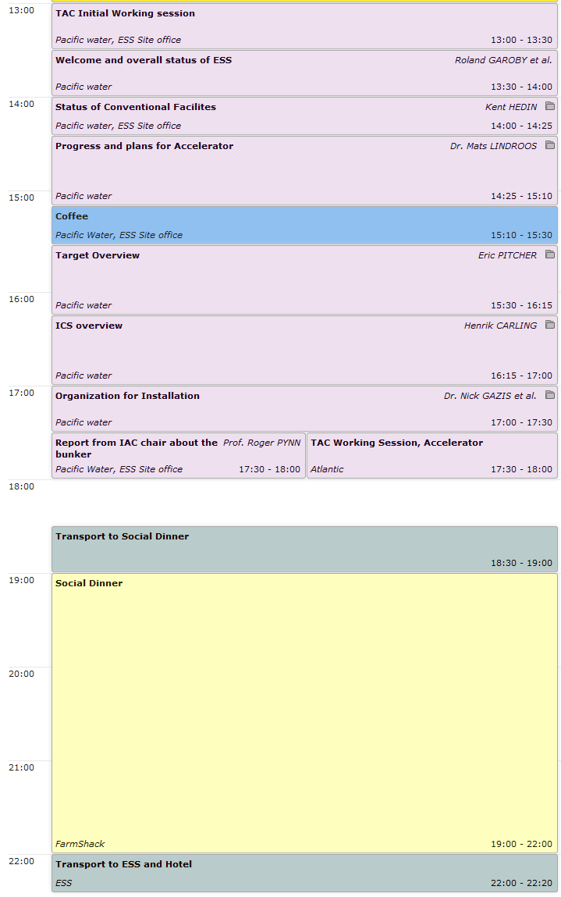
Agenda TAC#14:
Wednesday 5 October 2016
Meeting on construction site
Dinner at FarmSchak

Slide 27
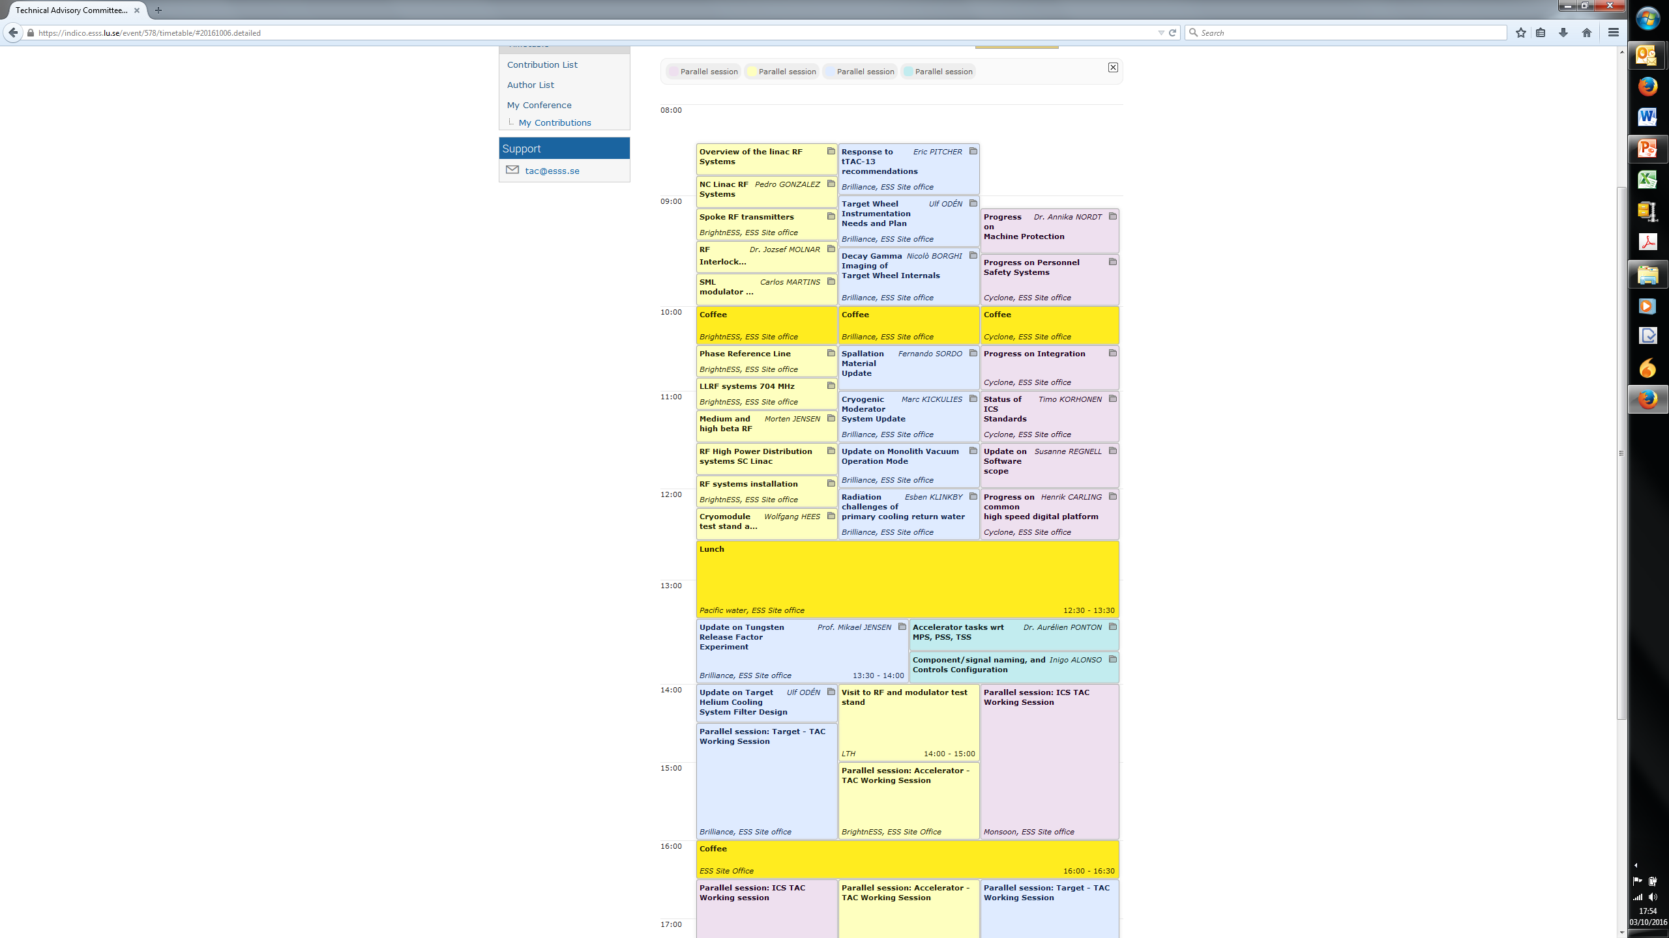
Agenda TAC#14:
Thursday 6 October 2016
Visit of ESS test place at Lund University
Buffet dinner at hotel

Slide 28
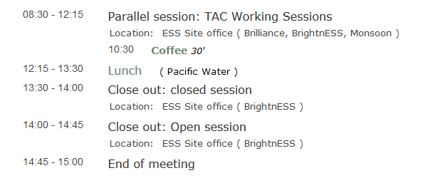
Agenda TAC#14:
Friday 7 October2016
3.25 hours TAC session: additional Q&As and presentations are possible
Optional private close out to the ESS management

Slide 29
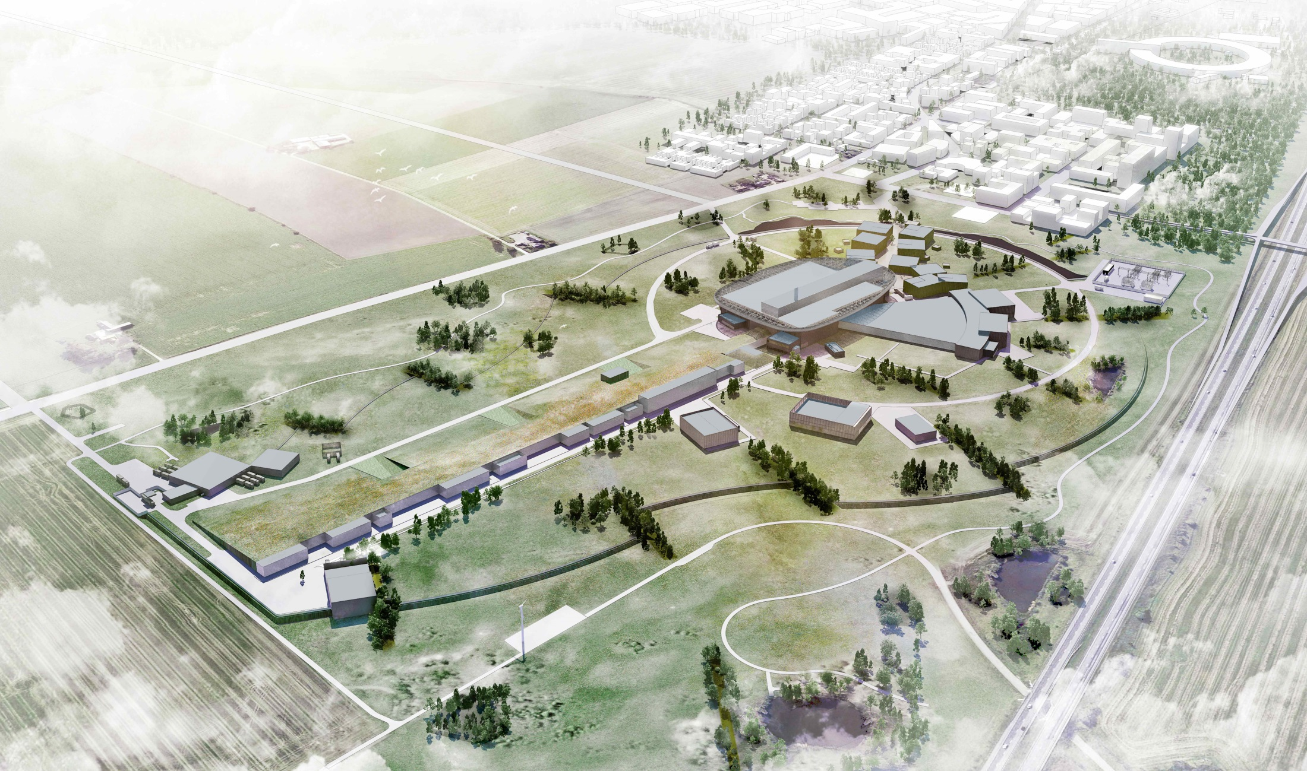
Thank you for being here.
We look forward to your advice!

