Slide 1
Conventional Facilities
Kent Hedin
Head of Conventional Facilities
www.europeanspallationsource.se
28 September 2016

Slide 2
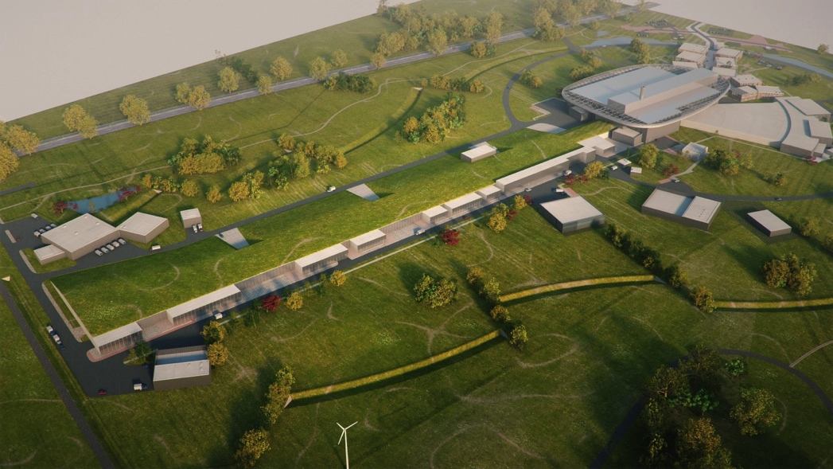
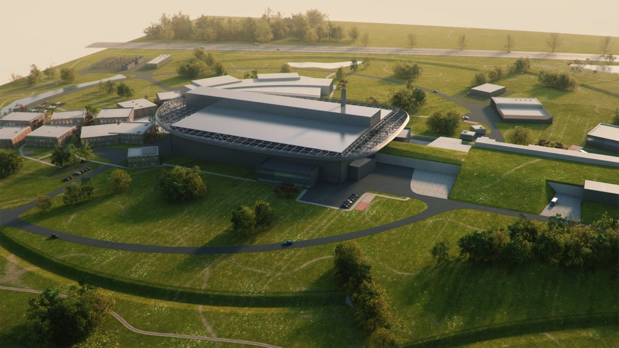
CF Scope
From CF Project Plan:
  “CF shall deliver the physical space for a sustainable research facility in a sustainable way, within budget, according to schedule and with the proper function and quality “.
CF will provide ESS with
Buildings,
Mechanical and electrical infrastructure
Layout and landscaping

Slide 3
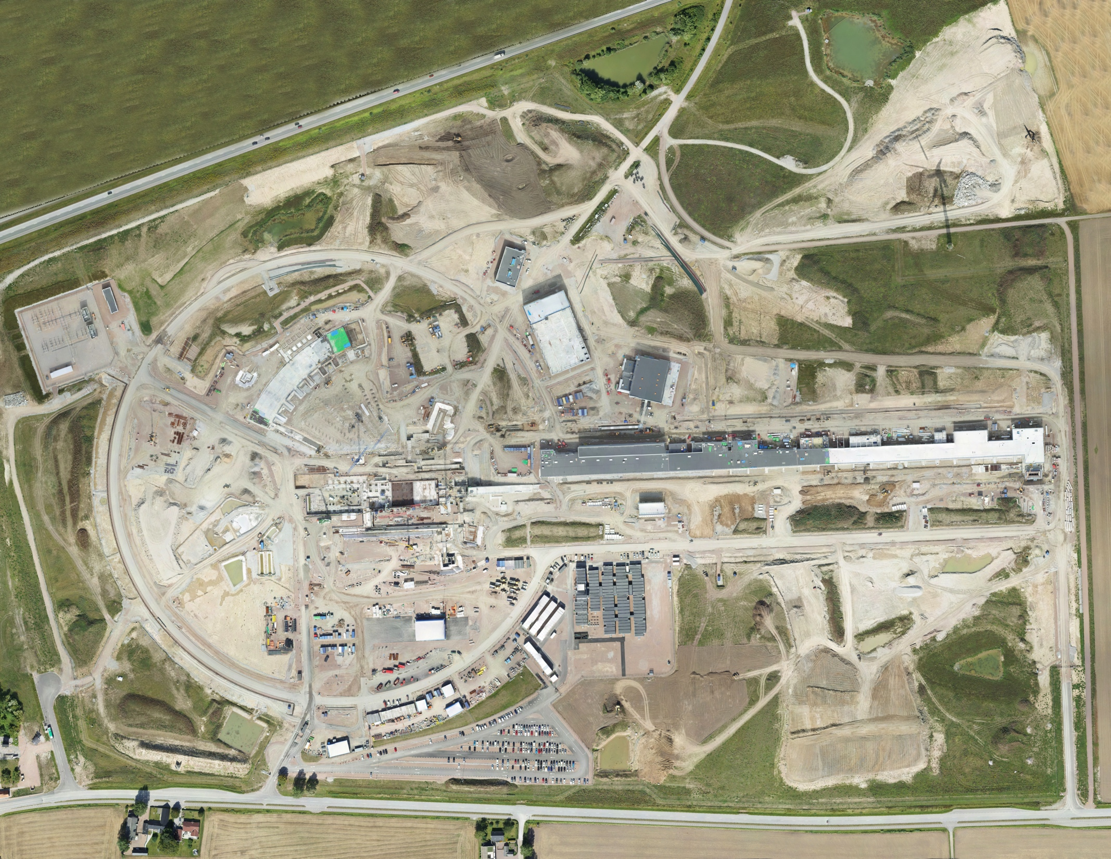
Aerial view
26 August 2016

Slide 4
Project Scope (23 buildings)
Plan, July to December 2016
E01-E05: Concrete Works completed by end 2016
Building complete
H09 Waste Storage
MEP in progress
H05 Primary Substation
E02 Beam Line Gallery
H06 Distribution Substation
Sectional Handover Inspection (SHIN)
Aug 2016
SHIN, Oct 2016
H01 CUB Building
MEP works
G02 Klystron Gallery
Internal finishes
E01 Experimental Hall 3
E04 Lab
G04 Cryo Compressor Building
Steel/frame erection completed by Sep 2016
Roofing & Facade
E05
H10 Sprinkler Central
Concrete works
E03
D03 Exp. Hall 2
Piling works
Start Oct 2016
D05
Earthworks/excavation
D04
D02 Target Building
Not started
Concrete works ongoing to Monolith & Active Cells
(remaining areas tbc)
D06
G04: First Access for Acc Div 09-Sep-16
D08
D07
G01 Linac Tunnel
G02: First Access for Acc Div 28-Nov-16
(Cold box)
F04 Guard House
D01
Experimental Hall 1
D01/D03-D07:Concrete Works completed by end 2016
F03 Logistic Centre/Shipping & Receiving
Civil works:
Backfill ongoing to all areas of G01
Excavation and installation of HV Cables between H06 and G-Bldgs.
Commencement of HA-HA wall construction.

Slide 5
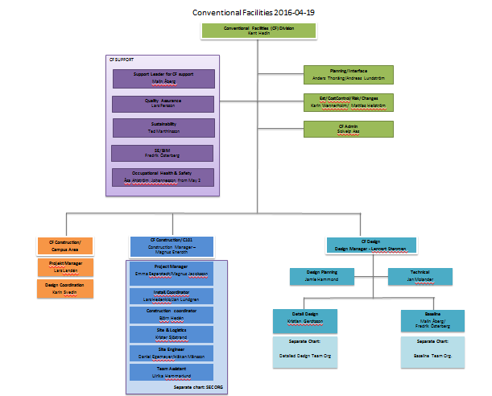
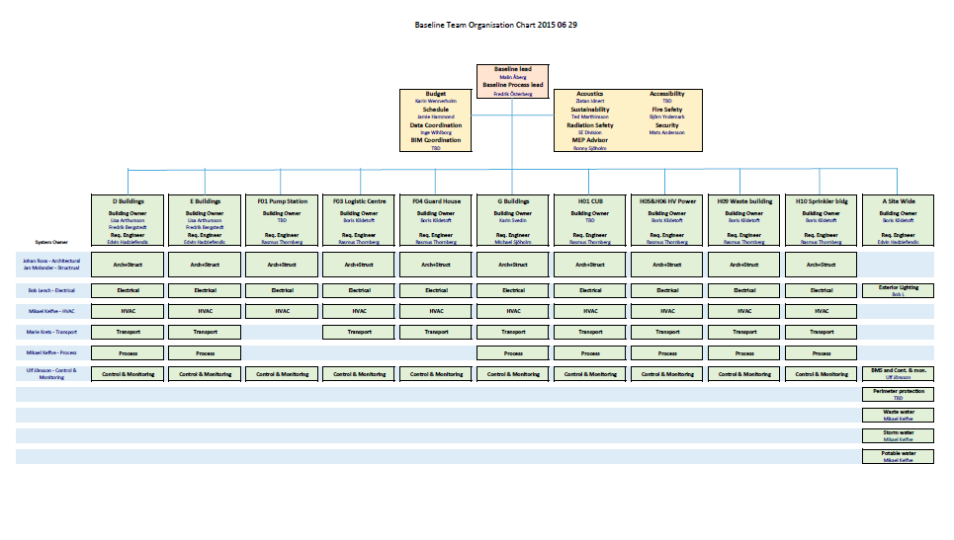
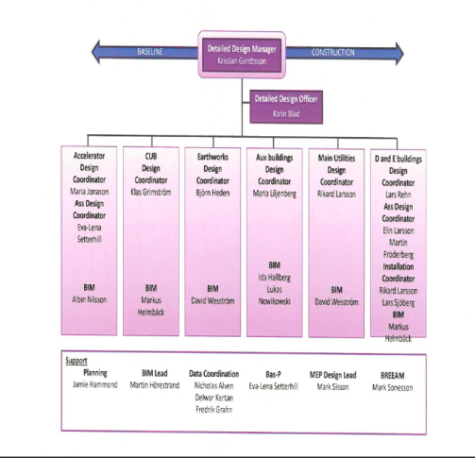
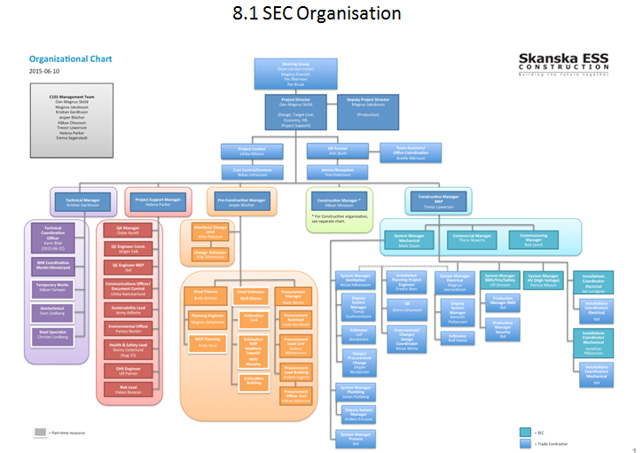
CF Organization
Employees 23
Consultants 206
On site 339
Sum 569
Notes:
Energy
Climate
Health
Agriculture
Digital society

Slide 6
CF Staff on site
360
336
324,5
250
201
178
181
127
106,5
83
159
158
123
143,5
93,5
6

Slide 7
CF Staff on site
402
365
342
324,5
250
251
194
217
181
127
106,5
83
148
123
143,5
151
148
93,5
7

Slide 8
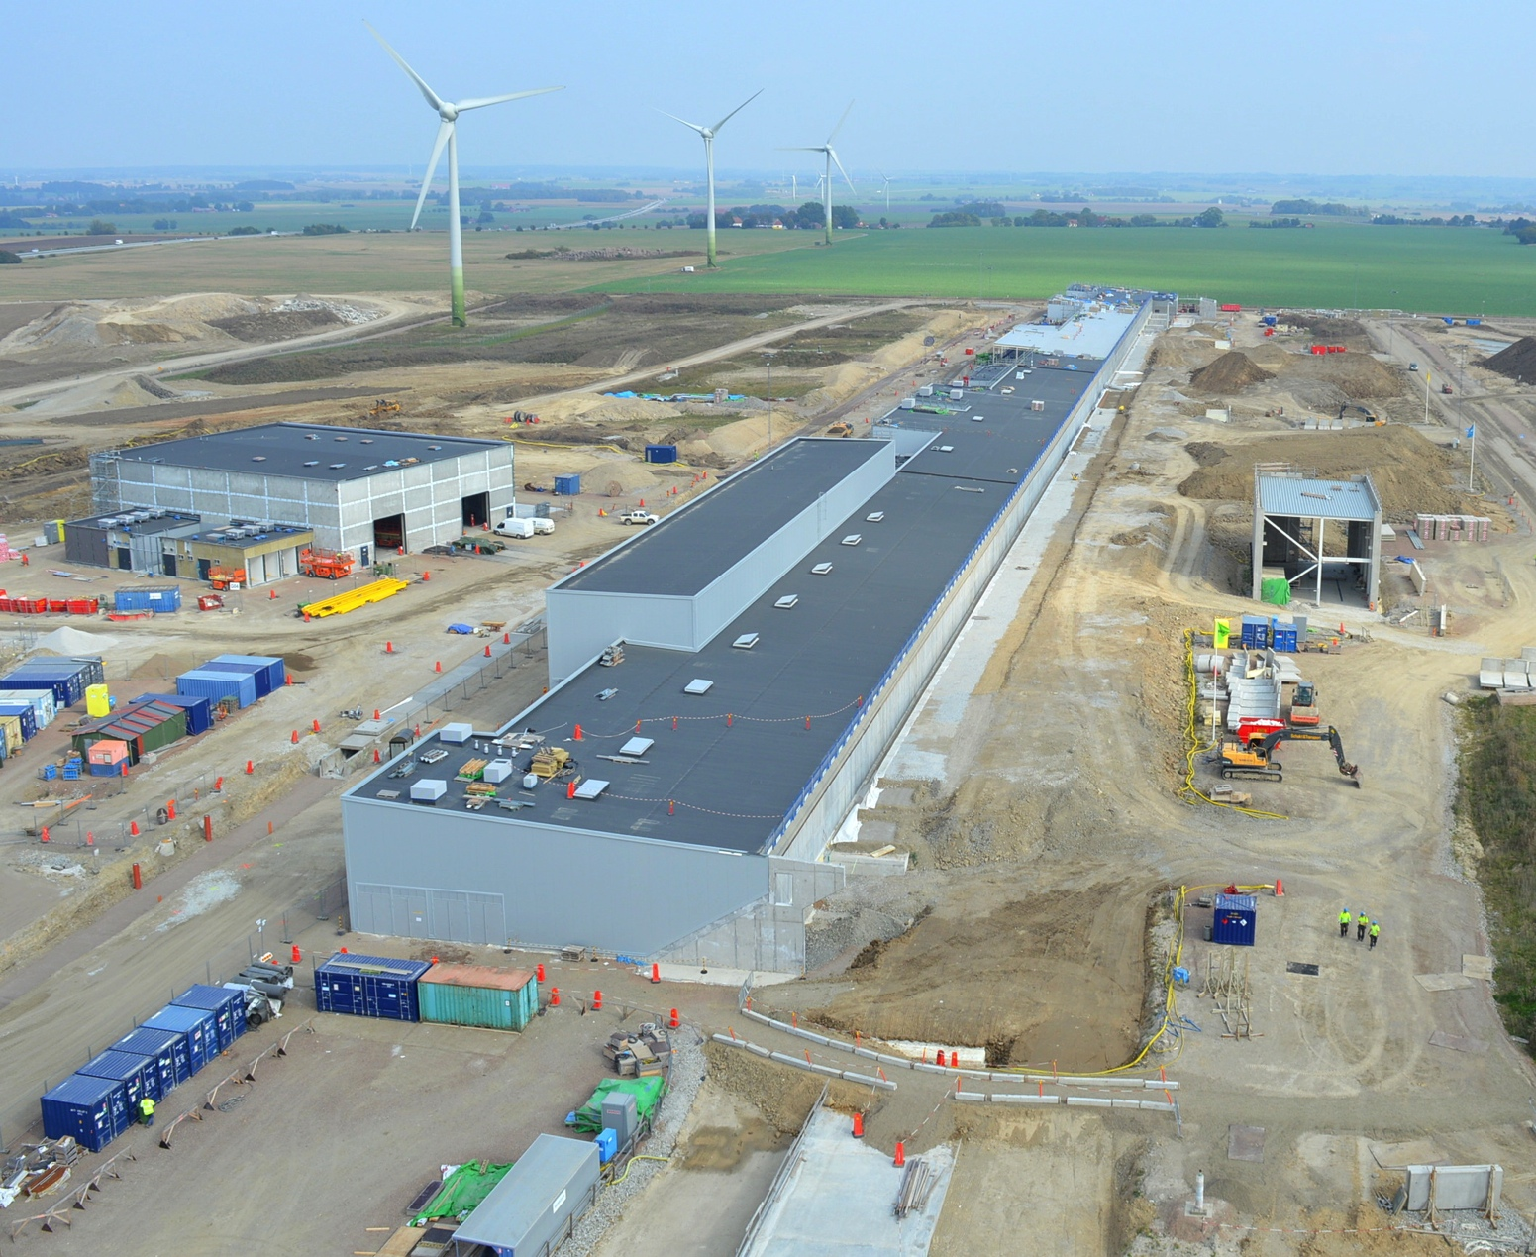
G02 Gallery & G01 backfill

Slide 9
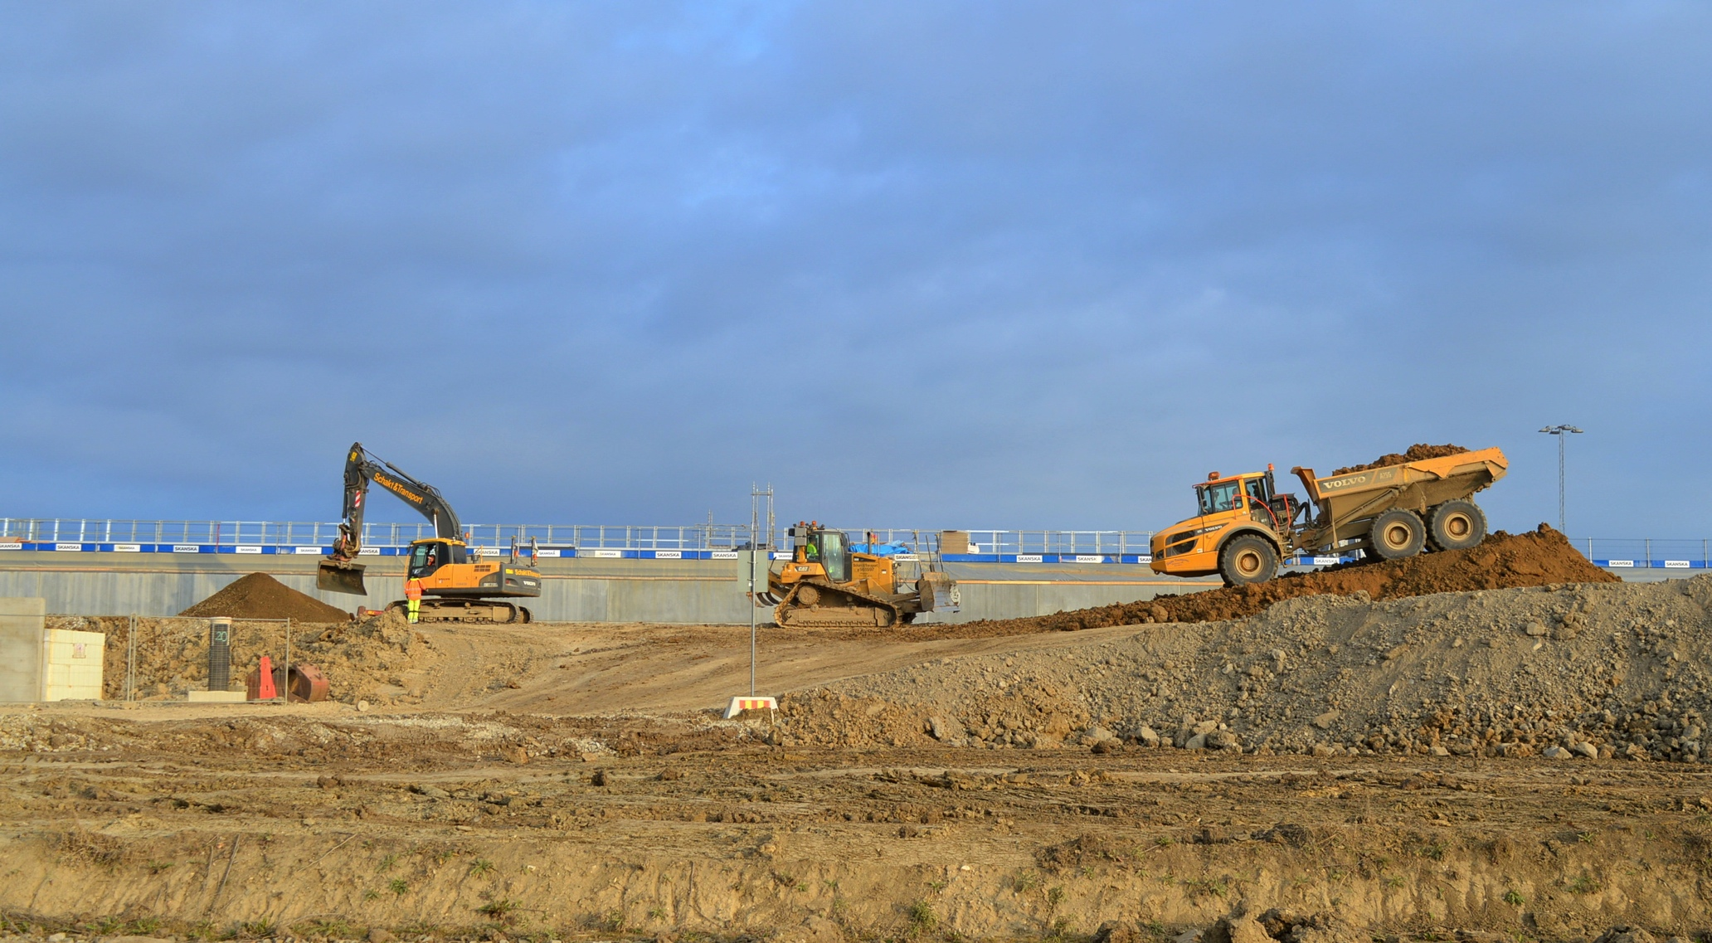
G01, Accelerator tunnel, topfill

Slide 10
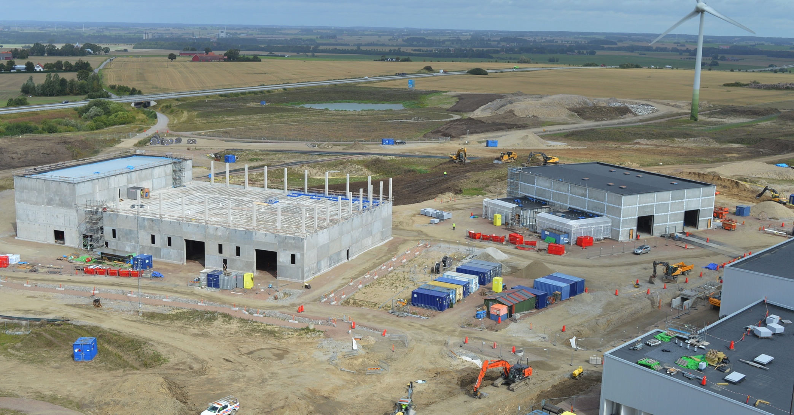
H01 & G04 from above

Slide 11
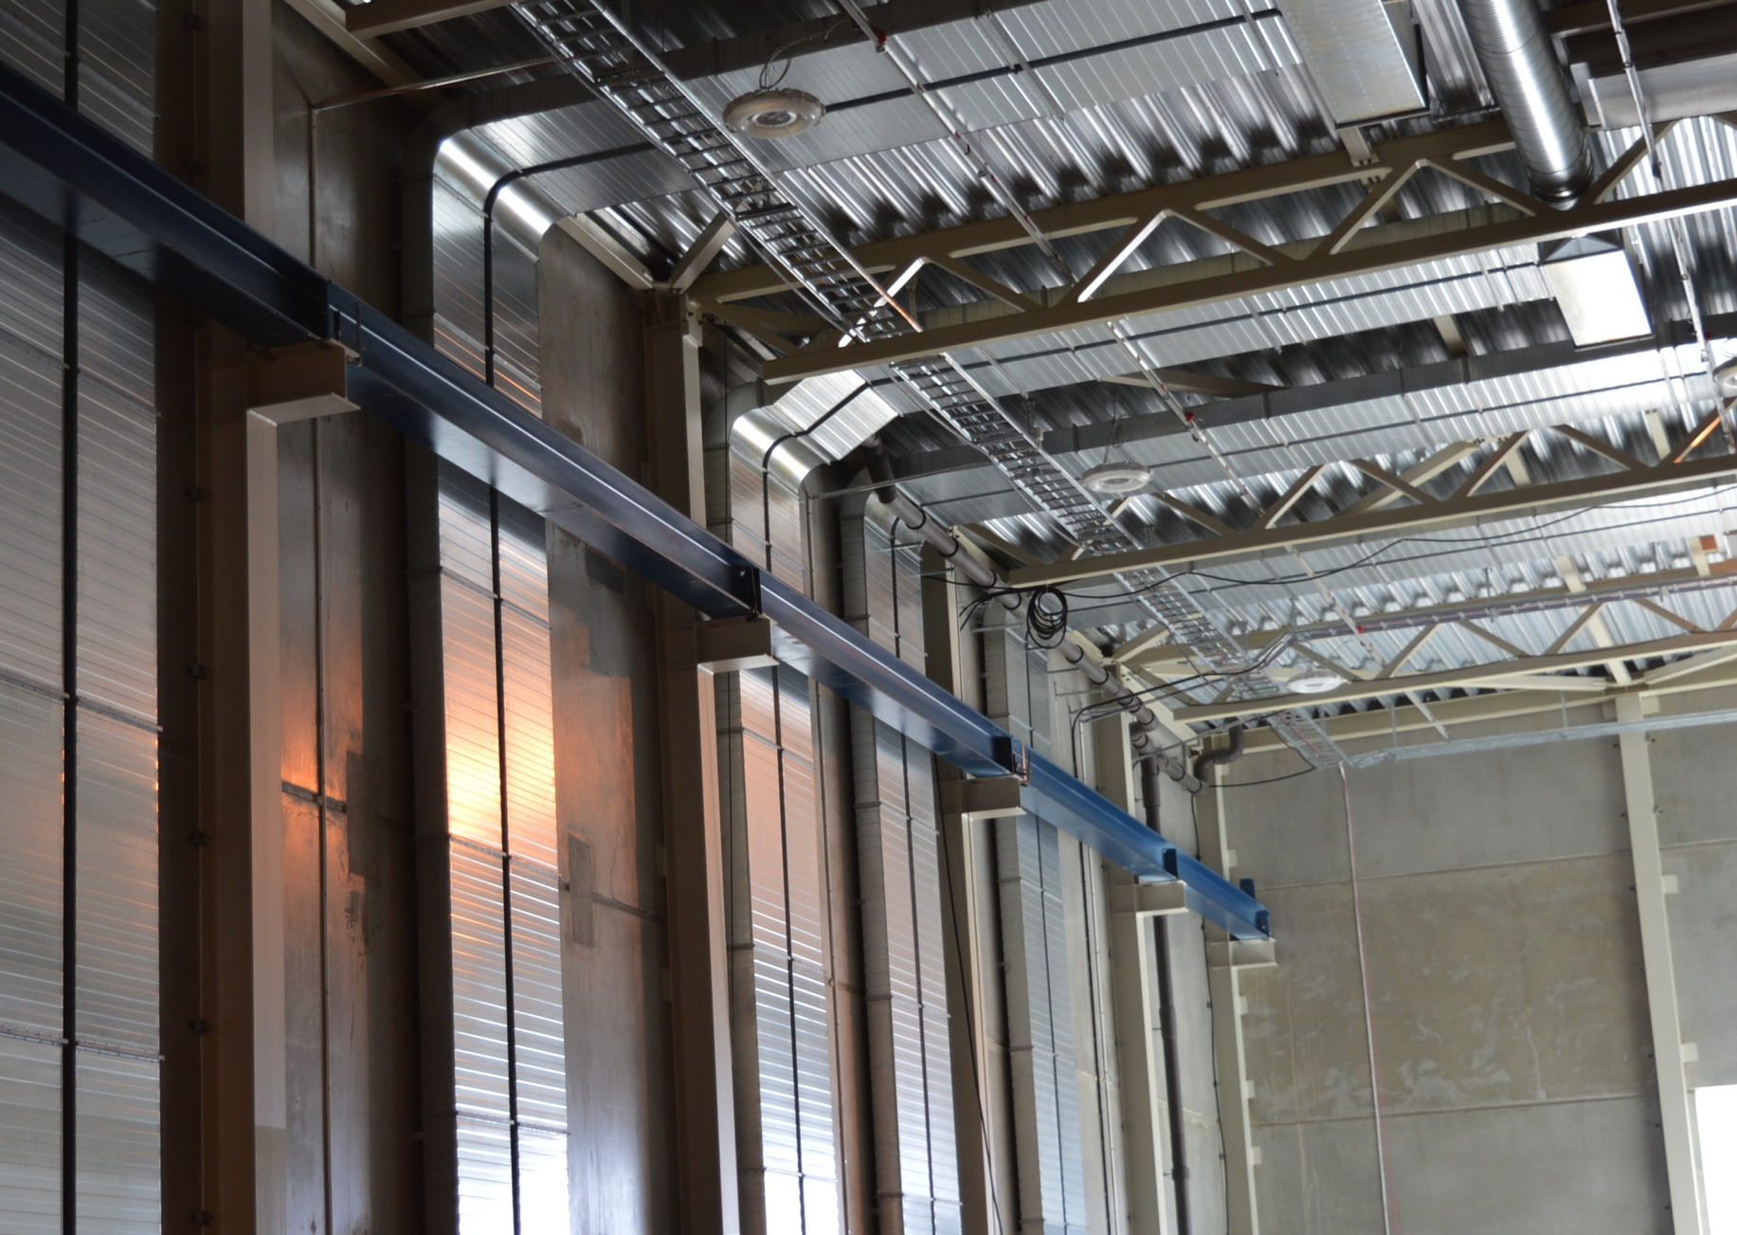
MEP works inside G04

Slide 12
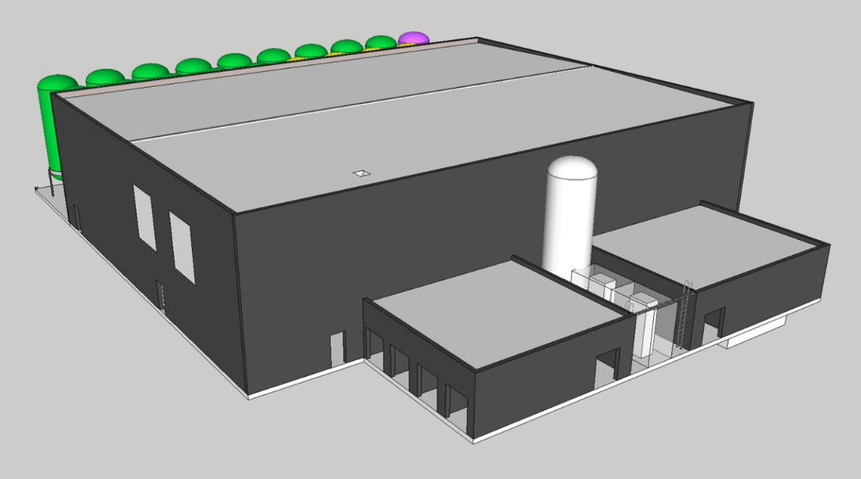
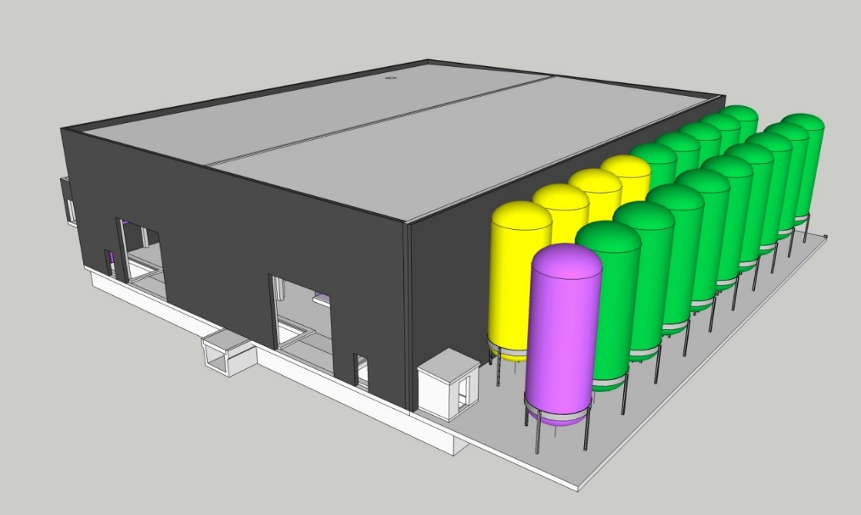
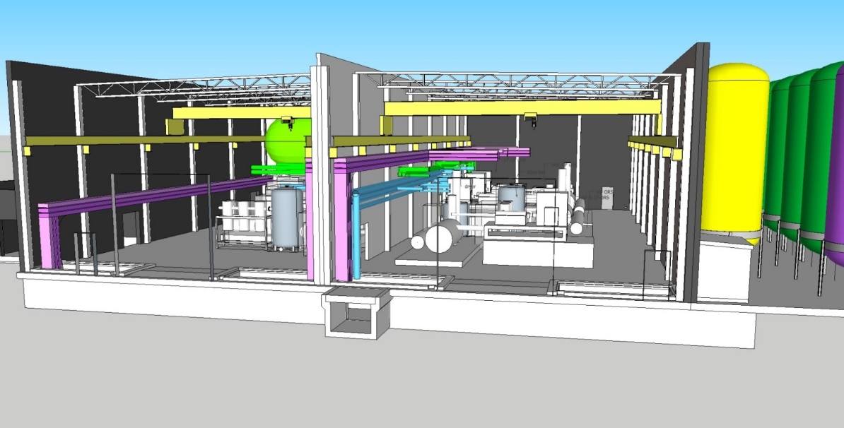
G04 – Cryo Compressor Building
- first handover to ESS
CTL Partial Access (09-Sep)
Linac Compressor Hall Early Access (07-Nov)
Gas Storage Compound Partial Access (07-Nov)
Substation Early Access (21-Nov)
TTI Hall Partial Access (05-Dec)

Slide 13
CF – project milestones 2016-03-04
G04 Cryo Compressor Building
Milestone | Access | Date | Status | Comment
G04 Cryo Compressor Building | Full Access | 02 May - 17 | OT
CTL Gallery (G04-G01) | Partial Access | 09 Sep - 16 | OT
Linac Compressor Hall | Early Access | 07 Nov - 16 | OT
Linac Compressor Hall | Partial Access | 04 Jan - 17 | OT
Electrical rooms (substation) | Early Access | 21 Nov - 16 | OT
Electrical rooms (substation) | Partial Access | 04 Jan - 17 | OT
TTI Compressor Hall | Early Access | 05 Dec - 16 | OT
TTI Compressor Hall | Partial Access | 01 Feb – 17 | OT
Gas Storage | Partial Access | 07 Nov - 16 | OT

Slide 14
CF – project milestones 2016-03-04
G02 Klystron Gallery
Milestone | Access | Date | Status | Comment
Gallery Test Facility & Coldbox | Full Access | 02 May - 17 | OT
Test Facility CM & RF | Partial Access | 28 Feb - 17 | OT
TTl Coldbox & Linac Coldboxhall | Partial Access | 28 Nov - 16 | OT
FEB Level 100+2 Stubs | Partial Access | 1 Sep - 17 | OT
Gallery + rem stubs B190-B510 | Partial Access | 29 Jan - 18 | OT
Gallery + rem stubs B510-B720 | Partial Access | 04 Dec - 17 | OT
Gallery + rem stubs B720-B820 | Partial Access | 03 Okt - 17 | OT
Cryo Control room | Partial Access | 31 Mar - 17 | OT

Slide 15
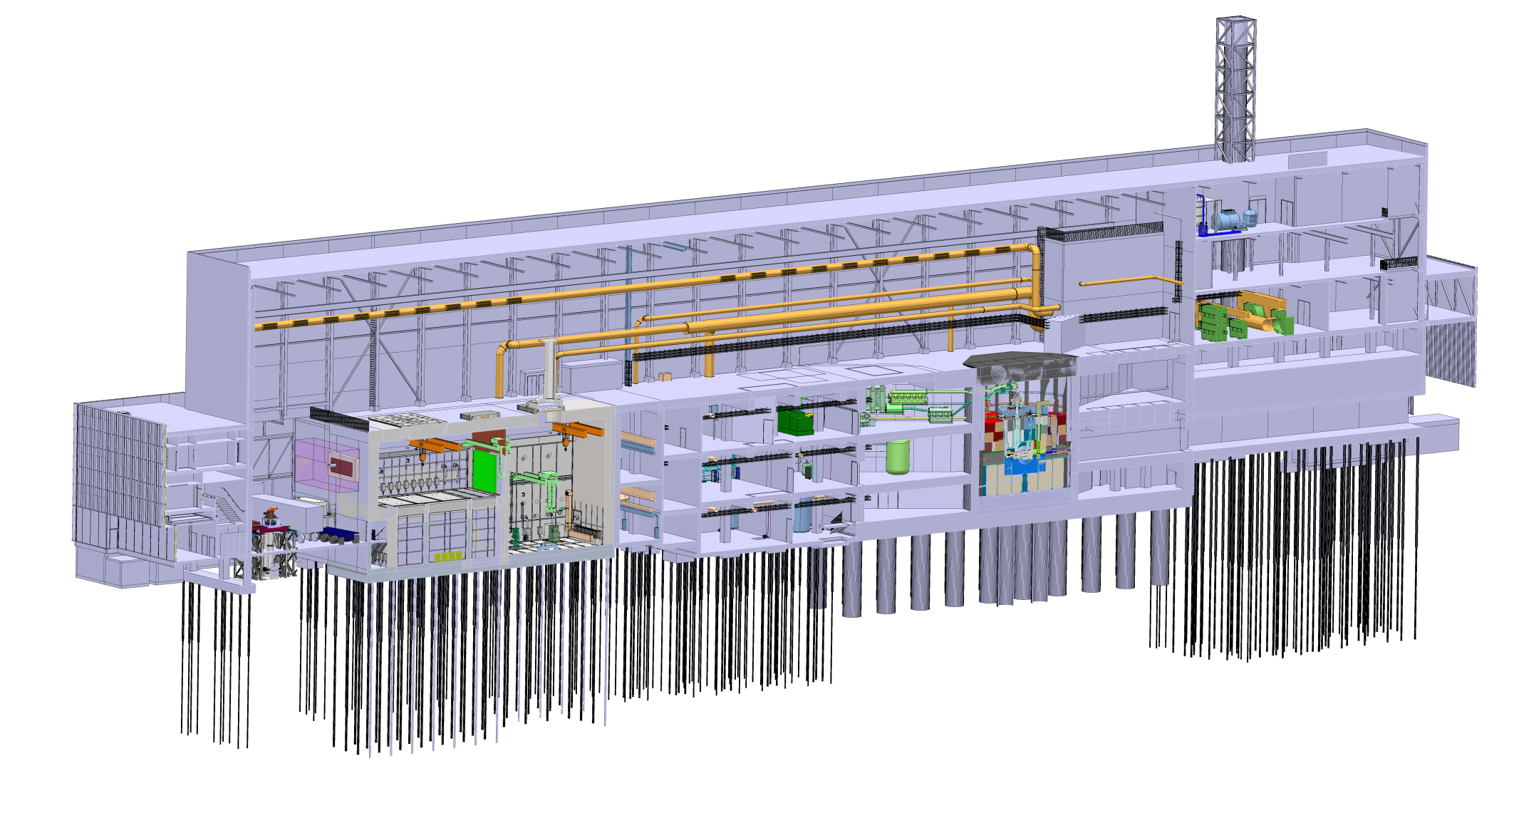
The ESS Target Station Layout
Isometric View
High bay
130 m
22 m
37 m
Target monolith
Utilities block
Accelerator – Target interface
Transport hall
Active cells

Slide 16
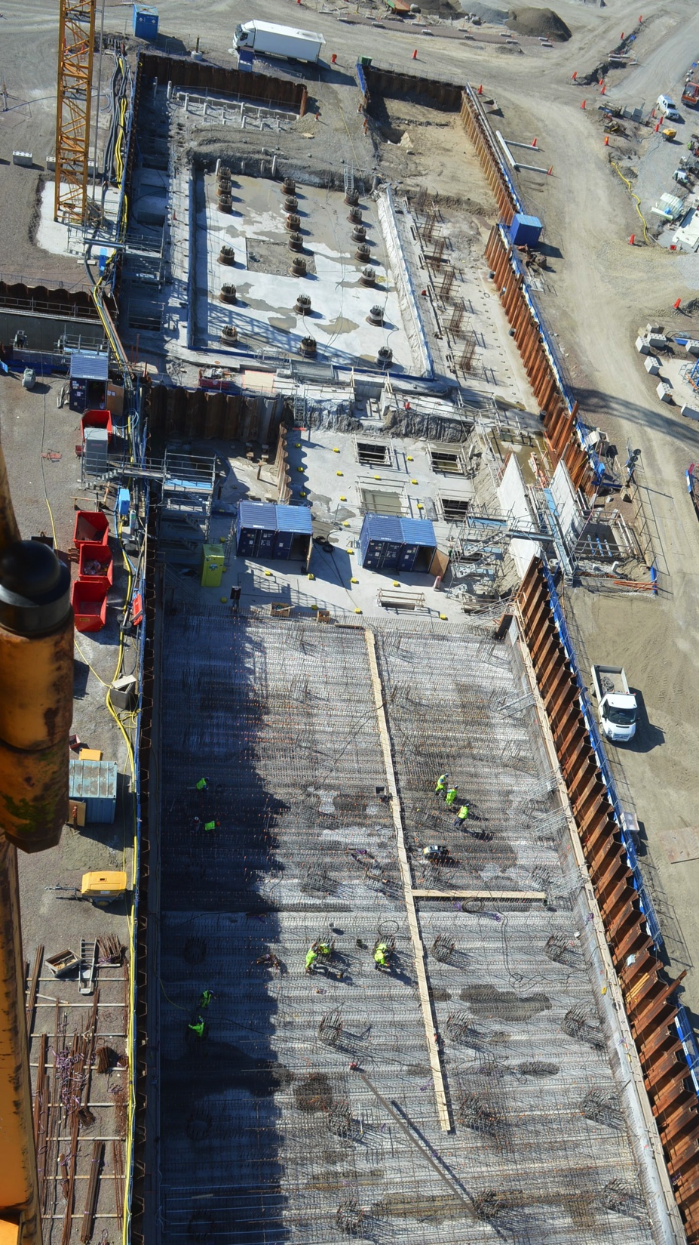
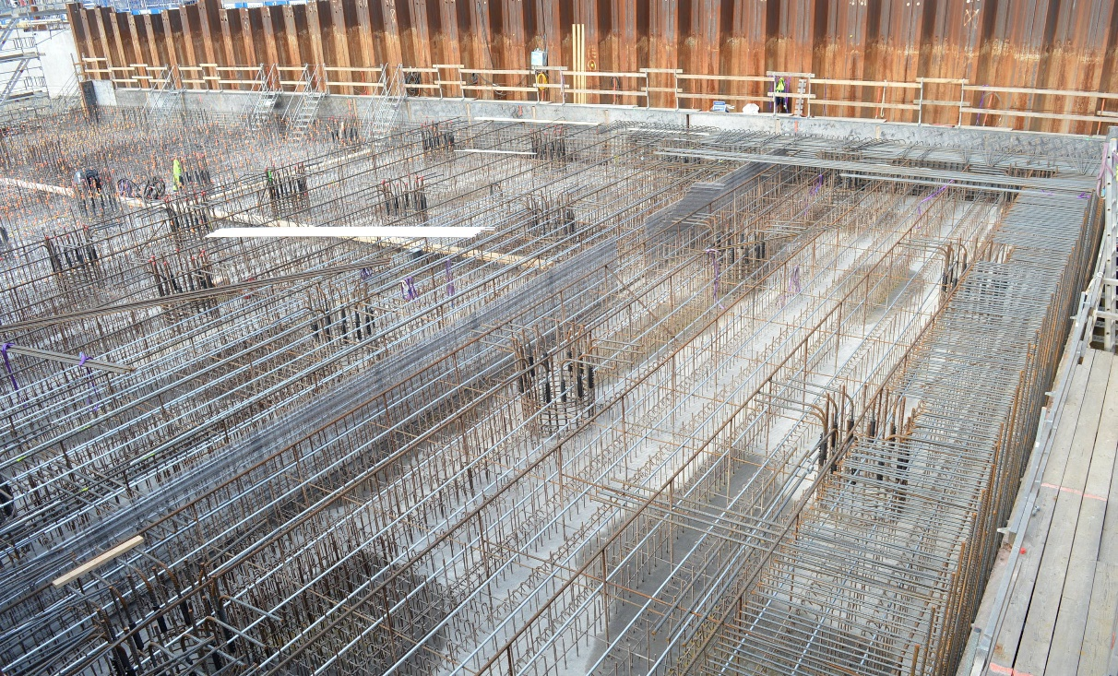
Target – Hot cell, Utility & Monolith
Reinforcement works, 1600 mm bottom slab, Monolith.
First casting: September 28.

Slide 17
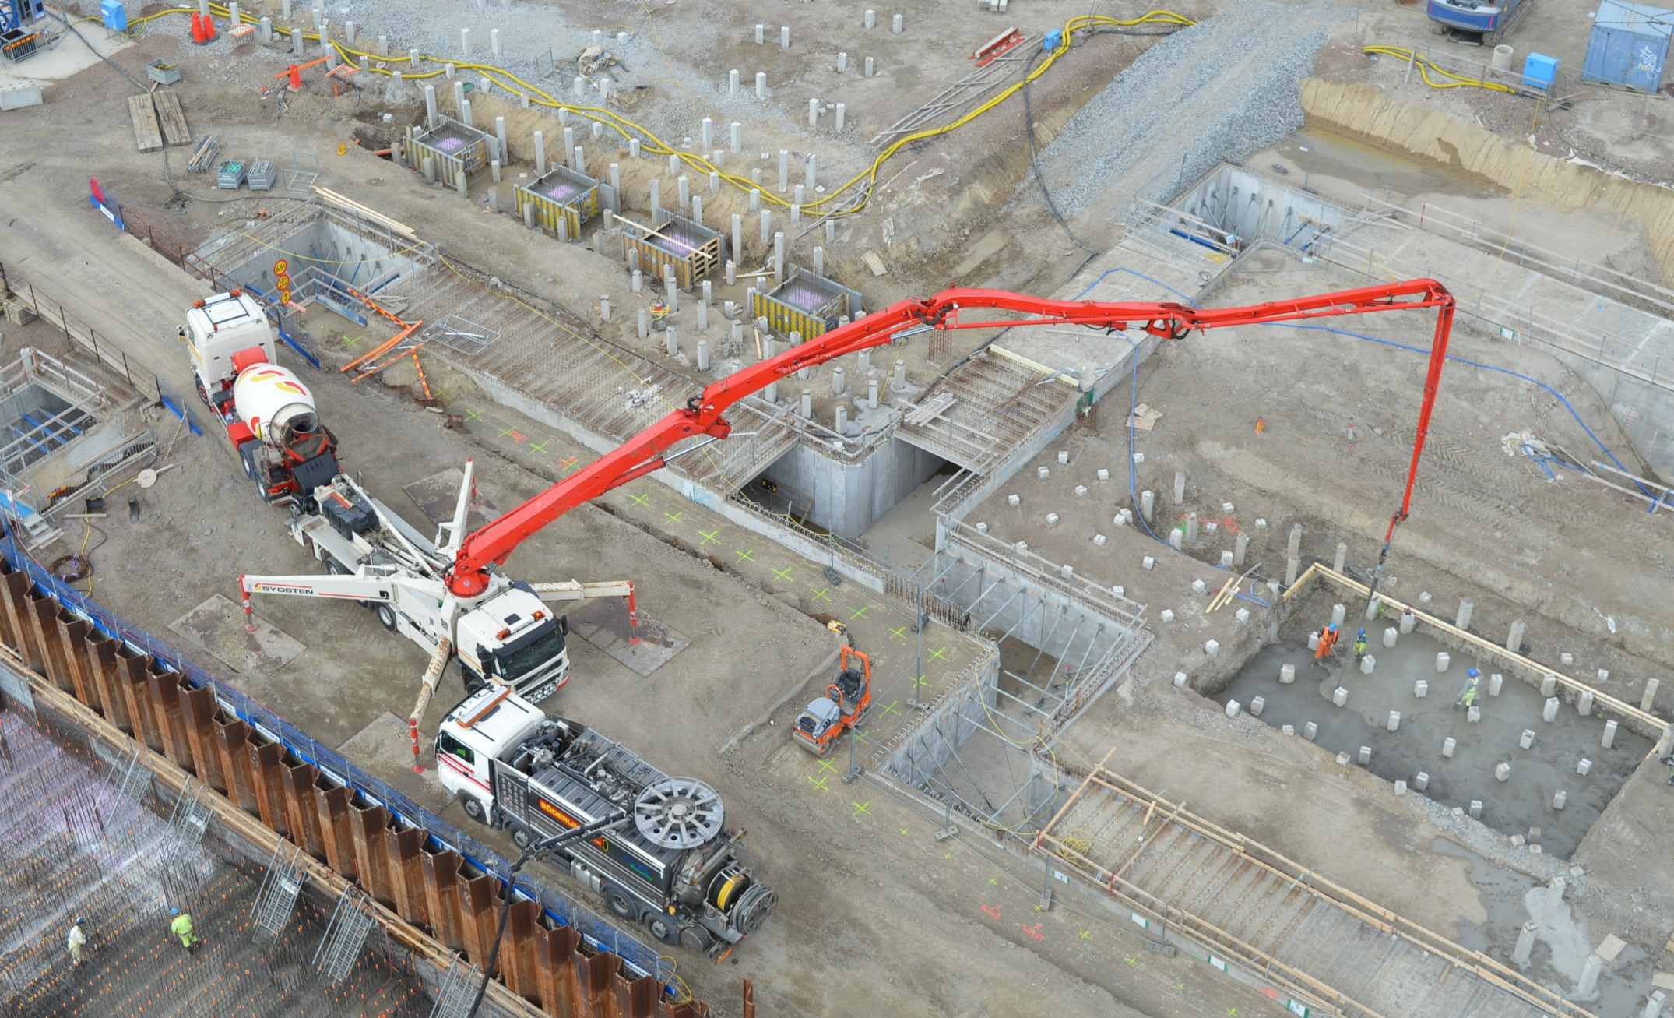
D03 – Installation Galleries

Slide 18
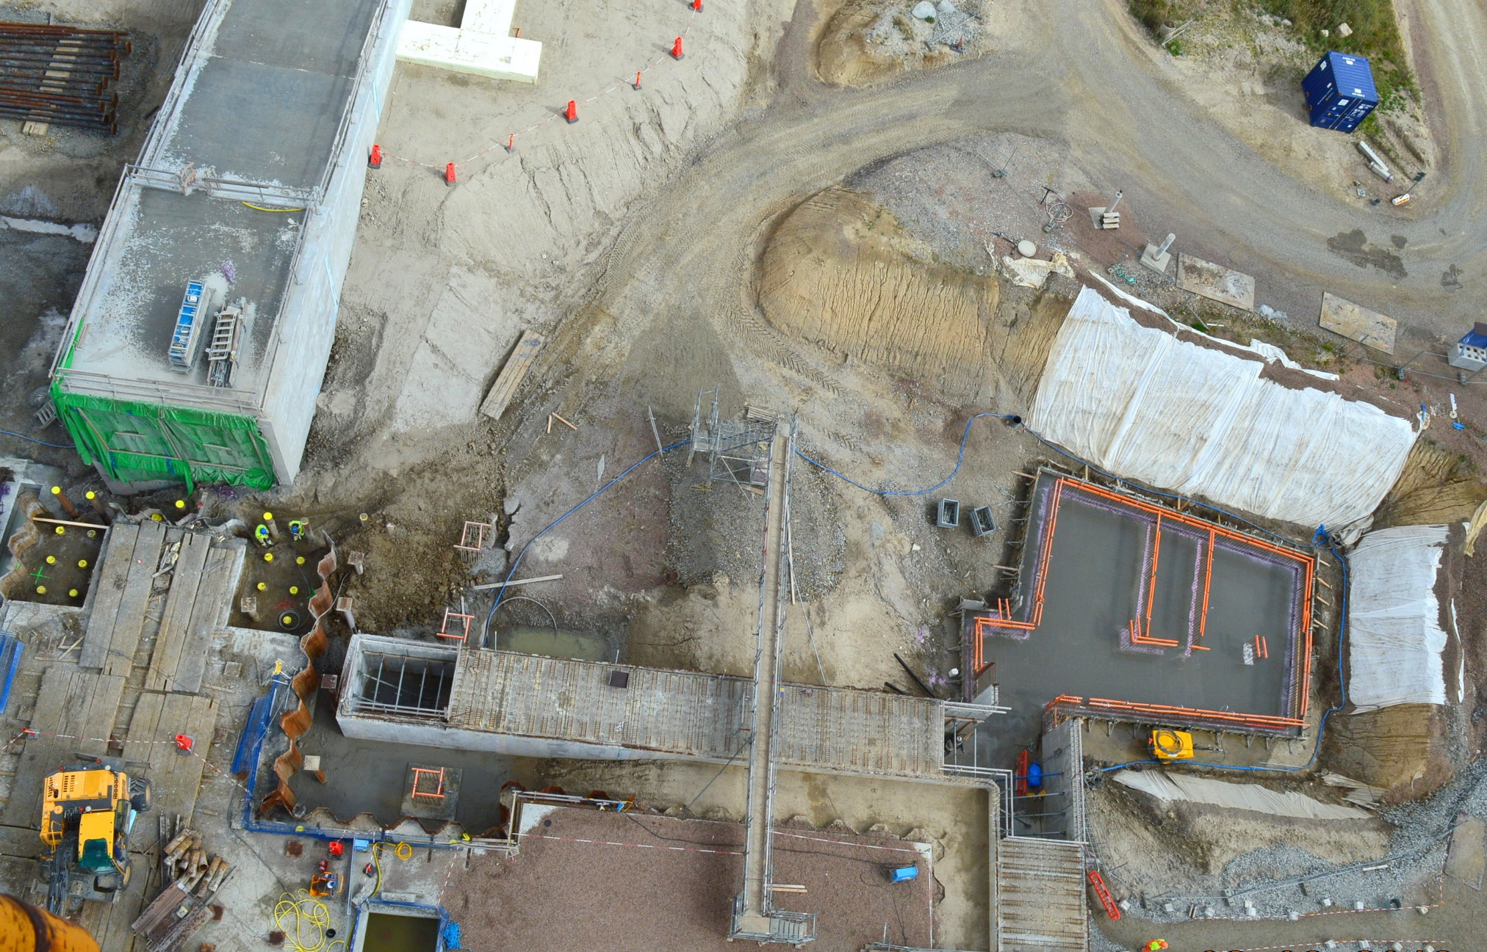
Dog Leg front, D01 installation galleries & D06 substation

Slide 19
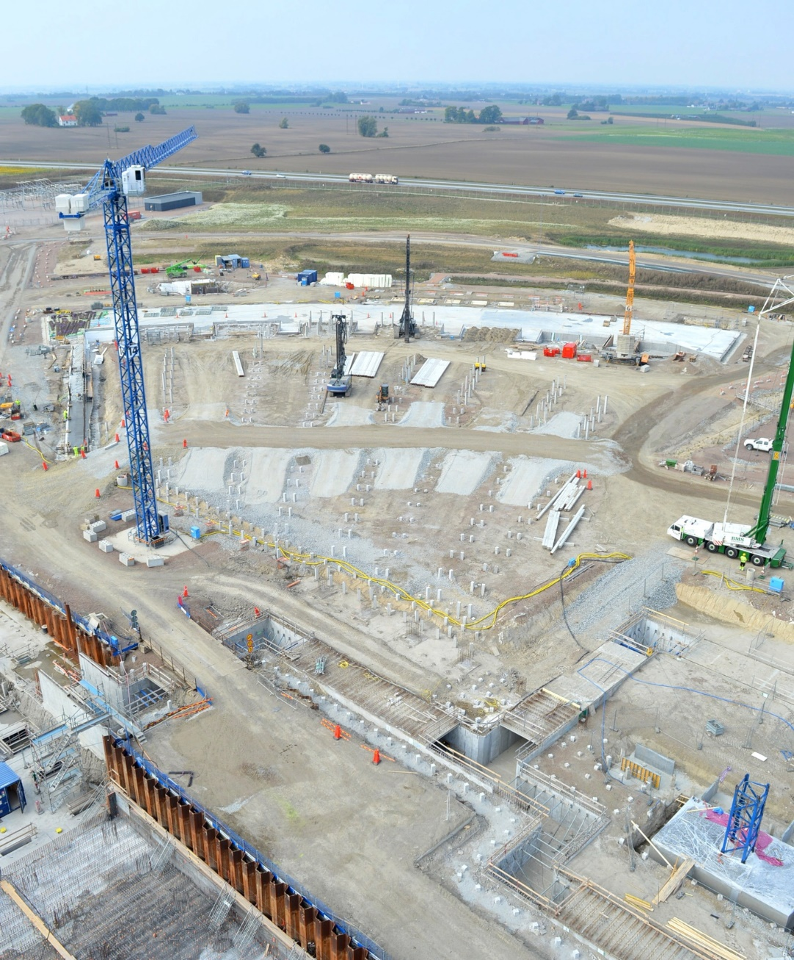
E02 Beam Line Gallery
Approx. half of the 838 concrete piles have been installed to date.
Total number of concrete piles on site: 6192, whereof 4868 completed (79%)

Slide 20
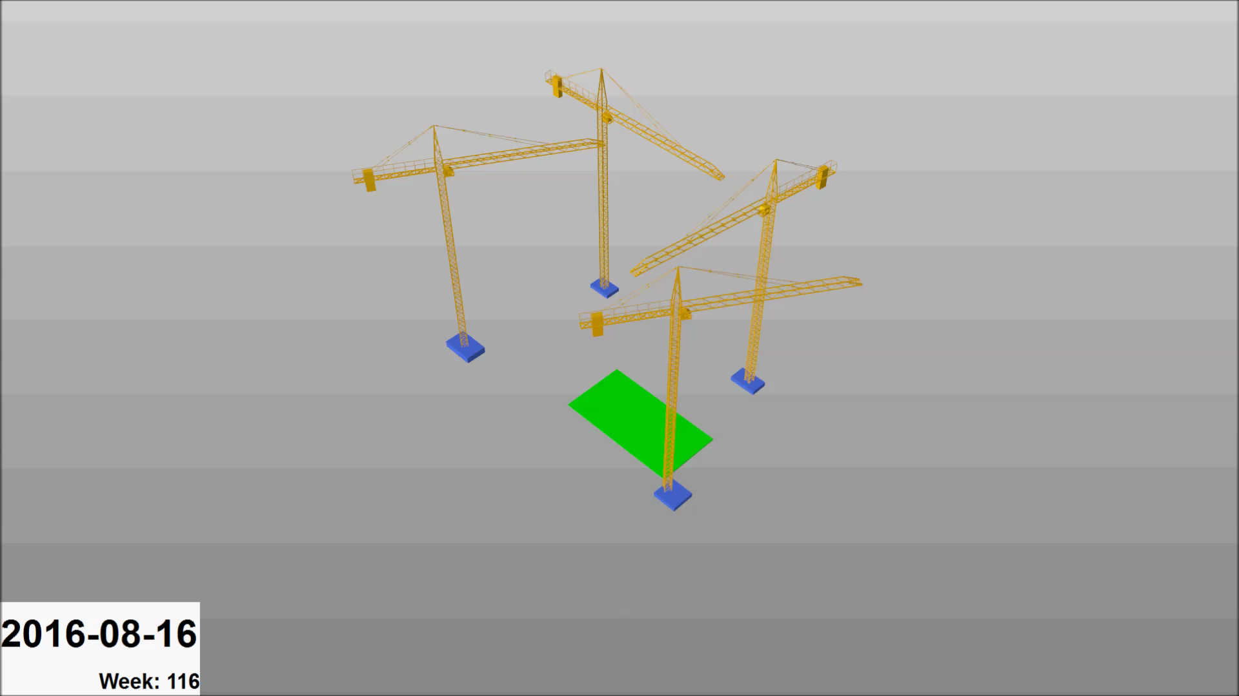
Target Station and Instrument Hall sequence

Slide 21
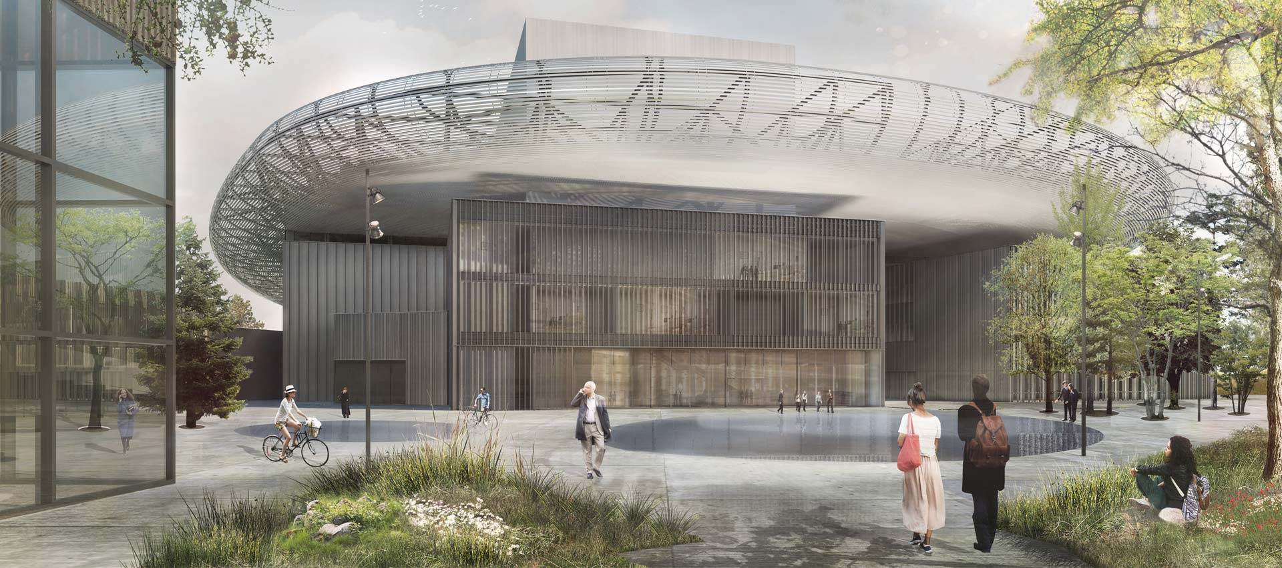
ESS vision

