Slide 1
TAC 14 - ICS overview
Integrated Control Systems
Henrik Carling
ESS/ICS
Date: 2016-10-05

Slide 2
TAC 14 - Integrated Control Systems
  ICS project plan overview, status and issues
  Activity highlights since last TAC
  Organizational management
  In-kind status
  Response to previous TAC recommendations
  Conclusion

Slide 3
TAC 14 - Integrated Control Systems
  ICS project plan overview, status and issues
  Activity highlights since last TAC
  Organizational management
  In-kind status
  Response to previous TAC recommendations
  Conclusion

Slide 4
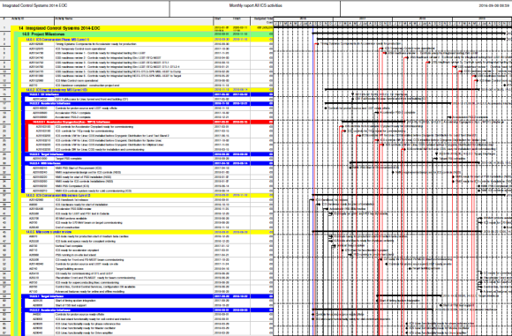
Project plan (1)
Project plan
  The new project plan was completed in the summer 2016
  The plan contains 1580 planning artefacts
  … and corresponds to approximately 475 man-years
  The plan contains 830 milestones as of today
    L1: 10 → relevant for ESS Construction Project
    L1b: 260 → to be linked or integrated with other divisions
    L2: 91 → relevant for ICS
    L2b: 26 → to be linked internally in ICS
    L3: 443 → internal for work-package traceability (including in-kind)
  The new plan is a first step towards maturity, it has allowed ICS systematically analyze the 2017 budget
  … yet more steps need to be done; refinements, integration, etc.

Slide 5
Project plan (2)
Project plan
  The new plan is being manually parsed into Primavera P6
    The update is expected to be completed by 2016-11
  Convergence with ESS integrated planning is ongoing
  ICS is starting a structured deployment of project management methods to track and follow up on planning execution
    Regular project meetings to follow up
    Prioritization and resource request/allocation processes
    Standardized project reporting
    Simple KPI:s for tracking
  Issues with the current plan:
    Known unknowns for work package 10 (Accelerator integration) have been identified and analyzed
      To be represented in Primavera P6 as “Forecast” - may affect budget decisions
    Installation planning was not considered until now.
      A preliminary proposal has been produced, but it needs refinement depending on the ESS approach to installation. For the moment, it is to be reflected as “Forecast” in Primavera P6

Slide 6
Estimate at completion forecast
Item | M EUR | Comment
BAC | 79,5 | Approved ICS Budget
Installation cost | 4,7 | Scope not considered in previous ICS plan and unleashed during the replanning exercise in 2016-H1
Management | -0,7 | Savings expected from trips and other expenses
SW | -0,8 | Savings expected after the replanning exercise in 2016-H1
HW Core | -1,8 | Savings expected after the replanning exercise in 2016-H1
Accelerator Integration | 3,6 | To cover orphan scope or known unknowns detailed during the replanning exercise in 2016-H1
In this analysis , the total ICS “Forecast” is 5,0M€
We are working on how to bridge this gap, however, the gap is currently limiting staff ramp-up
Notes:
Table showing baseline followed by list of EAC items with estimated cost and total EAC
At this meeting, only talk about changes since last month (show in red)

Slide 7






ICS Status by work package (WP)
WP 02 Software Applications - Executing to the newly clarified scope
WP 03 Software core - Executing according to plan, linking pending
WP 04 Hardware core - In-kind activity risks caused by slow ik process
WP 05 Machine protection - Progress with IK partner, plan refinement ongoing
WP 07 Controls infrastructure - Good progress but resource availability risks
WP 08 Physics - Executing according to plan
WP 09 Personnel safety systems - Slow progress due to system reviews’ demands
WP 10 Integration - Accelerator - High workload - staffing too slow to meet load
WP 11 Integration - Target - Some scope boundaries unclarities, linking pending
WP 12 Integration - Instruments - Executing according to plan
WP 13 Integration - CF - Finding ways to drive installation work, linking tbd
WP 20 Installation - Plan not clear yet

Slide 8
TAC 14 - Integrated Control Systems
  ICS project plan overview, status and issues
  Activity highlights since last TAC
  Organizational management
  In-kind status
  Response to previous TAC recommendations
  Conclusion

Slide 9
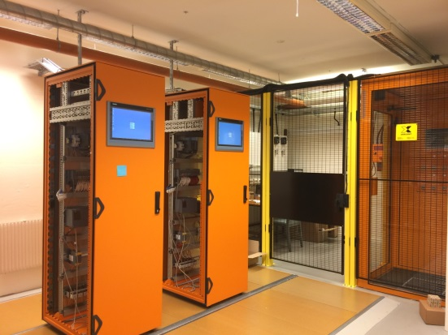
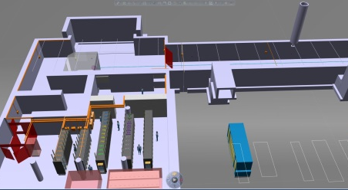
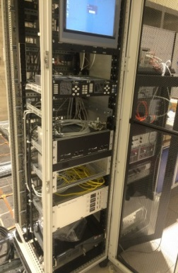
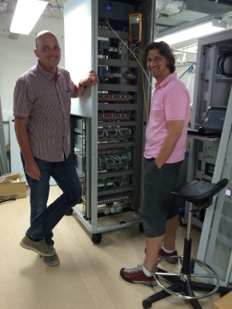
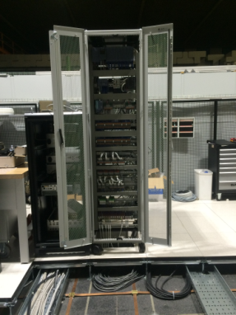
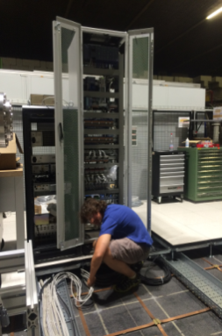
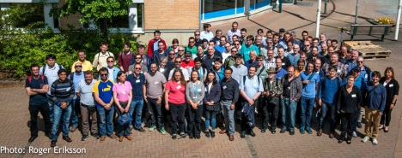
Project status - highlights
The Personnel safety system test stand is being used for active evaluation and system development since some months
The commissioning of the Access system in the Personnel safety lab has been finalized
The 3D-model for the PSS cabling has been
completed and can be used for estimating material
and effort
The Proton source and LEBT Vacuum Controls are operational and used for debugging and development This is the first full Vacuum control system powered on at ESS
  The proton source vacuum control system has been commissioned together with Accelerator division at INFN, Catania
Resources from the ICS Hardware and Integration team performed installation on-site together with colleagues to enable the commissioning of the ion source vacuum control system
ESS/ICS hosted the 2016 spring EPICS developer meeting
120+ participants from around the world contributed to a
productive meeting

Slide 10
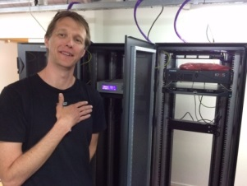
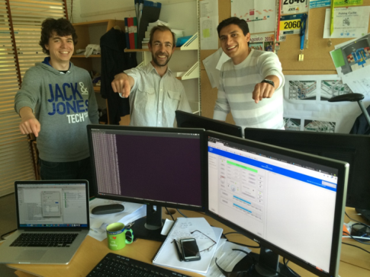
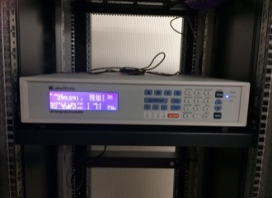
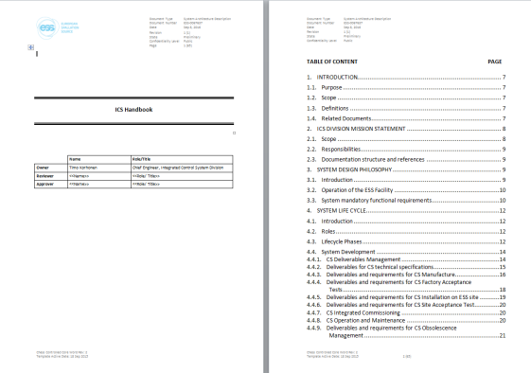
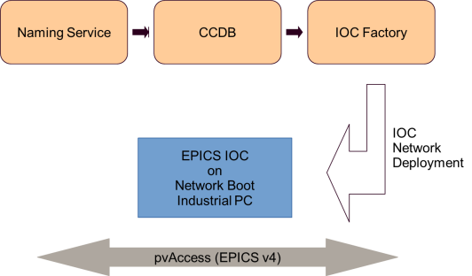
Project status - highlights
  The full ICS configuration and production software tool chain has been integrated and used in real production cases for the first time
  ICS integrators have been using the Naming Service and the CCDB configuration tool to produce a model for the Proton source vacuum control system
  The data is then used by the IOC Factory software to
  automatically generate ready-to-use EPICS IOC:s for the
  modelled system
  Training material has been prepared to facilitate this
  automated configuration/generation methodology with
  in-kind stakeholders
  ICS/NSS integration have been making good progress with
  collaborative work controlling choppers in the NSS ESSIIP lab with the full ECS/EPICS/CHIC control stack through the ICS software tool chain
  The ICS handbook, detailing ICS standards and best
  practices, has been released
  This is a critical document to facilitate wide-spread
  integration work with the ICS including in-kind and
  commercial partners’ work
  Shown are the racks in the front end building for ICS, PSS, MPS and the cable/trunks routing for PSS (orange).

Slide 11
TAC 14 - Integrated Control Systems
  ICS project plan overview, status and issues
  Activity highlights since last TAC
  Organizational management
  In-kind status
  Response to previous TAC recommendations
  Conclusion

Slide 12
ICS Organization
2016-09-01
Henrik Carling
Division head
In-kind project manager
Anna Gillberg
Team assistant
?
IT/Infrastructure ?
(Vacant?)
Annika Nordt
Safety and protection
Daniel Piso
Hardware and integration
Hector Novella
Deputy project manager
Susanne Regnell
Control Software
Timo Korhonen
Chief engineer
Angel Monera
FPGA Engineer
Benedetto Gallese
Integrator
Ben Folsom
PhD student
Denis Paulic
PLC Engineer
David Brodrick
Integrator
Claudio Rosati
Software engineer
Julen Etxeberria
Intern
François Bellorini
Integrator
Emanuele Laface
Accelerator physicist
Manuel Zaera-Sanz
PLC Engineer
Javier Cerejo
PhD Student
Karin Rathsman
Senior scientist
Morteza Mansouri
Safety Engineer
Jeong Han Lee
Integrator
Leandro Fernandez
Senior software engineer
Riccard Andersson
PhD student
Nick Levchenko
Integrator
Ricardo Fernandes
Senior software engineer
Stuart Birch
Senior safety engineer
Simone Farina
Embedded systems egineer
Remy Mudingay
Infrastructure engineer
Technical Coordinator (6 months)
Yong Kian Sin
IEC61508 engineer
Alexander Söderqvist
Integrator
Thilo Friedrich
PhD Student
Open positions (2)
Niklas Claesson
Integrator
Consultants
Employee
Consultant
Open positions (2)
Open positions (4)
Temporary employee
Consultant
off-site
Position under consideration

Slide 13
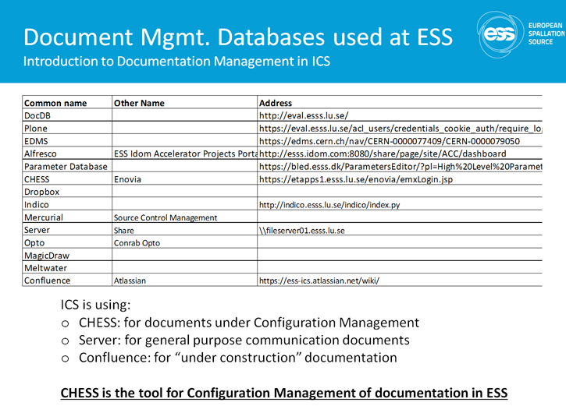
Improving ICS document management
The current overall document management at ICS is not satisfactory
  Documentation is spread over several systems and collections with no systematic structure
  There is no good controlled document version management performed by ICS
  A common complaint to ICS is that documentation is hard to find (or at least the latest version is hard to find) even by experienced ICS staff
  Guidance for ESS is very high level - but efforts are ongoing to
  improve this
The ICS management team has been working on
improving the document management situation
since > 6 months
  All groups have been involved through group leaders
  Hector and Thilo has been working to drive a proposal forward
  The proposal has been ”tested” internally in ICS and reviewed by external stakeholders
  Feedback from internal and external reviews has been considered in the the proposal

Slide 14
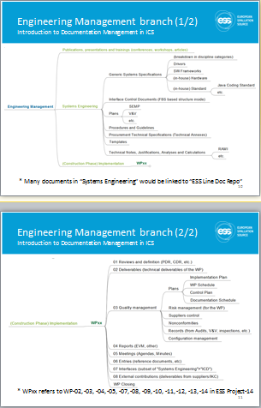
Highlights from the proposal
A new structure will be implemented in CHESS
The idea is that every document that will/can be shared shall be stored in this structure
The main function we are targeting is ”controlled document storage”
  Not using extended features in CHESS - only storage, version management, ownership
  Following a logical ”folder” structure
  Creating rules for how the structure can be expanded/adapted to specific needs
  Possibility to use the approval flow features of CHESS
Some documents need to transition from the current location
Provisions are made to allow in-kind partners access with good
granularity on access control
ICS’s proposal is now being used as a baseline for the ESS-wide standard for organizing documents

Slide 15
Organization management:
ICS meeting structure
Background
  There is no ICS-wide forum for tracking, coordinating and driving activities in the work packages
  This creates unnecessary communication and coordination glitches
  It also makes project-wide tracking and awareness in the project more difficult
  Another problem is that this makes it more time consuming to roll-out common processes and procedures across all work packages
Meeting scope
  The following topics need to be brought up in meeting settings
    Information exchange Project <-> Work packages, Work packages <-> Work packages, Work packages <-> Planners
    Risk management
    Quality management
    ESS planning integration
    Allocation, prioritization, resource management decisions
    Interaction with stakeholders (other divisions, in-kind partners, external suppliers etc)
    Project process and formal change control/ approvals
Purpose
  Openly present work package status (achievements/issues/next steps) as information sharing
  Collect tracking parameters (delays, cost increases, other impediments) for project management purposes
  Collect information about possible resource allocation/prioritization conflicts
  Distribute global project information (planning, changes, events) to all work packages
  Encourage cross-work package collaboration and improve team spirit

Slide 16
Meeting structure
Weekly project meeting
ESS planning integration meeting
Risk and quality management meeting
ICS decision forum
Coordination meeting

Slide 17
Weekly project meeting
Format and agenda
Purpose
    Information exchange - Project <-> Work packages, Work packages <-> Work packages, Work packages <-> Planners
    Interaction with stakeholders (other divisions, in-kind partners, external suppliers etc)
Participants
  Project and deputy project manager (chair)
  Work package leaders [initially work packages 02, 03, 04, 05, 07, 08, 09, 10, 11, 12, 13]
  Project planners
  ICS management team
Format
  Weekly group meeting with projector - 90 minutes
  Preferably Monday morning
Agenda
  General Information [project/deputy manager] 10 minutes
  Work package reporting [work package leaders] 10 x 5 minutes
  AOB [anyone] 10 minutes
Preparations/documentation
  Project/deputy manager prepare information presentation with project planners
  Work package leaders prepare a short report (template below - to be prepared on Fridays)
  All reports and any minutes from the meeting shall be checked into CHESS (no approval flow needed)

Slide 18
Weekly work package report
Work package nn w16xx
Guidance
Focus on your own work package even if you have done work outside that work package during the period
Focus on the project plan and this work package’s progress relative to the plan. Use the “attention” field to describe activities/progress/issues that happen outside the plan
Set your ambition level - this report should not take more than 45 minutes to fill
Traceable documentation - it is mandatory to check this report into CHESS. Use the structure provided by the Project manager
Assess your overall status - use the gauges to set a subjective overall status indicator. As the project progresses, more formal assignment of status will be made through KPI:s. All gauges are available outside the slide canvas to the right - zoom out!
Remove this Text box ☺ before you check the report in
Achievements
  Top 3 achievements for this week
  Focus on planning milestones met or status relative to planning (on track)
Issues
  Top 3 issues for this week
  Focus on delays or negative status relative to planning (off-track, cost increase)
Next steps
  Three activities for the coming week with most impact/visibility
Attention
  Maximum 3 topics you want to create attention on in the management team
  Include upcoming travel/absence/reviews/technical issues etc
Work package status

Slide 19
TAC 14 - Integrated Control Systems
  ICS project plan overview, status and issues
  Activity highlights since last TAC
  Organizational management
  In-kind status
  Response to previous TAC recommendations
  Conclusion

Slide 20
ICS in-kind overview
At the previous IKRC, ICS predicted the signature of two schedules for ICS but at this IKRC we are pleased to present five signed schedules, which in total more than doubles value of the existing ICS in-kind portfolio
One in-kind collaboration activity has been finalized in 2016-06 [link] and ICS has negotiated a continuation of this activity as a new in-kind contribution
Several new in-kind initiatives have been pursued in the period with promising results. The pattern of ”extending” existing partners’ in-kind contribution has been continued but also new partners have been involved
The formulation of in-kindable ICS software scope, which is one of the main venues for increasing the ICS in-kind portfolio, has been slower than expected but will see completion in Q1 2017
ICS is constantly trying to refine the process of discovering and creating in-kind opportunities.

Slide 21
ICS in-kind activities
ICS is presenting 5 new signed schedules at a total new value of 4.8 M€. This represents an increase in ”signed value” of 213% since IKRC 9

Slide 22
ICS in-kind portfolio development
ICS is continuously expanding the in-kind agreed and potential values by elaborating already known contributions and also finding new scope for partners to contribute
With increased clarity from the “new” project plan completed during the summer, we expect to be able to be more systematic in developing new in-kind opportunities
When analyzing the total in-kindable scope in the plan, we currently seem to see a limit at ~25 M€ which is 11 M€ short of the ICS in-kind goal. We will continue investigating new approaches for reaching the in-kind goal

Slide 23
ICS In-kind partners
Partner Institutes
Atomki, Hungary
CEA, France
CNRS, France
Elettra, Italy
ESS Bilbao, Spain
IFE, Norway
INFN Catania, Italy
INFN Legnaro, Italy
PSI, Switzerland
Tallinn Technical University, Estonia
ÚJV Řež, Czech Republic
University of Łódź , Poland
Uppsala University, Sweden
ZHAW, Switzerland
Agreement signed
Agreement waiting for signature
Early discussions
Collaboration agreement

Slide 24
In-kind issues
Negotiation of Schedules is much more time consuming than expected
  Estimations often include only agreement on technical scope
  Legal review is very time consuming and each partner ”starts from scratch”
  Also, cases where the ”hierarchy of agreements is not in place” - work can not be started
VAT issue
  The uncertainty of the VAT status is a disadvantage to ICS and partners in discusssions. Partners do assess the uncertainty in their risk calculations
Workload issue
  The problem reported on previous IKRC with in-kind project progress essentially limited by in-kind project management bandwith seems now to get a solution from 2016-11 when an in-kind project manager can be in place (potentially funded by the BrightnESS project)

Slide 25
TAC 14 - Integrated Control Systems
  ICS project plan overview, status and issues
  Activity highlights since last TAC
  Organizational management
  In-kind status
  Response to previous TAC recommendations
  Conclusion

Slide 26
Responses to TAC 13 recommendations
Integrated Control Systems
Recommendation 1
Design out dependencies on network services (e.g. LDAP or Active Directory) outside the operational ICS network to enable the machine to operate without an external network connection
Response
Attached presentation:
Recommendation 2
ICS should promote ICS solutions and standards within ESS and to IK partners
Response
ICS works through several channels to achieve this. One of the more important is the ICS handbook, which was released in a preliminary version during the period.
Through embedding ICS integration engineers in stakeholders’ teams (both internal and in-kind) we can promote and support standardization and also understand issues better.
Another important mechanism is offering support to stakeholders. This can be in the form of hardware or “services”. In this way, the standardization becomes a natural part of the project evolution.
Finally, ICS tries to be actively participating in standardization committees

Slide 27
Responses to TAC 13 recommendations
Integrated Control Systems
Recommendation 3
Strengthen the ICS Integration Group, by adding a few senior engineers, in order to meet the overall ESS project schedule
Response
Since the last TAC, the integration group has managed to recruit one engineer with Embedded/FPGA skillset. We are working to improve the rate of recruitments but are limited by workload and budget constraints. The budget consideration makes it hard to employ more engineers, this situation is a deep conflict with the plan
Consultant recruitments have also been slow due to a combination of workload limitations on the group leader and in the Procurement team. We need to improve this track record
Recommendation 4
ESS senior management should support the enforcement of standards from ICS across the project. Failure to do so will incur technical debt and introduce unnecessary risk to the project.
Response
There is no specific instance where this has happened - at least not in the last six months.
Stretching the recommendation, one could say that the E2H2C is such an “senior management sponsored initiative” but this committee is not working properly and it is not specifically targeting ICS standards.
Instead, ICS often has to drive the standardization topic on its own initiative - but we can also be more active in asking for support.

Slide 28
TAC 14 - Integrated Control Systems
  ICS project plan overview, status and issues
  Activity highlights since last TAC
  Organizational management
  In-kind status
  Response to previous TAC recommendations
  Conclusion

Slide 29






Project status - summary
Integrated Control Systems
Achievements
  A new project plan in place and we are executing accordingly
    Start of execution has not been as easy as we thought
    More interrupts and staffing delays than expected
  The team is undergoing a period of rapid expansion
    Eight new recruitments are ongoing - technicians are starting to come in
    Call-offs to the new consultant framework agreement are also ongoing
  Substantial growth of the in-kind portfolio
    Ongoing and new projects in Estonia, Norway and Switzerland
    Increased activity in the in-kind activities together with Accelerator

Slide 30
Issues
Slow procurement procedures and formal in-kind processes
Friction in early installation activity collaboration with CF
Recruitments are going too slow - resource depletion and excessive workload reported from several work packages
  Heavy workload due to upcoming reviews (IKRC, ESHAC, TAC, Operations) and workshops limits team efficiency
  Participation from ICS in the “CHESS Installation Project” requested - no resource available
  Heavy workload on team for Ion source and LEBT controls integration- vacuum system integration may be delayed
  Machine protection work also risks being delayed due to slow progress with (employee/consultant) recruitments
One case of a consultant recruitment had to be stopped and restarted (~4 weeks delay) due to problems with the process
Notes:
Identify all significant issues, but emphasize those that are unique to your sub-project
Expanded version of IPR meeting slide

Slide 31
ICS vision and mission statements
ICS vision statement
ESS operated efficiently, reliably and safely, with a control system that everyone loves
ICS mission
The ICS division shall provide and maintain world-class and cost-efficient control, protection and safety systems and services for the ESS facility.
The division shall develop competence and innovative solutions that can be shared in the community through open processes

