Slide 1
Personnel Safety Systems
The 14th meeting of the ESS Technical Advisory Committee -TAC14
Morteza Mansouri
Engineer for Safety Critical Systems
www.europeanspallationsource.se
26 September 2016

Slide 2
Contents
Scope of PSS at ESS
PSS strategy
PSS lifecycle
Accelerator PSS design
PSS review
Next steps
Concerns
PSS test stand

Slide 3
Scope of PSS at ESS
Access Control System for
  Accelerator
  Cryogenics test stand
  Target
  Neutron instruments
  Safety Interlock System for
  Accelerator
  Cryogenics test stand
  Target
  Neutron instruments
  Radiation Monitoring System for
  Accelerator
  Cryogenics test stand
  Target
  Neutron instruments
  ODH Monitoring System for
  Accelerator
  Cryogenics test stand
  Target
  Neutron instruments

Slide 4
PSS Strategy
The Personnel Safety Systems at ESS will be designed, installed, commissioned and validated in compliance with IEC61508 – 2010 (Functional safety of electrical/electronic and programmable electronic safety-related systems).
The Personnel Safety Systems at ESS will also implement the requirements by the Swedish Radiation Authority (Strålsäkerhetsmyndigh; SSM) detailed in SSMFS 2008-27: “regulations concerning operations at accelerators and with sealed radiation sources”.
The Personnel Safety Systems at ESS will be safety related systems which satisfy the following criteria in compliance with IEC 61508:
  Two train system
  Failsafe
  Redundancy
  Diversity
  Single failure
  Common cause failure
  Separation

Slide 5
PSS Lifecycle
Concept & scope definition
Installation, commissioning
IEC 61508 Concept Document for the Accelerator Personnel Safety System (ESS-0048724)
IEC 61508 Scope Document for the Accelerator Personnel Safety System (ESS-0049056)
Following a series of hazard identification meetings with participation of PSS team members and accelerator systems owners/designers, a list of hazards have been identified and detailed in IEC61508 Hazard Identification Document for the ESS Accelerator Personnel Safety System (ESS-0053098)
Hazard analysis & risk assessment
Validation
SIL determination using Layer of Protection Analysis (LOPA)
Apply non-SIS protection layers to prevent identified hazards or reduce risk
Operation, maintenance & annual functional tests
FTA & ETA used for Safety Integrity Level verification
Reliability Block Diagram used for PFD calculations
IEC61508 Safety Requirements Specification for the ESS Accelerator PSS (ESS-0062932) produced
Architecture design description (hardware and software)
Access control system design, Key exchange system design
Safety interlock system design, Radiation monitoring system design
PSS hardware and integration with EUC design, Enclosures and cable routing design
Prepare operation and maintenance instructions
Define Target SIL for each Safety Instrumented
Function
Modifications
Develop safety requirements specifications & Verify safety integrity levels
Back to appropriate overall safety lifecycle phase
ZHAW will review and audit all the PSS analysis, planning, design and realization documentation and will assess the ESS Personnel Safety Systems compliance with IEC 61508.
Configuration and Change Management:
Defined the technical activities in different phases of safety lifecycle which are necessary to achieve the required functionality.
Defined the responsibilities and activities in each phase of system lifecycle.
Identifying, tracking, reporting of the status of the documents / activities, including all actions and changes resulting from a change request.
Detailed design specifications
Decommissioning

Slide 6
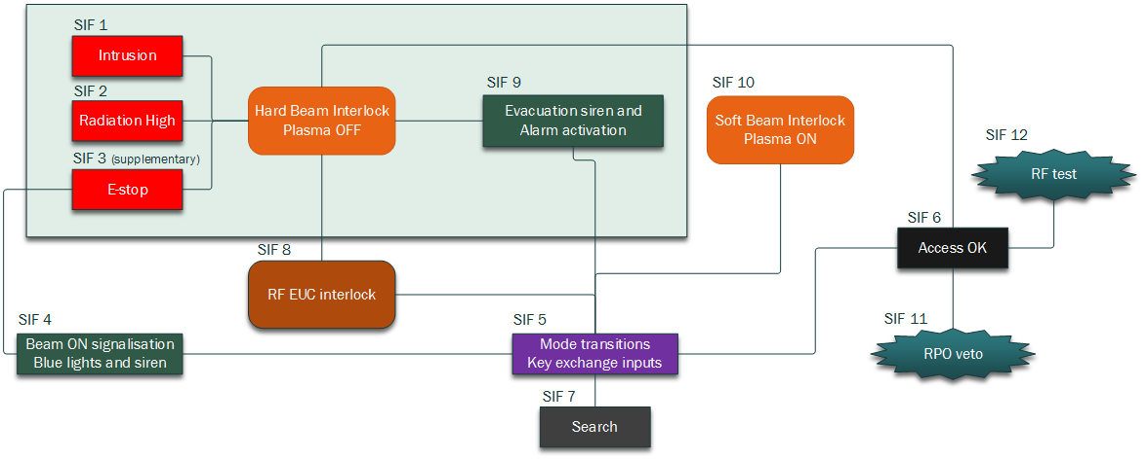
Accelerator PSS Safety Functions
SIF 1 to SIF 3: Detection of the alarm conditions that could potentially lead to most dangerous hazard (ionising radiation from proton beam) and immediate hard switching-off of the proton beam (proton source plasma included).
SIF 5 to SIF 7: PSS modes computation - rules to transit between the different modes (Beam ON, Tunnel Closed, Open Access, Restricted Access, Search and PSS test) according to the state of the controlled area and inputs from key exchange console.
Denis Paulic, Sep. 2016
Notes:
SIF 4: Informing personnel that Beam ON is active (the permit to run the beam is issued from PSS control system) by activating the blue lights in the tunnel and sounders on the Beam-off stations.
SIF 8: RF hazardous EUC interlock - always with delay of 50ms. Activation of this function depends on active PSS mode and state of various EUC. Should we distinguish between hard and soft (delayed) RF EUC switch-off? To be discussed.
SIF10: Soft beam interlock - Proton source plasma stays powered and RFQ is switched-off with a delay of 50ms. Activation of this function depends on active PSS mode and state of various EUC.
SIF 9: Informing users and operators if the hard beam interlock had happened (hazardous condition, evacuation requested)
Optional:
SIF 12 - RF test - Monitor the status of the RF waveguides and permit the powering of certain RF EUC if the waveguide is removed.
SIF 11 - RPO veto - If there will be RP sweep before enabling the access to the tunnel, do not enable entry stations (swipe/proximity readers) if veto is active.

Slide 7
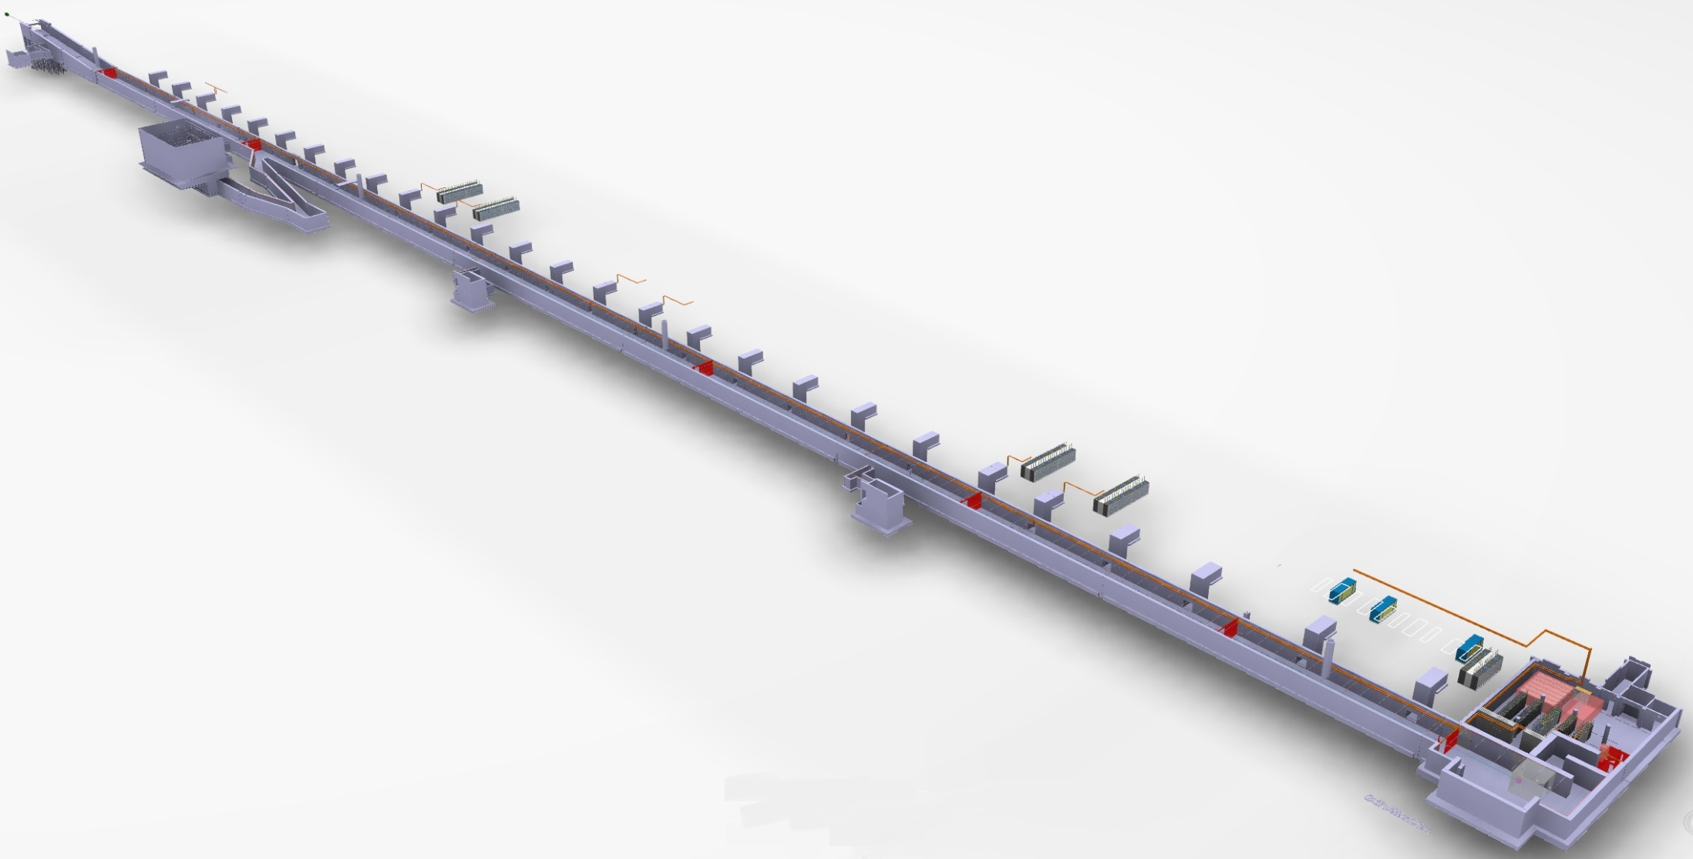
Accelerator PSS Design
Zone 6
Phase 2: Accelerator PSS
All accelerator tunnel area and emergency exit ways are considered as PSS controlled areas.
To facilitate the search procedure in accelerator tunnel, PSS has considered 7 zones in this area. The zones are
separated from each other by 6 fences. The position of these fences will be continuously monitored by PSS safety switches
Zone 5
Zone 4
Zone 7
Phase 1:
PSS 1; Linac warm section
Zone 3
Zone 2
Zone 1 includes: Proton Source, LEBT, RFQ, MEBT
Zone 1
Zone 2 includes: Drift Tube Linacs (DTLs)
Zone 3 includes: Spoke cavities
Zone 4 includes: Medium Beta Elliptical cavities
Zone 5 includes: High Beta Elliptical cavities
Zone 6 includes: High Energy Beam Transport (HEBT)
Zone 7: A2T

Slide 8
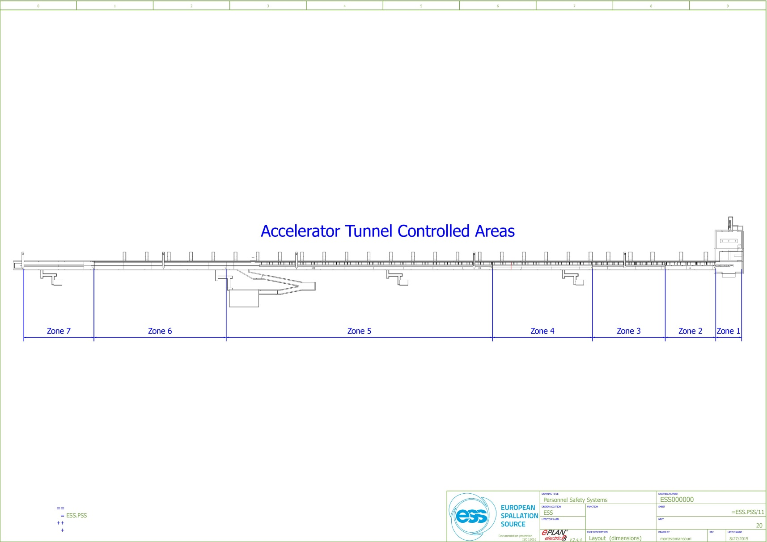
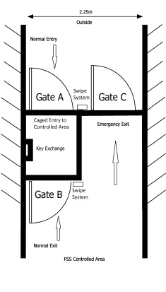
Access Points to Accelerator Tunnel
In order to control and monitor the personnel access to PSS controlled areas at any time, there will be two access points to PSS accelerator tunnel.
Front end building (G01 level 90)
HEBT loading bay (G01 Level 100)

Slide 9
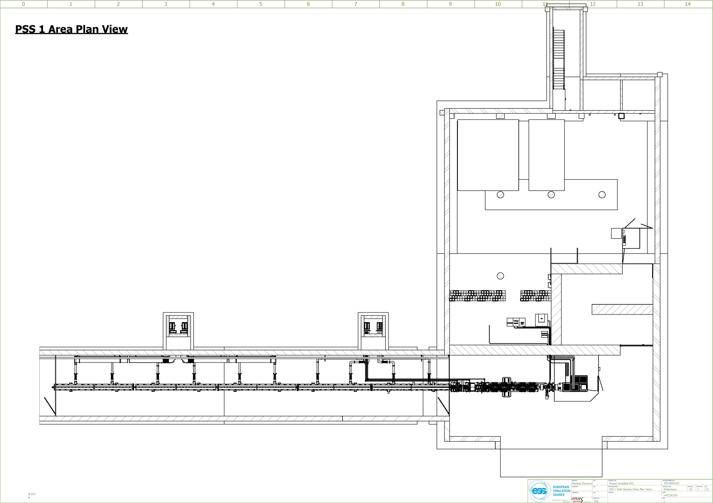
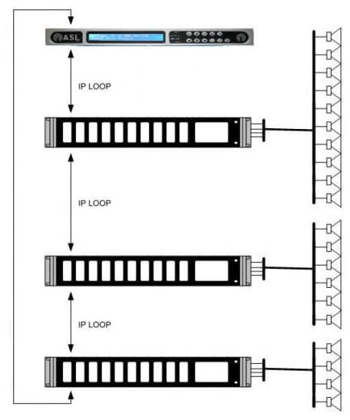

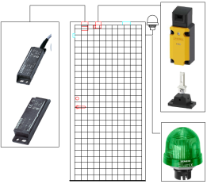
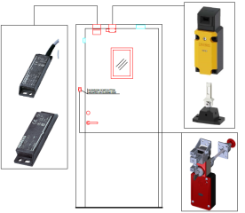
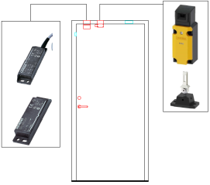
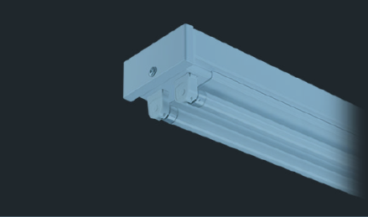
Accelerator PSS Design: PSS 1 Hardware
Access/E-exit Doors
Radiation Monitors
Beam-off Stations
PSS 1 Area Plan View
Message Display
Public Address System
Fire Door/Zone Fence
PSS Blue/Red Lights
Beam-off Station
Radiation Monitor
E-exit/Fire Door
Access System
Message Display
Zone 1
RM 2
Zone Fence
RM
B/R Light
E-Exit
Door
E-Exit
Door
PSS Zone Fences
Fire Door
Public Address System
Access System
FEB
PSS B/R Light
E-Exit Door
PSS B/R Light
Zone 1
BOS 3
BOS
Zone 2
RM 2
Zone 1
RM 1
RM
Zone 2
RM 3
RM
RM
PSS B/R Light
PSS B/R Light
Fire
Door
Zone 2
RM 1
Fire
Door
RM
PSS B/R Light
PSS B/R Light
PSS B/R Light
PSS B/R Light
PSS B/R Light
PSS B/R Light
PSS B/R Light
PSS B/R Light
PSS B/R Light
PSS B/R Light
Fence
PSS B/R Light
Zone 2
Fence
Zone 1
BOS 2
PSS B/R Light
Zone 1
BOS 1
PSS B/R Light
BOS
PSS B/R Light
PSS B/R Light
PSS B/R Light
PSS B/R Light
Fence
BOS
PSS B/R Light
Zone 3
Fence
BOS
BOS
BOS
Zone 2
BOS 1
Zone 2
BOS 2
Zone 2
BOS 3
Notes:
1. Beam-off station:
A box of H:300mm,D:210mm, W:300mm. The box will contain emergency beam-off button, search button, ODH lights indicators for 7 zones in accelerator tunnel, stack lights for beam-on indication and ODH, buzzer to be used in the search patrol.
2. In order to monitor the position of the access and E-exit doors, two switches with different technologies (one non-contact magnetic type and the other mechanical type) will be installed on each door.
3. PSS blue/red lights: as a layer of protection, PSS will install blue and red lights in the accelerator tunnel. The blue lights will turn on when the beam is on and the red lights will turn on when there is ODH.
4. Message displays will be installed at access points and E-exit doors. Information such as status of the tunnel (e.g closed, open access, etc.), level of radiation, ODH, etc. will be shown on the message displays.

Slide 10
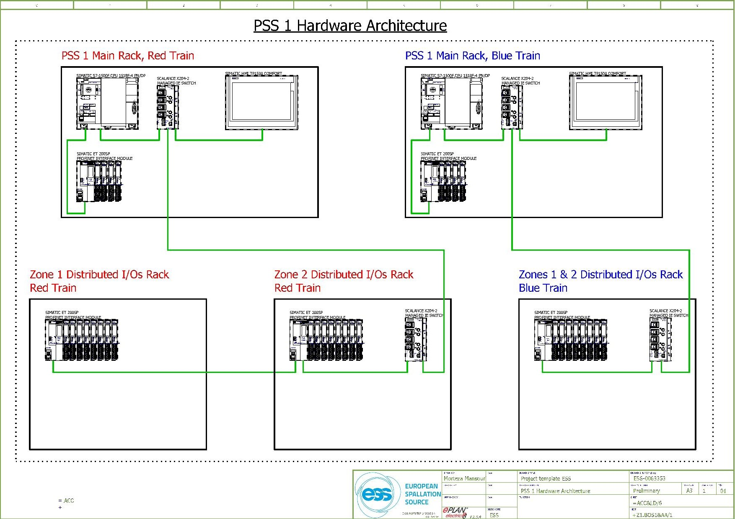
Accelerator PSS Design: PSS 1 Architecture
Latest version of Siemens fail-safe CPUs; S7-1500 series
TIA Portal V13 SP1; Safety Advanced V13 SP1
SIMATIC HMI TP1500 COMFORT
TIA Portal V13 SP1; WinCC Comfort V13 SP1
SIMATIC ET 200SP, PROFINET INTERFACE MODULE
SIMATIC ET 200SP F-DI & F-DQ Modules (fail safe)
SIMATIC ET 200SP DI & DQ Modules (standard)

Slide 11
PSS Interfaces
PSS will stop the accelerator proton beam by removing permit from following systems:
  The Ion source plasma generator system
  The Ion source extraction system
  The RFQ modulator system
PSS will remove permit from the following systems to mitigate against X-ray hazards when there is access to tunnel:
  MEBT bunchers (3 units)
  Drift Tube Linacs (5 units)
  Spoke cavities (26 units)
  Elliptical medium beta cavities (9 units)
  Elliptical high beta cavities (21 units)
PSS will interface with two gamma blockers (one for beam dump, one for Target).
PSS will interface with two bending magnets which send the beam towards Target.

Slide 12
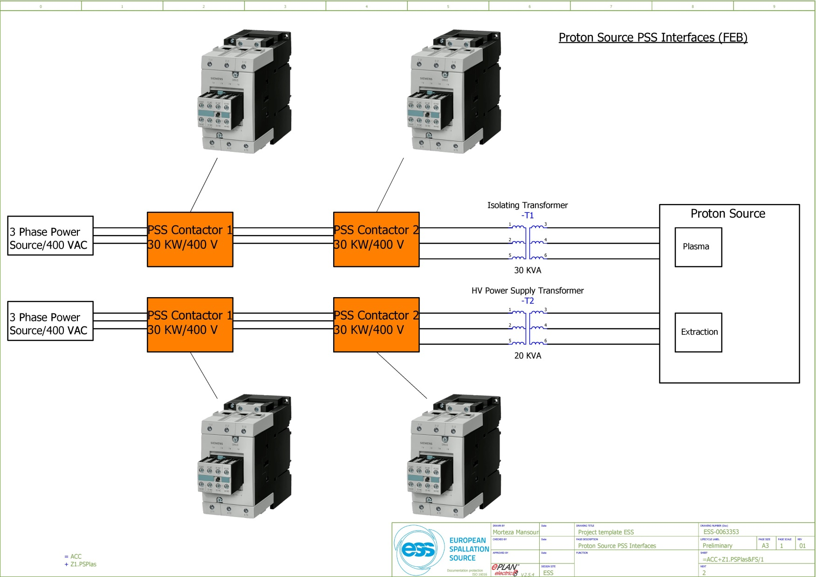
PSS Interfaces: Ion Source
Notes:
PSS interfaces with Ion Source (ISRC).
Accelerator PSS will interface two subsystems of ISRC.
Ion Source isolating transformer in G01 building.
PSS will have the opening order function of the 3-phase supply power to the ISRC isolating transformer. As a PSS Safety Instrumented Function (SIF), in order to de-energize ISRC plasma generator, the 3-phase supply voltage of the ISRC isolating transformer must pass through the two PSS contactors (in series) which are installed in a PSS sealed box.
2. Ion Source high voltage transformer in G01 building.
PSS will have the opening order function of the 3-phase supply power to the ISRC High Voltage transformer. As a PSS Safety Instrumented Function (SIF), in order to de-energize ISRC extraction system, the 3-phase supply voltage of the ISRC High Voltage transformer must pass through the two PSS contactors (in series) which are installed in a PSS sealed box.

Slide 13
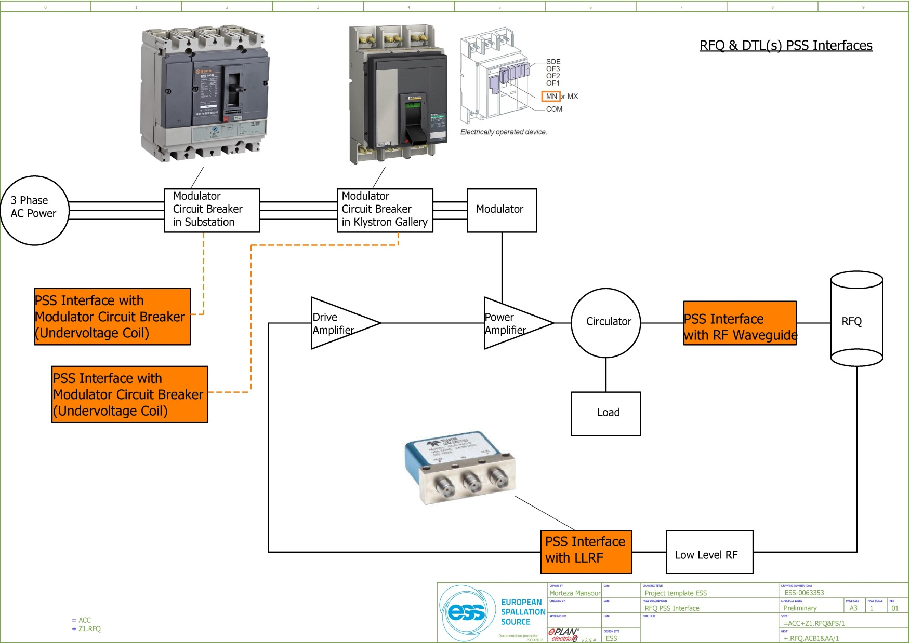
PSS Interfaces: RFQ & DTL(s)
In case of access to tunnel by personnel, the RF modules test can only be performed after a piece of waveguide has been removed and sealed properly in the Klystron Gallery.
The solution is not defined yet. More discussions needed here.
Notes:
Accelerator PSS will interface four subsystems of RFQ.
RFQ Modulator air circuit breaker (ACB) in substation.
RFQ Modulator air circuit breaker (ACB) in klystron gallery.
RFQ LLRF.
RFQ Waveguide.

Slide 14
Interface Control Documents
PSS team has started developing the Interface Control Documents (ICD) for any of the PSS interfaces with other systems. The ICD encompasses the definition, documentation, and control of all interfaces between the PSS and the system which is interfaced. The types of information contained in the ICDs include both mechanical and electrical interfaces such as physical footprint, environment temperature, power requirements, connector specification, and electromagnetic compatibility requirements. Also as part of the functional description of PSS, the impact of PSS on the interfaced system is defined and described in the ICD.
As an example, in case of PSS interfaces with Ion Source, the Accelerator Personnel Safety System and Ion Source ICD (ESS-0064042) is being developed. Currently the following information is missing:
  The Ion Source design specifications document.
  Block/circuit diagram for the Ion Source.
  Ion Source connection to the isolating and HV transformers.
Currently we are working on the ICDs for the Linac warm section. We have agreed to finalize, review and approve the PSS 1 ICDs by November 2016.

Slide 15
PSS Review
In July 2016 a group of PSS experts from facilities such as SNS, CERN and ISIS carried out the first review for ESS Personnel Safety Systems. The official charge of the review was:
Overall ESS PSS strategy and the Intermediate design review of the ESS accelerator personnel safety system 1
During the two day review, the PSS team presented the following:
ESS PSS Strategy.
  PSS Development and Quality Assurance Plan.
  PSS Configuration Management Plan.
Intermediate design review of the ESS Accelerator PSS
  Concept
  Scope
  Hazard identification
  SIL Determination
  SIL Verification
  Safety Requirement Specification
  Cable Management design G01 accelerator Tunnel PSS 1
  Beam OFF station Design
  Accelerator PSS1 Circuit Diagrams
  Accelerator PSS1 Rack Designs

Slide 16
PSS Review: Committee Recommendations
Major findings by the PSS review committee:
  Current Accelerator design does not contain sufficient detail for PSS to perform the required hazards analysis and support detailed design; in particular interfaces are not well enough known to support PSS design.
  Although it is apparent that a lot of work has been accomplished, the Risk and Hazard Analysis, plus SIL determinations, are not in an acceptable final form.
  The decision to integrate the ODH system into the PSS should be reevaluated, and the rationale documented.
  ESS is proposing a system to remove a section of waveguide to allow work on modulators while in tunnel access mode. If each modulator were to be tested, that is 152 waveguides that would be required to be disabled, and then returned and pumped down to restore the machine to operability.
  PSS should begin to log findings and changes in sofware even before FAT; otherwise some useful information discovered in preparation for FAT could be lost .
  Interfaces between PSS and the equipment being controlled, and other ESS systems relied upon to perform the PSS tasks, are not complete and require significant attention.
Notes:
2. These activities will require significant changes in the future, and some of the techniques appear to have been misapplied. In particular, excess credit is taken for multiple layers of protection, possibly caused by being overly conservative in the initial assumptions, thereby requiring more risk reduction to reach acceptable levels. The initial assumptions and named Credited systems should be reconsidered for some of the scenarios.
3. By linking the ODH sensors into the PSS, both systems are made more complicated and response times are increased.
6. Lacking detailed design information, PSS treats devices as a “black box”, and affects the power supply. This is not efficient, and ESS must develop a mechanism to provide detailed design information to PSS on a schedule that supports the Project schedule.

Slide 17
Next Steps
PSS team is reconsidering parts of hazard analysis and SIL determination.
PSS team has started developing the Interface Control Documents (ICD) for any of the PSS interfaces with other systems. These ICDs will be reviewed and officially approved by all the interface stakeholders.
The ODH monitoring system is separated from PSS. The new ODH monitoring system architecture and the chosen ODH monitors were presented in the ODH review in September 2016. The final report from the review committee will be ready by early October 2016.
PSS team is looking into solutions for PSS interfaces with RF waveguide used in other similar facilities. Removing a piece of waveguide is still the baseline design.
There will be a one-day visit by SSM (Swedish radiation authority) to ESS on 2016-11-29. PSS team will be presenting the ESS PSS strategy and accelerator PSS 1 design.
As part of PSS configuration management plan, a convention has been developed for PSS software files. The storage and retrieve method/tool is not defined yet.

Slide 18
Concerns
The organizational roles in developing safety systems are not well defined at ESS, for instance:
  The hazard and risk analysis done by PSS team should be reviewed and approved by …
  The specifications for the radiation monitors detectors (particle spectra, required response time, detectors’ expected energies for photons/gammas/…, RM thresholds managment and implementation, etc.), the type of data and reports to be produced by RM should not be defined by PSS!
  PSS can not define all the requirements for access control system in terms of personnel access (i.e. the databases required to authorise personnel to access the controlled areas according to training, annual dose level, etc.) or material/equipment transportation in/out of accelerator tunnel (i.e. the procedures to check the material radioactivity level, etc).

Slide 19
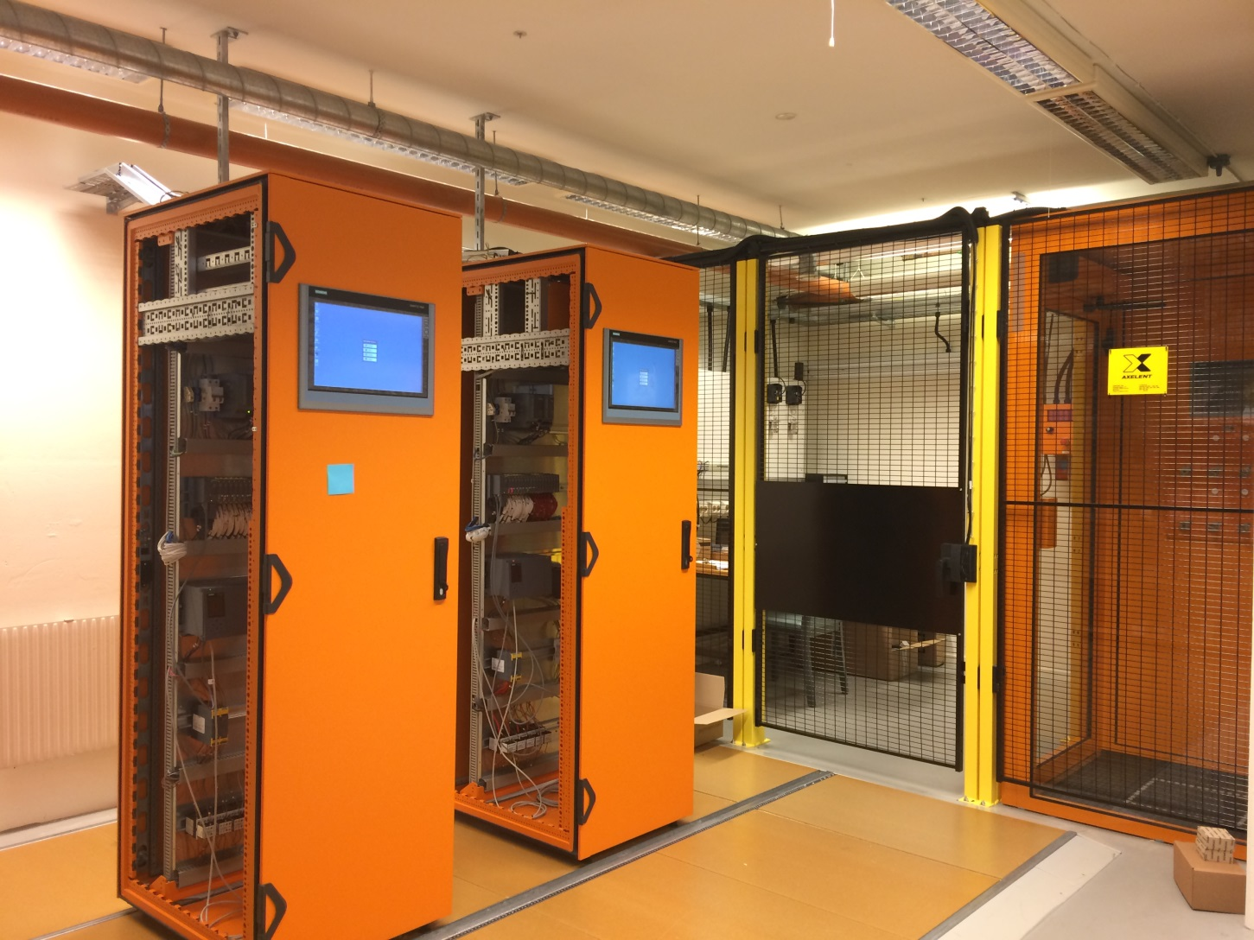
PSS Test Stand
The PSS test stand is being developed in the PS lab. The PSS test stand will be used for simulation and evaluation purposes of any systems to be developed by PSS team.
The test stand includes a two train safety PLC system, double-door access system, E-exit door, Beam-off stations, PSS blue/Red lights and a few contactors and lights which simulate the EUCs that PSS will interface.
The hardware installation is almost finished. The message display and public address system still need to be installed.
The PLC hardware configuration and I/O checking is done.
The Functional description for access system, search procedure, etc. in test stand is currently being developed.
Screens for HMIs are being developed.

Slide 20
Thank you for your attention!

