Slide 1
Progress on Machine Protection
Annika Nordt et al.
Group Leader for Protection and Safety Systems
ICS
Technical Advisory Committee TAC14, 2016-10-06, Lund, Sweden

Slide 2
Outline
Machine Protection Review and Status Report
Standardized Hardware Interfaces for the Beam Interlock System
In kind contract with ZHAW
Issues and Risks
Summary and Outlook

Slide 3
Machine Protection Review & Outcome
2 days review with external experts in 2015-12
10 top recommendations
Since then we got more support and valuable help from the RAMI, integration, beam physics, beam instrumentation teams in the accelerator division
Aurélien Ponton has been appointed to be the main contact person for all MP related issues regarding the accelerator systems
Awareness about Machine Protection is higher now, but
Establishing a protection and safety culture at ESS requires constant effort

Slide 4
Recommendation #1 and Status
The project should complete the hazard analysis to have a complete failure catalogue. The study should be extended to cover the dynamic evolution of the failures with estimated time constants (magnet circuits) as this provides essential input for the definition of MPS reaction times (BIS) and abort thresholds (BCMs BLMs).
Status:
Together with relevant experts from beam physics, RF, beam instrumentation, magnet systems, etc. we repeated and detailed the previous ACCSYS hazard & risk analyses.
Identified simulations and analyses needed to understand the dynamic evolution of failures. Work in progress.
Identification, classification of hazards and risks for target systems on-going.

Slide 5
Hazard Analysis: An Extract from RFQ List
 | Failure mode (Event) | Consequences on the device | Consequences on the beam | Possible beam induced damage
Element Failures | Spark in the RFQ | Degradation of the RF field (time depend on the storaged energy to be checked by CEA). Faster degradation than other failures. | Beam is partially or totally lost in the RFQ. Simulation 1 needed to define loss maps (time dependent). | Beam lost anywhere in the LINAC (to be simulated in 1). When RF is low enough, the beam is lost in the first part of the RFQ (75Kev).
 | Degradation of vanes | Degradation of the transmission. Very slow (years) | - | -
RF | No RF (e.g. Failure in RF generation) | No RF going into the cavity. RF decays in some time | Beam is partially or totally lost in the RFQ. Simulation 1 needed to define loss maps (time dependent). | Beam lost anywhere in the LINAC (to be simulated in 1). When RF is low enough, the beam is lost in the first part of the RFQ (75Kev).
 | RF too high | Possible damage to the coupler. Possible increase of Kilpatrick limit which leads to higher spark rate | No immidiate consequence | -
 | RF too Low | Lower RF field | Beam is partially or totally lost in the RFQ. Simulation 1 needed to define loss maps (time dependent). Maybe slower than previous. | Beam lost anywhere in the LINAC (to be simulated in 1). When RF is low enough, the beam is lost in the first part of the RFQ (75Kev).
 | Wrong RF (phase) | No effect | Wrong phase of the exit beam | Beam lost partially or totally in the rest of the linac
 | Wrong timing of the RF (RF comes before the pulse) | Possibility of having beam and no RF in the RFQ | No acceleration, focusing or bunching for part of the pulse | Beam is first lost in the whole linac and after some time is totally lost in the RFQ (simulation 1)
 | Wrong timing of the RF (RF comes after the pulse) | Possibility of having beam and no RF in the RFQ | No acceleration, focusing or bunching for part of the pulse | Beam is first lost in the RFQ and after some time (when RF starts) is lost in the whole LINAC (simulation 1)
Water cooling | Low cooling (high T) for any of the cooling circuits (tuning or cooling) | Detuning of the cavity or permanent damage of the cavity in case of too much heat | Beam is partially or totally lost in the RFQ. Simulation 1 needed to define loss maps (time dependent). Maybe slower than previous. | Beam lost anywhere in the LINAC (to be simulated in 1). When RF is low enough, the beam is lost in the first part of the RFQ (75Kev).
 | High cooling (low T) for any of the cooling circuits (tuning or cooling) | Detuning of the cavity | Beam is partially or totally lost in the RFQ. Simulation 1 needed to define loss maps (time dependent). Maybe slower than previous. | Courtesy of E. Bargallo, A. Ponton, M. Eshraqi, I. Kittelmann and many more

Slide 6
Risk Matrix: Aligned with ESS RAMI Goals!
Work in Progress
 |  | Downtime
 |  | < 1h | 1h – 3h | 3h – 8h | 8h – 1d | 1d – 3d | 3d – 14d | 14d – 3m | 3m – 10m | > 10m
Cost | < 10 k€ | Minor | Moderate | Moderate | Moderate | Significant | Significant | Significant | Significant | Severe
 | 10 k€ – 100 k€ | Moderate | Moderate | Moderate | Moderate | Significant | Significant | Significant | Significant | Severe
 | 100 k€ – 1 M€ | Moderate | Moderate | Moderate | Moderate | Significant | Significant | Significant | Significant | Severe
 | 1 M€ – 2.5 M€ | Significant | Significant | Significant | Significant | Significant | Significant | Significant | Severe | Severe
 | 2.5 M€ – 5 M€ | Significant | Significant | Significant | Significant | Significant | Significant | Severe | Severe | Severe
 | 5 M€ – 10 M€ | Severe | Severe | Severe | Severe | Severe | Severe | Severe | Severe | Severe
 |  | Consequence
Mean Time Between Occurrences |  | Minor | Moderate | Significant | Severe
 | > 5000 years
 | > 500 years
 | > 50 years
 | > 5 years
 | > 0.5 years
 | < 0.5 years
Not acceptable, reduction of occurrence and/or consequence required
Undesirable, tolerable only if risk reduction is impracticable or if the costs are disproportionate
Acceptable as it stands
Courtesy of E. Bargallo

Slide 7
Recommendation #1 and Status
The identified hazards and risks are managed in the Machine Protection Hazard and Risk Register/categorised according to technical and procedure-solved types.
Based on the register, overall machine protection functions are identified.
Traceable relations between these functions and the hazards are established to show the degree of hazard and risk coverage.
MP functions are translated to appropriate risk reduction measures and managed in the Machine Protection Functions document.

Slide 8
Recommendation #2 and Status
The project should pull all stake-holders from the Ion Source, LEBT and RFQ together. They should assess effective means to prevent production of the proton beam, such that it does not have a detrimental effect on machine availability.
Status:
Still no detailed actuator specifications available! Project risk.
3 Actuators for MP at ESS: Ion Source magnetron, LEBT chopper, MEBT chopper.
In addition the timing system will not be allowed to send event triggers for the next pulse(s).
Note: The MEBT chopper/absorber is exposed to 100μs of beam (maximum) ONLY in case 1 out of 2 devices fail.

Slide 9
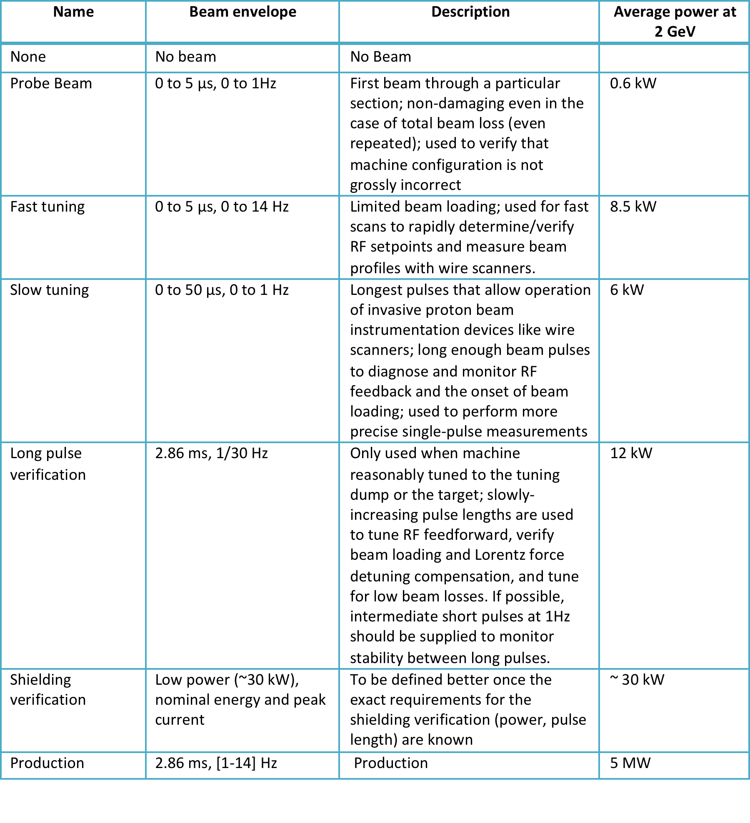
Recommendation #3 and Status
The accelerator operating modes should be defined and documented for all stages, commissioning through to final operation at full power.
Status:
On-going, ESS-0038258.
Basic modes are defined and most important MP requirements have been considered, like probe beam.
Courtesy of M. Munoz et al.

Slide 10
Recommendation #4 and Status
The architecture for the BIS should be finalised. Not all inputs will be known, not all control measures will be known, but the architecture can be fixed, reviewed, and moved into detailed design phase.
Status:
On-going.
Defined quality criteria to be used for evaluation of the different concepts and BIS candidates.
Refining concept ideas and improving these constantly.
Architecture shall be finalised by end of 2016 latest.

Slide 11
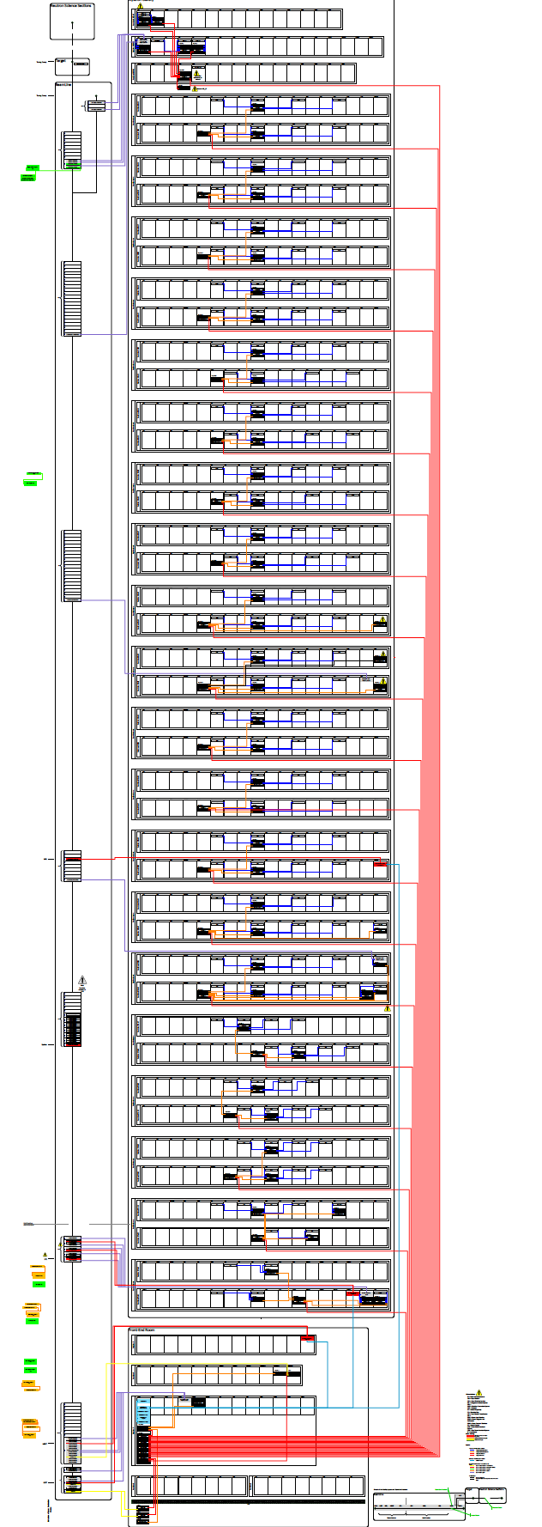
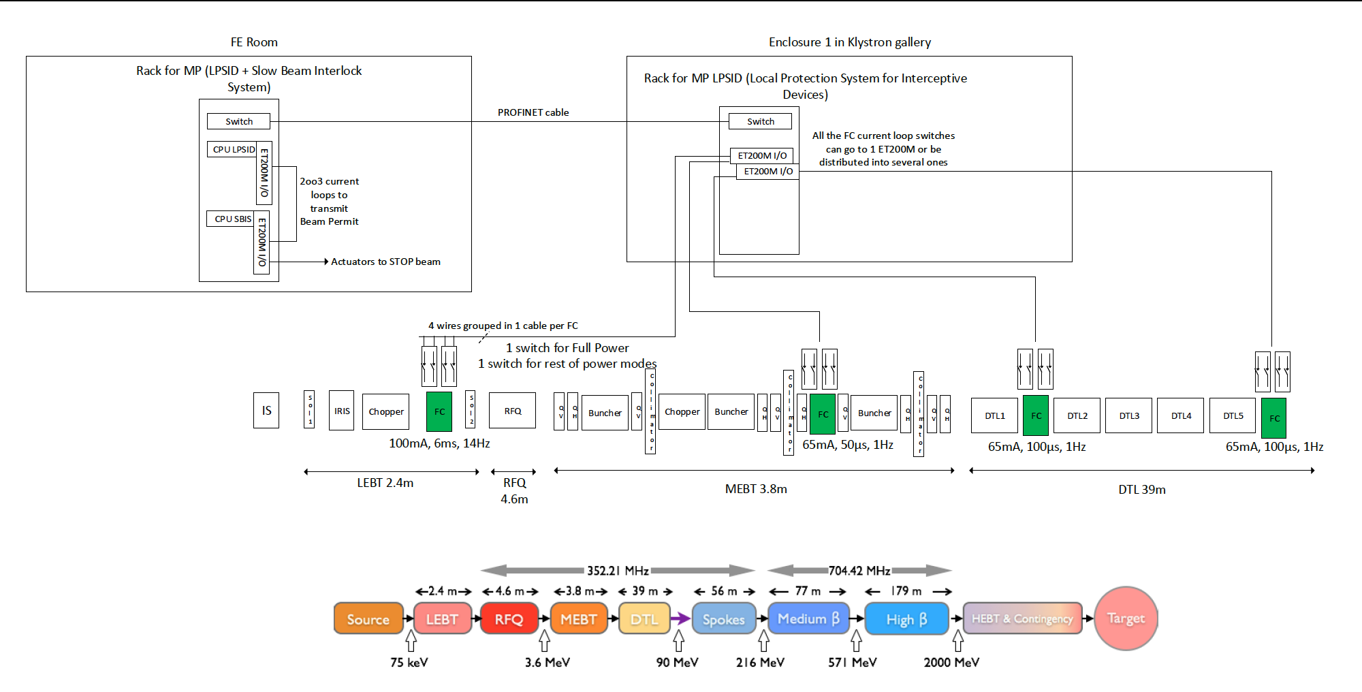
Physical Deployment Example BIS, LPSID
Physical deployment of LPSID
BIS input signal distribution in Klystron Gallery
Courtesy of M. Rejzek, A. Monera, M. Zaera-Sanz, R. Andersson

Slide 12
BIS-Architecture: Benchmark Use Cases
“Benchmark use cases” to evaluate different BIS architecture candidates
Examine intended interplay between systems from a Machine Protection point of view
Root of user and systems requirements
Follow scenarios appearing during regular machine operation
Graphical representation based on SysML activity diagrams
“Alternative Flows”: system’s reactions in case of a failure

Slide 13
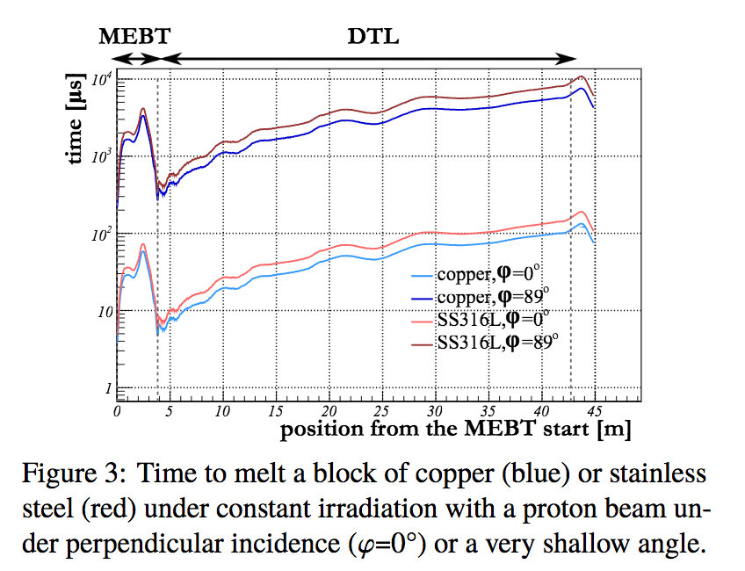
Recommendation #5 and Status
The most stringent MPS requirements should be challenged, in particular the sub 10μsec response time for damage.
Status:
Response time cannot be relaxed
Worst case scenario in warm LINAC:
90° beam impact in the MEBT scrapers
Courtesy of I. Kittelmann/ HB2016 THAM6Y01

Slide 14
Recommendation #6 and Status
The requirement and solution for communicating accelerator operating modes to technical sub-systems should be developed.
Status:
Communication of operating modes via timing system
But: It’s the intended mode information only (ie for next pulse)
BCMs to ensure the correct beam parameters as propagated by the timing system
Missing: concept for communicating the real beam energy to systems like bending magnets and raster magnet system

Slide 15
Recommendation #7, 8 and Status
MP Review Recommendation #7:
The rationale behind having half of the magnets pulsed and half still in DC, with water cooling should be revisited.
Status:
The decision for pulsed magnets has been changed on 2016-06-22 (i.e. no more pulsed quads in the cold LINAC!).
MP Review Recommendation #8:
In house and In Kind Partners should be made aware of the requirements imposed by the MPS SoS approach (to assure required dependability of safety function throughout the full chain).
Status:
Some progress has been achieved. We have drafted some general paragraphs for in-kind contracts, however we have no support yet from the in kind committee to include an MP relevant paragraph in all in kind contracts. Also its needed to go through relevant contracts one by one to ensure all MP relevant requirements are covered (e.g. MEBT IKC).

Slide 16
Recommendation #9, 10 and Status
MP Review Recommendation #9:
The BIS schedule needs to be developed, as part of which the requirement for phased start-up and the power ramp up of the accelerator should be used to define what has to be delivered.
Status:
Work in progress. Schedule and plan have been adapted and are aligned now to the different ESS installation and beam power ramp up phases (in P6/ESS planning tool).
MP Review Recommendation #10:
The machine start-up plans should be re-examined. In particular, the steps for MPS validation at powers greater than 12kW without using the target should be identified.
Status:
Not started yet.

Slide 17
Hardware Interface to the BIS
On the ICS digital controller board we have defined a
Rich interface to the Beam Interlock System:
    Beam Permit (OK/NOK) + communication link
    Standardized for all fast systems (BCMs, BLMs, BPMs, RF systems, Raster Magnet System, etc.)
This will greatly facilitate compliance with the MP requirements for hw integration of all “fast”/FPGA-based systems into the BIS at ESS!
Courtesy of T. Korhonen, M. Rejzek (ZHAW), C. Hilbes (ZHAW)

Slide 18
Major Risks and Issues
Being severely understaffed endangers the ESS - MP project!
1 PLC Expert Manuel Zaera-Sanz:
  Interlock System for Magnet Powering
  Interlock System for Interceptive devices
  Interlock System for vacuum gate valves
  Interlock System for Target
1 PhD Student Riccard Andersson:
  Writing a PhD thesis on Machine Protection
1 Group Leader Annika Nordt:
  Responsible for all Personnel Safety Systems
  Responsible for 10 interlock systems for Machine Protection
  Line Manger for 7 people
  Recruiter for PSS and MP (5 more positions to be filled)
  Project Manager for WP14.5
  MP Champion/Main Coordinator for ESS

Slide 19
In Kind Contract with ZHAW/CH
In 2015-12 we signed a Technical Annex with ZHAW/Switzerland for 2.7MEuro
Deliverables from this contract:
  MP-SoS Engineering Documentation Set
  Risk Analysis and definition of protection functions for the target systems, the Neutron Science Systems and the Raster Magnet System (RSMS)
  Development and production of the Fast Beam Interlock System (FBIS): documentation and hw modules for ESS operation
  Verification & Validation Systems (hw) for the FBIS and the RSMS
  IEC 61508/IEC 61511 Functional Safety Training for ESS
  PSS Safety Assessment Report
However the problem of not having enough staff at ESS, delays the progress of the in kind project. They currently take on more work than anticipated in the contract! The problem of not having the in kind contract signed causes further issues (delays the payment of the ZHAW team).

Slide 20
Summary and Outlook
Lots of work on going and lots of good news were presented
Help and commitment from Accelerator and Target is appreciated
However: Need even more commitment to make the MP and ESS mission possible
Technical detailed baseline is still missing (ACC, ICS)
Many systems are still a black box and make it impossible to assess the protection integrity level required
Need of organizational changes + definition of roles/responsibilities, even stronger need of further recruitment
More people must be involved in MP to make it happen

Slide 21
Machine Protection
Machine Protection can be implemented only with ESS wide commitment
Machine Protection cannot be implemented by a single team, its an ESS team effort
It needs to be addressed EVERY SINGLE DAY!
ESS will not achieve 95% of beam availability WITHOUT a good Machine Protection Strategy that is Functioning!
We cannot wait until the machine is built,
We are building our future NOW
If I am not for myself who is for me? And being for my own self, what am 'I'? And if not now, when?

