Slide 1
Progress on Hardware & Integration Technical Advisory Committee 14
Daniel Piso Fernández
Hardware & Integration Group Leader
Integrated Control System Division (ICS)
ESS/ICS
Date: 2016-10-06

Slide 2
Overview
The Group
Status of the group
Task Allocation
WP 4 – Hardware Core
Timing System
High-Speed Digital Platform, Digitizers & Low level Software, PLC Guidelines
WP 10 – Accelerator Integration Support
Data handling
Proton Source & LEBT
RF
Beam Instrumentation
BCM
BPM
LEBT EMU
NPM
Vacuum & Cryogenics
WP11 – Target Integration
WP12 – Instruments Integration
ESSIIP – V4
Motion Control
In-kind
WP13 – Conventional Facilities Integration

Slide 3
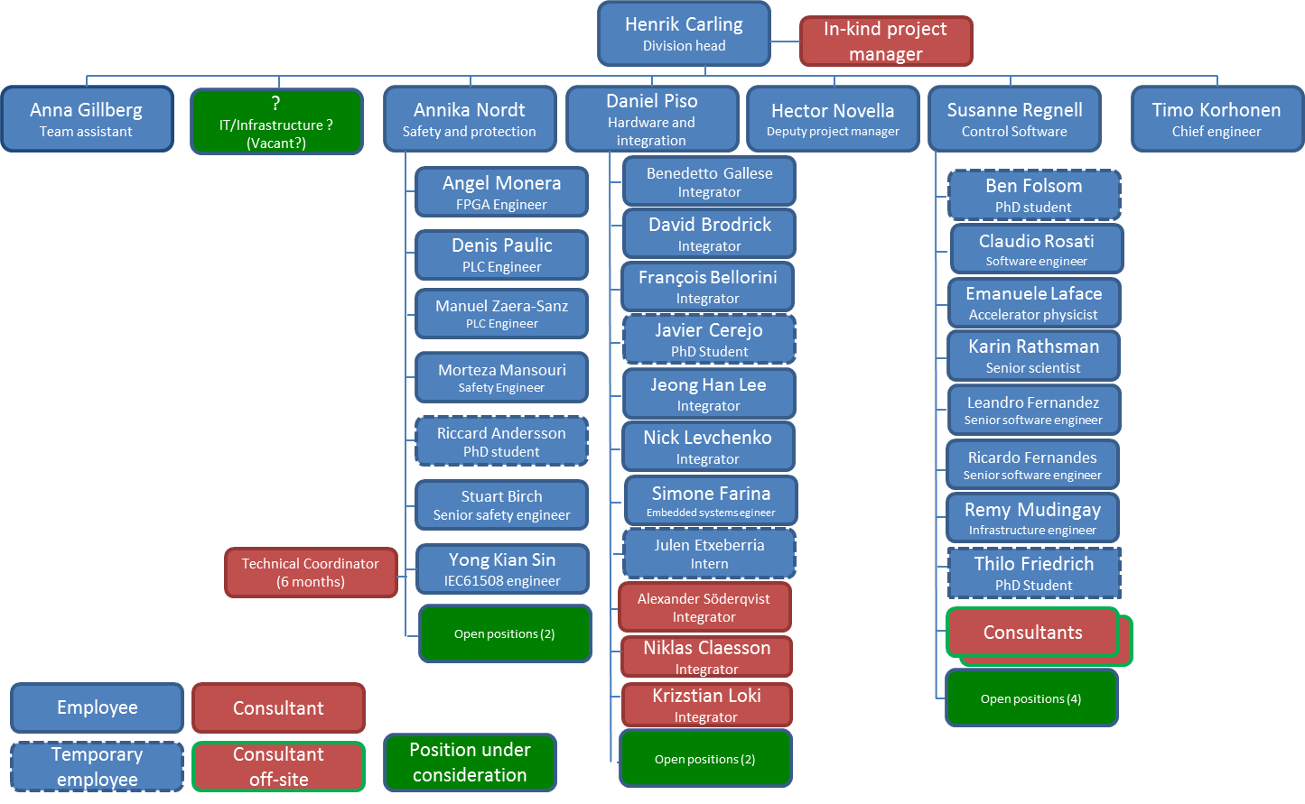
The Group Status
The team has expanded even though at less speed than planned
In some cases the reason was uncontrollable events
Issues regarding procurement processes are limiting the changes in the team

Slide 4
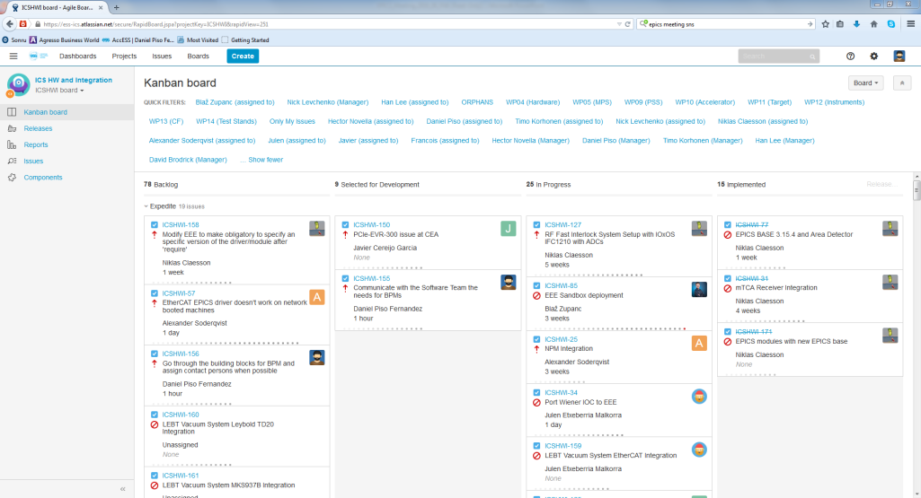
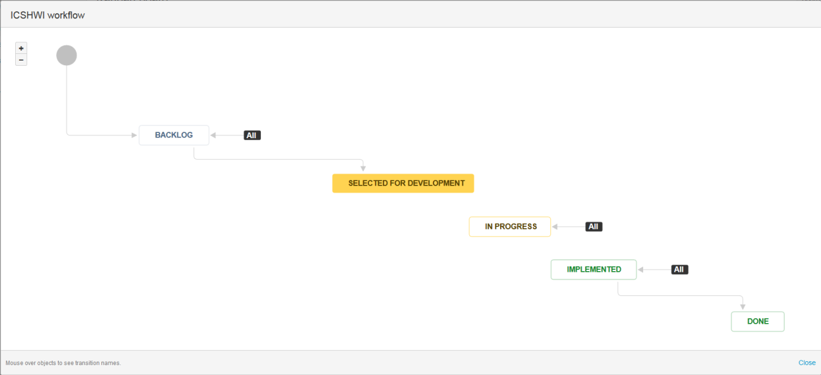
The Group Task Allocation

Slide 5
WP 4 – Hardware Core Timing System
All the hardware needed has been tested and is functional
Engineering Manuals for VME-EVR-230, PCIe-EVR-300, mTCA-EVR-300.
Next Steps
Migration of the legacy systems based on PMC-EVR-230
Setup of a production-ready timing distribution system in the lab
Increase the competency of the team of integrators regarding timing system
Create a commercial framework agreement in order to prepare for mass procurement of timing hardware.

Slide 6
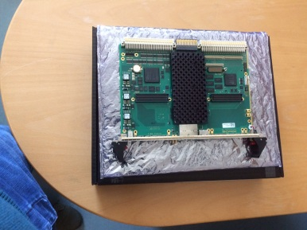
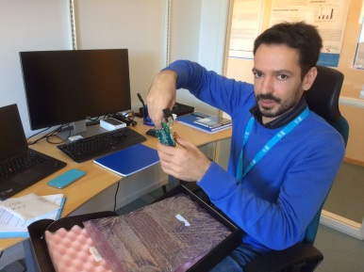
WP 4 – Hardware Core Hardware and Low Level Software
An in-kind agreement has been signed with PSI in order to provide hardware and EPICS integration for the High-Speed Digital Platform and some of the digitizers.
IFC1410 Series Production – 2017-01-16
IFC1420 Series Production – 2017-03-06
Final List of I/O:
ADC_3110/3111 by IOxOS SA
FM-S14 by Faster Technology (whereby "support" is limited, as explained)
DAC_3113 by IOxOS SA
ADC_3112 by IOxOS SA
ACQ420 FMC by d-tAcq Solutions
ADC3117 by IOxOS SA
EtherCAT slave FMC (In-kind agreement with UT Tallin)
PLC guidelines and PLC Factory
Problems to solve with EEE and development workflow.
Need for manual import of modules developed in remote locations
Need for manual recompile of modules when adding new EPICS version
These are not technical issues. An EEE ‘gatekeeper’ needs to be put in place.
A team needs to be put in place to support all this software (EPICS integration, kernel drivers, FPGA firmware). One employee and on contractor have been recruited. More resources are still needed.
A framework agreement in order to do mass procurement of mTCA insfrastructure (crates, MCHs, CPUs and power modules) will be put in place in the coming months.

Slide 7
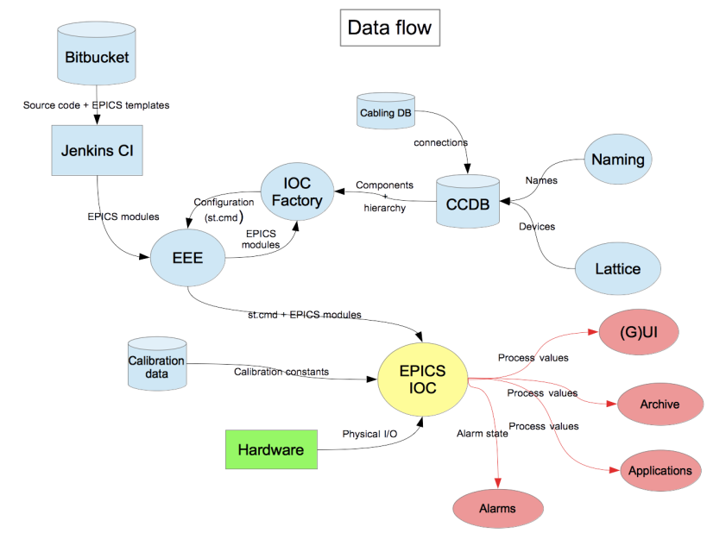
WP 10 – Accelerator Integration Support Data Handling
Collaboration with Accelerator Division in order to create a workflow for data entry to
Naming Tool
CCDB
Cable Database
Accelerator Division has appointed an engineer to coordinate the data entry together with the ICS Integration Group
Vacuum Group ICS working on the full approach with ESS Names and Tags. Device Consistency need to be implemented.
Problems solved regarding Eplan

Slide 8
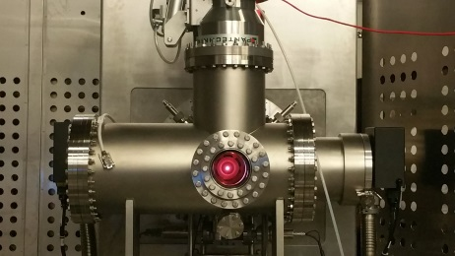
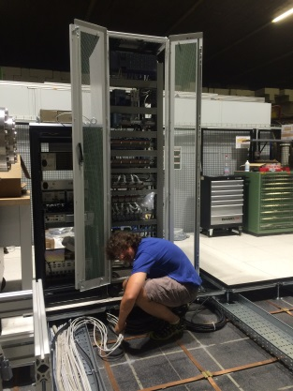
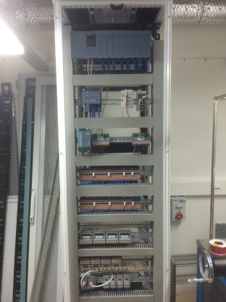
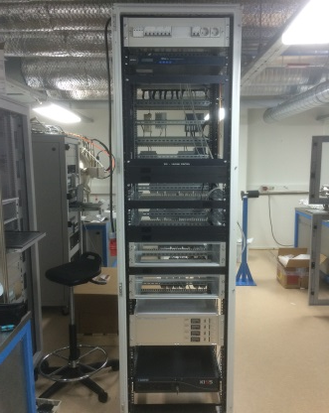
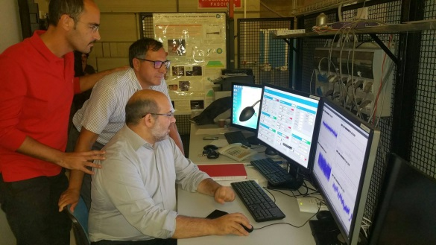
WP 10 – Accelerator Integration Support PS & LEBT Status
The installation of the Proton Source has been finalised and is being checked by the controls team
Vacuum Controls for the Proton Source have been installed and commissioned.
The Proton Source has already been started using the controls.
NPM and BCM will be sent in the following weeks to Catania.
The installation process has been cumbersome.
The local team needed help in order to ellaborate the electrical schematics from the signal lists
There was unclarity about the responsibility about installation.

Slide 9
WP 10 – Accelerator Integration Support RF
RF Local Protection System. A first version of the FPGA firmware has been produced for the IF1210. EPICS integration is being developed. The system will have to be migrated to the final IFC1410.
The number of sites that need support for LLRF has increased:
LTH, Lund.
Freia, Uppsala
ECCTD, CEA/Saclay
3 sites in Poland
ESS Bilbao
Next steps:
migrating to mTCA-EVR-300.
bring the design from a prototype phase to production
Phase Reference Distribution Prototype. Different EPICS integration activities

Slide 10
WP 10 – Accelerator Integration Support Beam Instrumentation
The main current active projects are:
BCM. There is a functional mTCA based prototype. It will be sent to Catania for the Proton Source commissioning in the following weeks. Pending of migration to mTCA-EVR-300 and a new version of the firmware. It lacks MPS interface.
BPM. There is a functional mTCA based prototype. Now procuring mTCA hardware for long terms tests.
LEBT EMU. To be developed in-kind by CEA Saclay. There are some delays in the production of the diagnostics. The first prototype will be VME based and sent to Catania. Afterwards it will be migrated to mTCA.
NPM. Prototype almost finalised. It will be sent to Catania in the following weeks. Trying to solve some performance problems with the cameras.

Slide 11
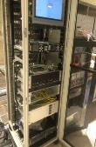
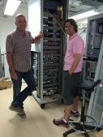
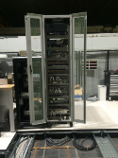
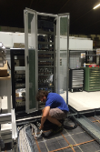
WP 10 – Accelerator Integration Support Vacuum and Cryogenics
The rack for Proton source and LEBT Vacuum Controls is operational and being use for the commissioning in Catania.
Testing Naming, CCDB, Tagging and Engineering Tools
Test bench for the lab in progress
Cryogenics Controls Test Stand is currently being developed at the lab. The Cryogenics Tests Stand will become operational in late 2017.

Slide 12
WP11 – Target Integration
For the moment there is not much development activity. We are looking at the design and different interface control documents.
In-kind Conversations with contributors in Czech Republic for the development of Liquid Systems Controls, HVAC and He Loop.
A Conceptual Design for the Motion Control of the Target Wheel has been developed. Now preparing to build a prototype at ESS facilities.

Slide 13
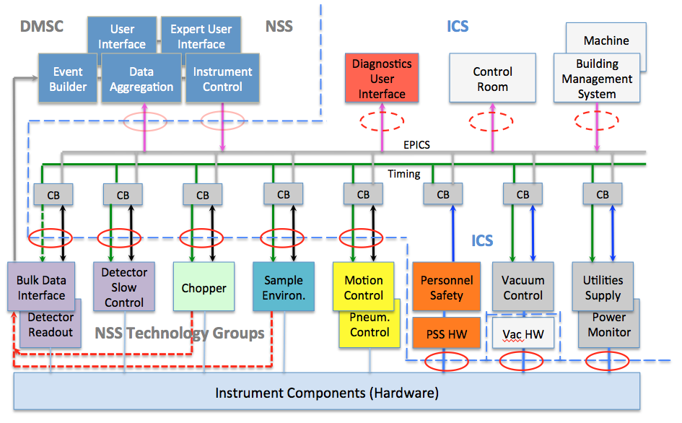
WP12 – Instruments Integration

Slide 14
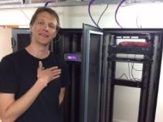
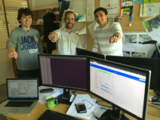
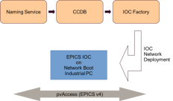
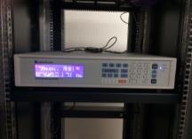
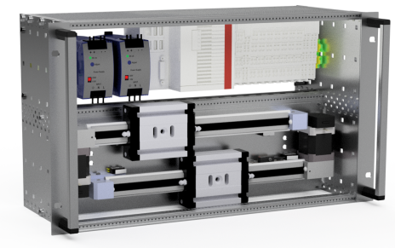
WP12 – Instruments Integration
Status of the ESSIIP (ESS Instruments Integration Project).
Full EPICS V4 and Naming Service, IOC Factory integration.
Sample Environment:
First equipment already integrated or underway (Lakeshore LS336 temperature controller, Julabo water bath), etc..
Sample environment controls integration workflow formally defined.
Prototyping for utility supplies (gases, compressed air, etc.) controls underway at Utgård laboratory.
Detector Systems:
Detector power supplies integrated in ESSIIP lab.
In-kind proposal in progress with STFC.
Motion Control
The full open-source ethercat motion controller has been developed. Starting to distribute the first motion controllers to stakeholders.
EPICS integration of standard motion control platform.
Neutron Chopper Systems:
Full DMSC – ICS – Chopper Group integration of the mini-chopper.
Chopper timing interfaces designed and prototyping in progress.
Instrument projects:
Controls consultation process defined, and in progress with some instruments.
NSS Integration has a big number of stakeholders. Difficult to keep control with limited resources. We hace decided to assign more resources to this area.
Instruments are a special case regarding pre-operations budget. The details are being worked-out with our colleagues in NSS
Producing interface documentation and providing integration support to the DMSC Experimental Control System.

Slide 15
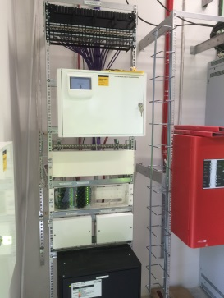
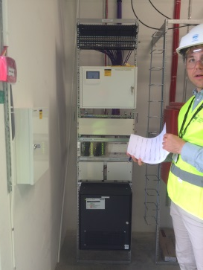
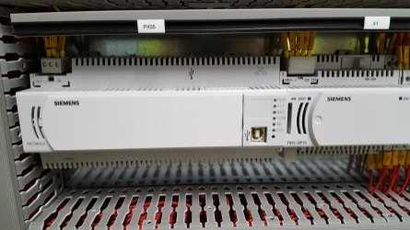
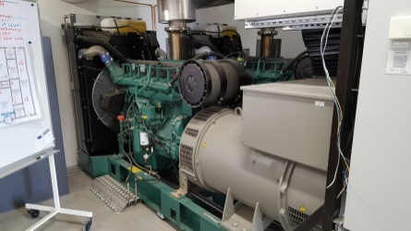
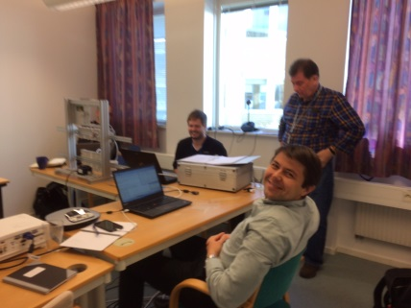
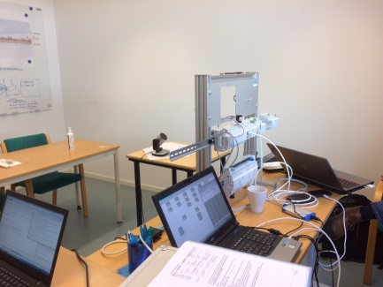
WP13 – Conventional Facilities Integration
All the hardware has been procured and is ready for installation in H05
Temporary Server Room and Monitoring Room are in place
The first visits to start with the installation of H06 already took place.
Requirements for buildings H05, H06, G01, G02, G04 and D02 have been generated.
Issues getting into contact with the commercial suppliers
First issues of Work Environment Safety and Installation Procedures. They still need improvement.

Slide 16
Questions

