Slide 1
TAC 14 - ICS Digital platform progress
Henrik Carling
2016-10-06

Slide 2


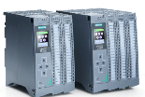
Three layer strategy - control systems at ESS
Signal speed
A custom made microTCA board with a powerful FPGA and a CPU. A FPGA framework constitutes the development environment. The CPU runs EPICS
ICS has adopted a three layer strategy for implementing the control system based on signal speed
  A custom made platform based on microTCA for applications with data acquisition exceeding 100 kHz
  The CPU will run EPICS and the FPGA will have a complete application development environment
  For slower signals, EtherCAT will be used as a real-time fieldbus with good price/performance ratio
  Synchronization and event information are key for applications where a full custom platform solution would be too costly
  Low speed signals are handled with commercially available PLC systems from Siemens
  This is a cost-effective solution that addresses ESS reliability and maintainability requirements
  The PLC:s will be connected to EPICS for further integration into the control system
10 MHz
1 MHz
100 kHz
Electronic front-end platform
10 kHz
1 kHz
EtherCAT I/O modules that are connected to commercial or open-source EtherCAT master controllers which are in turn connected to the EPICS based control system
100 Hz
EtherCAT
10 Hz
Slower signals are handled by industrial automation (PLC) for reliability and cost reasons. The standardized platform for ESS applications comes from Siemens
1 Hz
0.1 Hz
Industrial automation (PLC)

Slide 3
Reasons for having a standardized digital platform for control systems
High level requirements
  Support 14 Hz long pulse machine operation
  Ensure good integration with timing
  Acquisition (ADC sampling) possible at ~100 MSPS
    At 2.86 ms pulses@14 Hz : 4% duty cycle it is a lot of raw data
    The principle is to process locally but prepare for exposing the data for troubleshooting purposes
Interfaces to machine protection/interlock are crucial
MTCA.4 was selected as the standard for this
  Looking at alternatives and considering the lifetime of ESS
  The standards is still new and not solidly proven in operation
  Work needs to be done to ensure
    Maintainability
    Interoperability
    Development
    Long-term sustainability

Slide 4
Digital Controller Board for ESS
The development and delivery of the digital controller board is an in-kind contribution from PSI, Switzerland
  PSI will work with a well-known industry partner
The development is based on a port of an existing architecture to MTCA.4
  Risk is lowered since we will reuse existing design
  The development is considering components lifetime/availability
  The board will be able to act as an EPICS on Linux IOC
    CPU on-board (Freescale QorIQ T2081)
  The board is equipped with a Xilinx Kintex Ultrascale FPGA
    Delivery of the firmware library/framework TOSCA-III is included
    Network-On-Chip, non-blocking PCI Express
    Source code available to ESS partners/licensees (liberal but not fully open source)
  Schematics, board layouts, etc. included

Slide 5

The in-kind agreement with PSI
Endorsed by IKRC

Slide 6
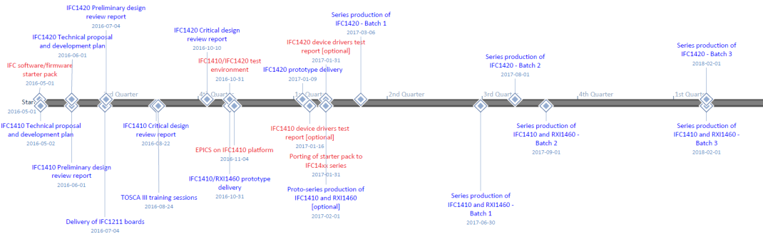
Project and delivery time plan
To be able to keep the delivery deadlines for the ICS digital controller board we are employing a ”hybrid” commercial/in-kind model
The critical points in the schedule are the deliveries/test/acceptance of prototype boards
To meet production series volumes we will follow a joint risk mitigation approach with stakeholders and the in-kind/commercial suppliers. The risk mitigation from the supplier allows this as long as we are fairly quick in acceptance testing
The hardware project prototype deliverables are so far on track (+/- 10 days). We need to keep tracking also firm and software deliverables

Slide 7
Digital Controller Board for ESS
The Digital Controller Board will be designed in two variants
  One dual FMC carrier with digital/serdes RTM
  One with 10 channel analog I/O through Zone 3 and single FMC slot
  This choice was made to accommodate existing ESS designs
  Analog I/O implemented with on-board ADCs with an FMC interface
All fast ESS systems have agreed to use this platform
  Beam Instrumentation systems (BPM, BLM, BCM, WS, etc.
  RF systems (LLRF, RF Fast Interlock(
    Early deployments may be using other hardware
  It is extremely important that ICS keeps the agreed delivery timeline
  Backup solutions have been identified

Slide 8
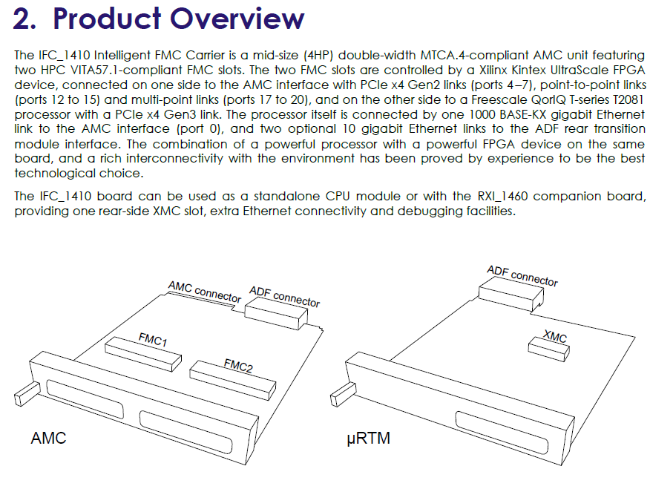
IFC1410 overview

Slide 9
IFC14xx feature summary (1)
General
  Backward compatibility with the IFC_1210 ecosystem
  PICMG MTCA.4-compliant mid-size double-width AMC board
  Ultra low jitter clock inputs on the front-panel, AMC and ADF interfaces
FPGA Processing Unit
  High-performance Xilinx Kintex UltraScale KU040 (default) or KU060 FPGA
  1024MB dual channel DDR3-1066 SDRAM (2x 256M x 16)
  Configuration from on-board SPI flash, or with remote configuration file fetched by the processor through Ethernet
  Powered by IOxOS Technologies proprietary TOSCA III FPGA Design Kit for faster and easier custom application design and integration
Processor Unit
  High-performance Freescale QorIQ T2081 processor, featuring the e6500 power architecture which includes Altivec (was not available on the P2020 implemented on the IFC_1210)
  On-board 2GB DDR3L 1866 SDRAM
  Non-volatile boot memories: SD card and dedicated SPI flash
  Non-volatile storage memory: 4Gbit NAND flash
  Powered by U-Boot/Linux and able to run EPICS-based applications

Slide 10
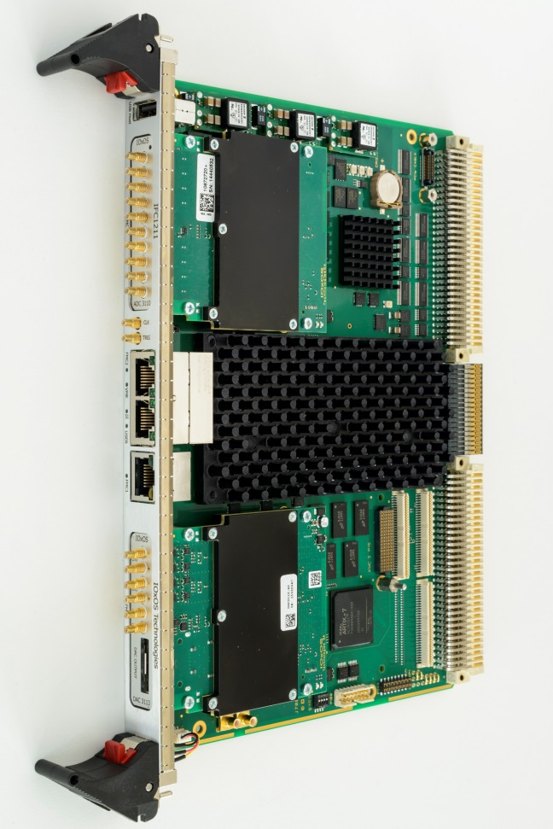
IFC14xx feature summary (2)
FMC Interfaces
  Dual HPC VITA-57.1-compliant FMC slots
  80 LVDS channels
  4 differential clocks
  1x GTH x4 channel (KU040 FPGA option)
  Programmable VADJ power supply (1.5V – 1.9V)
AMC Interface
  Port 0: AMC.2-compliant gigabit Ethernet link with the processor
  Ports 4-7: AMC.1-compliant PCI express x4 Gen3 link with the FPGA Processing Unit
  Ports 12 to 15: point-to-point LVDS links with the FPGA Processing Unit
  Port 17 to 20: shared bus M-LVDS links with the FPGA Processing Unit
  Telecom clock inputs TCLKA and TCLKB used for ultra low jitter clocks
ADF Interface
  1x SGMII Ethernet link with the processor
  2x XFI 10G Ethernet links or one PCIe x2 Gen2 link with the processor
  12x GTH links (3x Quad) with the FPGA Processing Unit
  8 LVDS/16 LVCMOS25 signalling with the FPGA Processing Unit
  AMC_CLK and AMC_TCLK clock outputs supplied to the RTM for ultra low jitter clocking
  RTM_CLK clock input can be used as source for the ultra low jitter clock generator
  Compliant with pin assignment recommendation class D1.4 from DESY

Slide 11
Board block diagram - simple
Four main functional blocks
  CPU, Central FPGA
  Power-On FPGA -> flexible FPGA management and powering management
  MMC handles the MTCA infrastructure

Slide 12
Block diagram – more details

Slide 13
Digital Controller Board for ESS
Usage of the FMC carrier board
  There are several integrated/tested FMCs available
    250 MSPS 16-bit ADC
    1 GSPS 4 CH 12-bit ADC
    ... and more
  Integration of new functions easy due to modular firmware library
  Use same application with different FMCs
  Implement a common base memory map
On-board CPU
  Gives te possibility as a processing “blade”.
  Can be used standalone when required, or as AMC for integration
  Better scaling than with a single central CPU
    Multiply simple units rather than integrate functions
  External, more powerful CPU can be easily added to a system if needed

Slide 14
X-ray view of the board (FMC variant)
No pictures of the final hardware yet. We expect the first boards in 1.5 to 2 months.

Slide 15
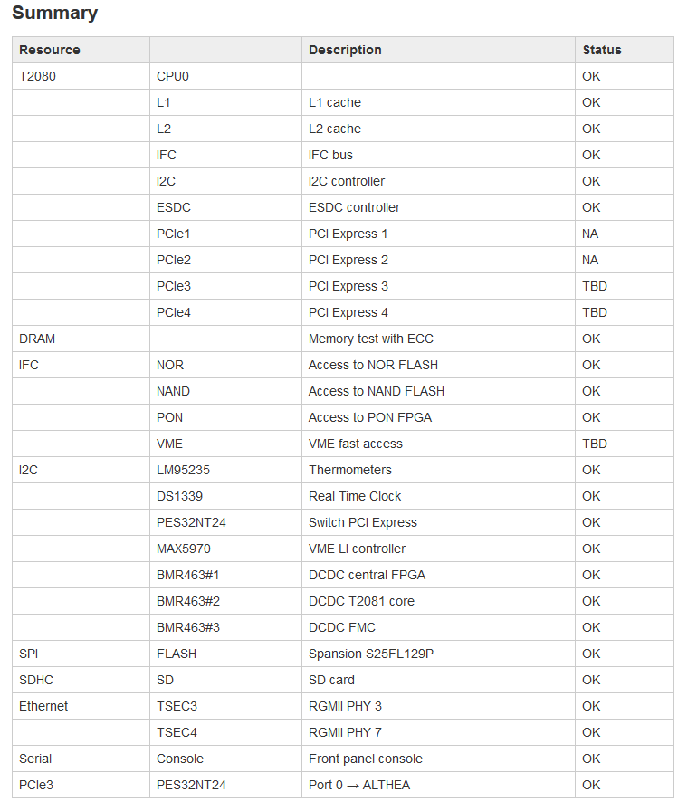
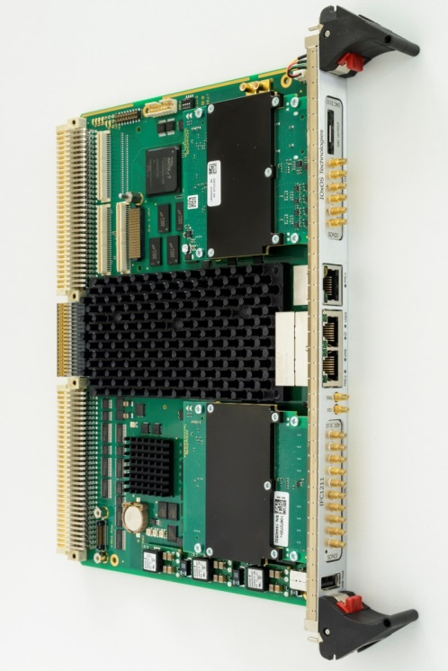
IFC1211 status
IFC14xx has a VME sibling, the IFC1211
IFC1211 has a very similar block diagram to the IFC14xx
Risk mitigation for hard and firmware

Slide 16

Thank you
Questions

