Slide 1
Spoke RF Transmitters
Alessandro Fabris, Cristina Pasotti
Elettra Sincrotrone Trieste
14th ESS Technical Advisory Committee Meeting
October 5-7, 2016
www.europeanspallationsource.se

Slide 2
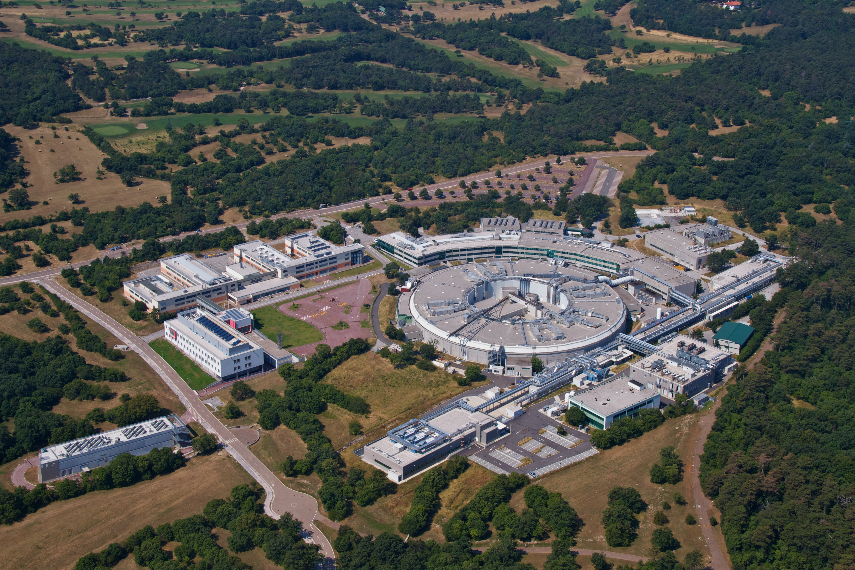
Elettra Sincrotrone Trieste
Who we are
No profit shareholder company recognized of national interest pursuant to Law 370/99 of the Italian Republic.
Shareholders: Area Science Park, Friuli Venezia Giulia Region, CNR, Invitalia.
Elettra 2.0-2.4 GeV 3rd generation Synchrotron Light Source
357 staff (31.08.2015)
100000 m²
6500 hours /year
32 beamlines
more than 1400 Users
from more than 50 countries
FERMI 1.5 GeV seeded Free Electron Laser Facility

Slide 3
Background
  Elettra, INFN and CNR are the three Institutions committed to the realization of the Italian in-kind contribution for the construction of ESS.
  INFN is the Representing Entity for Italy in the European Spallation Source ERIC.
  In August 2015 Elettra has signed the Accession Agreement to Collaboration Agreement for Design, Development and Construction of the ESS Accelerator.

Slide 4
Elettra for ESS
Possible Elettra in-kind contributions for the accelerator are identified in various specific technological areas:
    RF systems (power stations for the spoke cavities)
    Magnets for the sc linac and transfer lines
    Magnet Power Converters
    Diagnostics (wire scanner acquisition system)
    Installations
An internal project has been set up to manage the activities related to the involvement of Elettra in ESS.
Project Leader
A. Fabris
Elettra ESS - Preparatory Phase (ESS-PP) Project Structure
WP1
Management
A. Fabris
WP2
Radiofrequency
C. Pasotti
WP3
Magnets
D. Castronovo
WP4
Power Supplies
R. Visintini
WP5
Diagnostics
M. Ferianis
WP6
Installations
A. Fabris
WP7
Neutron Science
C. Masciovecchio

Slide 5
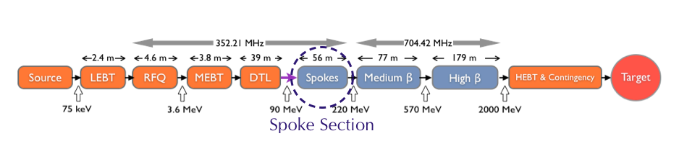
RF Contribution Scope
Build twenty-six pulsed 400 kW@352 MHz RF power stations for the spoke cavities
RF power requirements ranges between 260 kW and 335 kW
Power size standardised to 400 kW to take into account distribution losses and provide some safety margin.
One power source/one cavity scheme.
This scheme ensures the independent management and regulation of each system in terms of phase, amplitude level and power set required.
RFPS design benefits from return of experience at FREIA.

Slide 6
Key Personnel
Defined in the HoA agreement
General Coordinator | Alessandro Fabris
Defined in the schedule annexed to the agreement
Contract Coordinator | Cristina Pasotti
Engineering
RF | Vincenzo Ingravallo
Power Electronics | One Engineer to be hired, selections in course
Senior Technicians | M. Rinaldi, M. Bocciai
Support from infrastructure group, technical office and other technical groups as needed
Management Support (transverse to all Elettra Contributions)
Infrastructure Group Coordinator | Dino Zangrando (Head of Engineering, FERMI Project )
Documentation harmonization | Riccardo Fabris
Project assistant | Rodolfo Laghi
Secretarial support | Roberta Casson
Total 8 FTE in three years

Slide 7
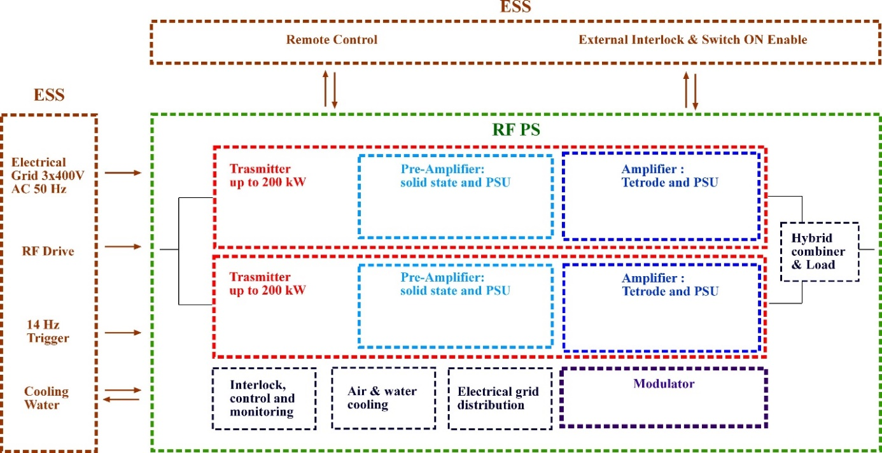
Technical Solution
  At present the tetrode is the simpler and the already available RF power source to achieve 400 kW peak power by means of the effortless combination of two tubes working in parallel.
  Construction will be outsourced to industry under Elettra supervision.
Each RFPS unit consists of:
RF distribution system.
Two equivalent transmitters with amplification chain composed by pre-amplifier – solid state and amplifier – tetrode.
One Modulator to supply both tetrodes.
Interlock, control and monitors.
Cooling, air and water.
Electrical grid distribution.
PDR held on April 12-13, 2016

Slide 8
PDR Documents
Specification for the 352 MHz, 400 kW Spoke RF Power Station
352 MHz, 400 kW Spoke RF Power Station Test and Commissioning
Spoke RF Power Station Interface
352 MHz, 400 kW Spoke RF Power Station Safety and Standards
Preliminary RAMI Considerations for the Spoke RF Power Stations
Spoke RF Power Station Contract Management and Quality Control
Spoke RF Power Station Schedule
Spoke RF Power Station IKC Risk register
Flicker and Harmonic Emission evaluation and Discussion
Power Factor and Flicker Measurements on FREIA Stations
Tetrode Type TH 595 Thales Technical Specifications
RF Cavity type TH 18395A Thales Technical Specifications

Slide 9
Parameters
CF monotone | 352.21 MHz
P_{N} | 400 kW
P_{ave,M} | 20 kW
BW | > ± 1 MHz
Gain at P_{N} | > 86 dB
Linearity from 50 kW to 250 kW | ± 0.5 dB
Linearity from 250 kW to 400 kW | ± 0.3 dB
RF Drive Maximum | 0 dBm
Operation | Periodic Pulsed
Nominal & Maximum Repetition Frequency | 14 Hz
Nominal Pulse Width, flat-top | 3.5 ms
Minimum Pulse Width | 140 us
Maximum Pulse Width | 4.0 ms
Input / Output impedance | 50 Ω
RF output line | 6 1/8 " EIA flange
RF efficiency h_{RF} | ≥ 50 %
Overall efficiency h_{O} | ≥ 35 %

Slide 10
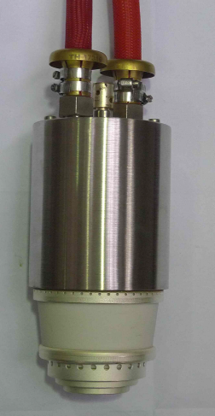
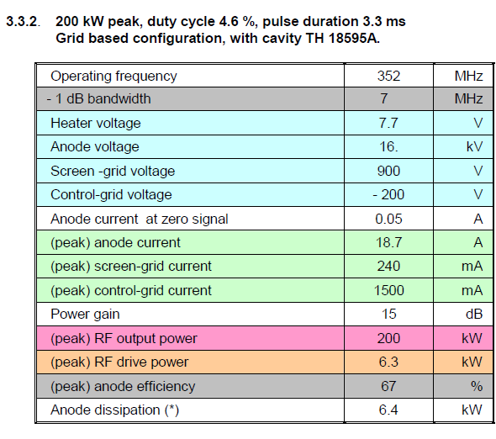
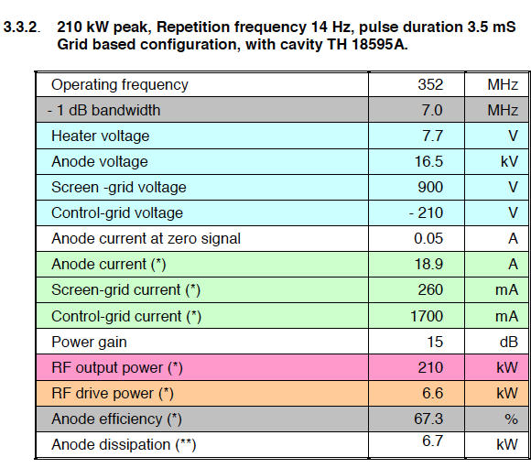
Tetrode
  Baseline: TH 595 with input circuit TH 18595A.
  Designed for 200 kW pulsed operation at the ESS RF pulse requirements.
  The proposed tube comes from an off the shelf air cooled tube.
  A specific water cooled version was designed for CERN.
  The TH 18595A cavity was designed for the ESS application.
  Tube can operate with ESS Hot water circuit.
  An upgraded version (TH595A) has been released middle of September, specified for 210 kW at the ESS pulse specifications with the same input circuit and slightly increased PS requirements.

Slide 11
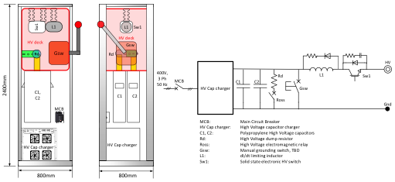
Modulator
  The Modulator supplies the anode voltage to the TH 595 tubes
  one modulator feeds two tubes
  built in a separate cabinet
  control and supervisory system fully integrated with the RFPS ones
Main characteristic of the modulator will be:
  HV stability regulation
  output pulsed power reproducibility
  voltage droop compensation
  solid state switches to protect the tube
  Maximum voltage: 18 kV
  Voltage drop : 1 kV
  Maximum Current: 22 A + 22 A (pulsed)
  *C. Martins, ESS
  The tetrode modulators shall be based on switched mode power converter technology with high voltage stability regulation, high reproducibility and voltage droop compensation.
  The recommended topology* for the modulator is a HV capacitor charger and main capacitor bank (160 μF).

Slide 12
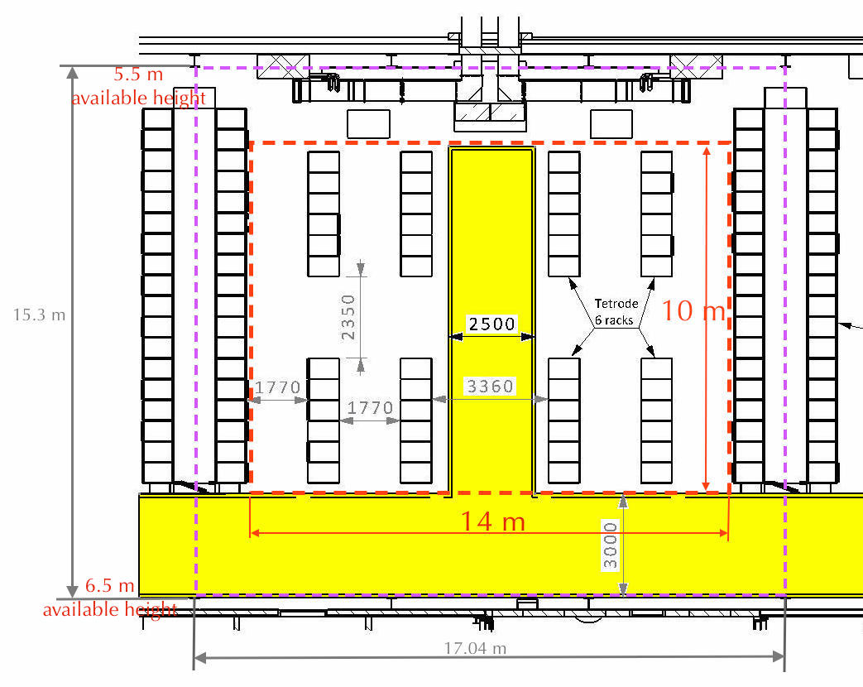
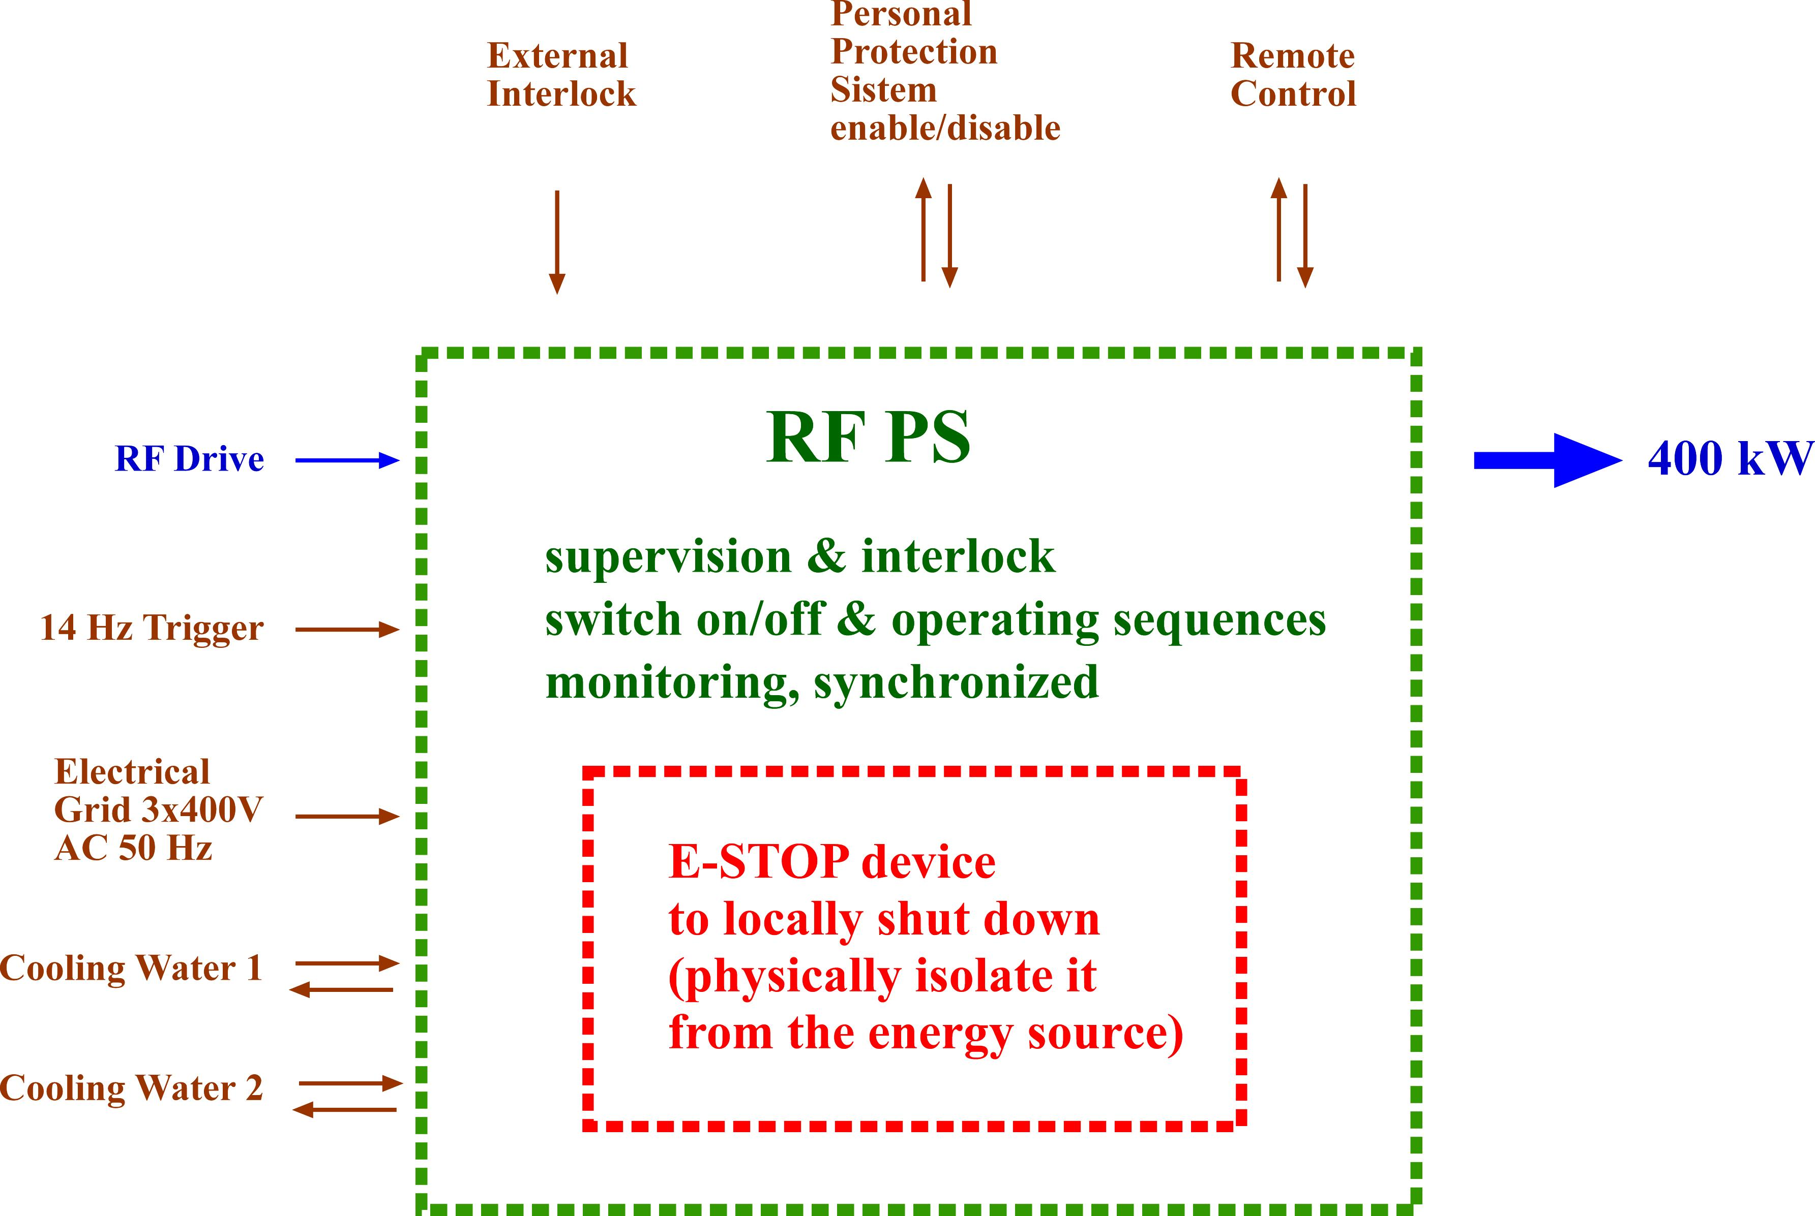
Layout
Controls and Interlocks
LAYOUT
The ideal foot print for the RFPS including the Modulator unit is 3600 mm x 900 mm.
Having this foot print, up to eight complete RFPS shall be hosted in a 14 m x 10 m surface, providing enough space to access the room.
  CONTROLS AND INTERLOCKS
  RFPS integrated control and monitoring equipment on board ensures the correct and safe operation of in automatic, unmanned standard operation.
RFPS fully integrated in the operating ESS EPICS based ICS.
The interlock control logic shall be a reliable, robust and independent system, separate from the control system but with a full communication capability.
The Siemens S7- 1500 controller is the suggested choice to allow a full integration with the ESS interlock system.

Slide 13
Construction Plan
Construction of one unit, followed by series construction in batches.
Constructions in collaboration with industry.
The first unit to be extensively tested to validate the design.
FAT shall demonstrate:
  Modulator reproducibility, stability and AC grid quality rating at the nominal voltage and output power amplitude.
  RFPS reproducibility, stability and efficiency at the nominal output RF power.
  The endurance test, 24 hours with no main fault, failure or interruption at the nominal RF output power on the ideal load.
  The full compliance with the tetrode switching on/off procedure and protection specification.
  The full compliance with the human safety rule and machinery safety standard.
  The full implementation of the interlock and supervisory system.
  The full operability of the local and the remote commands.
Once installed at the ESS site, the start-up and commissioning procedure will be carried out on each RFPS to ensure the proper operating parameters.

Slide 14
Phases of the Project
  STAGE 1 - DESIGN PHASE
    Detailed design and engineering phase
    SCOPE:
      Prepare a technical specification for the procurement phase
      Investigate and consolidate construction and procurement strategies
      Prepare tender documents
    Tendering
      Tubes
      Transmitters
    Ends with the Critical Design Review
Major milestones
Short description | Planned date | Comment
PDR | April 13, 2016 | PDR approval
Tendering Procedure | April 14, 2017 | Completion of tendering procedure
CDR | June 9, 2017 | CDR approval

Slide 15
Phases of the Project
  STAGE 2.1 - REALIZATION AND VALIDATION OF THE FIRST UNIT
    Construction and test of the first unit
    SCOPE:
      Verify and validate the design in all aspects.
      Consolidate the design for the construction of the series of 25 units.
    Ends with the Product Readiness Review.
Major milestones
Short description | Planned date | Comment
Construction of a TM first unit- test report on a resistive dummy load | Sept.1, 2017 | Experimental validation of 1st TM before assembling it to the RF transmitter
First unit construction | Dec. 1, 2017 | Construction of first unit finished
First unit validation (Production Readiness Review, PRR) | Jan. 25, 2018 | Completion of test on the first unit
First unit delivery to Lund | Febr. 28, 2018 | Delivery of first unit to Lund

Slide 16
Phases of the Project
  STAGE 2.2 - SERIAL PRODUCTION OF 25 UNIT
    Procurement, construction and test of 25 units
    SCOPE:
      Build the units and deliver them to Lund.
      Construction, delivery and installation performed in batches
      Assist in the installation and setting to work of the units on site.
Major milestones
Short description | Planned date | Comment
RFPS 2-6 construction completed | March 31, 2018 | FAT
RFPS 7-11 construction completed | May 31, 2018 | FAT
RFPS 12-16 construction completed | August 31, 2018 | FAT
RFPS 17-21 construction completed | Oct. 31, 2018 | FAT
RFPS 22-26 construction completed | Dec. 1, 2018 | FAT
SAR - System Acceptance Review | Dec. 31, 2018 | SAR

Slide 17
Time schedule

Slide 18
IKA status
Schedule (Technical Annex) agreed between Elettra and ESS.
Signature of Technical Annex is not yet done due to the need to clarify legal aspects due to the specific Italian case (one RE, three constructing bodies) on IKA and Schedules signatures.
A “cover page” has been submitted to the last IKRC.
Preparation of tender documents is in course.

Slide 19
Challenges
Technical
  RoE with the chosen tetrode in other facilities should allow to mitigate risk in the design.
  AC line flicker and harmonic content is important aspect which should be taken into account in the modulator design.
  First unit extensively tested to fully evaluate compliance to requirements and implement modifications if necessary.
Schedule
  Schedule is very aggressive and requires careful attention on all steps.
  Possibility of start tendering is fundamental to meet schedule.

Slide 20
THANK YOU FOR YOUR ATTENTION

Slide 21
BACK UP SLIDES

Slide 22
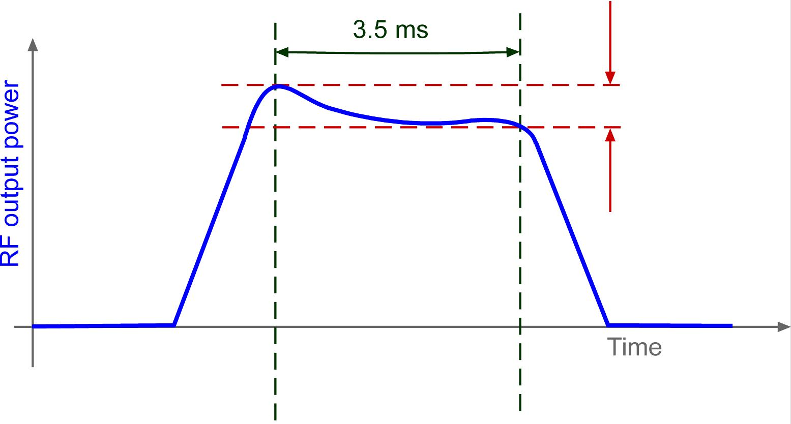
RF Pulse
During the flat-top, the quality of the output RF power is mandatory in terms of amplitude and phase stability. No dips or sudden surge of these parameters are expected but a smooth drop.
Time range | < 5 μs | 5 μs ÷ 10 μs | 10μs ÷ 1 ms | 1 ms ÷ 3 ms
Δ φ | < 0.1 ⁰ | < ±0.2 ⁰ | < ± 1 ⁰ | < ± 2 ⁰
Δ l | < 0.1% | < ± 0.2% | < ± 2 % | < ± 4 %

Slide 23
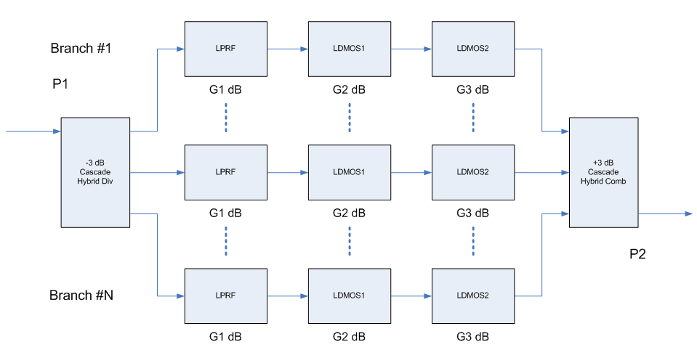
SSA pre amplifier
  Transmitter power ratings and thermal management shall be specified in cw regime.
  SSA power supply rated for high efficiency, low noise and ripple.
  Water cooled as from medium ESS water circuit.
  Design and positioning in the transmitter to profit of modularity and allow easy maintenance.
  All preamplifier built and calibrated to minimize variance of performance and operating parameters.
CF monotone | 352.21 MHz
P_{N} at amplifier input | 6.5 kW
BW | > ± 5 MHz
Gain at P_{N} | ≥ 71.3dB
Operation | Periodic Pulsed
Repetition Frequency | 14 Hz
Nominal Pulse Width, flat-top | 3.5 ms
Input / Output impedance | 50 Ω
RF efficiency η_{RF} | ≥ 60 %
Overall efficiency η_{O} | ≥ 40 %
  Different topologies are possible.
  A typical one could be the combination of 8 branches, each on composed by three cascading stages.
Stage | G | Gain | #tr
LDMOS2 | G3 | 23 dB | 1
LDMOS1 | G2 | 26 dB | 1
LPRF | G1 | 24 dB | 4

Slide 24
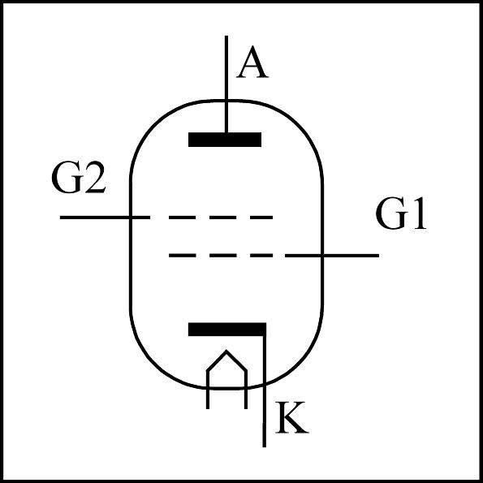
Heater, G1, G2
Power Supplies
Heater DC PSU (option UPS) – Voltage Controlled
Rating Maximum | 8.8 V, 200 A
Maximum heater surge limit at | 250 A
Warm up time from zero to full power (V ramp) | > 8 minutes
Voltage resolution | < 2.5 %
Voltage stability | < 1 %
DC PSU – Voltage Controlled | G1 Control Grid | G2 Screen Grid
Rating Maximum | -200 V, 1.5 A pulse | 900 V, 0.24 A pulse
Voltage resolution | < 0.5 % | < 2 %
Voltage stability | < 0.5 % | < 0.5 %
Overcurrent protection level | 1.5 x I nominal | 1.5 x I nominal
Switch OFF in case of overcurrent protection | 20 msec | 20 msec
Reverse current protection level | 0.5 A
RF switch OFF in case of reverse current | 100 us
G1 switch OFF in case of reverse current | 20 msec

