Slide 1

NC Linac RF Systems
Pedro J. González, RF Project Manager
on behalf of ESS Bilbao team
Technical Advisory Board #14
Lund, October 5th, 6th and 7th, 2016
www.europeanspallationsource.se

Slide 2
Background
SoW of the "RF Systems for Warm Linac“ contribution from ESS Bilbao:
  Design, Prototyping, Procurement, Assembly/Integration, FAT, Transportation, Supervision of Installation and Assistance to Commissioning
  RF power systems at 352 MHz for:
    RFQ
    3 MEBT Bunchers
    5 DTL Tanks
    + LLRF for Spoke Linac (26 cavities)

Slide 3
Background
High Voltage Power Converters (HVPC, Modulators)
  3x 660 kVA (115kV, 100 A, 3.5 msec, 14 Hz)
High Power Amplifiers (HPA)
  6x 2.85 MW Klystrons at 352.21 MHz (inc. auxiliaries, driver amp,…)
  3x 30 kW SSPAs at 352.21 MHz
RF Distribution (RFDI)
  6x WR2300 networks (inc. straight sections, bends, circulators, loads, splitters, switches, directional couplers, power detectors, arc detectors)
  3x 1-5/8in EIA networks
LLRF (Low Level RF Control, LLRF)
  (6+3+26)x LLRF systems, based on MTCA4
Interlocks (Local Protection System, LPS)
  (6+3)x Fast and Slow Interlock Modules

Slide 4
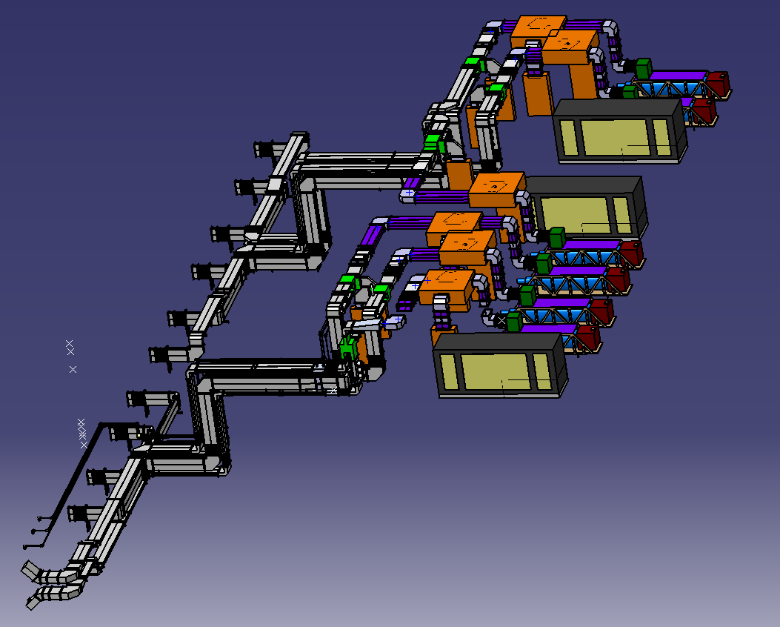
Background

Slide 5
Background
Cost of the Contribution:
  WP8, NC RF (inc. spoke linac LLRF): 7,257 k€
  WP8, MEBT RF: 891 k€
  WP17, Modulators: 3,370 K€
  Grand Total: 11,518 k€

Slide 6
Background
Contact Matrix:
Title | Name
Project Leader | Pedro J. Gonzalez
Deputy Project Leader | Nagore Garmendia
High Voltage Power Converters | Pedro J. Gonzalez
High Power Amplifiers | Arash Kaftoosian
RF Distribution | Oscar Gonzalez
LLRF | Open position
Interlocks | Leire Muguira
Mechanical Design/Manufacturing | Igor Rueda
Quality Assurance | Fiamma G. Toriello

Slide 7
Contracts
ESS and ESS Bilbao have signed a “non-binding” Heads of Agreement (HoA) and several Appendixes (e.g. Target, MEBT and RF for NC Linac)
Spain is not an ESS ERIC member yet (Expected for Dec. 2016-Jan.2017)
No In-Kind Contracts/Agreements (IKC/IKA) can be signed
Preparation of Technical Annexes is possible and even advisable

Slide 8
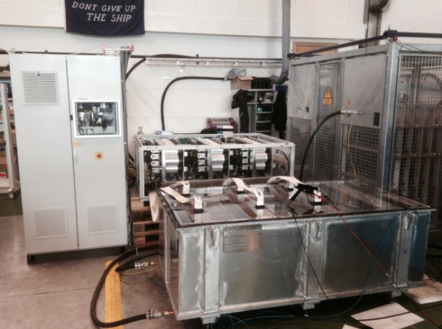
Technical Design
High Power Voltage Converters (Modulators)
  Stacked Multi-Level (SML), reduced scale prototype, developed and validated by ESS
  Full Scale version (660 kVA) design ready by ESS
  Currently preparing call for tenders to supply 3x modulators, on a “Build-to-Print” basis (contract notice to be published in Oct./Nov. 2016)

Slide 9
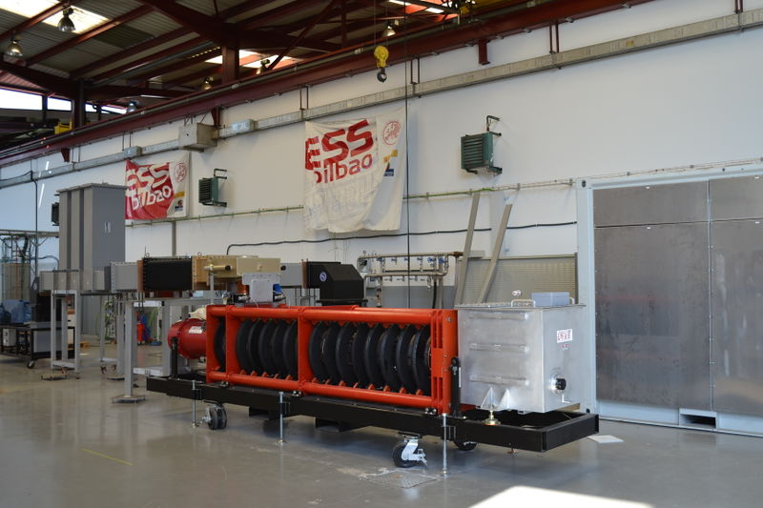
Technical Design
High Power Amplifiers
  3 klystrons already available in Bilbao
    Manufactured by CPI for 1.8 msec long pulses, 30 Hz Rep. Rate
    Conditioning of klystron collector for longer pulses, same duty cycle (3.5msec, 14 Hz) is feasible, according to CPI analyses.
  3 brand-new klystrons to be purchased soon
  SSPAs for MEBT
    30 kW
    Call for Tenders soon

Slide 10
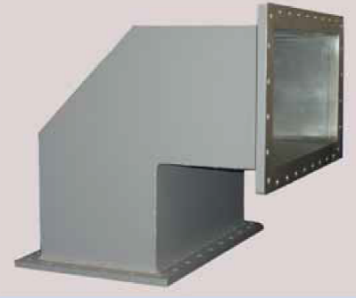
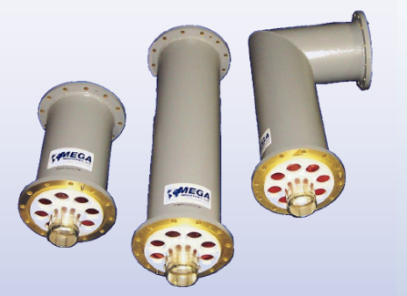
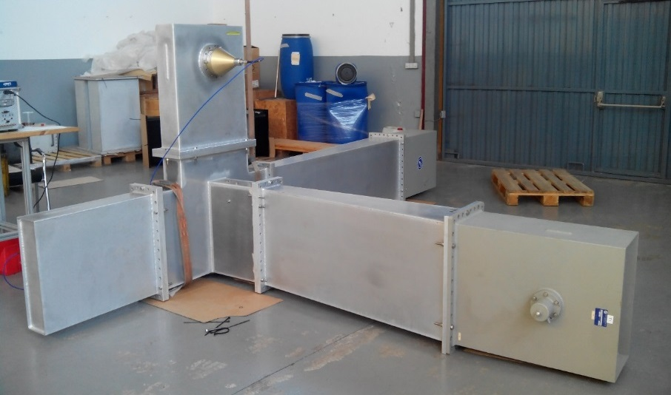
Technical Design
RF Distribution
  6x WR2300 FH/HH
    “Custom” components: Design of WG components for manufacturing in metal workshop (Aluminum, chromate conversion,…), e.g.: straights, bends, FH/HH Transitions, Power Splitters, Dual/Quad Directional Couplers, Phase Shifters,…
    Commercial Components: Loads with high temp. water (developed by ESS), Circulators, Power Detectors, Arc Detectors…
  3x 1-5/8in EIA Rigid Lines
    Mostly commercial
  RFDS Layout Optimization almost ready
    RFQ and DTL tanks require 2 couplers.
    Amplitude and Phase matching is required
    between both arms

Slide 11
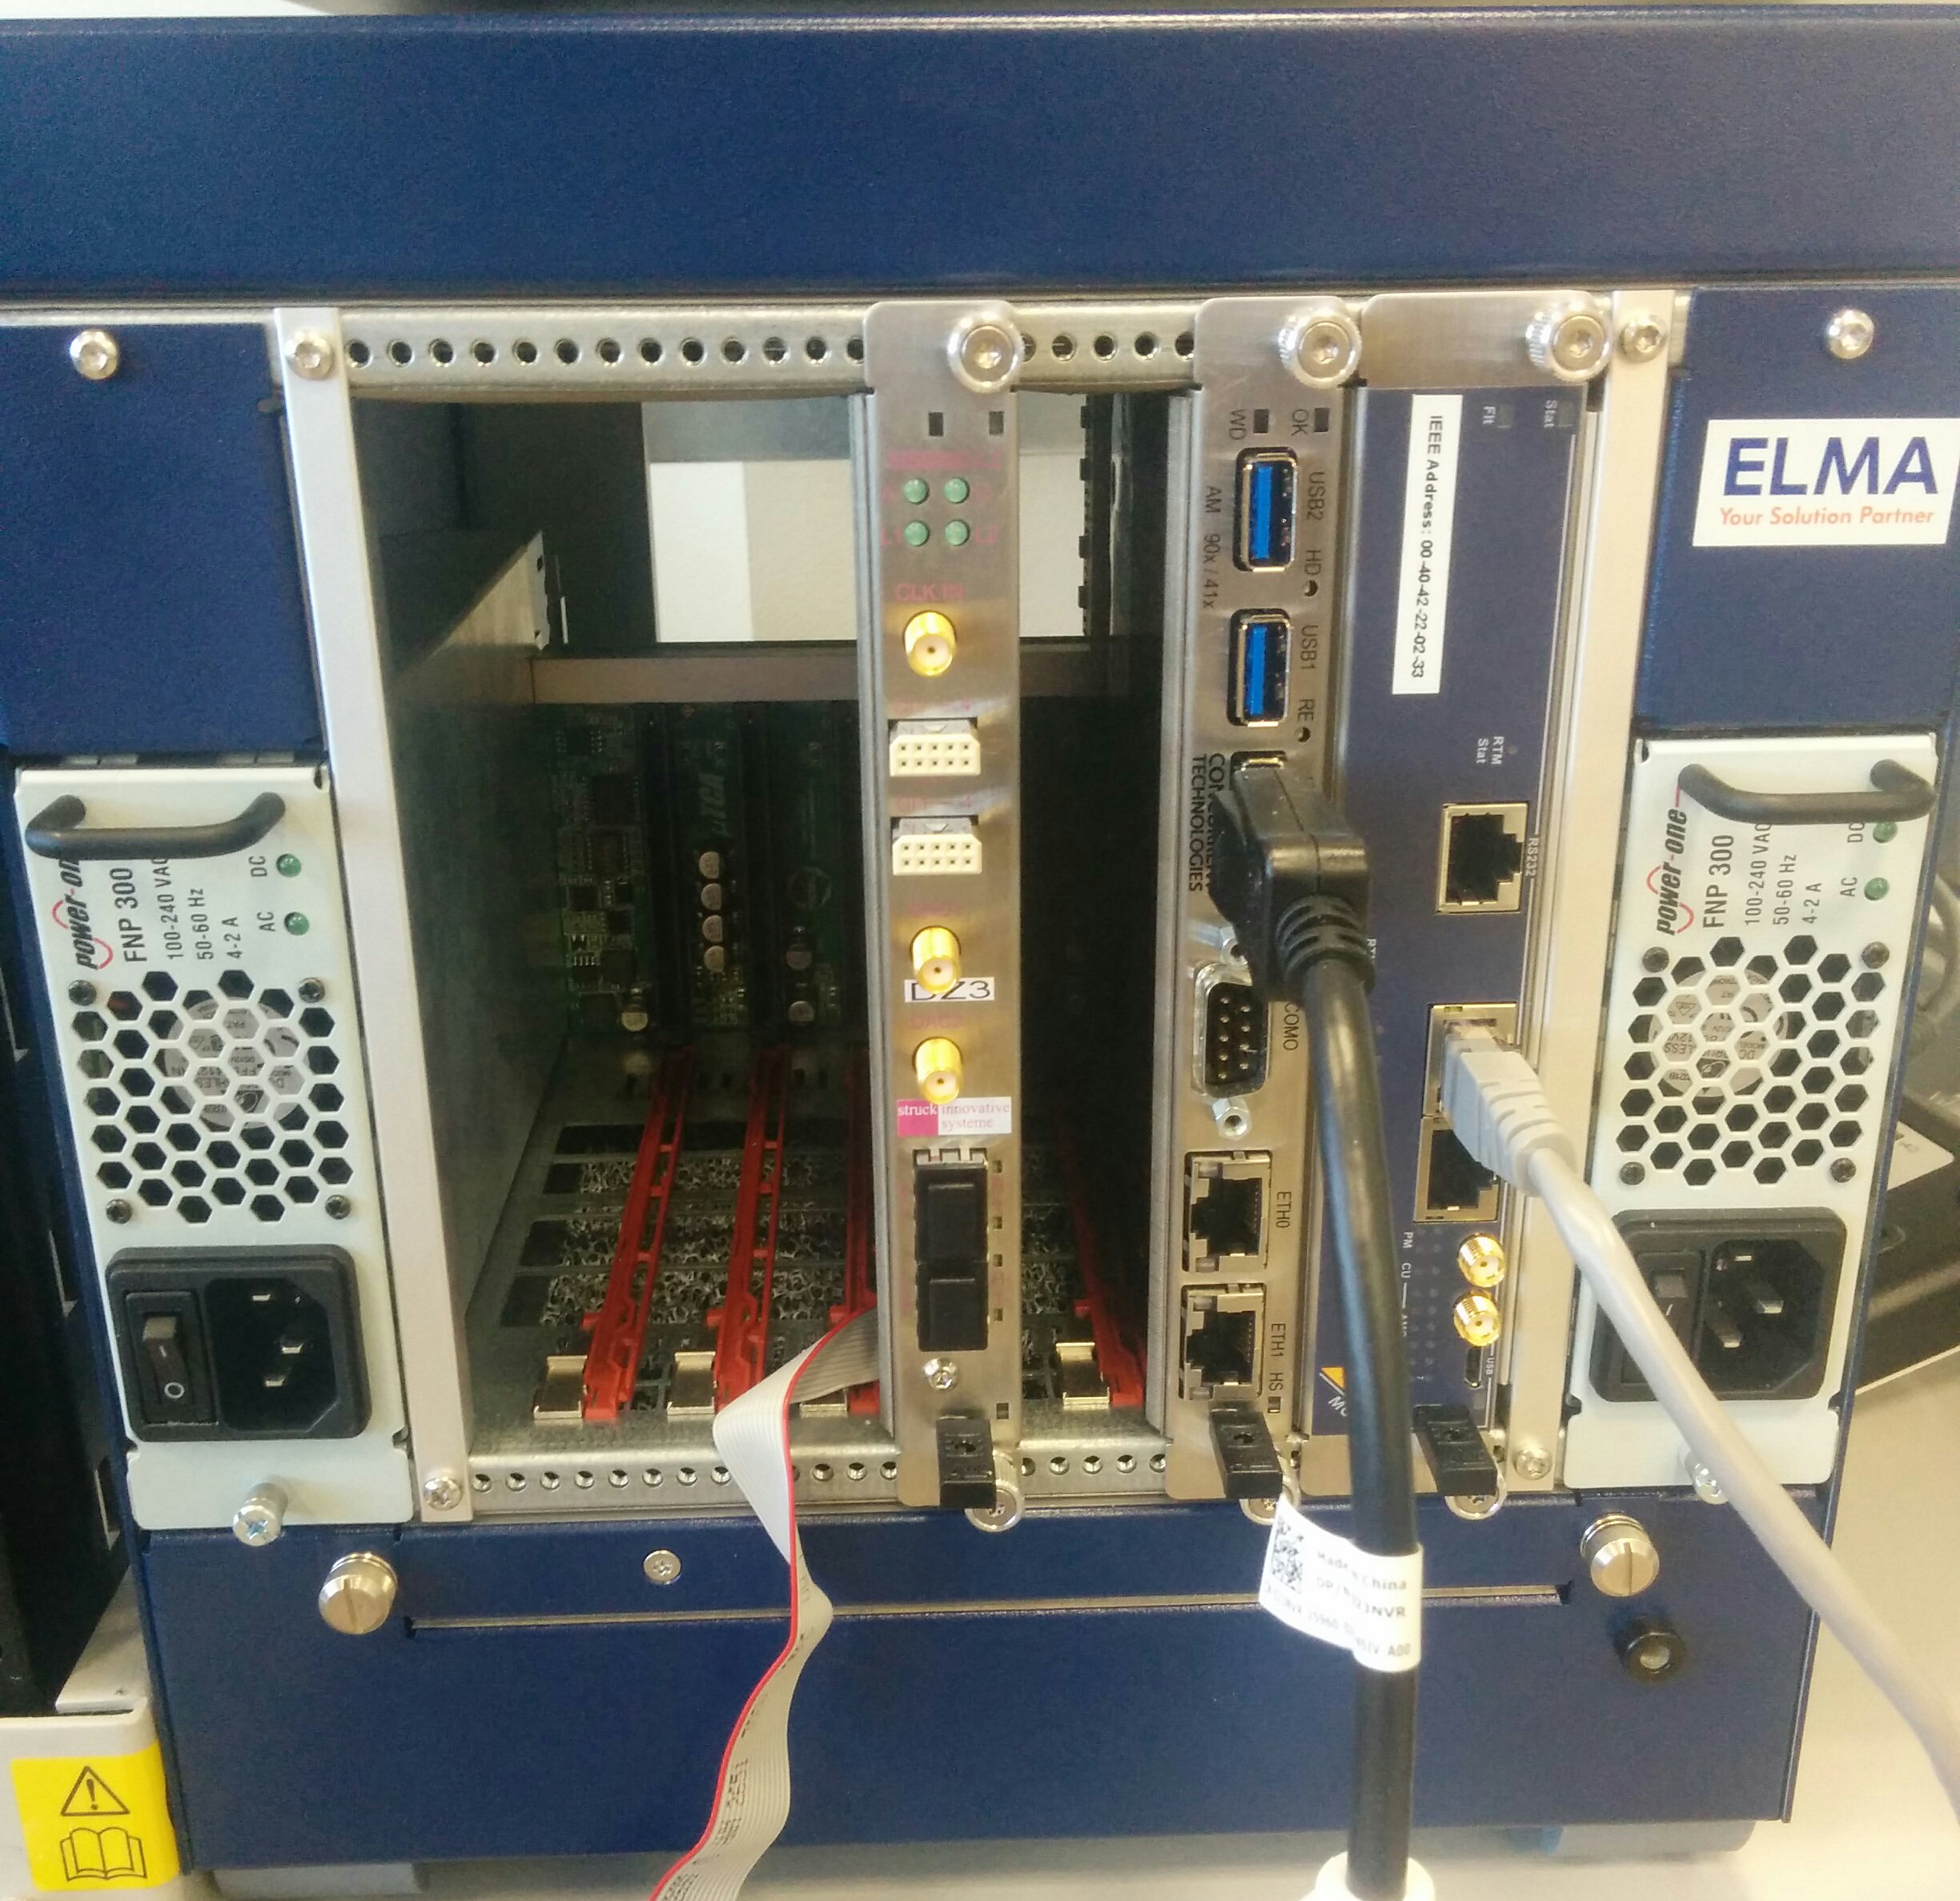
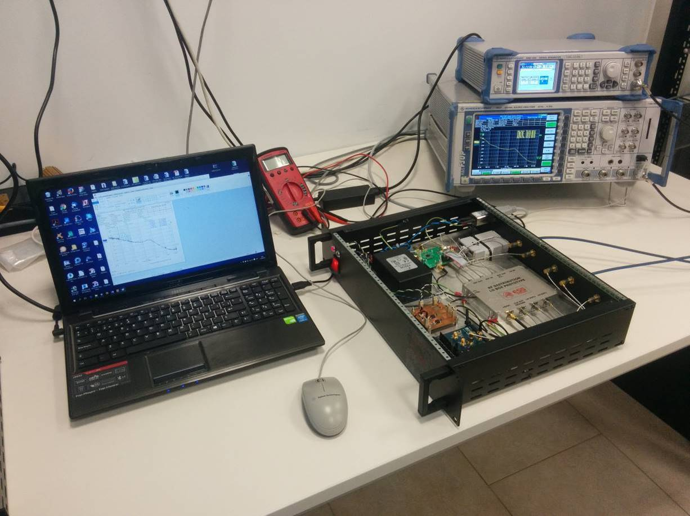
Technical Design
LLRF (Low Level RF Control)
  (6+3+26)x LLRF systems, based on MTCA4
LLRF Baseline Design by LTH (Lund University)
Customization of the design for the RFQ,
Buncher cavities, DTL tanks and the Spoke cavities:
  2 couplers per cavity,
  additional pickups
  slow frequency tuning by water temp. control/mechanical tuners
  fast (piezo) tuners
Low phase noise LO/Clock box prototype
for Down-Conversion to IF

Slide 12
Technical Design
Interlocks
  (6+3)x RF Local Protection Systems
    Fast Interlocks (FIM): based on Ni cRIO FPGA (prototype) and MTCA
    Slow Interlocks (SIM) & Machine State: based on Siemens S7-1500 PLC
  Protection features for arcs, forward/reverse power, PS voltage/current, temperature, cooling water flow/pressure/temp,…
  Baseline design by ESS

Slide 13
Interfaces
Interfaces
  With other systems (cavity, control, conventional facilities)
  Between RF subsystems (HVPC, HPA, RFDI, LLRF, LPS)
  Electrical/Mechanical/Software
AC grid (600 Vac / 400 Vac)
Cavity (Power couplers and pick-ups; Slow/Fast tuners for RFQ, Bunchers, DTL Tanks, Spokes)
Master Oscillator/Phase reference Line
ICS (EPICS, Ethernet, Timing)
Water cooling
MPS, PSS
WR2300 power splitter for RFQ, provided by CEA

Slide 14
Project Plan/Schedule
Main Milestones for installation of RF systems:
  STUBS INSTALLATIONS (NC): 4/Sept/2017 to 3/Nov/2017 (9w)
  RFDS Inst. in Stubs: 11/Sept/2017 to 22/Sept/2017 (2w) (waveguides and supports)
  GALLERY INSTALLATIONS: Access Date: 2/May/2017
  RFDS Inst. in RF Gal.: 6/Nov/2017 to 22/Dec/2017 (7w) (WG, loads, circ., supports, cables)
  SSPAs Inst.: 8/Jan/2018 to 12/Jan/2018 (1w)
  Klystrons Inst.: 15/Jan/2018 to 9/Feb/2018 (4w)(4pcs) and 2/Apr/2018 to 13/Apr/2018 (2w)(2x)
  Modulators Inst.: 12/Feb/2018 to 30/Feb/2018 (3w)(3pcs)
  Hardware Tests: 5/Mar/2018 to 30/Mar/2018 (4w) (Power to klystrons, LPS, LLRF,…)
  TUNNEL INSTALLATIONS: Access Date: 2/May/2017
  RFDS inst. in Tunnel.: 6/Nov/2017 to 1/Dec/2017 (4w) (cables and waveguides)
  RFQ Assembly: 19/Mar/2018 to 13/Apr/2018 (4w)
  RFQ Conditioning: 16/Apr/2016 to 13/7/2016 (13w)
  DTL #3,4 Inst.: 12/3/2018 to 6/4/2018 (4w)
  DTL #3,4 Comm: 9/4/2018 to 27/4/2018 (3w)
  DTL #1 Inst&Comm: 8/10/2018 to 2/11/2018 (4w)
  DTL #2 Inst&Comm: 10/12/2018 to 18/1/2019 (6w Xmas)
  DTL #5 Inst&Comm: 4/3/2019 to 29/3/2019 (4w)
  MEBT Assembly: 16/7/2018
  BEAM COMMISSIONING:
  RFQ-MEBT Beam Comm: 27/Aug/2018 to 21/Sept/2018 (4w)
  DTL1 Beam Comm: 12/Nov/2018 to 30/Nov/2018 (3w)
  DTL4 Beam Comm: 4/Feb/2018 to 1/Mar/2019 (4w)
  Beam on Target: 24/Jun/2019

Slide 15
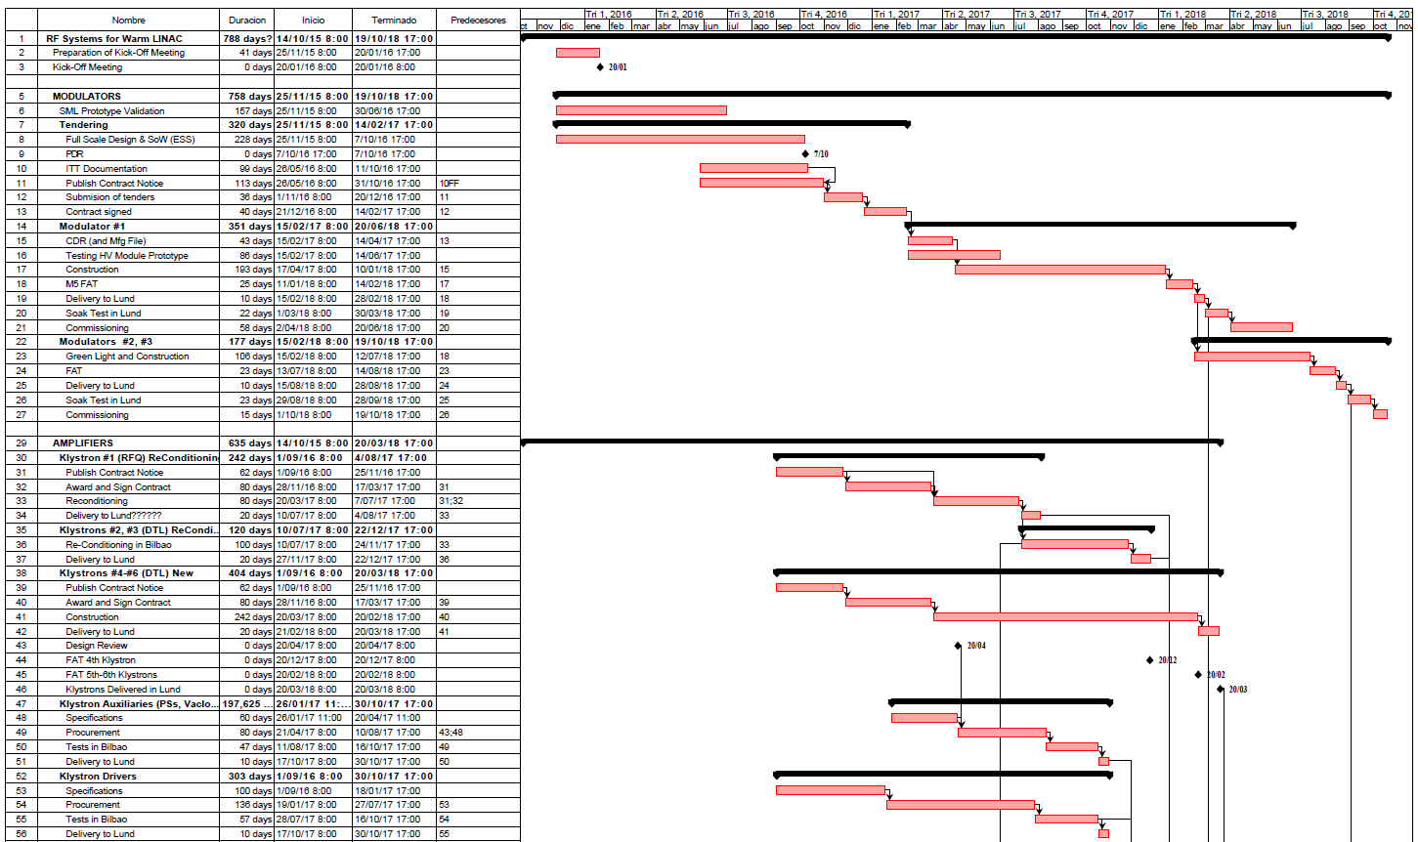
Project Plan/Schedule

Slide 16
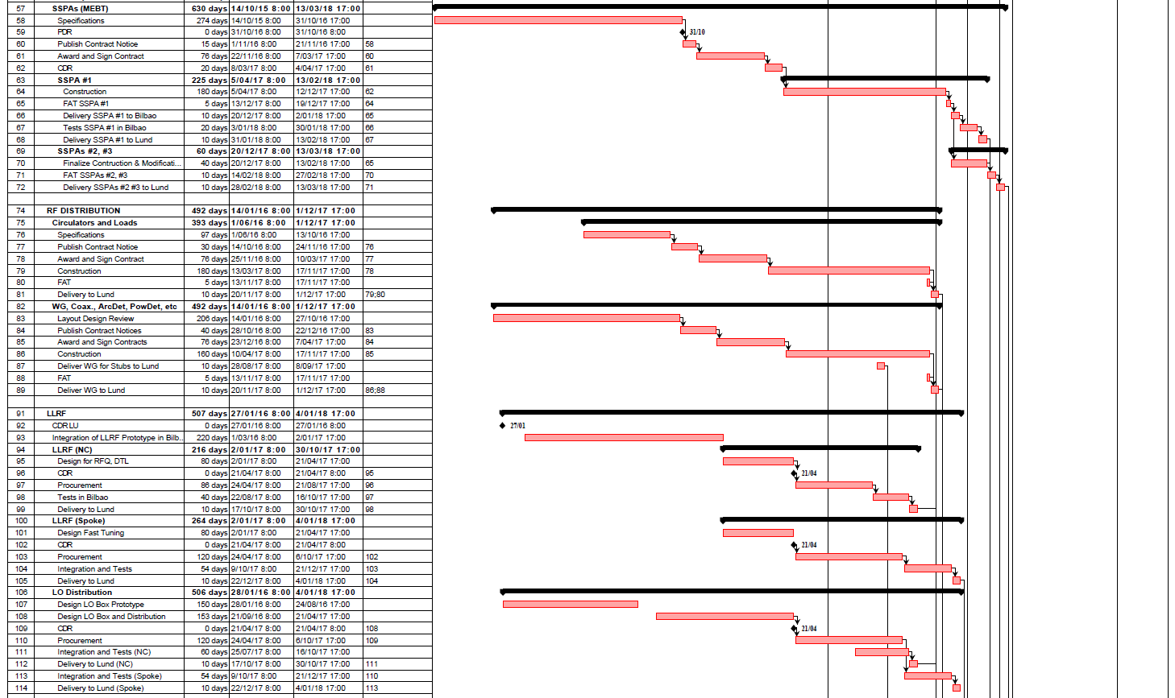
Project Plan/Schedule

Slide 17
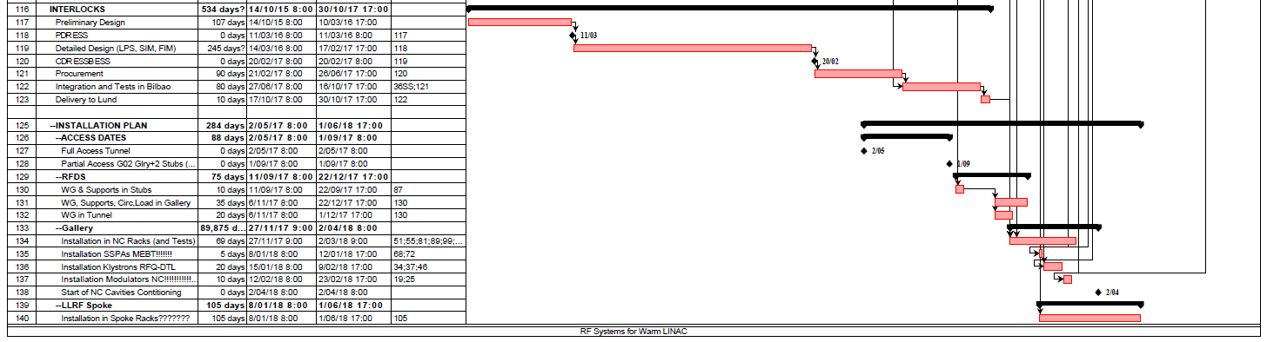
Project Plan/Schedule
Aggressive Schedule
  Large-Volume Orders + Long-Lead Items + Public Procurement → Integration Plan
  Several subsystems, each on a different stage of development:
    Modulators, Klystrons: design complete, procurement stage
    RFDS: design almost complete, procurement stage soon
    LLRF, Interlocks: design stage; require collaboration with relevant partners

Slide 18
Challenges
Spain not ESS ERIC member yet
Aggressive Schedule (deliveries and integration plan)
Public procurement procedures for large-volume orders (e.g.: modulators, klystrons)
Multiple Interfaces: ESS Divisions, Teams, Workpackages, In-Kind Partners,… (e.g.: LLRF systems)

Slide 19

The End
Thankyou for your attention!
Questions?

Slide 20
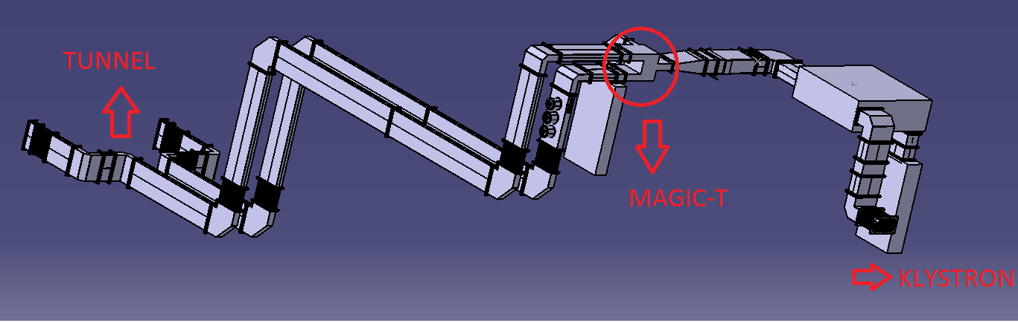
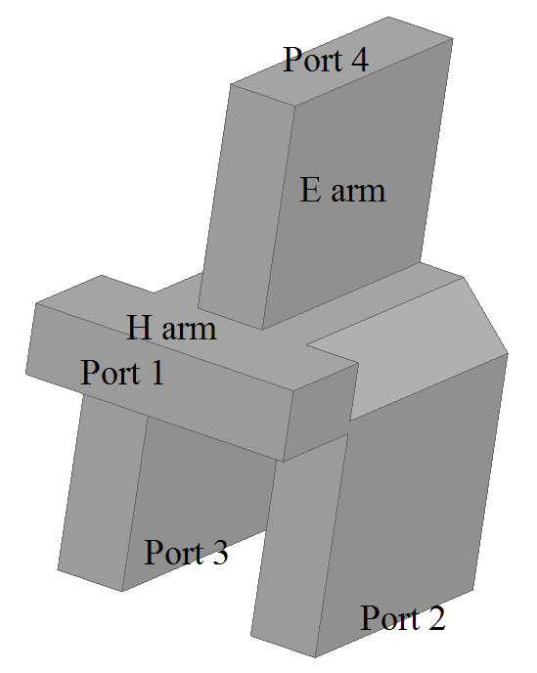
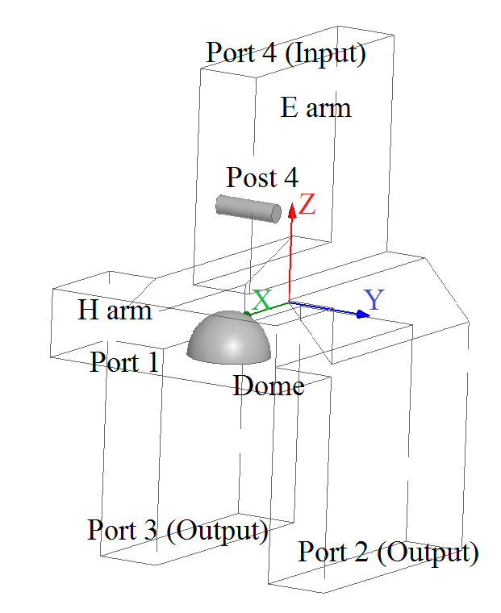
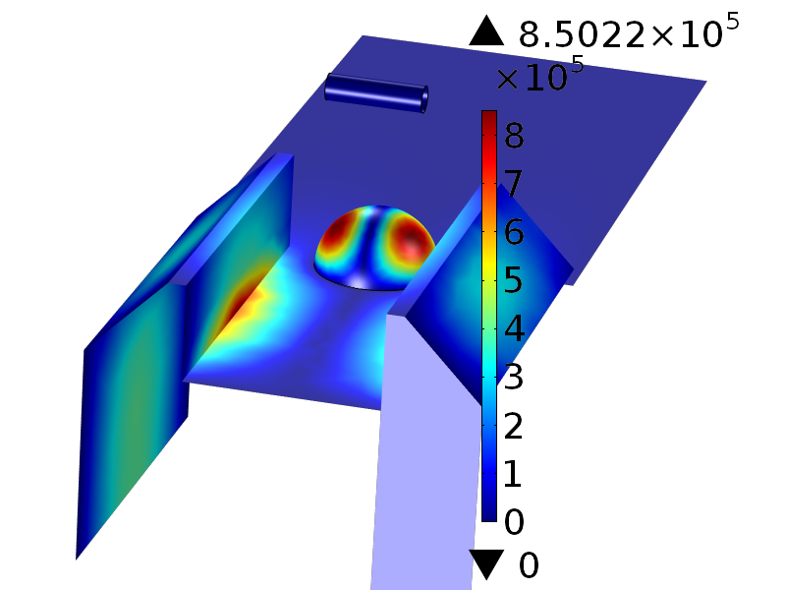
Backup Slides
RF Distribution Layout example
Compact Magic T Design

Slide 21
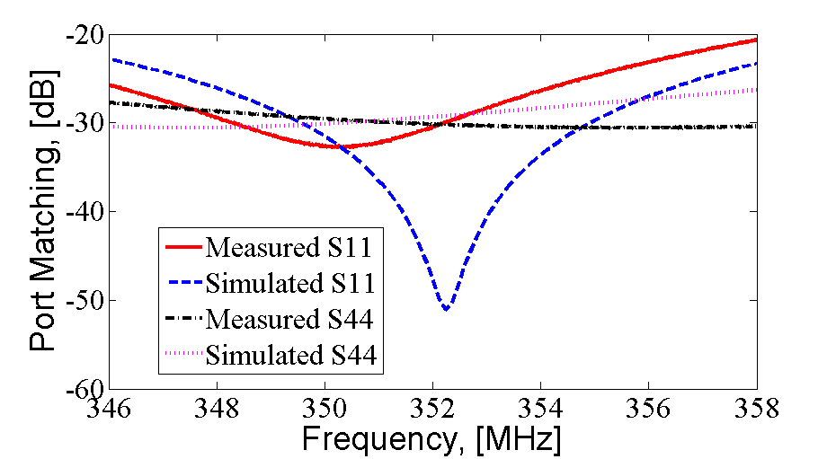
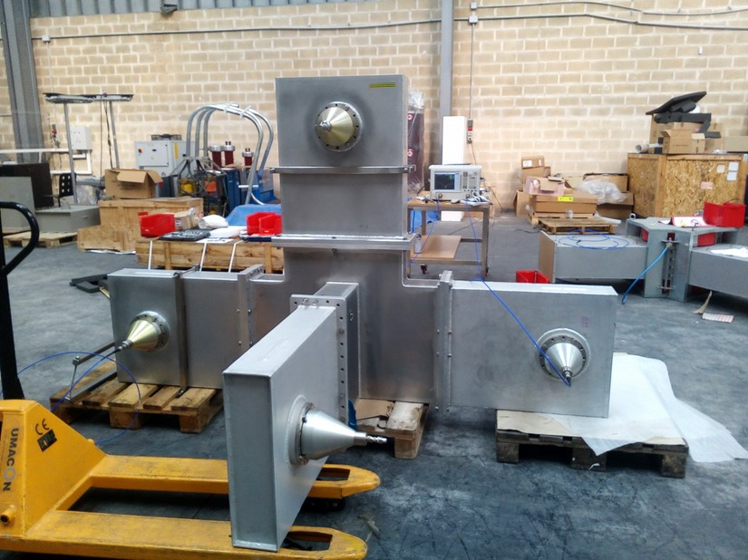
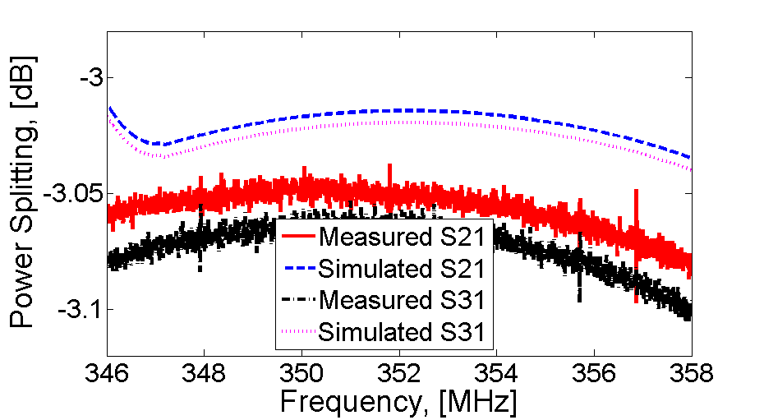
Backup Slides
Magic T Prototype

Slide 22
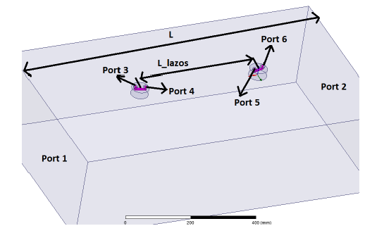
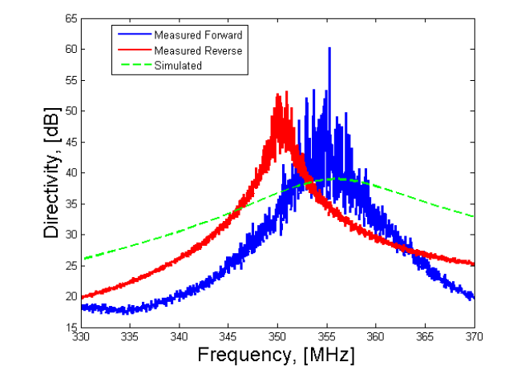
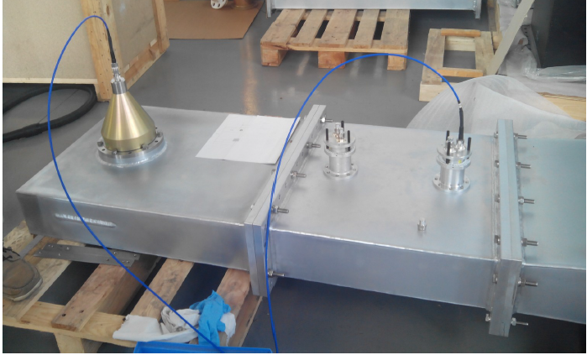
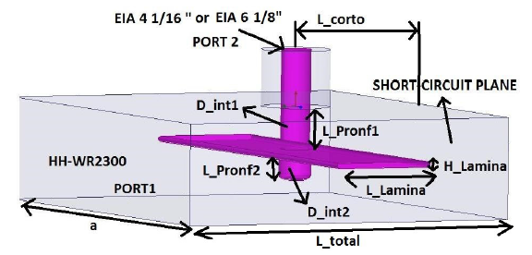
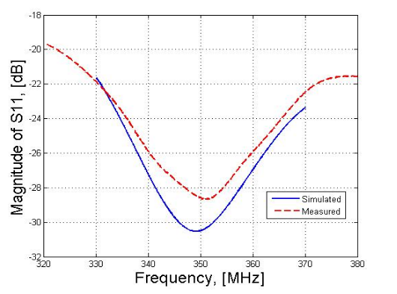
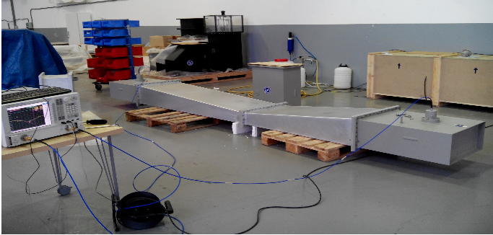
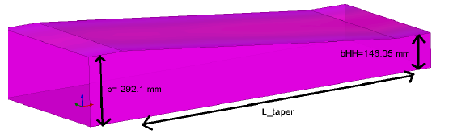
Backup Slides
WG Prototypes

Slide 23
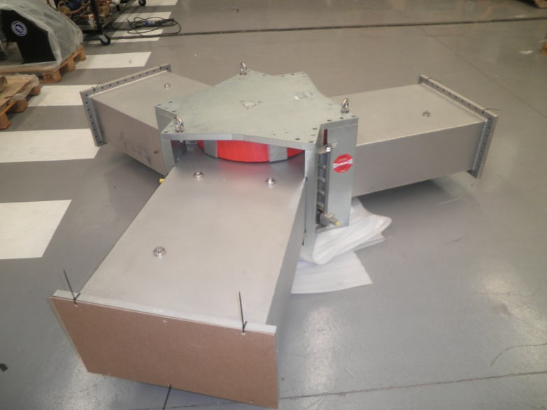
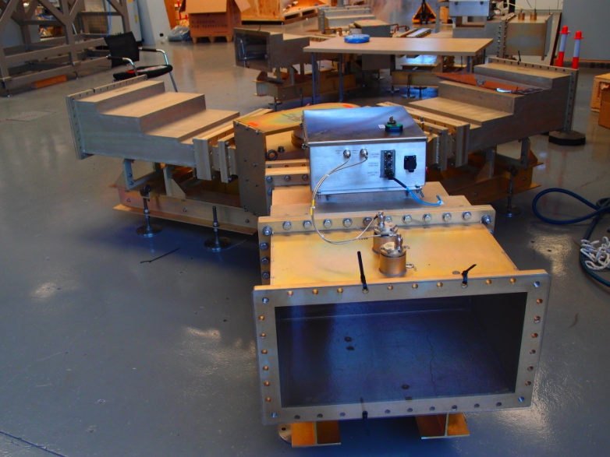
Backup Slides
CIRCULATORS (Ferrite & AFT)
Two strategies available to control circulator performance at high power,
by controlling the electromagnet current:
  AFT: temperature-based look-up table calibration
  Ferrite: measuring and minimizing power reflected to the input port
AFT
Ferrite

Slide 24
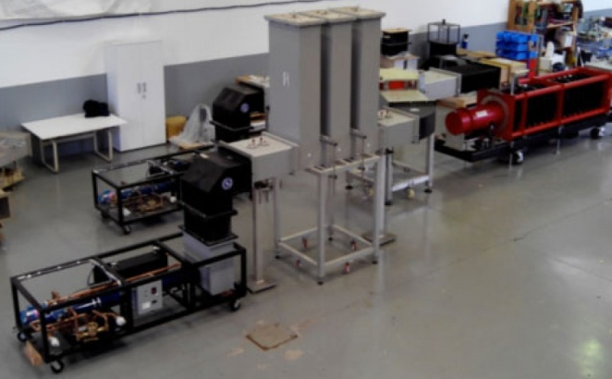
Backup Slides
RF Test Stand at ESS Bilbao

Slide 25
Backup Slides
RF Local Protection System
EPICS Communications
PLC for Slow Interlocks
FPGA for Fast Interlocks

Slide 26
Backup Slides
RF Local Protection System

Slide 27
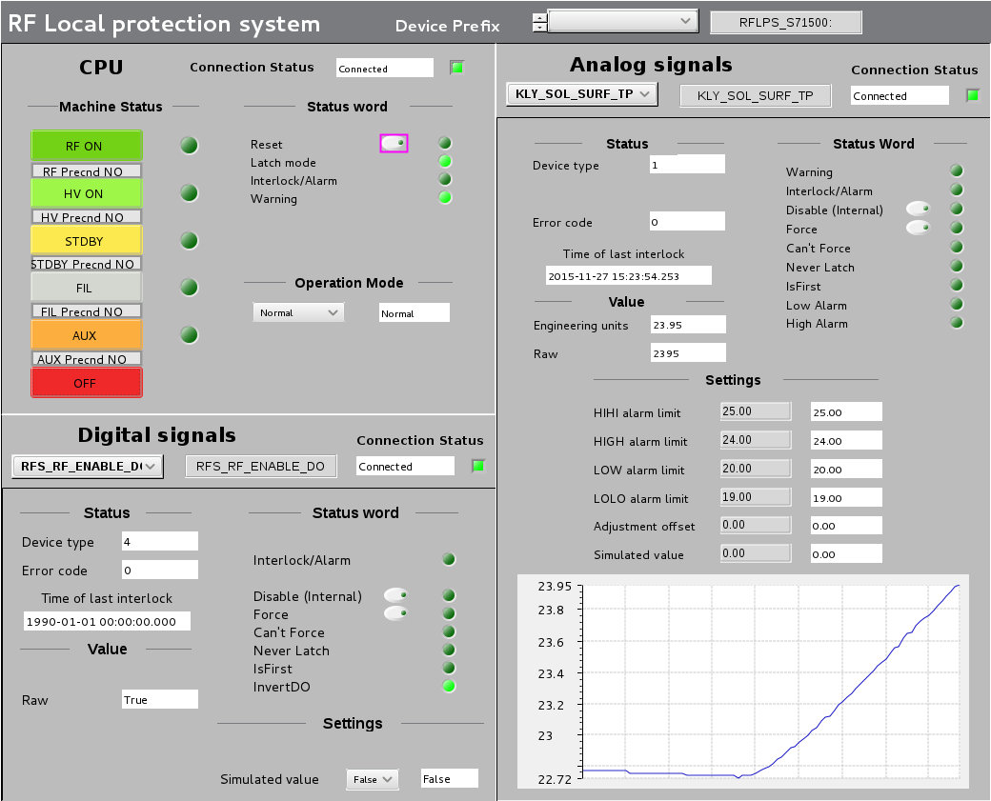
Backup Slides
RF Local Protection System
36

Slide 28
Backup Slides
LLRF: Control System that guarantees field quality and stability in the cavity
Amp/Phase loop and Freq. Tuning loop
Specs: 0.2% rms Amplitude Stability 0.2º rms Phase S tability

Slide 29
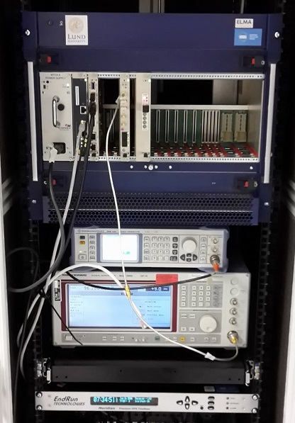
Backup Slides
LLRF: Hardware
MTCA.4 (uTCA) crate
RF/IF Up- and Down-Conversion
Non-IQ Sampling

Slide 30
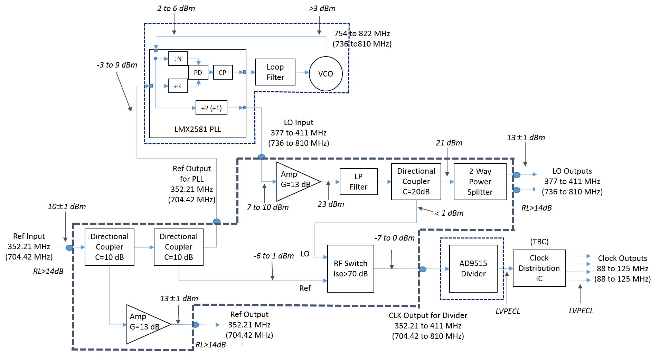
Backup Slides
LLRF: LO/CLOCK BOX
LO and Clock generation for mixer, ADC, FPGA, DAC and IQ modulator
Under development by the University of Cantabria
39

