Slide 1
RF systems overview
Anders Sunesson
RF group leader
ESS ERIC
TAC-14
October 6, 2016
www.europeanspallationsource.se

Slide 2
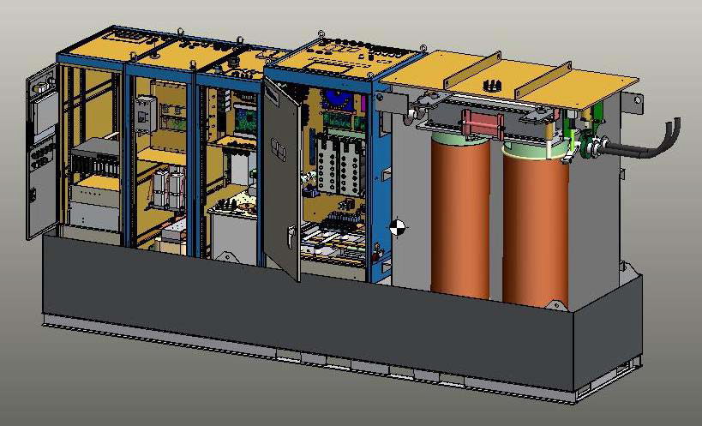
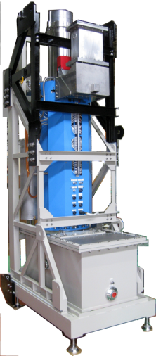
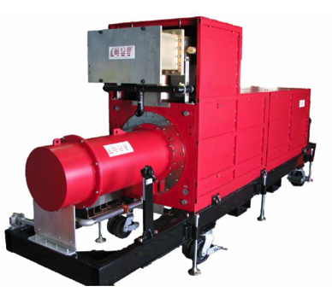
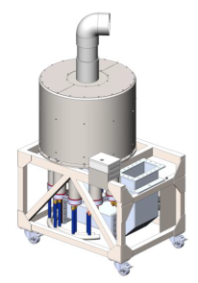

RF systems
RF provides the power to accelerate the particles
RF components are many and bulky
RF is costly – about 450 k€ per meter cavity length

Slide 3
RF Technical performances
352.21 MHz
704.42 MHz
2.4 m
4.5 m
3.6 m
40 m
54 m
75 m
179 m
Target
Source
LEBT
RFQ
MEBT
DTL
Spokes
Medium β
High β
HEBT & Contingency
75 keV
3.6 MeV
90 MeV
220 MeV
571 MeV
2000 MeV
 | Energy (MeV) | Frequency /MHz | No. of Cavities | βg | Temp / K | RF power /kW
Source | 0.075 | - | 0 | – | ~300 | –
LEBT | 0.075 | - | 0 | – | ~300 | –
RFQ | 3.6 | 352.21 | 1 | – | ~300 | 1600
MEBT | 3.6 | 352.21 | 3 | – | ~300 | 20
DTL | 90 | 352.21 | 5 | – | ~300 | 2200
Spoke | 220 | 352.21 | 26 (2/CM) | 0.5 βopt | ~2 | 330
Medium β | 571 | 704.42 | 36 (4/CM) | 0.67 | ~2 | 870
High β | 2000 | 704.42 | 84 (4/CM) | 0.86 | ~2 | 1100
HEBT | 2000 | – | 0 | – | ~300 | –

Slide 4
RF group
The RF group at Q3 2016 has 14 members
Growth according to staff plan until Q2 2019 (completion stage 1): 31 persons
These must handle
    In-kind contracts
    Procurement of items outside in-kind (example medium/high beta high power RF amplifiers)
    Installation support
    Commissioning of RF systems
    Early operations of RF systems

Slide 5
In kind overview
Work | Partner | Part of linac | Cost / k€ | Status
RF NC linac | ESS Bilbao | Turnkey RF systems and modulators | 9725 | HoA signed
LLRF | ESS Bilbao | Spoke linac | 1793 | HoA signed
High Power RF | Elettra | RF Transmitter Spoke linac | 19451 | TA signed
LLRF | Polish Electron. Group | LLRF systems 704 MHz (split IKC/cash) | 4496 + 2850 cash | TA signed
Phase Ref | Warsaw UT | Phase ref line | 1200 | TA signed
Interlock | ATM Atomki | Interlock med/hi beta | 2200 | IKC signed
Distribution | Univ Huddersfield | SC linac RF distribution | 19000 | TA signed
Installation | IFJ PAN | RF/modulator Installation | 7745 WP8 664 WP 17 | TA signed

Slide 6
Overview
RF for RFQ
RF for buncher cavities
RF for DTL tanks
RF for Spoke cavities
RF for Elliptical cavities
Focus on in-kind
Master oscillator/Phase reference
Installation

Slide 7
RF for RFQ and DTL
Turnkey Contribution from ESS Bilbao
352 MHz, 3 MW klystrons are employed
6 stations needed
HV will be 660 kVA using a novel topology, SML, stacked multi level, developed by ESS
One modulator powers two klystrons
LLRF based on micro-TCA, design by Lund University
Interlock based on PLC (slow) and micro-TCA (fast), design by ESS
Presentations: P. Gonzalez, ESS Bilbao and Carlos Martins, ESS ERIC (modulator)

Slide 8
RF for Buncher cavities
Turnkey Contribution from ESS Bilbao
352 MHz, 30 kW solid state amplifiers are employed
3 stations needed
LLRF based on micro-TCA, design by Lund University
Interlock based on PLC (slow) and micro-TCA (fast), design by ESS
Presentation: P. Gonzalez, ESS Bilbao

Slide 9
RF for Spoke cavities
Contributions from Elettra (RF transmitters), Huddersfield University (RF distribution), and ESS Bilbao (LLRF)
352 MHz, 400 kW tetrode based integrated amplifier stations are planned
26 stations needed
LLRF based on micro-TCA, design by Lund University
Presentations: A. Fabris, Elettra, and R. Edgecock, Huddersfield University

Slide 10
RF for Elliptical cavities (med/hi beta)
Contributions from Polish Electronic Group (LLRF), Huddersfield University (RF distribution), and MTA Atomki (Interlock)
704 MHz, 1500 kW klystrons or 1200 kW IOTs are employed (not provided in kind)
660 kVA HV modulators planned (SML topology, maybe in-kind?), one modulator / 4 klystrons/IOTs
36 + 84 RF stations needed
LLRF based on micro-TCA, design by ESS
Interlock based on PLC (slow) and micro-TCA (fast)

Slide 11
RF elliptical cavities, continued
Interlock design by ESS
Presentations: Maciek Grzegrzolka, Polish Electronic Group, J. Molnar, ATM Atomki, C. Martins, ESS ERIC, and Morten Jensen, ESS ERIC

Slide 12
Phase reference line
Contribution from Warsaw University of Technology
352 and 704 MHz, dual frequency line employed
Co-design ESS / Warsaw University of Technology
Presentation: K. Czuba, Warsaw University of Technology

Slide 13
Installation work
Contribution by IFJ PAN Krakow
Installation and testing/verification of RF systems
Install waveguides in all stubs
Install modulators, LLRF systems, interlock systems, Klystrons/SSPAs/IOTs/waveguides etc in gallery
Presentation: D. Bocian, IFJ PAN

Slide 14
RF summary
RF powers the acceleration of particles
The RF group workpackages are diverse and complex
All schedules are quite challenging
Installation will require a lot of co-ordination

Slide 15
Thank you

