Slide 1
Medium and High Beta
RF Sources
Morten Jensen
RF Section Leader, WP8 Manager
www.europeanspallationsource.se
2 October 2016

Slide 2
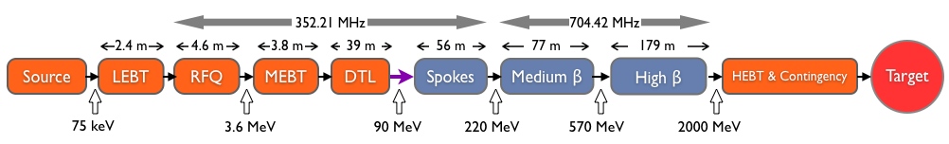
RF Power Requirements
Design Drivers:
Average Beam Power 5 MW
Peak Beam Power 125 MW
High Availability
Key parameters:
    -2.86 ms pulses
    -2 GeV
    -62.5 mA peak
    -14 Hz
    -Minimize energy use
    -Flexible design for mitigation and future upgrades
30 kW Solid State Amplifiers
3 MW Klystrons
200 kW Tetrodes
1.5 MW Klystrons
1.2 MW IOTs

Slide 3
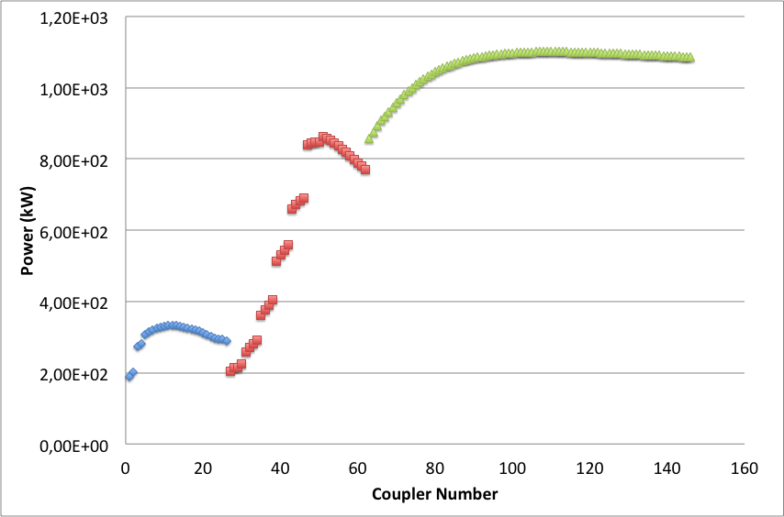
ESS accelerator power profile
36 Medium beta cavities: 704 MHz
1.5 MW Klystrons
26 spoke cavities:
352 MHz
Tetrodes
84 High beta cavities: 704 MHz
1.2 MW MB IOTs (klystrons as backup)
6 off 352 MHz klystrons 3 MW for RFQ and DTL tanks
3 off 352 MHz, 30 kW Solid state amplifiers for bunchers

Slide 4
Scope, Budget and Planning
Overall Scope: No In-Kind partner for these items
MB: 36 klystrons; Driver (20 k); Aux (Filament (15 k), solenoid x2 (10k), ion pump supplies (2.5k) and arc detectors (5k)
HB: 84 MB-IOTs; Driver (100 k); Aux - Depends on configuration
Risk
Medium Beta amplifier budget | 11 M EUR / 310 k EUR each | High
Medium Beta klystron call for tender | February 2017 | Low
Medium Beta klystron contract award | April 2017 | Low
Medium Beta klystron construction | June 2017 | Low
Medium Beta klystron delivery | Aug 2018 – June 2019 | Medium
High Beta– Technology decision | End 2017 / Early 2018 | High
High Beta amplifier delivery | June 2019 - … | TBD

Slide 5
Block Schematic – one for each linac and test stand

Slide 6
RF Source requirements
Medium Beta
  36 transmitters
  Based on 1.5 MW klystron, 704 MHz
  One transmitter chain per cavity, one modulator per 4 klystrons
High Beta
  84 transmitters
  Based on 1.2 MW IOT, 704 MHz
  Medium Beta klystrons as backup
  Otherwise similar to medium beta

Slide 7
Medium (and High) Beta amplifiers
Medium Beta
200 kW to 866 kW (plus 30%)
-> saturated power from klystrons up to 1.15 MW
High Beta
835 kW to 1.1 MW (plus 30%)
1.2 MW MBIOTs (or klystrons as backup)
Klystron specifications
MBIOT specifications
Nominal output power | 1.5 MW
Frequency | 704.42 MHz
BW | ≥ +/- 1 MHz
Pulse width | 3.5 ms
Repetition rate | 14 Hz
Conversion Efficiency | >60% (at saturation)
VSWR | Up to 1.2
Power Gain | ≥ 40 dB (may be increased)
Group Delay | ≤ 250 ns
Harmonic Spectral content | ≤ -30 dBc
Spurious Spectral content | ≤ -60 dBc
Peak output power | > 1.2 MW
Frequency | 704.42 MHz
BW | ≥ +/- 1 MHz
Pulse width | 3.5 ms
Duty factor | Up to 5%
Conversion Efficiency | >65% (at point of operation)
Overall efficiency (including idle current) | >65%
Gain | > 20 dB
Beam Voltage | < 50 kV
Beam current | < 45 A rms
Tube life | ≥ 50 khrs

Slide 8
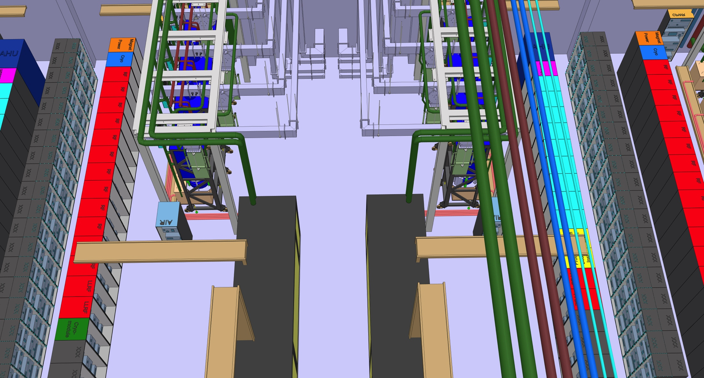
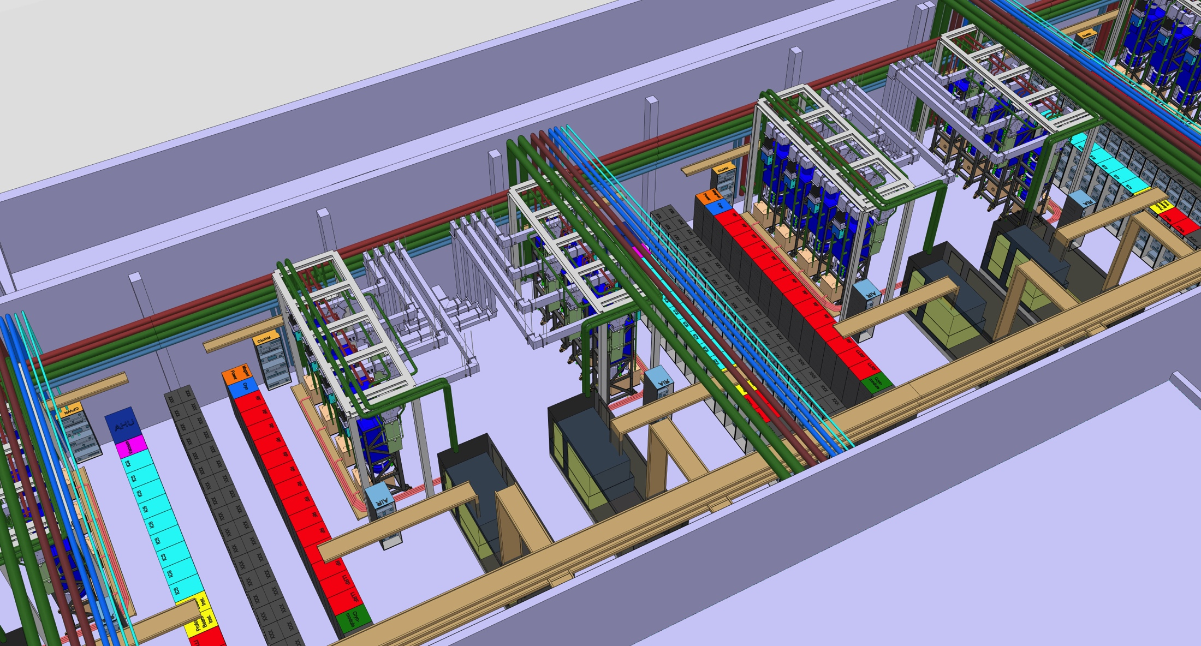
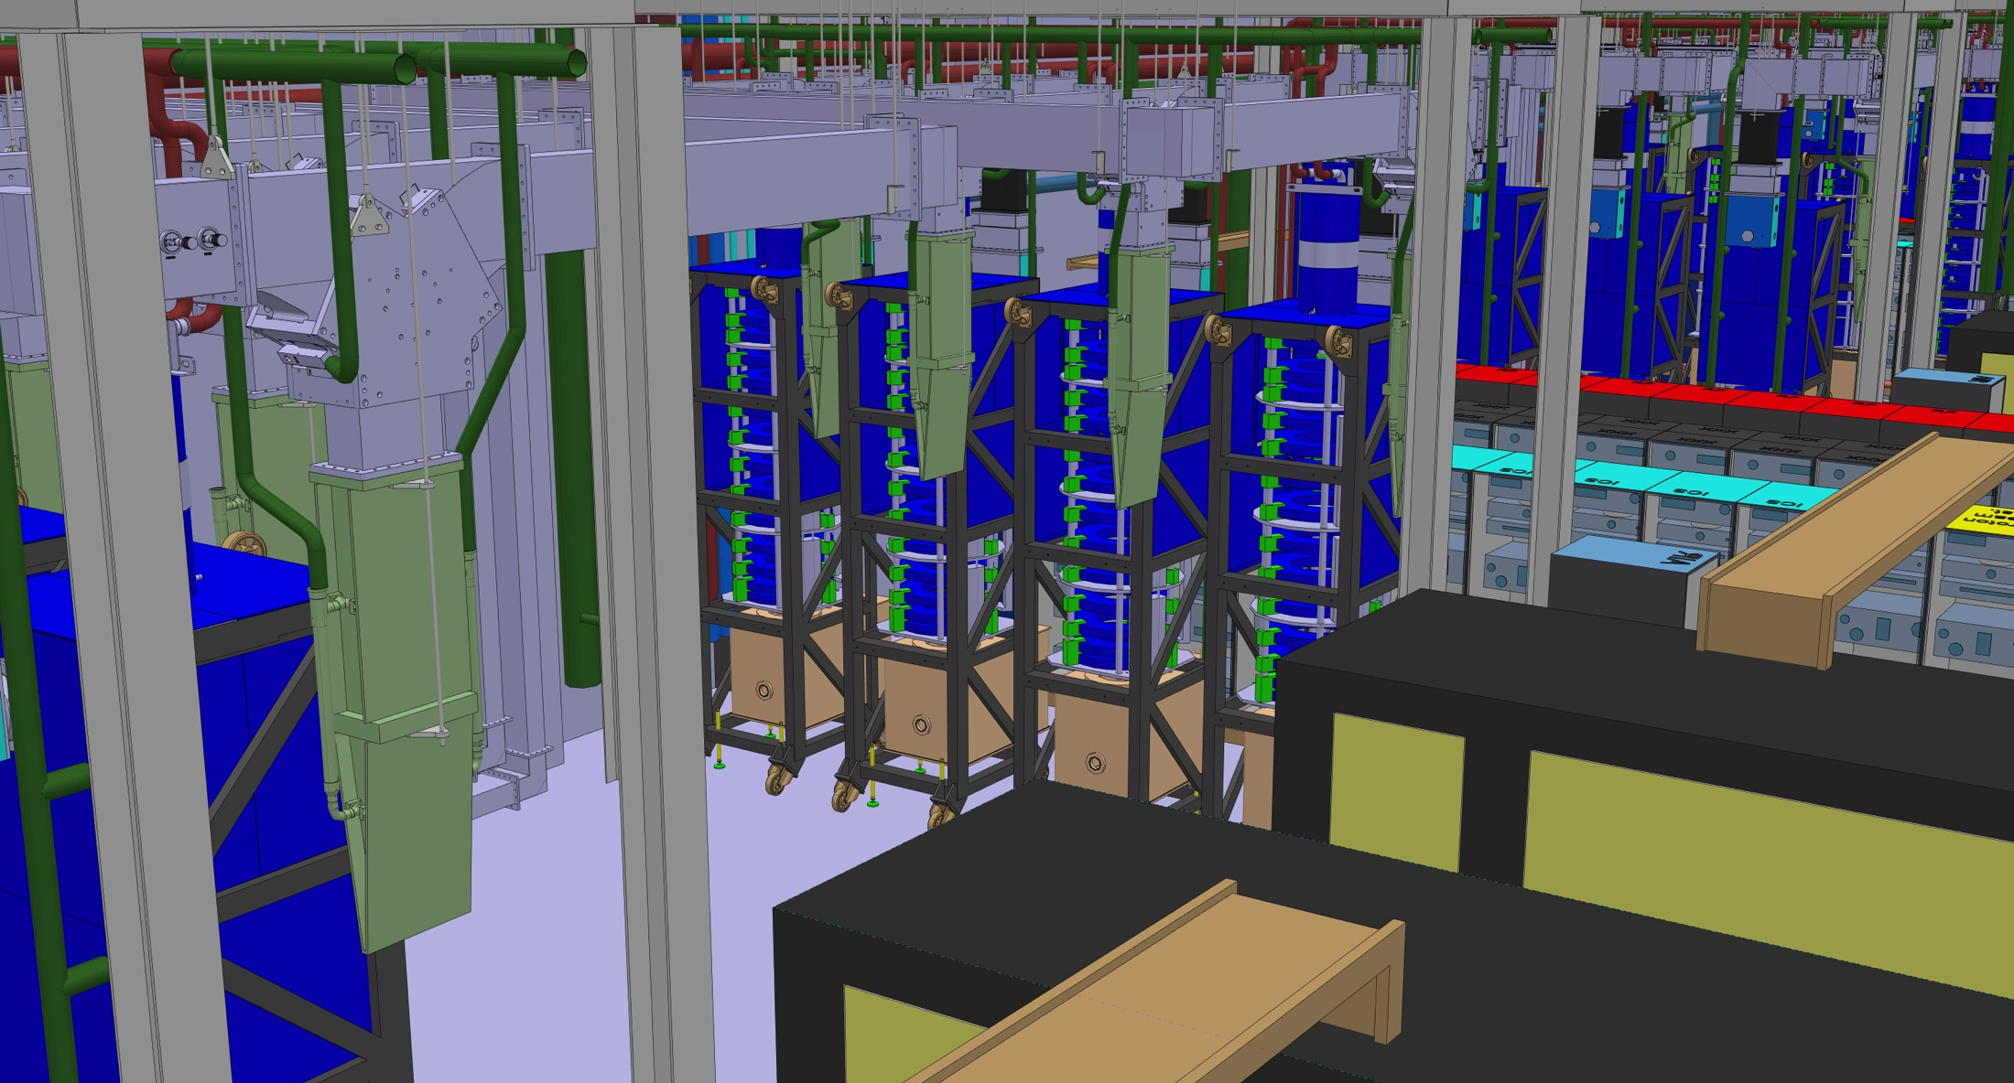
Medium Beta klystrons
One 660 kVA modulator will power 4 klystrons
4.5 Cells of 8 klystrons for Medium Beta
10,5 Cells of 8 klystrons (MBIOTs) for High Beta
WR1150 Distribution
Racks and Controls
Klystrons
The klystrons will have vertical orientation in order to fit in the gallery
Modulators
8

Slide 9
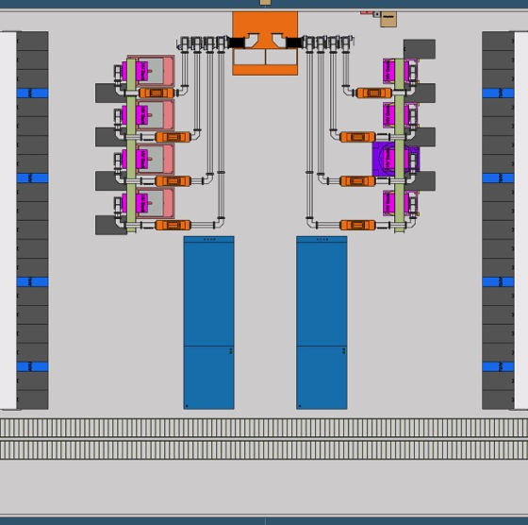
MBIOT - Possible Gallery Layout
Layout compatible with Klystron layout
(Important for utilities and building constraints)
Gallery design compatible with both MB-IOT designs
4 Tubes per HV supply
One driver rack per MB-IOT
HV-Deck for Filament and Grid supplies placed above the tube (Details will depend on final filament/grid requirements)

Slide 10
Medium Beta klystrons
Thales prototype contract placed January 2015
  First pass – Arcing in window region
    Factory Acceptance Test cancelled
    Tube opened for inspection
    Additional failure analysis and extra window design review held
  New window brazed
    Braze failed quality inspection
    New parts ordered
    Factory Acceptance Test expected in October, delivery November 2016
Toshiba prototype contract placed February 2015
  Delivered (March 2016)
CPI prototype contract placed April 2015
  Factory Acceptance 28 September (not observed)
  Observed Factory Acceptance test week of 10 October 2016
  Delivery expected October 2016

Slide 11
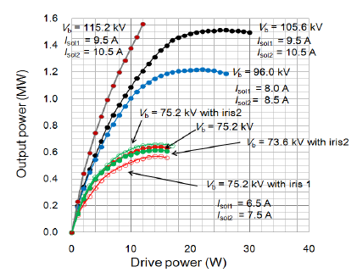
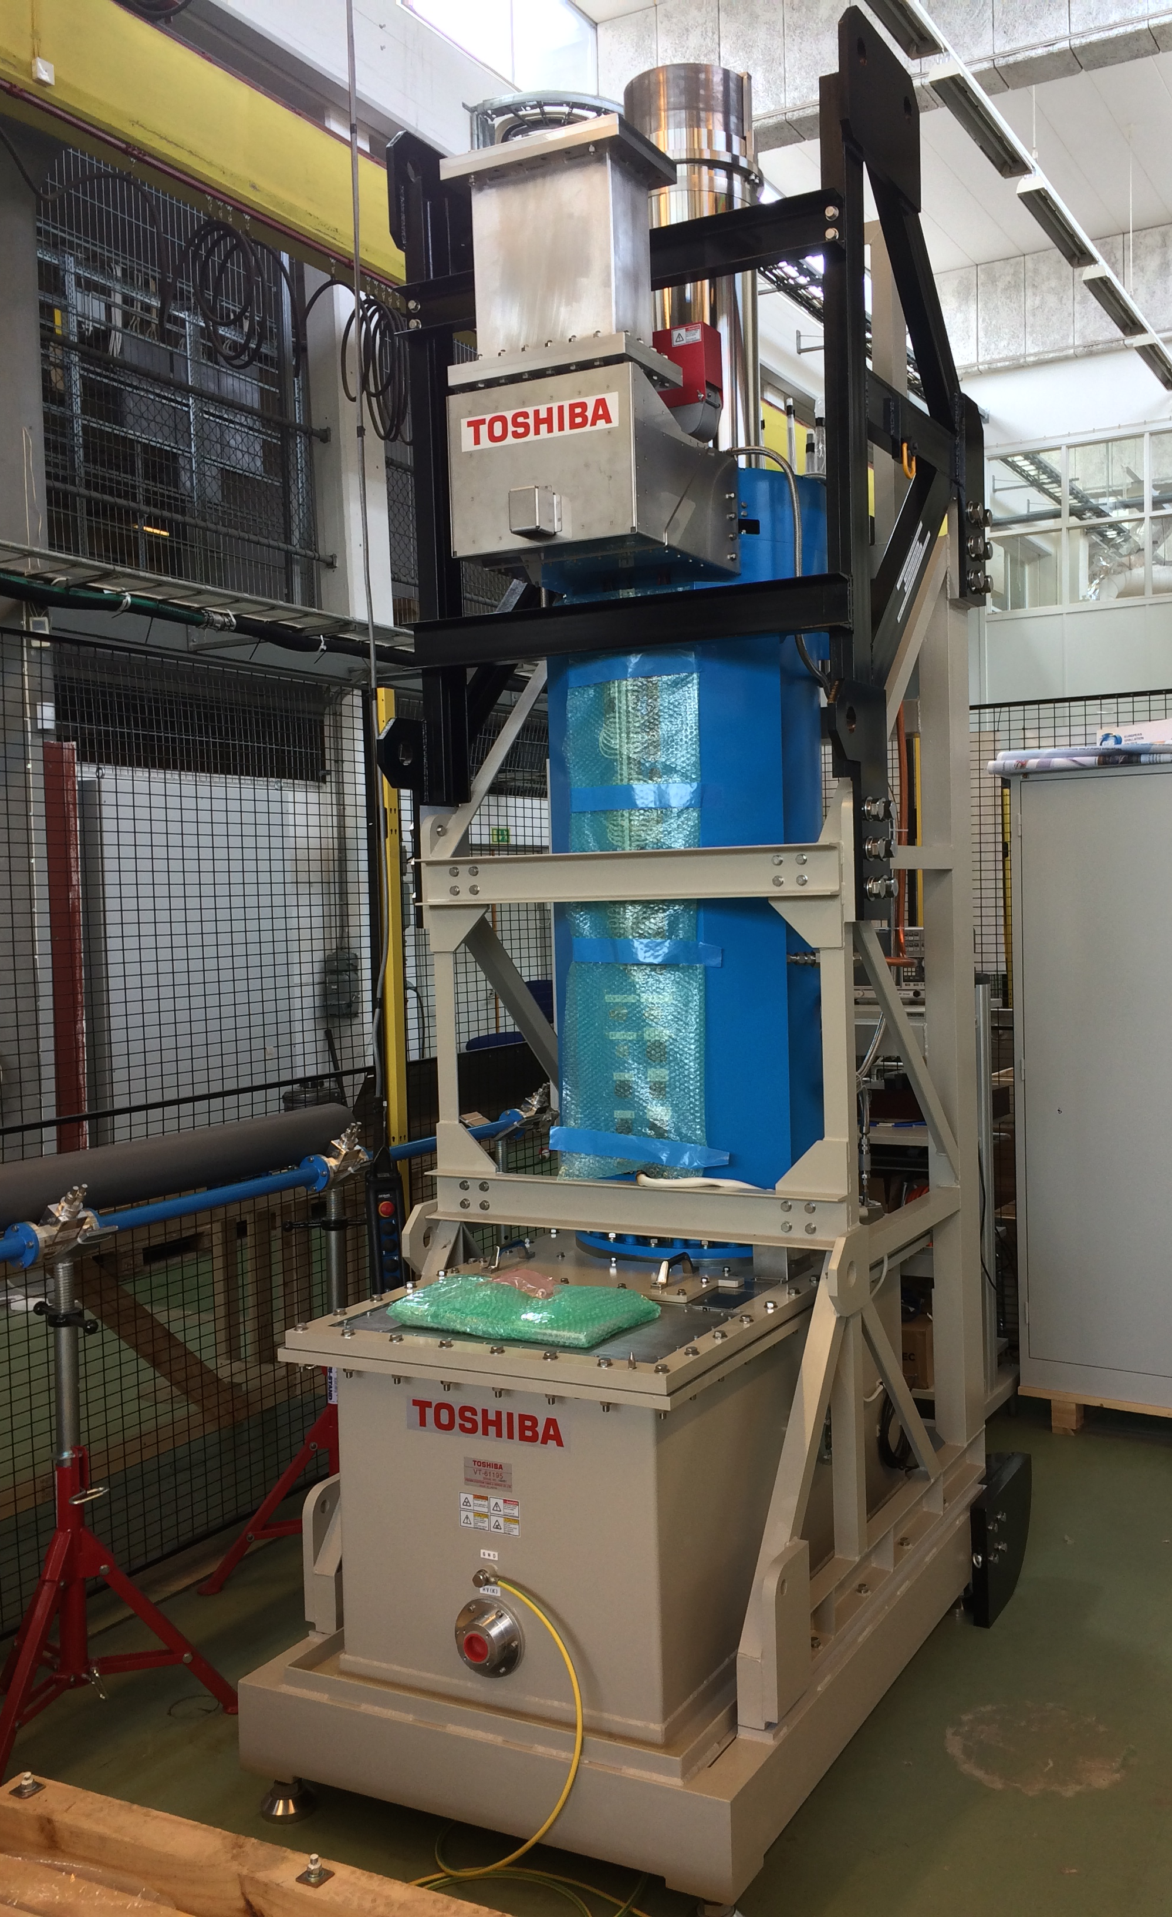
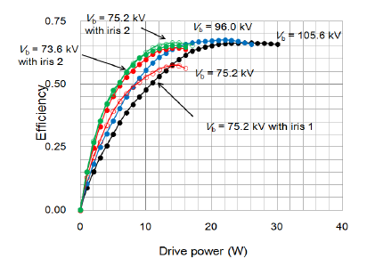
Toshiba klystron E37504 prototype
Some results from the Factory Acceptance Test (February 2016):
1.5 MW
Performance at 115 kV
> 60% efficiency even at 600 kW
Klystron accepted and delivered to Lund!

Slide 12
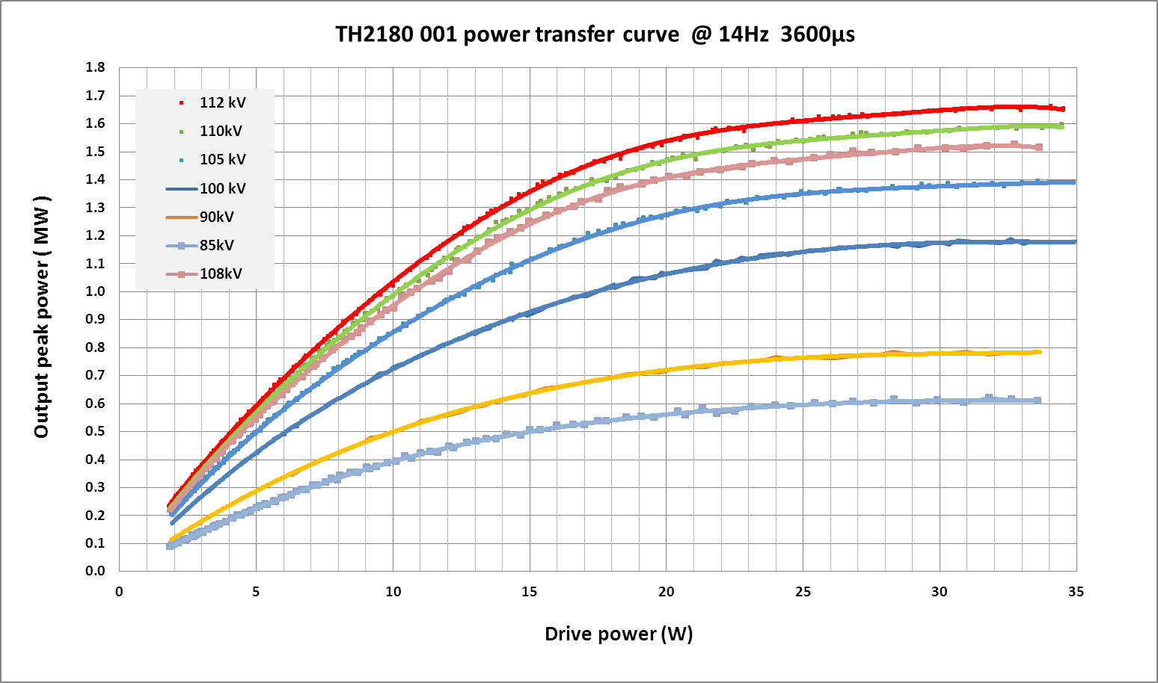
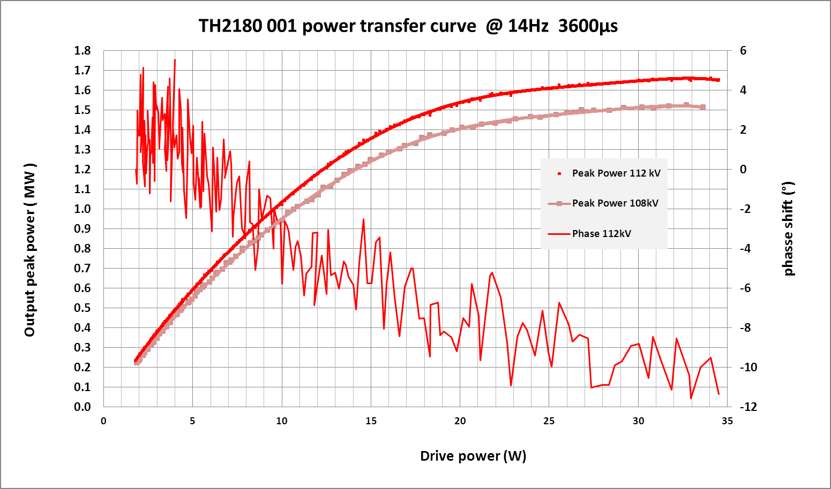
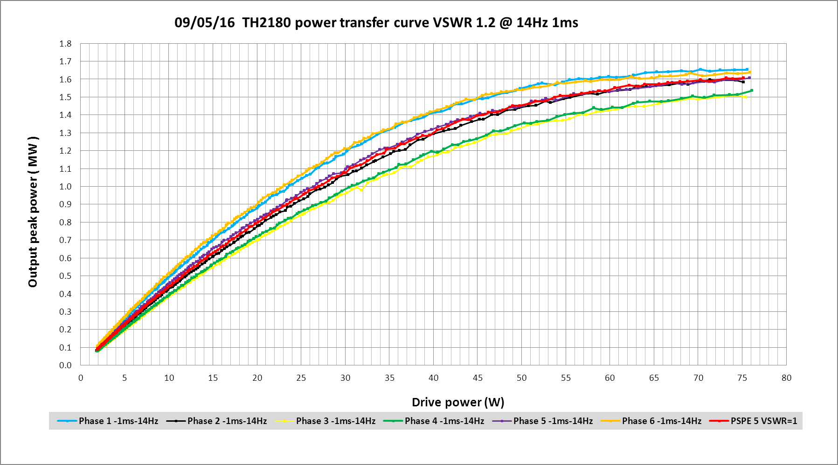
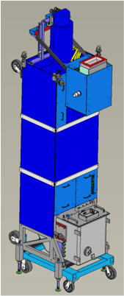
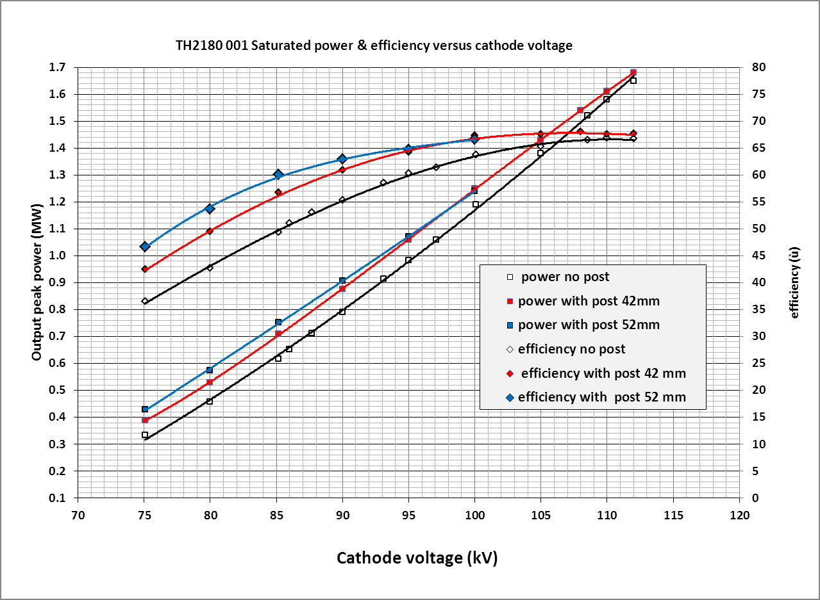
Thales klystron prototype TH2180
The tube has been tested at factory at full power for few days in May 2016.
Saturated efficiency 66%.
1.5 MW at 108 kV
Operation at low beam voltage: efficiency can be increased by using a mismatch at the output (post). Preliminary results (can be improved):
1.5 MW
65%
Efficiency
600 kW
55%
80 kV
Power

Slide 13
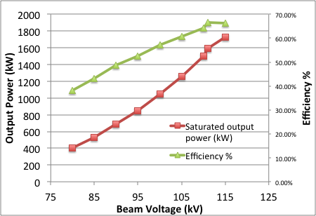
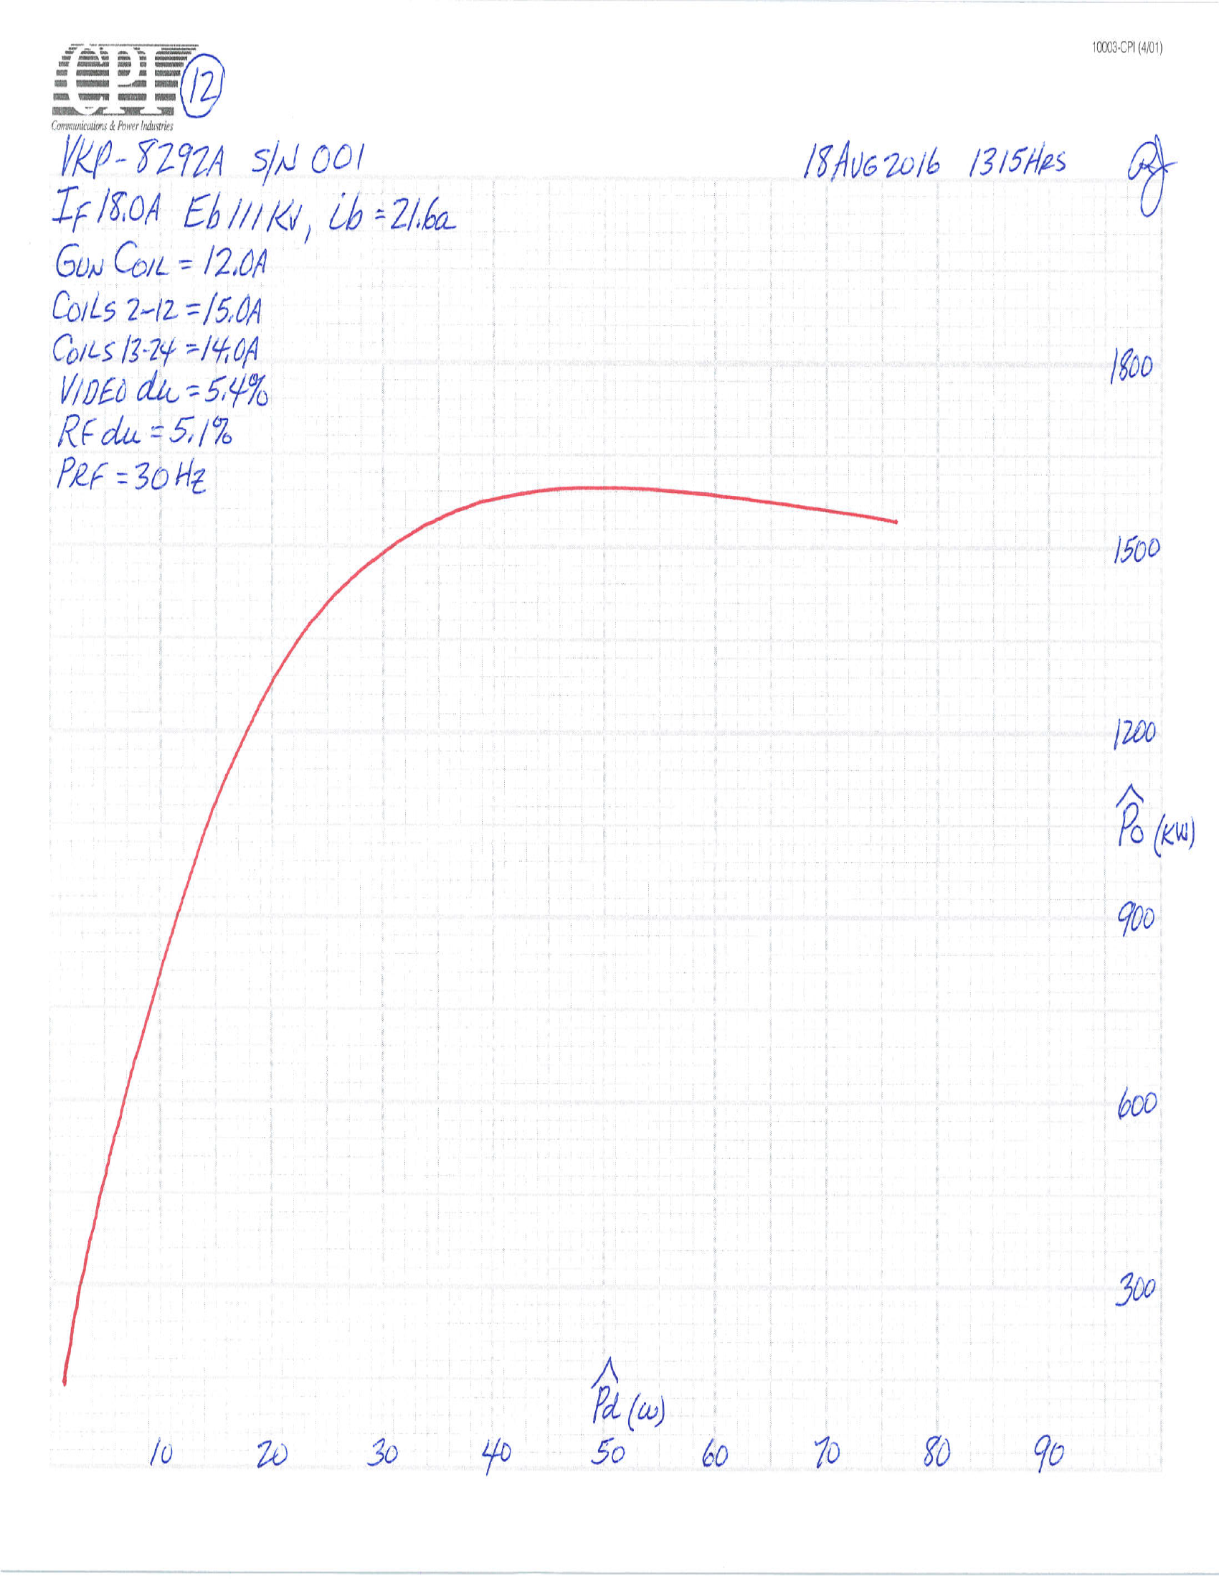
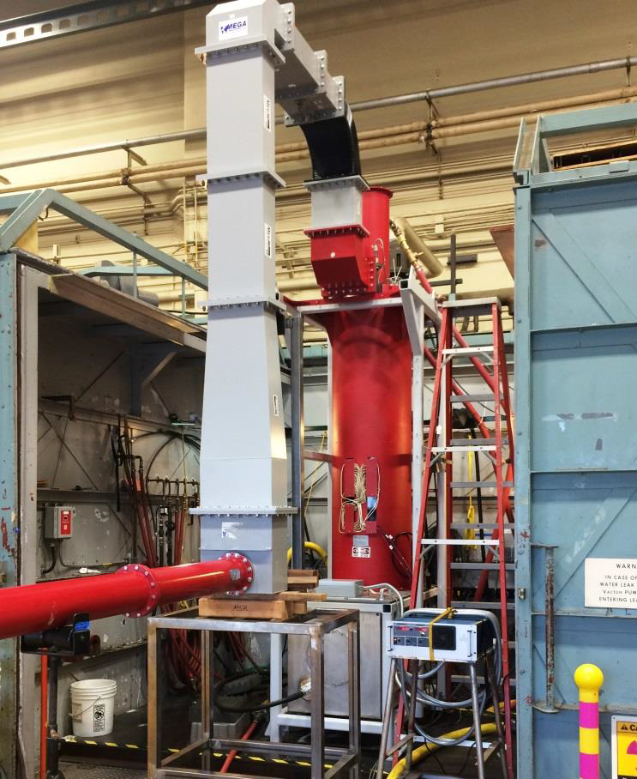
CPI results (Preliminary Factory Tests)
1.6 MW
Specification 1.5 MW
Output power and Efficiency
vs Beam voltage
Transfer curve at nominal 111 kV

Slide 14
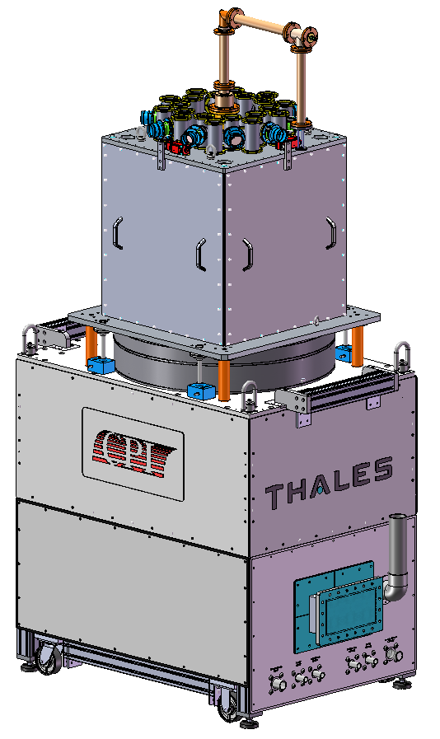
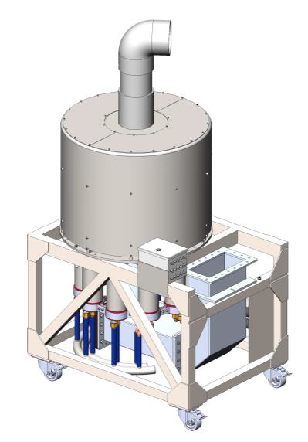


Multi-Beam IOTs for ESS
10 Beam Multi-Beam IOT
1.2 MW
704 MHz
Two Contracts for Technology Demonstrators
Thales/CPI Consortium
L3
Contracts signed in September 2014
Project duration: 24 months
Testing at CERN

Slide 15
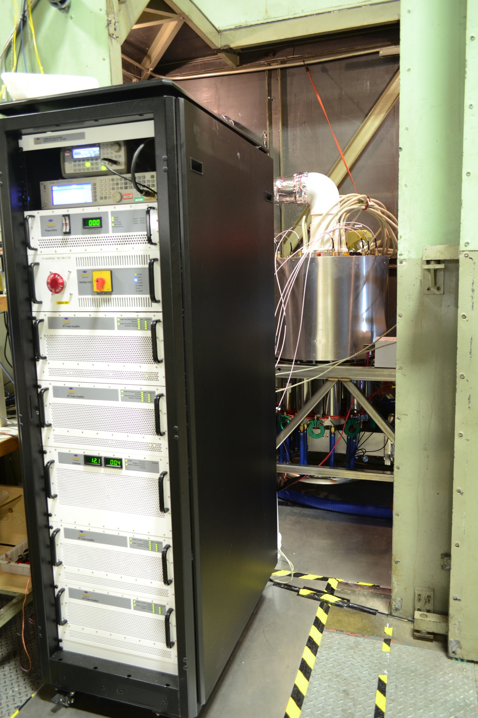
Solid State Driver
TOMCO 15 kW driver being used for Factory Testing at L3
Single Rack Configuration
Operating Frequency | 699 – 709 MHz
Output Power for 5 dBm input | 15 kW PEP
Gain linearity | +/- 0.5 dB
Pulse width | Up to 4 ms
Duty | Up to 10%

Slide 16
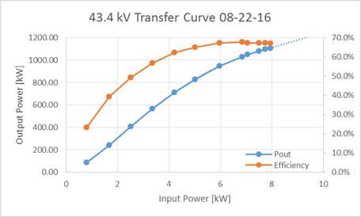
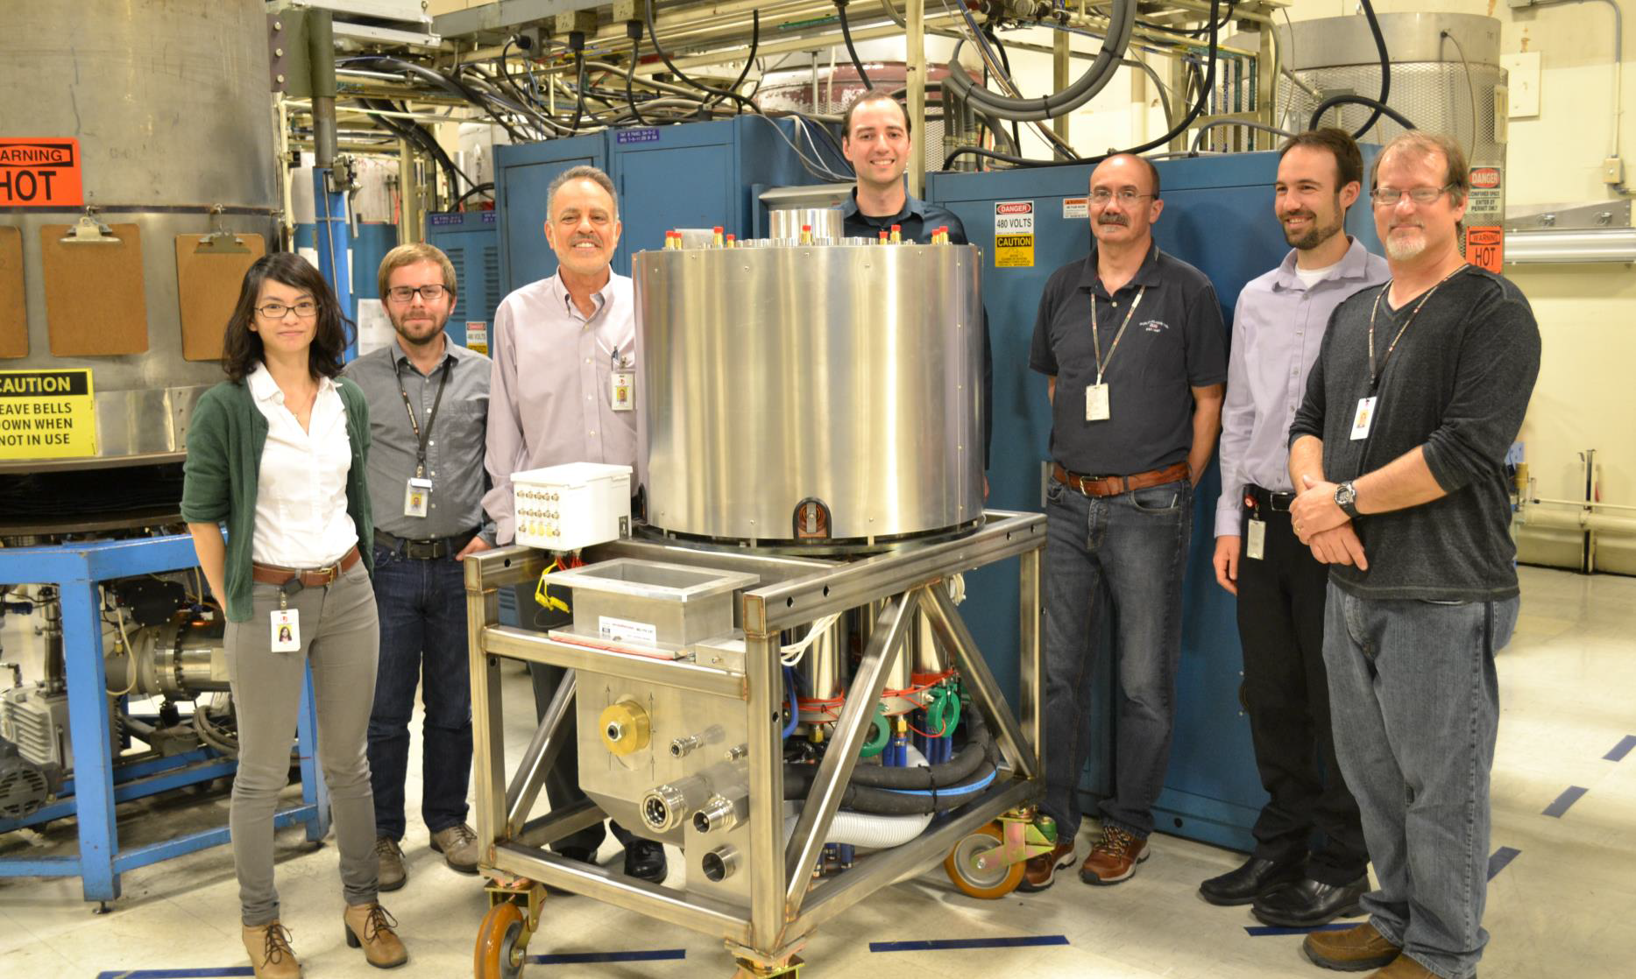
Preliminary Results
Efficiency ≥ 60% from 600 kW to 1.2 MW
(HV efficiency only)
Efficiency
Output Power

Slide 17
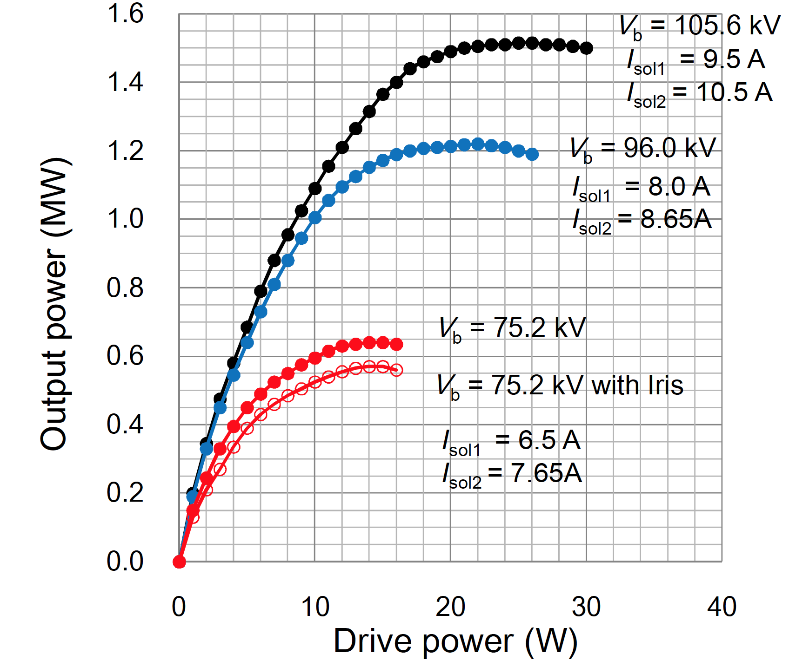
Comparison to Klystron
Efficiency at Saturation = 66%
Nominal Operating Point for High Beta = 1.1 MW
48% at 1.1 MW
64 % at 1.1 MW
36% at 825 kW
64% at 825 kW (75% of nominal)
1.1 MW
825 kW
Toshiba Klystron
Beam Voltage - 40 kV
L3 IOT

Slide 18
Interfaces
Modulator
  Well defined (Voltage, current, stability and fault handling; HV socket)
Distribution
  Well Defined (WR1150 and Arc detection)
Cabling and Racks
  Well defined, draft rack layout complete.
Layout
  Well defined and approved. Captured in 3D model of Gallery
Installation and commissioning
  Currently being detailed. Some clashes to be resolved.

Slide 19
Conclusions
Klystron prototypes well underway
  Two of the three prototypes tested, 3rd tube performance demonstrated but issue with arcing.
Contracts placed for two IOT technology demonstrators (Thales/CPI and L3)
  Thales/CPI construction started
    Tube delivery expected November 2016
    FAT/SAT expected End of January 2017
  L3 IOT already under test in the factory
    1.2 MW achieved
    Efficiency > 60% from 600 kW to 1.2 MW
MB-IOT Test stand at CERN under construction; ESS test stand planned
TS2 Preparations started – first permanent on-site RF stations.

Slide 20
Extra Slides

Slide 21
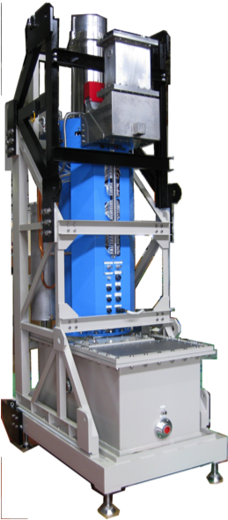
Toshiba klystron prototype E37504
Compact design: 3.5 m including collector and gun tank
High gain (>47dB)
High efficiency (65%)
3.5 m
Two electromagnet power supplies are required to provide current to the three focusing coils (one gun coil + two main coils):
Dispenser cathode
The output window is water cooled.
The tube can operate at low beam voltages (<85 kV) keeping high efficiency by using an output mismatch (Iris) and by changing the beam focusing

Slide 22
Thales klystron prototype TH2180
Based on the TH2182 developed for CERN (horizontal orientation)
Cern tube has been also tested at 1.7 ms, 2 Hz and 1.7 ms, 50 Hz (Factory Acceptance Test)
High gain (>47dB)
High efficiency (>65%)
Two electromagnet power supplies are required to provide current to the two focusing coils
The output window is air cooled.
The tube can operate at low beam voltages keeping high efficiency by using an output mismatch. The mismatch is provided through a post that can be inserted on the output waveguide (external to the X-rays shielding). Different posts can be used to optimize the tube performance at any operating voltage.
4.5 m
Courtesy of Thales

Slide 23
CPI klystron prototype VKP-8292A
New development based on CPI experience from the SNS klystrons
Courtesy of CPI
Up to three electromagnet power supplies are required to provide current to the focusing coils
The output window is air cooled.
3.8 m
The vacuum envelope has been assembled and sealed
Testing will start mid-June
Delivery expected in August 2016

Slide 24
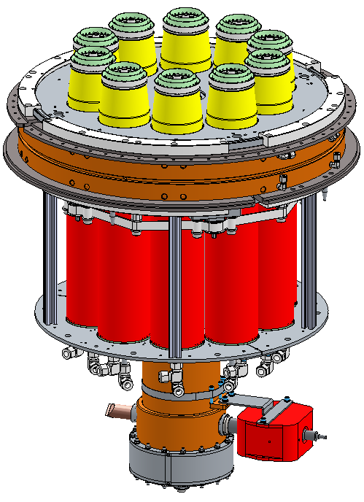
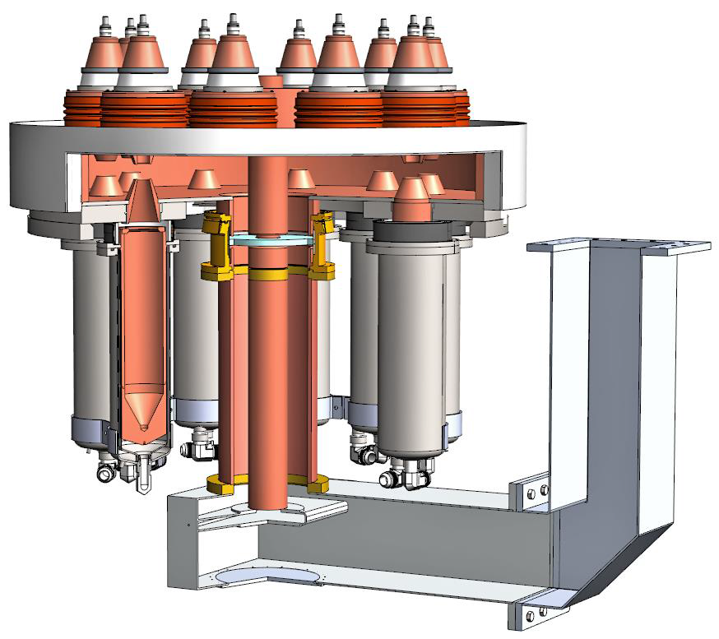
10 Beams placed on a bolt circle
Individual cathode and grid structures
Individual and isolated collectors
Single annular output cavity with one interaction gap per beam
Coaxial Output

Slide 25
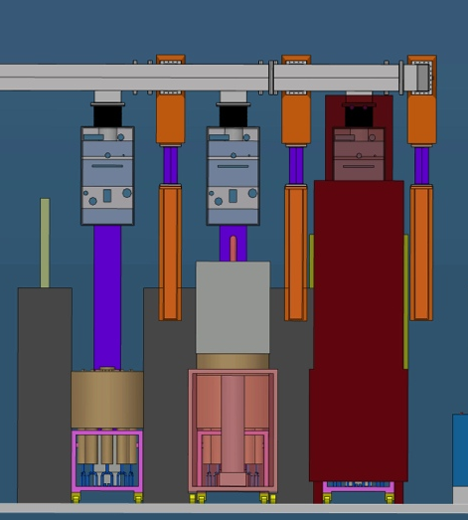
Comparison of Space envelopes
Waveguide
Space allocated for HV Deck for Grid and Filament supplies
4.5 m from the floor
IOT Driver Rack
704 MHz Klystron
Thales/CPI IOT
L3 IOT

