Slide 1

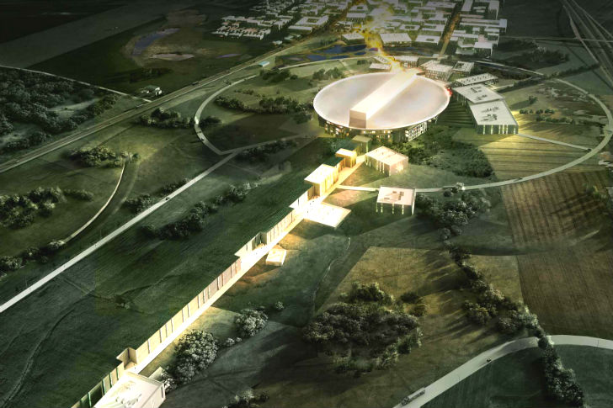

660kVA SML modulator design and procurement strategy
Carlos A. Martins
ESS – Accelerator Division - RF Electrical Power Systems
www.europeanspallationsource.se
Linac 2016 conference, Oct 2016

Slide 2
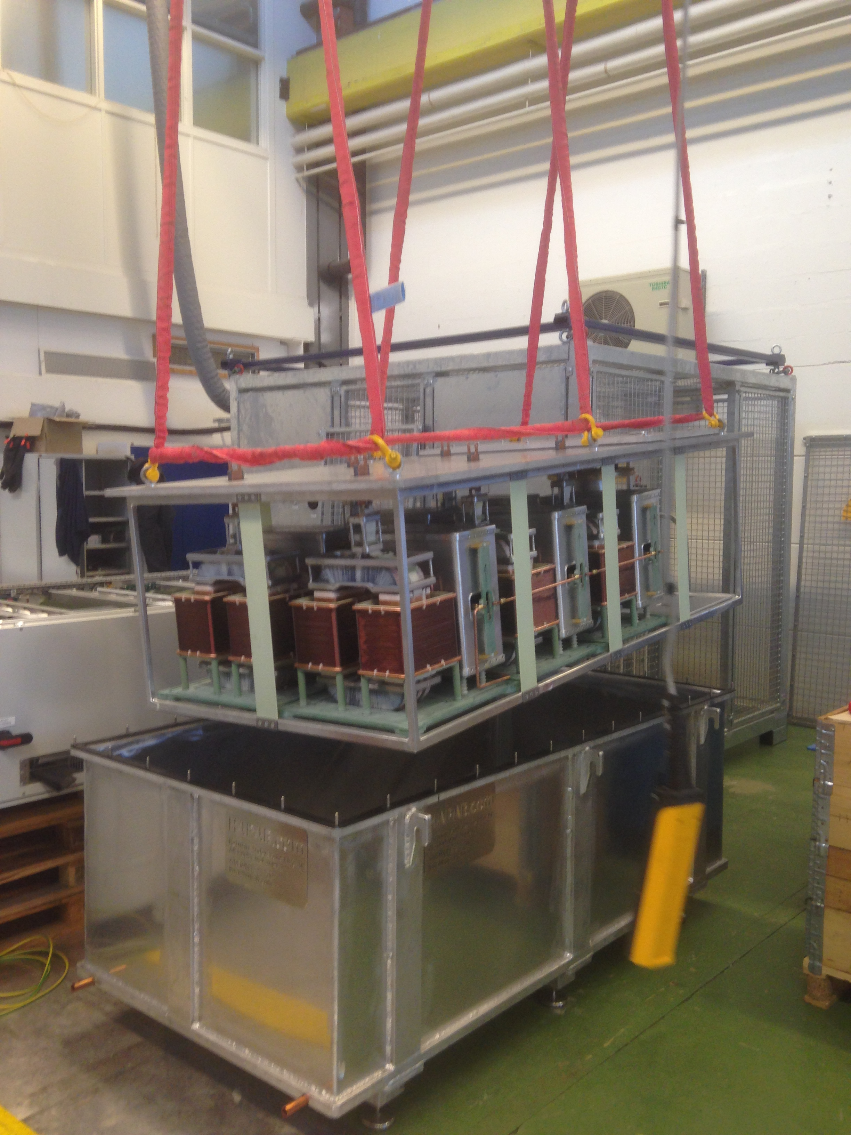
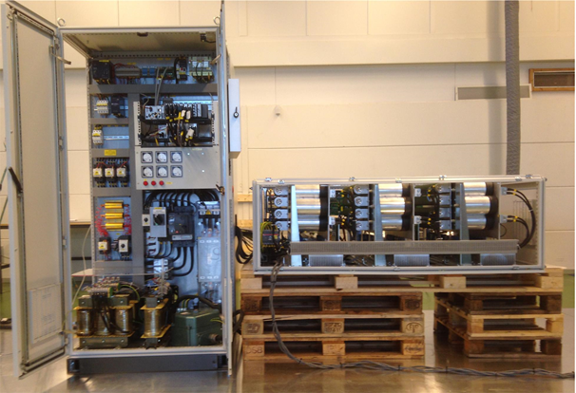
Reduced Scale modulator prototype
( SML topology status on March 2015 )
Electrical schematic
Part I
Part II
Part I – Low Voltage driver:
→ successfully tested from Feb. 2015 onwards on resistive loads (@1kV);
Part II – HV oil tank assembly:
→ Delivered at LTH test stand on March 4th 2016

Slide 3

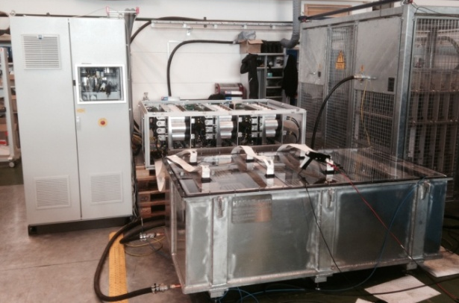
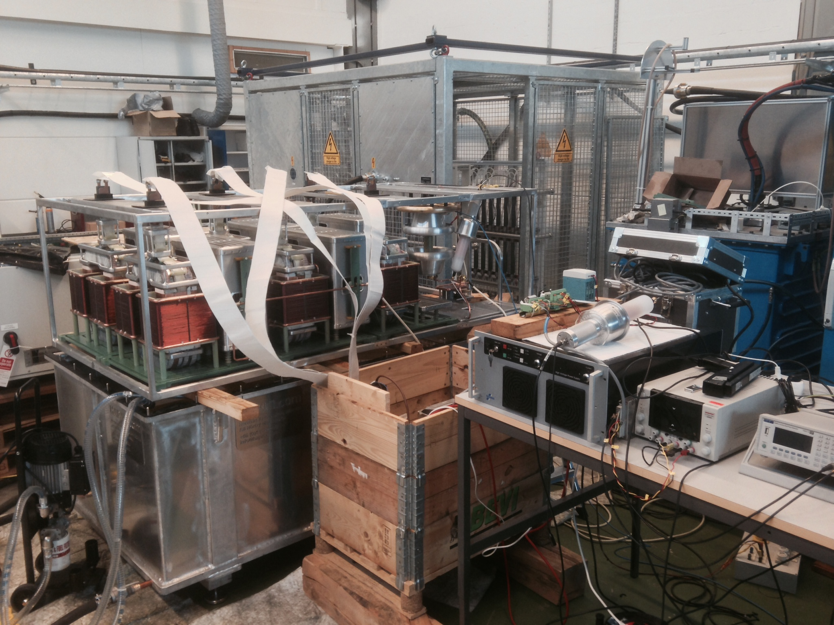
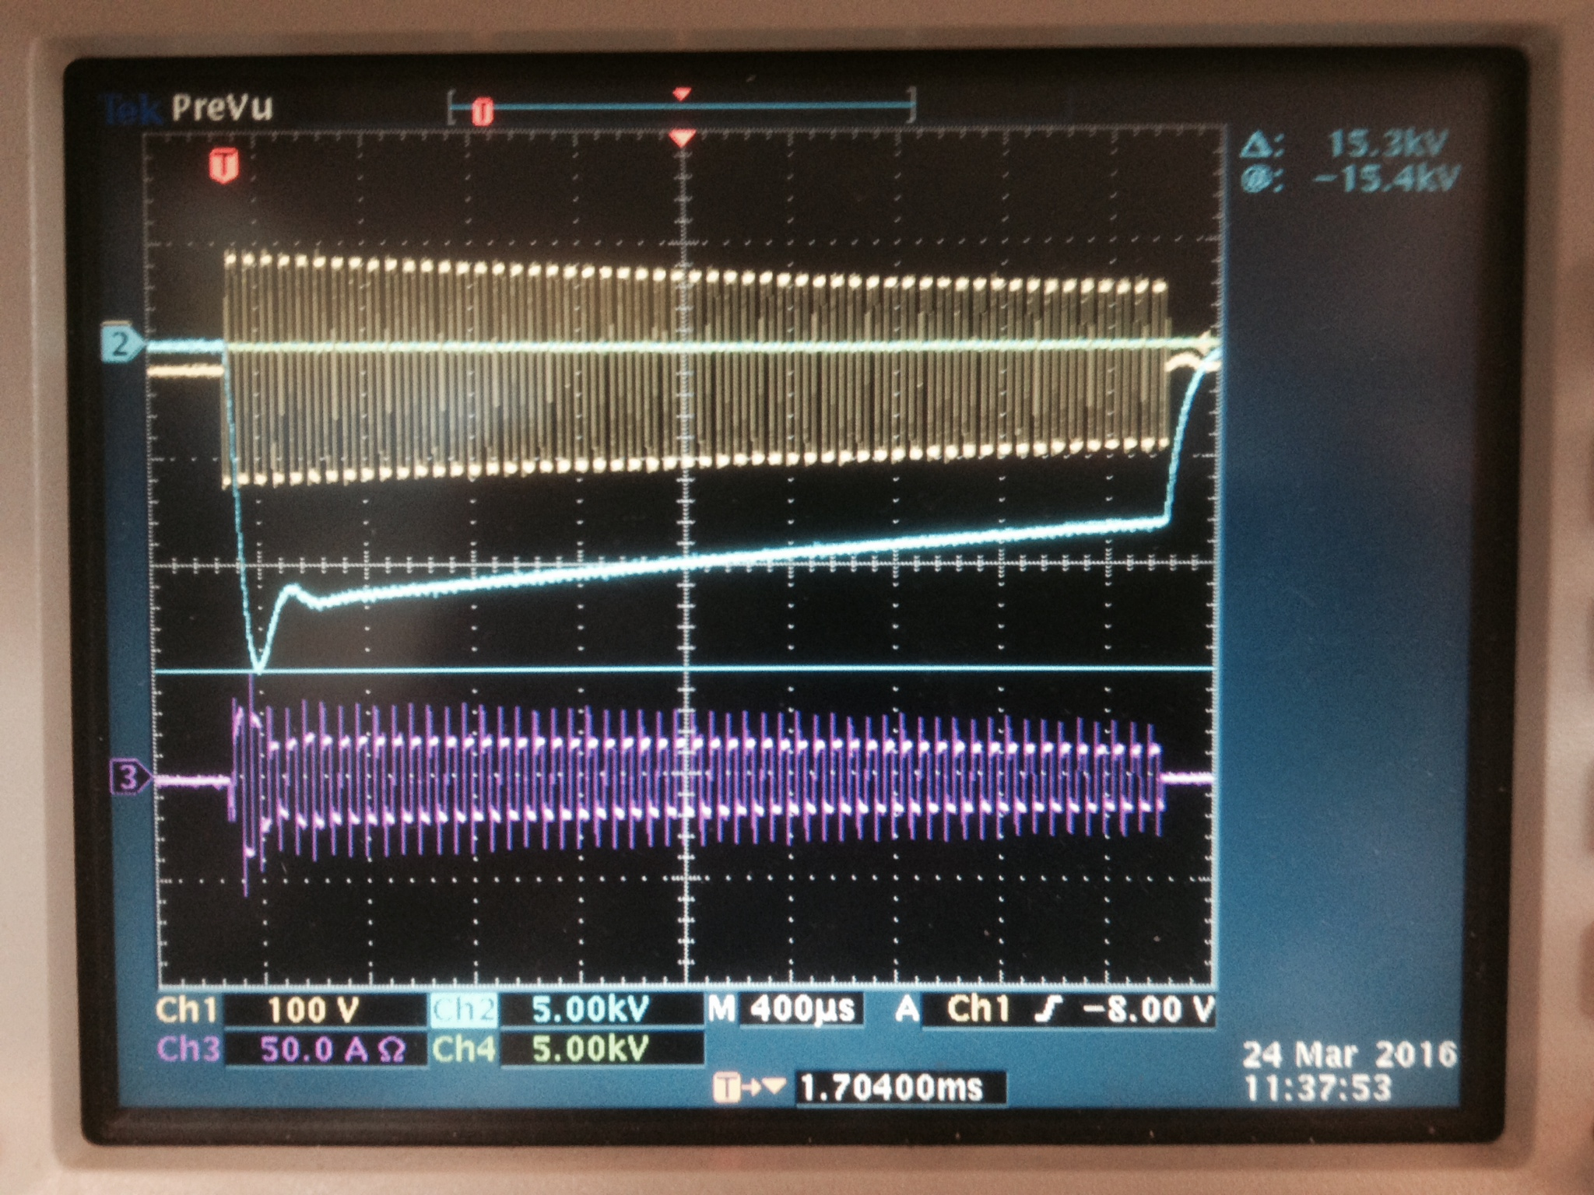
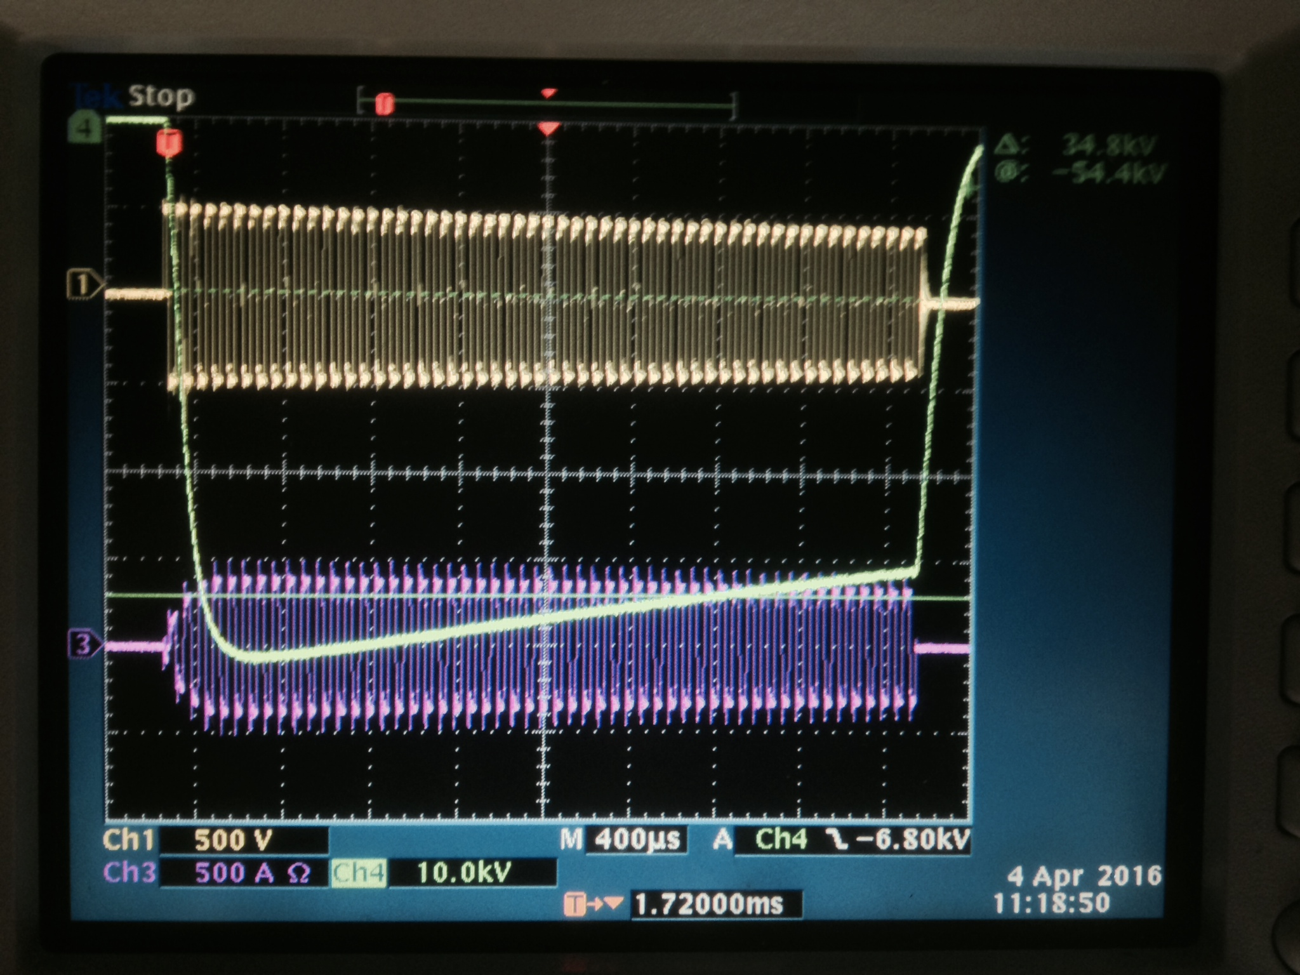
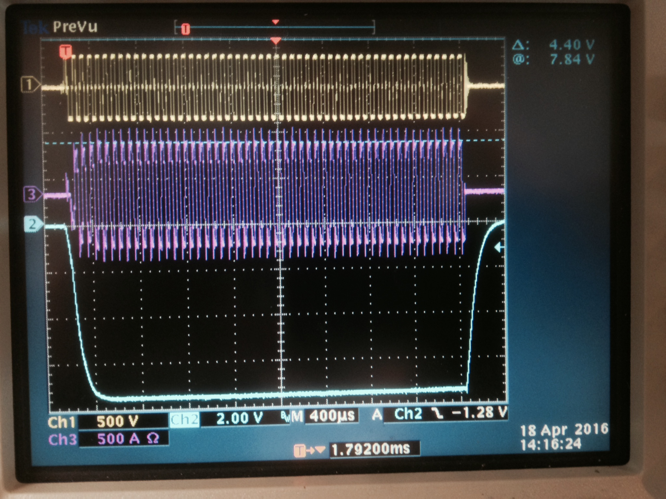
SML modulator :
Testing of the reduced scale prototype
( prototype rated: 115kV/20A; 3.5ms/14Hz )
HV oil tank assembly received at test stand - 4th March 2016
Preliminary testing of HV oil tank assembly at low voltage - 24th March 2016;
3 & 4 Testing of complete system
1st testing at High Voltage - 4th April 2016
90kV with droop comp. - 18th April 2016

Slide 4
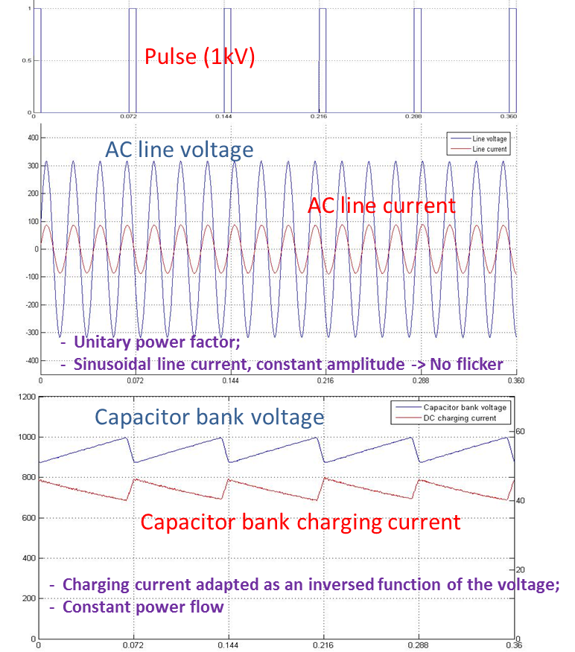
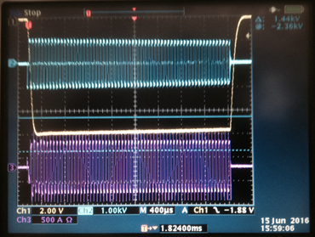
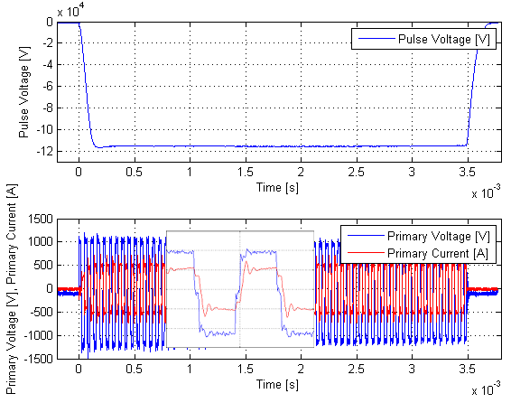
SML modulator :
Testing of a reduced scale prototype
( prototype rated: 115kV/20A; 3.5ms/14Hz )
Integrated test of complete system (Part I + Part II)
ref
Part I
Part II
→ Heat run test successfully performed at nominal (115kV, 20A, 3.5ms/14Hz) for 12 hours consecutively

Slide 5
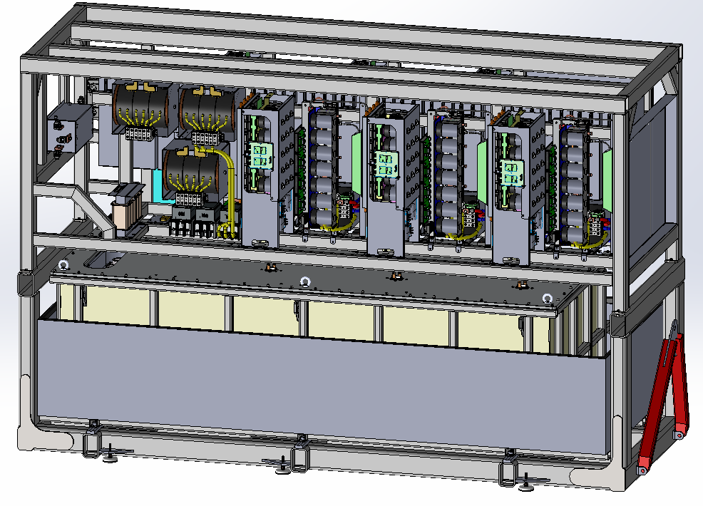
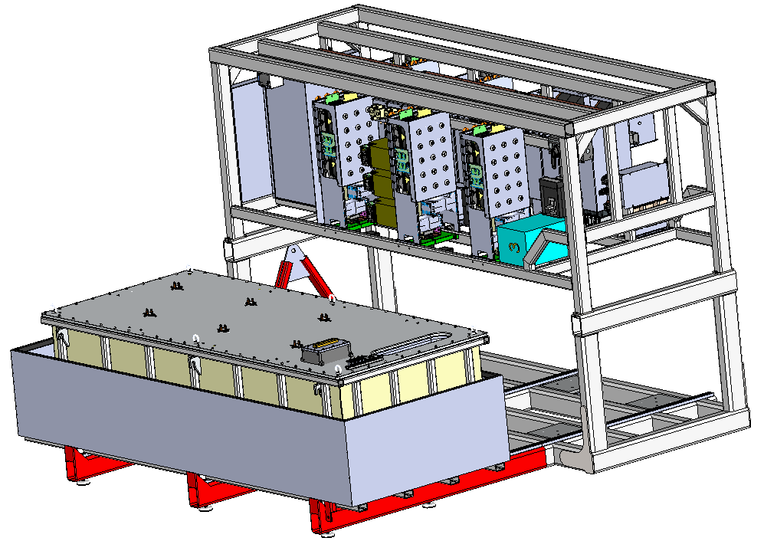
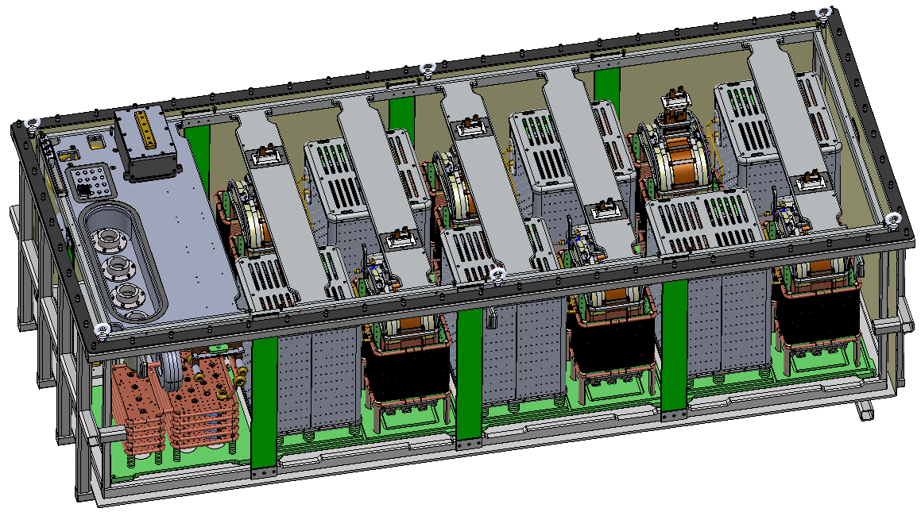
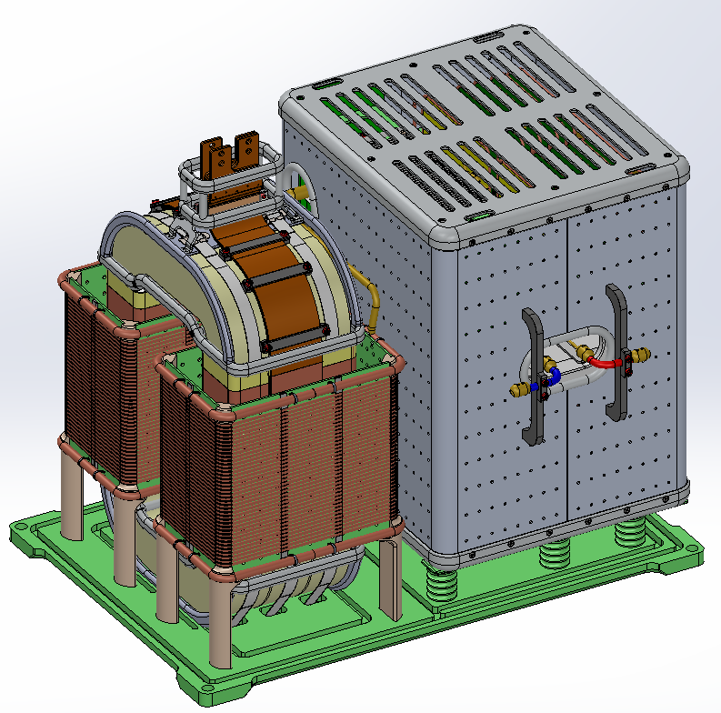
SML modulator, Full Scale design (660kVA)
- Supply of 4x 1.4MW_{pk} klystrons in parallel
3.8m
Compact
Retractable HV oil tank for easier access
2.4m
Integrated oil spill bin
All in one frame with permanently mounted wheels for easy transportation
1.4m
Total footprint: 3.8m x 1.4m
(planned was 5.5m x 1.6m, i.e. 40% less);
Total weight: < 5.5 tons (without oil);
Total volume of oil: ~ 2000 litters;
HV module

Slide 6
Procurement strategy
3 modulators rated 660kVA for RFQ and DTL to be procured by ESS Bilbao as part of Spanish IKC;
9 modulators rated 660kVA for Medium Beta to be procured either by ESS Bilbao (Spanish IKC) or directly by ESS ERIC;
In both cases:
  Technical Specifications based on “build-to-print” design:
    Detailed electrical schematics;
    Bill Of Materials;
    Set of 3D mechanical drawings;
Timing:
  SoW document is finished (79 pages);
  Set of mechanical drawings (12 annexes) in view of tendering are ready;
  Call for tender for 3 RFQ/DTL modulators to be launched in Oct. 2016;
  Launch of call for tender for 9 Medium Beta modulators not so clear;

