Slide 1
FREIA the way to TG2
Clara Lopez
Integration engineer
www.europeanspallationsource.se
16 May 2016

Slide 2
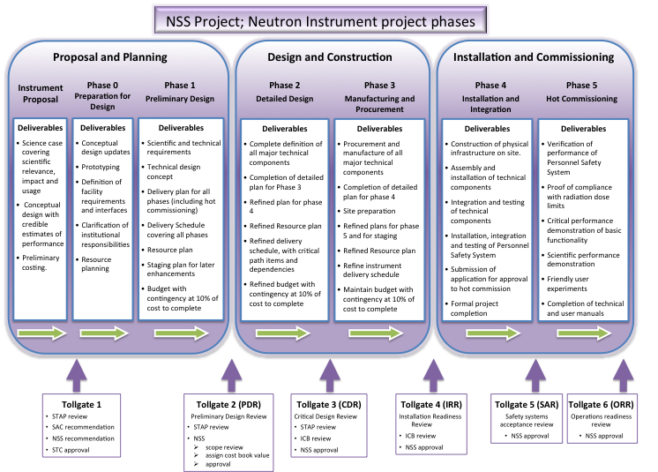
Neutron Instrument Design Construction ESS-0051706
Notes:
SAC Scientific advisory committee
STC Sterring committee

Slide 3
Neutron Instrument Design Construction ESS-0051706- Proposal and Planning
Neutron Instrument proposal
Scientific case for Neutron Instrument, scientific relevance, impact and usage. Conceptual design and a preliminary costing
Tollgate 1
Proposal accepted
Phase 0 – On going
Preparatory plan for phase 1 approved by NSS Project management, Agreements signed: MoU and TA for the IK collaboration Agreement before start Phase 1
Particular notes for Freia: Partner, motion control shutters, redesign of beam extraction, handling interfaces with Target group (reflector vessel design and beam port allocation)
Notes:
Tollgate 1: STAPs and SAC Scientific Advisory Committee endorsement to ESS, ESS management and recommend to ESS Council and ERIC Council makes the decision on the proposal

Slide 4
Neutron Instrument Design Construction ESS-0051706- Proposal and Planning
Phase 1: Preliminary engineering design
Starts having Instrument core team in place, that turn the proposal into a baseline project specification, defined scope, budget and schedule.
Budget include phase 1-4 and 10% contingency
Cost category is assigned (provisional budget)
Tollgate 2: (preliminary design review)
Baseline project specification, well defined scope, budget and schedule for the instrument
Proposal is reviewed by the NSS Project Management on: Scientific parameters, engineering, safety and licensing, budget, schedule, management, operations and maintenance and staging plan

Slide 5
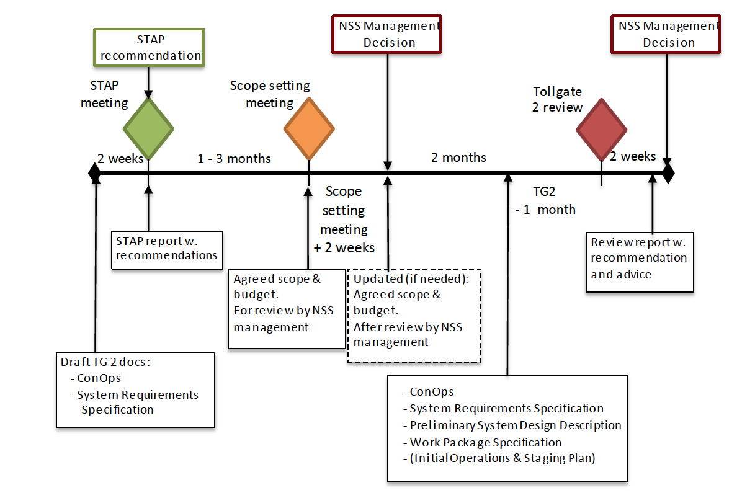
ESS- 0043330 NSS Guideline for Instrument Construction projects

Slide 6
STAP Meeting – June 14-15 2016 at ILL Grenoble
Scientific and Technical Advisory Panel- ESS-0032507
Participants:
Core instrument team
Instrument STAP
Representatives of instrument partners
ESS technical groups
ESS management
Notes:
Question, is Keving taking part of this meeting for Freia?
Technical groups?

Slide 7
STAP Meeting – June 13 2016 at ILL Grenoble
Documentation* shared 2 weeks in advance
Draft version of concept of operations document: Example ESS-0053465 Concept of operation ODIN
Draft System requirements specification
Instrument core team will present the current status of the project
Cost estimates
Instrument scope to be presented for the scope setting meeting (baselines and configurations)
*It is needed to identify what documentation can be achievable in the actual frame of time
Notes:
*** Comments about to achieve these documents in that short time

Slide 8
Scope setting meeting – Instrument Construction Projects –ESS-0055681 – Date?
Participants:
Instrument team
Instrument partners
Representatives of the ESS technical groups
NSS project management
Documentation: Scope report that includes (example from LoKI)
Overview of science case, high level requirements and basic instrument layout (based on the proposal and the STAP recommendations)
Description of configuration 1: within cost category including 10% contingency
Budget and schedule by WBS according to the table No. 1, achieving requirements and impact in science case, upgradeability through a staging plan, cost and funding plan
Description for configuration 2 and 3
Evaluate the following questions:
is the scientific performance competitive with the current state of the art?
to what extent does it correspond to the scope outlined in the approved instrument proposal?
to what extent is it upgradeable to the scope outlined in the approved instrument proposal?

Slide 9
Scope setting meeting – Instrument Construction Projects –ESS-0055681
Table No. 1
Labor/ Non labor
Notes:
Instrument team must contact the different technical groups and Instrument class coordinator and contacts to assure the adequate planning and ESS standard applicable

Slide 10
TG2 Review–ESS-0043330
Participants:
Core instrument team
Review committee
Representative of instrument partners
ESS technical groups and NSS project managements
Open to observers
The instrument team presents the proposed baseline for the instrument based on the documentation
Scope meeting is required previously to TG2 review
Notes:
High level questions need to be answered with the documentation and preparation:
has adequate planning been done to move the project into Phase 2?
is the proposed budget consistent with the proposed scope?
does the preliminary design satisfy the requirements?
is the presented baseline technically sound?
has anything been forgotten or neglected?
In case where several In-kind partners are collaborating - are roles and responsibilities adequately defined and agreed?
Lower level questions
have safety-related aspects in accordance with [[6]] been appropriately considered?
to what extent have appropriate connections been made with the critical project interfaces, such as software, data storage hardware and sample environment?
Has the instrument context been appropriately considered in terms of physical interfaces, such as bunker, beam extraction, ICS etc. ?
to what extent have available engineering standards been implemented appropriately?
are the cost and duration estimates reasonable?
to what extent has the team planned appropriately for the risks, both technical and otherwise?
to what extent have RAMI aspects in accordance with [6] been appropriately considered?

Slide 11
TG2 Review–ESS-0043330
Review committee:
Chairman chosen by NSS management
Two or three STAP members
One or more project engineers (external) with neutron instrument experience,
One experienced industrial engineer
One nuclear safety engineer
Notes:
Documentation must be available for the panel at least 1 month before the meeting
Following ESS technical standards, guidelines and constrains (see ref 6 in ESS-0043330)

Slide 12
TG2 Review Documentation–ESS-0043330
Documents included:
Concepts of operation (ConOps) 15- 25 pages, Example ESS-0053465 ODIN
System requirements specification 20-30 pages
System breakdown PBS acc. ESS-0034841
Functional Requirements
Non- functional/ constrain requirements
Preliminary system design description- 50 pages Example from NMX
Work package specification – 30 pages
Initial operations and staging plan 5 pages
Notes:
Conops: describing the instrument. It is derived from the instrument proposal widening the perspective from the scientific case of the instrument to include the context in which it intends to be designed, constructed and operated. Described with its complete life-cycle in mind
SYSTEM requirement specification: Follow high level PBS according to instruction NSS Generic Instrument PBS Number Designation, ESS-0034841
Preliminary system design description :
- layout drawings and positions for components
Description of the preliminary design of first level of subsystems includes drawings, specifications and more detail PBS if it is needed
P&ID and interfaces
Preliminary safety analysis for the instrument
Expected scientific performance
Workpackage specification
Project organization
Project scope
Work breakdown
Prolject schedule
Project budget
Desscription of the workunits
Project risk analysis

