Slide 1
Raster Scanning Magnets Kick-off meeting
High-level project overview & schedule
Heine Dølrath Thomsen
www.europeanspallationsource.se
June 22, 2016

Slide 2
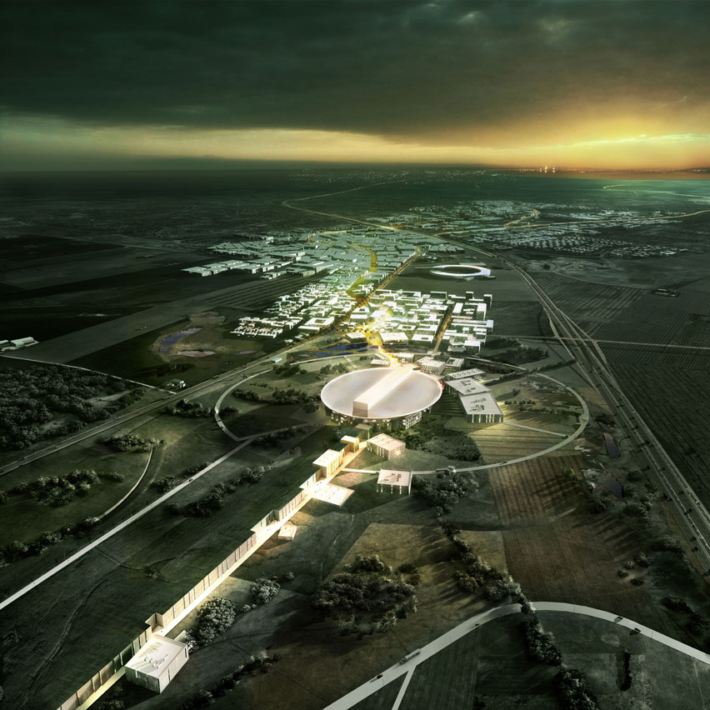
2019
European Spallation Source
Malmö
CPH (DATA)
Lund
Science Village
MAX IV
Target, moderators
Neutron beamlines
Pulsed LINAC
Notes:
By the end of the decade, 2 state of the art accelerator-based scientific tools will be completed in DK’s backyard
ESS: 5000 visiting scientist per year

Slide 3
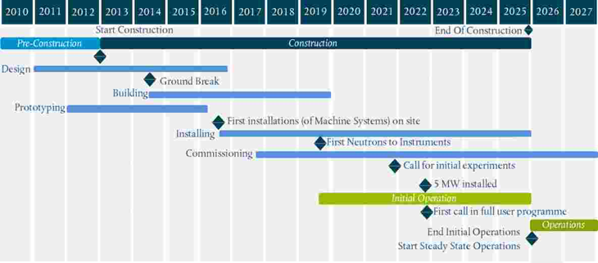
ESS Project Status
Now
Raster Magnets
Installation: 11 March 2019

Slide 4
ESS Accelerator: High-Power p SC LINAC
5 MW = 2.0 GeV x 62.5 mA x 2.86 ms x 14 Hz = 125 MW x 4%
5 MW = 0.360 MJ x 14 Hz
1.5E16 p / s, 1.1E15 PPP
5200 h / y, 95% availability
2.86 ms
2.86 ms
ESS
1 / 14 Hz
H⁺
Notes:
Standard defined by LANL
360 m linac
beta = 0.94

Slide 5
Aarhus University: WP6 SoW (2.635 M€)
Program management and project engineering
HEBT beam optics design and follow up
Raster Scanning Magnet (RSM) system
Gamma ray blockers (GBs)
Assessment of the need for collimators
Purchase of the raster system as being part of WP6: Beam delivery systems
Pulsed raster magnets, power supplies, cables, local control system, ceramic vacuum chambers, support, …
Redundancy / fail-safe (4H + 4V). Bdot, Idot, BPMs

Slide 6
RSM Past, Present & Future
Mid-2013: Raster system becomes baseline Beam Delivery System
Ultimo 2013: Conceptual design completed (CERN, ESS, Danfysik)
October 8, 2015 WP6 Critical Design Review-1
November 1, 2015: Procurement
Design and manufacture of complete system (in stages)
Potential suppliers: Danfysik, Ampegon (formerly PPT), BINP
June 1, 2016: Contract signed with Danfysik

Slide 7
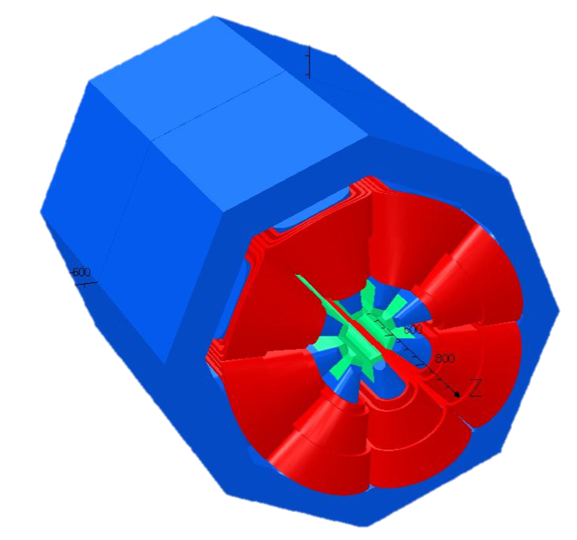
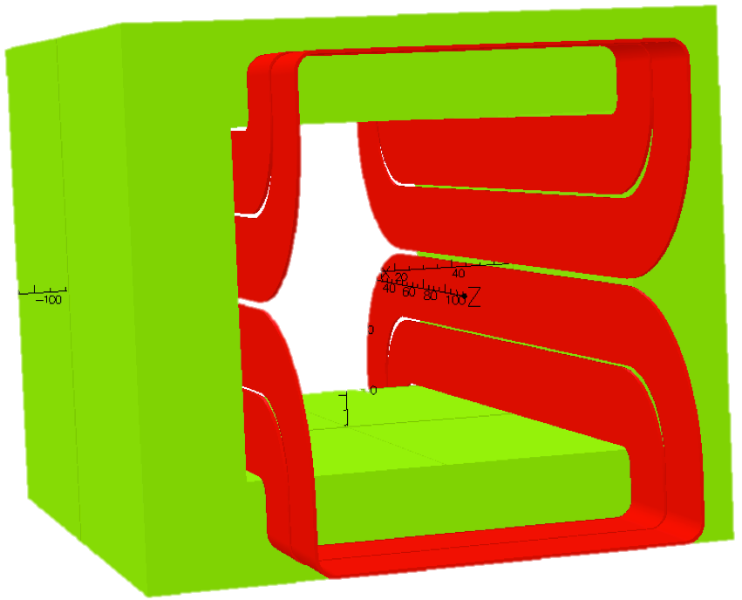
200 mm
160 mm
140 mm
B_{y}
B_{y}
B_{y}
f_{raster} ~40 kHz
x
x
x
Non-linear DC field distorts phase space and focuses tails
Complex tuning
Overfocusing of halo
Dodecapole comp.: overfocusing is neutralized
SFM: cheap magnet?
Suitable for CW or long-pulse machines
Linear focusing and pattern is decoupled

Slide 8
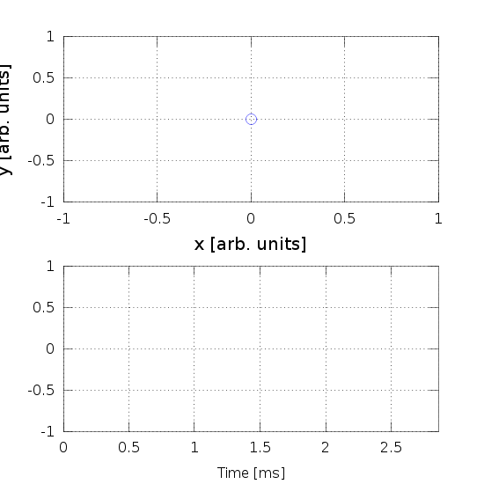
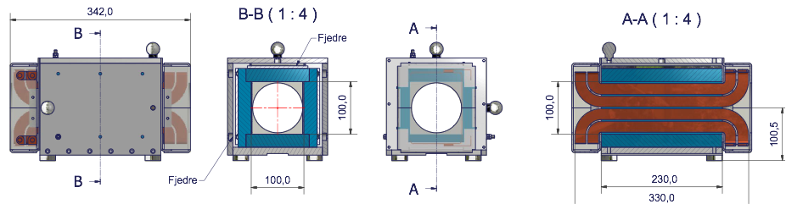
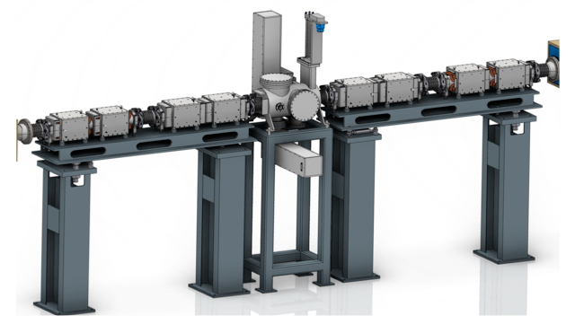
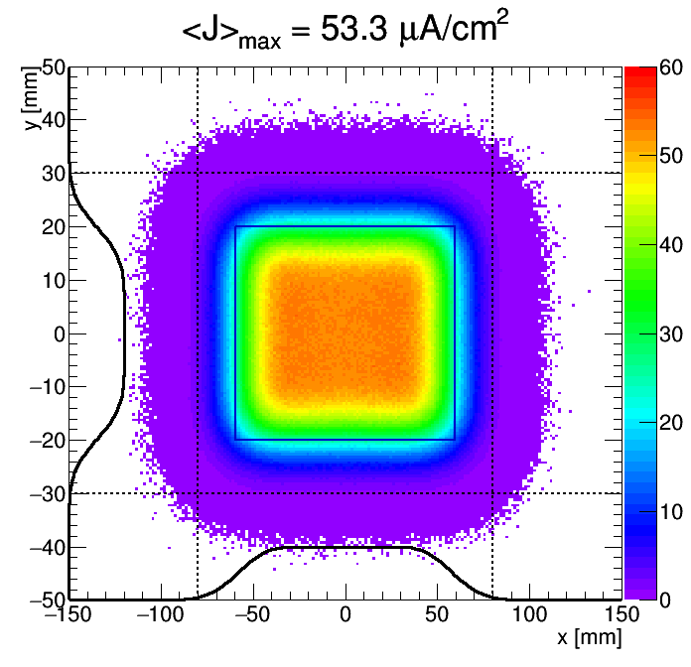
Principle
Raster system sweeps beam across target
8 colinear magnets, 8 dedicated, identical supplies
Crosshatch pattern (f_{x}/f_{y}, ϕ_{xy}, a_{x}, a_{y}) within 2.86 ms pulse
BX BY
BY BX

Slide 9
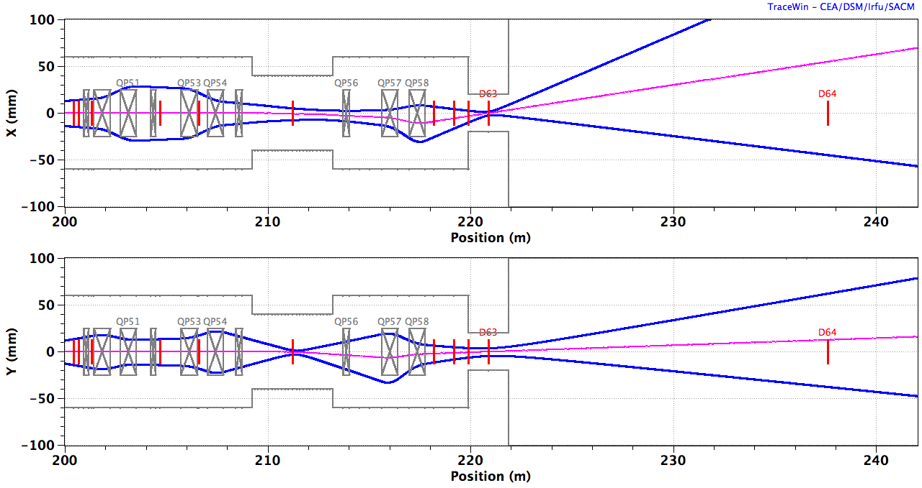
A2T Beam Optics
Centroid
10 x RMS beamlet
QP1-4
8 x RSMs
QP5,6
PBW
Target
B_{y} B_{y} B_{x} B_{x} | B_{x} B_{x} B_{y} B_{y}
ACH
A2T
AP
CO
2.0 GeV: B_{x}L = ±2.6 mT.m, B_{y}L = ±1.5 mT.m, ±5 mT.m
Notes:
RSM physical apertures

Slide 10
Requirements: Beam
Figures of merit:
Peak current density (J_{max}) on target
Beam inside nominal footprint regions (>99%, >99.9%)
 | Unit \ Location | PBW | BEW (Target)
amp. x | mm | 47.1 | 59.5
amp. y | mm | 15.8 | 20.0
rms (x) | mm | 10.7 | 13.5
rms (y) | mm | 4.10 | 5.05
rms(x)*rms(y) | mm^2 | >44 | >68
Jmax | uA/cm^2 | --- | <56
p outside 160x60 | % | <1 | <1
p outside 180x64 | % |  | <0.1
p outside 180x62 | % | <0.1
Max. displacement | mm |  | ± 5 (H) ±3 (V)
H raster freq. | kHz | >= 35
d.o.f.
requirements
Raster deflection offset (pulse-averaged deflection) <= 1%
Notes:
50 billion particles from E2E

Slide 11
Raster Scanning Magnet: Project Scope
Raster magnets
4 x H, 4 x V, ~identical
Bdot pickup loops
long cables, ~30 m
Power supplies
Local control system & electronics
Regulation loops
Switching clock: down conversion of 88 MHz ESS Master Oscillator
Reliability:
controller watchdog
…
Vacuum chambers
Ceramic (NO coating)
Possibly 4 pieces.
QCF connections + a few bellows
Support incl. alignment
Girder-based
Detailed design phase
Pre-series manufacture (2-magnet setup)
Pre-series testing @AU
Production-series manufacture (8-magnet setup)
Integration, installation, testing @ESS
(Nov. 2015 – March 2019)

Slide 12
CDR 2
Contract
Delivery to Aarhus
Preliminary Design
FAT I
Proposed Schedule
Phase 1
CDR 1
Design
Pre-Series
Prod. + Assembly + Inst.
First Protons on Target, 570 Me V (12 Aug. 2019)
Phase 2
@Danfysik
CDR 3
RFI (10 Apr. 2019)
SAT I
FAT II – SAR 1
Pre-Series Test
Delivery to ESS
Phase 3
@Aarhus
Pre-Series Extended Test
TRR
SAT II – SAR 2
Phase 4
@Danfysik
Prod.-Series
Production + Assembly
Phase 5
@ESS
Testing & Commissioning
2015
2016
2017
2018
2019
2020
2021

Slide 13
Questions?

Slide 14
Raster Scanning Magnets Kick-off meeting
Technical system scope
Heine Dølrath Thomsen
www.europeanspallationsource.se
June 22, 2016

Slide 15
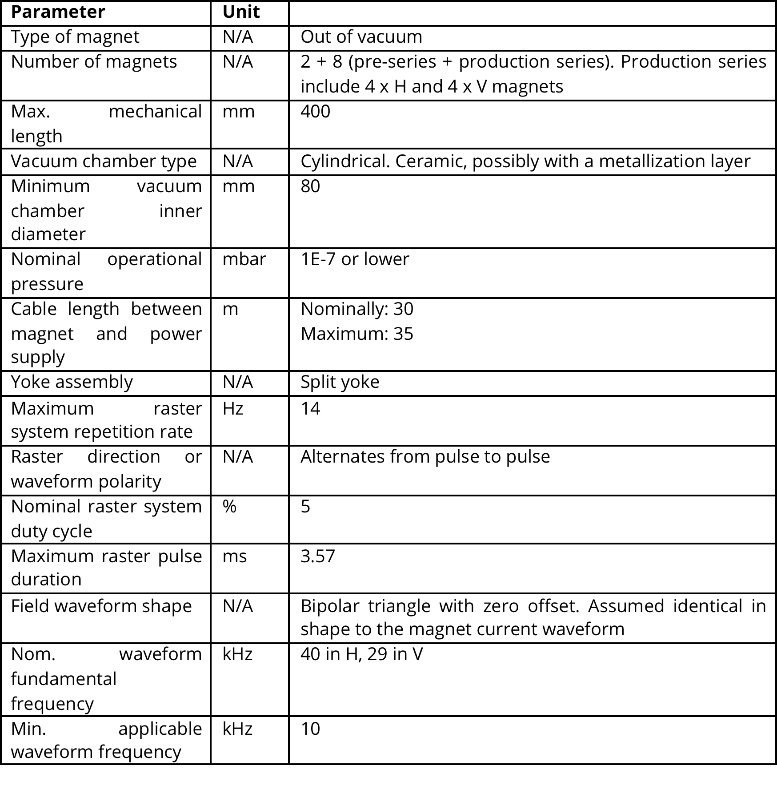
Appendix 1, Table 2: Minimum Requirements

Slide 16
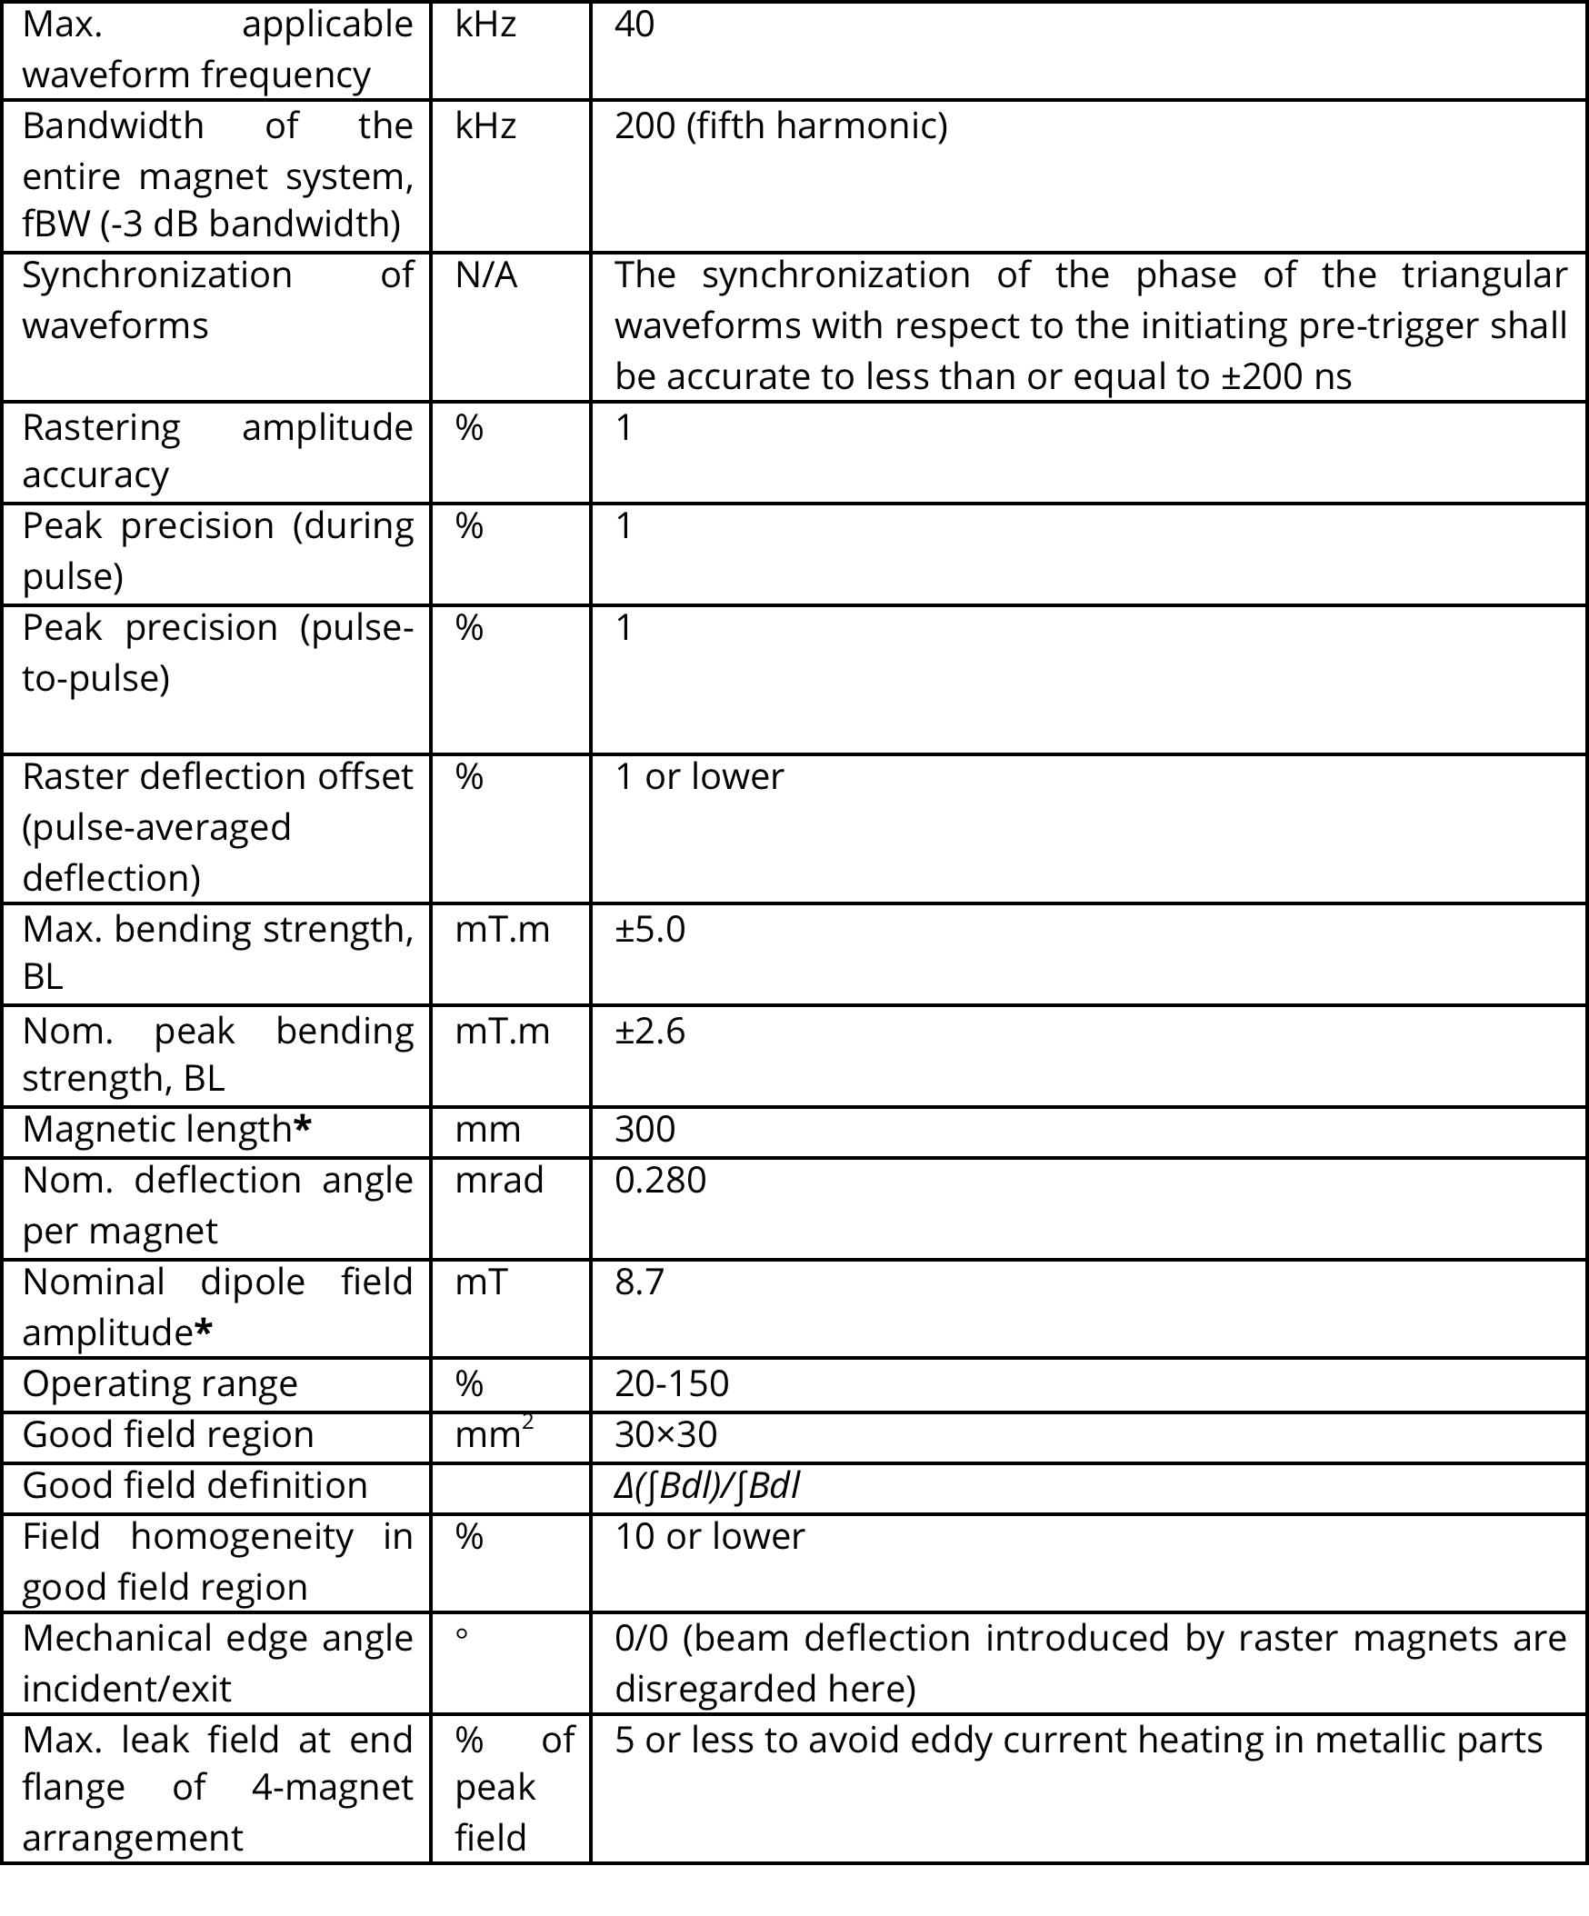

Slide 17
Hardware: Raster Scanning Magnet (RSM)
Coils (Cu, air), Bdot
Window frame magnet (ferrite)
Alignment targets
Notes:
PSS, covers

Slide 18
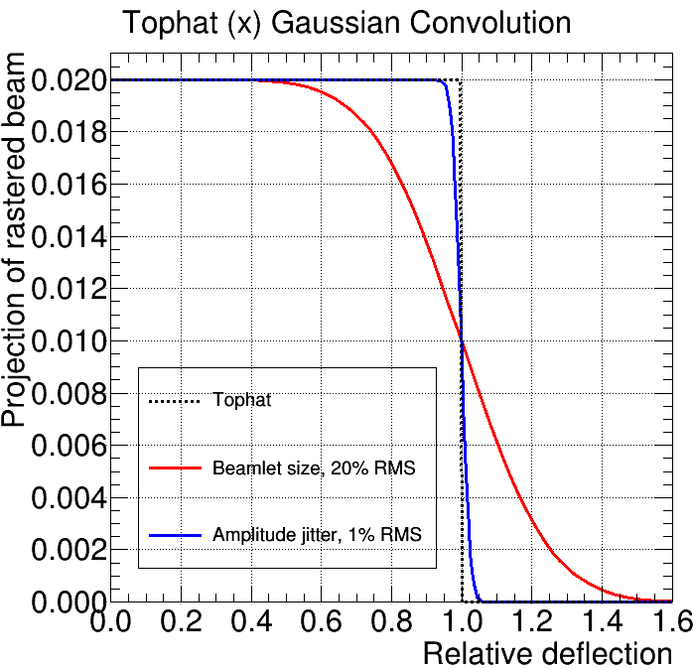
Amplitude Accuracy & Stability
Requirements
Rastering amplitude accuracy <= 1%
Peak precision (during pulse) <= 1%
Peak precision (pulse-to-pulse) <= 1%

Slide 19
RSM Systematic Sextupole?
u₃ = ∫∆B₃/B₀(t) x 10⁴
Beam along RSMs:
rms size < 1 mm
dx, dy < 3 mm
RSMs
GFR = ± 15 mm
Gap = ± 50 mm
Aperture = ± 40 mm
RSM u₃ < 10³ (or 10%)
Systematic sextupole (u₃) in H RSM set

Slide 20
RSM Alignment Errors?
Insensitive to displacements:
dx, dy < 0.5 mm
dz < 0.3 mm
Roll errors:
distorts pattern outline (shearing)
depends on average roll error in H/V set
pitch, yaw, roll < 1 mrad
Roll error distribution < 100 mrad

Slide 21
Raster Pulse: Alternating Parity
Shea et al, ICANS’15
Notes:
Amplitude spectra of neutron intensity fluctuations induced by raster scanning the
proton beam (0.8 Å neutron pulses from the thermal moderator)

Slide 22
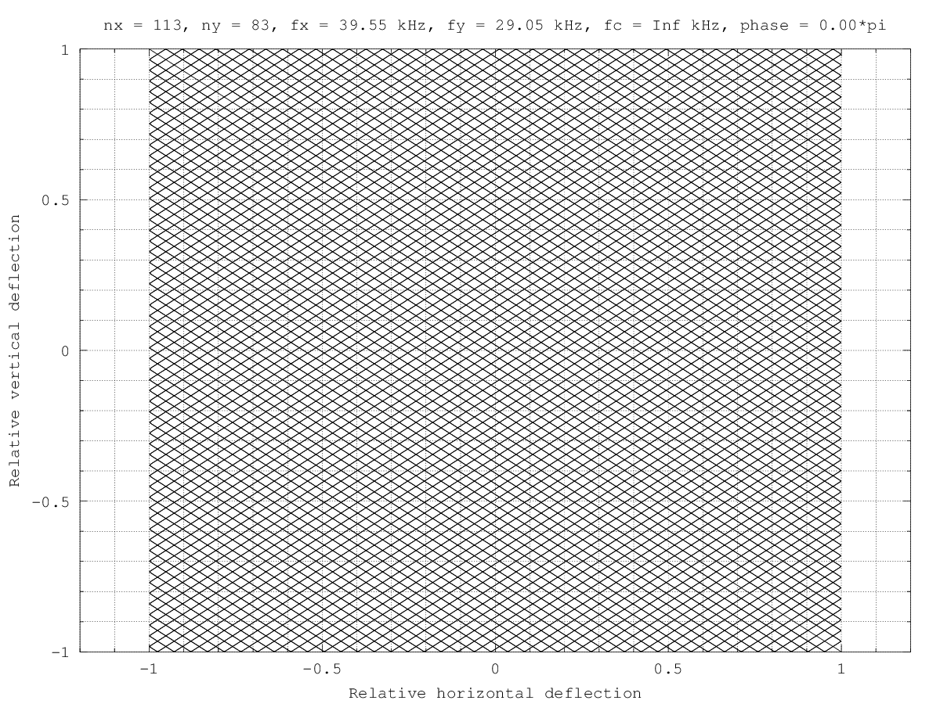
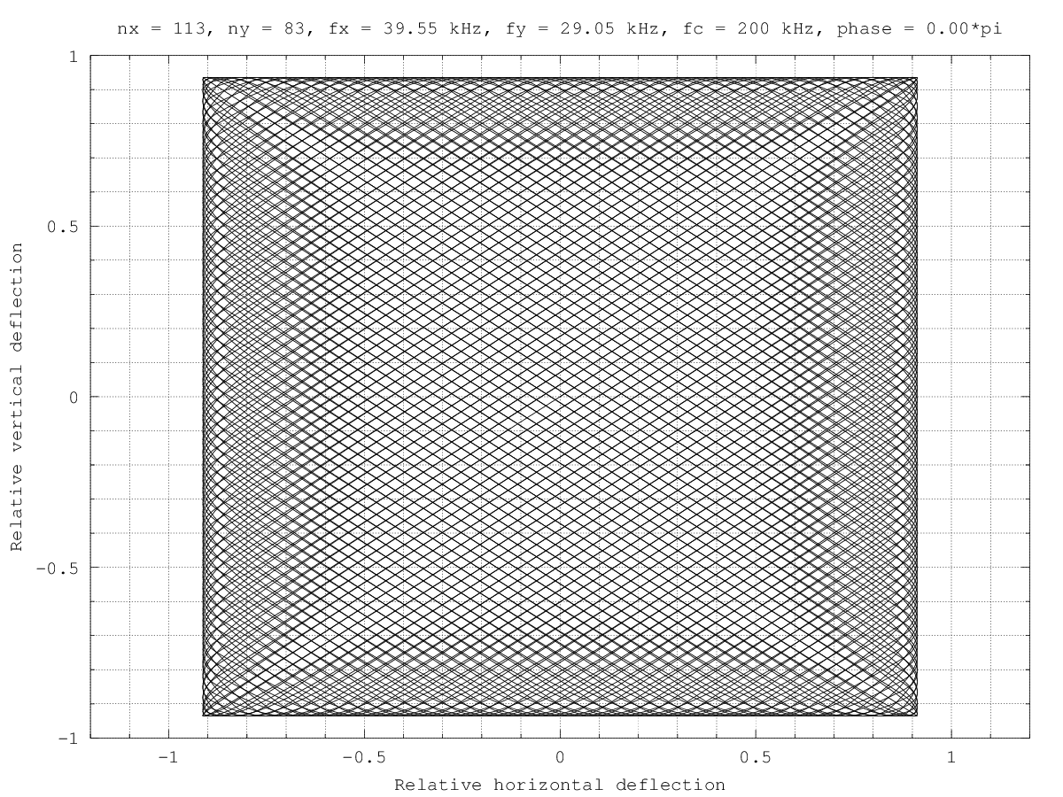
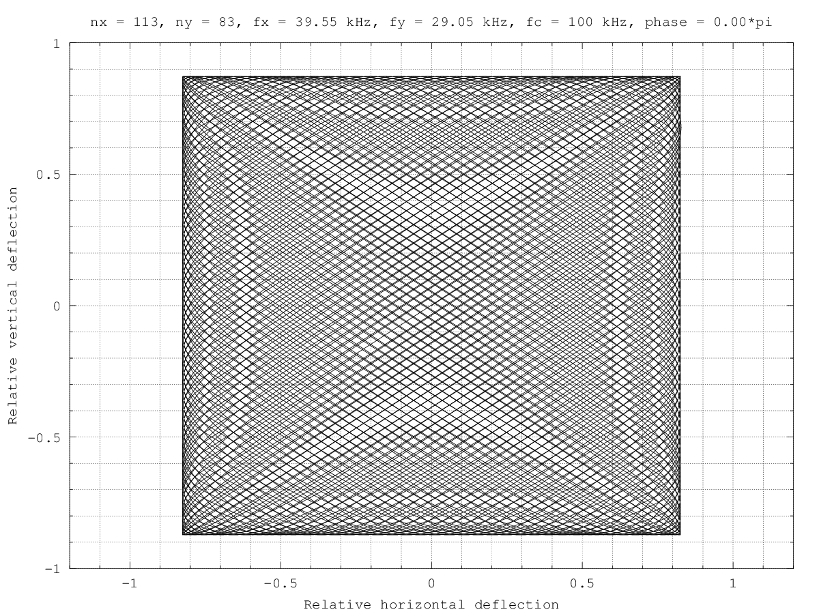
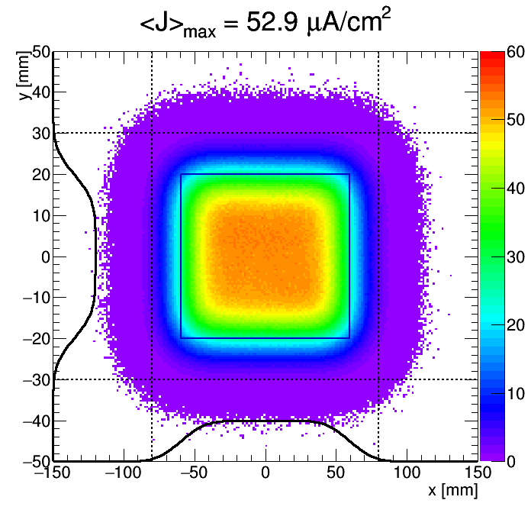
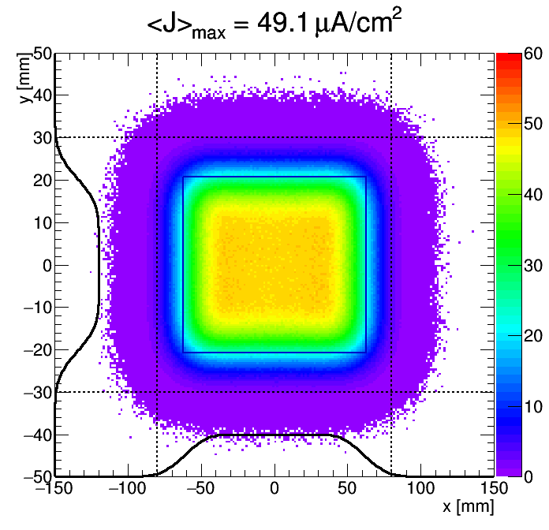
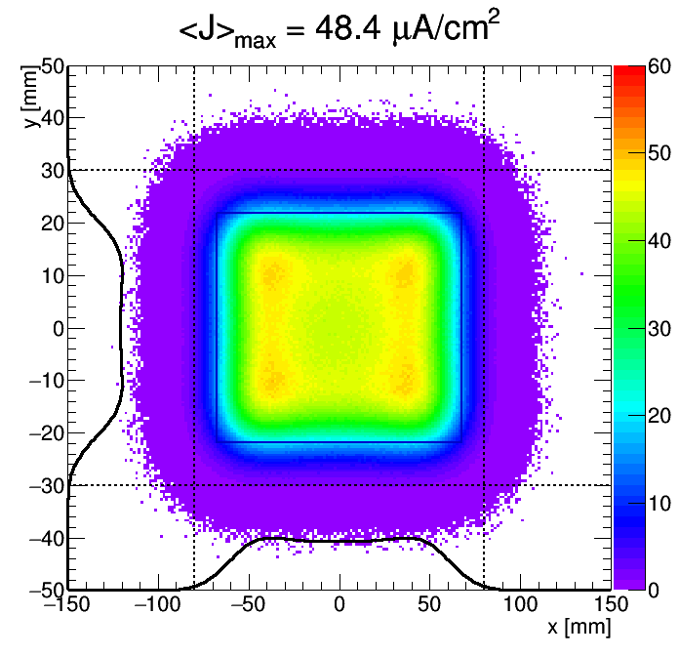
RSM Waveform Bandwidth
f_{c} = Inf
f_{c} = 200 kHz
f_{c} = 100 kHz

Slide 23
Block Diagram & Interfaces
Interface control documents are to be agreed upon before detailed design is completed

Slide 24
Questions?

Slide 25
Interfaces

Slide 26
RSM Failure Detection?
RSM Supply: (Danfysik)
Raster pulse relative to trigger from timing system
Capacitor charge supply
General supply status
DC link voltage discrepancy from setpoint
Temperatures: magnet and supply
Fault Detection Unit: (ZHAW + ESS)
Input:
Bdot loops in each magnet
Idot current transformers in each supply (square wfms)
RSM supply status (cf. above)
BPMs near target?
Wfm analysis:
Point by point comparison of actual (current, voltage) waveforms and anticipated waveforms (tabulated upon configuration)?
FFT?
Output:
Interface to ESS Beam Interlock System (BIS): Initiates beam abort
Details, implementation, redundancy is to be analyzed in collaboration with experts from ZHAW.
Notes:
http://accelconf.web.cern.ch/accelconf/l98/PAPERS/TU4089.PDF

Slide 27
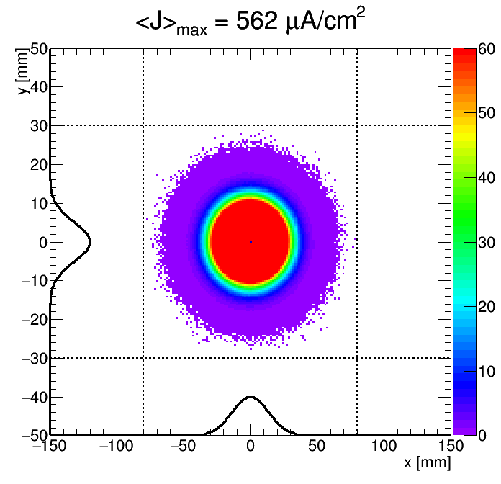
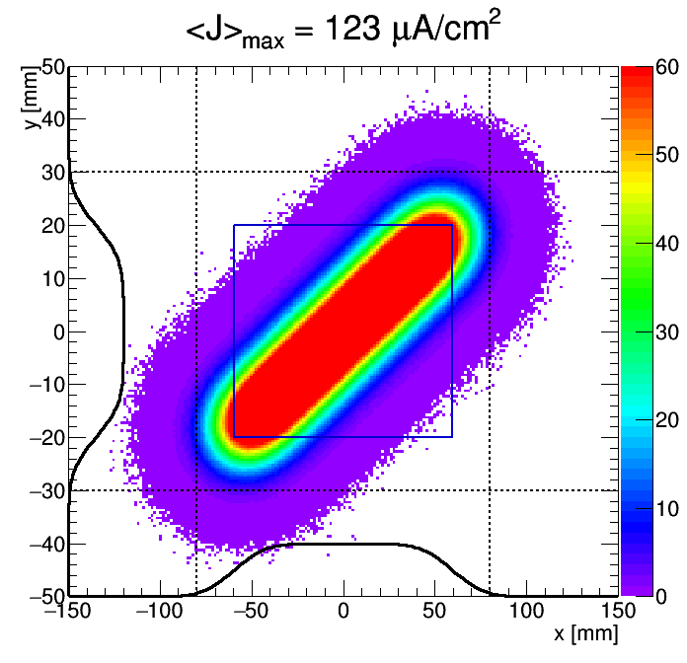
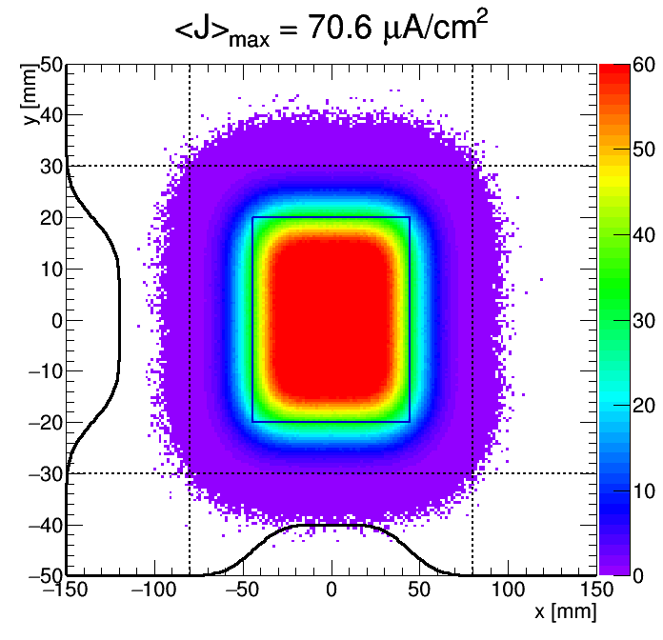
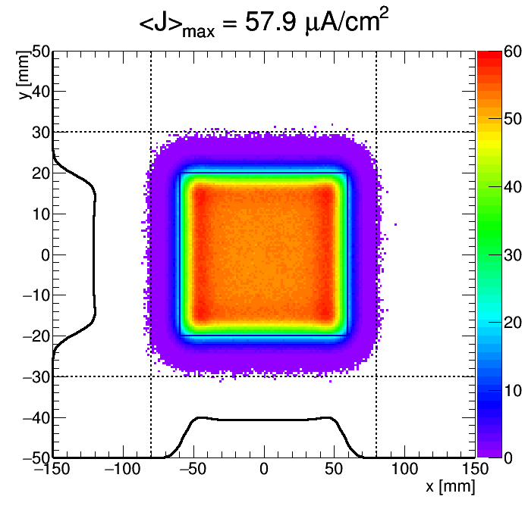
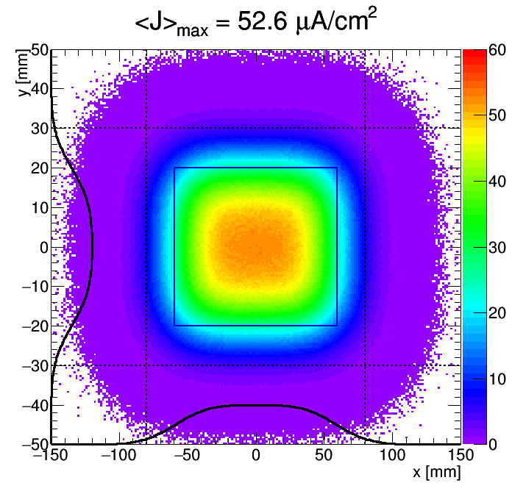
RSM Failure?
Figure of merit:
Peak current density (J_{max}) on target
Beam outside nominal footprint regions
Nominal
No rastering
f_{x} = f_{y}
Loss of 1 H RSM
50% smaller beam size
50% larger beam size

Slide 28
RAMI
Incident | Type | Occurence | Impact | Time to recover | Preventive measures
1 x power supply failure | Random | < 1 / y | Not harmful for short periods | < 10 min. by adjusting the remaining 3 RSMs. | Monitor internal operating temperatures
8 x power supply failure | Random, common mode (central system failure, configuration) | ? | Single pulse: not harmful | < 10 min. depending on cause | High degree of parallel redundancy, BIS
 |  |  | Multiple pulses: PBW / target failure | 1-6 months
Cable, coil insulation deterioration | Lifetime | 1 / 5-10 y? | Not harmful, assuming a localized sudden event | Minutes | Regular inspection for embrittlement
Vacuum leak | Random (following replacements, alignment) | ? | Could prevent operation (beam loss on res. gas) | 1-2 days depending on cool down time and preparation | Monitor pressure near raster section
Redundant system of raster magnets with strength contingency allows for a quick recovery
Supplies are located in GSA: is access during operation possible?
Supplier has been asked to provide list of expected component lifetimes in radiation fields

Slide 29
Electrical Interfaces
Racks
Conventional power
Grounding

Slide 30
Questions?

