Slide 1
Raster Scanning Magnet System
Vacuum Interfaces
Fabio Ravelli
Vacuum System Engineer
Specialized Technical Service – Vacuum
www.europeanspallationsource.se
22 June 2016, Danfysik A/S DK

Slide 2
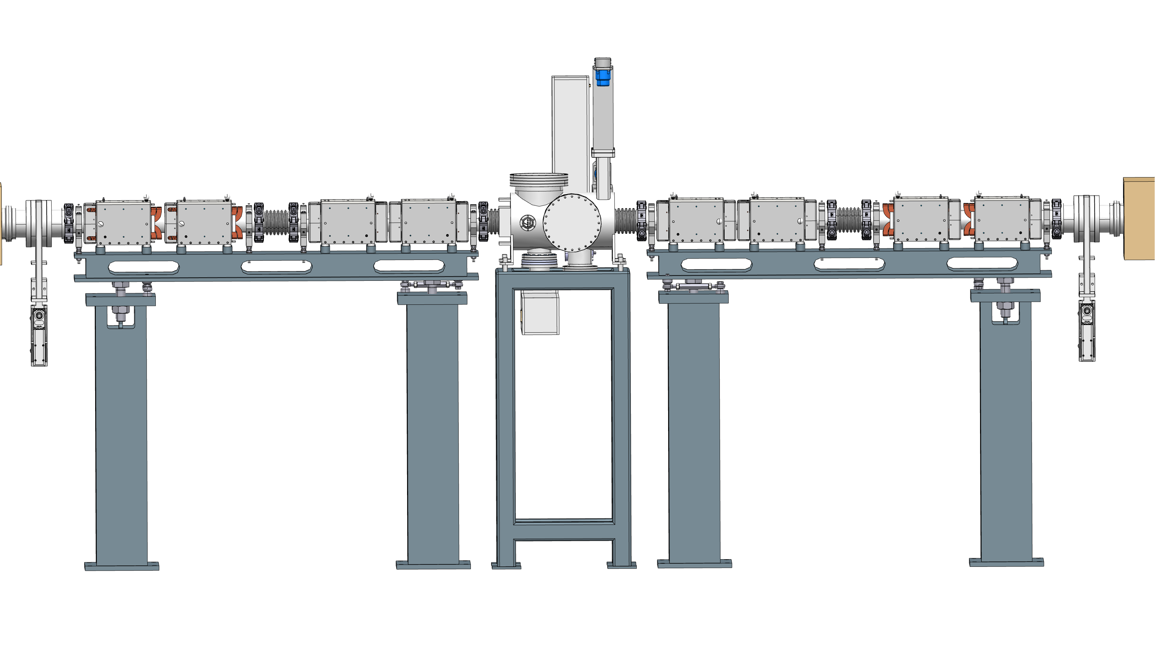
Lay-Out & Rules of the Game
Pumping unit is LWU, IKC from STFC Daresbury,
RSM System shall be delivery “ready for vacuum”, clean for UHV and pack/transported properly, (Ref. ESS Vacuum Handbook)
Vacuum related drawings shall be approved by ESS Vacuum team before fabrication,
Leak rate and RGA results (Ref. ESS Vacuum Handbook) shall be provide prior shipment,

Slide 3
Lay-Out & Rules of the Game
QUESTION: are the holding frames included in Danfysik IKC?
Pumping unit is LWU, IKC from STFC Daresbury,
RSM System shall be delivery “ready for vacuum”, clean for UHV and packed properly (Ref. ESS Vacuum Handbook)
Vacuum related drawings shall be approved by ESS Vacuum team before fabrication,
Leak rate and RGA results (Ref. ESS Vacuum Handbook) shall be provide prior shipment,

Slide 4
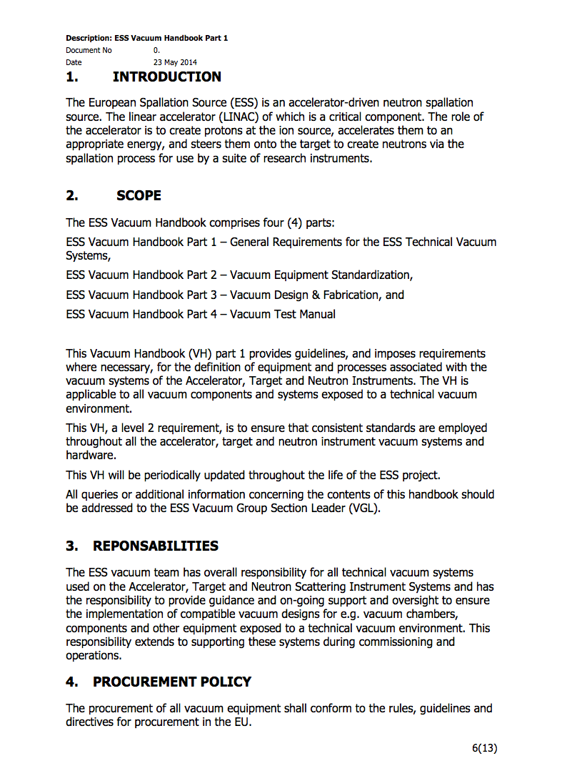
Design per ESS Vacuum Handbook
ESS Vacuum Handbook as main document, cover all requirements for accelerator, target and instruments,
Vacuum Policy applied for all “in kind” contributions.
In the Handbook spec. leak rate, accepted materials, cleaning procedure
http://europeanspallationsource.se/accelerator-documents

Slide 5
Mechanical Interfaces, bellows
Hydro-formed bellows, min ID 120 mm, material 304/316, minimum cycles 1000
Flanged NW160, Clamped CF Style, from MKT, for quick maintenance

Slide 6
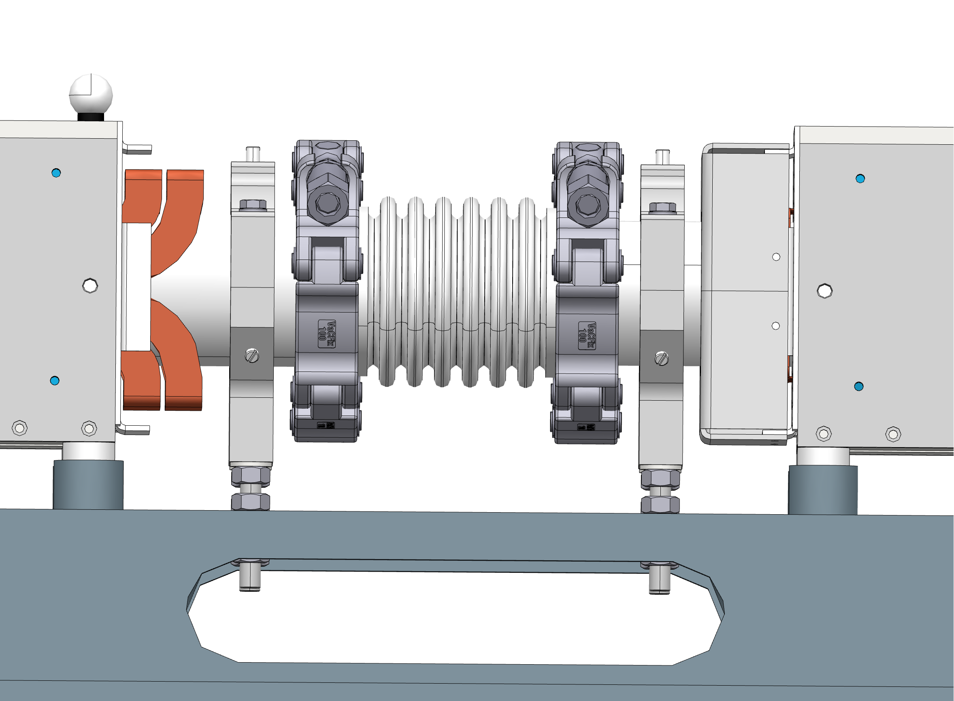
Mechanical Interfaces, bellows

Slide 7
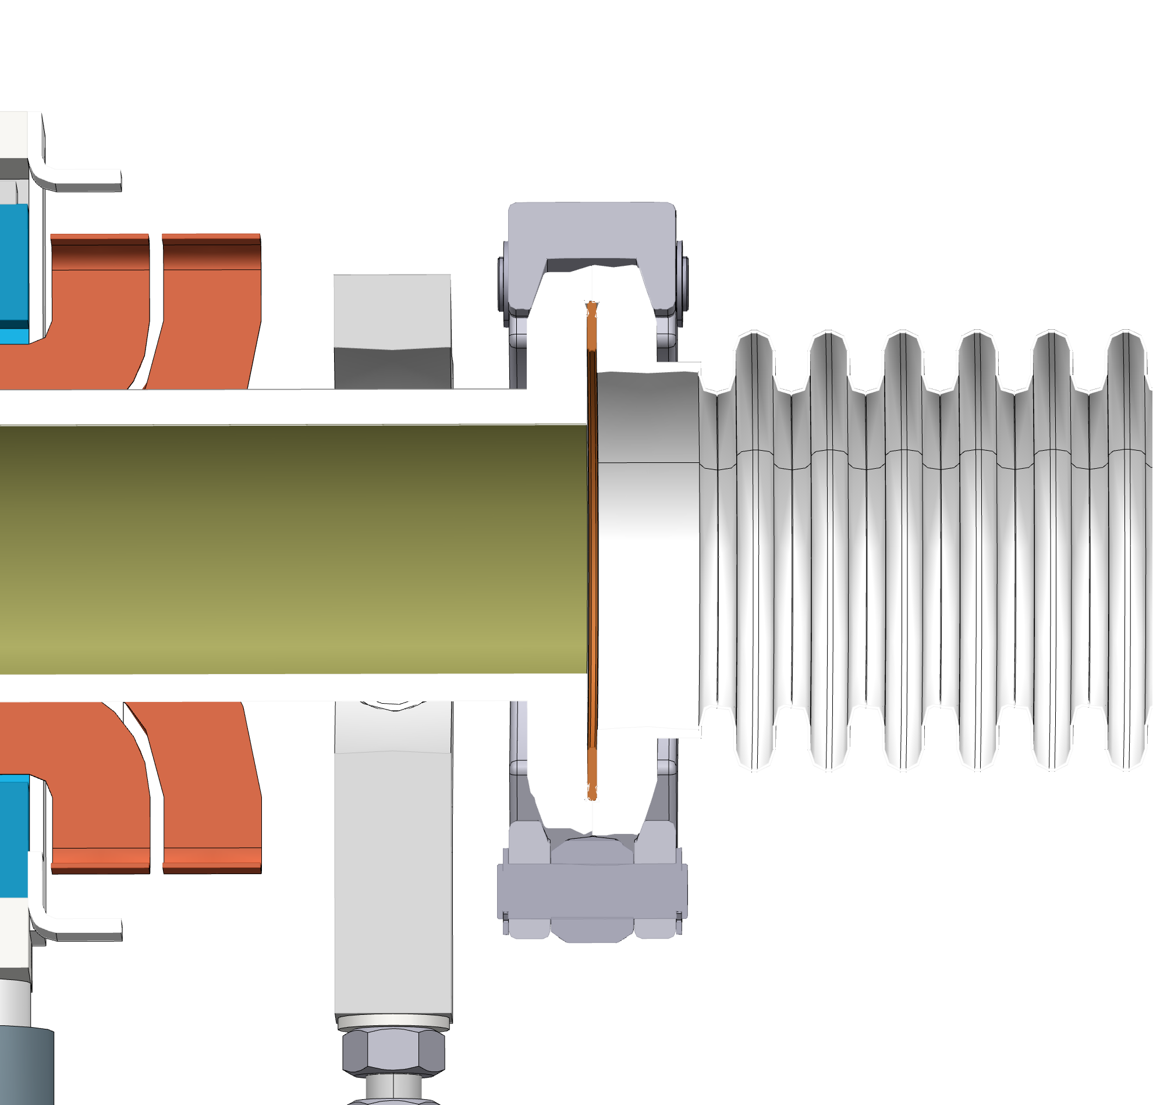
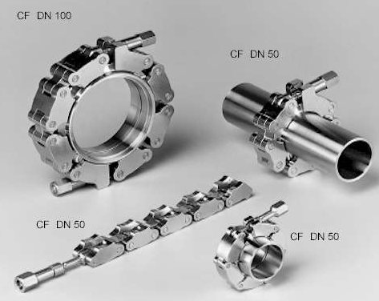
Mechanical Interfaces, flanges
For additional info and help:
Fabio Ravelli, Fabio.Ravelli@esss.se Vacuum System Engineer
Thomas Grandsaert, Thomas.Grandsaert@esss.se Mechanical Design Engineer

Slide 8
Questions
Timeline, delivery of RMS to ESS
Is the Installation in the tunnel responsibility of ESS? Vacuum chambers, magnets?

Slide 9

Thank you for your attention!

