Slide 1
Target Project Status
Rikard Linander
Deputy Head of Target Division
www.europeanspallationsource.se
July 6, 2016

Slide 2
Outline
Organization
Update on all work packages
Project execution performance
Progress on Securing In-Kind Partners
Issues
Concluding remarks

Slide 3
Target Project Management Change
Irmgard Zerrle has accepted the position as Interface Coordinator, starting beginning of November
Rikard Linander appointed as Deputy Head of Target Division, starting mid May
Magnus Göhran assumes the role as acting Group Leader for Monolith and Handling group

Slide 4
Target division organizational structure has remained stable for the past 2 years
TARGET DIVISION
Eric Pitcher
Head of Division
Rikard Linander
Deputy Head of Division
Carina Blixt
Administrative Assistant
Target Controls Group Linda Coney (GL) Atefeh Adeghzadeh
Mikael Olsson (C)
Jan Espen Presteng (C)
Monolith & Handling Group
Magnus Göhran (Act GL) Daniel Lyngh Ulf Odén
Naja de la Cour
Marc Kickulies
Kristoffer Sjögreen
John Jurns (M)
Markus Andersson (C)
Lennart Åström (C)
Reinhard Blum (C)
Paul Erterius (C)
Jens Harborn (C)
Rickard Holmberg (C)
Bengt Jönsson (C)
Jarich Koning (C)
Mikael Möller (C)
Eldin Mukovic (C) Anders Olsson (C)
Jesper Ringnér (C)
Srdjan Vareskic (C)
Mattias Wilborgsson (C)
Federico Masi (IKS)
Materials Group Yongjoong Lee (GL) Monika Hartl
Srinivasan Iyengar
Jemilia Habainy (S)
Neutronics Group Luca Zanini (GL) Konstantin Batkov Alan Takibayev
Esben Klinkby (C)
Nicolò Borgo (S)
Zsofia Kokai (S)
Target Physics Group Günter Muhrer (GL) Riccardo Bevilacqua
Fluid Systems Group Håkan Carlsson (GL) Per Nilsson Andrea Polato
Klaudiusz Dybowski (C)
Leif Emås (C)
Björn Eriksson (C)
Allan Lundgren (C)
Anna Bieliaieva
Coordination & Planning
Tobias Lexholm Installation Coordinator
Irmgard Zerrle Interface Coordinator
Anders Ingels (M) Project Planner
12.1 Management and Administration
12.7 Controls
Linda Coney (WPM)
12.8 Physics
Günter Muhrer (WPM)
12.5 Fluid Systems
Håkan Carlsson (WPM)
12.2 Target System
Ulf Odén (WPM)
(GL) Group Leader
(C) Contractor or Consultant
(M) Matrixed
(S) Student (IKS) In-Kind Secondment
12.3 Moderator & Reflector Systems
Daniel Lyngh (WPM) Marc Kickulies (Act WPM)
12.4 Monolith Systems
Rikard Linander (Act WPM)
12.6 Remote Handling Systems
Magnus Göhran (WPM)

Slide 5
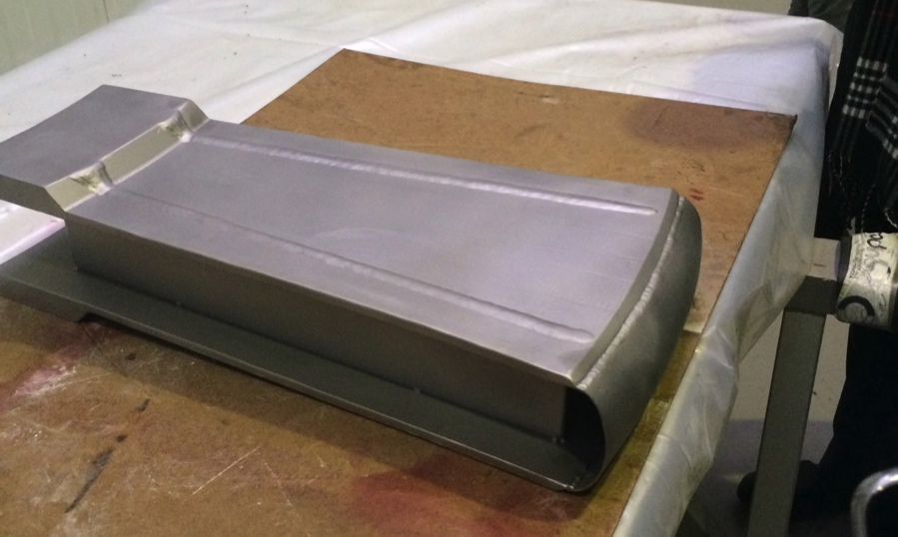
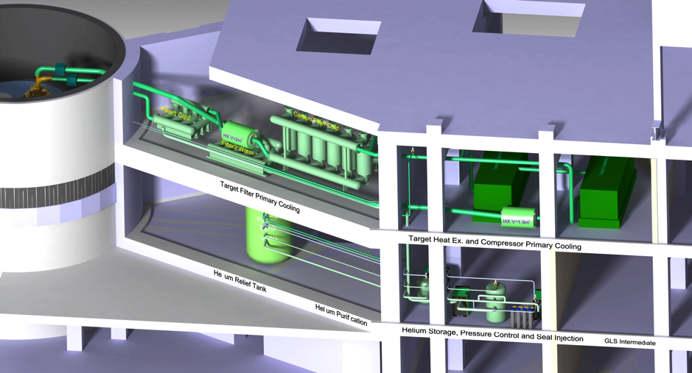
WP2: Target Systems
Target Wheel, Drive & Shaft
ESS-Bilbao team performing detailed design and prototyping
CDR for spallation material and cassettes scheduled for September, delayed two months due to urgent need of additional accident event analyses (see below)
Target Helium Cooling System
CDR for the helium circulator of the target cooling system, conducted June 1
Accident analyses supporting the PSAR
ESS-Bilbao team performing accident event analyses to support safety case assessment
Nuclide inventories in helium, filters and getters calculated
Target Wheel Sector Prototype
Target Helium Cooling System

Slide 6
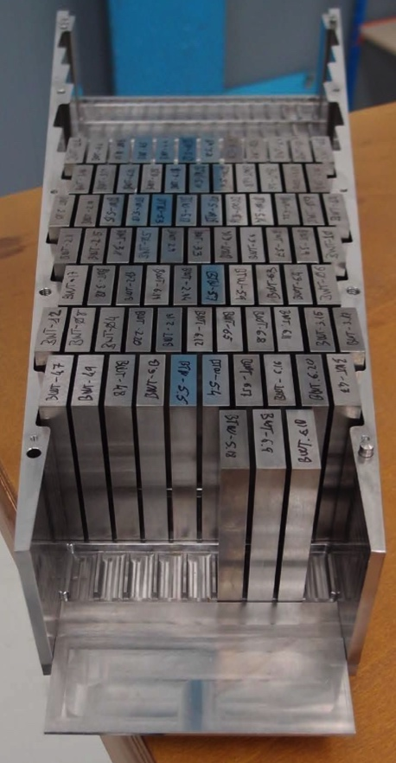
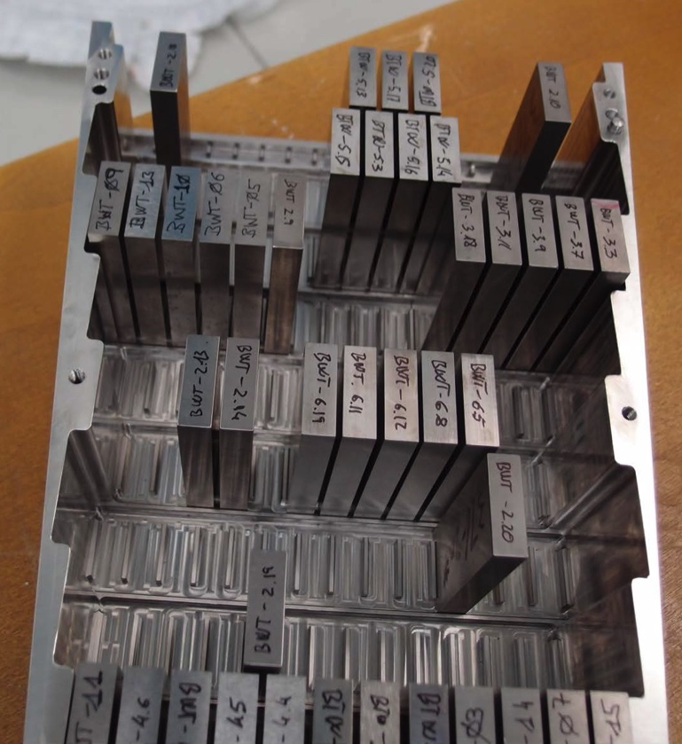
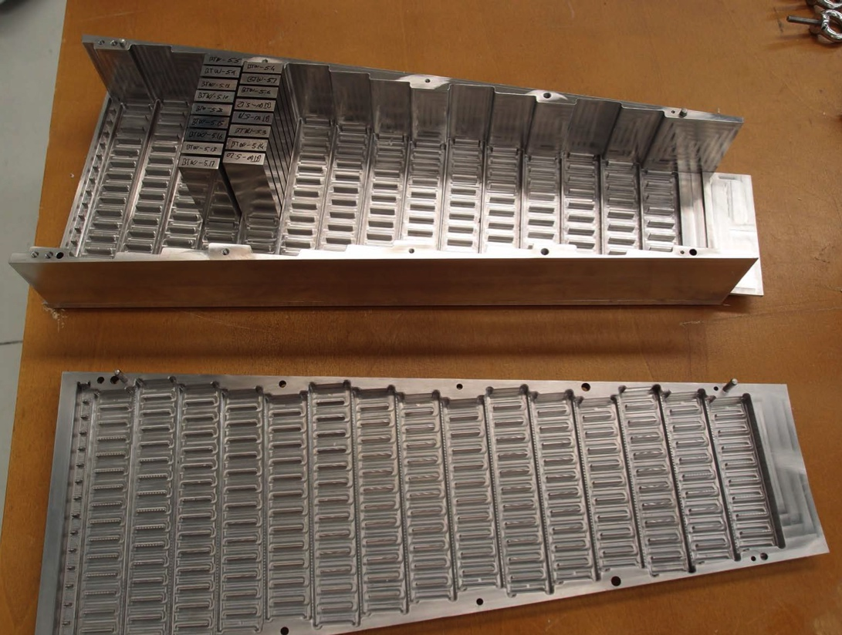
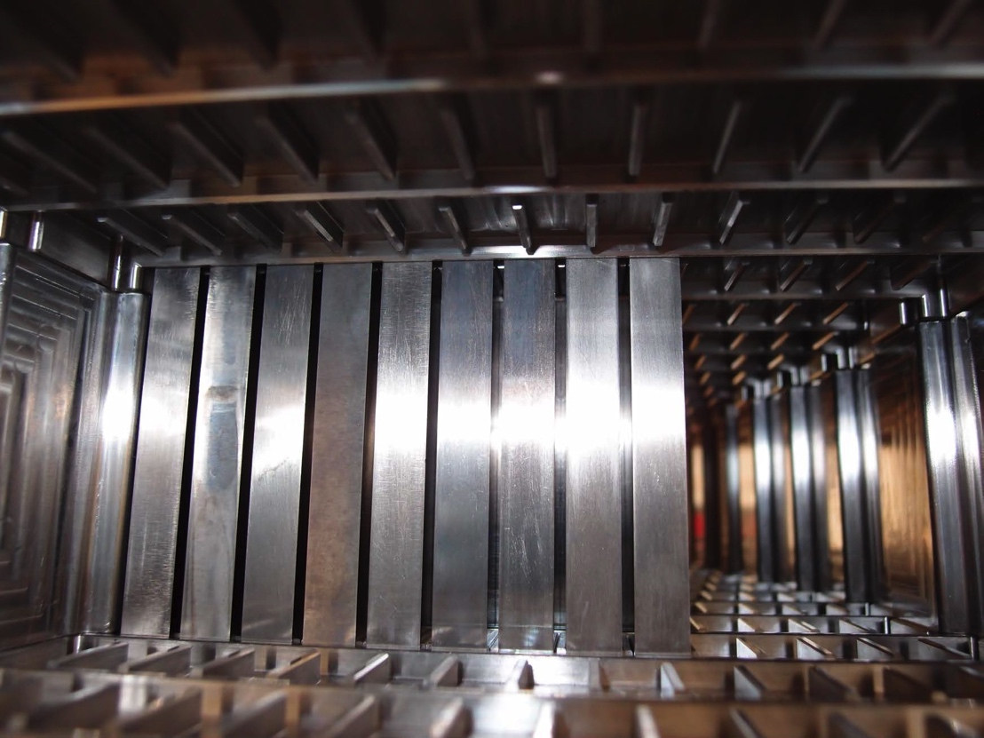
Second target cassette prototype
Assembly test of second cassette prototype conducted
Up to 100 tungsten bricks successfully fitted in different patterns

Slide 7
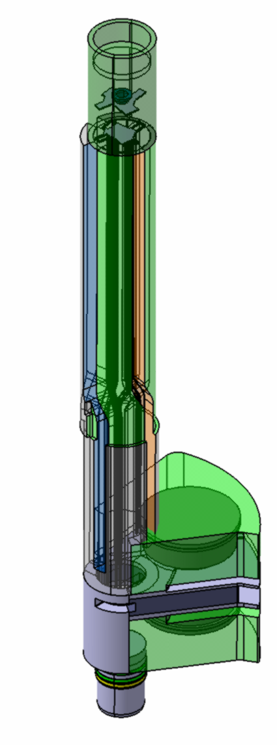
WP3: Moderator and Reflector Systems
Design and prototyping work for the MR plug structures underway by FZJ
Helium cryoplant contract awarded on schedule
Linde selected as the supplier
Change Request for cost decrease of Helium Cryoplant is approved in Program CCB
Bilateral research contract between ESS ERIC and FZ Jülich signed
First payment 50% has been effectuated
FZJ is now able to report actual progress
Preliminary design approved for three work units
Moderator Reflector,
Hydrogen Cryoplant
Helium Cryoplant
4 CDRs are performed;
Rotation Unit – with minor comments
Be specification – with minor comments
LH2 pumps specification – need improvements
LH2 transfer line specification – need improvements
Upcoming CDRs:
Reflector vessel and measuring plug: August
Thermal and cold moderators: September
Cryostat and twister: December
MR Plug

Slide 8
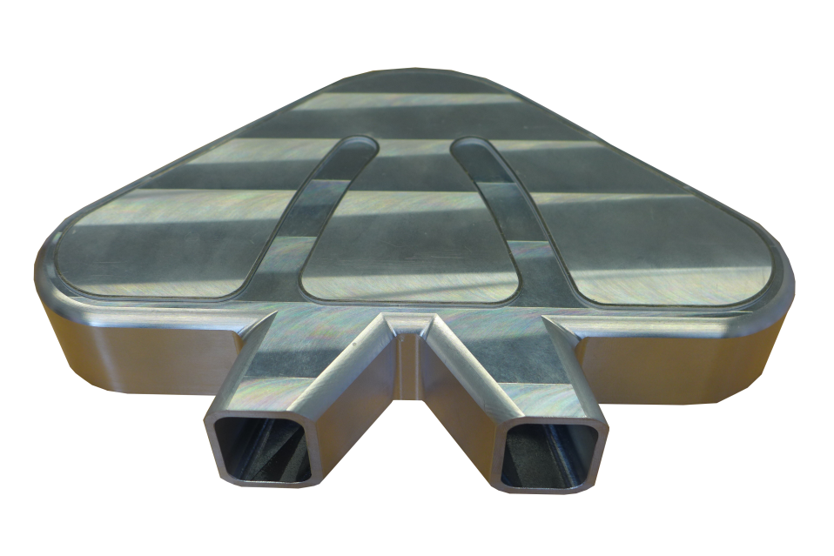
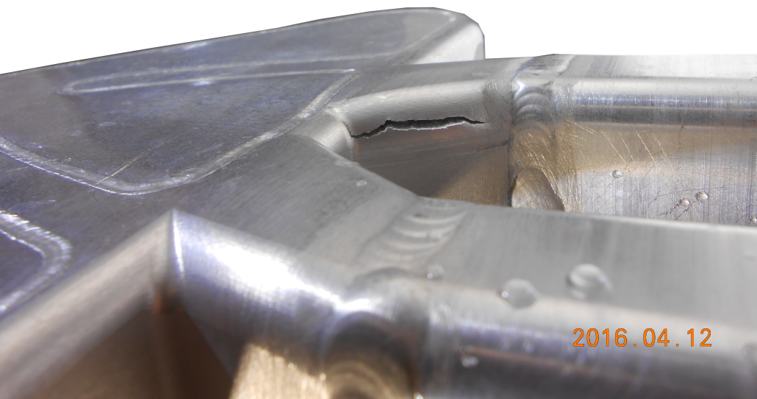
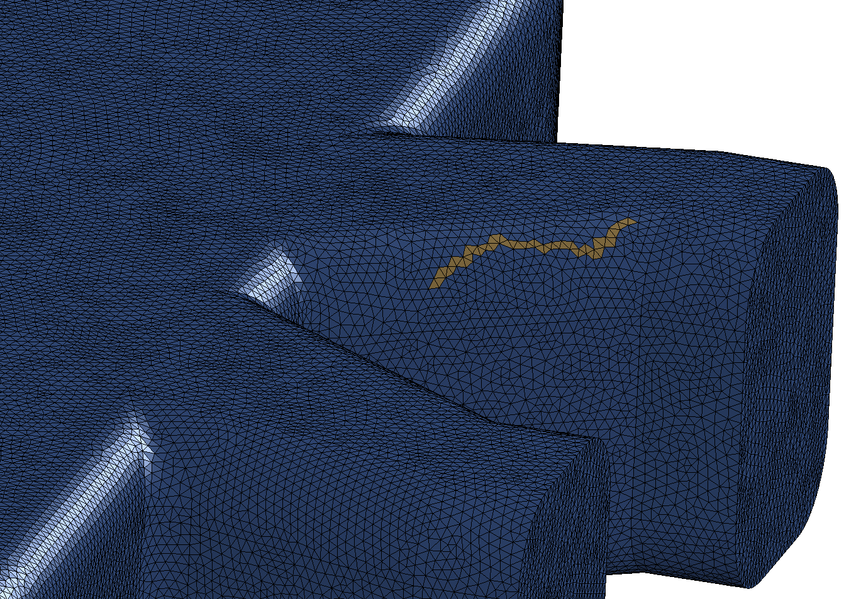
Cold moderator prototype tests at FZJ
Cold moderator prototype in Aluminium 6061-T6
Crack resulting from the burst test at 200 bars, compared to simulated crack formation in FE model

Slide 9
WP4: Monolith Systems
Conducted 6 PDRs
Monolith Vessel
ECHIR Embedment
Proton Beam Instrumentation Plug
Monolith Atmosphere and Vacuum Pump Systems
Irradiation Module
Tuning Beam Dump Shielding
Planned 1 PDRs, near term
Neutron Beam Extraction System (July 7)
PDR for Proton Beam Window delayed until September due to re-prioritizing resources to work on safety case analyses
Design progress on:
steel shielding (internal and external)
integrated neutron beam extraction system, neutron beam window, and light shutter
ESS-Bilbao is evaluating the viability and cost of performing monolith vessel welds that are compliant with RCC-MRx and concurrently to vacuum standards

Slide 10
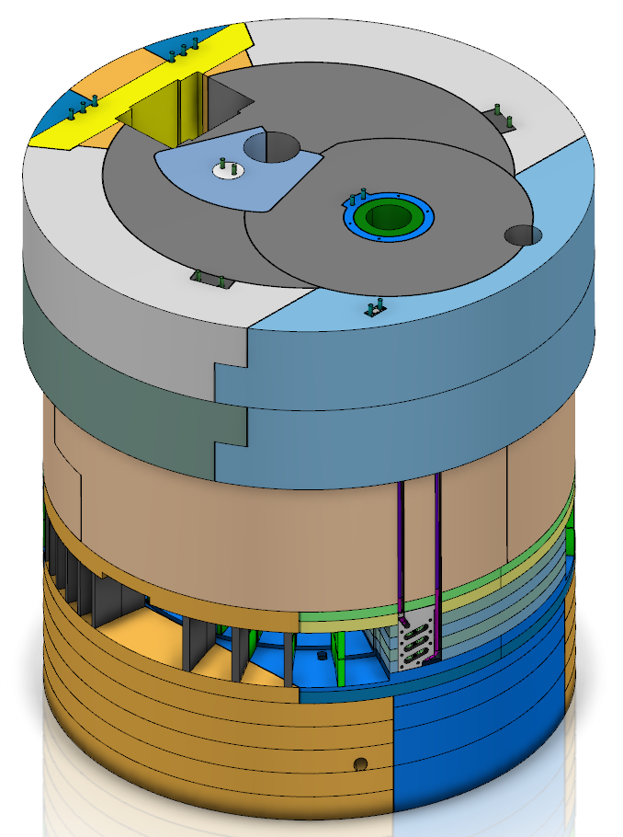
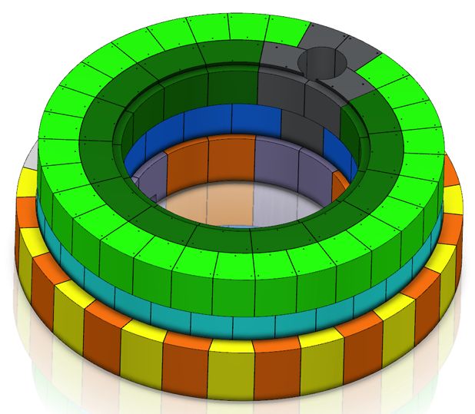
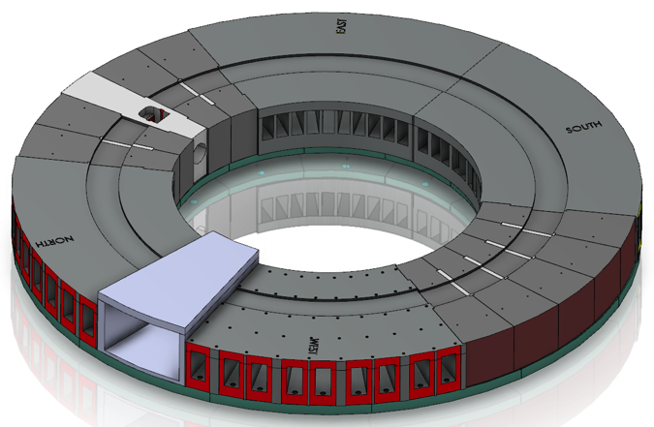
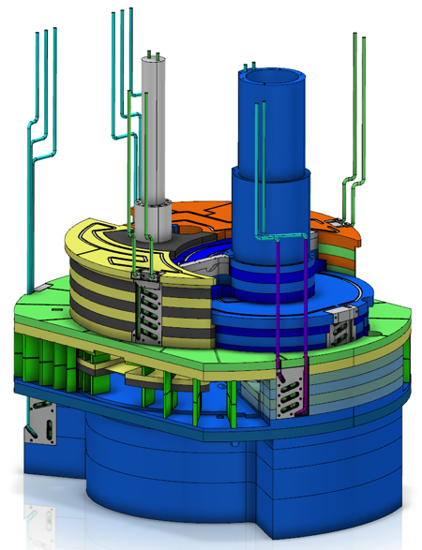
Significant progress on monolith shield design
Monolith outer shielding
Stacked steel blocks (installation and decommissioning)
Staggered and stepped (neutron streaming)
Interlocked (earthquake)
Modular (minimum number of shapes)
About 1600 tons of material
Baseplate
12 segments anchored to concrete foundation
High manufacturing and installation precision
Distributes upper mass loads to concrete foundation
Port blocks
Neutron beam port blocks (4 normal + nnbar)
Proton beam port block
Filling blocks
Monolith inner shielding
Stacked steel blocks (access to internals)
Water-cooled blocks
Upper removable blocks
Peripheral blocks
Staggered and stepped (neutron streaming)
Interlocked (earthquake)
Unique blocks (adapting to internals and beam extraction needs)
About 1000 tons of material

Slide 11
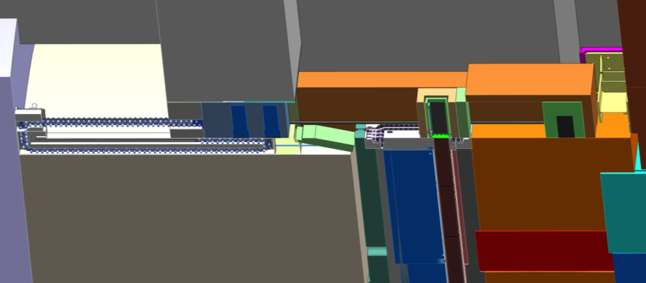
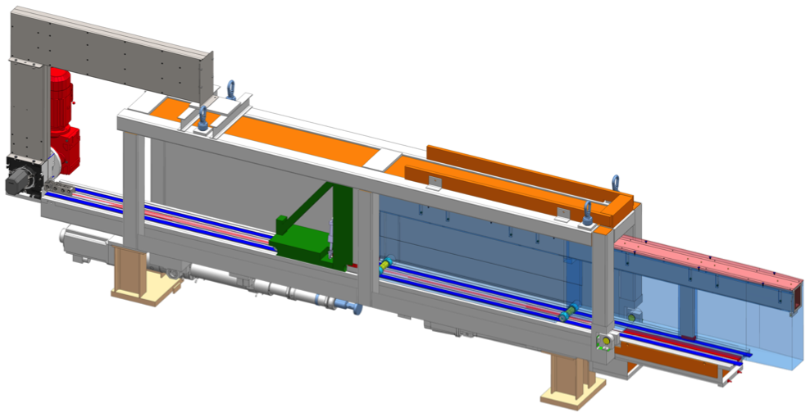
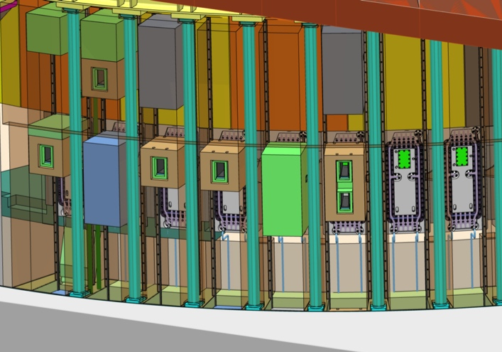
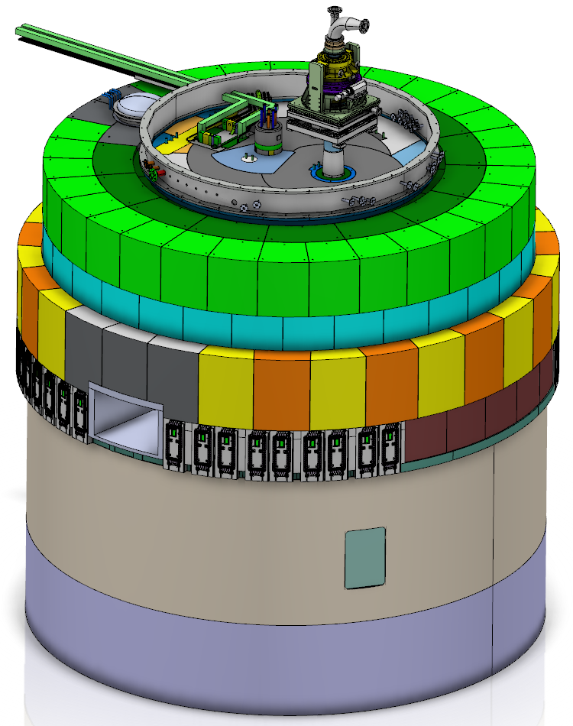
Significant progress on neutron beam extraction
Examples of possible configurations of light shutters
Handling tool
Shutter drive in basement
Neutron beam extraction system
42 neutron beam ports, whereof
39 normal modular beam ports
3 beam ports within the superstructure of the nnbar port
One fast neutron beam port for ESS chip irradiation (ECHIR) station
Double decker neutron beam port inserts with capability to view either the upper or the lower moderators
Light shutters with drive and handling mechanisms in the basement rooms
Handling tool for neutron beam port inserts replacement
Neutron beam port insert
nnbar port
Neutron beam ports
ECHIR port

Slide 12
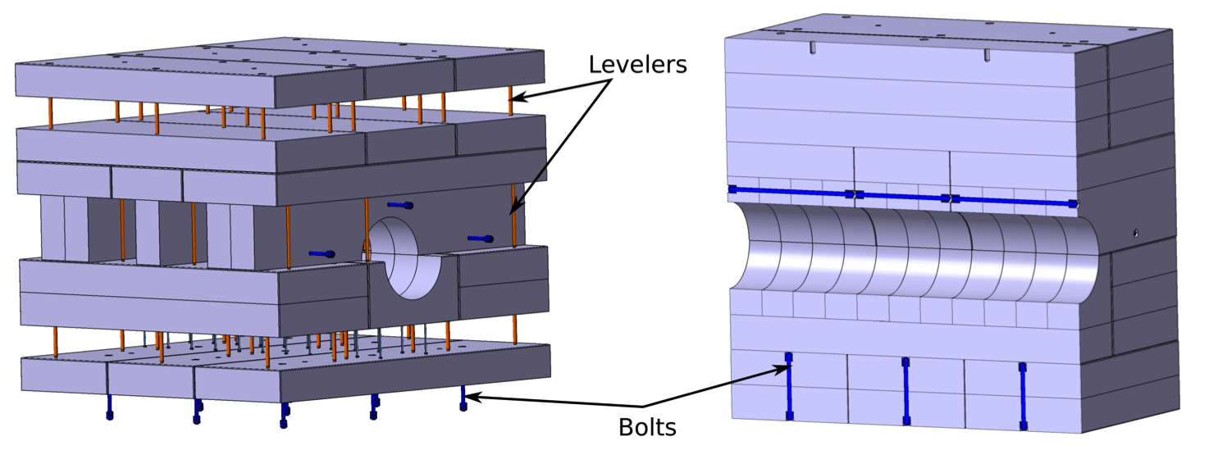
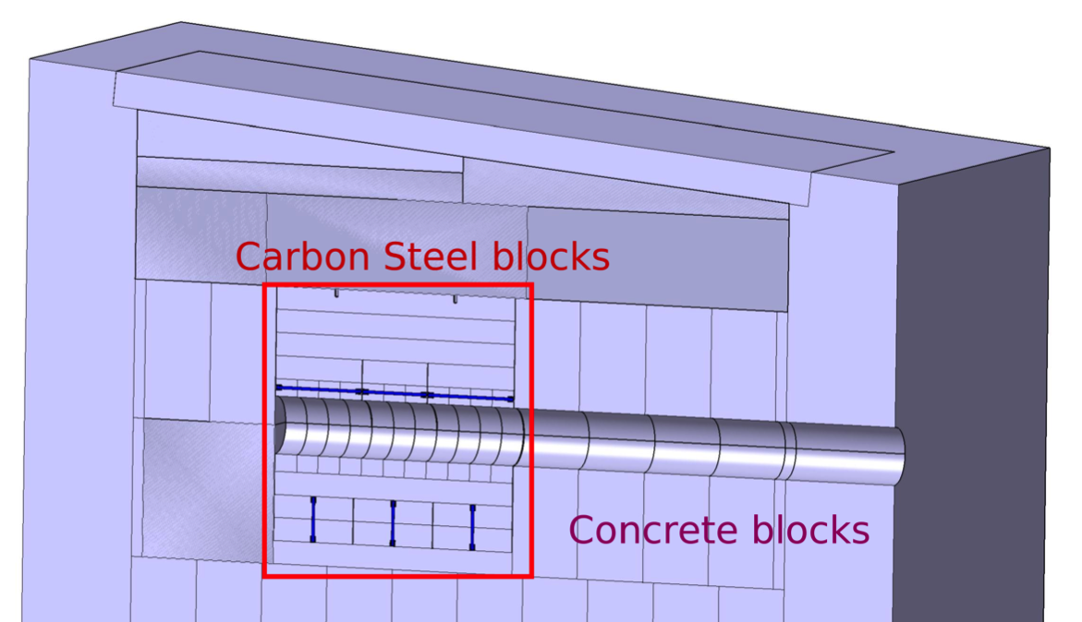
Tuning beam dump shielding, final design
PDR and CDR on July 5
On-going coordination with CF/SEC to match possible delivery dates with suitable opportunity for installation of
concrete blocks
steel blocks

Slide 13
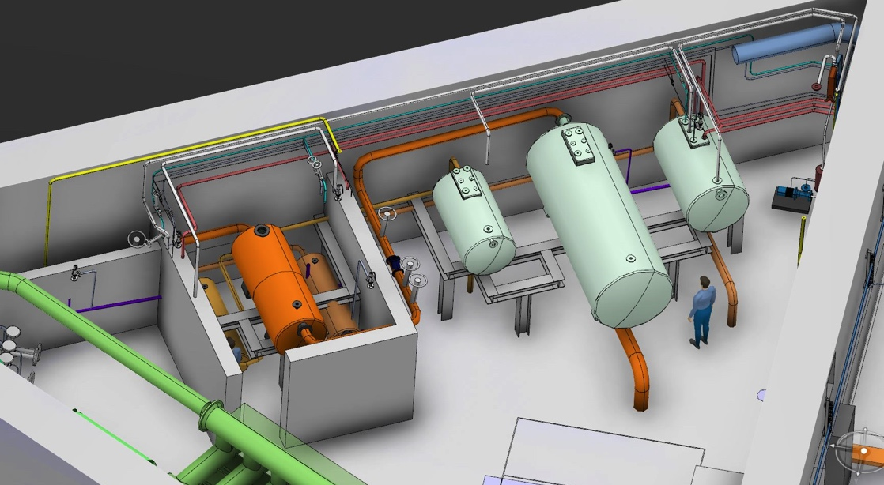
WP5: Fluid Systems
Updated the layout so that all primary water loop components are confined to the triangular utility rooms
Conducted 3 PDRs
Water Purification System
Water Drainage System
Radiolysis Gas Treatment System
Working with IK partner’s (UJF) contractor, Nuvia, to clarify the scope of work and schedule for the primary and intermediate water systems, and Target HVAC
Performed accident analyses for the Target HVAC and water systems in support of the design and PSAR
Utility Room Layout Level 110 Triangular Room
Delay tanks
Control Valves
GLS tanks

Slide 14
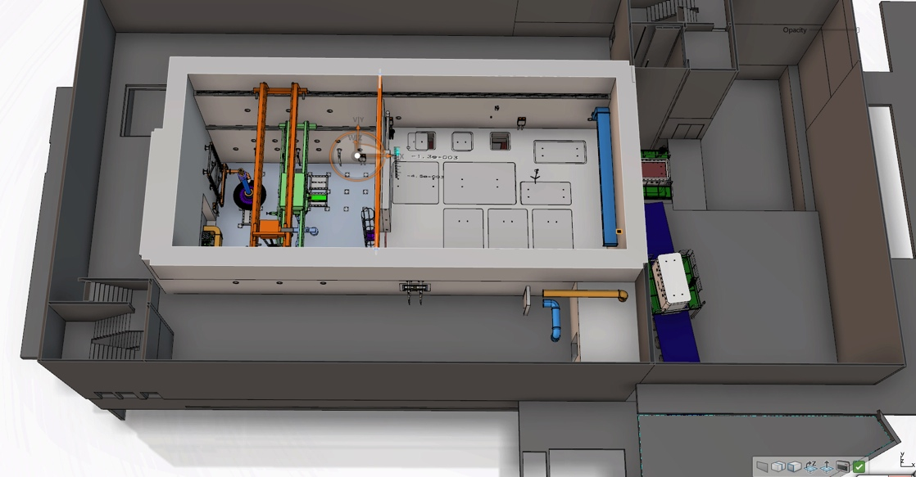
WP6: Remote Handling Systems
Progress on active cells liner package is according to plan
Stainless steel liner package, part one, manufactured and awaiting delivery to site
Media penetrations package awarded to RFR Solutions
Shielding lead package quotes under evaluation
Stainless steel liner package, part two, quotes under evaluation
Complementary accident scenario analyses are on-going
In-kind partner is not yet reporting progress, but work is on-going according to draft schedule
Requirements workshop in mid June, with participants from ESS Lund and UKAEA
PDR for shielded casks and mock-up & test stands planned for September
Storage Pits
Transfer Area
Shipment
Technical Galleries
Process Cell
Maintenance Cell

Slide 15
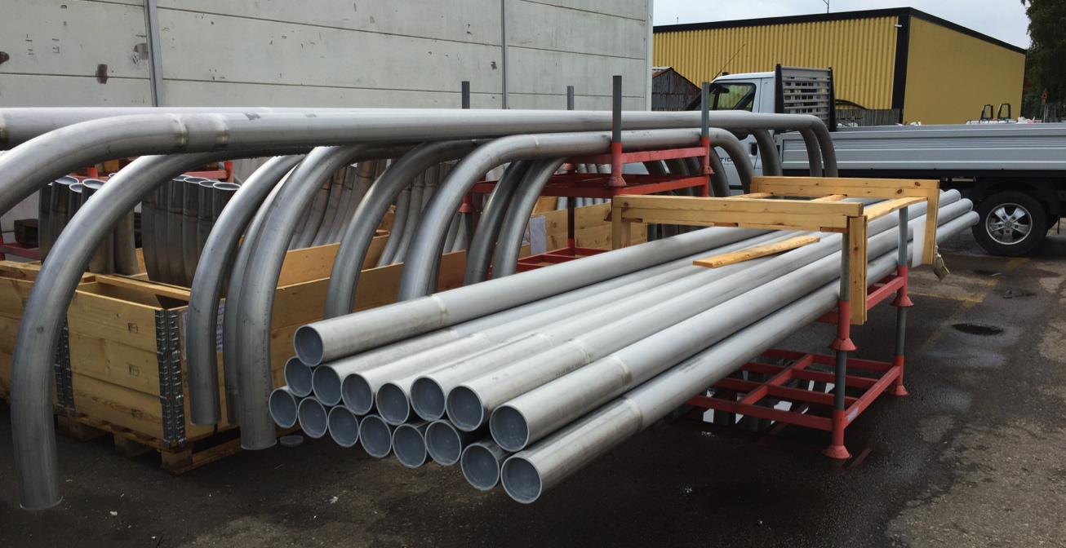
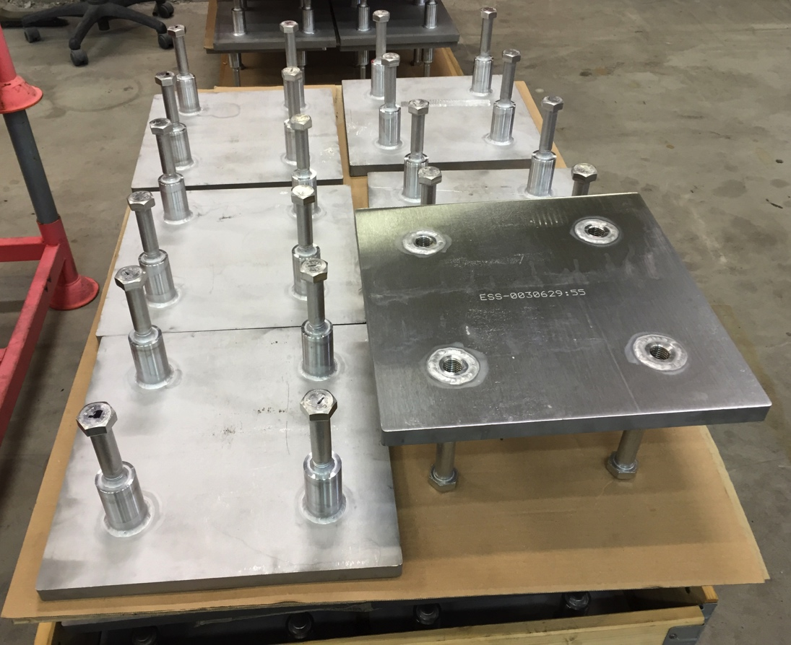
Fabrication of Active Cells embedment structures
Wall and floor anchor plates …
… and electrical conduits, awaiting factory acceptance tests and transportation to site.

Slide 16
WP7: Controls
Completed qualitative hazards analyses for all Target systems for operations
Qualitative analyses for maintenance on-going, to be completed by end of June
Coordinated and guided the accident analyses included in the PSAR
First 7 cases completed for the SSM application
Remaining 14 cases in progress
Conducted PDR for Pilot Target Safety System in February
Constructed a test stand for Target Safety System component testing

Slide 17
Radiation Hazards Analysis and Safety Functions
Hazards analyses identified 350 events from which 21 were deemed “bounding”
Bounding events for operations:
8 events with abnormal heating of tungsten due to beam excursions or loss of cooling
6 events associated with the Active Cells
5 events associated with water leaks, hydrogen explosion or fire, chopper malfunction, and errant beam on tuning beam dump
2 events associated with earthquake
Additional bounding events for maintenance will be selected by end of June
Safety functions identified:
Safety related SSCs
Helium loop components
Helium purification
Utility room ventilation system
Target drive unit and associated control system
...
Safety SSCs
Target Safety System: safety-class beam permit
Personnel Safety System: personnel access control
...

Slide 18
WP8: Target Physics
Calculated radionuclide inventories in:
Tungsten bricks and target shroud
Beryllium reflector
Helium coolant
Moderator-reflector cooling water
Supported all work packages with shielding calculations
Measured rate of back conversion of para-to-ortho due to neutron irradiation at SNS
Applied for beam time at CERN ISOLDE to support measurement of tungsten release factors
Materials Handbook updated regularly
Currently 140 pages covering 27 chapters

Slide 19
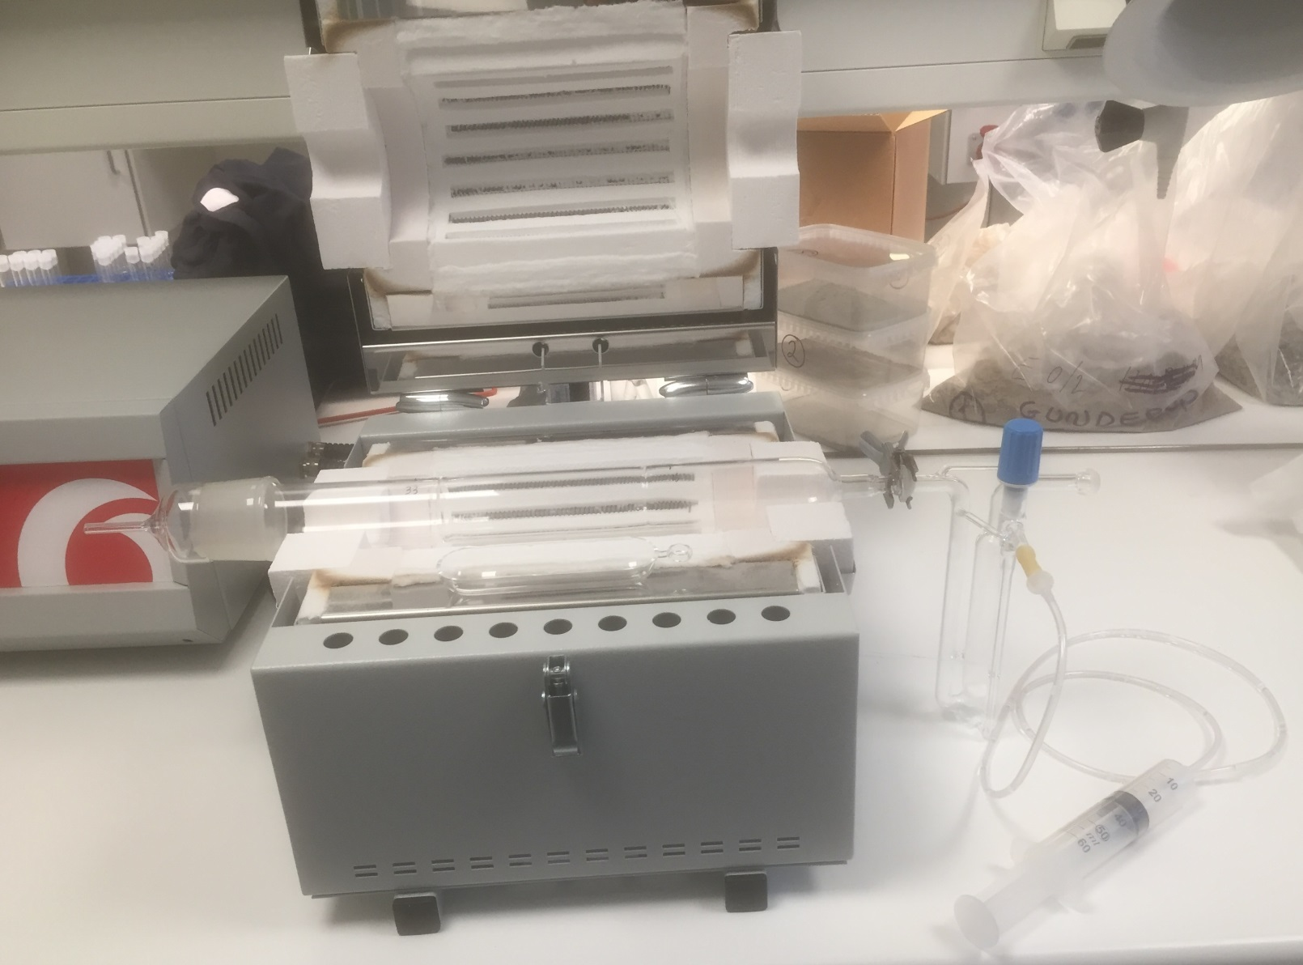
DTU’s setup for measuring release fraction of iodine and bromine at different temperatures
Apparatus capable of taking tungsten sample to 1000°C
Minimum detectable release fraction expected to be 2E-8
irradiated tungsten

Slide 20
Installation and site works
Target project will deliver first hardware to site, during 2016 Q3, for installation
Active Cells concrete embedments for stainless steel liner
ECHIR embedded structure
Cast-in metal shielding
Main installation of target station system will start by end of 2017
Target project installation organization
Interim and minimal organisation to be established by 2016 Q3
Full organisation to be up and running by end of 2017
Large parts of the installation will be performed in parallel with construction works, hence close collaboration and coordination with CF/SEC is essential
Temporary services will be offered by SEC

Slide 21
Provisional Site Organisation for Target Project
Project Organization
Target Site Manager
Deputy Site Manager
QC
Installation Inspection
Receival inspection
NDT (X-ray, PT, UT etc.)
Accredited Inspection Body AIB
Accredited Body AB
Final quality documentation
Site Admin
Document control
Time Schedule
Work Permit
Accommodation (Site & Hotel)
Financial control
Procurement inst. hardware/manpower
NCR (Non Conformity Report)
Installation Supervisors
#1
#2
#3
Temporary Services
Scaffolding
Laydown Areas
Crane Drivers
Logistics/Transport
Warehouse
Heavy lifting
Temporary Power & Fluids
Concrete Boring/Drilling
Survey/Alignment
Waste
In-House 1
Installation Manager
In-Kind 1
Installation Manager
In-House 2
Installation Manager
In-Kind 2
Installation Manager
In-House 3
Installation Manager
In-Kind 3
Installation Manager
In-House 4
Installation Manager
In-Kind 4
Installation Manager

Slide 22
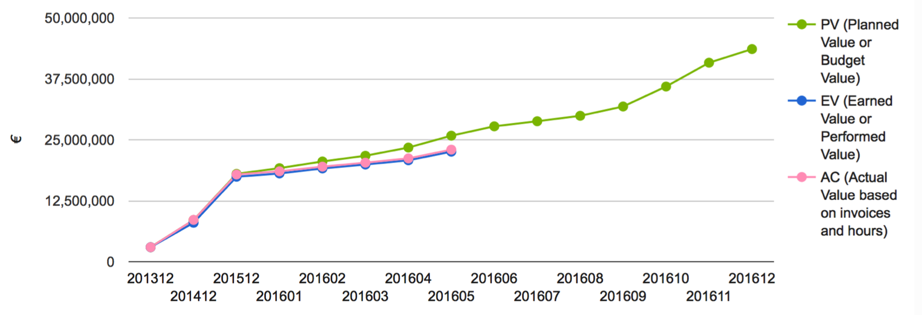
EV Performance
Schedule variance due to:
Under-reporting of work performed by in-kind partners
Delay in Monolith Systems WP due to late design changes and lack of resources

Slide 23
Target Schedule: Level 1 Milestones
2015
2016
2017
2018
2019
2020
Project Milestones
Target Project End
First Beam on Target
Design
PDR Monolith Shielding System
CDR Target Safety System
CDR Neutron Beam Extraction System
Procurement
Contract Awarded – Helium Cryoplant
Delivery on Site – Floor Embedments
Contract Awarded – Target Spallation Material
Ready for Installation – Bulk Shielding Below Base Plate
Delivery on Site – Cold Moderator Assembly
Delivery on site – Target Wheel
Delivery on site – Monolith Vessel
Installation
Installation Complete – Helium Cryoplant
Complete SAT – Monolith Vessel
Installation Complete – Liquid Hydrogen System
Commissioning
Integrated System Test (without proton beam) completed
Integrated System Test (with proton beam) completed

Slide 24
Partner Selection for Target Project IKCs
18 of 22 Target IKC packages released for partnering at four Target Collaboration Meetings held in 2014-2015
Partners selected for 16 packages
No partners expressed interest in 2 of the packages
The remaining 4 packages will be released this year
2 are being revised to reflect progress in Target Station design
All 4 will be released via email notification of parties who have already expressed interest and broad communication (ERIC Council, IKRC, ESS newsletter, …)

Slide 25
Strategy for the six remaining Target Project IKC Packages
TIK.4.1: Target Monitoring Plug - 0.5 M€
Serious interest expressed, partnering likely
Will release for partnering in September 2016
TIK.4.7: Monolith Atmosphere System – 1.3 M€
Released Mar 2015 but no interest from partners
Undergoing revision due to evolution in the design, potential for cost savings
Will be re-released in Q3 2016
TIK.4.8: Monolith Shielding Systems – 14.2 M€
Released June 2015 but no interest from partners
Breaking into several pieces and working to combine some with existing packages
Remainder will be re-released for partnering in Q3 2016
TIK.5.4: Proton Beam Window Primary Cooling System – 0.5 M€
Scope of work under revision due to evolution in the design of the PBW
To be released in May 2016
TIK.6.2 & 6.7: Internal Casks and Handling Devices & Remote Handling Support – 4.5 M€
Serious interest expressed, partnering likely
Will release in July and October 2016 for partnering and expect positive outcome

Slide 26
List of agreements with partners
Target Project has 22 in-kind work elements
5 approved by IKRC
11 with partners selected
2 released but no partner interest
4 IKC packages remain to be released
*Cash in-kind.

Slide 27
Progress in securing in-kind partners

Slide 28
Issues
Coordinating early access to the Target Building with Conventional Facilities is making it difficult to meet our high-level “Ready for Beam on Target” milestone
Working with CF to achieve earlier and differentiated “early access” dates
Mobilization of some of our in-kind partners has been slower than hoped
Have self-performed or planning to self-perform some work originally slated for partners
Lack of funding or liquidity has delayed or threatened delay of some of our partners
Working actively with ESS ERIC organization for External Relations and In-kind management to find solutions
Interfacing is proving challenging throughout ESS
Hiring an Interface Coordinator dedicated to address this

Slide 29
Concluding Remarks
Prioritization of safety case analyses
Need to support on-going hazard and accident scenarios assessment
Decisions taken to delay work and design review milestones
Near term efforts focus on:
Radiation hazard and accident analyses for maintenance
Continued transition from Preliminary to Final Design
Neutronic calculations for engineering support and shielding verification
Intensifying interface integration and coordination
Internally within Target project and between in-kind partners
With other projects
Good progress on:
Prototyping and testing of key hardware
Clarification on licensing framework
Definition of safety-credited active controls (TSS)
Still on track for project completion in 2019
Plan relies on success of In-Kind Contribution partners
Partners for 16 of 22 work elements selected
Transitioning work to our six partners that are already in place
Lund team focusing on integration of partners’ work with the rest of ESS
Relies on successful integration with civil construction
Diligent response from in-kind partners to re-prioritize
Moving resources and efforts to perform urgent analyses for licensing purposes
Accommodating to scheduling and planning issues

