Slide 1

European Spallation Source ERIC
- Status -
Roland Garoby
ESS Technical Director
6 July 2016
www.europeanspallationsource.se

Slide 2
ESS project status
Performance goals and constraints
Funding
Project status
Summary

Slide 3
ESS top level goals and constraints
  ESS Mission:
  design, build, and operate
  the world’s leading
  research facility using neutrons
ESS shall be a spallation neutron source based on a pulsed proton accelerator
Goals
  22 public instruments (16 in construction budget)
  Record neutron brilliance (30 to 100 times ILL)
  5 MW proton beam power
  “Sustainability”:
    Energy responsible (Yearly consumption < 270 GWh)
    Renewable energy
    Recyclable heat
  Large fraction of “in-kind” (>60% excl. CF)
Constraints
  Safety & Environment objectives
  Cost (1843 MEuros2013)
  Schedule [Mid-2019: beam ready (570 MeV), End 2022: 2 GeV]
World top
performance
World
reference

Slide 4
ESS project status
Performance goals and constraints
Funding
Project status
Summary

Slide 5
Construction investment
CURRENT
Sweden (member) | 35.0 %
Denmark (member) | 12.5 %
Germany (member) | 11.0 %
United Kingdom (founding observer) | 10.0 %
France (member) | 8.0 %
Italy (member) | 6.0 %
Spain (founding observer) | 5.0 %
Switzerland (member) | 3.5 %
Norway (member) | 2.5 %
Poland (member) | 2.0 %
Czech Republic (member) | 2.0 %
Hungary (member) | 0.95 %
Lithuania (future member) | 0.45 %
Estonia (member) | 0.25 %
Total (minus preconstruction) | ~97 %
FUTURE
Belgium (founding observer) | tbd
Netherlands (founding observer) | tbd
Greece (future observer) | tbd
Turkey (future observer) | tbd
Latvia, Portugal, Finland | tbd
Notes:
Founding Members
Czech Republic
Denmark
Germany
Estonia
France
Italy
Hungary
Norway
Poland
Sweden
Switzerland
Founding observers
Belgium
Spain
Netherlands
United Kingdom
Ireland

Slide 6
Construction and operations budget profiles

Slide 7
In-kind goals
Construction cost: € 1,84 Billion
In-kind: € 747.5 Million
€ 510 M
€ 350 M
75%
65%
€ 155 M
€ 73 M
65%
50%
Controls
Target
Instruments (NSS)
Accelerator

Slide 8
ESS project
Performance goals and constraints
Funding
Project status
Summary

Slide 9
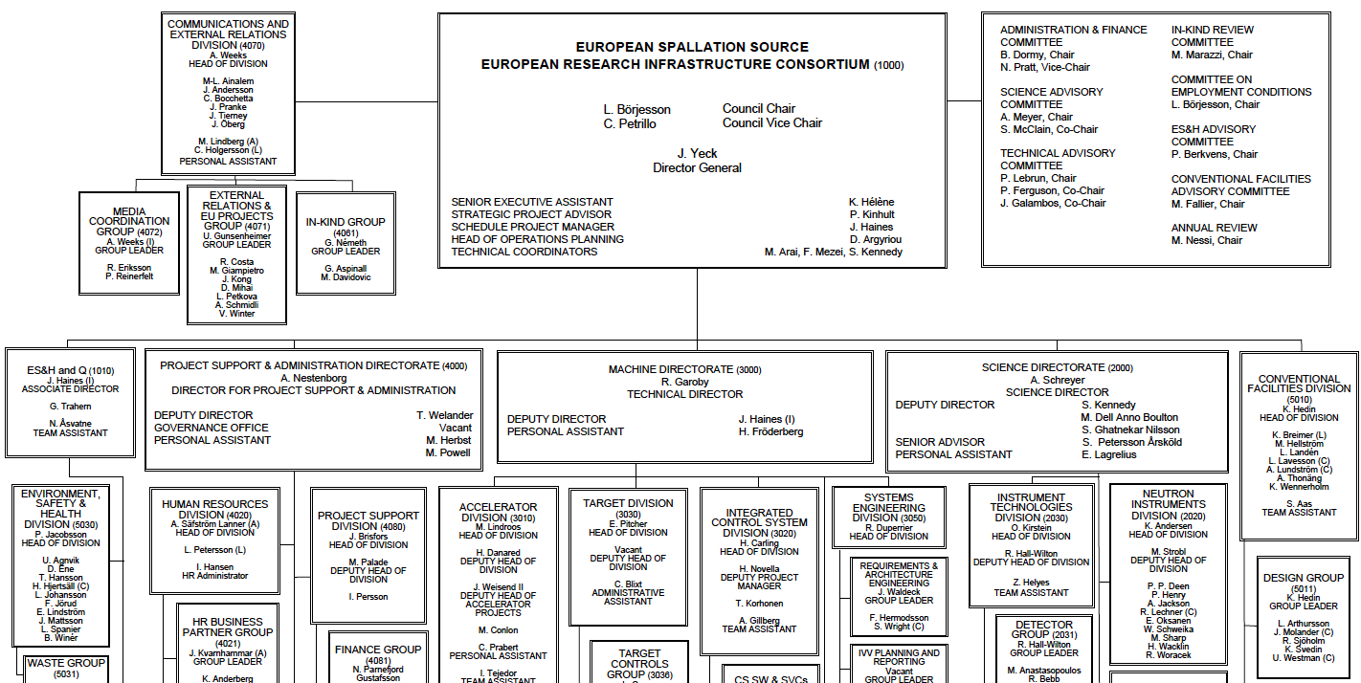
Organisation
~ 100
Collaborating Institutions
42 In-kind Partners
60 Collaboration, MoU and Grant Partners
47
Nationalities
368
Employees

Slide 10
ESS Schedule Objectives
2013
2014
2015
2016
2017
2018
2019
2020
2021
2022
2023
2024
2025
Jun 2014
Sep 2016
Oct 2017
Jun 2019
Sep 2022
Dec 2025
Ground break
First installations on-site (Accelerator)
Start of
User Programme
First installations on-site (Target & NSS)
Submission of 2nd permit application
Machine* ready for first beam on Target
Machine installed
for 2.0 GeV
Dec 2019
First instrument
ready for hot commissioning
Dec 2022
6m
Late finish – Machine installed for 2.0 GeV
3m
Last Construction Phase
Instrument handover
to Operations
Machine*: Accelerator, Target & ICS

Slide 11
Construction funding & budget profile
(January 2013 Prices)

Slide 12
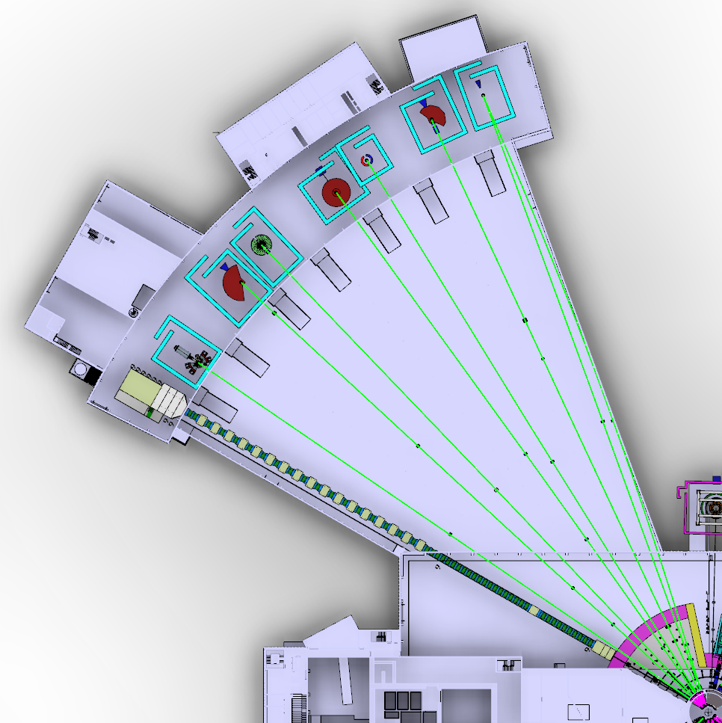
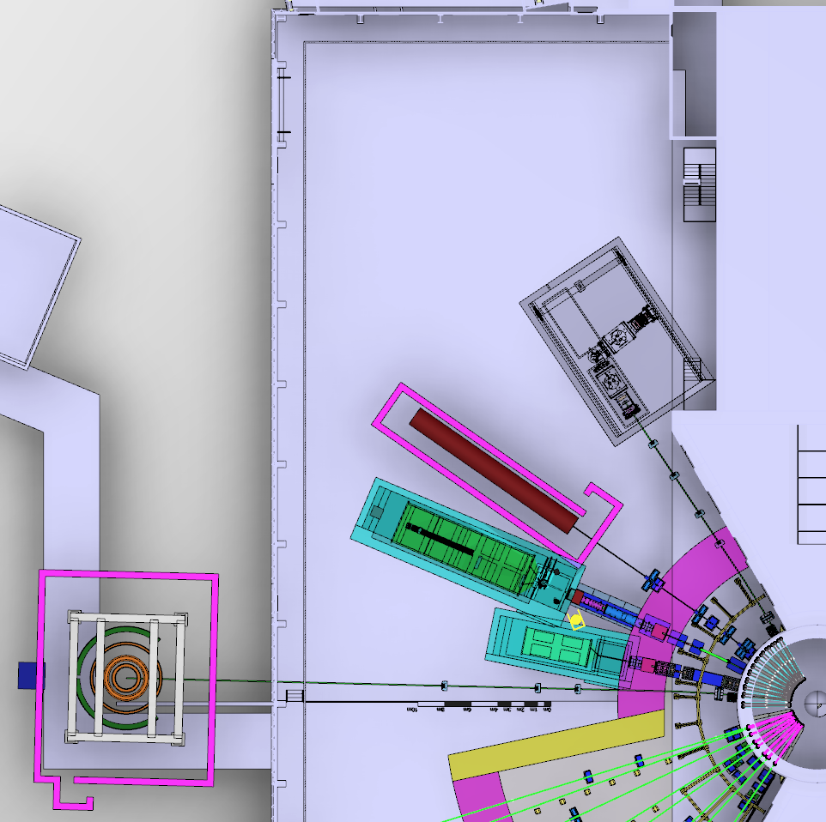
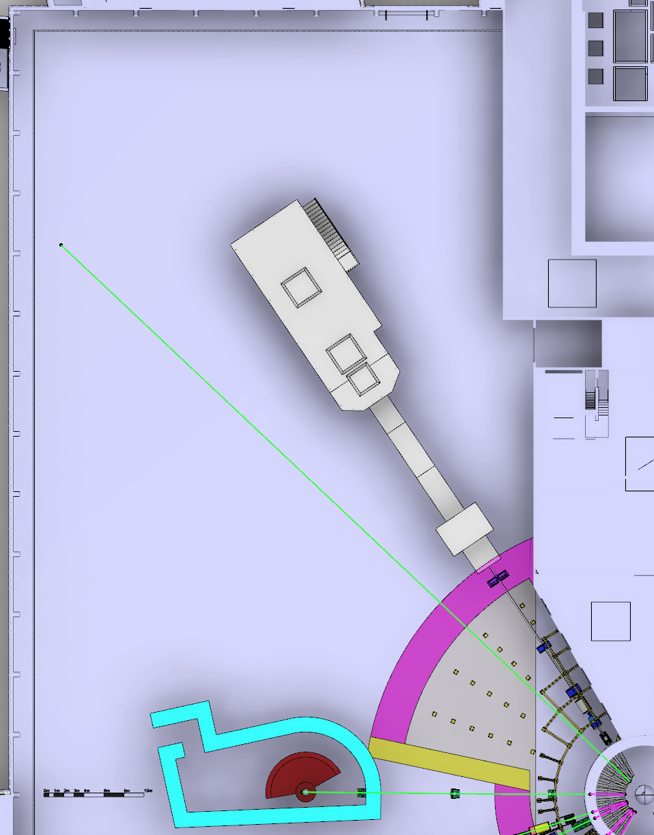
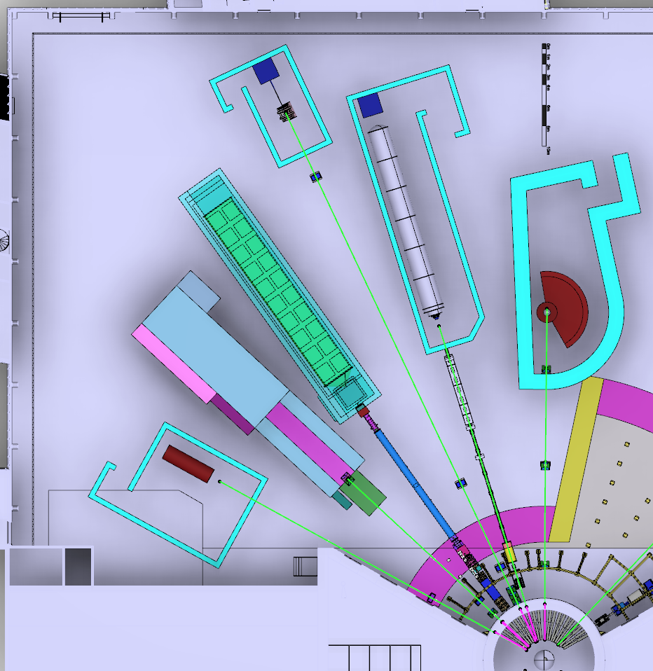
Priorities for instruments in 2016
TREX
HEIMDAL
MAGIC
Decision taken on the first 16 instruments
Bunker design advancing fast
Developing a realistic schedule for all
instruments ensuring early science
success in line with available in-kind
resources and partner capabilities
MIRACLES
BIFROST
CSPEC
BEER
NMX
Propose which instruments
are to be operational first
Submit to Council in
December 2016 a proposal
for funding and a strategy
for early science success
within the budget of
350 M€.
LOKI
FREIA
HR-NSE
Baseline Layout of the Neutron Beam Instruments
(January 2016)
ESTIA
ODIN
DREAM
VOR
SKADI
VESPA

Slide 13
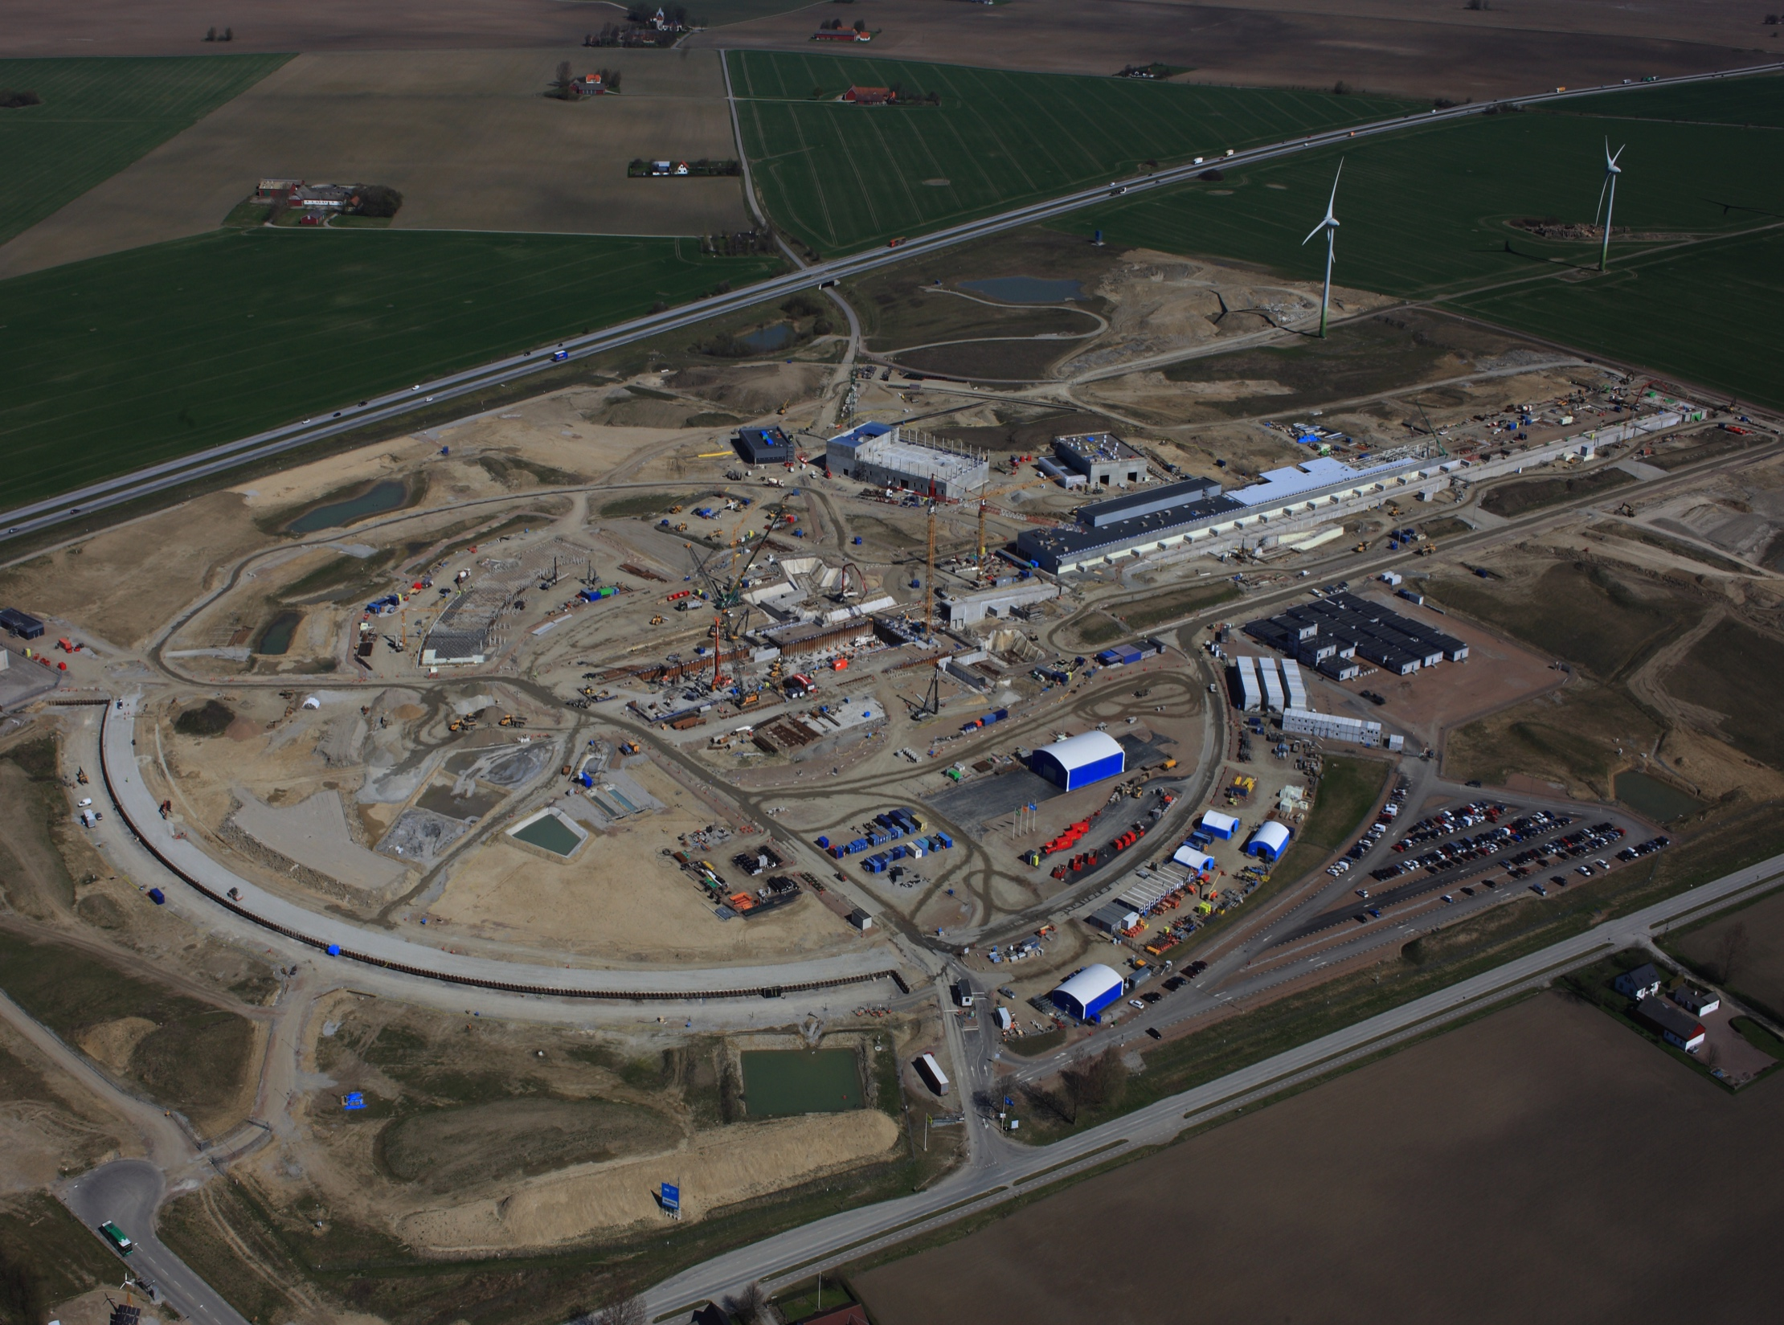
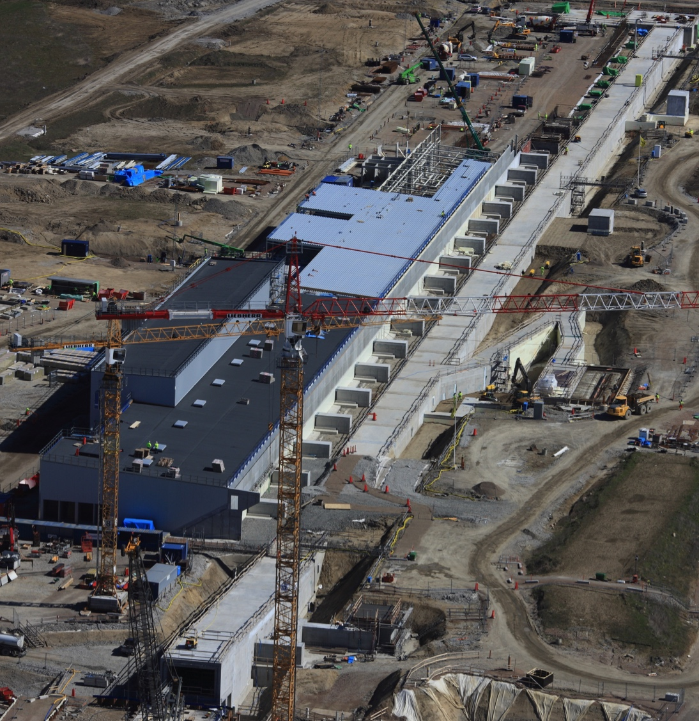
ESS construction site
27 April 2016

Slide 14
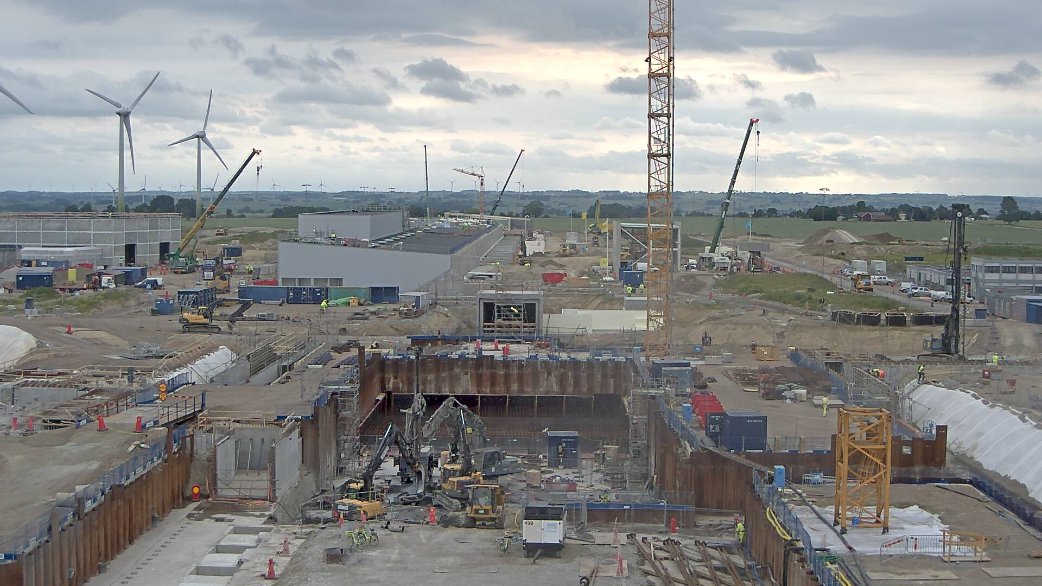
ESS site today

Slide 15
2016 priorities
Continue emphasis on schedule performance – key to success
Ensure transition In-kind Partners into the execution phase of their work
Exploit recommendations from 3rd Annual Project Review (32 experts, 3.5 days) – April 2016
Pursue interaction with SSM for getting the installation & early commissioning permit in Spring 2017
Install 1st accelerator equipment on site – Fall 2016
Establish operations plans consistent with facility requirements
Engage potential new members

Slide 16
ESS project
Performance goals and constraints
Funding
Project status
Summary

Slide 17
Summary
The project is on track with respect to the plan: construction 25% complete today and over 30% by end of 2016.
Priority on schedule performance: pace of work is accelerating, both at Lund and at the partners. Important steps have been made during the last 12 months, preserving the feasibility of the nominal schedule.
However, additional risks have been taken and a number of tasks are on the critical path…
Start of User Programme in 2023

Slide 18
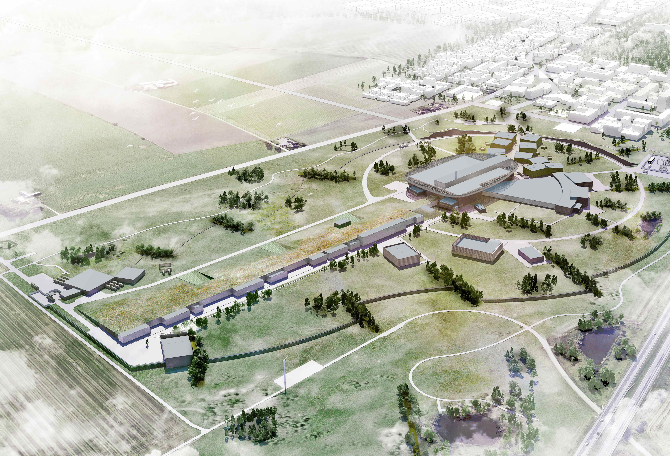
  ESS Core Values:
    Excellence,
    Openness,
    Collaboration,
    Sustainability

