Slide 1
TIK-4.3 Irradiation Module
In-Kind Partner Team: Consiglio Nazionale delle Ricerche (CNR)
F. Masi [1], R. Senesi [1,2] , C. Vasi [2]
[1] Università degli Studi di Roma Tor Vergata ; [2] CNR-IPCF;
G. Gorini [3,4], A. Milocco [3], G. Scionti [3],
[3] Università degli Studi di Milano Bicocca; [4] CNR-IFP
ESS Teams: Moderator and Reflector, Neutronics, Handling, Materials
R. Linander, M. Kickulies, D. Lyngh, L. Zanini, V. Santoro, M. Gohran, Y. Lee
www.europeanspallationsource.se
July 6th, 2016

Slide 2
Outline
Highlights
Near-term plans
Risks and issues
Concluding remarks

Slide 3
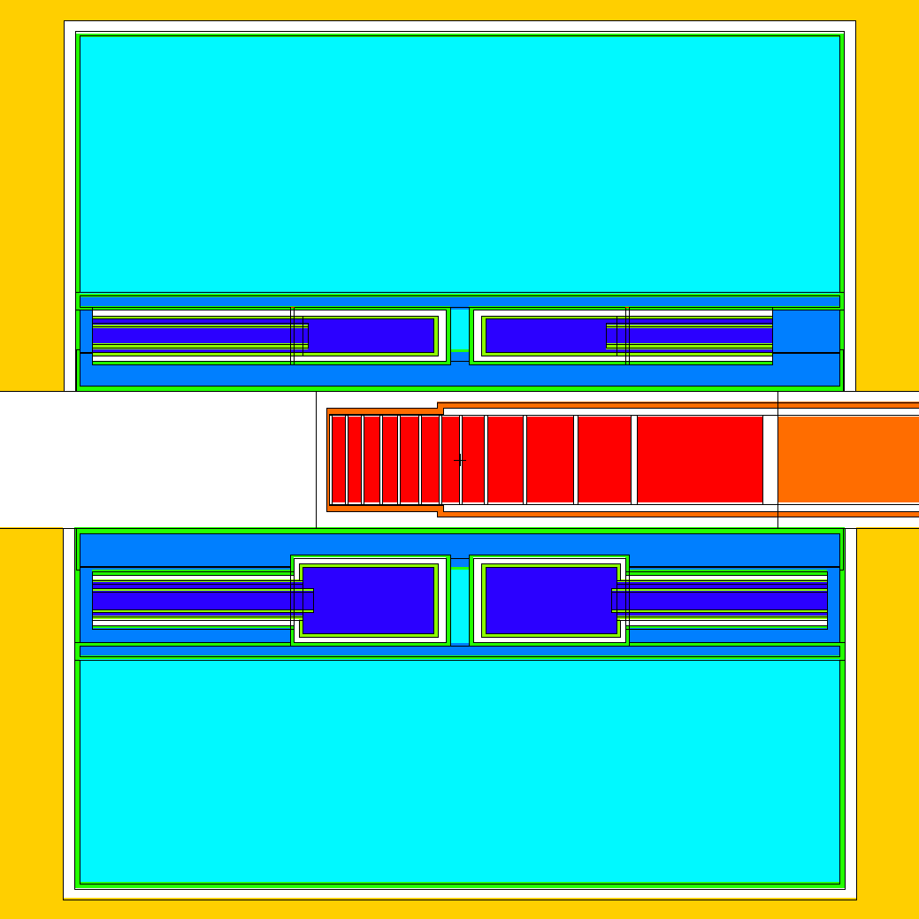
Highlights of work since last meeting
Following the final choice of location for the module (Nov. 2015), the Irradiation Module work element has been put under the Moderator Reflector plug work unit.
Scheduling has changed considerably due to Interfaces. Changes to the scheduling moved inward the final delivery on site to Nov 1 st 2016, with respect to previously scheduled date of July 31st 2017
IM

Slide 4
Highlights of work since last meeting
To this aim restructuring of the work plan includes:
Manufacturability test and manufacture of the IM and samples to be carried out by Julich (MR plug in Kind partner)
Compliance of the design with the intent of the design standards of RCC-MRx to be carried out by Julich (MR plug in Kind partner)
Handling, defining the logistical and interface needs, concepts for extraction of the Irradiation Module after irradiation, to be carried out in collaboration between CNR, ESS, Julich
IM

Slide 5
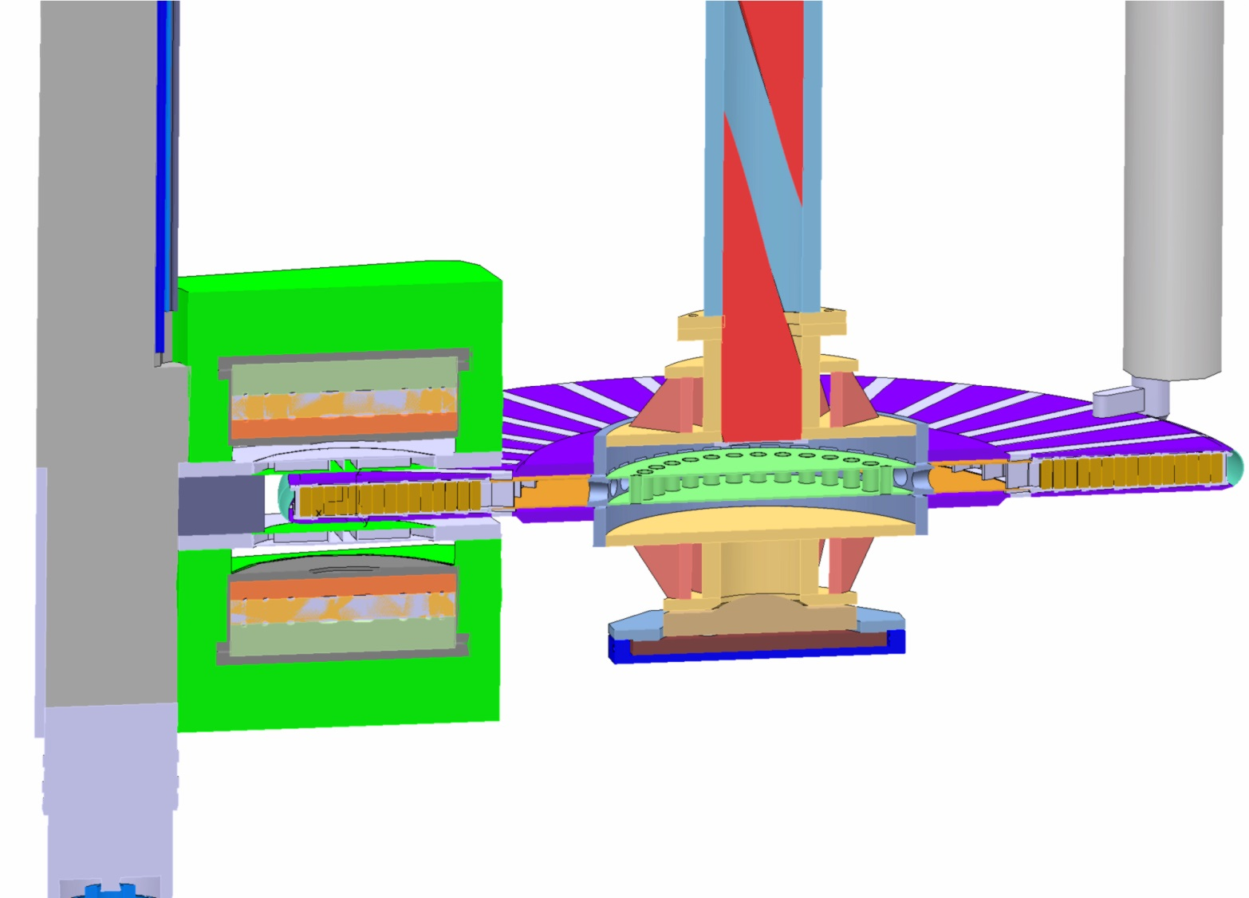
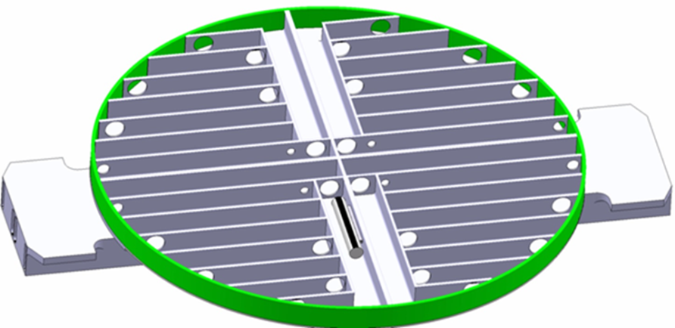
Highlights of work since last meeting
Updated concept
Proton Beam
Note: not close to primary p-beam
Different from STIP at SINQ

Slide 6
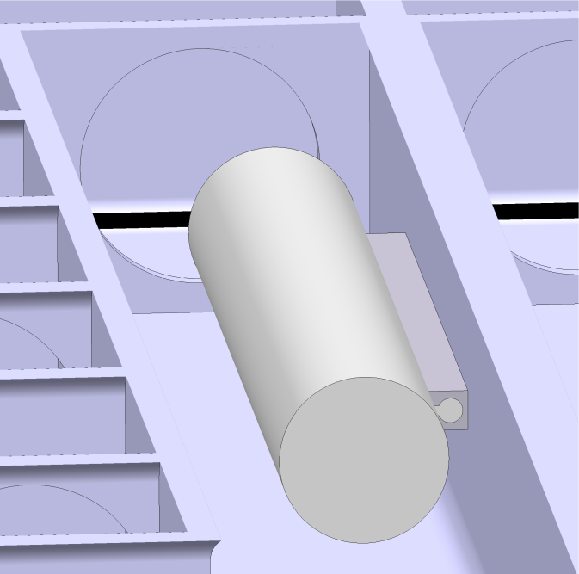
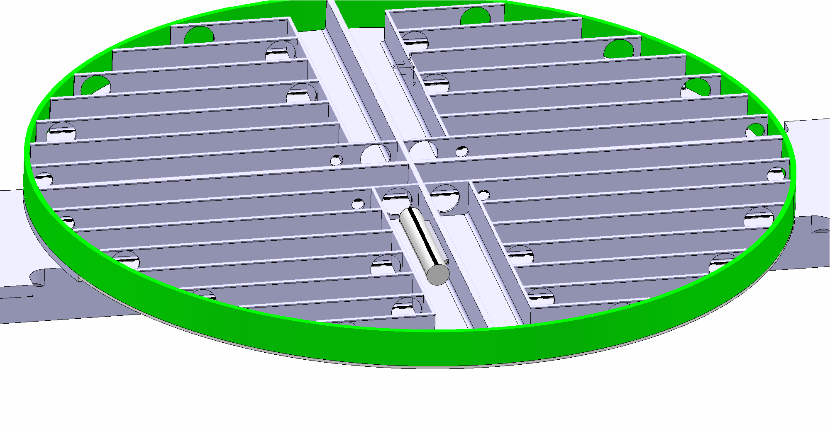
Highlights of work since last meeting
Updated concept
Sample specification description completed in June 2016, led by ESS Materials group

Slide 7
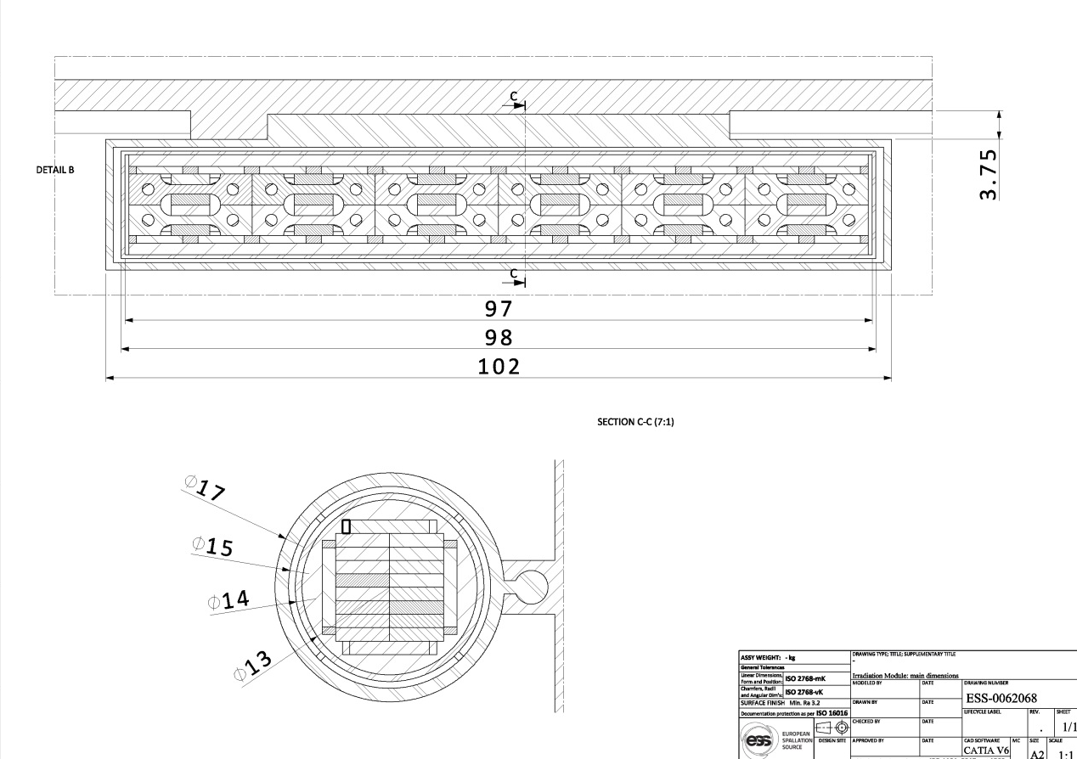
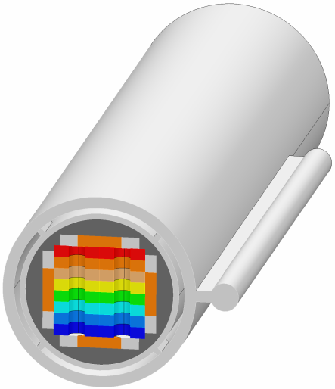
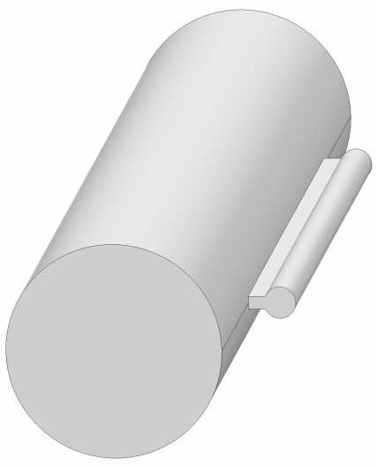
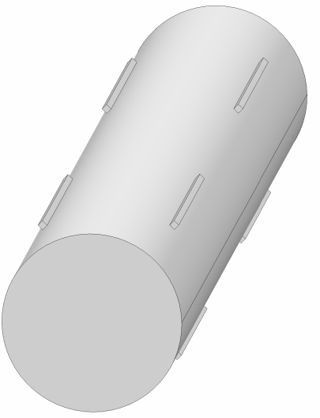
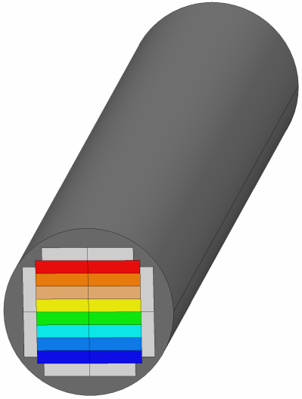

Highlights of work since last meeting
Updated concept
Outer Vessel: Al 6061 –T6
Inner Vessel: Zircaloy-2
Sample holder: Al 5754
F. Masi, Y. Lee

Slide 8
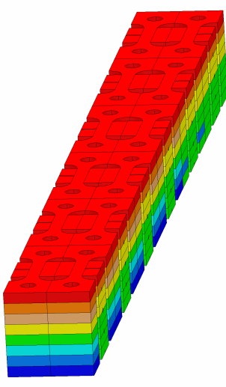
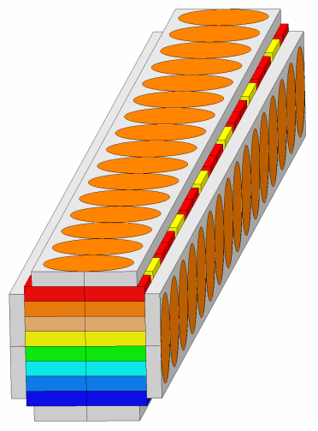

Samples specifications
Nonferrous Metal | Ferrous Metal
Al6061-T6 | Invar
Al5754-NET-O | Stainless Steel 316L
Al6061-T6 with Al4047 filler | EUROFER97
Al6061-T6 and Al5754-O hybrid | F82H
Y. Lee

Slide 9
Post Irradiation Examination Plan
Y. Lee

Slide 10
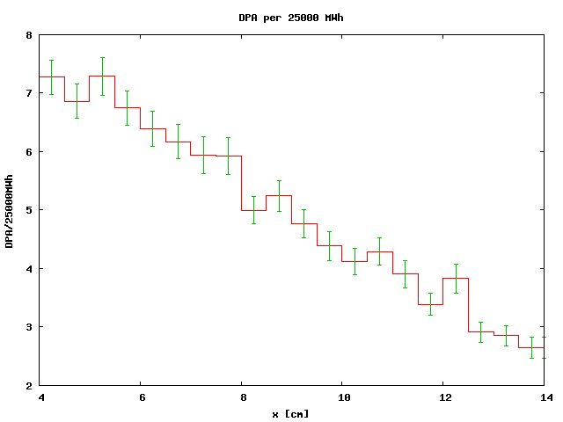
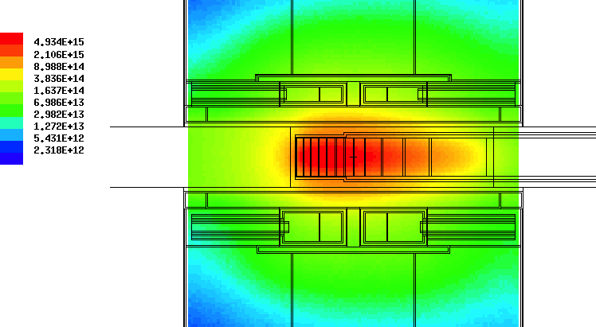
Expected Damage and He-Production in SS 316L
Damage Rate:
  7 dpa/25000 MWh
Helium Production Rate:
  110 appm/25000 MWh
He/DPA: 15
Y. Lee, L. Zanini, V. Santoro

Slide 11
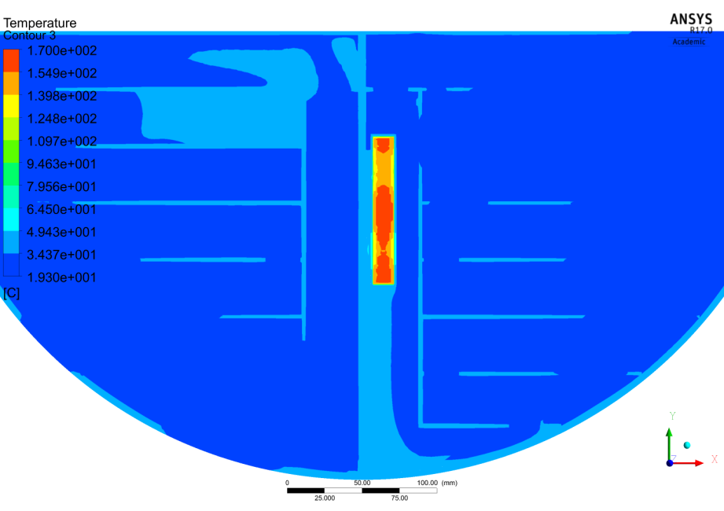
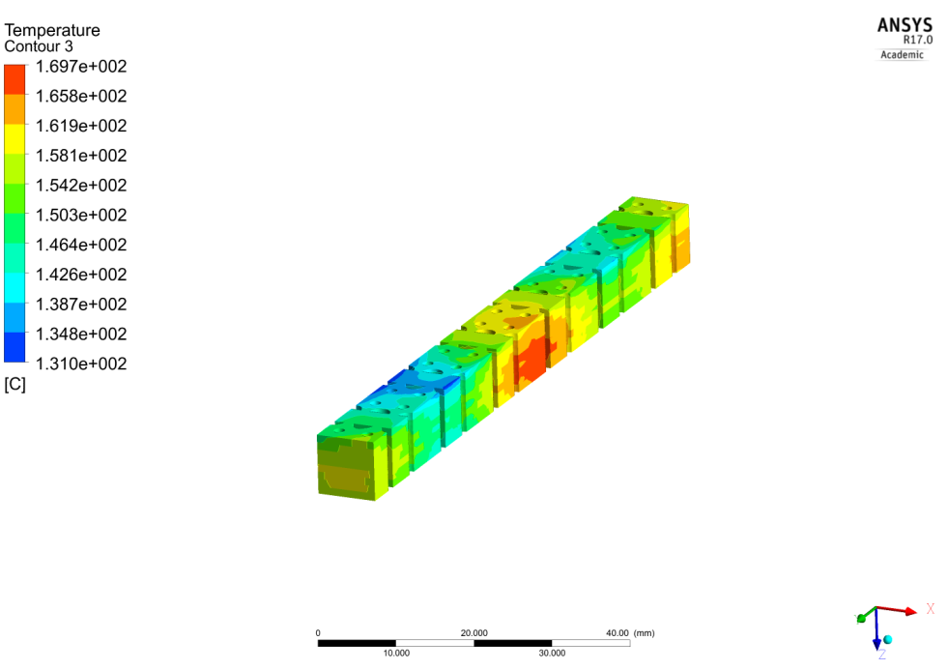
Thermal analysis
Location | Highest Temperature (C°)
Samples | 170
Holder | 155
Inner Vessel | 150
Helium | 150
Outer Vessel | 70
Water | 50
Th. Moderator (interface) | 50
He gap thickness, length of spacers between inner and outer vessel influence
Maximum temperature
Largest temperature reached on Steel samples
Parameters should be adjusted to T<130 C to avoid loosing temper on T6 Al alloy samples
F. Masi

Slide 12
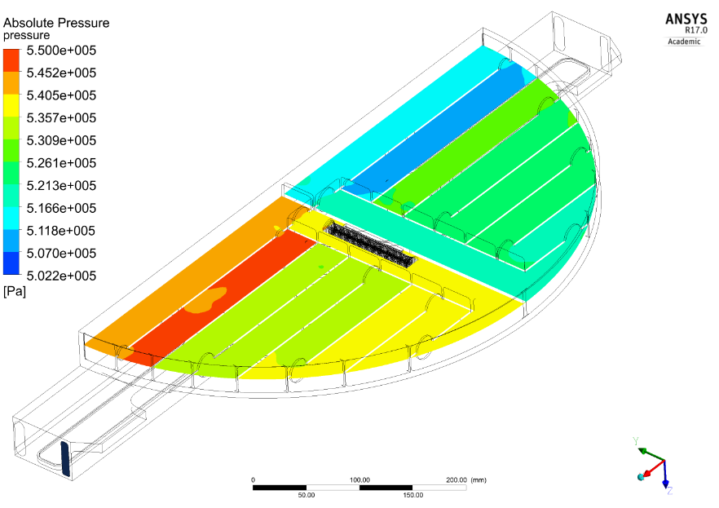
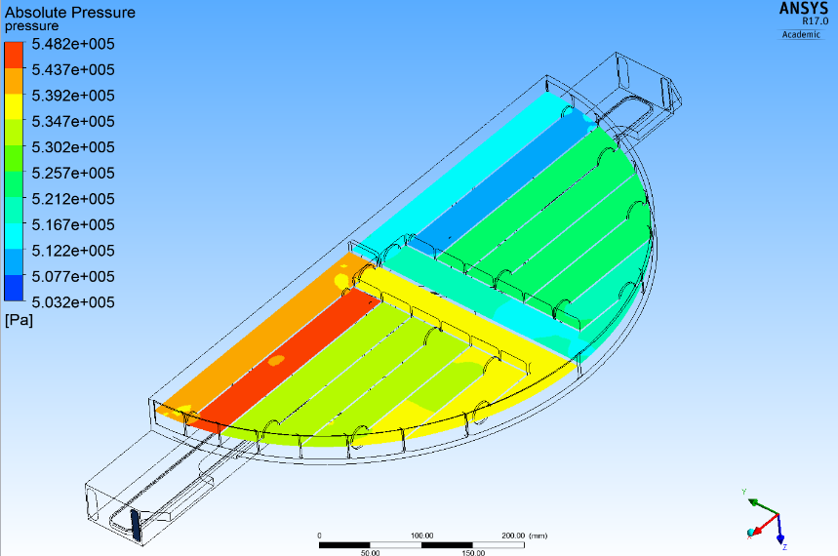
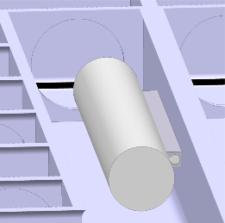
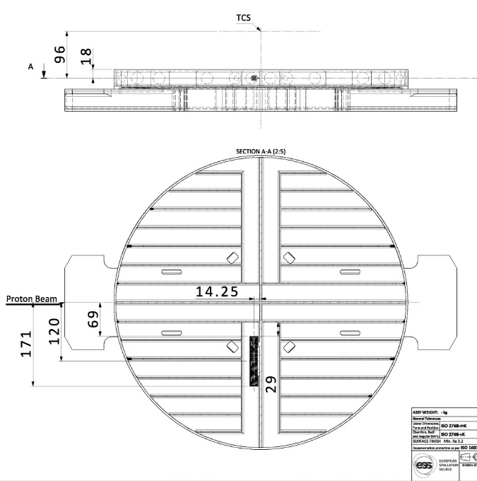
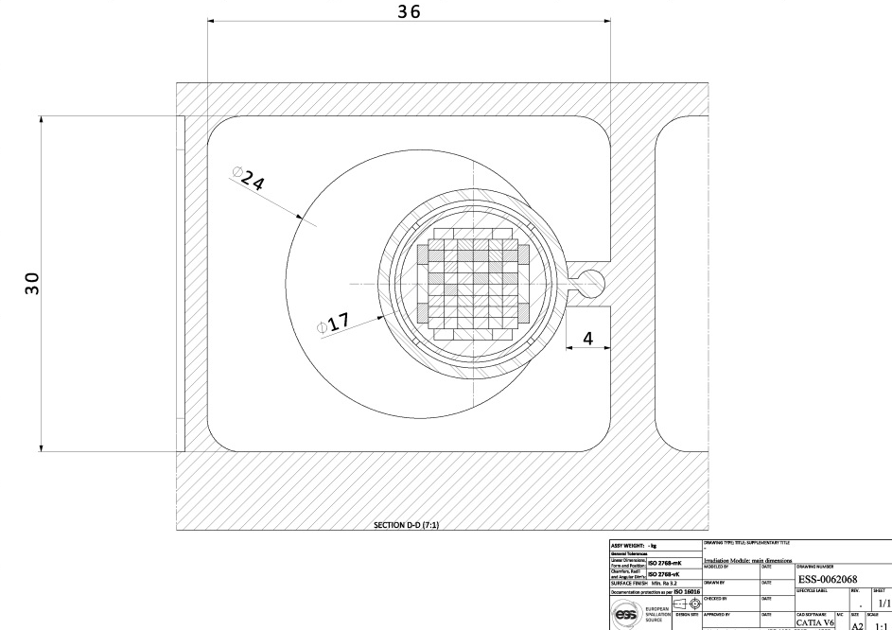
Fluid dynamics analysis
Negligible contribution to the pressure drop
F. Masi

Slide 13
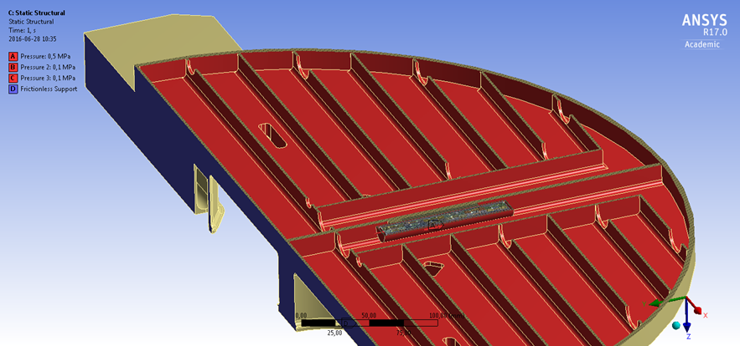
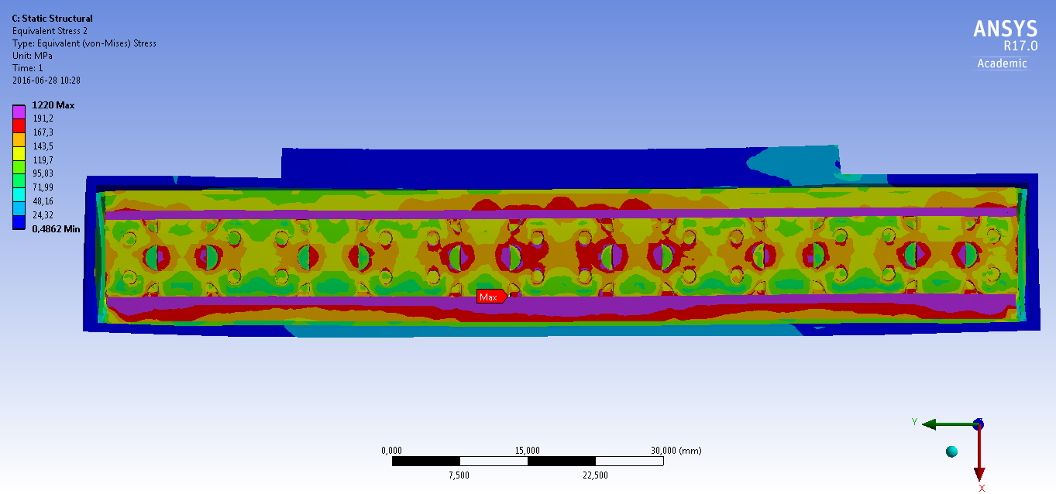
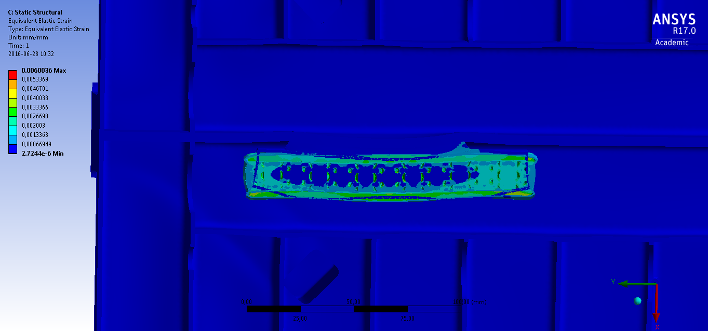
Structural analysis
Clearance between parts needed to mitigate stresses from thermal expansion
F. Masi

Slide 14
Highlights of work since last meeting
-PDR carried out on July 1st 2016
Recommendations report expected on July 15 th 2016
Cost estimate for manufacturing received by Juelich, including strategies to incorporate IM into premoderator

Slide 15
Near Term Plans
Define paths and dates towards CDR
Complete interface documentation to full setting of system requirements: Handling ; Waste.
Final neutronic analysis and final design of part of samples (charpy samples), input from PSI
Refine hazard analysis
Update cost estimates and Post Irradiation
Examination plans (outside In-Kind)

Slide 16
Risks and Issues
Project work load is very high- to critical
Time to receive review/approval of documents is critical
Prompt feedback/support from ESS Reflector & Moderator Systems
All partners are working towards a common goal and are helping each other to reach the milestones

Slide 17
Concluding remarks
Refine scope: Post Irradiation Examination will be at the end of first generation MR- past the construction phase
Case for Post Irradiation Examination programme on the longer term (see for example STIP-I, STIP-II,STIP-III,… at PSI)
Opportunities towards non-ESS related activities
All partners are working towards a common goal and are helping each other to reach the milestones

