Slide 1
TIK-8.1 EDD Tungsten Release Factors status TTB 6.july 2016
Release factor of radio iodine from tungsten target
Xiaolin Hou
Mikael Jensen

Slide 2
Motivation
Most of radioactive inventory in the target station is bound in the tungsten target material
If the temperature in tungsten target increases in during an off-normal event, some of the radionuclides may be released
Measurements of the temperature-dependent release factors of important radionuclides is necessary for estimation of the radiation dose to workers and members of the public during off-normal events and design of the target station for prevent or reduce the exposure of the works and public to such radiation

Slide 3
Objectives/requirement
Experimental determination of the fractional release rates at various temperatures (300, 350, 400, 450, 500, 550, 600, 650, 700, 750, 800, 900, and 1000°C) for the following elements:
Halogens (I, Br)
Noble gases (Kr, Xe, Ar)
Alkali metals (Cs, Rb, K, Na)
Others (Gd, Re, Ta, Hf, Yb, Lu)

Slide 4
Release factor
Fractional release rate (F): fraction of radionuclides released in unit time.
Amount of radionuclide released
Totoal inventory of radionuclide in the target
Experiment time
For iodine, the minimum sensitivity on the fractional release rate is 10^{–13} s^{–1}. Minimum sensitivities for Br is to be derived. Minimum accuracy on each measured value is ±50%.

Slide 5
Two experimental approaches
”Main road”:
Irradiate two tungsten blocks
1E18 protons at 1.4 GeV at CERN
Decay for 2-3 weeks at CERN
Transport from CERN to DTU-NUTECH
Measure I-125 release as function of temperature
”pilot experiment”:
Load a tungsten tube with 50 MBq I-131
Plug the tube with tungsten wire
Seal the tungsten tube against tungsten
Measure I-131 release as function of temperature
10x20x80 mm
o.d. 1.6 mm
i.d. 0.6 mm
Wall = 0.5 mm

Slide 6
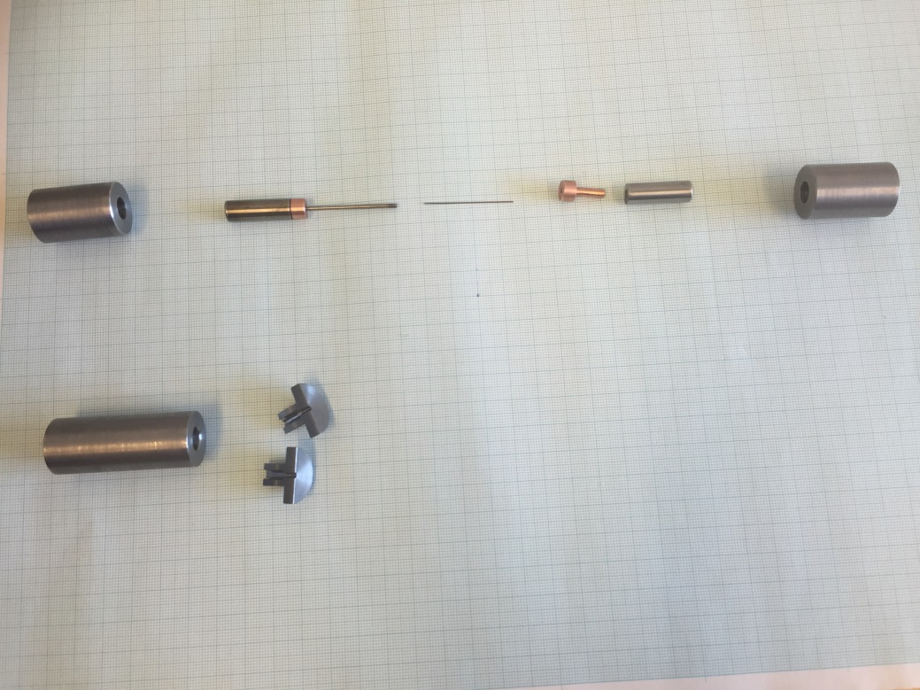
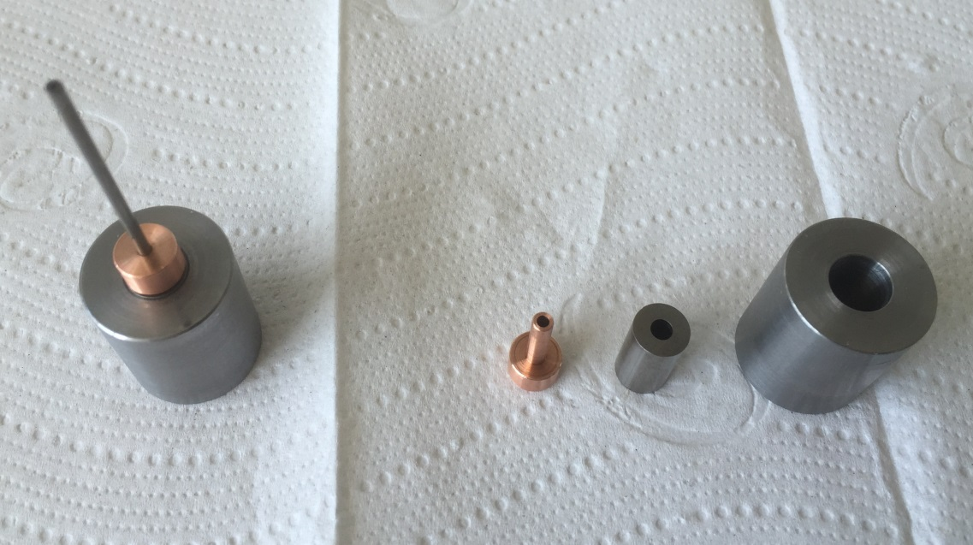
Tungsten tube accessories for ¹³¹I release experiment

Slide 7
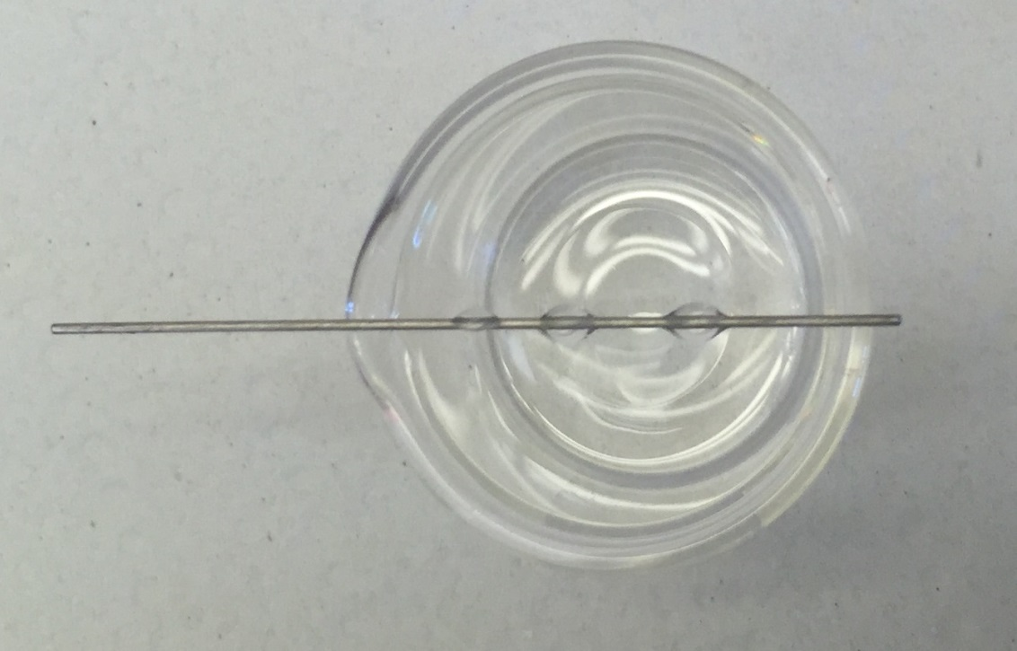
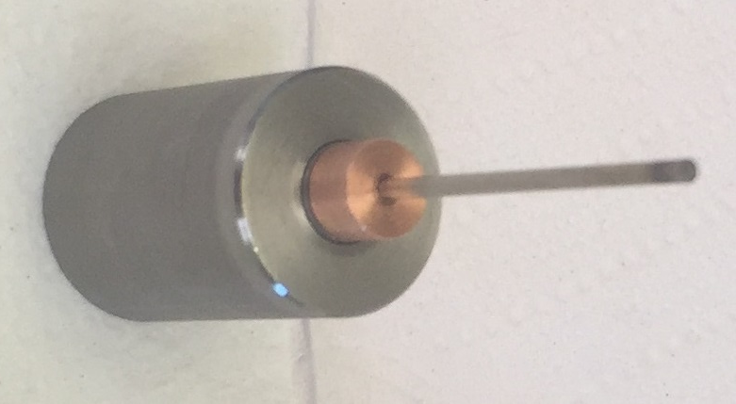
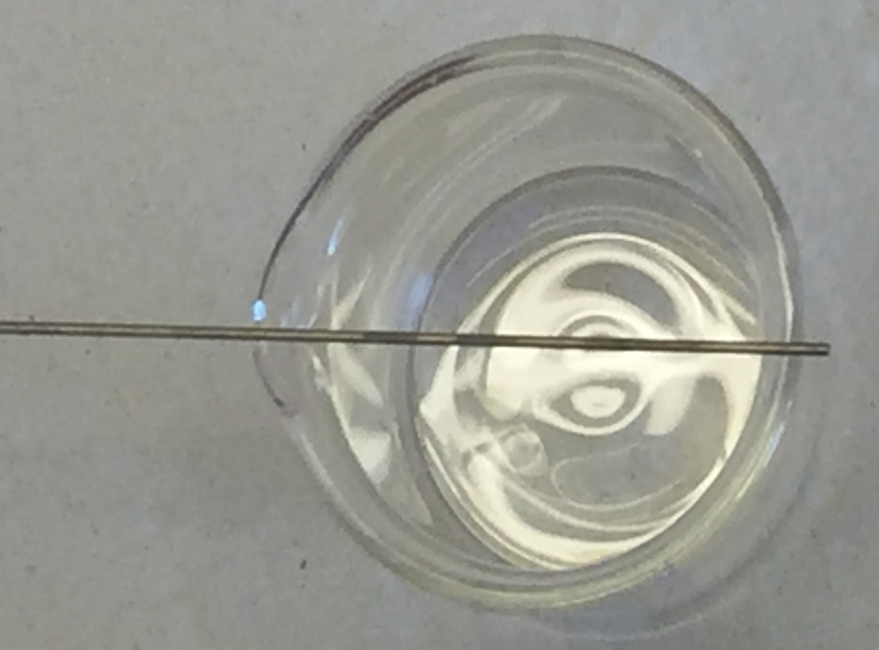
First Experiment
9 µl ¹³¹I loaded on the tungsten rod (0.5mm)
50 MBq ¹³¹I loaded
Dried tungsten rod

Slide 8
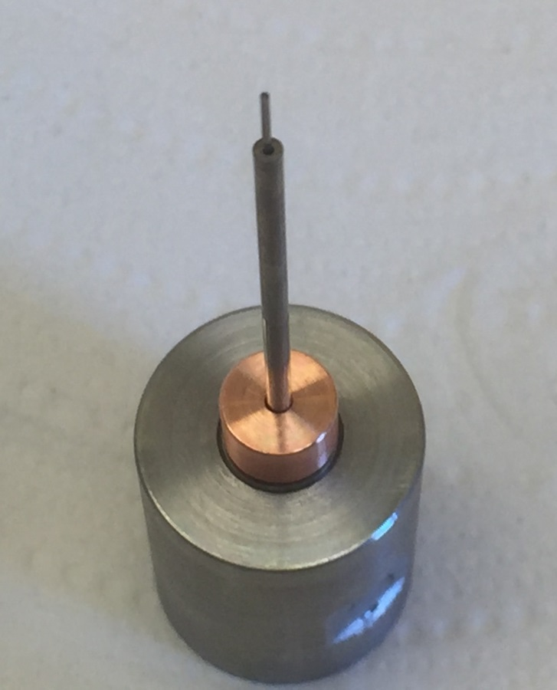
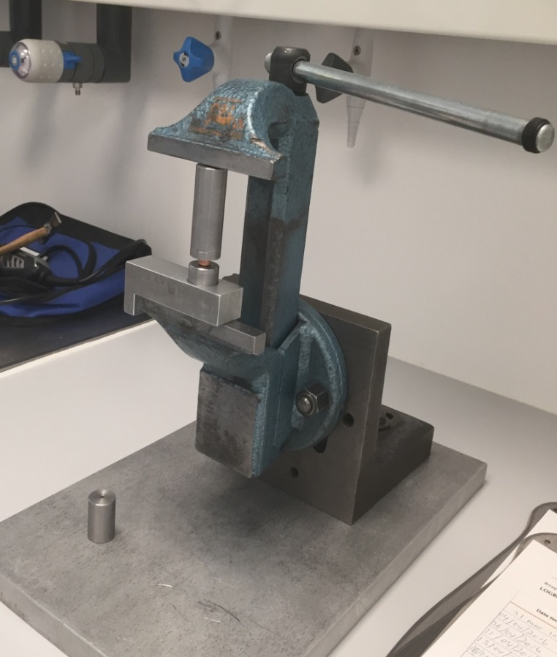
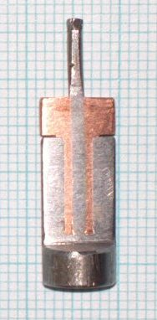
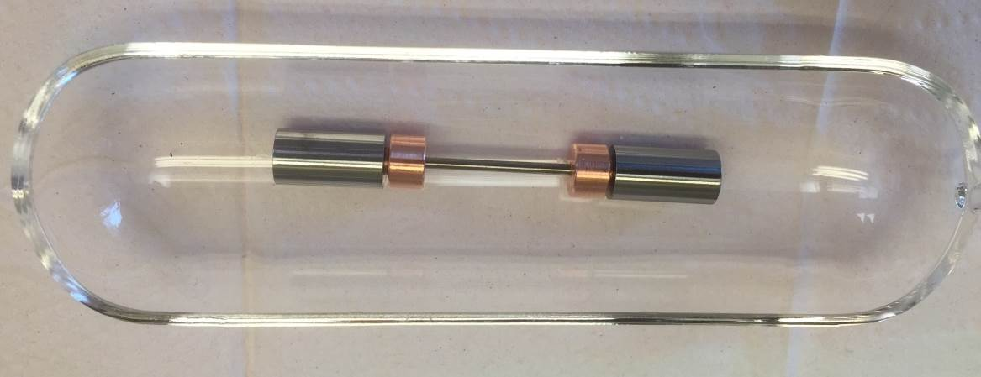
Tungsten tube Assembly for ¹³¹I release experiment

Slide 9
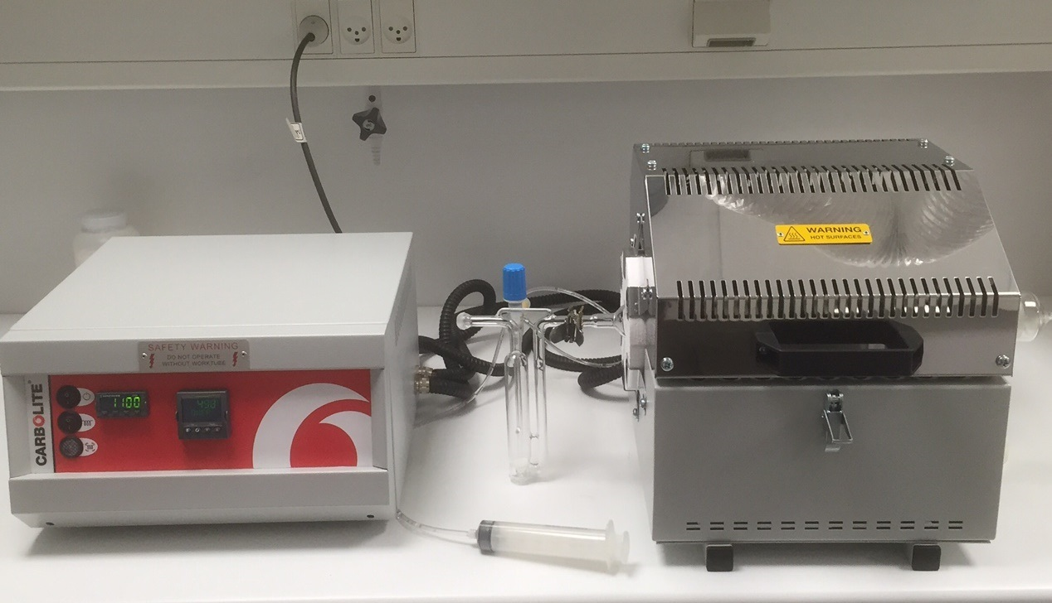
Experimental setup for measurement of the release factors of iodine in tungsten target
Temperatures, °C: 2 h of each point
RT
250, 300
350, 400
450, 500
550, 600
650, 700
750, 800
850,900
950, 1000 °C

Slide 10
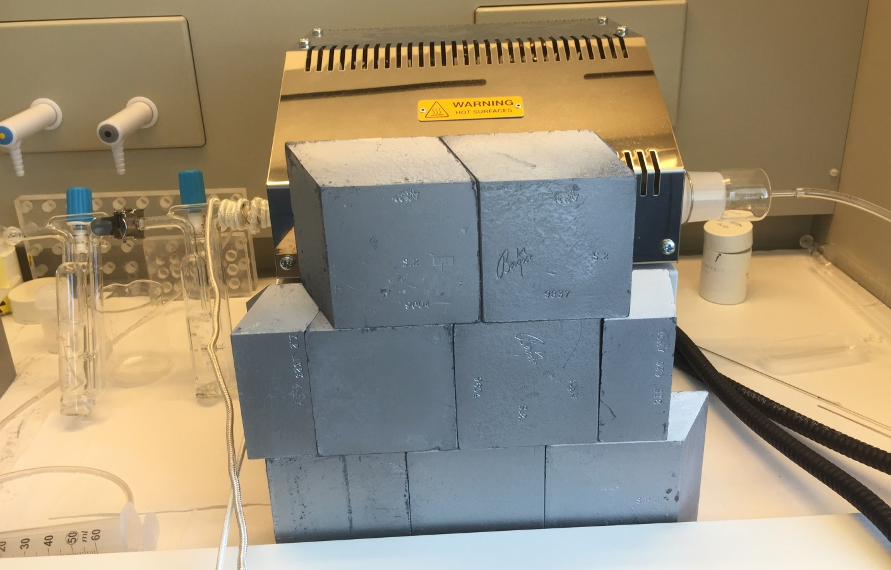
Heating experiment for ¹³¹I release from sealed tungsten tube
Experiment :
Temperature: RT - 950°C
He flow: 30-80 ml/min
Trap solution: 0.5M NaOH-0.05M NaHSO₃
Duringation: 2-15 h per temperature segment
Change for each temperature segment
All 30 ml trap solution is used for gamma measurement
The bubbler is washed with H₂O every time

Slide 11
Heating experiment for ¹³¹I release from sealed tungsten tube
1-1 heating experiment using ¹³¹I loaded tungsten tube (surface contamination observed)
He gas flow stopped during change trap solution at each temperature segment (air enters to the furnace)
Heat was turn off during night
1-2 heating experiment using the same ¹³¹I loaded tungsten tube
He gas flow contuine all time
Heat was turn off during night
3) 2nd Experiment using a new ¹³¹I loaded tungsten tube (no surface contamination)
He gas flow contuine all time
Heat was turn off during night

Slide 12
Result of the first experiment for ¹³¹I release from sealed tungsten tube
Helium not pure – Low flow

Slide 13
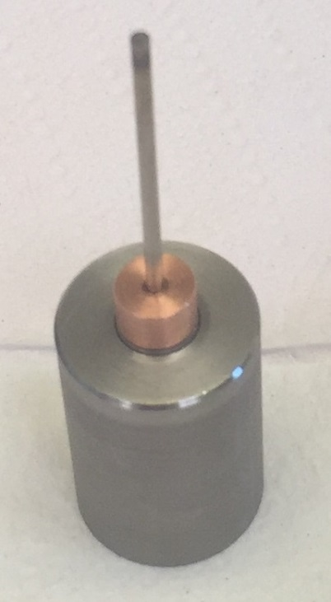
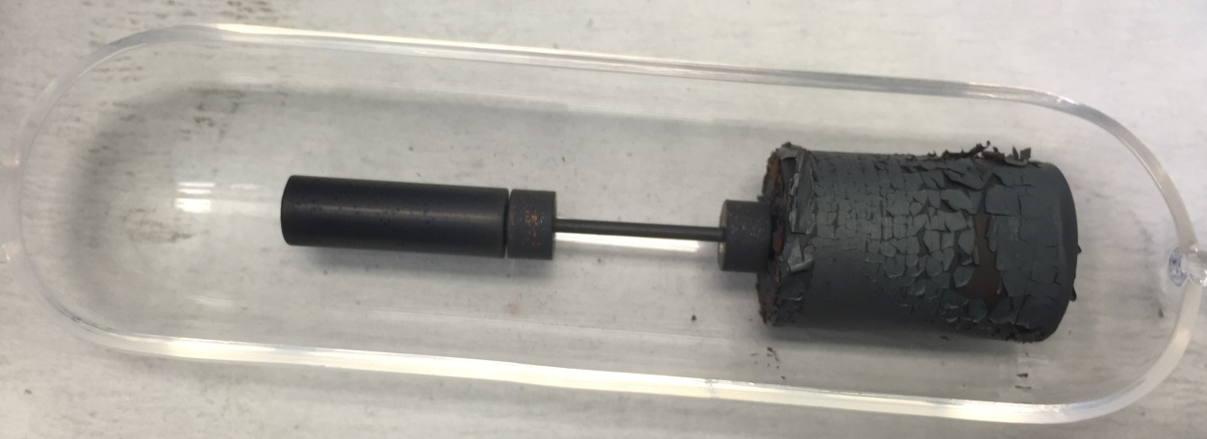
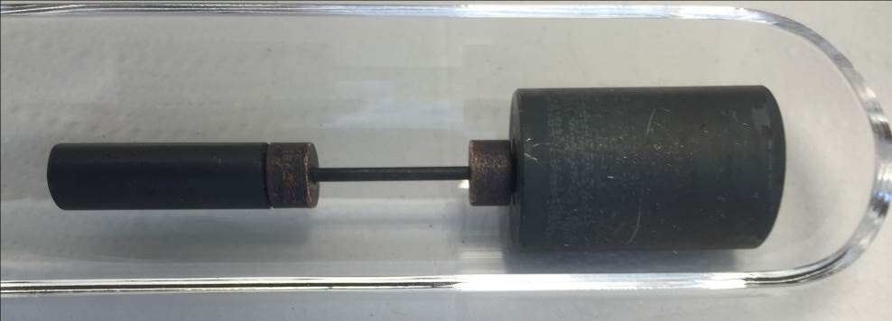
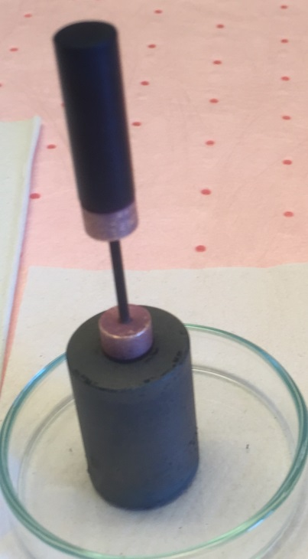
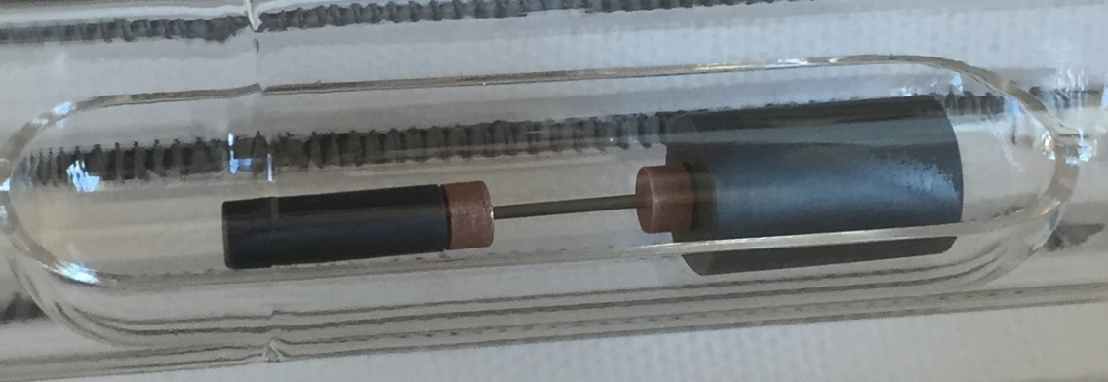
Before heating
After first heating heating
Cleaned after first heating heating
After heating
After 1-2 heating heating

Slide 14
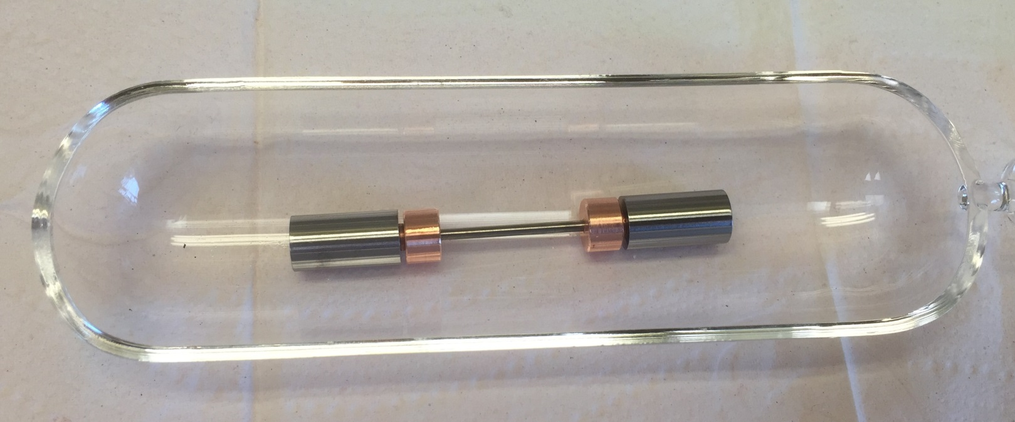
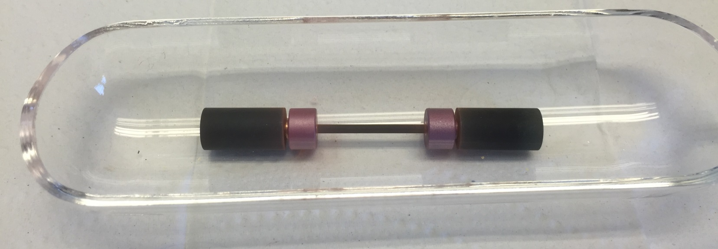
Result of the Second experiment for ¹³¹I release from sealed tungsten tube- pure Helium
Before heating
After heating

Slide 16
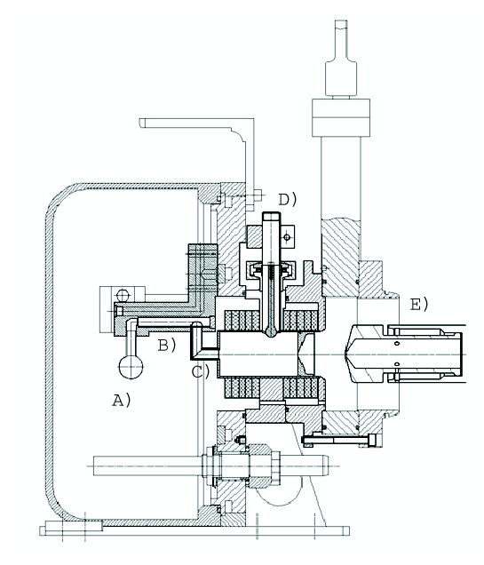
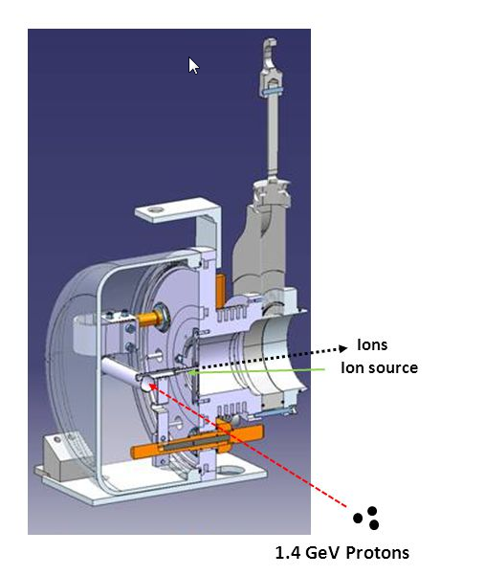
Isolde irradiationII
Isolde ion source assembly
Tungsten cooled during irradiation T<50 deg C
200 mbar Helium atmosphere absolute
Gas phase analysed upon receipt at NUTECH
Ø 300 mm
W

Slide 17
Activity/ milestone | Date/time
Contract approved | 2015-11-18 V
DTU begins work | 2015-05-01 V
Experimental design | 2015-12-31 V
Kick-off meeting (experiment plan accepted) | 2016-02-05 V
Setup of the heating system | 2016-02-01 V
Method development for dissolution of tungsten | 2016-03-01 V
Pre-experiment (1) for testing the heating system and iodine releases from the tungsten surface | 2016-05-01V
Pre-experiment (2) for testing release of iodine sealed in tungsten tube | 2016-07-01 V
Preparation of laboratory for hot experiment using a hot cell | 2016-08-01 V
Irradiation of tungsten blocks in the CERN – ISOLDE facility | 2016-08-15
First hot experiment using irradiated tungsten | 2016-09-15
Second hot experiment using irradiated tungsten | 2016-10-15
Experiment complete | 2016-12-15
Final report submitted | 2017-02-28
Acceptance review/report approved | 2017-03-30

