Slide 1
Document management system I2I for essi project
ESS Quality workshop at Saclay 30/06/2016 | Anaïs BRUNIQUEL
Sous titre

Slide 2


Presentation of I2I system (1/4)
I2I system
I2I system is a collaborative tool based on sharepoint microsoft.
I2I system is used to storage and classify all the document of the ESSI project and ESSI WPs:
Project documents,
Design documents,
Manufacturing documents,
Test and assembly results.
I2I system is for internal use of CEA ➔ The tool is in french.
I2I system is organized as a big library.

Slide 3
Presentation of I2I system (2/4)
Process to use I2I system
The contributor of ESSI project can create, update and check in a document. The document can be approved in I2I and distributed by e-mail or by I2I.
I2I system takes account :
The ESSI rules to identify the documents,
The organization of the ESSI Project (PMO, WPs),
The following of the different editions of a document.
The quality team manages the tool and helps the users to create their documents (the tool is progressively deployed.).
Create a new document
Up-date a document
Check in the document
Approve the document
Publish the document

Slide 4

Document management (3/4)
Issuer
Project
WP code
Type of doc.
number
Edition (1.0, 2.0, …)
C | E | A | - | E | S | S | - | X | X | X | - | X | X | - | X | X | X | X | - | X | Y
Doc | Type of document
CR | Minutes
RP | Technical report
NT | Technical note
ST | Technical specifications
… | …
A document is identified by the WP AND by its type.
WP | Désignation
CMD | ECCTD
CMS | Serial cryomodules
RFQ | RFQ
DIA | Diagnostics
CSD | Control System Domain
PJT | ESSI Project

Slide 5
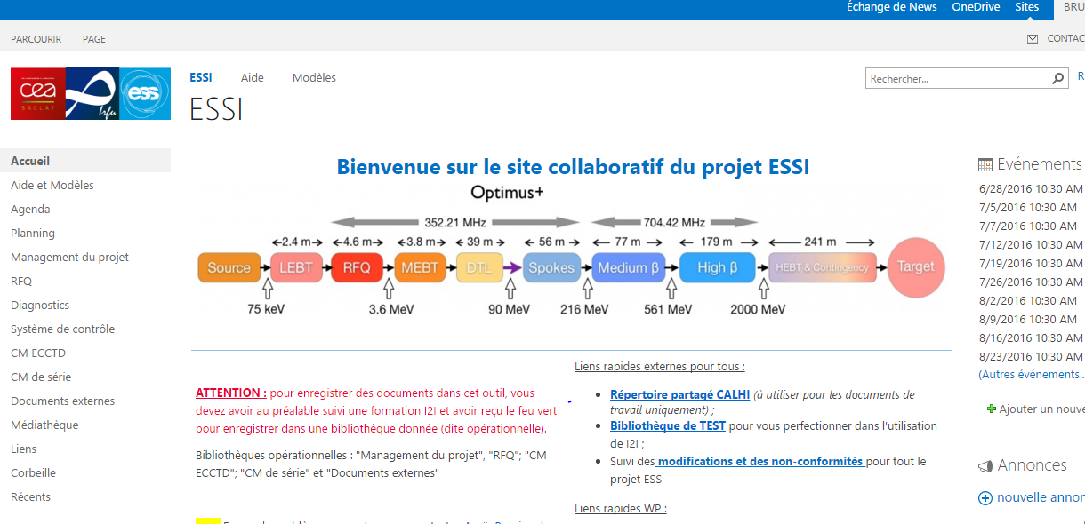
Presentation of I2I system (4/4)
Libraries

Slide 7
DSM Irfu
Commissariat à l’énergie atomique et aux énergies alternatives
Centre de Saclay | 91191 Gif-sur-Yvette Cedex
T. +33 (0)1 69 08 xx xx | F. +33 (0)1 69 08 99 89
Etablissement public à caractère industriel et commercial | RCS Paris B 775 685 019

