Slide 1
ESSI CHANGE AND nonconformity control SYSTEM
Quality Assurance and Quality Control – Learning and Planning Workshop - 30 June 2016
Christelle Cloué

Slide 2
DEVIATION CONTROL SYSTEM
The procedure CEA-ESS-PJT-AQ-0004 (Procédure de traitement des non-conformités et des demandes de modification du projet ESSI) covers nonconformity and change request.
It describes the process for the control of nonconformities and for the configuration baseline changes.
As design configuration
(baseline configuration)
As built configuration
Product life cycle
Change and nonconformity control
For the ESSI project, the reference configuration for an item is the configuration defined at the kick off meeting (extract from ESSI Quality Plan).

Slide 3
OBjectives
Ensure the traceability of all the nonconformities and change requests. All the discrepancies should be fully documented and processed.
Ensure that nonconform items are identified and segregated from all other material in a quarantine area under QA supervision.
Implement corrective actions to cure nonconformity.
Implement preventive actions to eliminate the cause(s) of a nonconformity and prevent any recurrence.

Slide 4
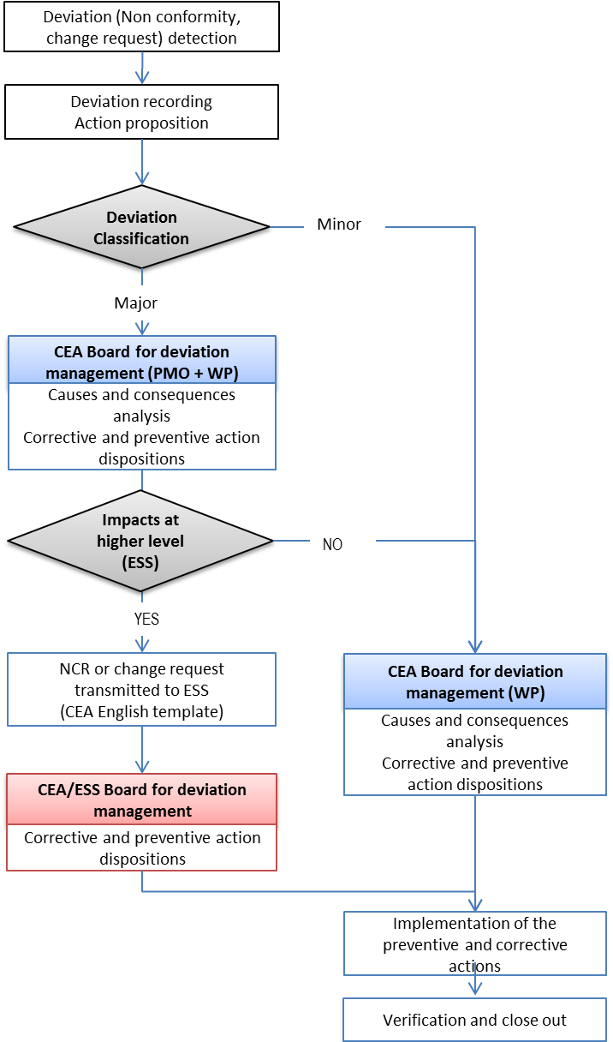
PROCESS flowchart
Procédure de traitement des non-conformités et des demandes de modification du projet ESSI (Référence CEA-ESS-PJT-AQ-0004)
Step 1: Detect and record the deviation
Step 2: Analyse the root causes and the consequences
Validate the corrective and preventive actions
Step 3: Implement the actions
Step 4: Check the actions and close the report

Slide 5
Disposition on the product
Use as is
The item is found to be usable without eliminating the nonconformity.
Rework
The component is recoverable to conform completely to all specified requirements. It is possible that preliminary work is needed before the recovery, this work should not have any impact on the operations performed before and those that will be made later. A control recovery is required before further operations.
Repair
The component is recoverable such that it fulfils the intended usage requirements however it will not comply with the initial requirements. A control repair is required before further operations.
Return to supplier
A nonconform product may be returned to the supplier for repair or rework by it when they can not be performed in house.
Scrap
The component is affected by major nonconformities, it is not recoverable by rework or by repair for technical or economical reasons.

Slide 6
Classification of the deviations 3 LEVELS
 | MINOR CEA WP responsibility | INTERMEDIATE MAJOR CEA PMO/WP responsibility | MAJOR ESS responsibility
 | L1 | L2 | L3
Safety of people and equipment |  | X | DEVIATION WITH « USE AS IS », « REPAIR » AND « SCRAP » DISPOSITIONS TRANSMITTED TO ESS ------------------ ALL MAJOR NONCONFORMITIES RELATIVE TO CAVITIES
Operational, fucntional and technical requirements |  | X
Interfaces with subsystems of the accelerator |  | X
Reliability, maintenability and availability |  | X
Lifetime |  | X
Changes or nonconformance from approved qualification or established procedure |  | X
Internal interfaces | X
Deviations occurred during assembly and test | X
Minor deviation:
Deviation which cannot be classified major. In case of several minor deviations on the same component, the classification shall be reevaluated (remain minor or reclassified major).

Slide 7
Corrective and preventive actions
Corrective actions
Actions to eliminate the deviation and/or the causes of the conformity.
Preventives actions
Actions to eliminate the cause of a potential nonconformity or other undesirable potential situation. It aims to prevent the occurrence of nonconformities on similar components.
The boards shall establish criteria for checking that all the actions are performed and efficient.
Responsible (s) for the actions are named during the boards. They will be consulted before the close-out of the nonconformity report.

Slide 8
CEA deviation management BOards
Deviation management board @ WP level (CTE WP) include the following people:
WP leader,
System engineer WP,
AQ engineer,
Products responsible (depending on the subjects),
Experts (depending on the subjects).
Meeting every 2 weeks, the frequency will be adjusted in function of the project phase.
Deviation management board @ PMO-WP level (CTE PMO- WP) include the following people:
Project leader,
Instrument scientist,
System engineering and configuration management officer,
PMO AQ Engineer,
WP leaders (depending on the subjects),
AQ engineers (depending on the subjects),
Experts (depending on the subjects).
Meeting every 2 weeks, the frequency will be adjusted in function of the project phase.

Slide 9
Step 1: Detect and record the deviation
 | DETECT and RECORD THE DEVIATION
Member of the team | Detect the deviation (NCR : nonconformity/ change request) and open a report for recording the event. (2 types of templates).
AQ WP | Record the deviation in the database (Excel file).
AQ WP et member who initiates the report | Classify the deviation in accordance with severity of their consequences and the importance of the affected function for the global performance of the system (experts consulted if necessary).

Slide 10
STEP 2- Analyse the root causes and the consequences / Validate the corrective and preventive actions
AQ WP | Communicate the report to team members.
WP leader + member who iniates the report | Analyse the root causes and the consequences. Propose corrective and preventive actions.
MINOR DEVIATION
Board for deviation management @ WP level | Decide the correctives and preventives actions after identifying all the causes and consequences.
MAJOR DEVIATION
Board for deviation management @ PMO-WP level | Analyse the impact for the higher level (ESS). Propose corrective and preventive actions.
Board for deviation management @ ESS-CEA level | If the deviation has an impact at higher level, the corrective and preventive actions will be take by the ESS-CEA board (process to be defined).
 | If the deviation has no impact at higher level, the dispositions for the corrective and preventives actions are taken by the CTE WP.

Slide 11
STEP 3: Implement the actions Step 4: Check the actions and close the report
 | IMPLEMENT THE ACTIONS
WP leader + Design Office + responsible (s) of the actions | Implement the corrective and preventive actions
AQ WP AQ PMO | Check that all related actions have been performed, and verify the results of the tests/inspections.
 | CLOSE-OUT
AQ WP AQ PMO | Communicate the report after the close-out

Slide 12
CONCLUSIONS
Define an efficient process to manage deviations between CEA and ESS.
Define all acceptance criteria (supplies, tests) to avoid generating many nonconformities.
Each cavity shall be delivered with the major nonconformities reports.
A list of all the nonconformities and changes will be adressed regularly to ESS.

