Slide 1
XFEL cryomodule production and Reliability improvement
XFEL Cryomodule production -2016

Slide 2
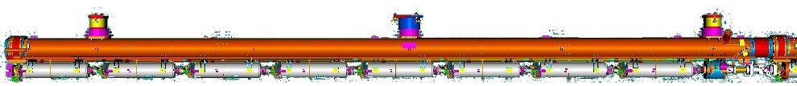





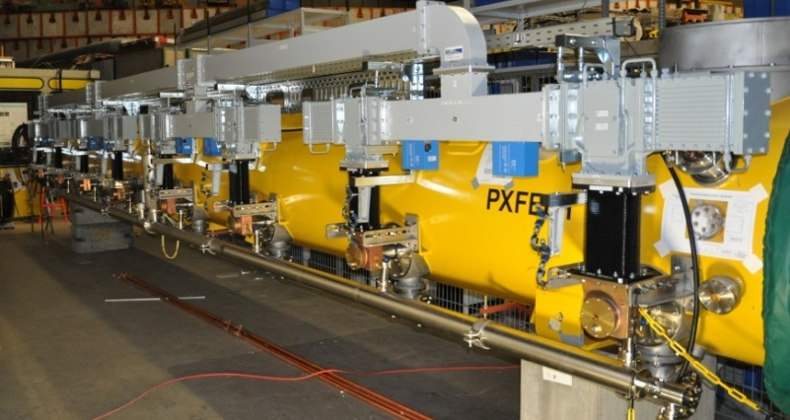
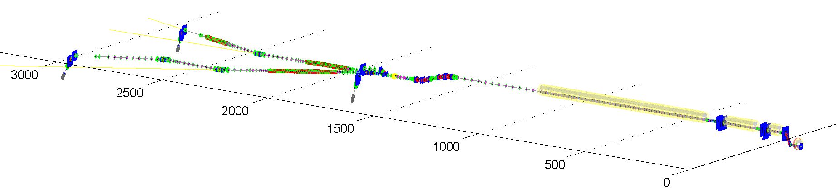
Superconducting Linac Accelerator E-XFEL 17,5 GeV
101 Cryomodules
808 accelerating cavities
1.3 GHz / 23.6 MV/m
25 RF stations 5.2 MW each

Slide 3
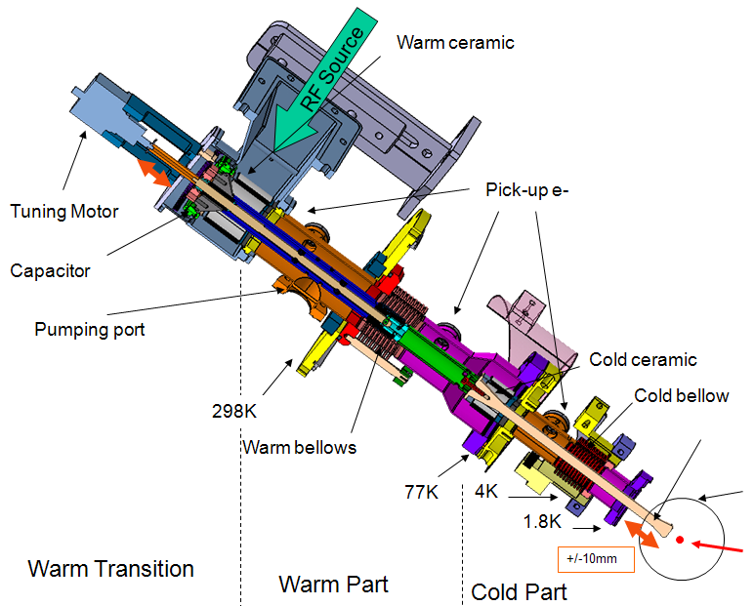
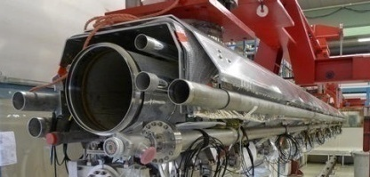
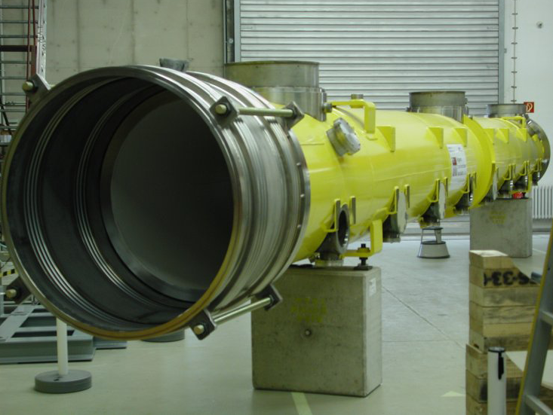
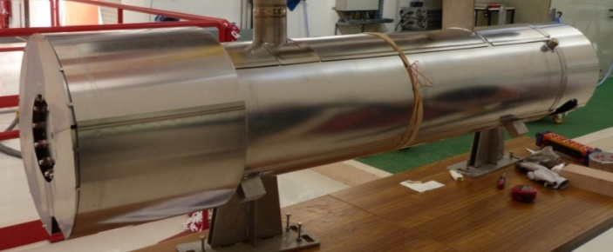
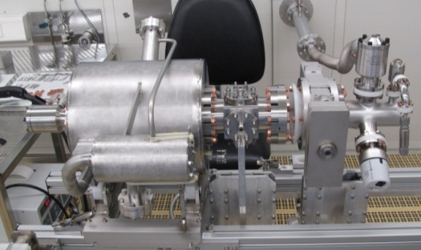
The main components of the cryomodule
Cold mass & vacuum vessel/DESY
Couplers / IN2P3
650 Thales-RI
150 CPI
45 Zanon / 58 IHEP
Magnetic shield/ CEA
Quadrupoles-BPM / DESY
103 Magnets/ Ciemat
72 BPM DESY
31 BPM CEA
Cavity/ DESY
400 Zanon / 400 RI

Slide 4


STATUS DELIVERIES
In the context of the XFEL project, CEA is in charge of assembling the 100 linac cryomodules
CEA has contracted with ALSYOM for assembly
97 cryomodules have been delivered up until now
The XM100 will be delivered at the end of July 2016

Slide 5
The challenges
Make the assembly of 100 cryomodules by an industrial on the Saclay site within the CEA infrastructures
no company was trained and qualified for module integration
Workforce provided by an industrial contractor Alsyom
Maintain a tight time schedule
Production of one cryomodule every 5 days over 2 years
Then schedule acceleration of 25% with one cryomodule every 4 days from January 2015
Guarantee a good quality of the cryomodule assemblies
Avoid gradient degradation, cryogenic losses, coupler mis-assembly, major misalignments, non-compliant welds, etc.…
Manage the interfaces and the changes
Many interfaces or changes have to be managed with different producers and manufacturers
Make a production with a module design not completely adapted to the series
Tools or prototype assembling instructions too complex

Slide 6
CRYOMODULE PRODUCTION RATE
Prototyping phase : assemblies/desassemblies of 3 prototypes (18 months)
Pre-series : assemblies of 3 cryomodules (14 months)
Ramp-up for the series: XM1 to XM8
In mid-October 2014, with XM15, one cryomodule was delivered every 5 days
Since January 2015 (XM25), the delivery rate has reached once every 4 days.
26/03/2014
15/10/2014
07/01/2015

Slide 7
Make the assembly of 100 cryomodules by an industrial
To reduce the risk due to the lack of experience of Alsyom in the cryomodule assembly
CEA got skills in the cryomodule assembly with training his team during prototype assemblies at DESY and at Saclay (18 months)
Three pre-series assemblies had been used to trained Alsyom at Saclay (14m)
One made by CEA and Alsyom in observation with instructions for mounting range
One made by a mixed team CEA/Alsyom
One made by Alsyom with CEA in expertise
Ramp up for the series until XM8 in order to perform the process and evaluate correctly the resources
CEA experts were extremely present during the Alsyom cryomodule assemblies until the operators got enough skills

Slide 8
Maintain a tight time schedule
To Perform a Production of one cryomodule every 5 days over 2 years
Then schedule acceleration of 25% with one cryomodule every 4 days from January 2015
September 2014 a new organization have been implemented by Alsyom
Increased work force 30 to 34 people
New daily organisation with 2 shifts :
7h-14h for assembly activities
11h-19h for welding/Alignment/craning and transfer
extra work if needed in the afternoon
Development of new tooling
Make the process more efficient with mitigating the waste time

Slide 9
Guarantee a good quality of the cryomodule assemblies
In order to avoid gradient degradation, cryogenic losses, coupler mis-assembly, major misalignment, non-compliant welds…
January 2015, a new string assembling procedure has been implemented from XM53 on. Advantage: reduction of the number of operations on cavity => The cryomodule performance has been increased from XM53
Audits have been conducted by CEA per workstation
Both quality teams CEA/Alsyom have been reinforced, in order:
to develop the quality control at component reception
To check if the assembling instructions are followed by the operators
To control the operations quality on assembling line
To implement the preventive actions

Slide 10
Manage the interfaces and the changes
The management of the interfaces was done by DESY
Few issues with the interfaces
70K interfaces didn’t match with the 70K thermal shields
The management of the changes due to different manufacturers for the same component was complex
In general we got the information from EDMS too late
Sometimes we had to manage two different hardware or assembling instructions for a same component
The management of changes need the CEA expertise and a close supervision of the assembly.

Slide 11
Make production with a module design not completely adapted to the series
In order to reduce the risk few actions have been implemented
Production of Assembling instructions
Simplification of complex operations like alignments, mounting of tuner systems,
Automatic control systems for RF, electric test, piezo and tuner motor

Slide 12
Actors of the assembly improvement
ALSYOM Quality control
Improvement
of Assembly Reliability
ALSYOM
Operator
skills and experience
CEA Quality control
CEA expertise

Slide 13
Quality team essential for reliability improvement
After the Alsyom re-organization in September 2014, the main impacts on quality were:
Better coordination (weekly meeting) between the CEA and Alsyom quality teams
The number of component inspections after delivery or preparation has continued to increase
The turning point in reliability improvement was due to the recruitment of a new quality manager in January 2015.
Since this date, the Alsyom Quality team has been in the field
An operator qualification process has been implemented for all new operators
Preventive actions are taken and checked
The operators are made aware of non-conformity issues

Slide 14
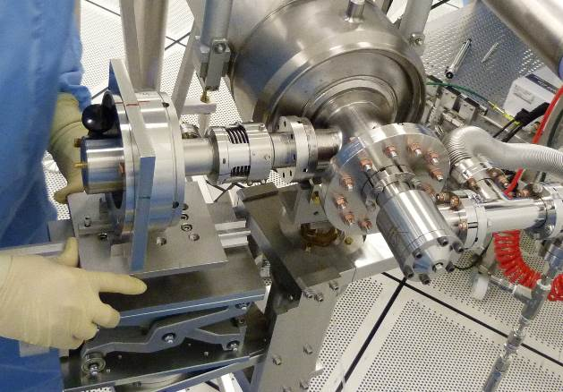
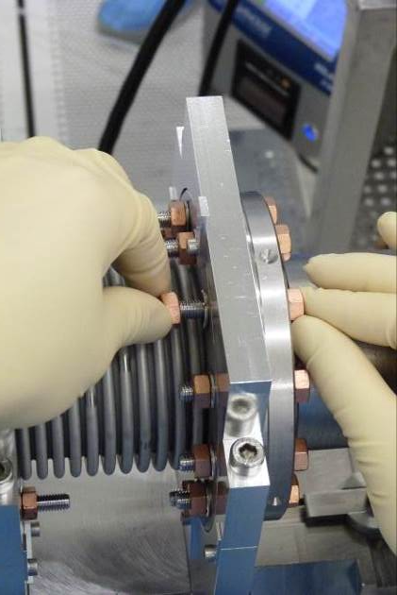
CEA Quality actions From end of 2014
CEA informs Alsyom of any non-conformity detected at DESY and preventive action is decided together
CEA issues reports to DESY (by WP) on the non-conformities detected at Saclay involving components or assembly errors. This makes it possible to foresee the necessary number of components, taking into account the expected end of component production, any manufacturing changes or required spares.
CEA conducts audits, with the help of experts, such as the one performed on XM26, to be sure that the process is actually accomplished according to procedure
Example:
During the XM26 Audit, CEA concluded that 2 operators are necessary to fasten the first 2 bolts that connect the cavity to the bellows. The same applies to the coupler connection

Slide 15
Improvements related to operators
In April 2014, 5 months after their contract began, Alsyom decided to recruit operators with better skills and more experience
Since September 2014 each operator is dedicated to one work station, except for 2 operators who may work at different WS.
At the same time, the assembly process was frozen on each WS
By specialising the operators, they have been able to propose improvements on tools or processes (saving time and improving quality)
Example
In December 2013, the decision was made to x-ray the Ti welds of the 2-phase He pipe. Alsyom mastered this technique in October 2014 with the help of DESY and a new welding engineer. We are now able to weld with Ar instead He/Ar and achieve the same quality
Alignment operators improved the process and can align the cavity string with the cold mass in 6h! All the phases where a plumb line was used have been replaced by another method.

Slide 16
Improvements made by CEA Experts
Process improvements such as the new assembly process in the clean room as of XM54
Experts trained Alsyom operators up to February 2015 when Alsyom took over training activities.
The role of CEA experts remains essential when taking decisions on important issues (repair/replace/use as is).
Experts also gave recommendations to the operators

Slide 17
DSM Irfu DIR
Commissariat à l’énergie atomique et aux énergies alternatives
Centre de Saclay | 91191 Gif-sur-Yvette Cedex
T. +33 (0)1 69 08 xx xx | F. +33 (0)1 69 08 99 89
Etablissement public à caractère industriel et commercial | RCS Paris B 775 685 019

