Slide 1
Radio-Frequency Quadrupole PBS & ConfigurAtion Management
CEA-ESS Quality Workshop June 30th 2016| Louise Napoly

Slide 2
TABLE OF CONTENTS
PRODUCT BREAKOWN STRUCTURE & CONFIGURATION MANAGEMENT
GENERAL CONCEPTS………………………………….P.3
GENERAL SCHEMATIC PBS………………………………………………………….P.6
RFQ PBS AS A TOOL FOR CONFIGURATION TRACEABILITY………………….P.8
TEST MATRIX…………………………………………………………………………..P.12

Slide 3
Product Breakdown Structure Configuration management General Concepts

Slide 4

Definition of A PBS
A Product Breakdown Structure is a tool that details the components of an object or system. Its aim is to define said components, and have a clear understanding of how they interact.
The breakdown structure can be physical, functional or conceptual, among others. Therefore the product or system under consideration can be sub categorized in different manners : there can be various PBSs for only one object.
In order to choose the most appropriate breakdown structure, 2 rules should be followed :
Each category (or sub category) should be 100% complete when its sub components are added up
The PBS should best suit the task it is created for

Slide 5
Configuration Management
The configuration management of a system aims to establish and maintain consistency of its performance and physical components in compliance with the system’s requirements.
Configuration traceability is important to keep track of possible modifications and the overall conformity of the object during its life span.
Therefore, a PBS used as reference for configuration traceability should be the foundation that allows following up on changes and compliance of deliverables.
Sub categories of the first few levels should be project deliverables
The table should identify quantities, buyers and suppliers for each category
Identification references should appear for each deliverable (consequently, objects of the same type cannot be grouped)

Slide 6
GENERAL Schematic PBS

Slide 7
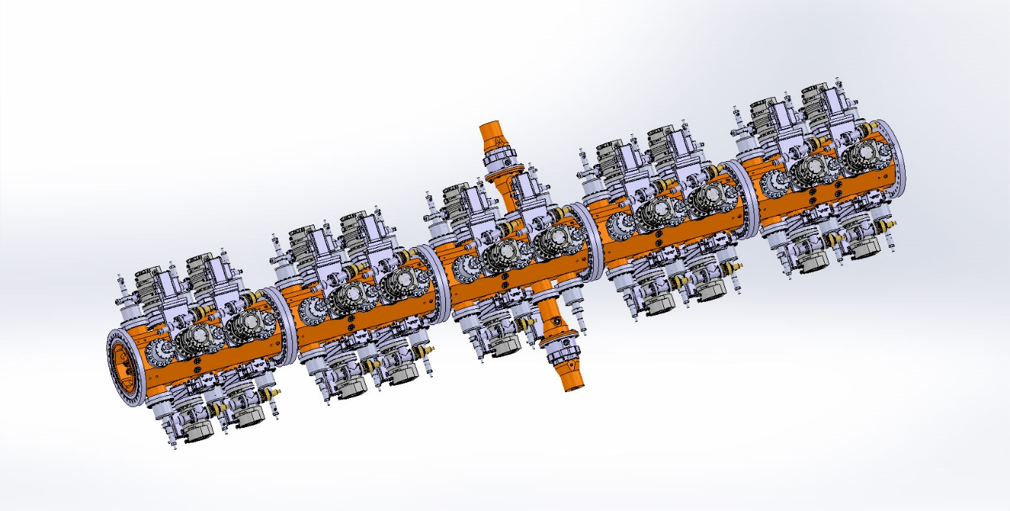
RFQ Deliverables
RFQ (cavity)
RF tuning
Support
Power divider
Sections
RF feed &distribution
I/O Plates
Transition & bidir couplers
Waveguides
Load
Couplers
Vacuum
Tuners
Pick-ups
Cooling
SKID
H2O distribution
RFQ support frame
Coupler support frame
RF distribution support frame

Slide 8
RFQ PBS as a Tool for Configuration Traceability

Slide 9
Configuration Management
Sub categories of the first few levels should be project deliverables
The table should identify quantities, buyers and suppliers for each category
Identification references should appear for each deliverable (consequently, objects of the same type cannot be grouped)

Slide 10
Configuration Management
Sub categories of the first few levels should be project deliverables
The table should identify quantities, buyers and suppliers for each category
Identification references should appear for each deliverable (consequently, objects of the same type cannot be grouped)

Slide 11
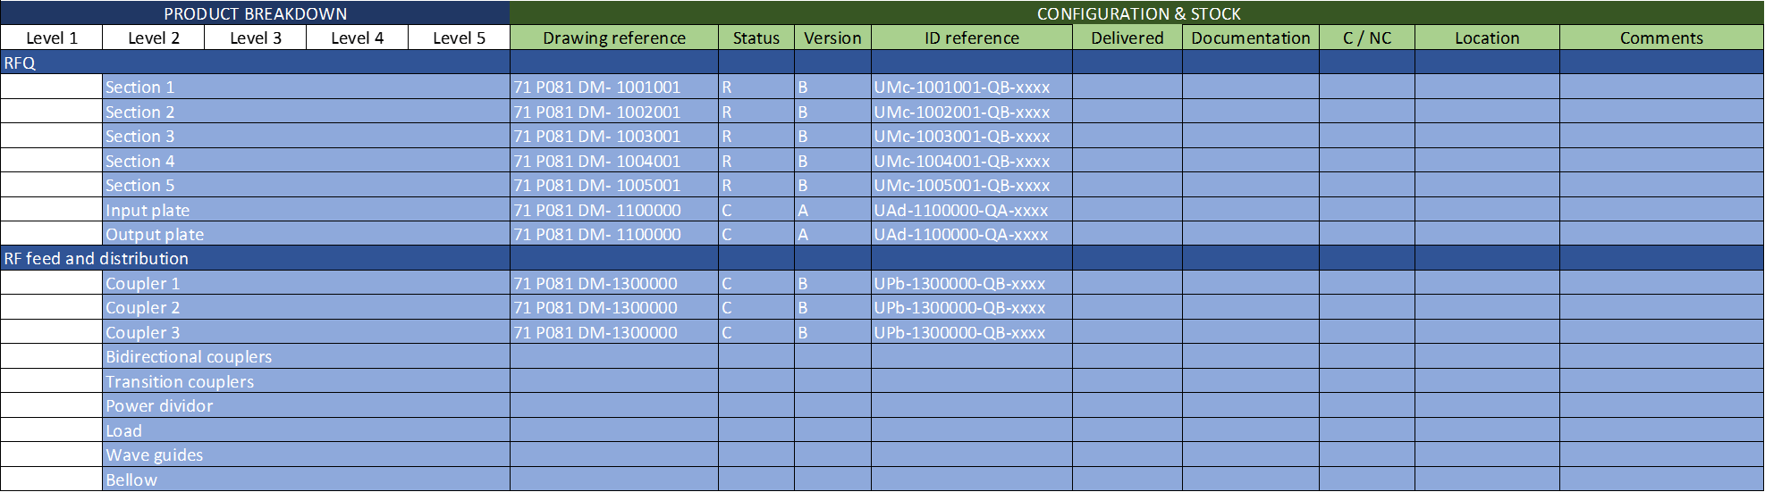
Configuration Management
Sub categories of the first few levels should be project deliverables
The table should identify quantities, buyers and suppliers for each category
Identification references should appear for each deliverable (consequently, objects of the same type cannot be grouped)

Slide 12
Test Matrix

Slide 13
Configuration Management
DRAFT

Slide 14


DRF Irfu
Thank you for your attention !
Commissariat à l’énergie atomique et aux énergies alternatives
Centre de Saclay | 91191 Gif-sur-Yvette Cedex
T. +33 (0)1 69 08 xx xx | F. +33 (0)1 69 08 99 89
Etablissement public à caractère industriel et commercial | RCS Paris B 775 685 019

