Slide 1
Lessons learnt from NSS scope setting & notes on delivery schedule
Shane Kennedy
NSS Project Leader
European Spallation Source ERIC
www.europeanspallationsource.se
IKON-11, 14 September 2016

Slide 2
NSS Project: Priorities for 2016
To establish a robust plan for early science success
Key steps;
Align the instrument budgets with the NSS budget
Align all other infrastructure (such as bunker, services and labs) and support activities with the NSS budget (Completed on 6 Sept)
Develop a realistic schedule for all instruments in line with ESS dependencies, available in-kind resources and partner capabilities
Match NSS scope to ring-fenced budget of 350 M€

Slide 3
NSS Internal WP scope setting Changes since selection of instruments (2015 & 2016)
NSS has shifted budget and resources into priority areas for early science success;
Major scope changes;
scope is limited to the first 16 instruments,
emphasis is on success with first 8 instruments –including essential sample environment
Nett budget changes;
from internal NSS work packages; - 32 M€
to neutron instruments/bunker; + 29 M€
to contingency; + 3 M€
Notes;
NSS contingency now at 10 % of cost to complete. (This is a minimum acceptable level)
Bunker provisional budget set in Aug 2015 – currently being re-costed

Slide 4
Instrument Scope-Setting Meeting
2 months before TG2 review
Small meeting
instrument team
NSS project management
partners and technical groups, as required
Instrument team presents scope and budget for 1-3 options
1: within cost category (9/12/15M€) minus 10% contingency
2: configuration 2 (optional)
3: configuration 3 (optional)
For each configuration, describe:
degree of achieving requirements and impact on science case
upgradability through staging plan

Slide 5
Objectives for scope setting meetings
Agree on the scope for the instrument within the NSS budget (including essential Sample Environment)
Agree on the cost book value for that scope
Agree on the key delivery dates (Toll gates) – particularly TG4 (installation) & TG5 (hot commissioning)
Evaluate upgrade options; including paths, scope, strategy & timing

Slide 6
NSS Project; Neutron Instrument project phases
Proposal and Planning
Design and Construction
Installation and Commissioning
Instrument Proposal
Phase 0
Preparation for Design
Phase 1
Preliminary Design
Phase 2
Detailed Design
Phase 3
Manufacturing and Procurement
Phase 4
Installation and Integration
Phase 5
Hot Commissioning
Deliverables
Science case covering scientific relevance, impact and usage
Conceptual design with credible estimates of performance
Preliminary costing.
Deliverables
Conceptual design updates
Prototyping
Definition of facility requirements and interfaces
Clarification of institutional responsibilities
Resource planning
Deliverables
Scientific and technical requirements
Technical design concept
Delivery plan for all phases (including hot commissioning)
Delivery Schedule covering all phases
Resource plan
Staging plan for later enhancements
Budget with contingency at 10% of cost to complete
Deliverables
Complete definition of all major technical components
Completion of detailed plan for Phase 3
Refined plan for phase 4
Refined Resource plan
Refined delivery schedule, with critical path items and dependencies
Refined budget with contingency at 10% of cost to complete
Deliverables
Procurement and manufacture of all major technical components
Completion of detailed plan for phase 4
Site preparation
Refined plans for phase 5 and for staging
Refined Resource plan
Refine instrument delivery schedule
Maintain budget with contingency at 10% of cost to complete
Deliverables
Construction of physical infrastructure on site.
Assembly and installation of technical components
Integration and testing of technical components
Installation, integration and testing of Personnel Safety System
Submission of application for approval to hot commission
Formal project completion
Deliverables
Verification of performance of Personnel Safety System
Proof of compliance with radiation dose limits
Critical performance demonstration of basic functionality
Scientific performance demonstration
Friendly user experiments
Completion of technical and user manuals
Tollgate 1
STAP review
SAC recommendation
NSS recommendation
STC approval
Tollgate 2 (PDR)
Preliminary Design Review
STAP review
NSS
scope review
assign cost book value
approval
Tollgate 3 (CDR)
Critical Design Review
STAP review
ICB review
NSS approval
Tollgate 4 (IRR)
Installation Readiness Review
ICB review
NSS approval
Tollgate 5 (SAR)
Safety systems acceptance review
NSS approval
Tollgate 6 (ORR)
Operations readiness review
NSS approval
STC approval

Slide 7
Instrument scope setting meetings
SKADI, ESTIA and DREAM have had scope setting meetings.
10 more scope setting meetings have been schduled in October
SKADI scope agreed & cost book value still under evaluation – Cost setting meeting scheduled for 29th September
ESTIA scope/cost book value (11.8 M€) essentially agreed – Toll Gate 2 planned for November
DREAM scope/cost book value (13.66 M€) essentially agreed – Toll Gate 2 planned for December

Slide 8
Lessons Learnt from scope setting (1/2)
NSS project management depends on our specialist support teams for input into scope setting meetings
Before scope setting, we expect that all our specialist teams have been fully informed of your plans, and support them. This includes;
neutron optics and shielding,
choppers,
detectors,
motion control and automation,
sample environment and
DMSC
If you have not informed our specialist support teams of your plans do not expect a favourable outcome from scope setting.

Slide 9
Lessons Learnt from scope setting (2/2)
The cost category target value for your instrument is ALL we have in the NSS budget at this time.
Your proposal must demonstrate a serious assessment of the level of performance that can be delivered within the cost category.
Any option higher than the cost category value must be backed by
A detailed breakdown of costs – including labour
A mature delivery plan, and
An evaluation of the competitiveness of the instrument against current best-in-class instruments

Slide 10
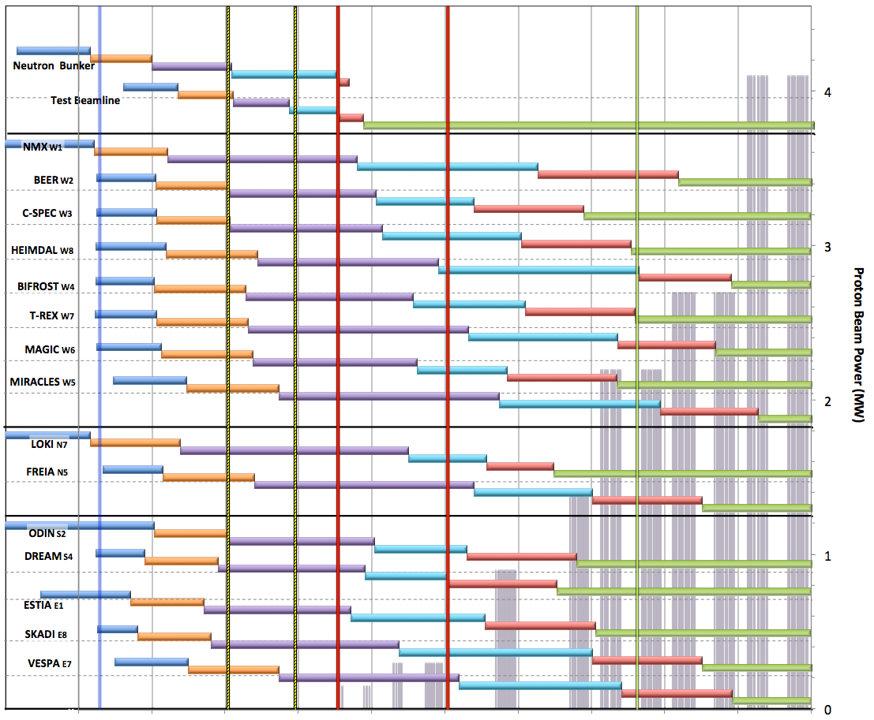
Neutron Beam Instrument Draft Schedule V1.6, 7th April 2016
Currently under review
Current date
Early Access D01/D03
Full Access D01/D03
Beam on Target / 1st spectrum
Start Hot Commission
User instruments
Start User Program
Commissioning of test beam – to demonstrate performance and inform instrument projects
Notes;
The order of completion 1- 8 chosen for science and deliverability
Shift 9-16 to focus on 1-8 for early science success
Hot Commissioning start;
E ≥ 200 MeV
P ≥ 200 kW
January 2021
DRAFT
West sector
North sector
Preliminary Design
Detailed Design
Manufacturing & Procurement
Installation & Integration
Hot Commissioning
Operation
East and South sectors
2016 2017 2018 2019 2020 2021 2022 2023 2024 2025

Slide 11
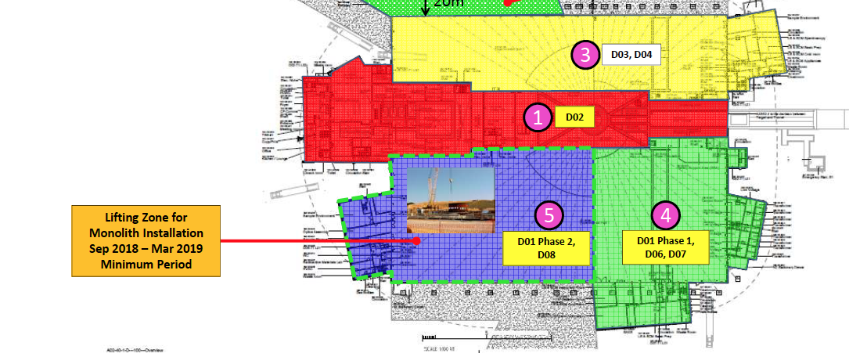
Conventional Facilities - Target construction plans
Access to NSS construction areas will be later than current plan:
NSS priorities;
full Bunker construction before Beam On Target
Early Success (first 8 neutron Instruments)
Lifting zone for Target installation should not restrict access to bunker work area

Slide 12
Notes on schedule;
There is schedule pressure on preparation of our (NSS) workspaces.
There is pressure on date for Beam on Target - toward early 2020
Bunker must be complete for Beam on Target
Target/Bunker installation to include as many “beam-inserts” as possible –message for instrument teams is to prioritize design of optical inserts to the can be manufactured in time for installation in 2019
Instrument access to site unlikely before mid – late 2019
Early instruments should plan for parallel installations in 2020 and for start of Hot Commissioning in 2021

