Slide 1
IKON 20160914 The Bunker Project
Zvonko Lazic
Project Leader
www.europeanspallationsource.se

Slide 2
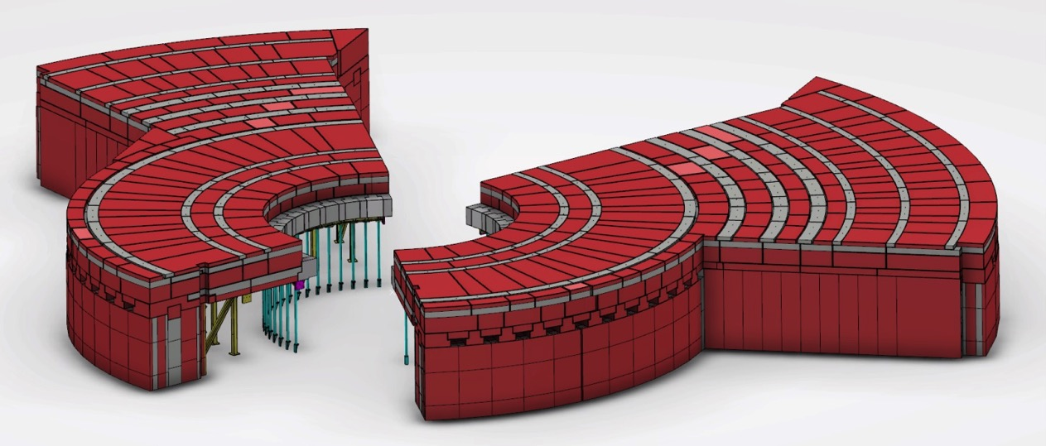
Content
Project/organisation/communication
Engineering Design
Interfaces
Q/A
Neutronics
Q/A

Slide 3
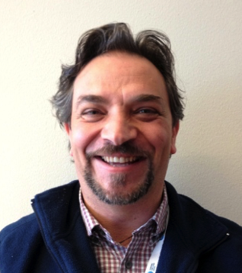
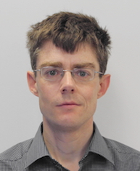
Bunker Project the Who
Planning – Sofie Ossowski
NSS Project Planner
Neutronics– Valentina Santoro
PostDoc - Neutron Beam and Shielding
Mechanical design – Benjamin Davidge
Mechanical Design Engineer
Project lead – Zvonko Lazic
NSS Integration Engineer
Neutronics– Stuart Ansell
Senior Beamline Scientist

Slide 4
Bunker Concept Update 2016-09-08
Benjamin Davidge
Mechanical Design Engineer
www.europeanspallationsource.se

Slide 5
Content
Bunker base and CF floor
Wall configuration
Instrument wall feedthru concept
Utilities feedthru concept
Support frame
Roof
Sector Reduction
Transport

Slide 6
1. Bunker base and CF floor - Basic details
Wall horizontal chicane detail
Roof vertical chicane detail. Shelf also used for roof edge support
Wall horizontal chicane detail
Inner surface of bunker floor at -1250mm below TCS
(regular concrete poured at same time as CF floor)
Wall support floor level -1500mm below TCS
D03 instrument hall floor (West) -2000mm below TCS
D03 instrument hall floor (North) -2500mm below TCS
Monolith D02 building and instrument hall D03 section (North and West instrument sectors)

Slide 7
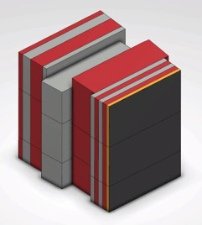
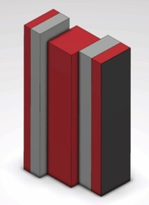
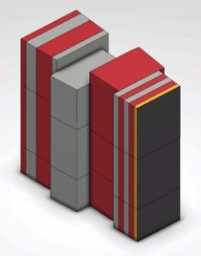
2. Wall configuration - North and West sector wall

Slide 8
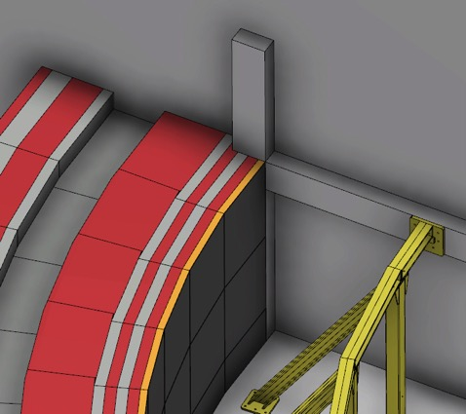
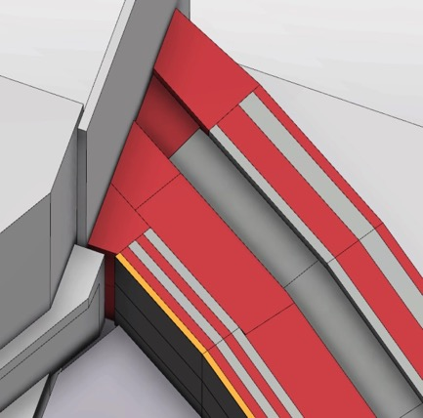
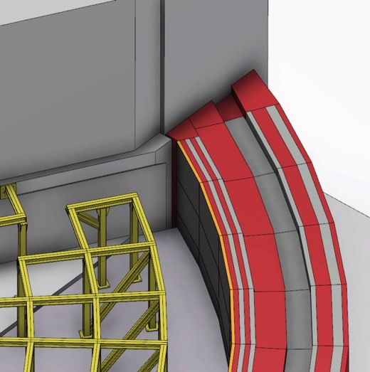
2. Wall configuration - R15m and R28m wall CF interfaces
R15m Wall
R28m Wall

Slide 9
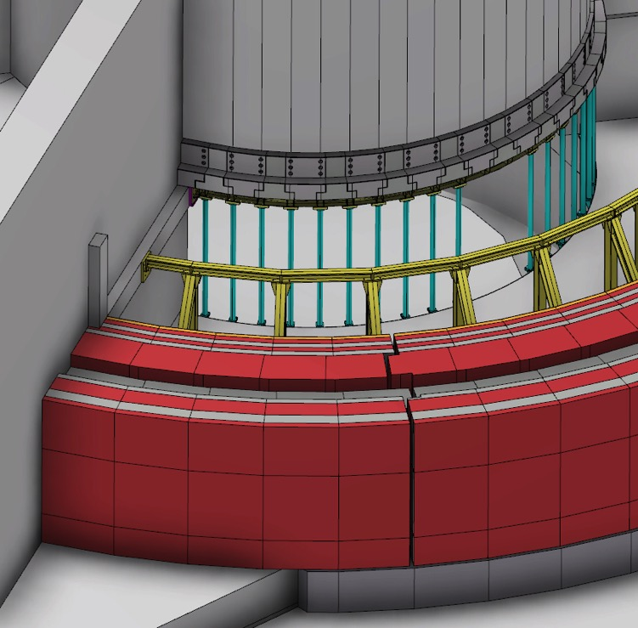
3. Instrument wall feedthru concept - Sequence for R15m wall mid-section replacement with customized instrument feedthru block set
Default wall mid-section block set in place

Slide 10
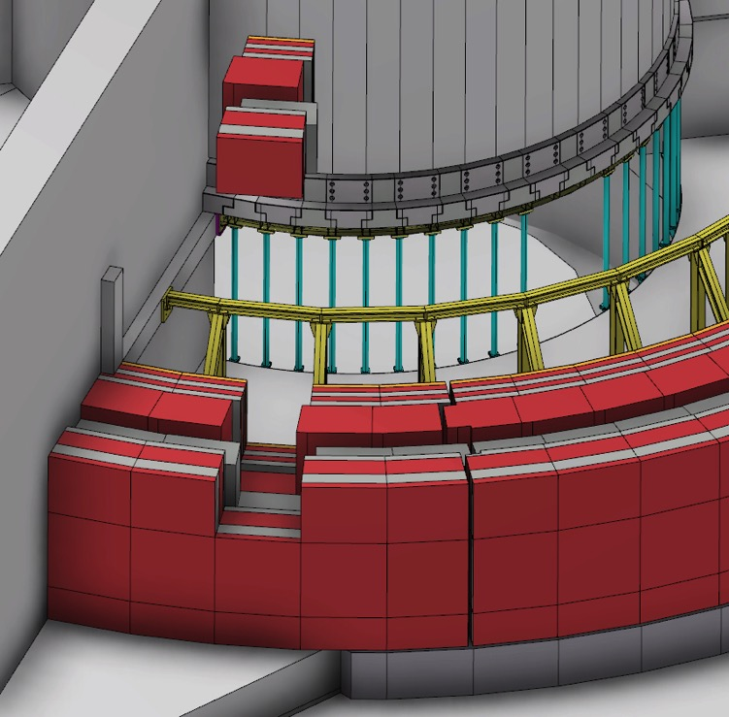
3. Instrument wall feedthru concept - Sequence for R15m wall mid-section replacement with customized instrument feedthru block set
Default wall upper-section block set removed

Slide 11
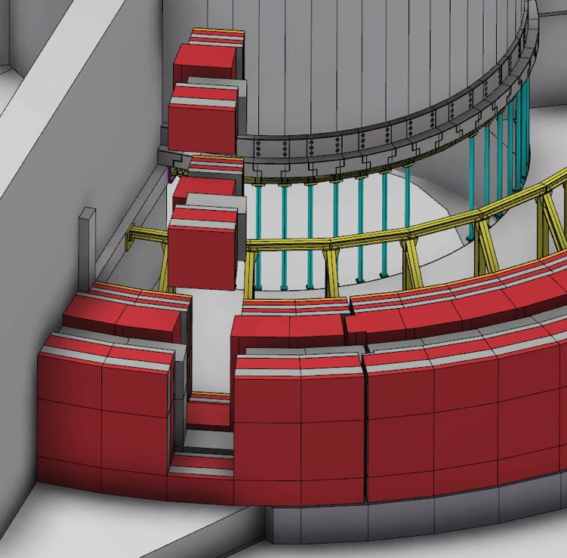
3. Instrument wall feedthru concept - Sequence for R15m wall mid-section replacement with customized instrument feedthru block set
Default wall mid-section block set removed

Slide 12
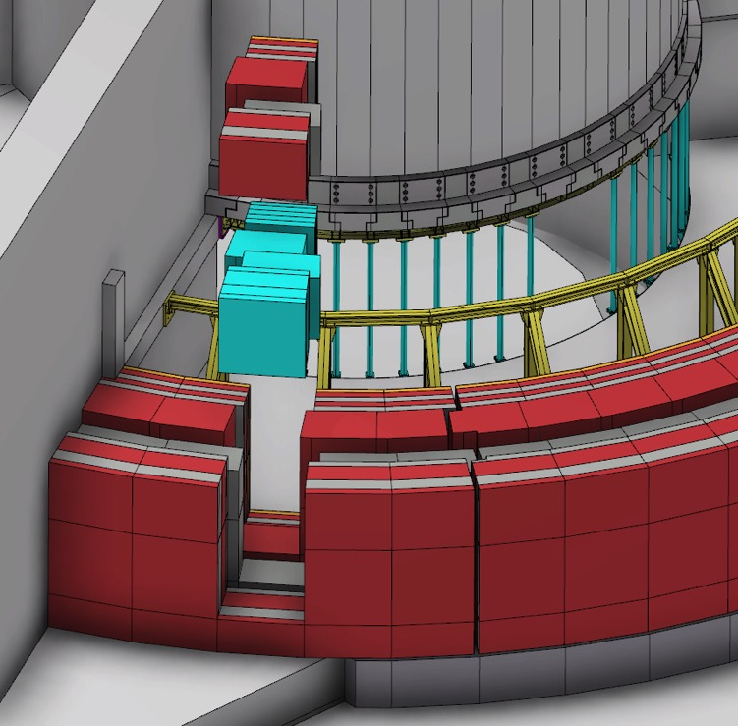
3. Instrument wall feedthru concept - Sequence for R15m wall mid-section replacement with customized instrument feedthru block set
Default wall mid-section block set replaced by customized instrument feedthru block set

Slide 13
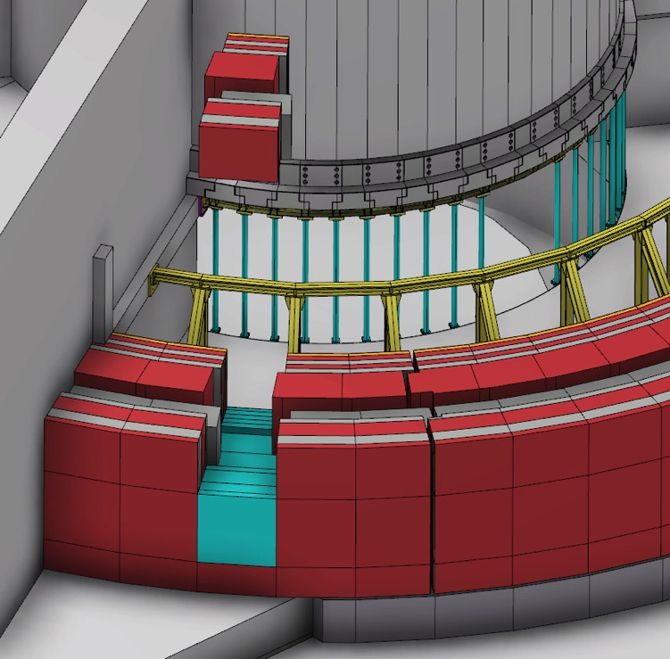
3. Instrument wall feedthru concept - Sequence for R15m wall mid-section replacement with customized instrument feedthru block set
Customized instrument feedthru block set installed

Slide 14
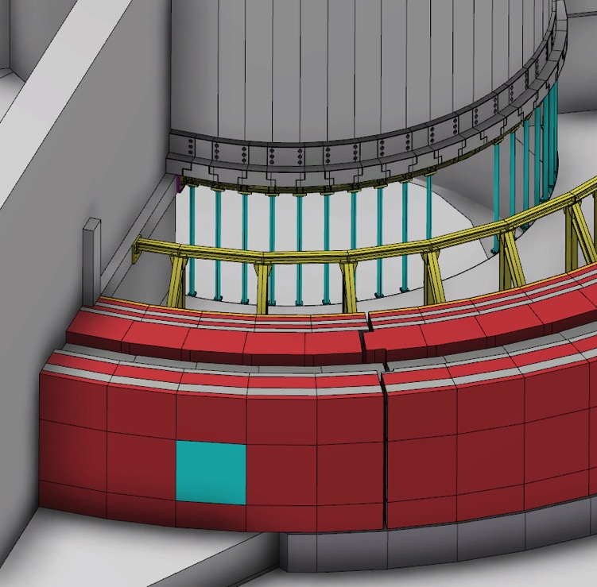
3. Instrument wall feedthru concept - Sequence for R15m wall mid-section replacement with customized instrument feedthru block set
Default wall upper-section block set reinstalled

Slide 15
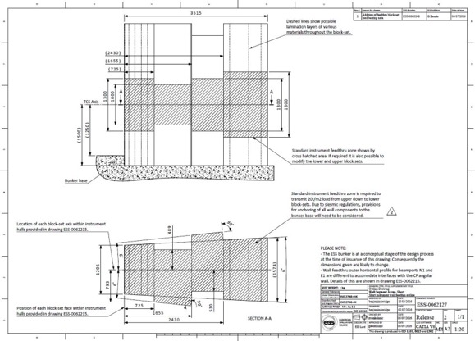
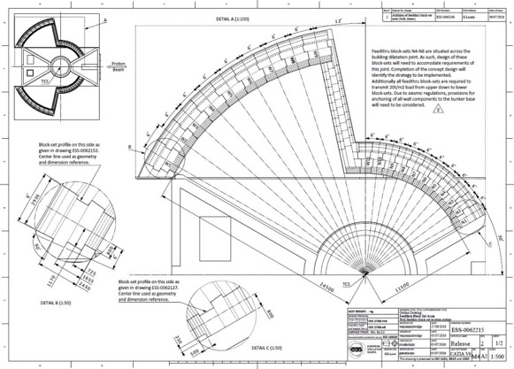
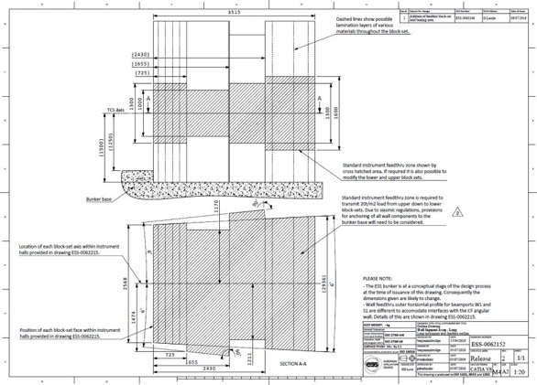
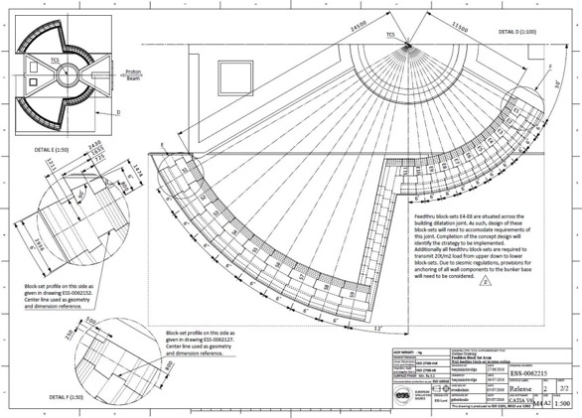
3. Instrument wall feedthru concept - Available mid-section block set outline drawings
Outline drawings of geometry, dimensions and positions for mid-section block sets.
ESS-0062215 (Assm.), ESS-0062127 (Short) and ESS-0062152 (Long).

Slide 16
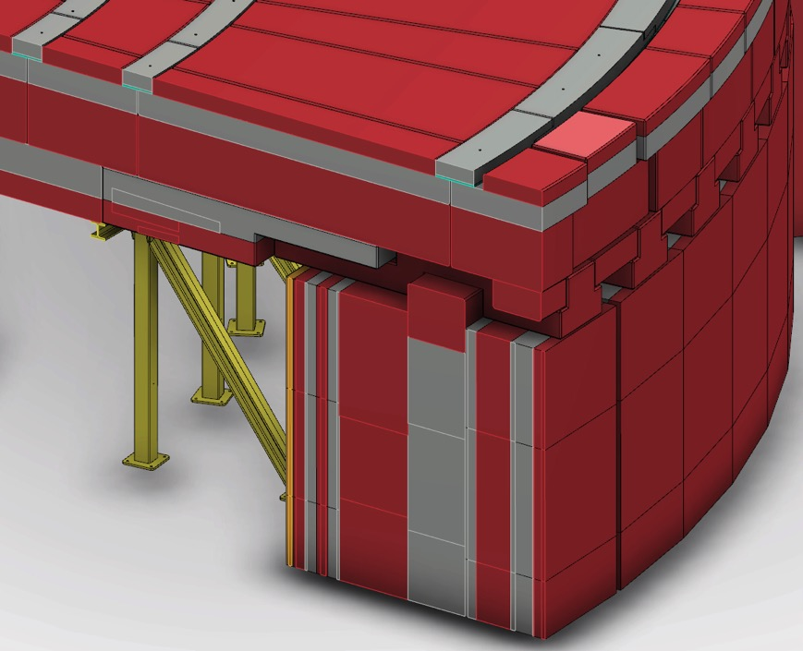
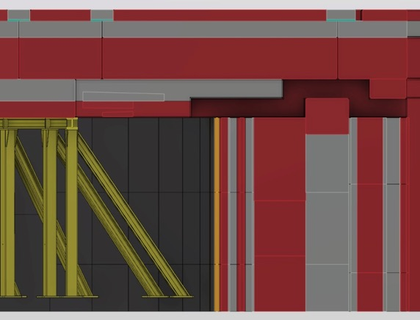
4. Utilities feedthru concept - Utilities routing above the wall, under the roof
Images show proposed geometry of utilities cavity. Investigation underway into maximum foreseeable cavity area required.
(shown 70cm x 35cm high)

Slide 17
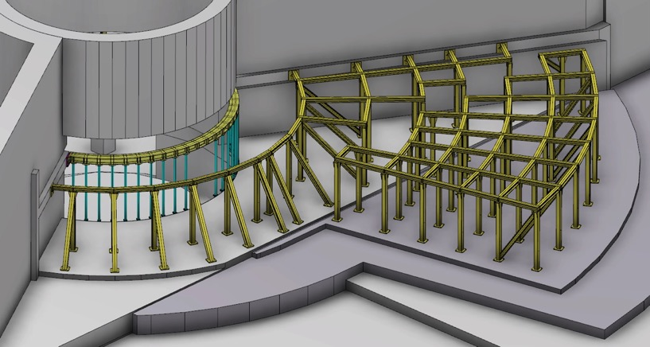
5. Support frame - Basic concept, seismic analysis underway
R6m Frame
Outer Frame E&S
Outer Frame
Inner Frame
D01
D02
D03
The roof support frame consists of 3 separate frame structures per side.

Slide 18
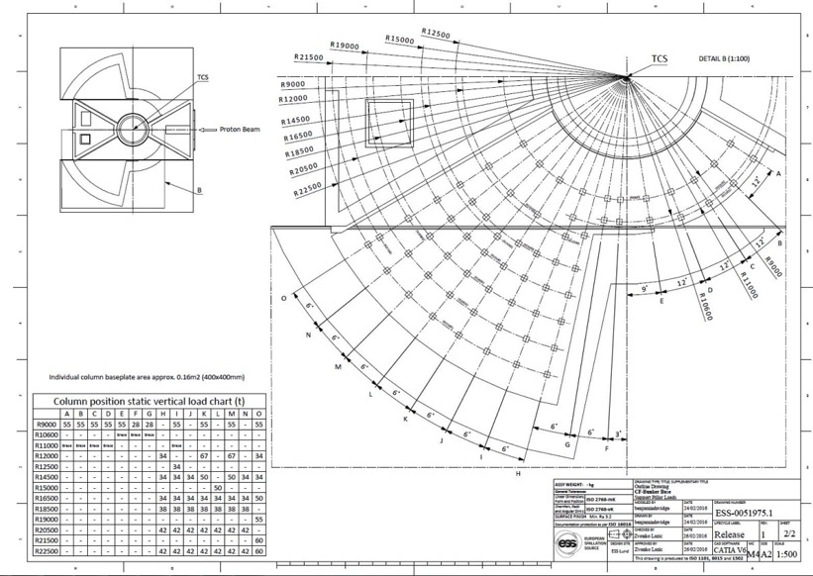
5. Support frame - Column and brace positions set
Positions for columns and brace beams have been set.
CF is currently undertaking concrete reienforcement design to suit.
Positions are provided in drawing ESS-0051975.

Slide 19
5. Support frame - Column and instrument integration
Shifting of the pillars and angle braces should be considered a ‘last resort’ by instrument teams.
Individual frame elements must be considered in context of the whole frame structure.
Modification will involve additional design effort and recertification having sizeable cost implications.

Slide 20
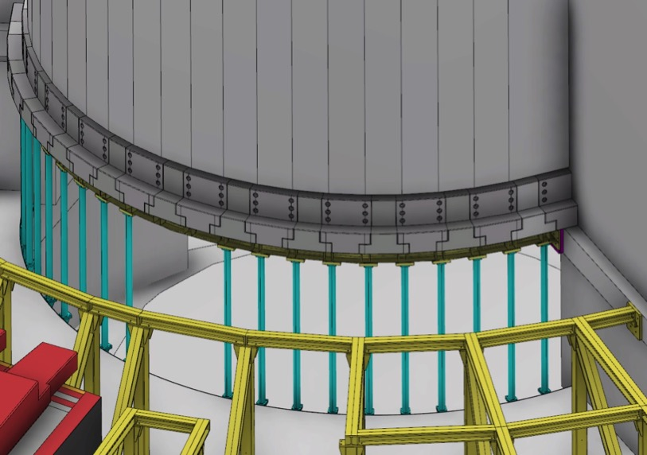
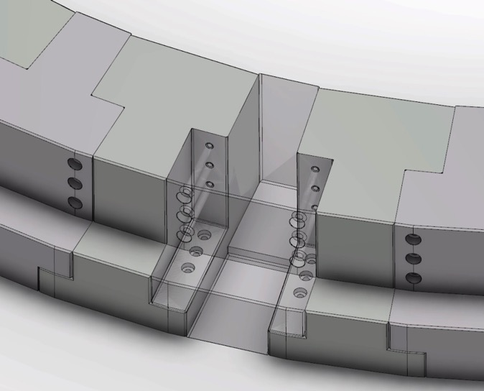
6. Roof - R6m semi-permanent shield block ledge support
Interlinking steel blocks bolted together and to CF structure through yellow lower curved beam and blue support columns.
Front ledge of blocks extend to R6.2m from TCS.
Blocks considered a semi-permanent installation not intended to be removed during regular access into bunker.

Slide 21
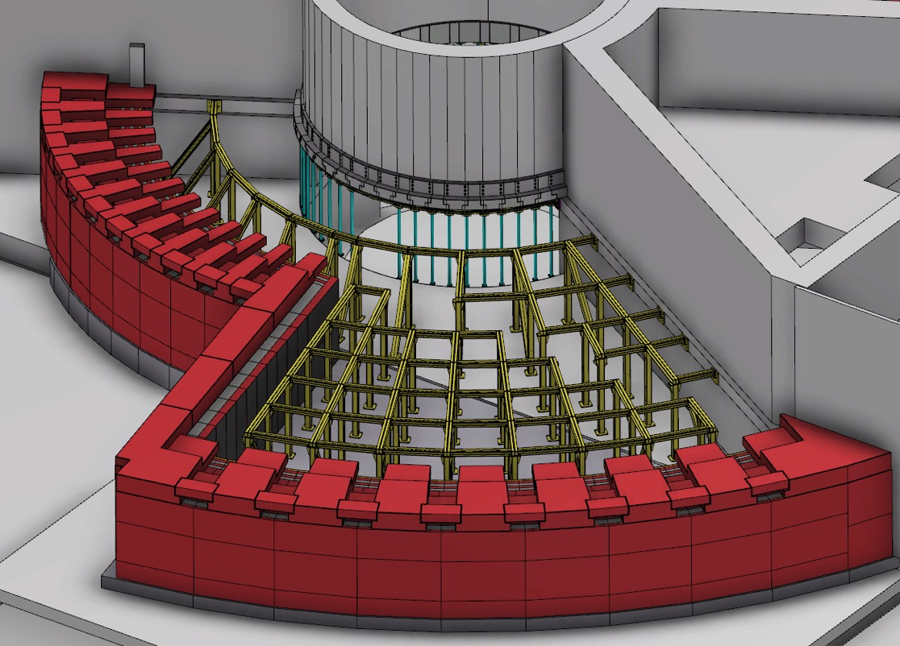
6. Roof - Utilities block layer
Utilities blocks placed on top of wall sections to provide duct cavity.
Blocks will likely be bolted in place.
All unused utilities ducts will be filled with temporary shielding blocks.

Slide 22
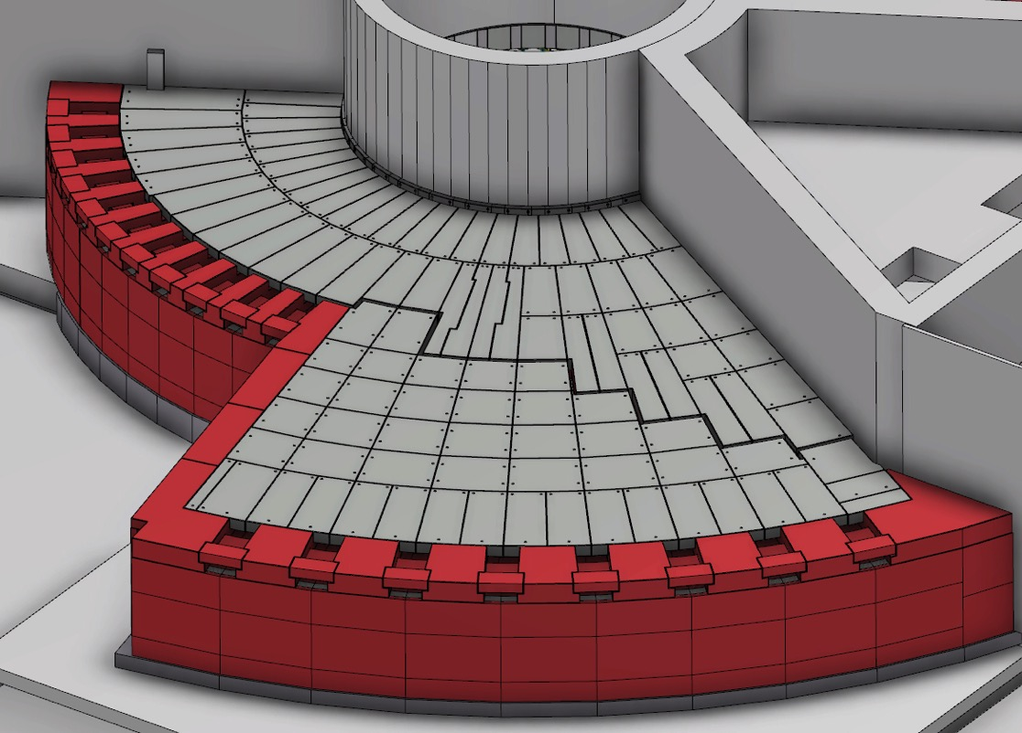
6. Roof - First 2 roof layers
Proposal for first 2 roof layers (30cm ESS-PBC + 40cm steel) to be single composite blocks.
Blocks will be bolted or pinned in place.
Create a ’floor’ for consectutive blocks to be placed.
Dilatation joint propagated vertically between D02 and D03 (shown) & D01 buildings.
Blocks anchored to D02 side
Blocks anchored to D03 side
Dilatation joint

Slide 23
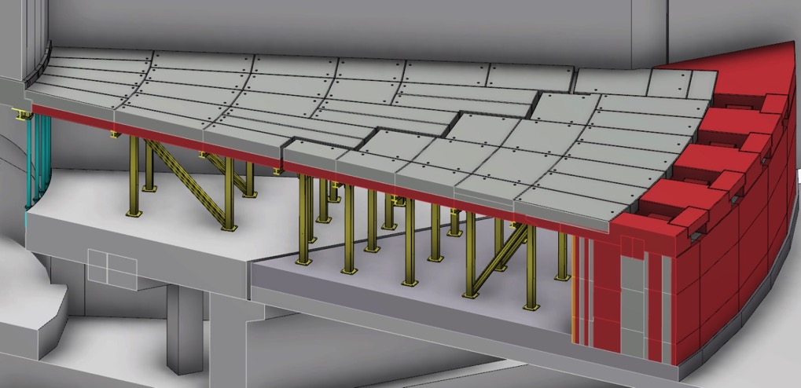
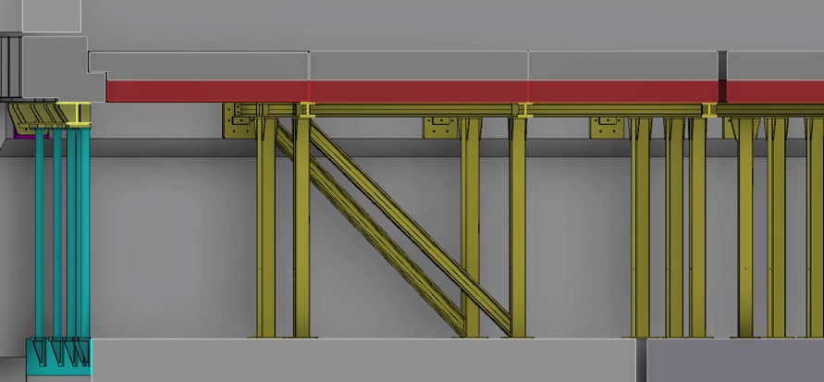
6. Roof - First 2 roof layers
Dilatation joint

Slide 24
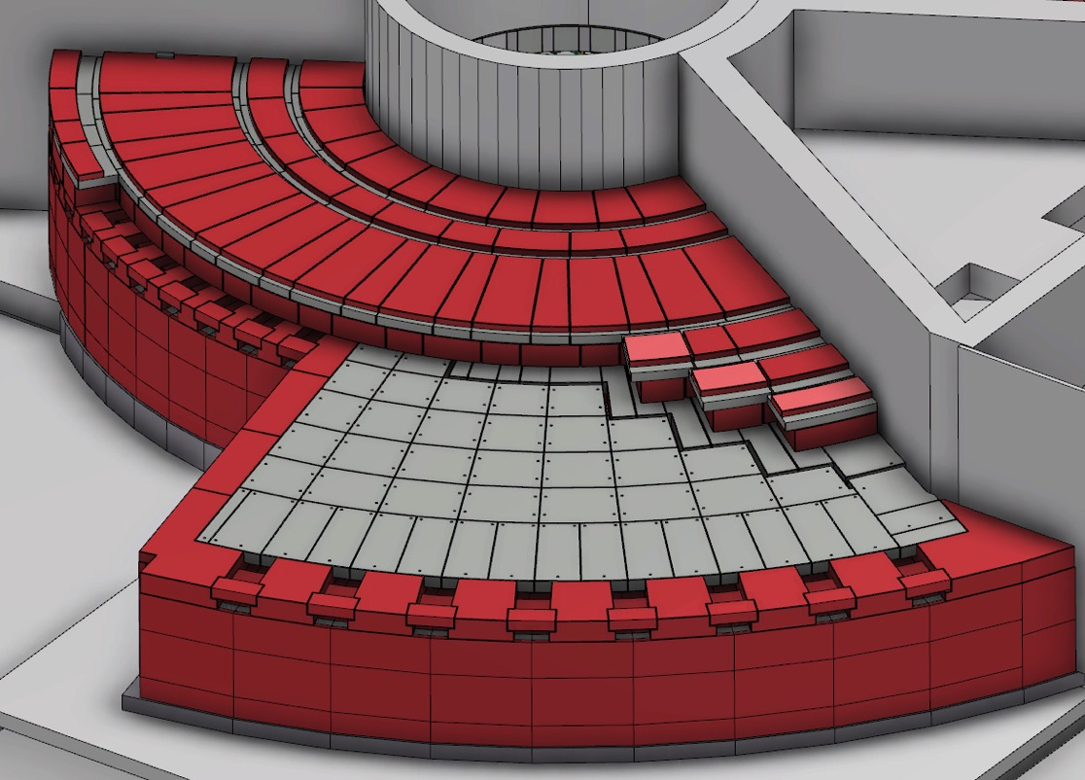
6. Roof - Last 3 roof layers – D02 Blocks
Proposal for last 3 roof layers (75cm ESS-PBC + 30cm steel + 20cm ESS-PBC) to be single composite blocks.
Perimeter blocks to be pinned in place to corresponding side of dilatation joint.
Continued vertical dilatation joint propagation.
Blocks anchored to D02 side

Slide 25
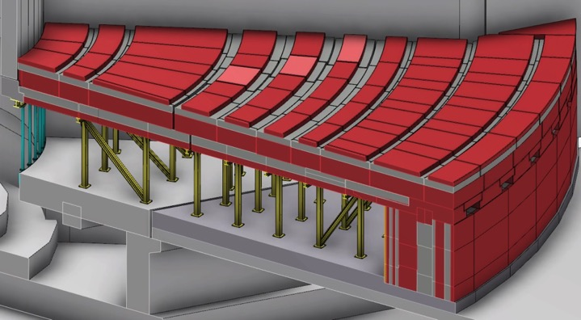
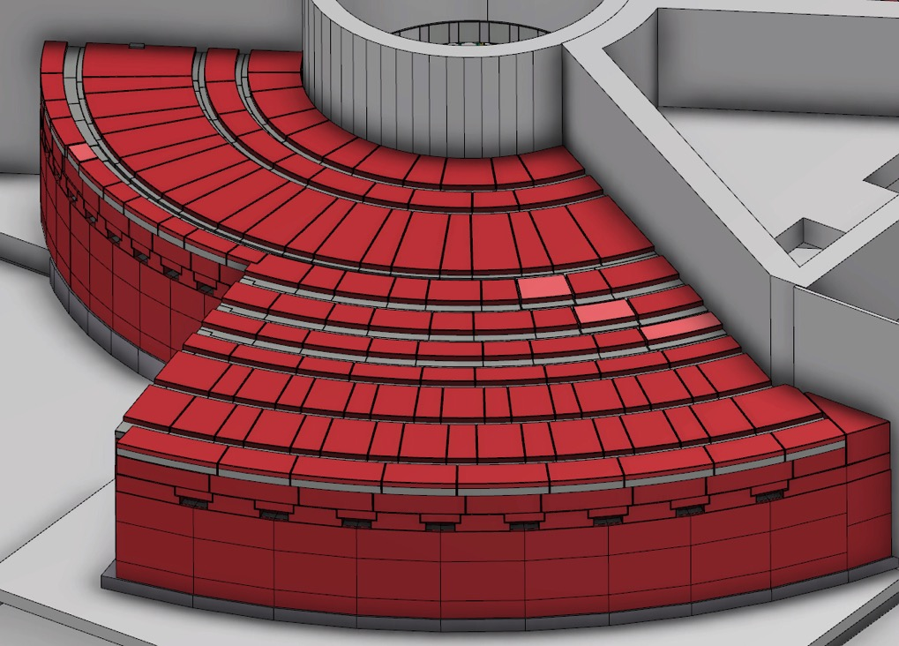
6. Roof - Last 3 roof layers – D02 + D03 Blocks
Blocks anchored to D02 side
Blocks anchored to D03 side

Slide 26
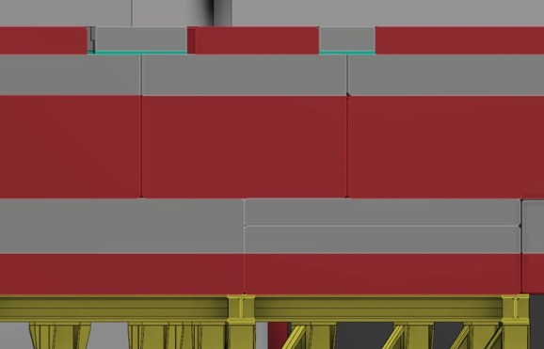
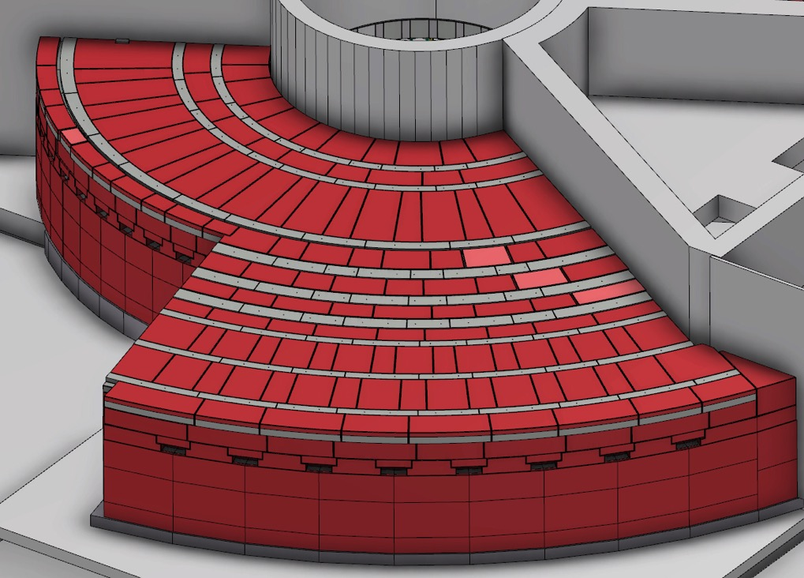
6. Roof - Cross-streaming blocks
Cross-streaming blocks
Cross-streaming blocks
Borrated PE and Steel radial blocks for small cross-streaming gap mitagation.
Individual blocks between 1-2t each.
Potential location of interlocking within these blocks.

Slide 27
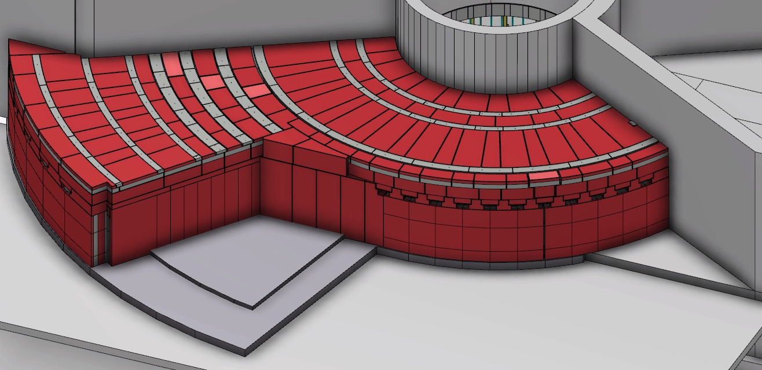
7. Sector Reduction
- South sector
Cost analysis underway for building a reduced South Sector.
Only first 3 – 4 beamport wall blocks initially installed.
Temporary shielding implemented in remaining beamport positions.
Design work to be completed allowing extension to a full South Sector when required.

Slide 28
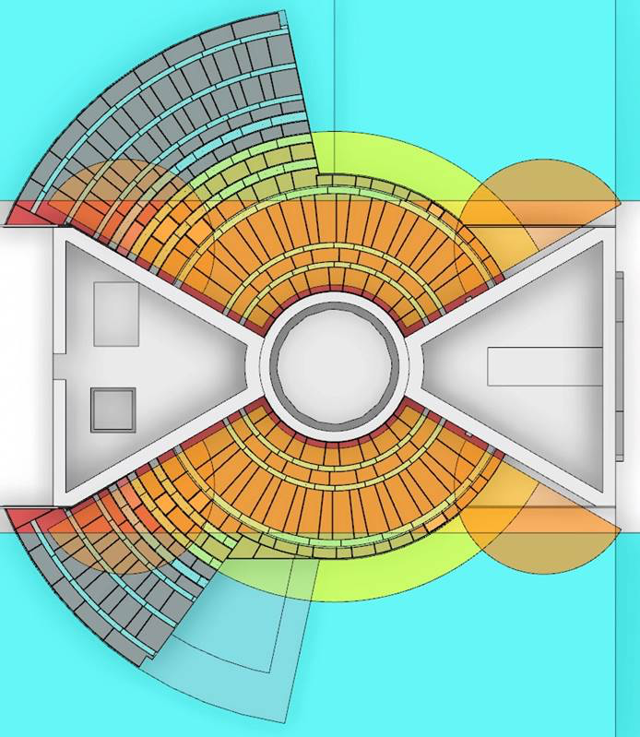
8. Transfer/buffer zone
The yellow colored surface is planned ‘monolith crane’ [20t] coverage
The cyan colored surface is the experimental halls crane [30t] coverage
The transfer/buffer zone is indicated by overlap of the two
The monolith crane is not fully defined yet
Once the monolith crane is defined, we will decide on need of extended platform to facilitate the transfer/buffer zone
If the platform is deemed necessary, it is likely to be at the same level as the top of the bunker roof

Slide 29
Reference documents
Documents (PDF’s, available in CHESS):
Neutronics Design of the Bunker – ESS-0052649
Baseline Geometry of Monolith and A2T Supporting Structure – ESS-0042957
Monolith and A2T Appendix (supporting drawings for above) – ESS-0051605
CF-Bunker Base Support Pillar Loads – ESS-0051975
Feedthru Block Set Assm – ESS-0062215
Wall Segment Assm - Short – ESS-0062127
Wall Segment Assm - Large – ESS-0062152
CAD Models (available in Catia V6 and 3D Live Examine in CHESS):
Bunker Top Assembly - ESS-0047079
Bunker & Monolith Assembly – ESS-0053442
EPL (Entire Plant Layout) – ESS-0016885

Slide 30
Outlook and plan
Important events coming up
Technical Advisory Committee review early October
Preliminary Design Review mid December
Critical Design Review Second Quarter 2017
Production commencement mid-2017
Key outstanding issues in the process of resolution
Requirements (SSM related/ratings/safety/personal safety) {draft by the end of September}
Structural analysis incorporating Internal Structure Response Spectra to seismic event (structure sized to withstand dynamic loads corresponding to above requirements) {by the end of October}

Slide 31
Q/A
The bunker design will be scrutinized throughout the remainder of the concept design. We welcome any constructive comment and suggestion.
Myself, or Benjamin Davidge (the Design Engineer) will be available throughout the parallel sessions on Shielding.
I wish to thank the Bunker Project team at ESS, and all contributions from the partners, resulting in the design that will be cost effective, buildable, and will perform to specifications.
Thank you!

