Slide 1
ACCSYS
Upcoming milestones
Status reporting
Submitting deliverables

Slide 2
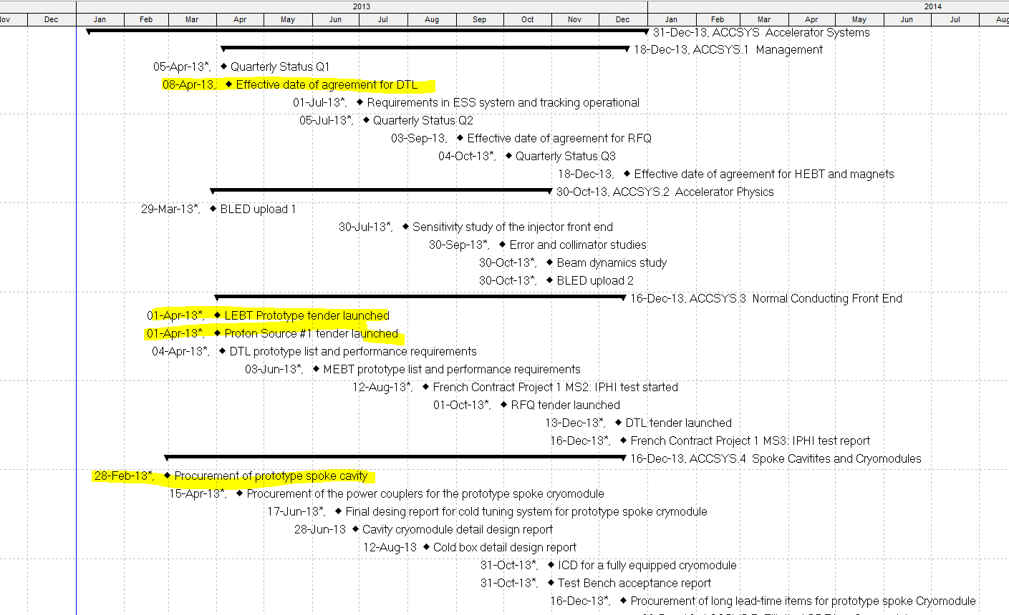

Slide 3
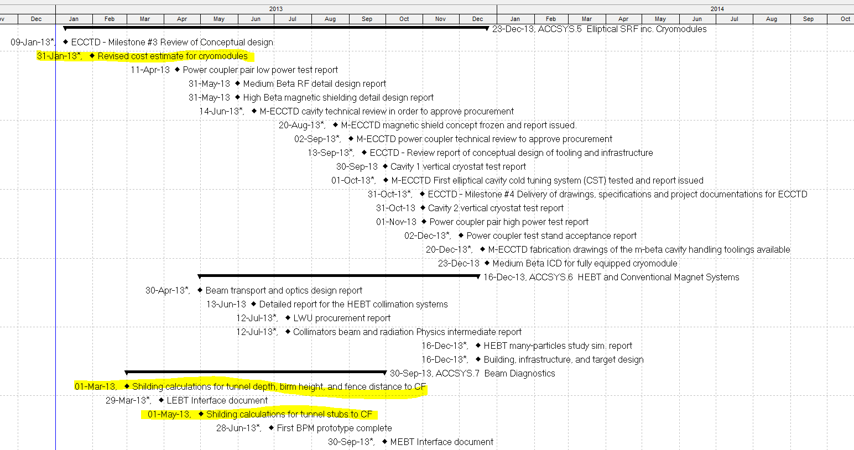

Slide 4
