Slide 1
Accelerator Prepare-to-build (AP2B) WP19 - Monthly Report – 2013-01-23
R
Y
Status | Summary: FREIA hall construction ongoing Final report spoke RF source review: Preparing tender spoke RF power station
Key Achievements |  | Planned Key Activities | Main Risk and Issues
FREIA hall indoor work started final report spoke RF source review (positive!) horizontal cryostat basic design finished liquefier kick-off meeting with vendor |  | finalizing tender spoke RF power station (pre-series) study spoke RF distribution with coax horizontal cryostat 3D design preparation SSA studies RF bunker layout, incl. RF distribution layout and cryo lines | contract update discussions Uppsala-ESS in process timely tender of horizontal cryostat
G

Slide 2
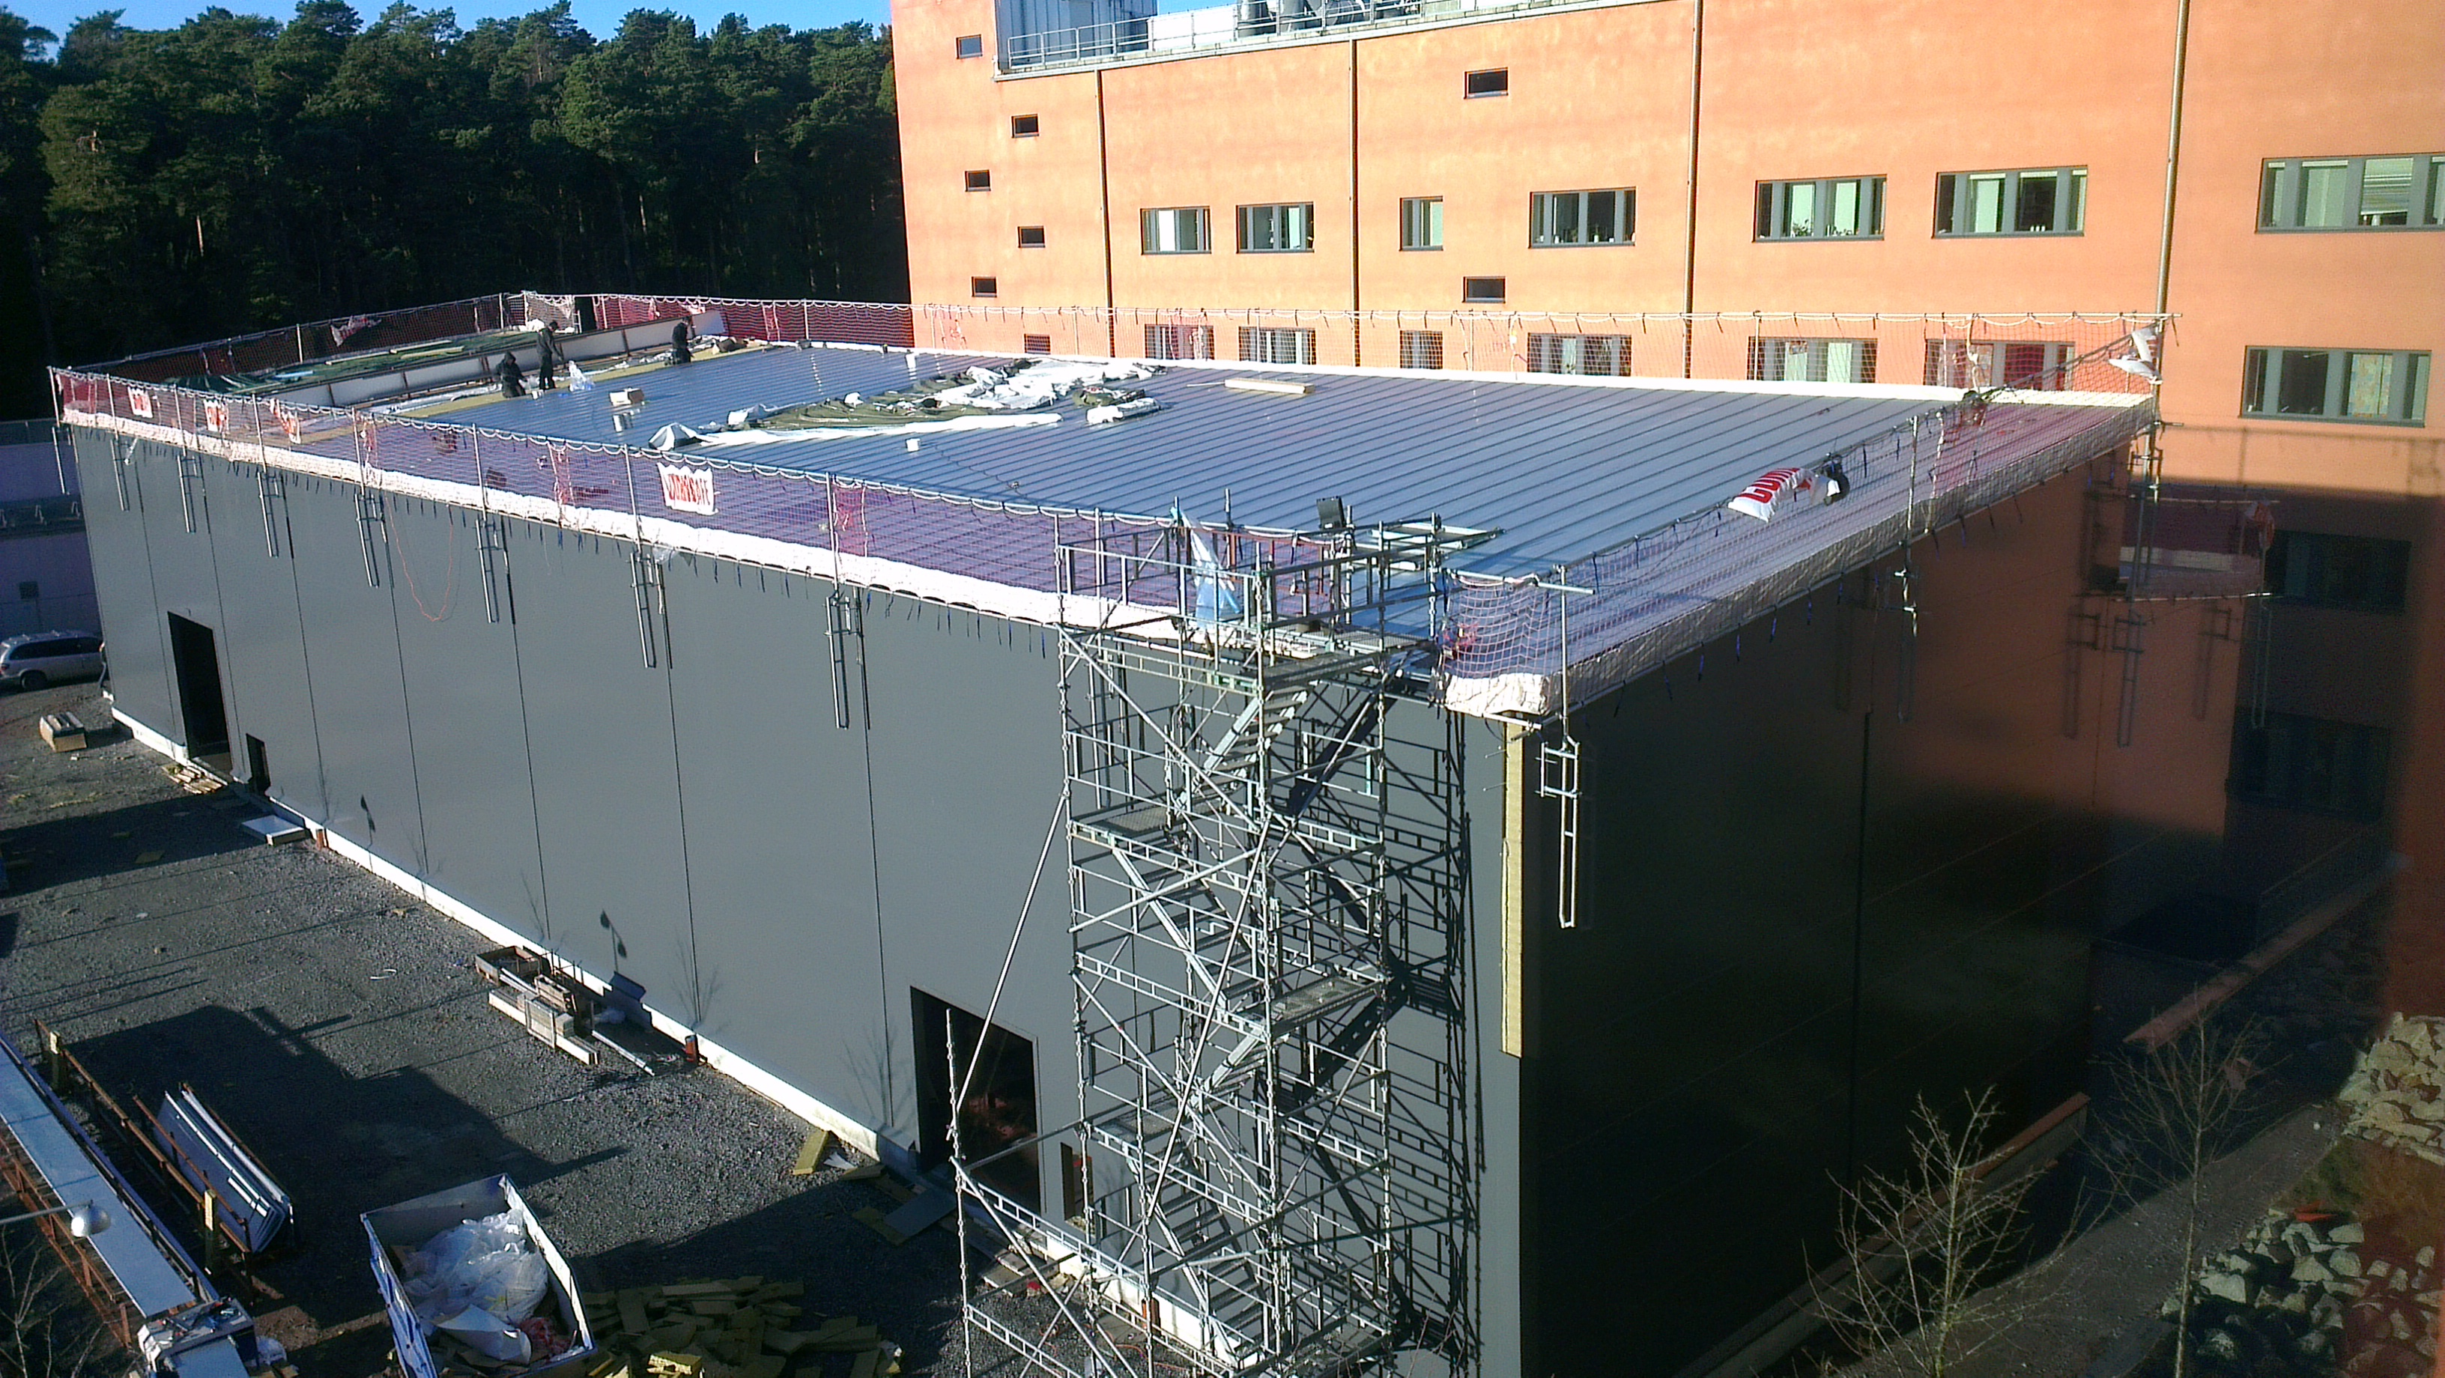
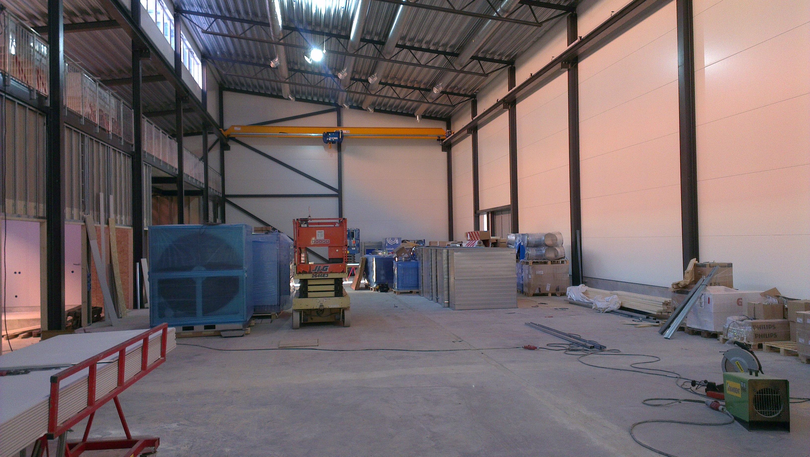
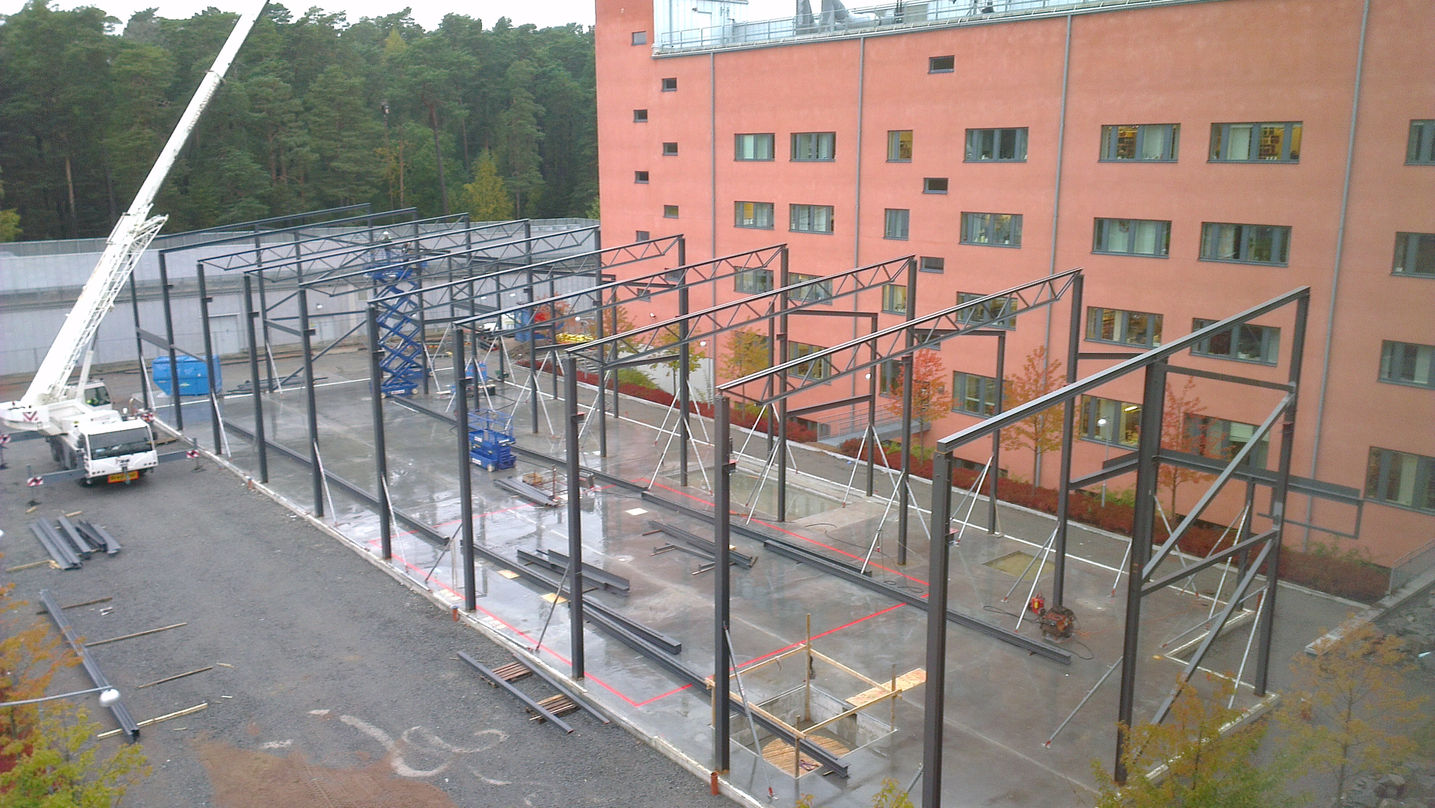
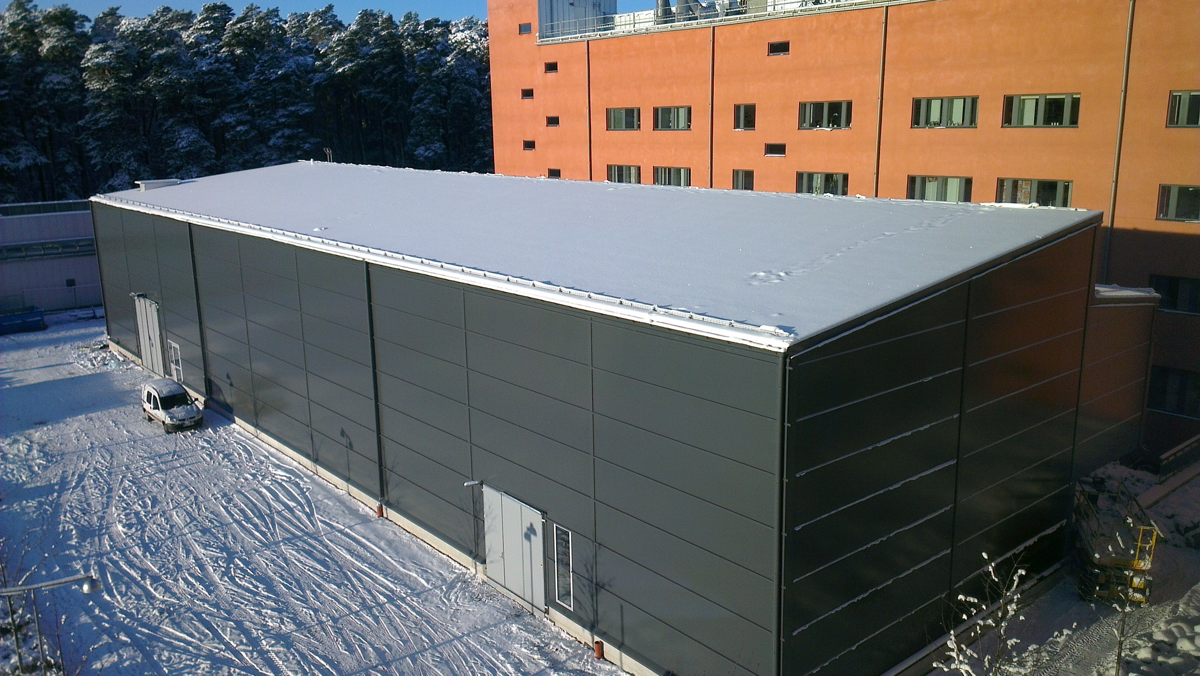
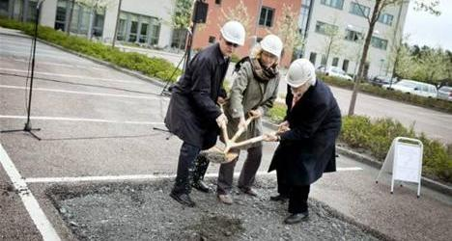
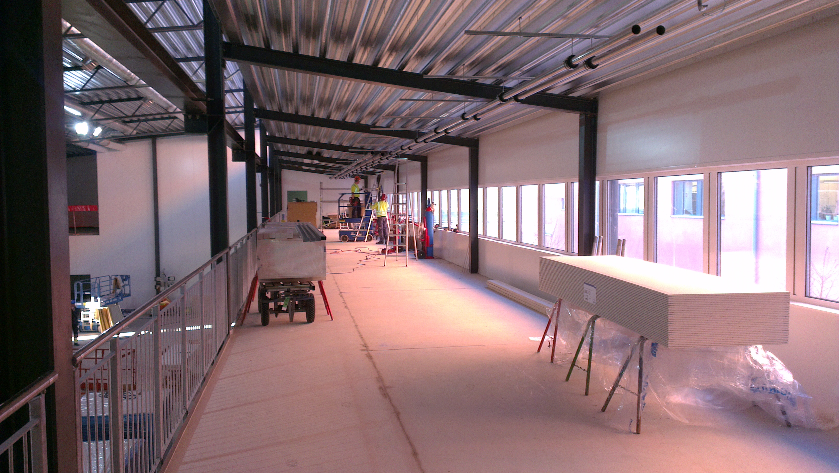
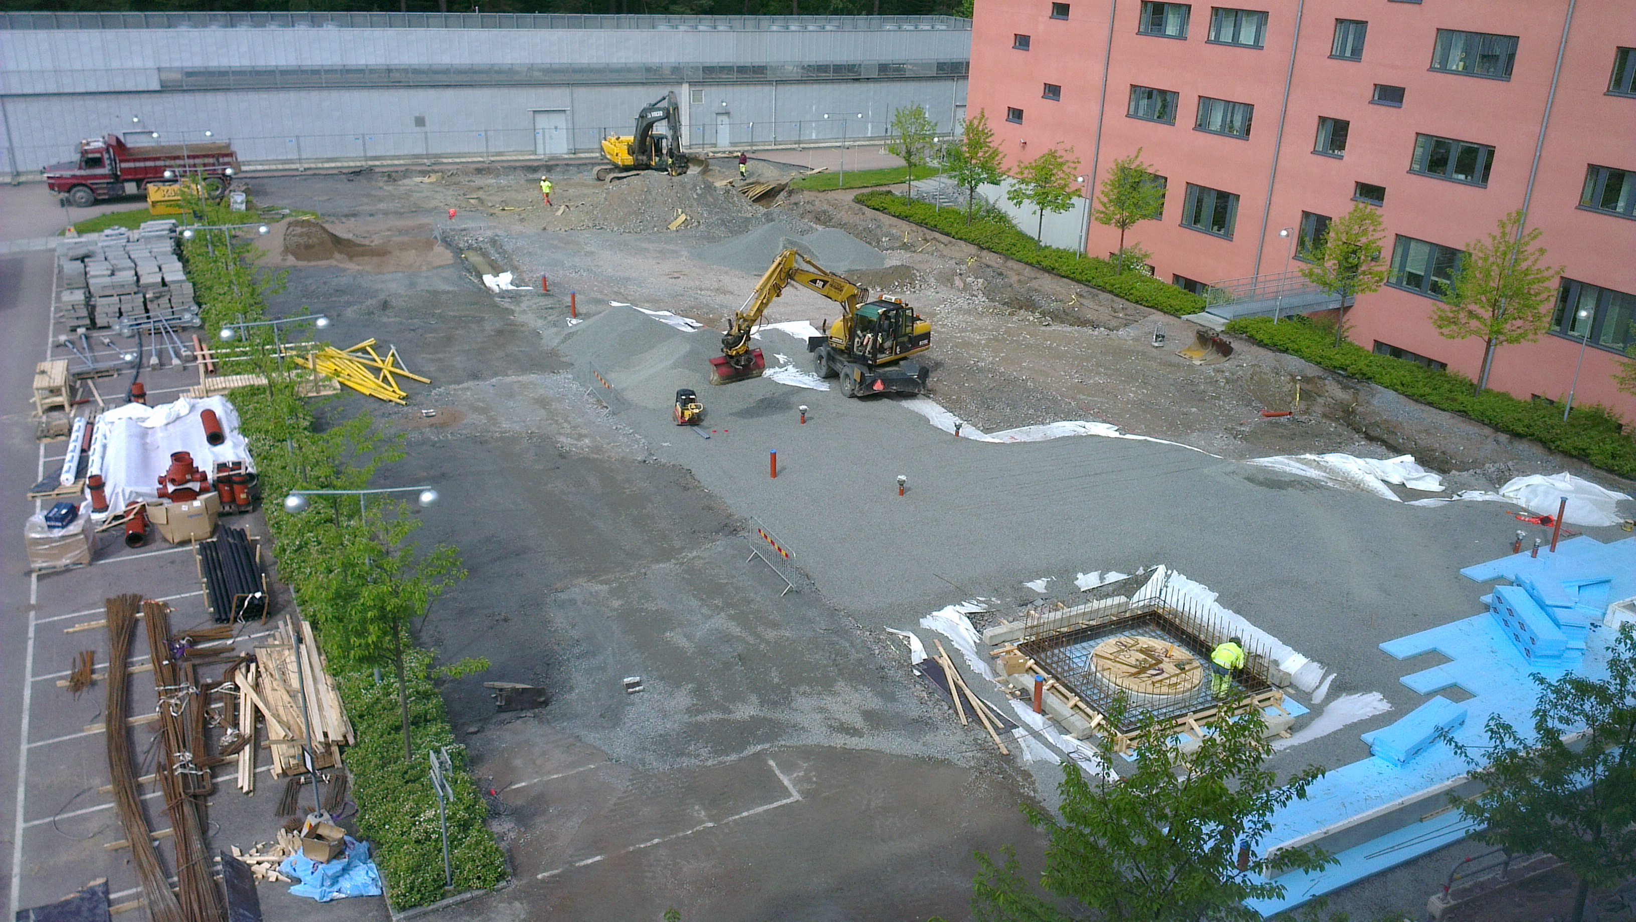
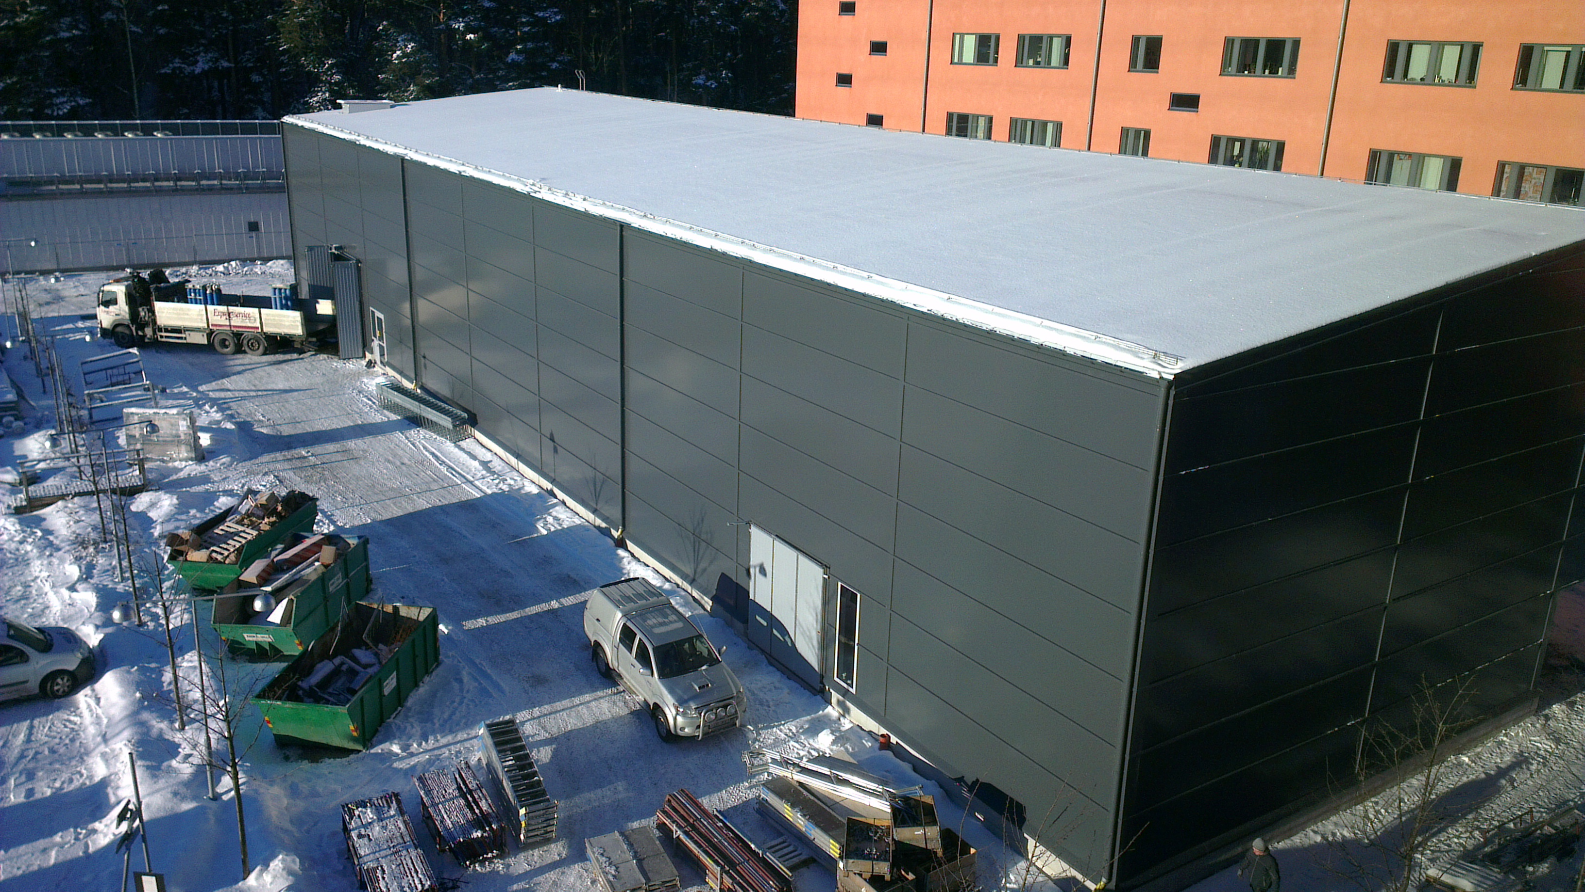
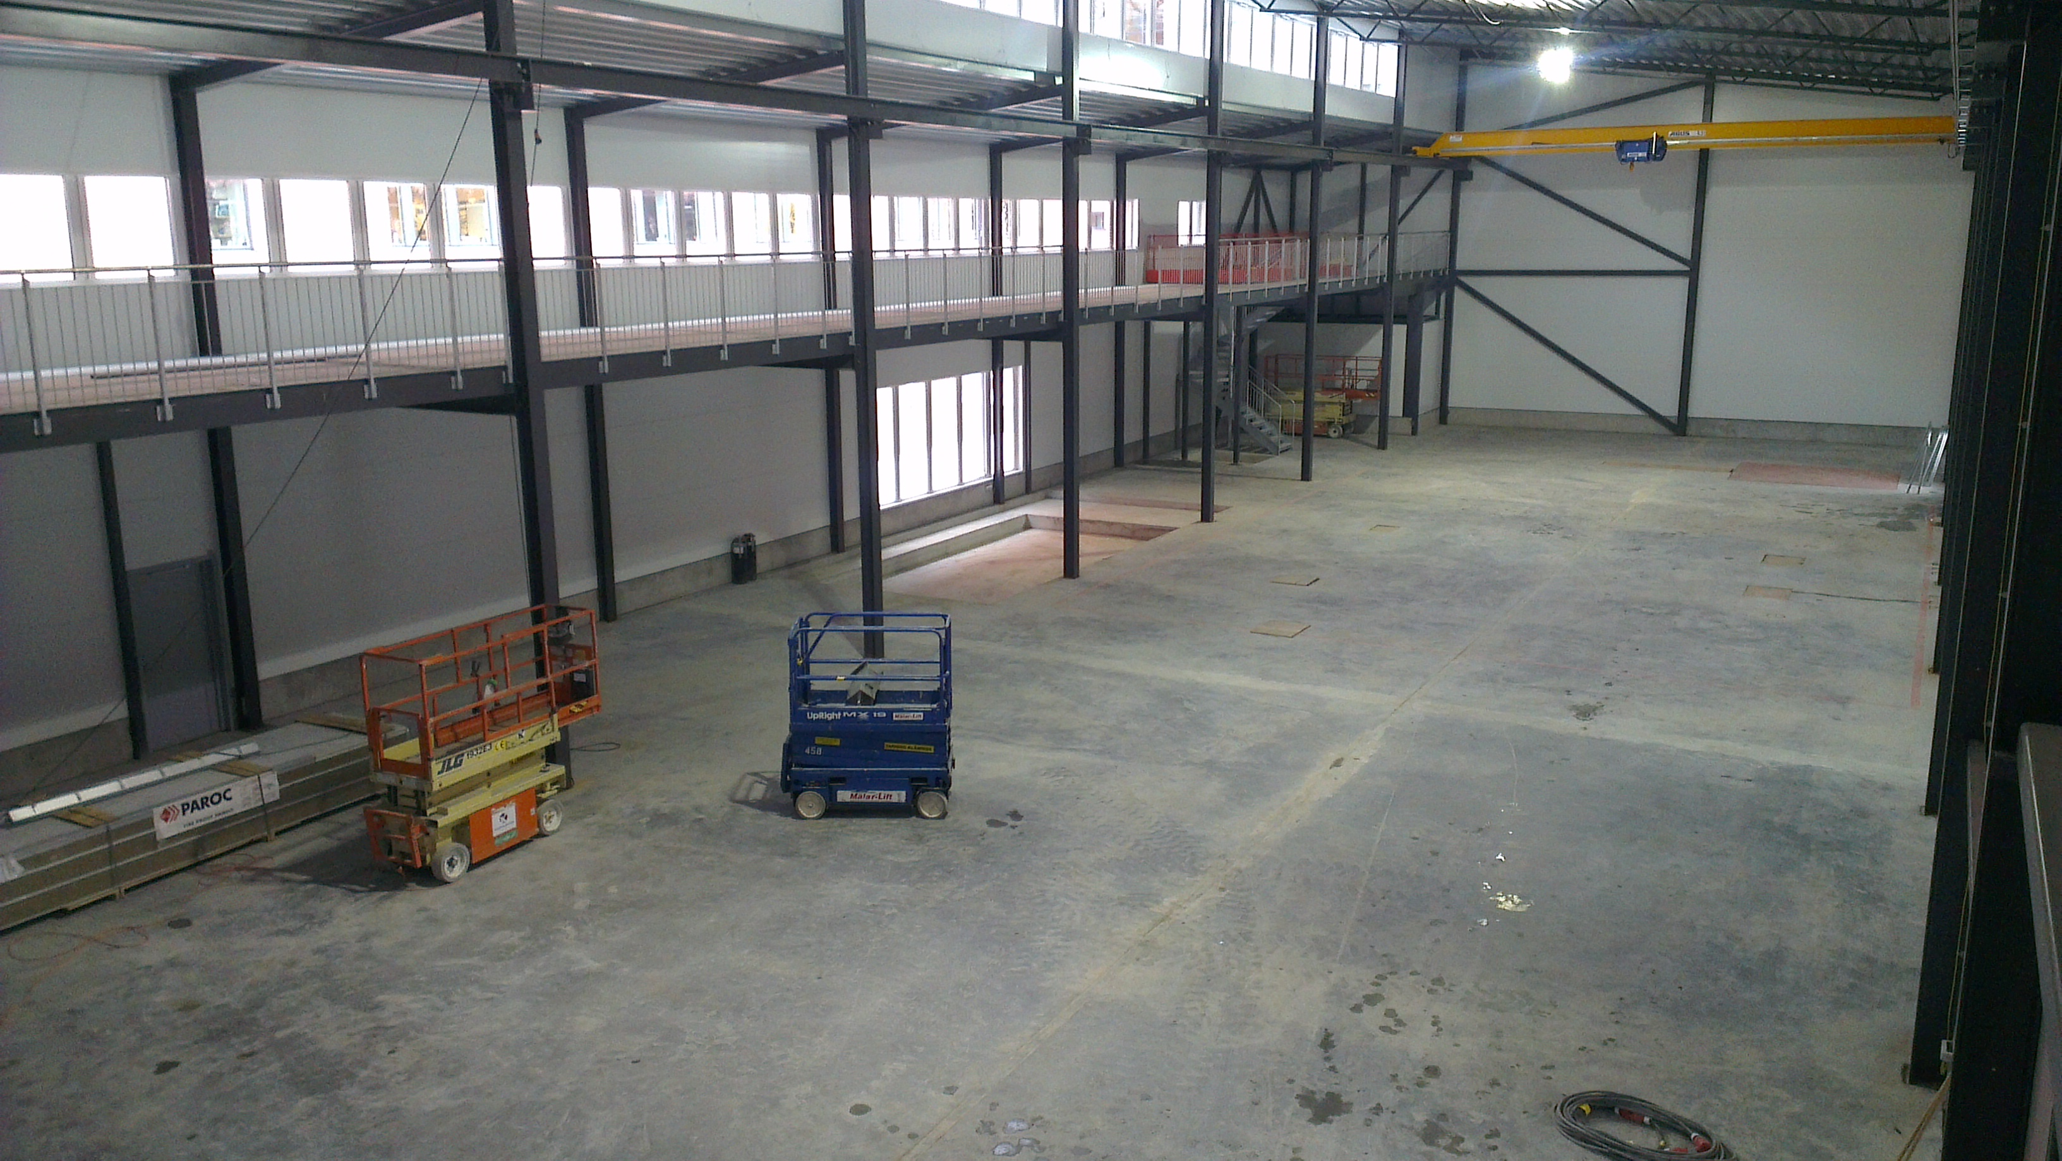
FREIA Hall
15 November 2012
22 January 2013
28 September 2012
3 December 2012
14 May 2012
22 January 2013
5 June 2012
22 January 2013
7 Dec. 2012

Slide 3
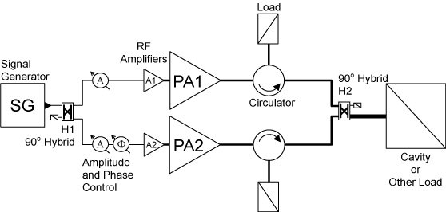
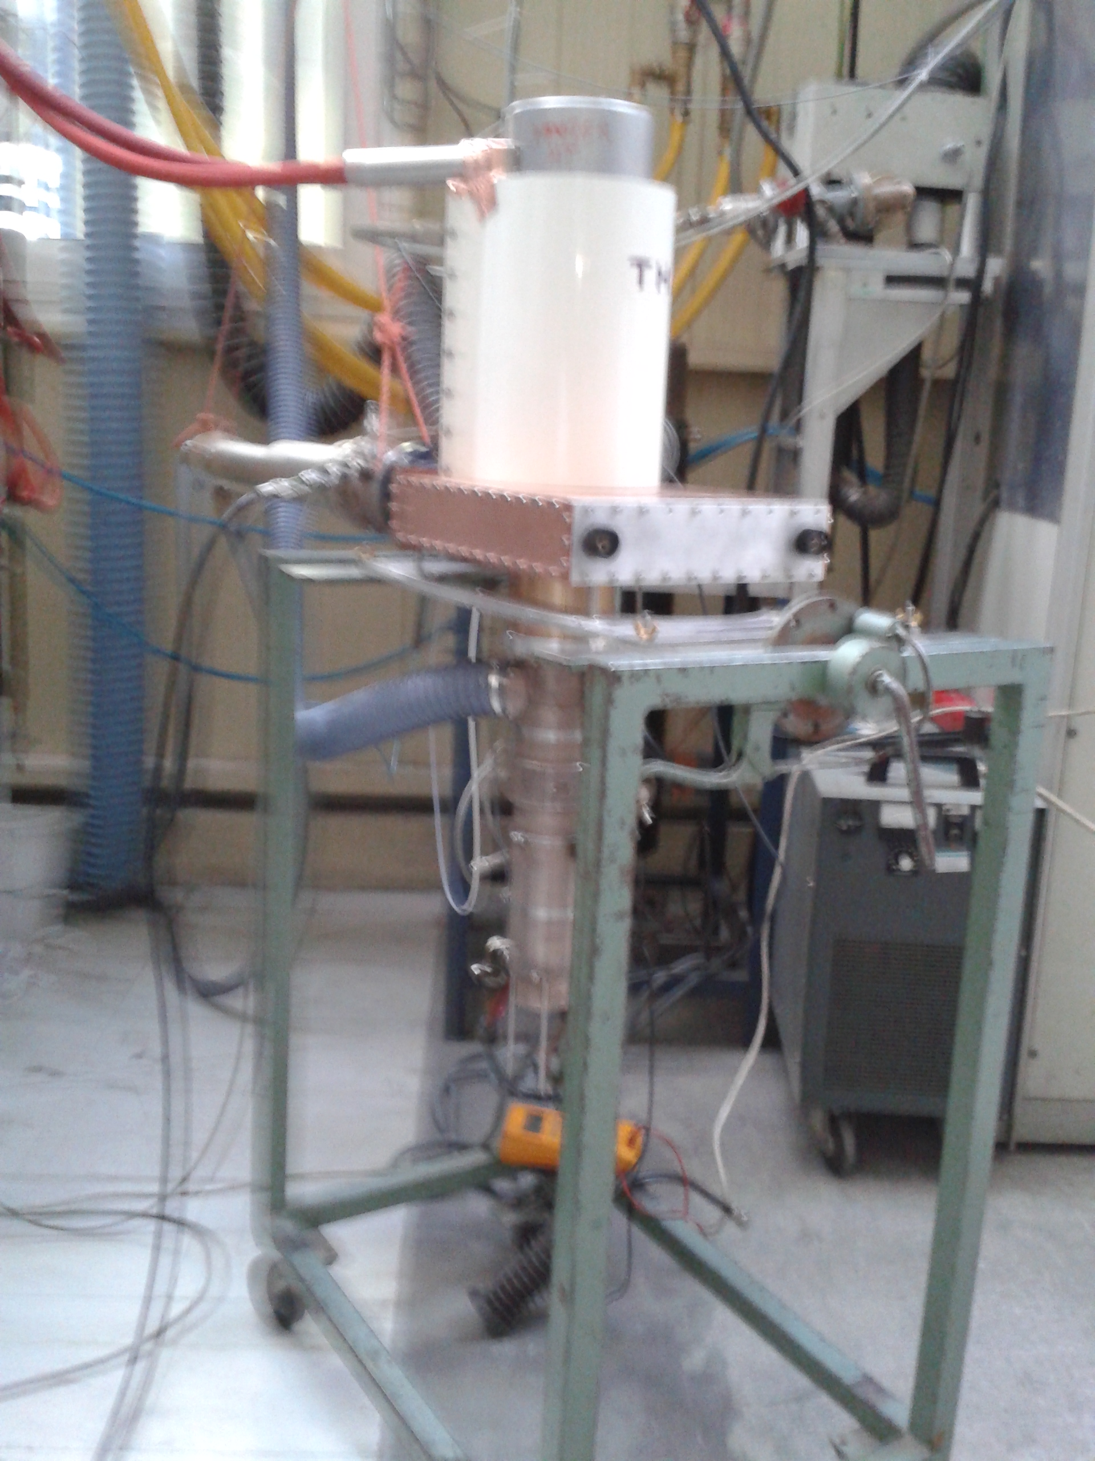

352 MHz Spoke RF Power Station
Thales
TH595
350 kW/18 kW
Wrong phase
350 kW/18 kW
wrong phase
350 kW
/18 kW
350 kW
/18 kW
350 kW/18 kW
wrong phase
200 kW
/10 kW
200 kW
/10 kW
200 kW
/10 kW
200 kW
/10 kW
Option A
Option B
Option C

Slide 4
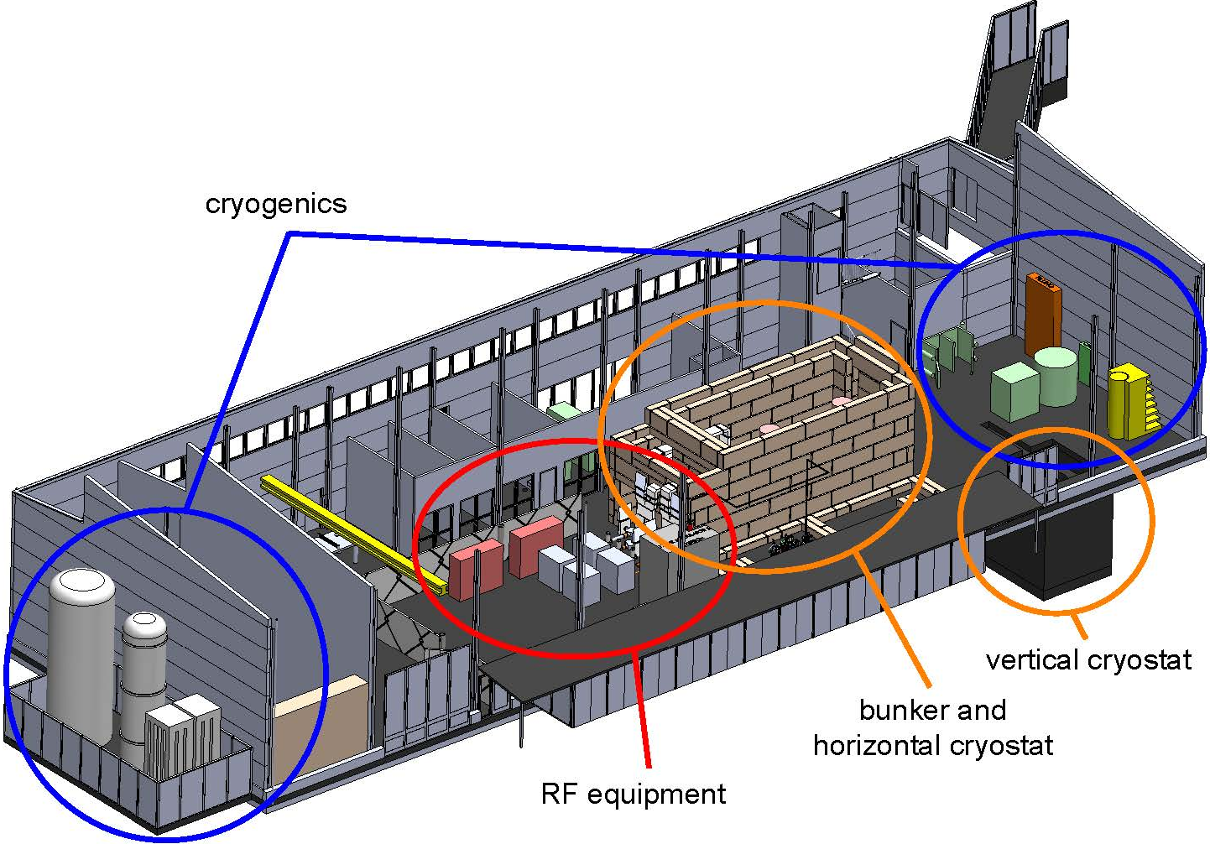
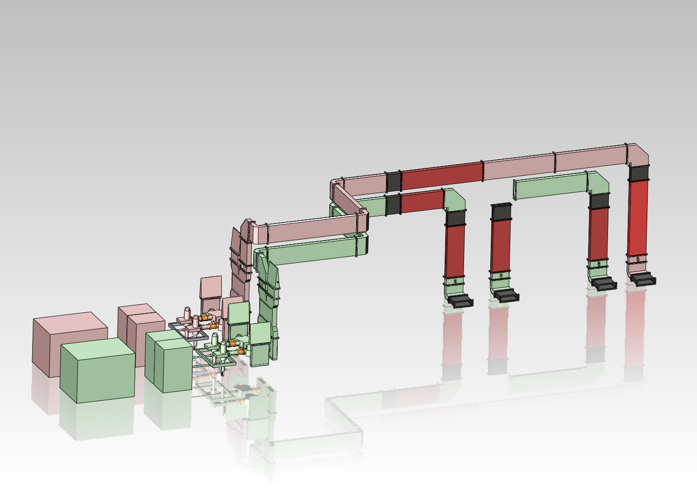
RF Distribution Layout for FREIA

Slide 5
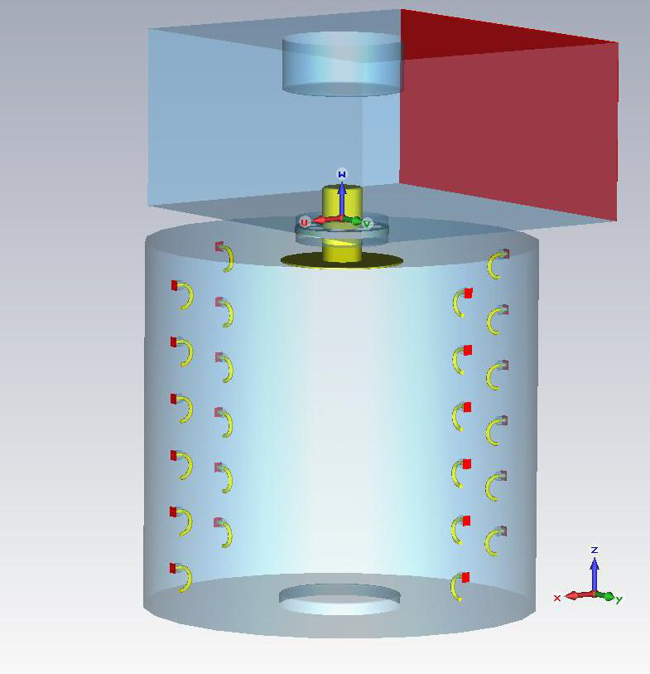
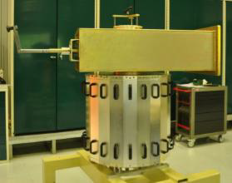
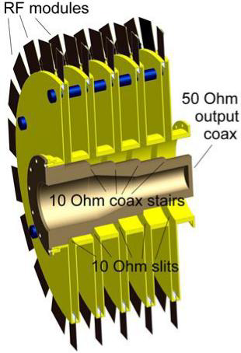
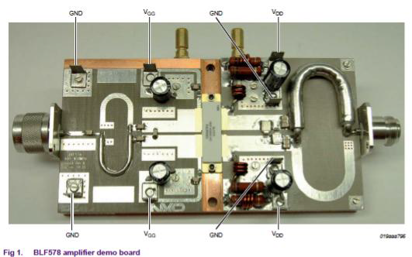

Solid-state Amplifier Studies
ESRF
SSA with cavity-combiner
Siemens
SSA with cavity-combiner
NXP
amplifier board
transistor

Slide 6

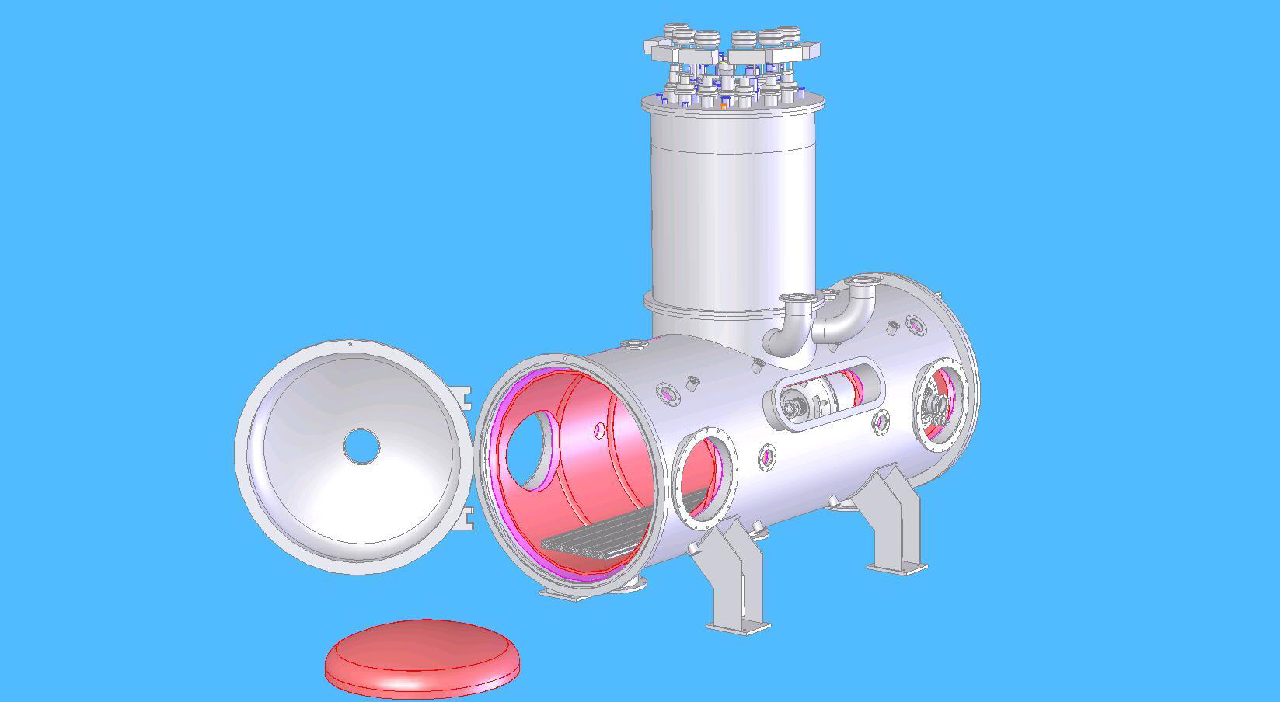
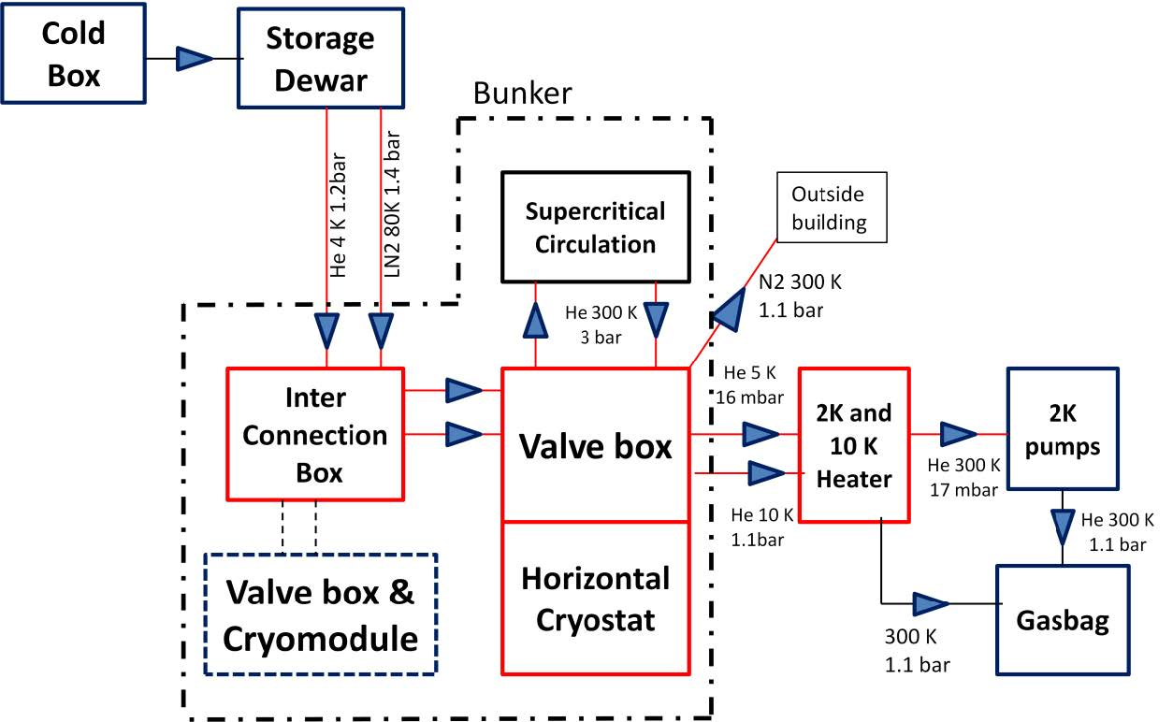
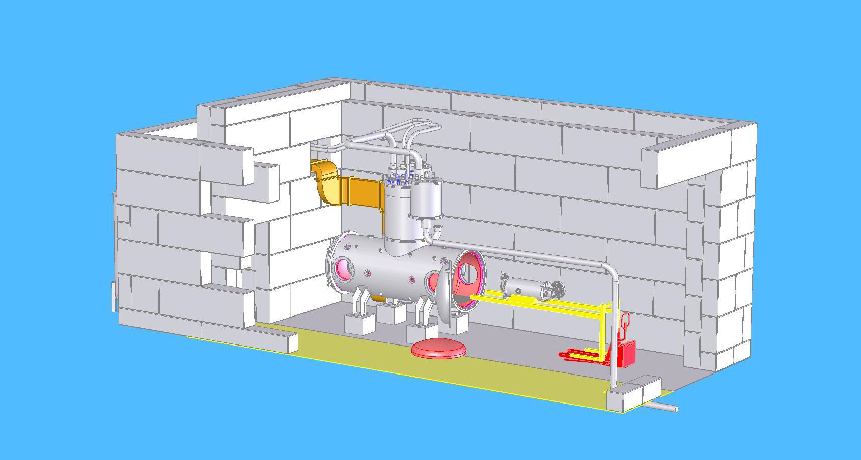
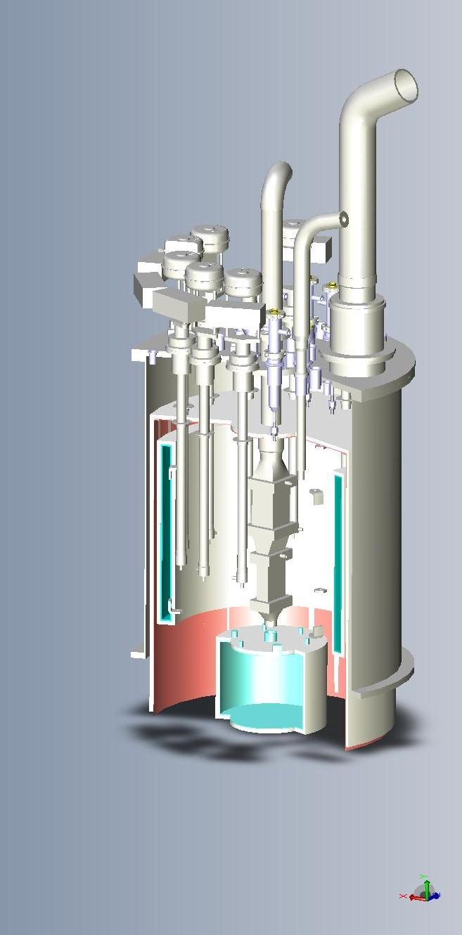
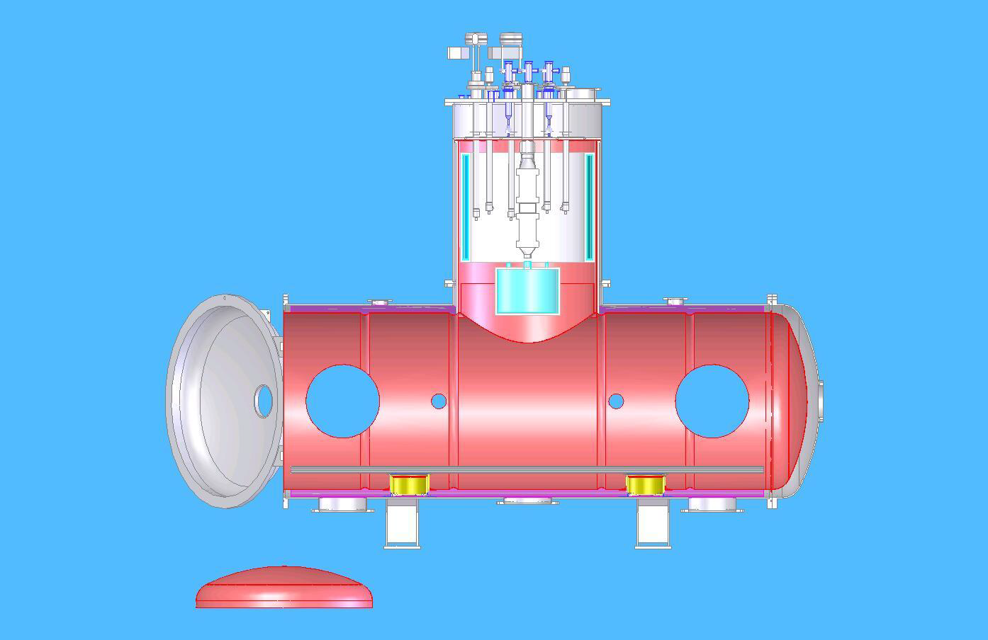
Horizontal Cryostat

Slide 7
R-Y-G Reporting
R
RED – Performance is not according to plan and goals. Activities to close gap are not defined or approved.
YELLOW - Performance is not according to plan and goals but a contingency plan is defined and approved.
GREEN - Project is on track and the prediction is that it will meet the plan and objectives.
Y
G

