Slide 1
Linac Design Update Project WP7 - Monthly Report – 2013-Jan 25
AARHUS
UNIVERSITY
Status | Summary: A revision of the beam expander system alternatives is suggested. Work on final reports.
Key Achievements |  | Planned Key Activities | Main Risk and Issues
What progress have been made Collimator study. Beam expander systems Octupole Step-field magnet Raster scanning What is delivered FINAL ADU deliverables: Detailed report for the beam expander system Detailed report for the LWU Solved issues Managed risks |  | Work planned for next period Conceptual design report on Raster Scanning by June 20’th. Report on Beam Spreading comparison by September 31’st? January, 16-18, Collimator and HEBT meeting in Aarhus, attendance from ESS, Aarhus and Poland. Collimation and shielding Planned deliveries Planned activities and events Risk & Hazard analysis of the HEBT (Annika) | What issues exist? Are any risks active or imminent? What actions are taken? Is help needed? What decisions are needed? Requirements on PBW and BEW: in particular < 10%~500 kW outside footprint. Maximum proton beam energy in HEBT: 2.5 GeV.
G
Notes:
Trade-off between reducing SCL cost and A2T beam quality, i.e. halo
Comparison:
Beam quality @ BEW (+PBW): J_max, losses, beam outside nominal footprint
Technical feasibility
Risks, etc.
IPAC’13 contribution

Slide 2
Beam Footprint???
Footprint edge
Beam footprint
 | Normal conditions | Off-normal | Off-normal | Unit
 |  | <10 pulses | <1 pulses
Nominal footprint @ BEW
Footprint width | 160 | 160 | 160 | mm
Footprint height | 60 | 60 | 60 | mm
Beam power within footprint | >90 | 50 | 50 | % of nominal current
Maximum current density | <64 | 100? | 100? | microA/cm2
Horizontal tolerance on beam centroid | ±6 | ±6 | ±6 | mm
Vertical tolerance on beam centroid | ±6 | ±6 | ±6 | mm
Notes:
Initiated by Tom Shea and Tom McManamy.
Additional zones are defined
Numbers are adopted from SNS

Slide 3
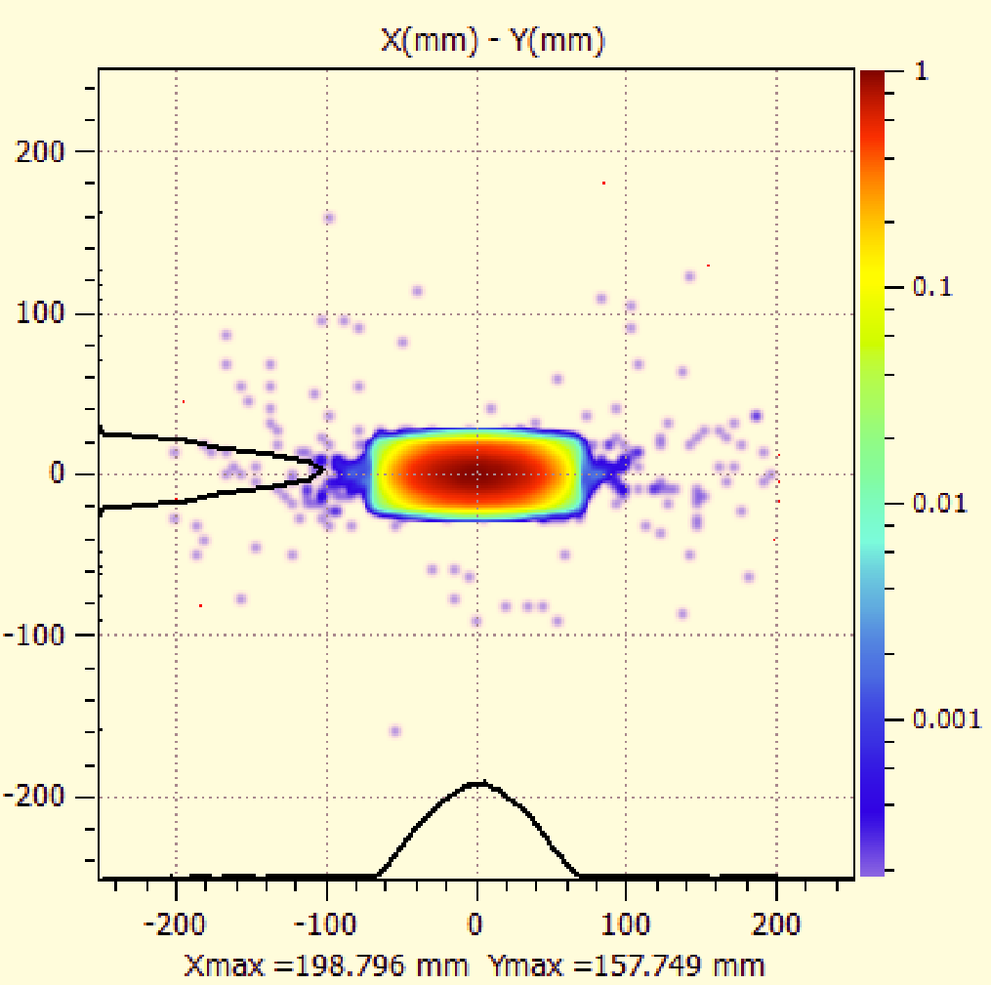
Beam profile at BEW
TD to specify acceptable levels! < 10%?
Notes:
Fixed collimator -> emergency mitigation component?
TD specifications will help establish the fixed collimator aperture

