Slide 1

Raster Scanning of the ESS Beam
Heine Dølrath Thomsen

Slide 2
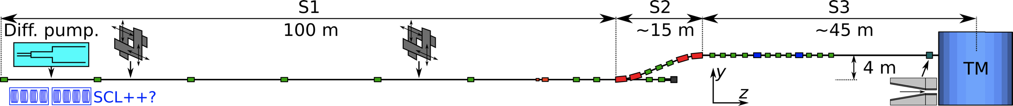
The HEBT (28.05 2012)
Dipoles,
Quadrupoles
Octupoles
UHB: Energy upgrade + movable collimators.
ACH: Achromatic elevation. Tune-up lines below.
A2T: Beam expander system (non-linear) + fixed collimator.

Slide 3
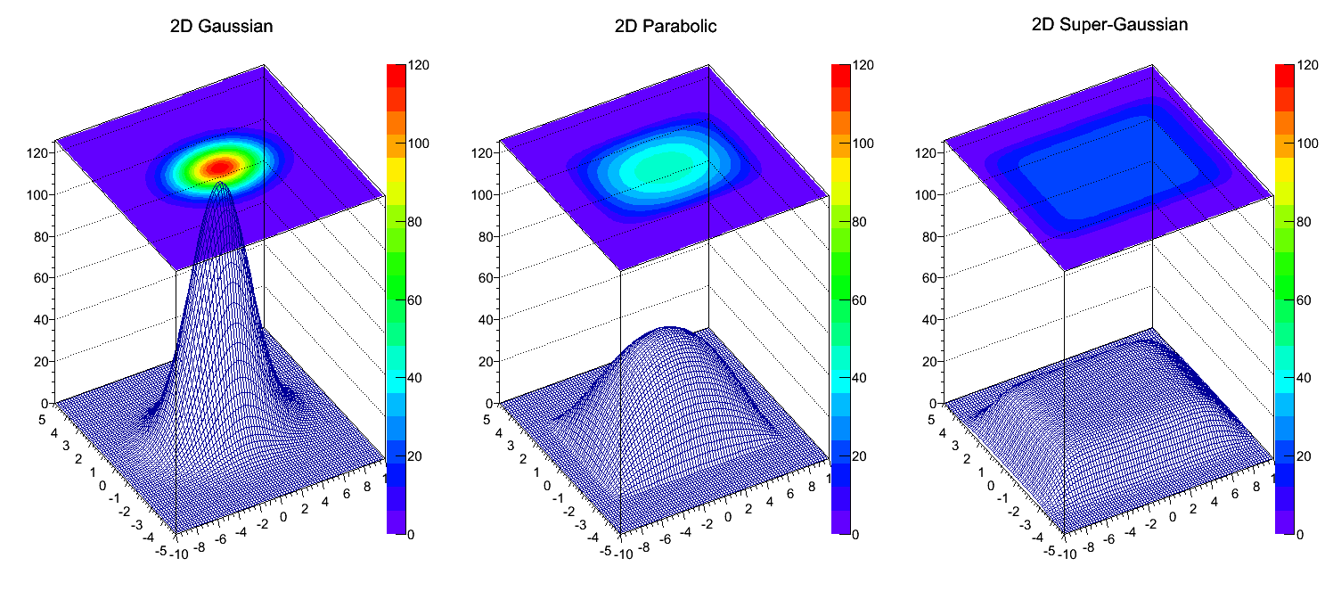
Exploiting the target footprint area!
J [µA/cm²]
Lowering the max. current density J => increasing target life!
Notes:
Target + PBW: critical components in the facility

Slide 4
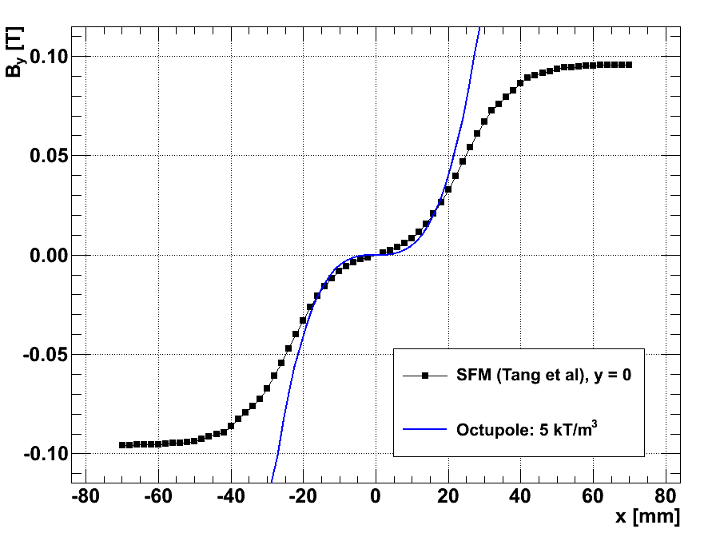
Beam Expander Systems I: DC Magnets
ESS2003-LP ESS2003-SP, CSNS, IFMIF
Notes:
Octupole:
‘Simple’ tuning (1 button)
Limited fields per aperture
Overfocusing
SFMs:
4 x dipoles
Less flexible (step)

Slide 5
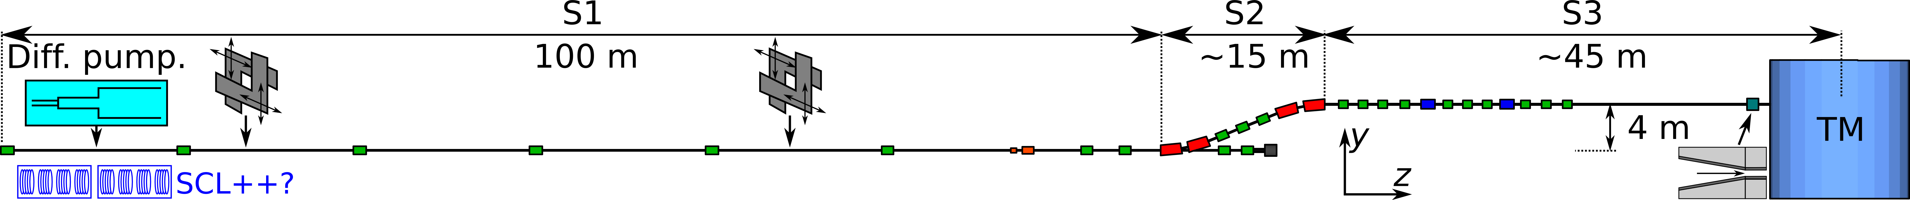
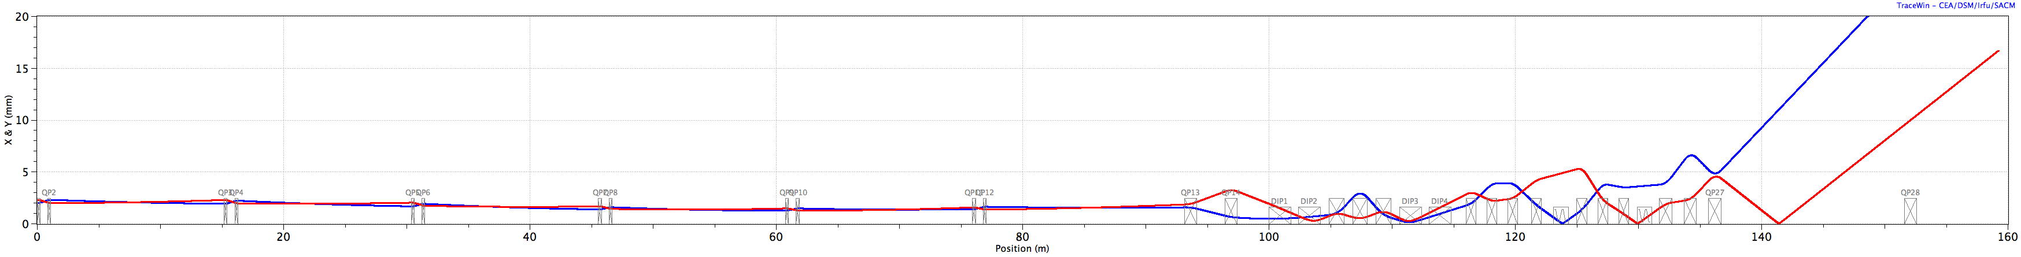
The HEBT (28.05 2012)
Dipoles,
Quadrupoles
Octupoles
Notes:
Beam optics constraints:
- Large beam aspect ratio in multipoles!

Slide 6
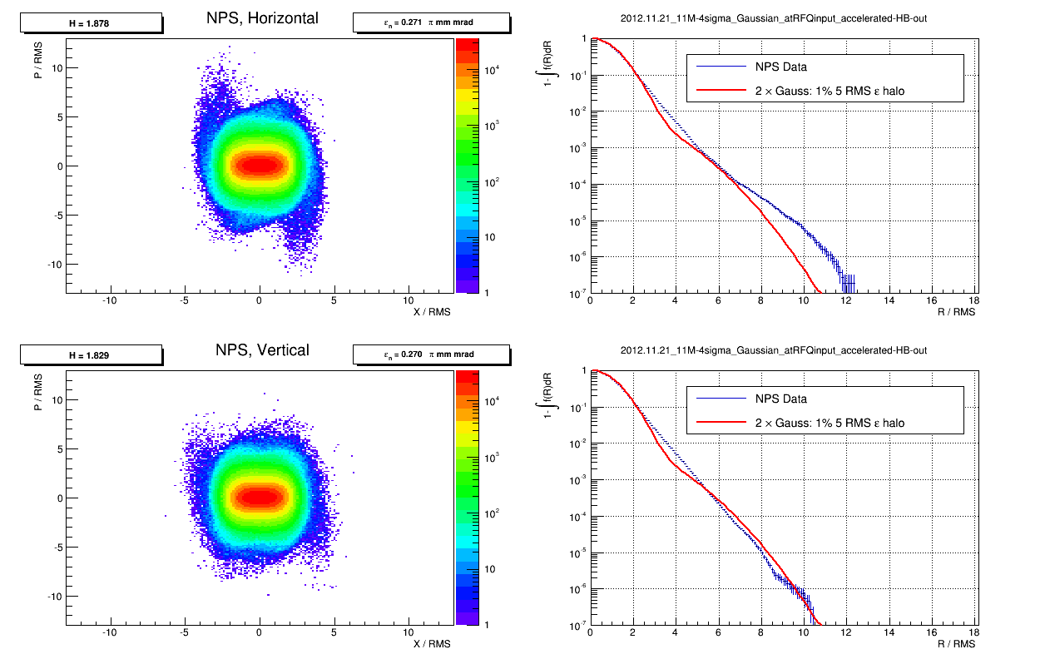
Notes:
Trade-off: compromising SCL beam quality and reducing cost

Slide 7
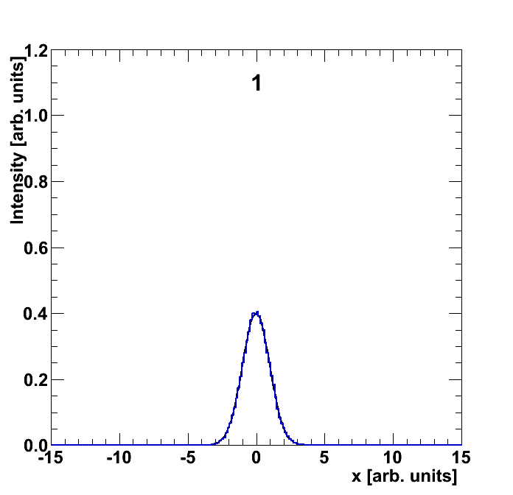
Beam Expander Systems II: 1D Rastering

Slide 8
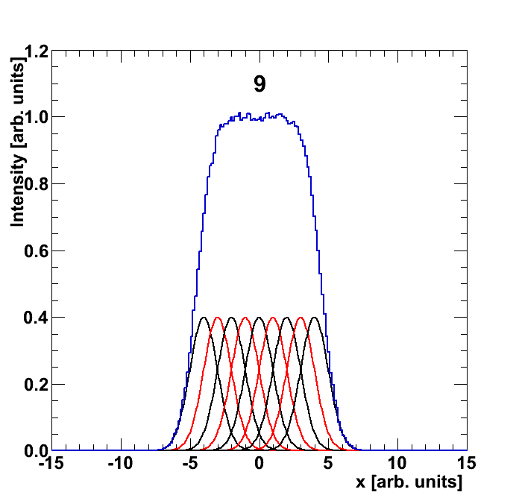
Beam Expander Systems II: 1D Rastering
Notes:
Beamlets

Slide 9

Beam Expander Systems II: 1D Rastering

Slide 10
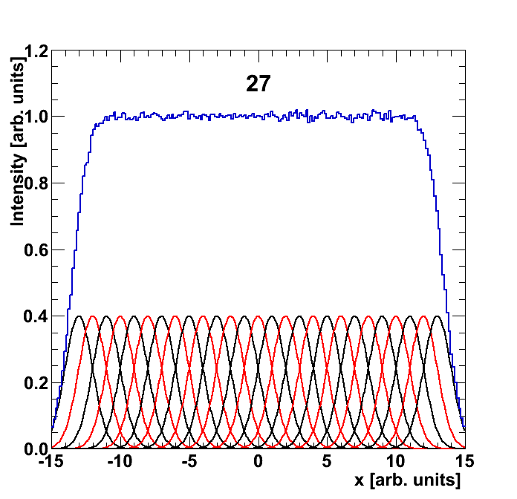
Beam Expander Systems II: 1D Rastering

Slide 11
Beam Expander Systems II: 2D Rastering
Traditionally: Hor. MPS: Slow
Ver. MPS: Fast
Notes:
Currents need to be controlled (and monitored?)

Slide 12
Beam Expander Systems II: 2D Rastering
Notes:
Raster scanning: Dependence of SCL beam quality: octupole > SFM >> Raster scanning
AC magnets sweep beam
IGBT-based modulators -> triangular current waveforms, electronic (resonant) generation of frequencies
J-LAB (2 systems) + APT

Slide 13
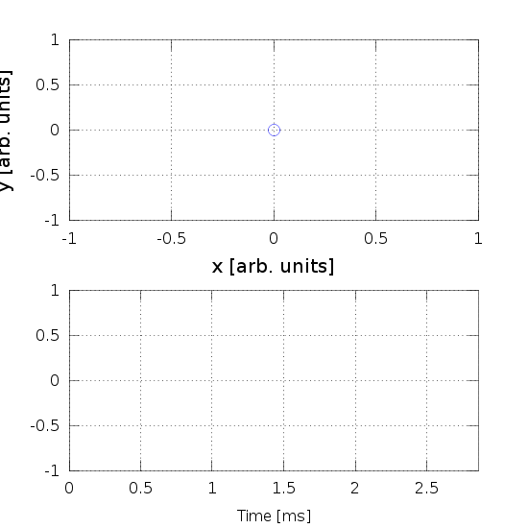
Beam Expander Systems II: LANL APT
fy/fx = 5:4
x,y [arb. units]
One ESS pulse
Notes:
Raster scanning:
Pattern determined by frequency ratio
AC magnets sweep beam footprint within 1 ESS pulse
Fields vs. frequency (1.4 kHz and 1.75 kHz), nx = 4, ny = 5, ny/nx = 1.25,
Dependence of SCL beam quality: octupole > SFM >> Raster scanning

Slide 14
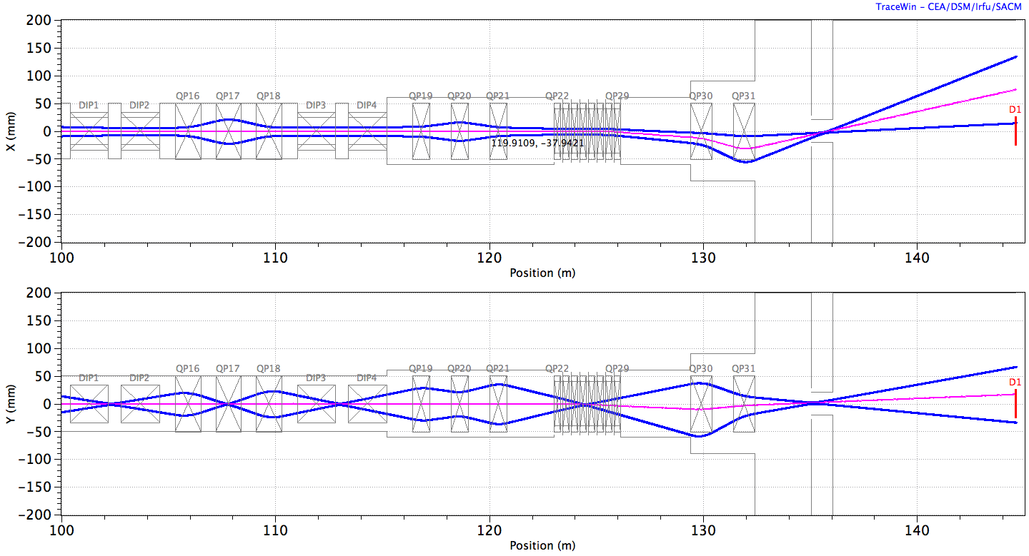
Linear optics: 10 RMS beam size
triplet 4+4 r.m. doublet
ACH A2T
Notes:
Triplet + 2 x 4 raster magnets + doublet
Only slight coupling of steering and expansion in expander quads!
Maximum deflection in both directions, x_max = 75 mm, y_max = 17 mm
RMS beam sizes: 6 mm, 5 mm -> will depend on scanning pattern and thus freq.s!
COMPARISON
Simpler tuning – 5 vs. 10 quads.
One extra UHB period or weaker magnets!
NO monster-magnets?!
Eric’s backshine shield feasible!
Small divergence vs. double waists

Slide 15
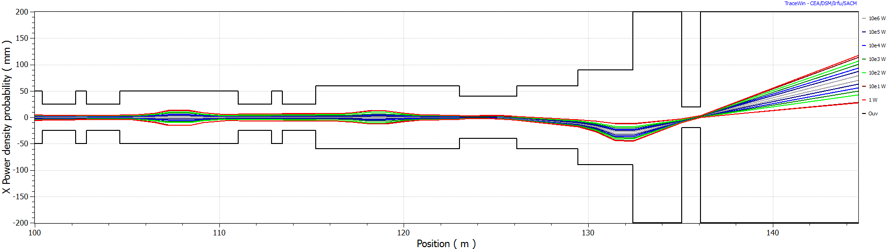
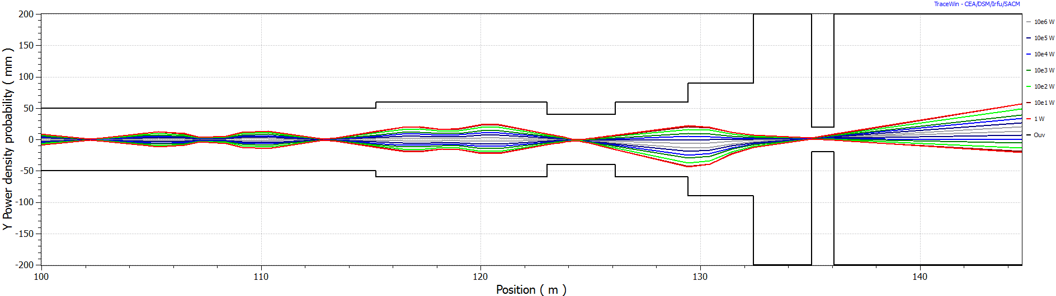
Multiparticle: 1 Mparticles of SCL output
Notes:
~Linear optics!
Losses: 0 / 1E6!

Slide 16
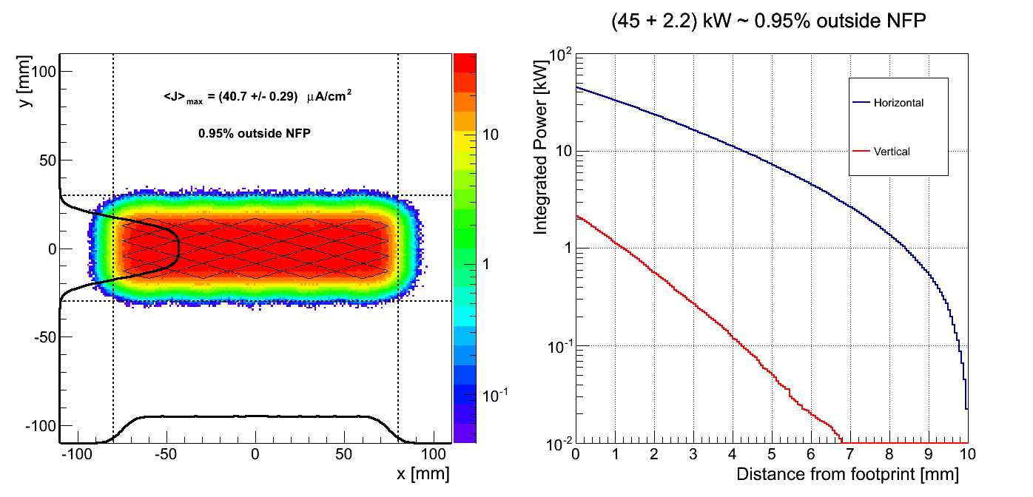
Monte Carlo Simulation: 5:4 pattern
10 Mparticles - time-lapse:
http://users-phys.au.dk/heinetho/raster_anim_MC.gif

Slide 17
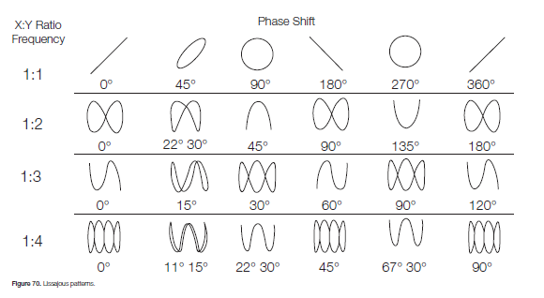
Choice of frequencies?
f0 = 1 / Δt = 350 Hz
fx = nx × f0
fy = ny × f0
Conditions:
nx, ny are integers
nx/ny as irrational as possible?
Intensity modulations at instruments?
Frequency stability
Modest phase stability
Notes:
Footprint fully illuminated within 0.3-0.5 ms
Neutron yield modulation at instruments?
Target stress & fatigue?

Slide 18
High Frequencies?
Existing Systems
ESS?
J-LAB:
  B = 40 G, L =15 cm
  f = 10-45 kHz
  Air-coils of Litz-wire
  H-bridge of MOSFETs
LANL APT (1.7 GeV, 100 mA):
  B = 500 G, L = 4 x 30 cm
  f = 0.5-0.6 kHz
  Ferrite-based magnets
  H-bridge of IGBTs
LANL MTS:
  f = (20 + 60) kHz (sinus.)
  B = 250 G, L = 4 x 30 cm?
  f = 5-20 kHz? (TD + Science)
  Air-coils?
Notes:
Ceramic beam tube should also be considered!
Eddy current heating could be air-cooled
Ferrite: larger inductance + remanent field
Air-coils: no remanent field due to hysteresis
Feasible set of magnet + modulator?
B = 150 G – 250 G, 250 G ~ 0.7 mrad / magnet @ 2.5 GeV

Slide 19
ESS Lissajous System
Linear optics!
All feasible magnetic elements
Losses: 0 / 10⁶ particles!
Choice of frequency set?
  Neutron yield modulation at instruments?
  Target stress & fatigue?
  …

Slide 20
Development of the Lissajous System
Design partner
AC Magnets
Modulator
Beam Optics
HDT, ISA
2013.06: CDR for Lissajous system
2013.10: Comparison of beam expanders
2014: TDR + prototype
Notes:
Comparison of beam expander systems:
Risks? Impact of magnetic element-failure? Can component-failure cause breaking of target?
Carlos: many years of experience at CERN in charge of the pulsed power group

