Slide 1

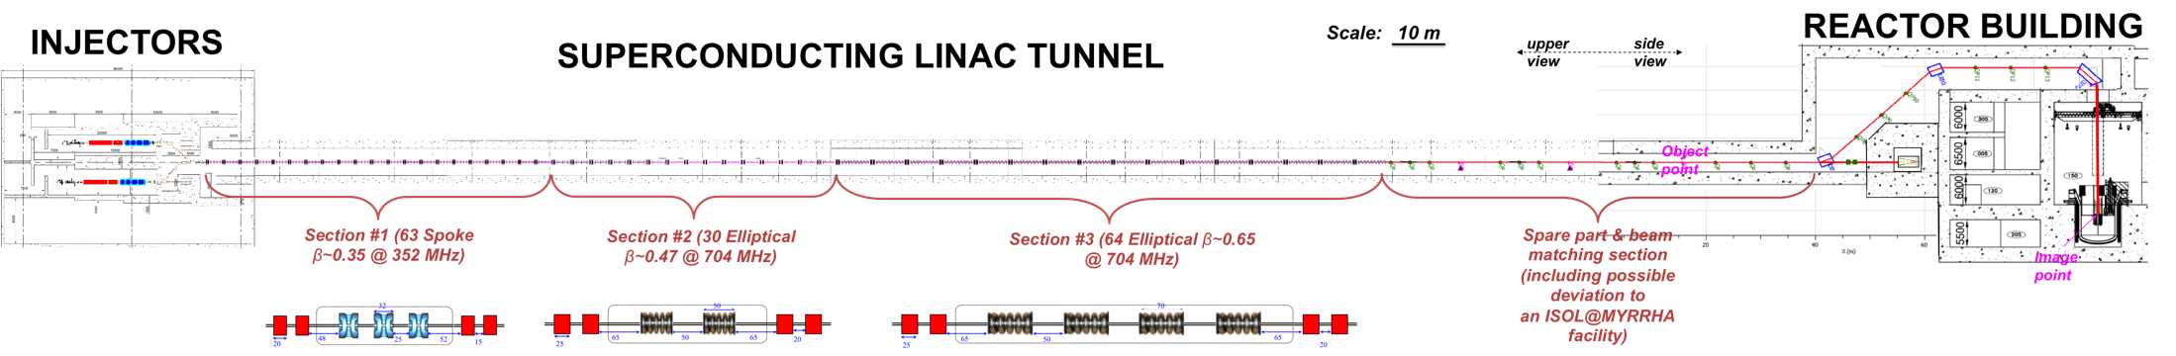
Status of MYRRHA
Multipurpose hYbrid Research Reactor for High-tech Applications
Luis Medeiros Romão
Dirk Vandeplassche
SLHiPP-3, SCK•CEN, Louvain-la-Neuve, Belgium
17-18 April 2013

Slide 2

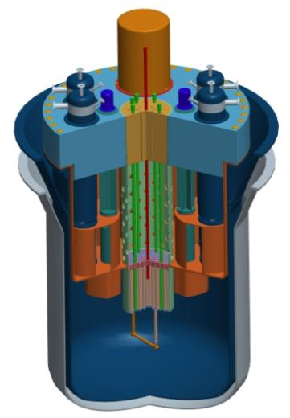
Accelerator Driven System
Accelerator
600 MeV
4 mA proton CW
Reactor
Subcritical or Critical modes
~ 100 MWth
Spallation Source
Multipurpose
Flexible
Irradiation
Facility
Fast
Neutron
Source
Lead-Bismuth
coolant

Slide 3
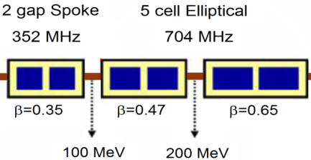
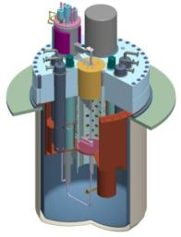
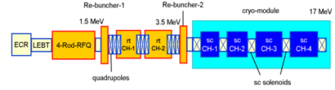
Fundamental Research
MYRRHA
protons: 2-4 mA, CW, 600 MeV
2 gap Spoke 352 MHz
5 cell Elliptical 704 MHz
Beam splitter
17 MeV
100 MeV
200 MeV
600 MeV
~ 100-200 μA,
~DC
ISOL@MYRRHA
Ruggedized target:
e.g. Ta, UC/C
RFQ cooler and buncher
Sustainable 1⁺ ion source:
Pure and intense RIBs
of ~50-60 keV
Low-resolution mass separator
High-resolution mass separator

Slide 4
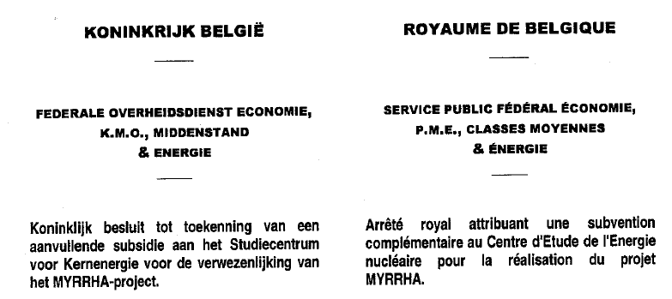
Decision of Belgian Government 05.03.2010
Strongly supporting the project
Special endowment of 60 MEUR for 2010-2014
Milestones to reach in 2014 for continuation of the project
  Completion of the engineering design
  Obtaining licencing permit
  International consortium formed (additional 40% financing)
Govt follow-up committee: MYRRHA Ad Hoc Group

Slide 5
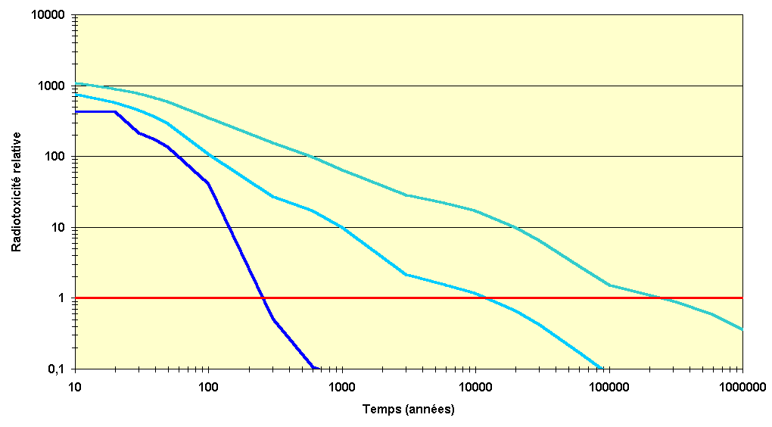


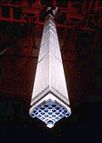



Path to Transmutation
transmutation
of spent fuel
spent fuel reprocessing
no reprocessing
Relative radiotoxicity
Uranium
naturel
Time (years)
Duration Reduction 1.000x
Volume Reduction 100x

Slide 6
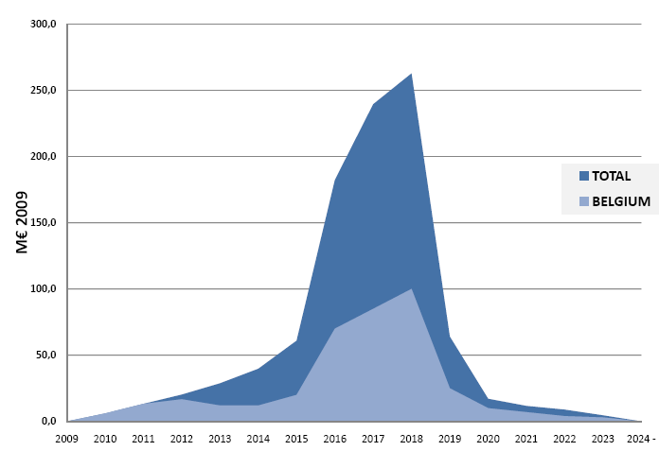
Program Budget
2nd phase (11 y)
others 576 M€
960 M€
(2009)
Consortium
Belgium 324 M€
(36 M€/y x 9 y)
Belgium 60 M€
(12 M€/y x 5 y)

Slide 7

Program Timeline
2010-2014
- R&D
- Front End
Engineering
Design
2015
Tendering &
Procurement
2016-2018
Construction of
components &
civil engineering
2019
On site
assembly
2020-2022
Commissioning
2023
Progressive
start-up
2024-
Full
exploitation
Minimise technological risks
Secure the licensing
Secure a sound management and investment structure
PDP
preliminary
dismantling
plan
PSAR
preliminary
safety
assesment
EIAR
environmental impact
assesment
FEED
(Front End
Engineering
Design)
Central
Project
Team
Owner
Consortium
Group
Owner
Engineering
Team

Slide 8


International Consortium
(*) European Research Infrastructure Consortium
Primary «investors»
Participation vehicle
(Consortium members)
Contribution to investment capital
(960 M€’09)
«ERIC» ^{(*)}
IPR
management rules tbd
Belgian Federal Ministry
of Energy
(50%)
SCK•CEN
(on behalf of Belgian
Federal
Government)
BE
40 %
Belgian Federal Ministry
of Science Policy (50%)
Major European partners
EU country
Public foundation
EU countries
A major Asian partner
Asian country
Asian country
EU FP7 (RTD) / SET-Plan (Energy)
EU participation
EU
ROW
ROW participation
ROW

Slide 9
Marking events
Selection of the FEED Consortium (headed by AREVA)
MYRRHA Linac International Design Review
Visit to Chinese Academy of Sciences
LEBT Kick-off
Arrival of Roberto Salemme
Arrival of Jean-Pol Poncelet (ex-Belgian Minister of Defence, Energy) as High Representative of MYRRHA
Notes:
Passing away of Horst Klein

Slide 10
Marking events
Revision of the budget for the 2011 – 2014 program (75% of the accelerator’s budget is put on hold)
High level meeting at the Belgian embassy in Paris to gain French support
Green light for the MARISA FP7-Fission project
“Support to the MYRRHA research infrastructure for its development as a pan-European and world-level facility”

Slide 11
Linac Specifications
fundamental characteristics (ADS)
beam energy | 600 MeV
beam current | 4 mA
mode | CW
MTBF | > 250 h
challenge !
failure = beam trip > 3 s
implementation and design guidelines
SC Linac
frequency | 176.1 / 352.2 / 704.4 MHz
reliability = redundancy | dual injector
 | fault tolerance

Slide 12
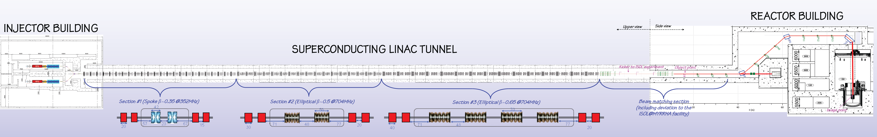
Layout of the MYRRHA linac

Slide 13
R&D Program
MAX
FP7
today
RFQ@UCL
Cryomodule prototypes
end 2014
engineering
construction
test
INJ@UCL
RT-CH
Horizon
2020
SC-CH
spoke
elliptic
end 2016
elliptic
INJ@UCL
SC-CH
Prod
Prod
end 2018
Prod
Notes:
Reinforced by the design review conclusions

Slide 14
R&D Program
today
LEBT@UCL
Phase 1
end 2014
RFQ@UCL
Phase 2
end 2016
INJ@UCL
RT-CH
end 2018
INJ@UCL
SC-CH

Slide 15
R&D Program
today
end 2014
Cryomodule prototypes
end 2016
engineering
construction
test
SC-CH
spoke
elliptic
end 2018
elliptic
Prod
Prod
Prod
end 2020
Notes:
Engineering design → finished at the end of MAX → can be started earlier

Slide 16
R&D Program
FP7 - MAX
3 years | coordinated by IPNO
Goal | coherent concept of the Myrrha accelerator
Technical WP’s | Global coherence Injector Main linac System optimisation
Main topics: simulations (beam and reliability) injector design of spoke cryomodule tests with legacy elliptical cryomodule perspectives for 704 MHz SS ampl. | Principal partners: IN2P3 - IPN Orsay IAP Frankfurt INFN Milano CEA SCK•CEN

Slide 17
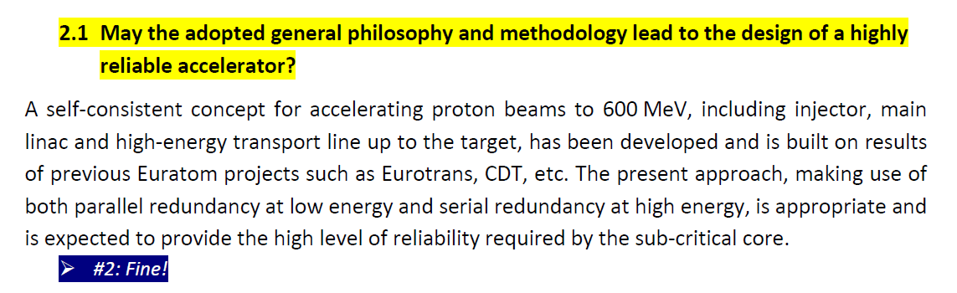
MYRRHA International
Design Review
Yes
Reliability model appreciated
Recommendations to complete the design (already foreseen in MAX):
  End to end simulations
  Error simulations
  Diagnostic needs
  Tuning scenarios
  MPS strategy

Slide 18
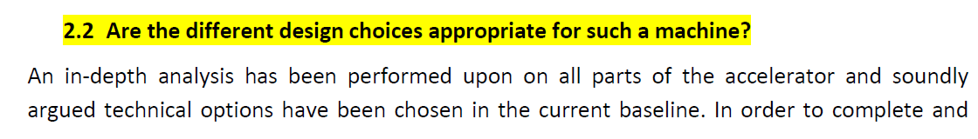
MYRRHA International
Design Review
All parts have “soundly argued technical options”
  The team also feels confident with the design choices
Main points of attention:
  SC-CH cavities
  KONUS based CH design

Slide 19
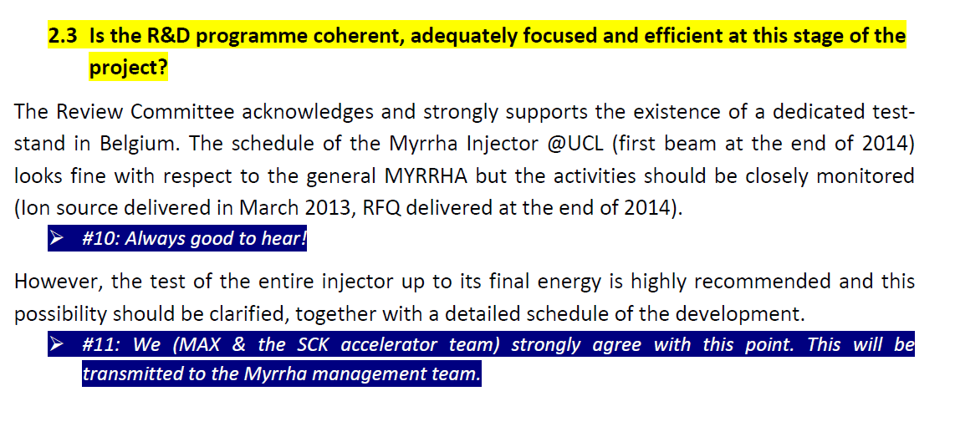
MYRRHA International
Design Review
Not yet complete but…
Strong support for:
  Injector@UCL program (up to 17MeV)
  Prototyping of a solid state 700MHz amplifier
Main recommendations:
  More detailed trip-to-recovery 3sec timeline
  Start R&D on fast switching dipoles, scanning magnets and near target beam shape diagnostic

Slide 20
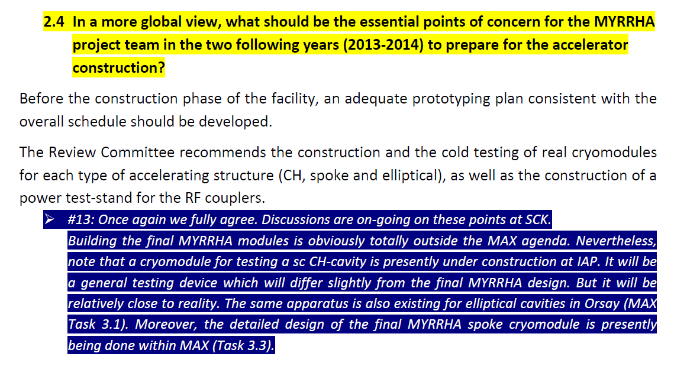
MYRRHA International
Design Review
Construction of a cryomodule prototype for each type (foreseen in the R&D Program)
Complete the R&D program especially in terms of prototyping
Overall MYRRHA schedule is too aggressive
Lack of an adequate accelerator core team

Slide 21
R&D Program
INJ@UCL
Up to 2014 and beyond | led by SCK•CEN
Goals | experimentally address the injector design tool for relevant reliability oriented experiments experience – education
Main topics: source, LEBT, RFQ, CH cavities (RT, SC) RF amplifiers diagnostics relevant control system | Principal present partners: IAP Frankfurt IN2P3 UCL/CRC IBA

Slide 22
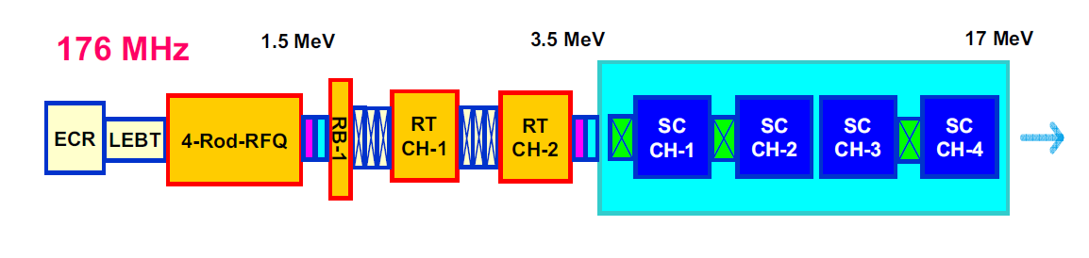
Injector@UCL
Notes:
Holger’s talk → alternative design being considered

Slide 23
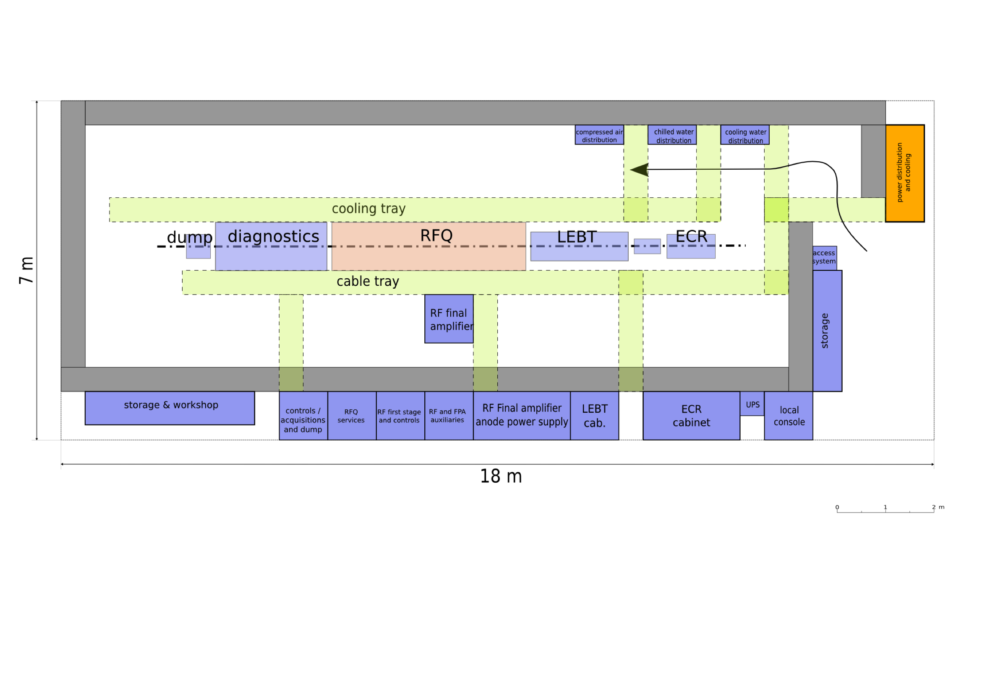
RFQ@UCL

Slide 24
2014 Revised Scope
LEBT@UCL

Slide 25
R&D program
Cryomodules
After 2014 | coordinated by SCK•CEN executed by “principal architects”
Goals | 3 prototype cryomodules engineering design construction tests feedback to design
Main topics: reliability data for the reliability model industrialization | Principal potential partners: IPNO Jlab ACS AMOS

Slide 26
Accelerator Group
Baseline

Slide 27
Accelerator Group
2013 Revision
Notes:
Not in line with the design review

Slide 28
Active collaborations
CNRS/IN2P3
Institute | Foreseen project | Estimated Period
IPN Orsay | Spoke cryomodules (engin., manufac. and tests) | On hold
Subatech Nantes | Full power beam-dump (design) | On hold
LPSC Grenoble | LEBT (engin., manufac. and tests) | 2012 – 2014 Ongoing
IPHC Strasbourg | High power Emittancemeter (engin., manufac. and tests) | To be determined

Slide 29
Active collaborations
Ganil/Spiral2
Beam diagnostics
Facility needs (later stage)
ISOL (later stage)

Slide 30
Collaborations in preparation
CERN
  Accelerator and RIB targets collaboration
  Technical scope has been defined
Others (IAP, TTC, ESS, SNS, PSI, …):
  On stand-by

Slide 31
SLHiPP-3
MYRRHA Accelerator talks
Design status of the spoke cryomodule design for MYRRHA, Hervé Saugnac
Reliability modelling activities – MAX Linac (MYRRHA Project), Adrian-Eugen Pitigoi
Injector development for MYRRHA, Holger Podlech
RF and mechanical studies on single-spoke resonator for MYRRHA, Guillaume Olry

Slide 32
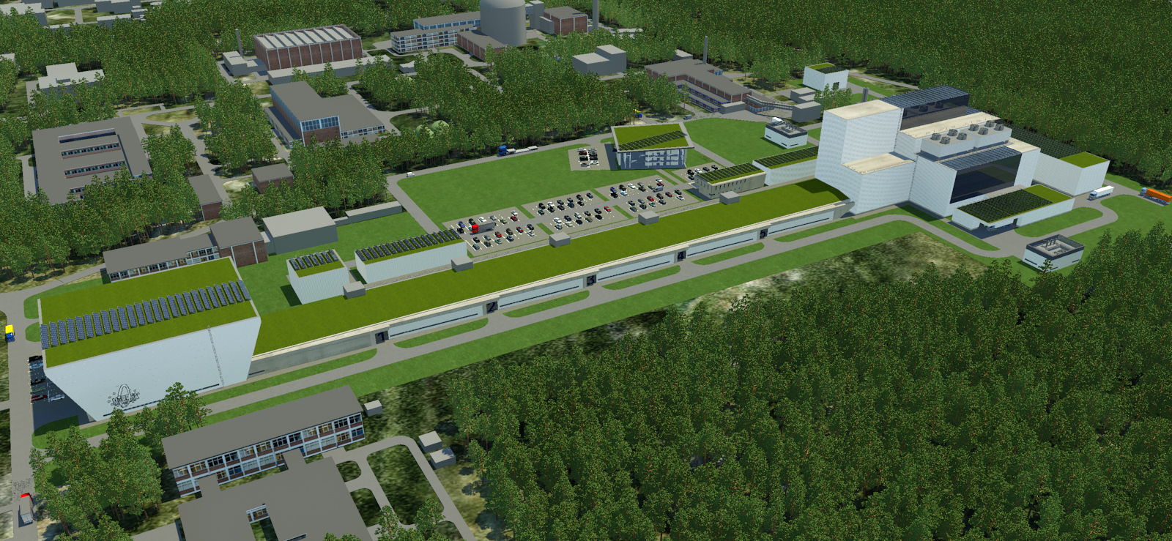
MYRRHA
Look into the future…

Slide 33
Thanks for your attention!
Enjoy your stay in Louvain-la-Neuve…

